Slide 1
Socket Programming
Computer Network
Project 1

Slide 2
What is Socket?
Socket is an API to use internet.
API = Application Programming Interface.
Work at the Transport layer.
Why do we need socket?
Application Layer
Socket API
Transport Layer
Network Layer
Link Layer
Physical Layer

Slide 3
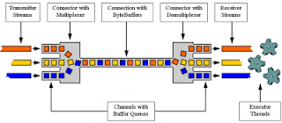
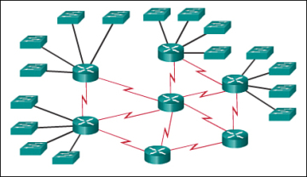
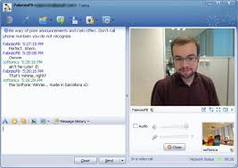


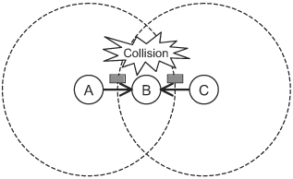
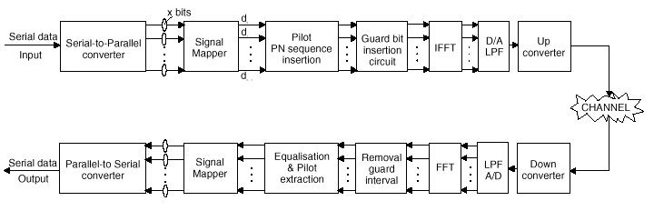
Why do we need socket?
Layering

Slide 4
Formal Definition
Definition: A host-local, application-created, OS-controlled interface (a “door”) into which application process can both send and receive messages to/from another application.
controlled by
application
developer
controlled by
application
developer
process
process
socket
socket
TCP with
buffers,
variables
TCP with
buffers,
variables
controlled by
operating
system
controlled by
operating
system
Internet
host or
server
host or
server

Slide 5
A History
Berkeley Socket Library
First provided with Berkeley Software Distribution (BSD 4.2) Unix in 1983.
Popularized in the 1986 BSD 4.3 release.
1989, BSD 4.4, free from license constraint.
Widely used in UNIX
De facto standard.
Windows Sockets (Winsock)
Since 1993 for Windows
Notes:
Bill Joy: BSD Unix, TCP/IP, Vi, csh… During student time.
BBN: APARNET, Email…
AT&T: Multics -> UNIX -> BSD etc. -> Copyright
Novell: ->BSD 4.4
BSD: -> FreeBSD -> Mac OSX, Linux
VAX: $20,000
BBN had a big contract to implement TCP/IP, but their stuff didn't work, and grad student Joy's stuff worked. So they had this big meeting and this grad student in a T-shirt shows up, and they said, "How did you do this?" And Bill said, "It's very simple — you read the protocol and write the code."

Slide 6
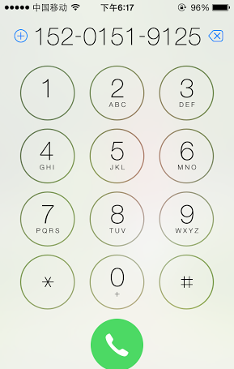
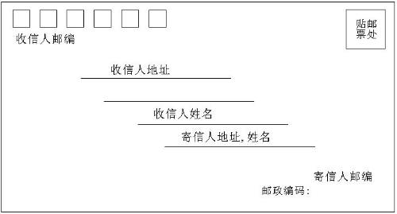
Socket Identification
Socket | Mail | Call
Local Socket Address | Your Address | Your Phone Num.
Remote Socket Address | Her Address | Her Phone Num.
Protocol | Envelop | Radio
Socket?

Slide 7
Address
The address must identify the sender/receiver.
Address of the host – IP Address
IPv4: 32bit, X.X.X.X, X:8 bit
IPv6: 128bit, Y:Y:Y:Y:Y:Y:Y:Y, Y:16 bit
Address of the process – Port
0~65535

Slide 8
Port Usage
Popular applications have “well-known ports”.
E.g., port 80 for HTTP, 25 for SMTP, 21 for FTP
For more, refer to Wikipedia.
By convention, between 0 and 1023; privileged
Custom client gets an unused “ephemeral” port.
By convention, between 1024 and 65535.

Slide 9
Protocol
Socket at Transport Layer.
UDP
TCP

Slide 10
Socket Programming with UDP
UDP Service: Best-effort transfer of groups of bytes (“datagrams”) between client and server.
Connectionless
You have no idea whether the packet is received, unless notified by the receiver.
Datagrams == Groups of bytes == packets
Every packet requires address information.
Out-of-order
Best-effort == unreliable
Lightweight

Slide 11
Socket Programming with UDP
Server (running on hostid)
Client
create socket,
port=x, for
incoming request:
create socket,
clientSocket =
DatagramSocket()
serverSocket =
DatagramSocket()
Create, address (hostid, port=x,
send datagram request
using clientSocket
read request from
serverSocket
write reply to
serverSocket
specifying client
host address,
port number
read reply from
clientSocket
close
clientSocket

Slide 12
Socket Programming with TCP
TCP Service: Reliable transfer of byte-stream from one process to another.
Connection Oriented
Byte-stream
No packetization and addressing required at application layer.
In order.
Build a reliable “pipe” on the unreliable network.
Maintenance of the connection.

Slide 13
Socket Programming with TCP
What is byte-Stream?
A sequence of characters that flow into or out of a process.
Input stream: stdin (keyboard), socket
Output stream: stdout (monitor), socket

Slide 14
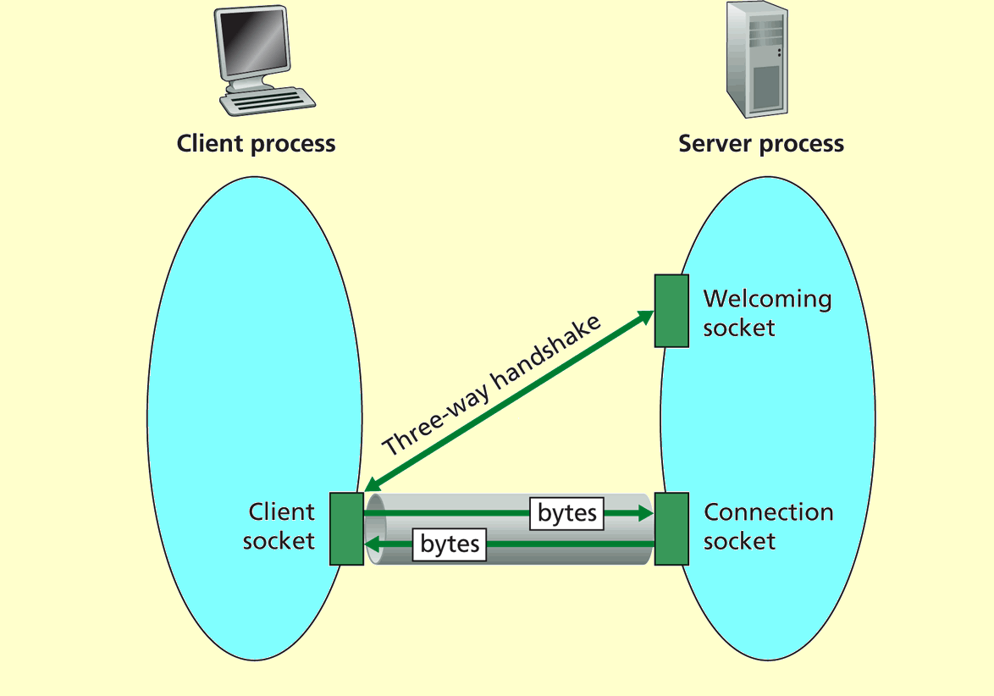
Sockets in TCP

Slide 15
Socket Programming with TCP
Server (running on hostid)
Client
create socket,
port=x, for
incoming request:
welcomeSocket =
ServerSocket()
TCP
connection setup
create socket,
connect to hostid, port=x
wait for incoming
connection request
connectionSocket =
welcomeSocket.accept()
clientSocket =
Socket()
send request using
clientSocket
read request from
connectionSocket
write reply to
connectionSocket
read reply from
clientSocket
close
connectionSocket
close
clientSocket

Slide 16
Tips on Socket Programing
One server one port many clients.
All clients connect to the same port number (Web).
How do you distinguish between clients?
Source IP Address!
How do you distinguish between multiple connections from the same IP Address?
OS uses the incoming packet’s source IP address and port number to distinguish.
The five tuples:
(SrcAddr, SrcPort, DstAddr, DstPort, Protocol)

Slide 17
Tips on Socket Programing
When you chat with someone else.
If TCP, how many streams at client side?
4: stdin, stdout, socketin, socketout.
If UDP, how many streams at client side?
2: stdin, stdout

Slide 18
Socket Programing in C
Client
Server
socket
socket
bind
listen
Connection Request
connect
accept
write
read
read
write
Waiting for next
connection Request
EOF
close
read
close

Slide 19
Socket Programing in C
Create a socket
int socket(int domain, int type, int protocol)
Establish a connection
int connect((int sockfd, struct sockaddr *serv_addr, int addrlen)
Struct sockaddr & Struct sockaddr_in
Interpreting one thing in different ways.
Notes:
struct sockaddr = struct sockaddr_in

Slide 20
Socket Programming in C
Byte Ordering
unsigned long int htonl(unsigned long int hostlong)
unsigned short int htons(unsigned short int hostshort)
unsigned long int ntohl(unsigned long int netlong)
unsigned short int ntohs(unsigned short int netshort)
IP Addresses
int inet_aton(const char *cp, struct in_addr *inp)
char *inet_ntoa(struct in_addr in);

Slide 21
Socket Programming in C
Send Data
ssize_t write(int sockfd, const void *buf, size_t nbytes);
ssize_t send(int sockfd, const void *buf, size_t nbytes, int flags);
Receive Data
ssize_t read(int sockfd, void *buff, size_t nbytes);
ssize_t recv(int sockfd, void *buff, size_t nbytes, int flags);
For UDP, use
ssize_t sendto (int sockfd, void *buff, size_t nbytes, int flags, const struct sockaddr *dest_addr, int addrlen);
ssize_t recvfrom (int sockfd, void *buff, size_t nbytes, int flags, const struct sockaddr *src_addr, int addrlen);

Slide 22
Socket Programming in C
Server listening
Bind some port
int bind (int sockfd, struct sockaddr *my_addr, int addrlen)
Define how many connections can be pending
int listen(int sockfd, int backlog)
Accept a new connection from a client
int accept(int sockfd, struct sockaddr *addr, int *addrlen)

Slide 23
Socket Programming in C
Handle multiple sockets, stdin and timers.
Polling
Very inefficient.
Select
int select(int maxfdp, fd_set *readfds, fd_set *writefds, fd_set *errorfds, struct timeval *timeout);
Wait on multiple file descriptors/sockets and timeout
Application does not consume CPU while waiting
Macros
FD_ZERO(fd_set *set) – clears a file descriptor set
FD_SET(int fd, fd_set *set) – adds fd to the set
FD_CLR(int fd, fd_set *set) – removes fd from the set
FD_ISSET(int fd, fd_set *set) – tests to see if fd is in the set
Does not scale to large number of descriptors/sockets
Epoll

Slide 24
Socket Programming in C
Debug
perror(“socket error: ”)
prints "socket error: " + the error message.
printf("an error: %s\n", strerror(errno));
prints "an error: " + the error message from errno.

Slide 25
Other Tools
How to check if particular port is listening
Windows – use netstat
netstat -an
Linux – use nmap
nmap -sT -O localhost
Server can’t bind because old connection hasn’t yet gone away.
Use setsockopt with the SO_REUSEADDR option.
Not knowing what exactly gets transmitted on the wire
Use tcpdump or Ethereal (www.ethereal.com)
Check RFCs if in doubt about protocols.
RFC 959

Slide 26
Project
Goal: Learn to build client/server applications that communicate using sockets.

Slide 27
Task1: UDP Programming
Reading the sample code
Choose any language you are familiar with.
Modify the UDP Server
Modify the UDP Client
Optional Questions:
How to write a chat programming (two clients chat with each other) with UDP?
Can we use the UDP to transfer a file? If so, how?

Slide 28
Task2: Implementing FTP
FTP server
Must use the Berkeley Socket API and write your server in C.
Must accept command line arguments:
Port
Directory
Must handle USER, PASS, RETR, STOR, QUIT, SYST, TYPE, PORT, PASV, MKD, CWD, LIST, RMD commands.

Slide 29
Task2: Implementing FTP
FTP server
Handling invalid input reasonably and generating defensible error codes.
Must support connections from multiple clients.
May not use any libraries containing code speci-fically designed to implement FTP functionality.
Optional Questions:
How to transfer large files without blocking the server?

Slide 30
Task2: Implementing FTP
FTP client
You can write your client in your favorite progra-mming language.
Must use USER, PASS, TYPE, RETR, STOR, QUIT, PORT and PASV commands to log in a common server and download/upload files.
Support directory operations including creating, changing, listing, removing.
Optional Questions:
Interesting features like GUI.

Slide 31
Some Important Issues
Grading
UDP Programming (15%)
Implementation of FTP (60%)
Server (35%)
Client (25%)
Project Report (20%)
Bonus (10%)

Slide 32
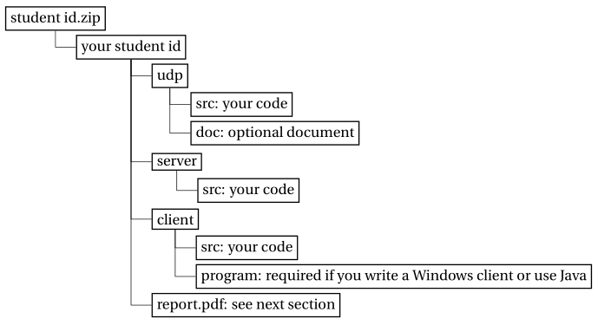
Some Important Issues
Submission
Files are to be organized as follows:
Report
Anything you think valuable…
No longer than THREE pages.
Evaluation
Auto-grading program for FTP server.
Face-to-face check for FTP client.
Note: Demonstrate your optional innovative features.

Slide 33
Some Important Issues
Important Date
Start up: today (2017.10.13.)
Due date: 3 weeks later (2017.11.3.)

Slide 34
Some Important Issues
Award (for best projects)
Best Project
Best Implementation
Best Design
Award requirements
Less or no systematic errors.
Clear program architecture & decent coding style & comprehensive comments.
Innovative features.

Slide 35
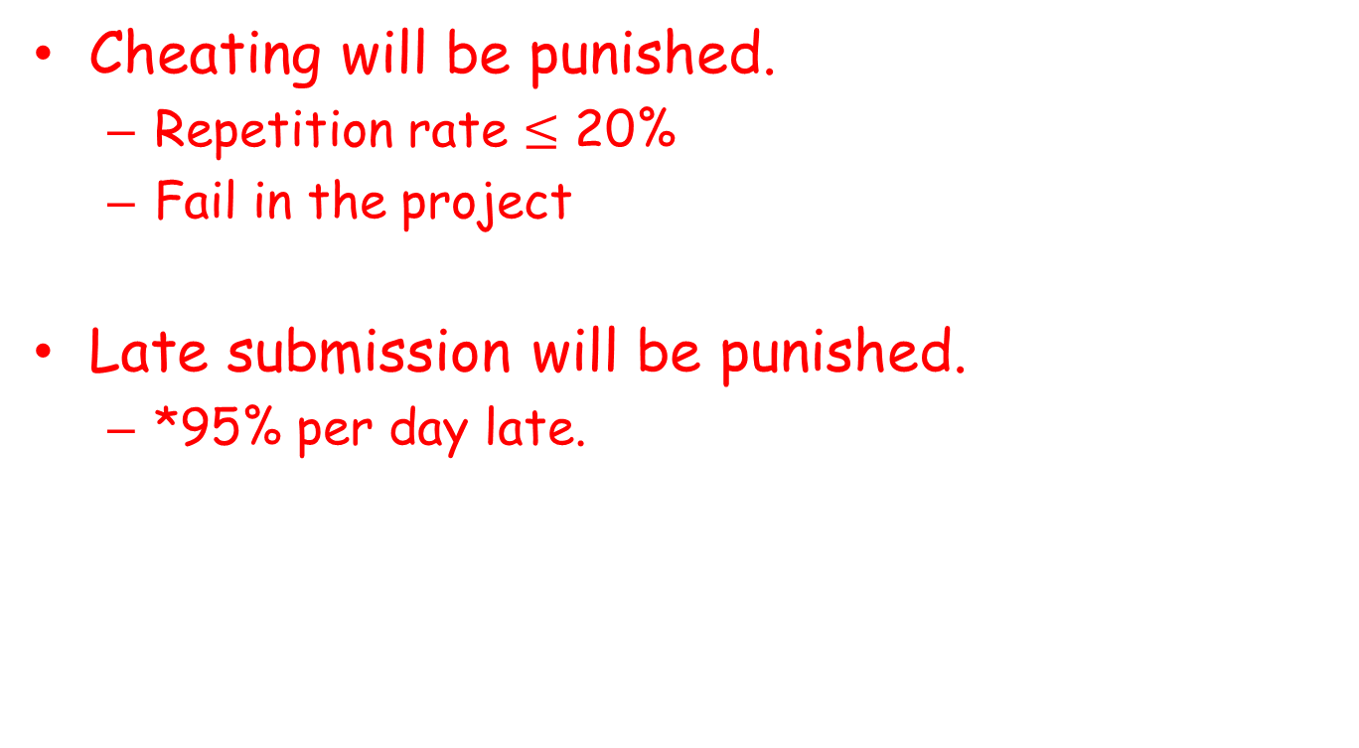
Some Important Issues
Cheating will be punished.
Repetition rate $≤$ 20%
Fail in the project
Late submission will be punished.
*95% per day late.

Slide 36
Q&A

