Slide 1
01
BiTe – Food Ordering System
Presented by:
JINS JAIMON
PRN NO : MG24103A4348
BCA (Hons)
Department of Computer Applications
School Of Technology and applied Sciences Pullarukkunnu
INTERNSHIP
PROJECT
Academic Year: 2026 - 27

Slide 2
CONTENTS
Overview
01
Project Overview
05
Admin & Architecture
What BiTé Kitchen is and its core capabilities
Dashboard, Django admin and database design
02
Technology Stack
06
Technical Implementation
Django, Python and the tools behind the build
Validation, sessions and cart logic
03
Features & UI
07
Future Scope & Conclusion
User-facing features and interface highlights
Enhancements, learnings and wrap-up
04
Project Screenshots
A visual walkthrough of the live application
School of Technology and Applied Sciences Pullarikkunnu
01

Slide 3
INTRODUCTION
Project Overview
An end-to-end online food ordering platform built with Python and Django.
01
02
Full-Stack Django App
Dual-Role System
End-to-end online food ordering built with Python and Django, covering both frontend and backend.
Separate user and admin experiences with distinct permissions and dashboards.
03
04
Real-Time Cart
Secure Auth
Live cart management with dynamic, real-time order processing and totals.
Built-in authentication with registration, login and full profile management.
School of Technology and Applied Sciences Pullarikkunnu
02

Slide 4
TECH STACK
Technology Stack
1
Backend
Django — Python's most powerful web framework, handling routing, views and business logic.
2
Frontend
HTML, CSS & JavaScript — server-rendered templates with responsive, dynamic interfaces.
3
Database
Django ORM — clean relational data modeling with SQLite
4
Authentication
Django Auth System — secure, session-based login and registration out of the box.
School of Technology and Applied Sciences Pullarikkunnu
03

Slide 5
SECTION 02
User Experience
Features and interface built for a smooth ordering journey.
School of Technology and Applied Sciences Pullarikkunnu
04

Slide 6
FEATURES
User Features
01
02
Authentication
Browse Menu
Register, log in and manage a personal profile securely.
Explore 120+ premium dishes with images and prices.
03
04
Shopping Cart
Checkout
Add or remove items and adjust quantities on the fly.
Review the order summary and confirm payment seamlessly.
School of Technology and Applied Sciences Pullarikkunnu
05

Slide 7
INTERFACE
User Interface Highlights
01
02
Branded Home Page
Responsive Design
50K+ customers and a 4.9-star rating shown with restaurant stats front and center.
Modern dark theme optimized for usability across all screen sizes.
03
04
Food Listings
Streamlined Checkout
Product cards with high-quality images, names and clear pricing.
Minimal-step checkout flow with a clear order summary.
School of Technology and Applied Sciences Pullarikkunnu
06

Slide 8
PROCESS
User Workflow
1
2
3
4
5
Login & register
Browse Menu
Add to Cart
Checkout
Order Confirmed
Explore dishes by category with images and prices.
Select items and adjust quantities in real time.
Review the order summary and enter delivery details.
Payment is confirmed and the order is placed.
Signin to an existing account
Or quickly create a new one
To get started
School of Technology and Applied Sciences Pullarikkunnu
07

Slide 9
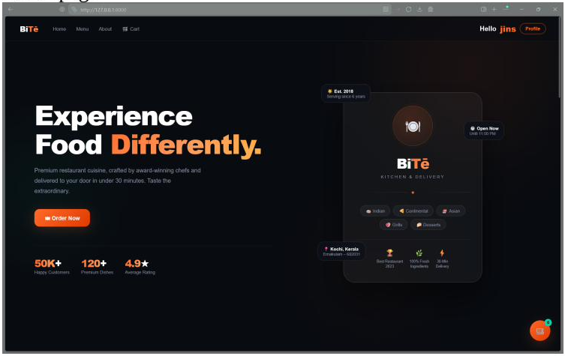
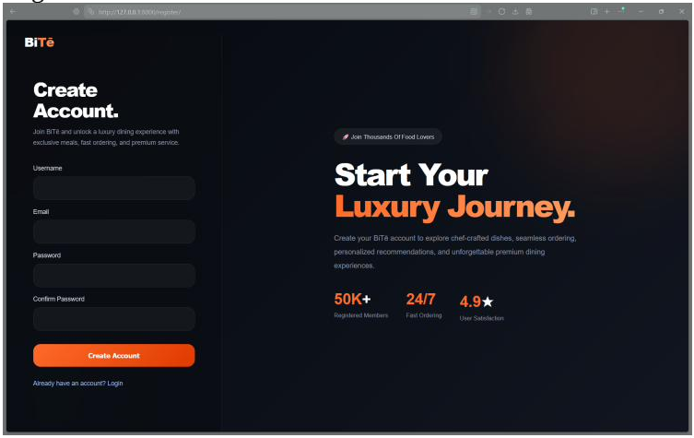
SCREENSHOTS
Home & Registration
The landing experience and new-account sign-up.
Home Page
Register
Hero section with brand stats — 50K+ customers, 120+ dishes and a 4.9 rating.
Create-account form with a promotional panel alongside.
School of Technology and Applied Sciences Pullarikkunnu
08

Slide 10
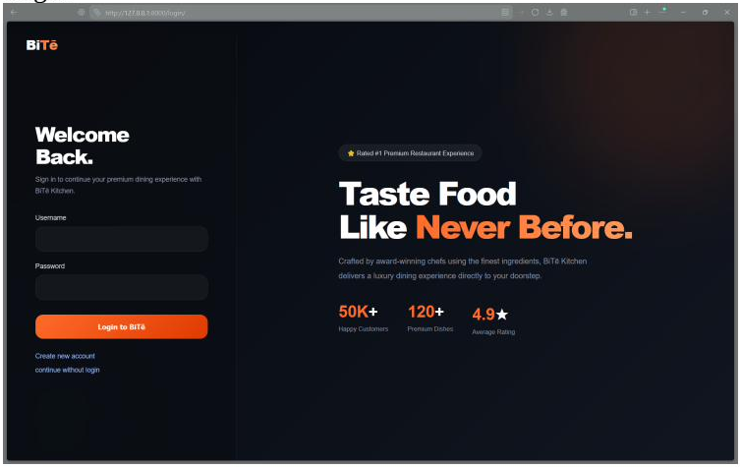
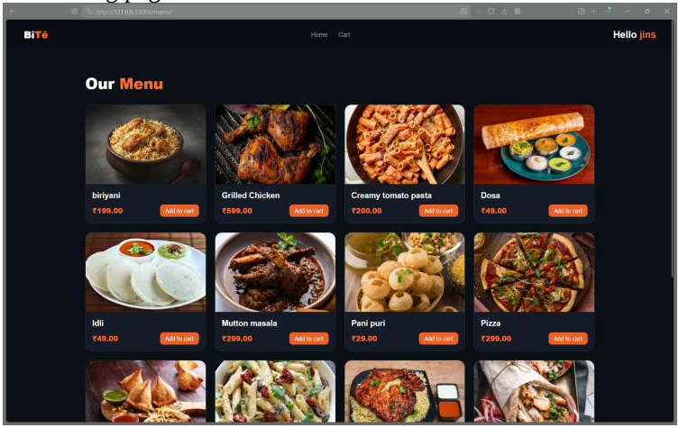
SCREENSHOTS
Login & Menu
Returning-user sign-in and the full food menu.
Login
Food Listing Page
Secure sign-in form paired with the brand's value proposition.
Grid of dishes with images, names, prices and quick add-to-cart.
School of Technology and Applied Sciences Pullarikkunnu
09

Slide 11
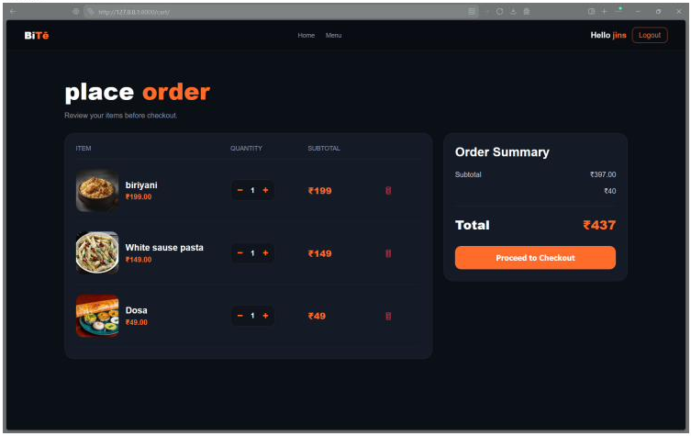
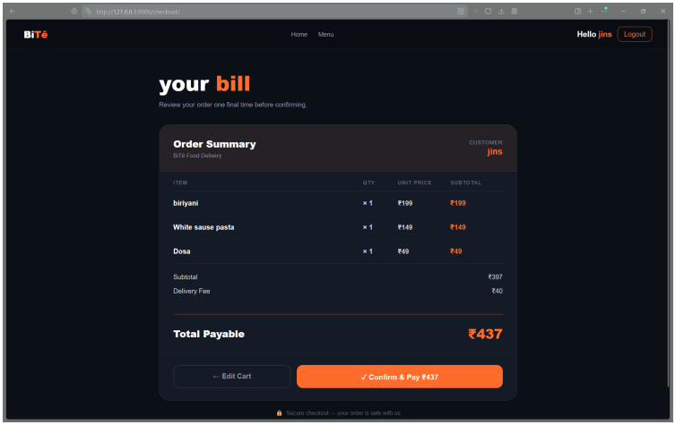
SCREENSHOTS
Cart & Checkout
From reviewing the cart to confirming the order.
Cart
Place Order
Item quantities, subtotal, delivery fee and total before checkout.
Final bill summary with a confirm-and-pay action.
School of Technology and Applied Sciences Pullarikkunnu
10

Slide 12
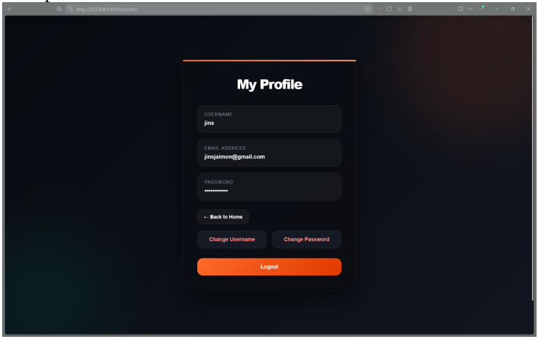
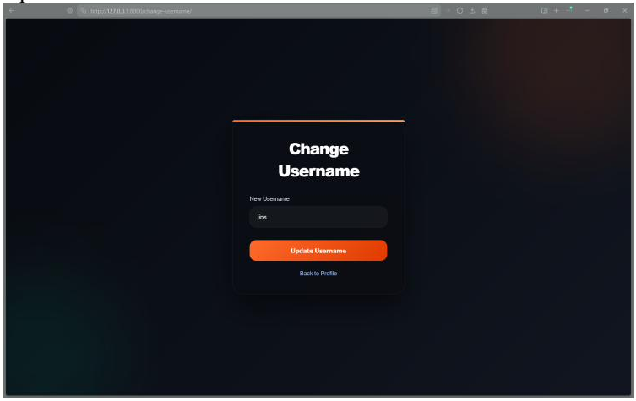
SCREENSHOTS
Profile & Account Settings
Managing a personal account after logging in.
User Profile
Update Username
View account details and access username/password changes.
Simple form to change the account's display username.
School of Technology and Applied Sciences Pullarikkunnu
11

Slide 13
SECTION 05
Admin & Architecture
Backend management, the Django admin panel and data design.
School of Technology and Applied Sciences Pullarikkunnu
12

Slide 14
BACKEND
Admin Dashboard Features
01
02
User Management
Food Inventory
View and manage all registered users from a central panel.
Add, update and delete menu items in real time.
03
04
Order Tracking
Analytics
Monitor every customer order live as it comes in.
Recent actions log and full order history at a glance.
School of Technology and Applied Sciences Pullarikkunnu
13

Slide 15
ARCHITECTURE
Admin Panel Architecture
Django Admin Interface
The project leverages Django's powerful built-in admin interface for all backend management operations, requiring minimal custom configuration.
1
2
Authentication
Users
Quick-access add/change operations per model
3
4
Recent actions log for full activity tracking
Menu Management
Order Tracking
Role-restricted access for admin users only
School of Technology and Applied Sciences Pullarikkunnu
14

Slide 16
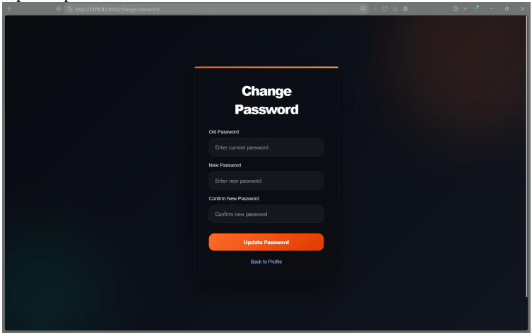
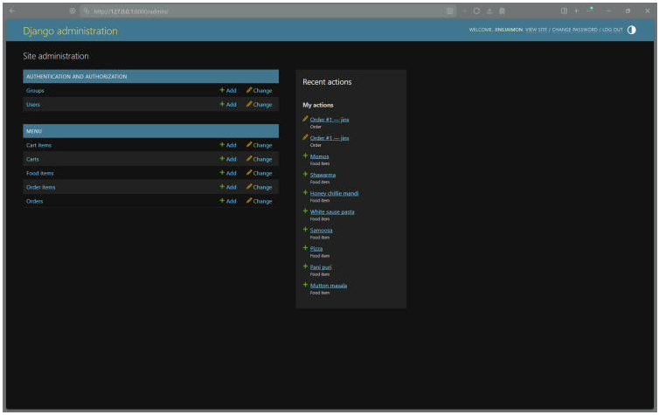
SCREENSHOTS
Security & Admin Dashboard
Password management and the Django admin panel.
Update Password
Django Admin Dashboard
Old/new password fields with confirmation for secure updates.
Central panel for Auth, Menu, Carts and Orders management.
School of Technology and Applied Sciences Pullarikkunnu
15

Slide 17
DATA DESIGN
Database Models
01
02
User Model
Food Item
Username, email, password and extended profile data for each registered customer.
Name, price, description and image fields to represent every dish on the menu.
03
04
Cart
Order
Linked to a user, holds multiple food items with quantities for active sessions.
Stores order details, item list, subtotal, delivery fee, total and customer info.
School of Technology and Applied Sciences Pullarikkunnu
16

Slide 18
DEEP DIVE
Key Technical Implementations
01
02
Form Validation
Session Management
Server-side validation on registration and login forms to prevent malformed or duplicate entries.
Django's session framework maintains secure, persistent authentication state across requests.
03
04
Dynamic Cart Calculations
Order Confirmation Flow
Real-time computation of subtotal, delivery fee and total as users modify cart contents.
Structured checkout pipeline guiding users from cart review through payment confirmation.
School of Technology and Applied Sciences Pullarikkunnu
17

Slide 19
OUTCOMES
Project Achievements
01
02
Complete End-to-End System
Secure Auth & Data Management
Fully functional food ordering platform covering browsing, cart, checkout and order management.
Robust user authentication with protected routes and reliable relational storage via Django ORM.
03
04
Professional Responsive UI
Functional Admin Dashboard
Responsive interface delivering a polished, modern user experience across devices.
Business-ready admin panel supporting inventory, order tracking and user management.
School of Technology and Applied Sciences Pullarikkunnu
18

Slide 20
FUTURE SCOPE
Future Enhancements — Near-Term
01
02
Payment Gateway Integration
Order Tracking & Notifications
Add real payment providers (Razorpay/Stripe) for live, end-to-end transactions.
Real-time order status updates via email/SMS or in-app notifications.
03
04
Ratings & Reviews
Search & Filter
Let customers rate dishes and leave reviews to build trust and feedback loops.
Add menu search, category filters and sorting for faster browsing.
School of Technology and Applied Sciences Pullarikkunnu
19

Slide 21
FUTURE SCOPE
Future Enhancements — Long-Term
01
02
Mobile App Version
Multi-Restaurant Support
Extend BiTé Kitchen to a native or cross-platform mobile app.
Scale from a single kitchen to a multi-vendor marketplace model.
03
04
Delivery Partner Integration
Advanced Admin Analytics
Connect with delivery services for live rider tracking and logistics.
Sales dashboards, demand trends and revenue reporting for admins.
School of Technology and Applied Sciences Pullarikkunnu
20

Slide 22
WRAP-UP
Key Learnings & Conclusion
01
02
Full-Stack Proficiency
Real-World Problem Solving
Gained hands-on experience building an end-to-end app with Django, from models to templates.
Learned to design a relational schema and handle cart/order logic used in production apps.
03
04
Admin Tooling
Backend Development
Understood how Django's built-in admin accelerates backend management without extra effort.
Learned to build and manage backend functionality using Django and python
School of Technology and Applied Sciences Pullarikkunnu
21

Slide 23
22
THANK YOU
Questions and feedback are welcome.
Jins Jaimon
Luminar Technolab, Kochi
BCA (Hons) | 2026 - 27
Python Full Stack in django.
School of Technology and Applied Sciences Pullarikkunnu

