Slide 1
Ch0.1
What is light?
Ghatak, Optics, Ch2

Slide 2
For the rest of my life, I will reflect on what light is. ----Einstein 1917
All the fifty years of conscious brooding have brought me no closer to the answer to the question, ‘What are light quanta?’ Of course today every rascal thinks he knows the answer, but he is deluding himself. ----Einstein 1951

Slide 3
1. Conclusion
Newton thought that light was made up of particles, but then it was discovered that it behaves like a wave. Later, however (in the beginning of the twentieth century), it was found that light did indeed sometimes behave like a particle. Historically, the electron, for example, was thought to behave like a particle, and then in many respects it behaved like a wave. So it really behaves like neither. Now we have given up. We say: ‘it is like neither.’ There is one lucky break, however—electrons behave just like light. The quantum behaviour of atomic objects (electrons, protons, neutrons, photons, and so on) is the same for all, they are all ‘particle–waves,’ or whatever you want to call them. ----Feynman

Slide 4
2. The corpuscular model
“Are not the ray of light very small bodies emitted from shining substance?” ----Newton, Opticks, 1704
The law of reflection and refraction
Finally, according to Newton, corpuscles of different sizes give rise to the sensation of different colors at the retina of the eye. He explained the prismatic spectrum by assuming
that particles of different sizes refract at different angles

Slide 5
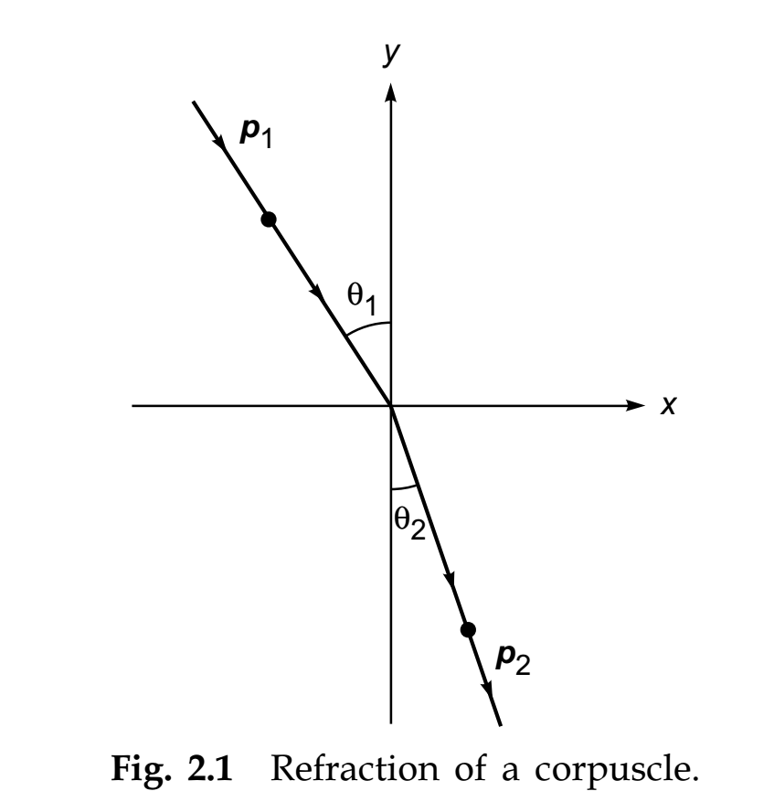

Slide 6
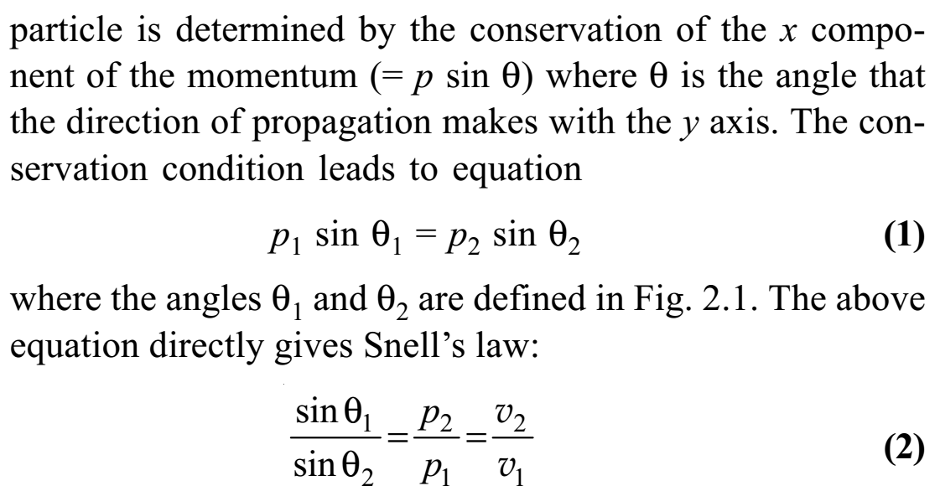
Q: Why p_x is conserved?
prediction: light will have higher velocity in denser medium (water compared with air)←WRONG

Slide 7
Geometrical optics
Perhaps the two most important experimental facts which led to the early belief in the corpuscular model of light were:
(1) the rectilinear propagation of light which results in the formation of sharp shadows and
(2) that light could propagate through vacuum.
The domain of optics in which light is assumed to travel in straight lines is known as geometrical
optics

Slide 8
However…
The shadow are not perfectly dark: diffraction
You can read a book in the shadow of a building: not diffraction, but scattering of light by air molecules
Blue color of the sky & red color of the setting sun: scattering (due to Earth’s atmosphere)
Shadows in the moon: extremely dark (the moon has no atmosphere)

Slide 9
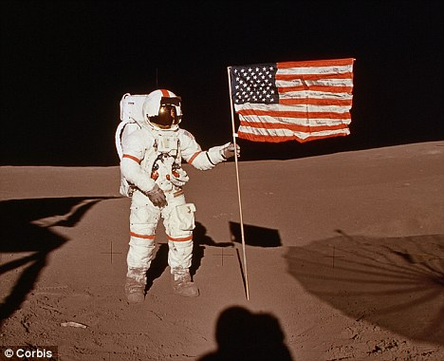
图片来源：百度

Slide 10
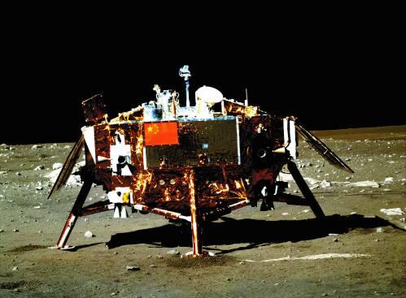
嫦娥三号着陆器 （图片来源：百度）

Slide 11
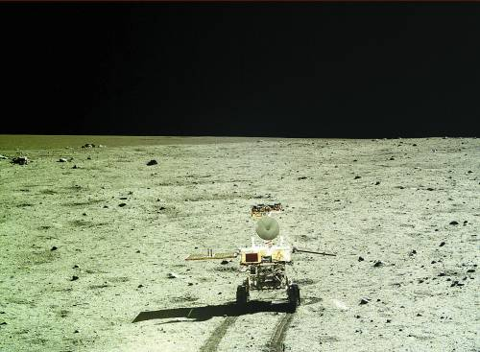
玉兔号月球车 （图片来源：百度）

Slide 12
Chronicles
140 AD, Ptolemy: measured the angle of refraction in water from for different angles of incidence in the air and made a table of it
1621, Snell: using Ptolemy’s table, discovered the law of refraction
1637, Descartes: derived Snell’s law, corpuscular theory
1662, Fermat: principle of least time
1704, Newton: Opticks

Slide 13
3. The wave model
1665, Grimaldi: diffraction of white light (also by Hooke later)→``light is a fluid that exhibits wave-light motion”
1678, Huygens: wave model of light→reflection, refraction, and double refraction (1669, Bartholinus).
However, so compelling was Newton’s authority that it is said that people around Newton had more faith in his corpuscular theory than Newton himself and no one believed in Huygens’ wave theory until 1801 when
Thomas Young performed the famous interference experiment which could only be explained on the basis of a wave model of light.
1802, Young: explanation of Newton’s ring (observed by Hooke in 1650s)

Slide 14
1806, Malus: observed the polarization of light
1816, Fresnel: explanation of diffraction
In 1816, Fresnel along with Arago performed the famous experiment on the superposition of linearly polarized light waves, which was
explained by Young, by assuming that light waves were transverse in character.

Slide 15
It was believed that a wave would always
require a medium and since light could propagate through vacuum, the presence of an “all pervasive” medium called the ether was assumed.
In 1832 Fresnel derived the expressions for the reflection and transmission coefficients by using models for ether vibrations. Poisson, Navier, Cauchy, and many other physicists contributed to the development of the ether theory which also necessitated the development of the theory of elasticity.

Slide 16
1865, Maxwell: electromagnetic theory of light “Light waves are electromagnetic waves” (electromagnetic version of ether)
1888, Hertz: measured the speed of electromagnetic waves
toward the end of the nineteenth century, physicists thought that one had finally understood what light really is.

Slide 17
4. The particle nature of radiation
1887, Hertz: ultraviolet radiation from the first spark that was helping the electrons to jump across the gap.
1897, Thomson: discovery of electrons, electrons are emitted when light falls on a metal surface (1899)
1902, Lenard: observed
(1) the kinetic energy of the emitted electrons was independent of the intensity of the incident light and (2) that the energy of the emitted electron increased when the frequency of the incident light was increased.
1905, Einstein: energy quanta (1900, Planck: quanta)
1926, Lewis (US Chemist): coined the word “photon”

Slide 18
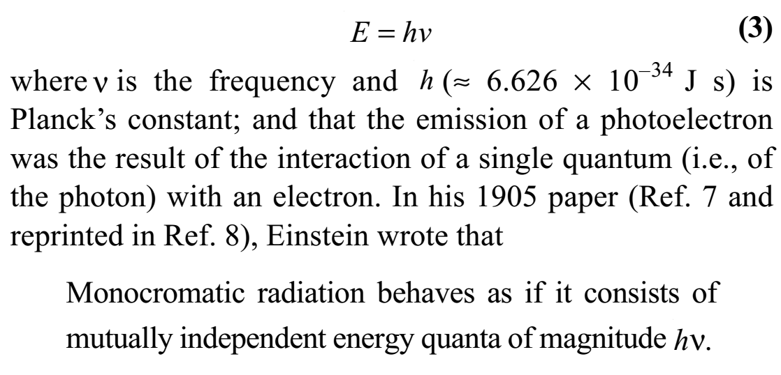

Slide 19
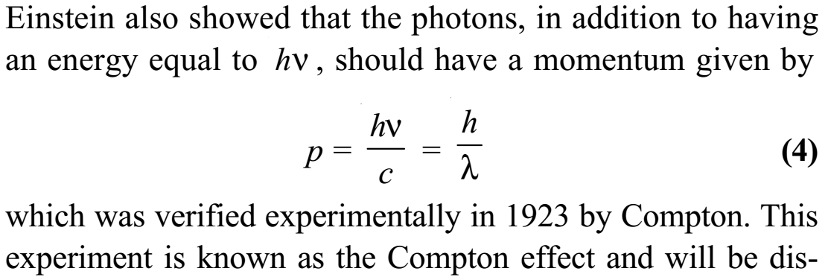

Slide 20
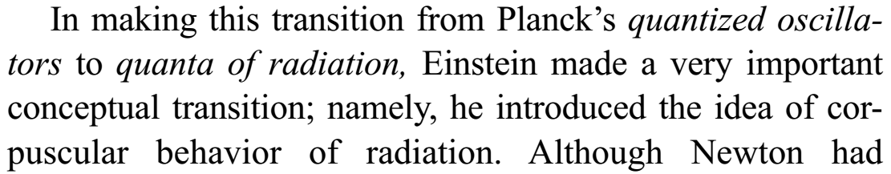

Slide 21
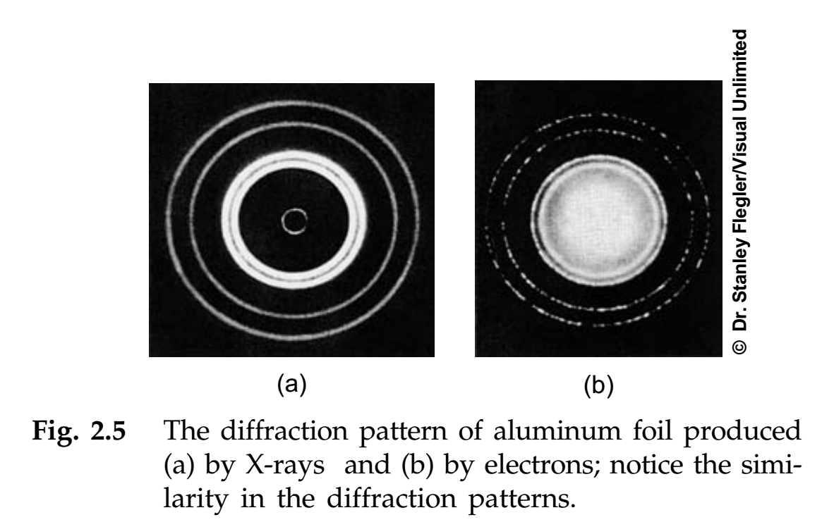
5. Wave nature of matter
Q: how to prove electrons are waves?

Slide 22
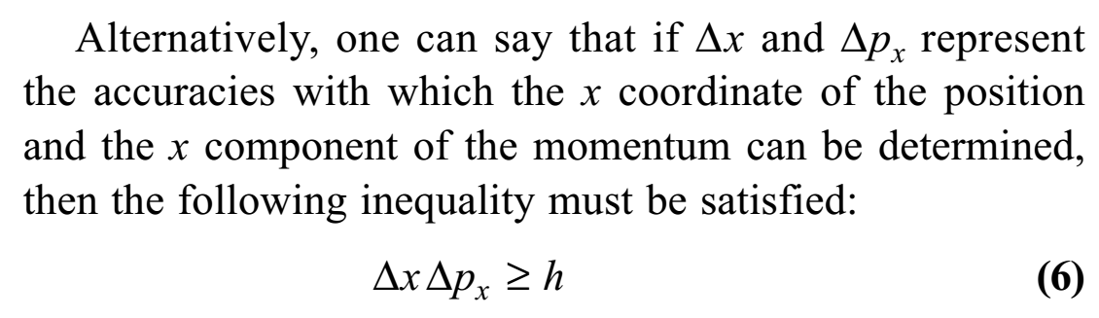
6. The uncertainty principle

Slide 23
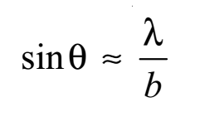
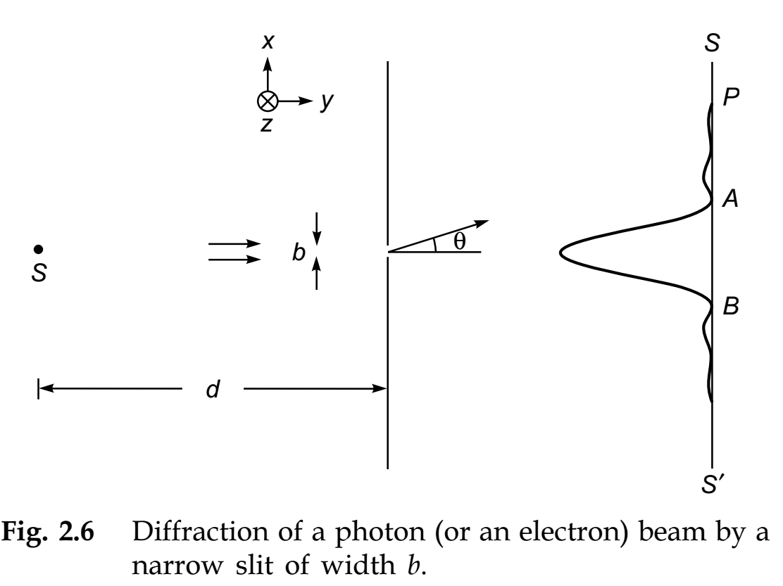
从不确定性原理角度看光的单缝衍射实验：

Slide 24
蝶恋花 （晏殊）
槛菊愁烟兰泣露，罗幕轻寒，燕子双飞去。明月不谙离恨苦，斜光到晓穿朱户。
昨夜西风凋碧树，独上高楼，望尽天涯路。欲寄彩笺兼尺素，山长水阔知何处？
-->学习的第二层、第三层境界，主要靠个人努力！

