Slide 1
A Locality and Memory Congestion-aware Thread Mapping Method for Modern NUMA Systems
张钰鑫 5.10

Slide 2
Background
Memory access in NUMA systems is not uniform
Remote-access communication is slower than local-access communication
Modern NUMA systems are susceptible to congestion
Current CPUs can cause a massive load to the memory controllers
Maximizing locality can hurt performance due to the memory congestion[1]
[1] Mulya Agung, Muhammad A. Amrizal, Kazuhiko Komatsu, Ryusuke Egawa, and Hiroyuki Takizawa. 2017. A Memory Congestion-Aware MPI Process Placement for Modern NUMA Systems. In 2017 IEEE 24th International Conference on High Performance Computing (HiPC). 152–161.

Slide 3
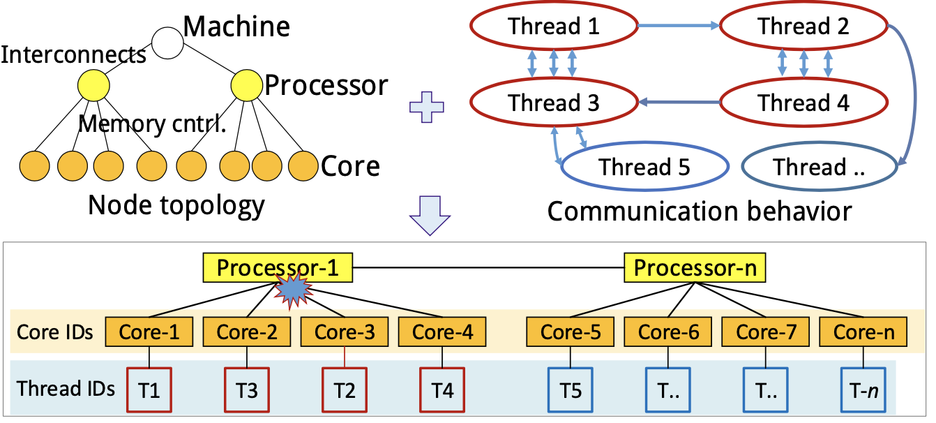
Background

Slide 4
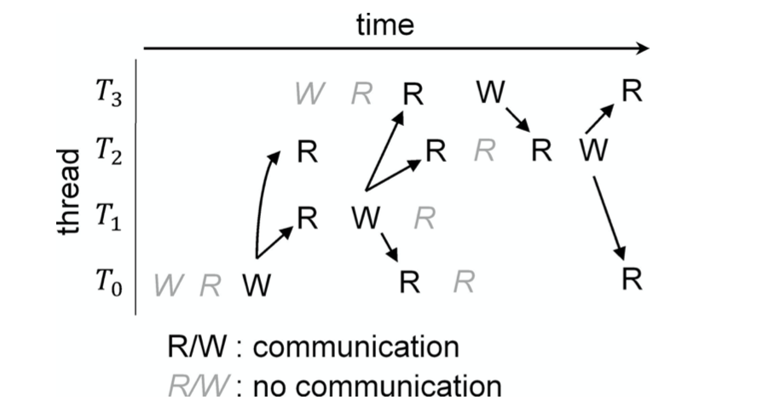
Method
Step 1: 检测线程间的通信行为，利用Pin工具[2]
两个不同的线程依次对相同数据的访问和读写操作称为线程间的通信
A communication event (E): [a pair of threads, timestamp, ..]
[2] Chi-Keung Luk, Robert Cohn, Robert Muth, Harish Patil, Artur Klauser, Geoff Lowney, Steven Wallace, Vijay Janapa Reddi, and Kim Hazelwood. 2005. Pin: building customized program analysis tools with dynamic instrumentation. SIGPLAN Not. 40, 6 (June 2005), 190-200.

Slide 5
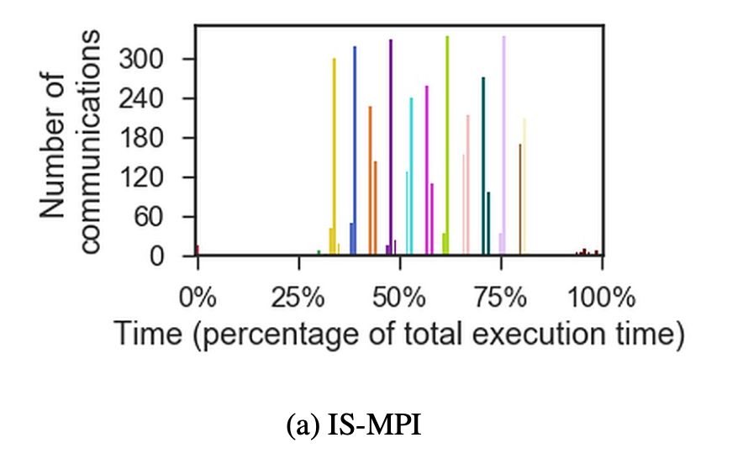
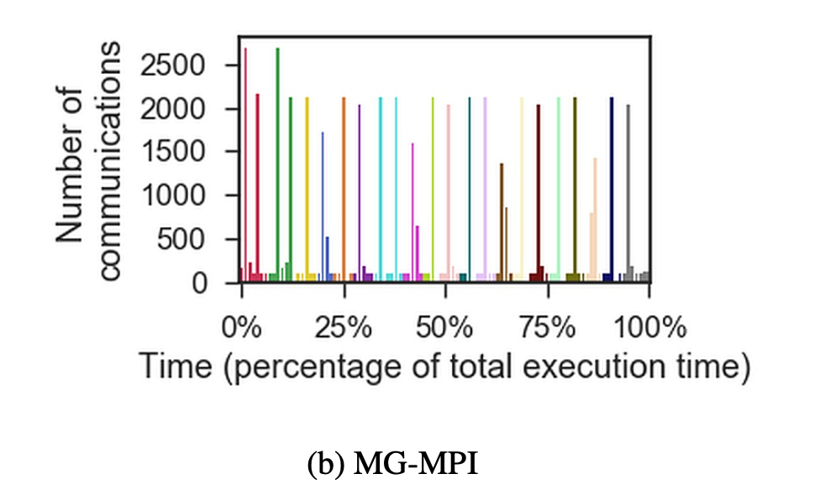
Method
Step 2: 确定可能导致拥塞的线程组
a set of communication timestamps {t1 , t2 , ..., tn}
clusters {C1 , C2 , ..., Ck }

Slide 6
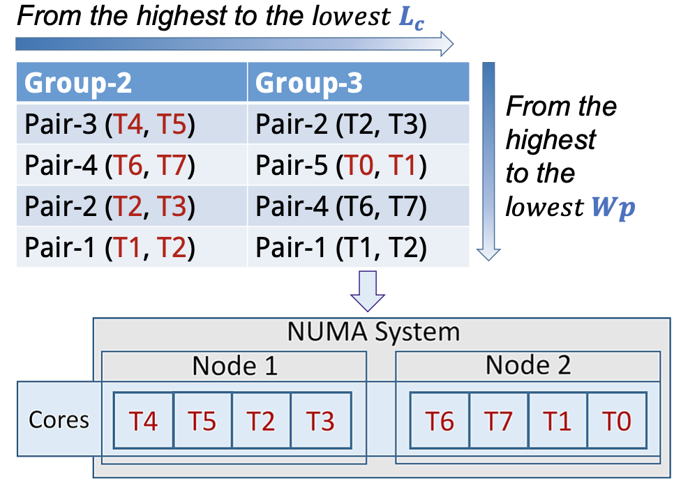
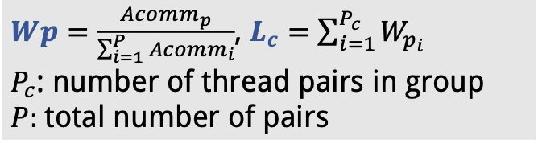
Method
Step 3: 计算映射

Slide 7
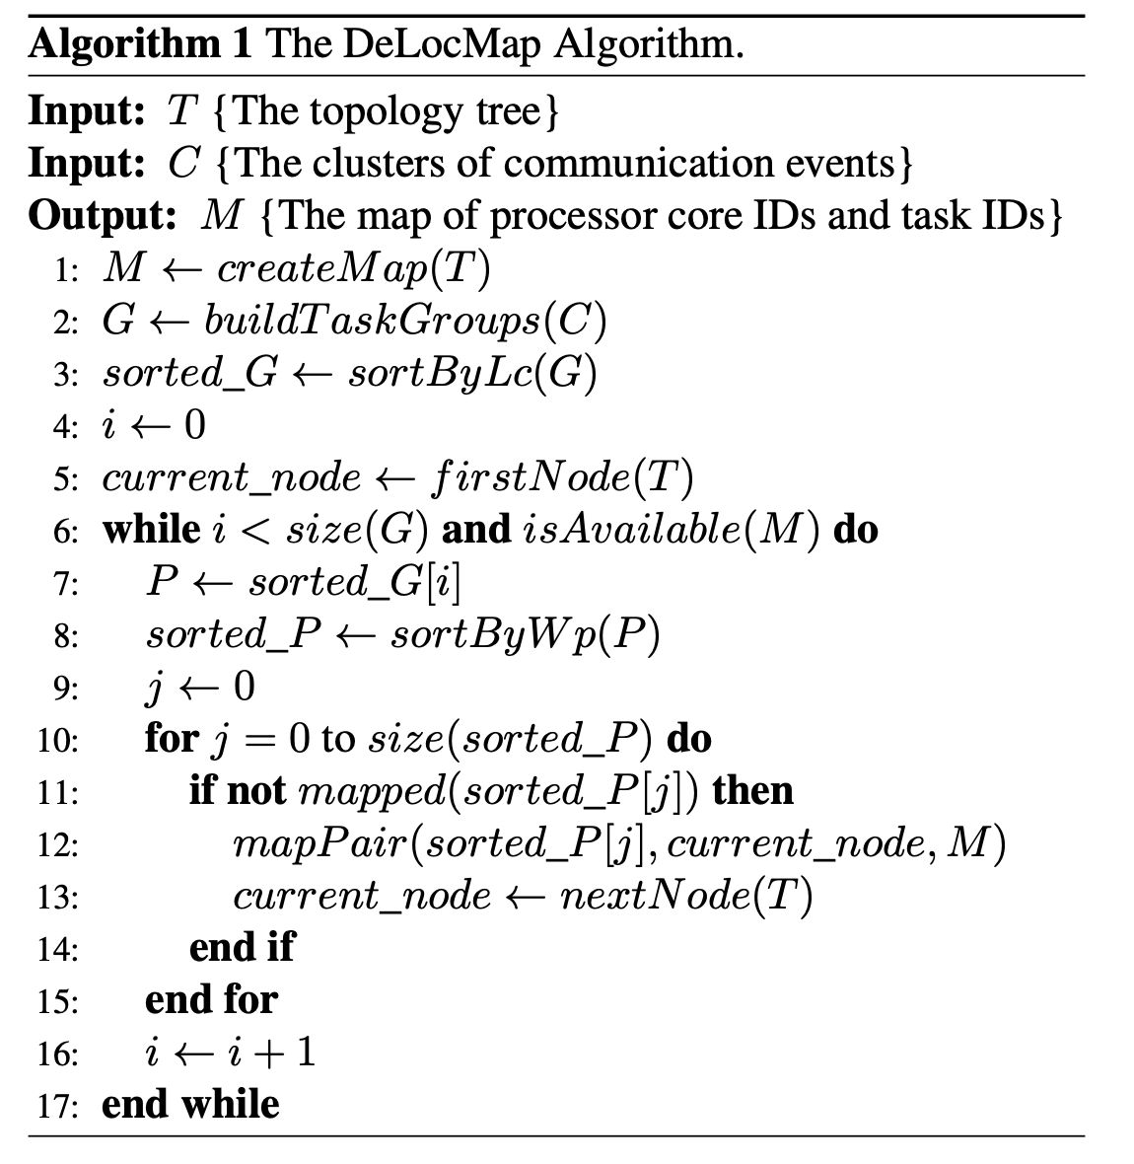
Method

Slide 8
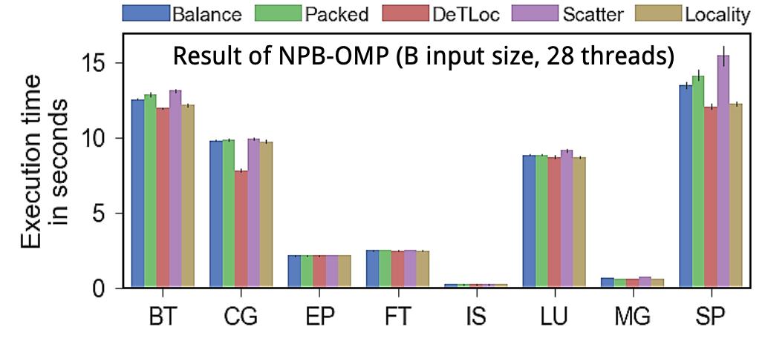
Experiments
2-node Intel-based NUMA system with two Intel Xeon E5-2680v4 processors, and each node consists 14 cores (2.4 GHz) and 64 GB RAM.

Slide 9
Thanks

