Slide 1
工作汇报
张钰鑫 9.14

Slide 2
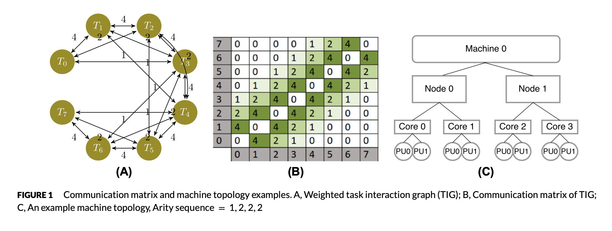
背景
[1] Soomro PN, Sasongko MA, Unat D. BindMe: A thread binding library with advanced mapping algorithms. Concurrency Computat Pract Exper. 2018;30:e4692. https://doi.org/10.1002/cpe.4692

Slide 3
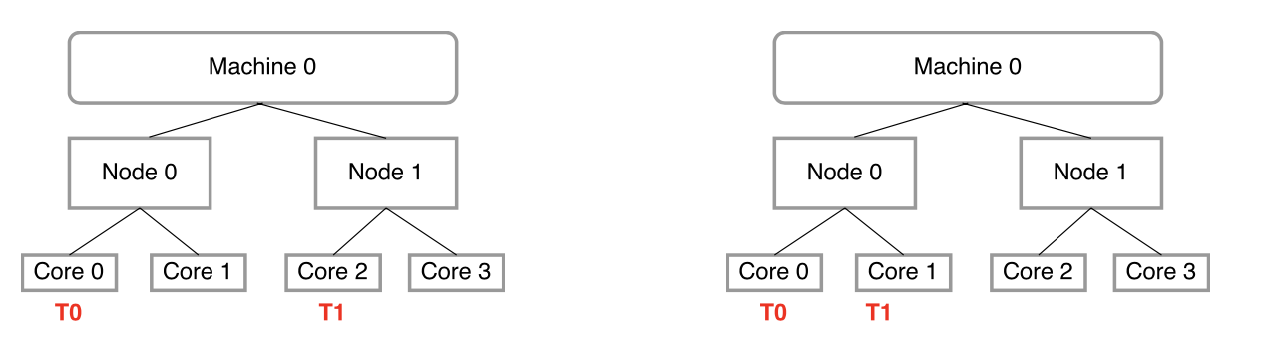
背景
scatter
compact
[1] Soomro PN, Sasongko MA, Unat D. BindMe: A thread binding library with advanced mapping algorithms. Concurrency Computat Pract Exper. 2018;30:e4692. https://doi.org/10.1002/cpe.4692

Slide 4
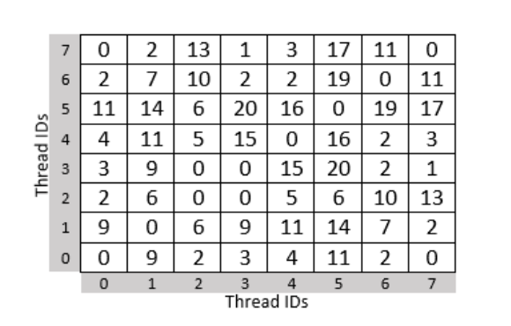
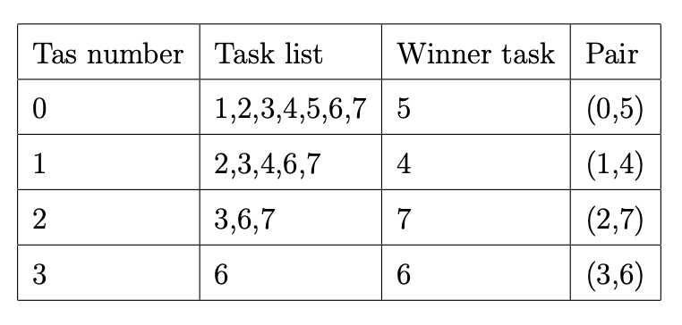
背景
Eagermap 算法 [2]，使用贪心策略进行线程配对:
0与5配对，从0的角度看mat[0][5]=11,是最优选择，但从5的角度看mat[5][3]>mat[5][0]
配对只考虑0显得不公平，需要一种较公平的配对算法
[2] Cruz, E. H., Diener, M., Pilla, L. L., and Navaux, P. O. (2015). An efficient algorithm for communication-based task mapping. In Parallel, Distributed and Network-Based Processing (PDP), 2015 23rd Euromicro International Conference on, pages 207–214. IEEE.

Slide 5
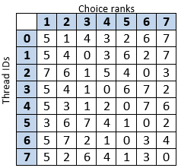
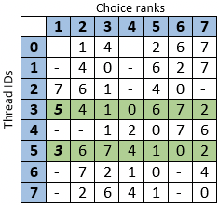
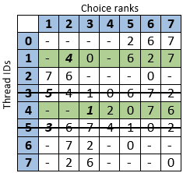
算法
Choicemap算法 [1]，较公平的线程配对:
线程i 的Choice ranks 越靠前，说明该rank对应的thread id与i通信量越大
[1] Soomro PN, Sasongko MA, Unat D. BindMe: A thread binding library with advanced mapping algorithms. Concurrency Computat Pract Exper. 2018;30:e4692. https://doi.org/10.1002/cpe.4692

Slide 6
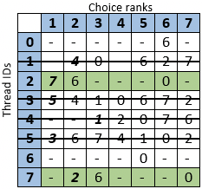
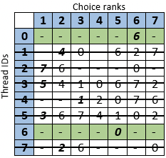
算法
Choicemap算法 [1]，较公平的线程配对:
线程i 的Choice ranks 越靠前，说明该rank对应的thread id与i通信量越大
[1] Soomro PN, Sasongko MA, Unat D. BindMe: A thread binding library with advanced mapping algorithms. Concurrency Computat Pract Exper. 2018;30:e4692. https://doi.org/10.1002/cpe.4692

Slide 7
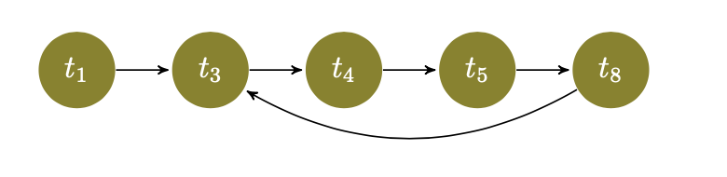
算法
Choicemap算法 [1]，较公平的线程配对:
线程rank匹配对出现环，无法pair
强制指定一个线程ti,使ti与其通信量最大的匹配,打破cycle
[1] Soomro PN, Sasongko MA, Unat D. BindMe: A thread binding library with advanced mapping algorithms. Concurrency Computat Pract Exper. 2018;30:e4692. https://doi.org/10.1002/cpe.4692

Slide 8
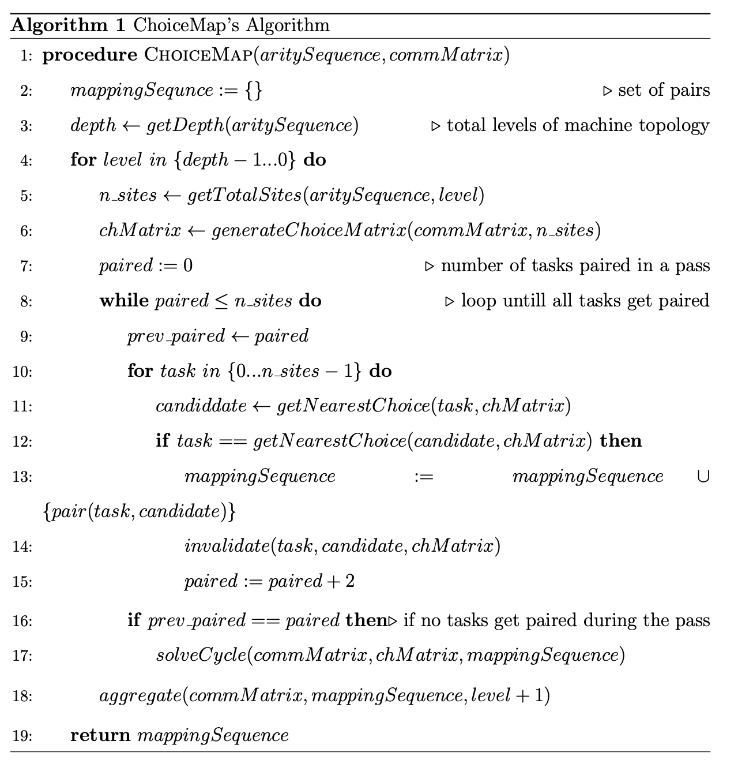
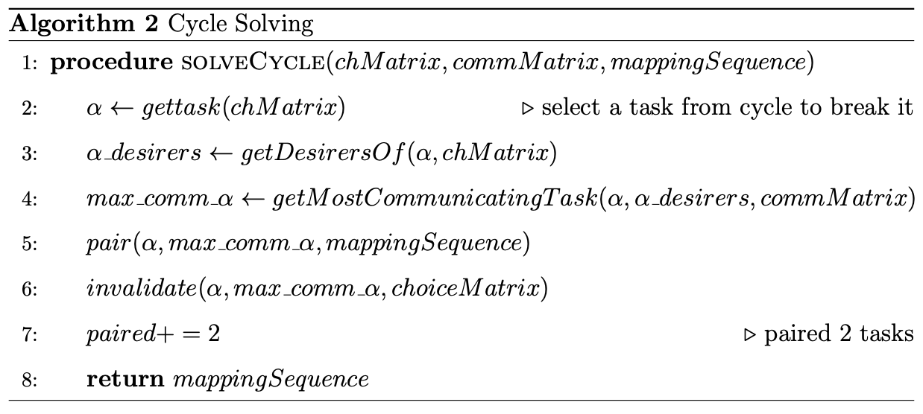
算法
[1] Soomro PN, Sasongko MA, Unat D. BindMe: A thread binding library with advanced mapping algorithms. Concurrency Computat Pract Exper. 2018;30:e4692. https://doi.org/10.1002/cpe.4692

Slide 9
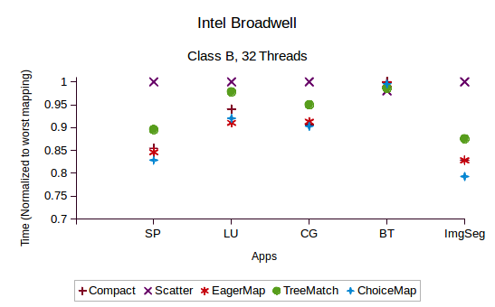
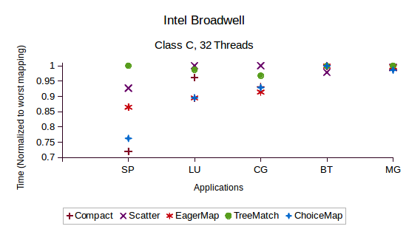
实验
[1] Soomro PN, Sasongko MA, Unat D. BindMe: A thread binding library with advanced mapping algorithms. Concurrency Computat Pract Exper. 2018;30:e4692. https://doi.org/10.1002/cpe.4692

Slide 10
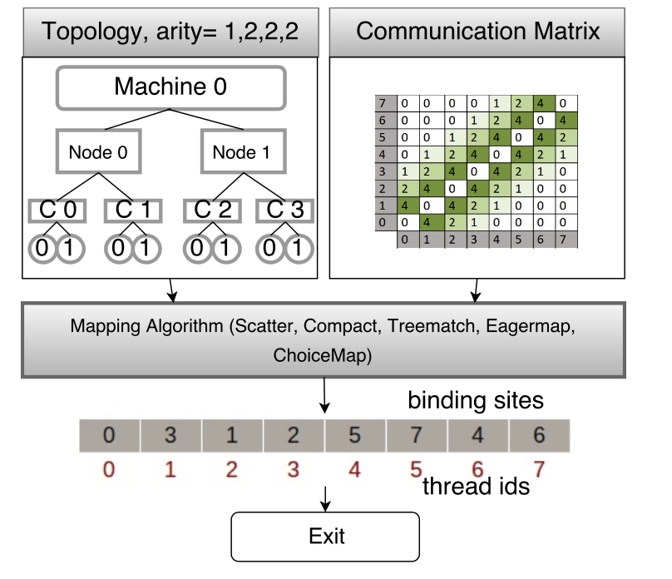
Bindme
[1] Soomro PN, Sasongko MA, Unat D. BindMe: A thread binding library with advanced mapping algorithms. Concurrency Computat Pract Exper. 2018;30:e4692. https://doi.org/10.1002/cpe.4692

Slide 11
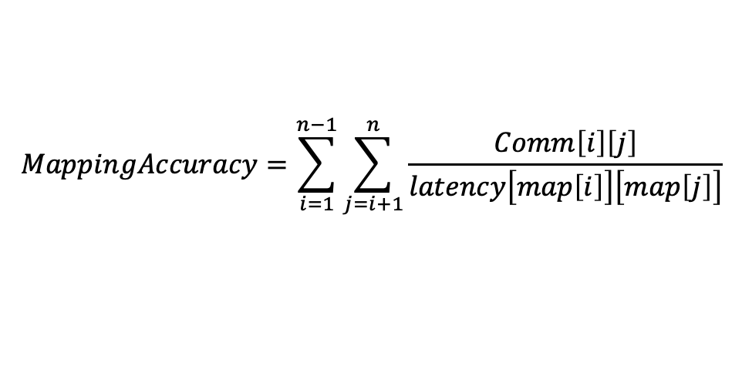
结论
1 Choicemap 较Eagermap 采用rank矩阵，更公平的线程配对，线程通信局部性较高
但由于存在cycle问题，可能使其退化为Eagermap(打破 cycle还是单方面指定线程)。
算法复杂度与Eagermap差不多
2 Choicemap 与 Eagermap 类似，会将通信量大的线程对放置在一个node内，导致潜在的内存拥塞问题
3 bindme映射算法库，需要手动去设置选用哪个算法，感觉不太灵活，可以考虑使用师兄论文里提到的公式计算下映射的精确度，每种映射算一遍，自动选取精确度最高的
$$MappingAccuracy=\sum_{i=1}^{n−1}{\sum_{j=i+1}^{n}{\frac{Comm\left[i\right]\left[j\right]}{latency\left[map\left[i\right]\right]\left[map\left[j\right]\right]}}}$$
[3]Jeannot E , Mercier G , Tessier F . Process Placement in Multicore Clusters:Algorithmic Issues and Practical Techniques[J]. TPDS, 2014.
[4] Mcvoy L W , Staelin C . lmbench: Portable Tools for Performance Analysis[C]// Proceedings of the 1996 annual conference on USENIX Annual Technical Conference. 1996.

Slide 12
下一步计划
1 调研相关文献
2 在parsec benchmark 测试之前的映射算法

