Slide 1
🌐
Internet Router Network Optimization
Shortest Path Problem Using Directed Weighted Graphs
COT - 4400: Analysis of Algorithms
USF Bellini College of AI, Cybersecurity and Computing
Team Members
Seyoung Kan | U36444259 Kaushik Selvakumar | U75300364
Notes:
Kaushik: Hey everyone, we’re presenting our project on router network optimization using graph algorithms. We modeled a real-world internet routing problem and analyzed different algorithms for it.

Slide 2
Problem Overview
The Problem
Real-World Impact
The internet routes billions of data packets daily through networks of interconnected routers.
Each router must decide the optimal next hop to deliver packets efficiently. This is fundamentally a Shortest Path Problem on a directed weighted graph.
OSPF (Open Shortest Path First) routing protocol
BGP (Border Gateway Protocol)
Content Delivery Networks (CDN)
VoIP & real-time streaming
Cloud service routing (AWS, Azure, GCP)
Notes:
Seyoung:
-> So the main idea is that the internet is basically a network of routers constantly passing data. -> Each router needs to decide the best next hop to minimize delay.
-> This naturally becomes a shortest path problem on a graph.
-> And this is exactly what real protocols like OSPF and BGP are solving.

Slide 3
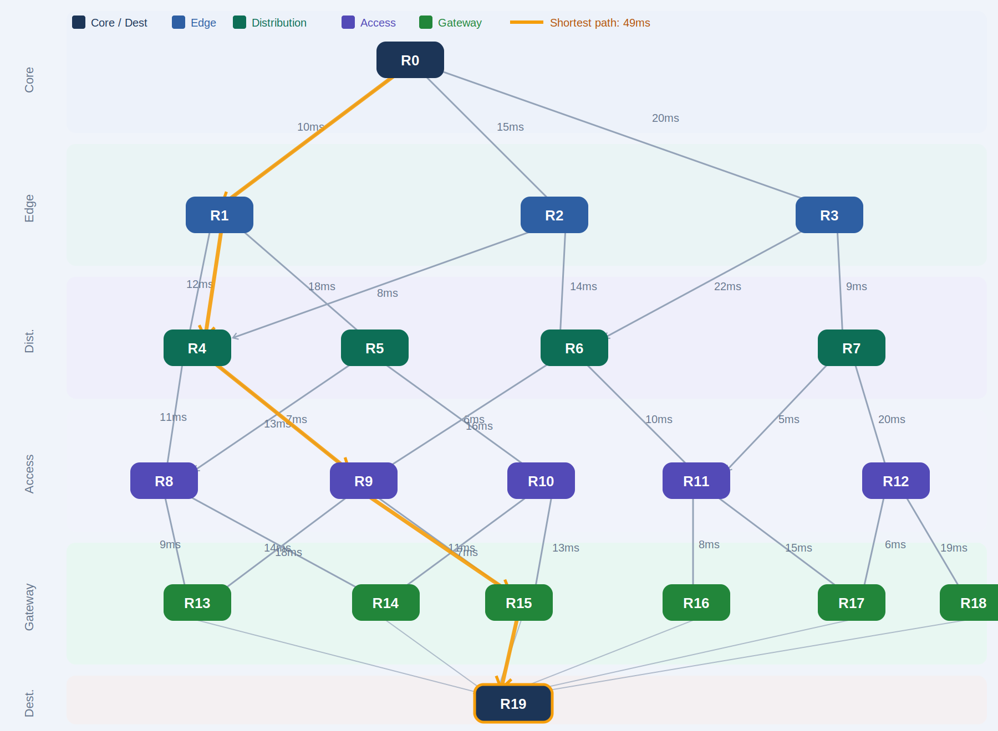
Graph Model — Router Network
Vertices (V)
20 Routers • Labeled R0 – R19
Each = a physical network node
Edges (E)
33 Directed connections
One-way links between routers
Asymmetric routing supported
Weights (W)
Latency in milliseconds (ms)
Range: 5ms – 22ms
Higher = slower link
Directed • Weighted • No Negative Weights
G = (V,E) |V|=20 |E|=33 w(u,v)=latency(ms) ★ Orange = shortest path R0→R19 = 49ms
Notes:
Seyoung:
We model the network as a directed weighted graph.
We have:
20 routers as vertices,33 directed edges and weights represent latency in milliseconds
So overall, it’s a directed, weighted graph with no negative weights.

Slide 4
Graph Architecture Layers
Layer | Routers | Role
Core | R0, R1 | High-speed backbone; interconnect all distribution routers
Distribution | R2–R4 | Aggregate edge-layer traffic; route to core
Edge | R5–R9 | Connect to ISPs and CDNs; first-hop for external traffic
ISP/CDN | R10–R13 | Internet service providers and content delivery nodes
Firewall | R14, R15 | Security gateway before access subnets
Access | R16–R19 | End-user subnets; final hop to user devices
Notes:
Seyoung: We also structured the network into layers to reflect real systems.
Core handles backbone routing, Distribution aggregates traffic, Edge connects to external networks, and Access connects to end users.
This makes the model more realistic instead of just a random graph.

Slide 5
Dataset — 20 Router Network
Key Edges (Source → Destination : Latency)
Network Layers
Core
R0, R1
R0→R1
R0→R2
R0→R3
10ms
15ms
20ms
Distribution
R2–R4
R1→R4
R1→R5
R2→R4
12ms
18ms
8ms
Edge
R5–R9
R3→R7
R4→R9
R7→R11
9ms
7ms
5ms
ISP/CDN
R10–R13
R9→R15
R11→R16
R16→R19
11ms
8ms
7ms
Firewall
R14–R15
R13→R19
R14→R19
R15→R19
Access
R16–R19
10ms
12ms
9ms
Notes:
Seyoung: Here are some key edges from our dataset.
These represent actual latency values between routers.
And on the right, we show how routers are grouped into layers.
The full structure is shown in the adjacency list output next.

Slide 6
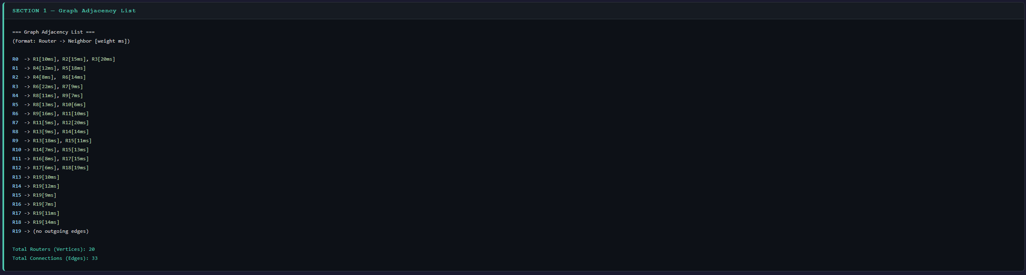
Graph Adjacency List Output
Notes:
Seyoung: This is the actual graph printed from our program. It confirms that we correctly built all 20 routers and 33 edges.

Slide 7
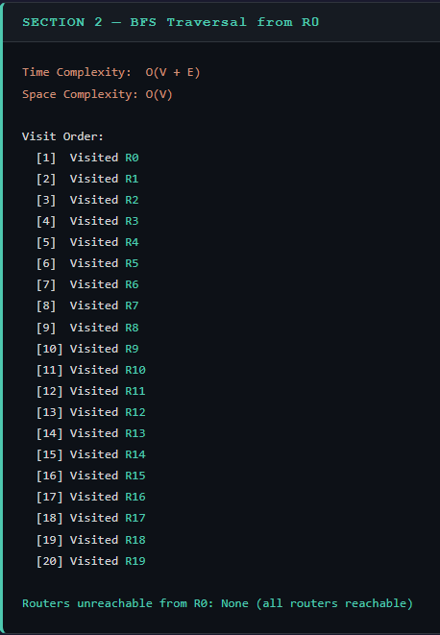
Algorithm 1 — BFS & DFS Traversal
BFS — Breadth-First Search
• Uses a FIFO queue • Explores level by level • Finds shortest hop count Time: O(V + E) Space: O(V) Use: Network discovery, reachability analysis
BFS Terminal Output
Notes:
Kaushik: For traversal, we first used BFS.
It explores the graph level by level using a queue.
It’s useful for checking reachability and finding shortest paths in terms of hops.
Time complexity is O(V + E), so it’s very efficient.

Slide 8
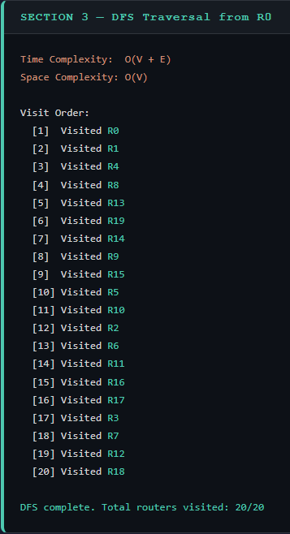
Algorithm 1 — BFS & DFS Traversal
DFS — Depth-First Search
• Uses recursion (call stack) • Explores deep paths first • Detects cycles Time: O(V + E) Space: O(V) Use: Cycle detection, topological ordering
DFS Terminal Output
Notes:
Kaushik: DFS goes deep into the graph first using recursion.
It’s useful for exploring structure and detecting cycles.
It has the same time complexity as BFS, O(V + E), but behaves differently.

Slide 9
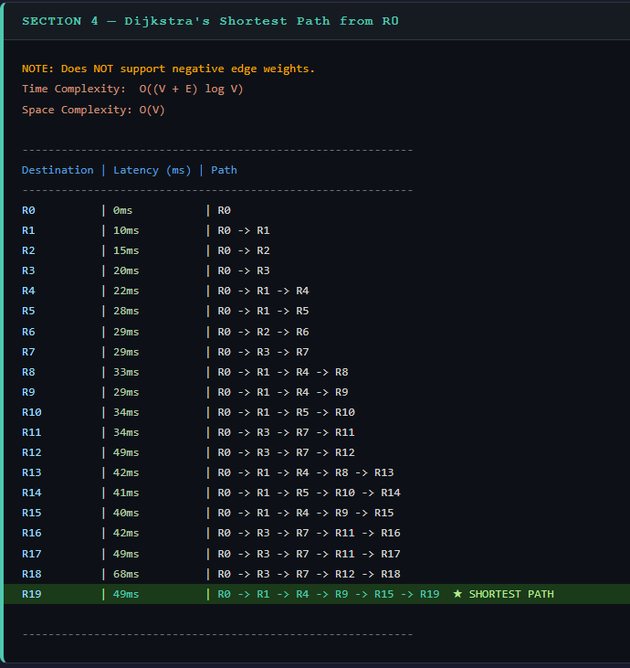
Algorithm 2 — Dijkstra's Shortest Path
Shortest Paths from R0
R0 → R1
10 ms
R0 → R2
15 ms
R0 → R4
22 ms
R0 → R7
29 ms
R0 → R9
29 ms
R0 → R11
34 ms
R0 → R16
42 ms
R0 → R19
49 ms ★
★ R0→R3→R7→R11→R16→R19
How It Works
1. Initialize all distances to ∞, source to 0
2. Insert source into min-heap (priority queue)
3. Extract vertex with minimum distance
4. Relax all outgoing edges
5. Repeat until queue is empty
Time: O((V + E) log V) Space: O(V) Best Case: O(V log V) — sparse graph Worst: O((V+E) log V) — dense
⚠ Does NOT support negative edge weights
Notes:
Kaushik: This is the main algorithm for shortest path.
Dijkstra uses a priority queue and always expands the node with the smallest distance.
Time complexity is O((V + E) log V).
From our output, the shortest path from R0 to R19 is: R0 → R1 → R4 → R9 → R15 → R19 = 49 ms
This is the minimum latency path found by the algorithm.

Slide 10
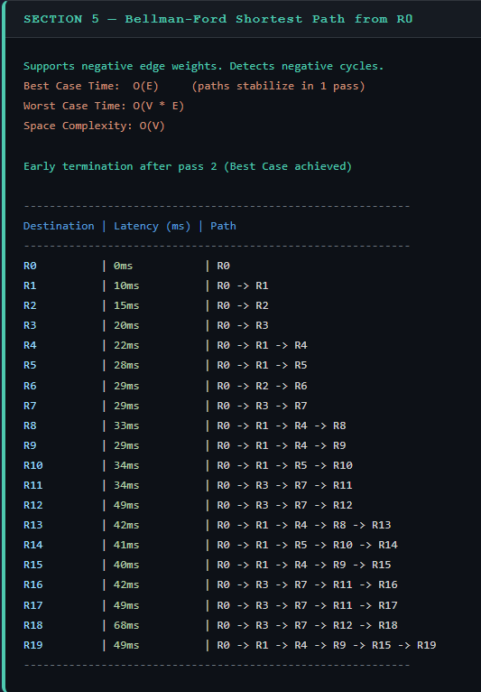
Algorithm 3 — Bellman-Ford
Feature | Dijkstra | Bellman-Ford
Negative weights | ✗ Not supported | ✓ Supported
Cycle detection | ✗ No | ✓ Detects negative cycles
Time complexity | O((V+E) log V) | O(V × E)
Speed (sparse) | Faster | Slower
Speed (dense) | Fast | Very Slow
Best for | Non-neg weights | General graphs
Bellman - Ford Terminal Output
Key Insight:
Use Bellman-Ford when your network may have negative-cost links or when you need to detect routing loops (negative cycles). Otherwise prefer Dijkstra for speed.
Notes:
Kaushik: Bellman-Ford is similar to Dijkstra but more flexible.
It supports negative weights and can detect negative cycles.
However, it’s slower with O(V × E) time complexity.
In our case, both algorithms produced the same shortest path, confirming correctness.

Slide 11
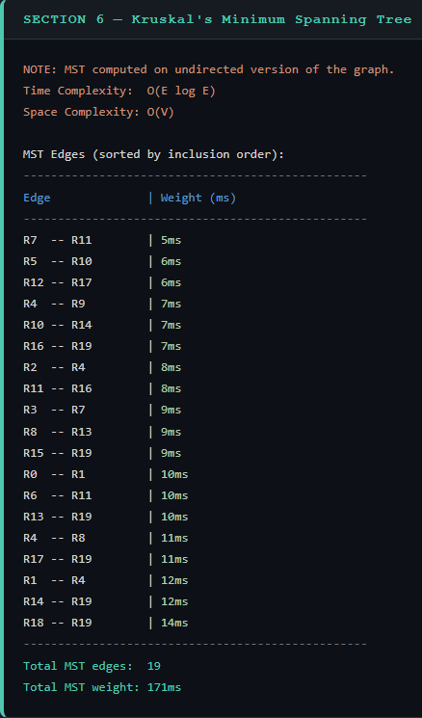
Algorithm 4 — Kruskal's MST
Kruskal's Algorithm Steps
1. Sort all edges by weight (ascending)
2. Initialize Union-Find (DSU)
3. For each edge (u, v, w):
If find(u) ≠ find(v):
Add to MST, union(u, v)
4. Stop when MST has V−1 edges
Network Use Case
Kruskal’s MST Terminal Output
MST gives the minimum cost backbone to connect all routers with no redundant links. Real-world applications: • Fiber optic cable layout • Network infrastructure design • Cluster network minimization ⚠ Applied to undirected version of the router graph.
Time: O(E log E) Space: O(V)
Notes:
Kaushik: Kruskal is used for building a minimum spanning tree.
Instead of shortest path, it minimizes total network cost.
From our output:
19 edges
total weight = 171 ms
We apply it on an undirected version of the graph.

Slide 12
Complexity Analysis Summary
Algorithm
Time Complexity
Space
Best Case
Worst Case
BFS
O(V + E)
O(V)
O(V + E) - tree
O(V + E) ) — dense
DFS
O(V + E)
O(V)
O(V + E) - tree
O(V + E) — dense
Dijkstra
O((V+E) log V)
O(V)
O(V log V) -sparse
O((V+E)logV)
Bellman-Ford
O(V × E)
O(V)
O(E) – early stop
O(V × E)
Kruskal
O(E log E)
O(V)
O(E log E) - sparse
O(E log E) — dense
Notes:
Kaushik: This slide summarizes the complexity of all algorithms.
BFS and DFS are linear, Dijkstra is logarithmic due to the heap, Bellman-Ford is slower, and Kruskal depends on sorting edges.

Slide 13
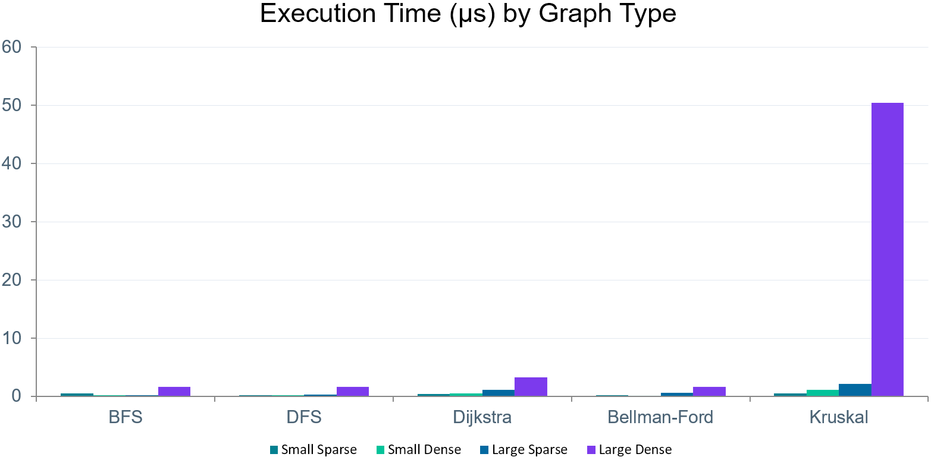
Experimental Results
Algorithm
Small Sparse
Small Dense
Large Sparse
Large Dense
BFS
0.561 µs
0.231 µs
0.260 µs
1.644 µs
DFS
0.250 µs
0.180 µs
0.361 µs
1.623 µs
Dijkstra
0.461 µs
0.471 µs
1.112 µs
3.317 µs
Bellman-Ford
0.170 µs
0.140 µs
0.611 µs
1.644 µs
Kruskal
0.541 µs
1.172 µs
2.194 µs
50.466 µs
Key Observations
• BFS/DFS fastest — O(V+E) linear, consistent across densities
• Kruskal 50.466µs on large dense vs 0.541µs small sparse — O(E log E) sorting dominates
• Dijkstra more efficient than Bellman-Ford on all graph sizes
• Bellman-Ford & BFS identical on large dense (1.644µs)
Notes:
Kaushik: We tested all algorithms on different graph sizes.
Key observations:
BFS and DFS are the fastest
Dijkstra and Bellman-Ford perform similarly at this scale
Kruskal increases significantly on dense graphs due to sorting overhead

Slide 14
Discussion & Conclusion
Best Algorithm
When Bellman-Ford
Dijkstra for shortest path — optimal for non-negative weights at O((V+E) log V). Confirmed by experimental data. Used in real protocols: OSPF, IS-IS, GPS navigation.
Required when negative edge weights exist (e.g., currency arbitrage, cost models with subsidies). Only algorithm that detects negative-weight cycles.
Traversal Use
MST Use
BFS: network discovery, reachability, hop-count minimization.
DFS: topology discovery, cycle detection, topological sorting, strongly connected components (Tarjan's, Kosaraju's).
Kruskal for minimum infrastructure cost. MST = 19 edges, total weight 171ms. Practical for fiber optic layout, cluster network minimization, backbone design.
Key Finding:
Both Dijkstra & Bellman-Ford produced identical shortest paths: Shortest path R0→R19: R0 → R1 → R4 → R9 → R15 → R19 = 49ms
Kruskal assumes undirected graph interpretation. The directed router graph is converted to undirected for MST computation.
Limitation:
Notes:
Kaushik: So overall:
Dijkstra is best for shortest path with non-negative weights
Bellman-Ford is useful when negative weights exist
BFS and DFS are great for graph exploration
Kruskal is useful for network design
This shows how these algorithms directly apply to real-world internet routing.

Slide 15
Thank You!
Notes:
Kaushik: And that’s our project — thank you.

