Slide 1
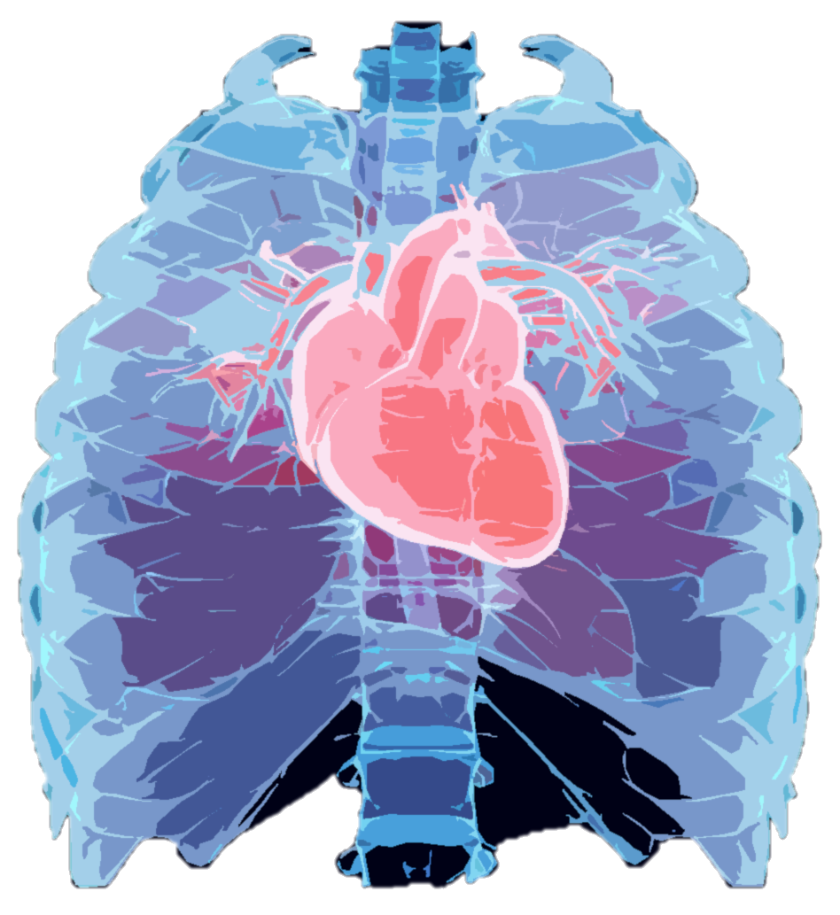
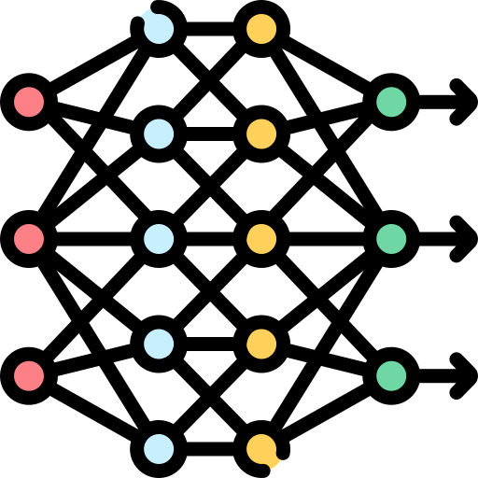
Pre-text Task Training
Backbone
Task
Head
t
Low-SNR Signals
Sparse Signal Recovery
Knowledge
Transfer
0.4m
0.2m
Backbone
Task
Head
0.4m
Search Space
ECG Outputs
High-SNR Signals
Fine-tuning
Chapter 3
Chapter 6
Efficient High-SNR Signal Acquisition
Alleviation of Data Scarcity
Chapter 1
Introduction
Conclusions and Future Work
Background and Literature Review
Robust Single-cycle ECG Generation
Robust Long-term ECG Generation
Chapter 7
Chapter 2
Chapter 4
Chapter 5
…
ODE-embedded DNN
Multi-task Learning
Notes:
Already graduated and will get the degree in November

