Slide 1
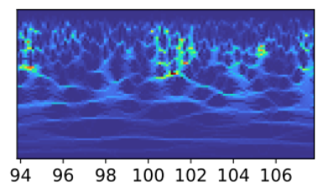
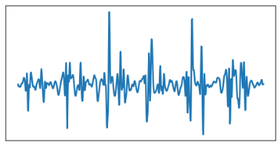
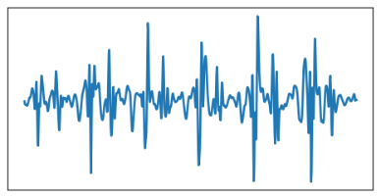
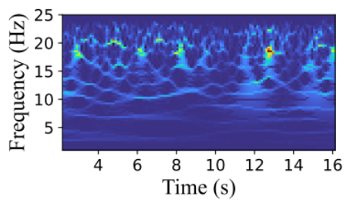
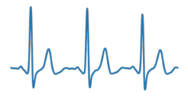
Pre-text Task Training
Backbone
Task
Head
t
Sparse Signal Recovery
Knowledge
Transfer
Backbone
Task
Head
High-SNR Signals
Spectrograms
Fine-tuning
ECG Outputs
Notes:
Already graduated and will get the degree in November

