Slide 1
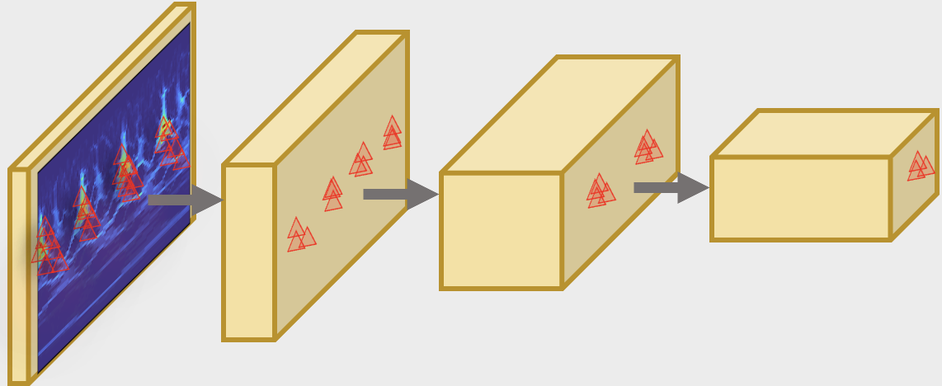



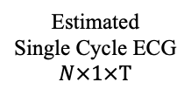

Backbone
Spectrogram Slices
$N×F×$T
Deformable
Kernel
Squeezer
&
Encoder
ECG Feature Decoder
Temporal Feature Decoder
Temporal
Feature
1D CNN
1D CNN
Feature
Fusion
…
Params. Estimation
$$η, τ$$
ODE
Solver
Estimated
Single Cycle ECG
$$N×1×T$$
Initial Decoder
Morphological
Feature
ODE Decoder
Notes:
Already graduated and will get the degree in November

