Slide 1
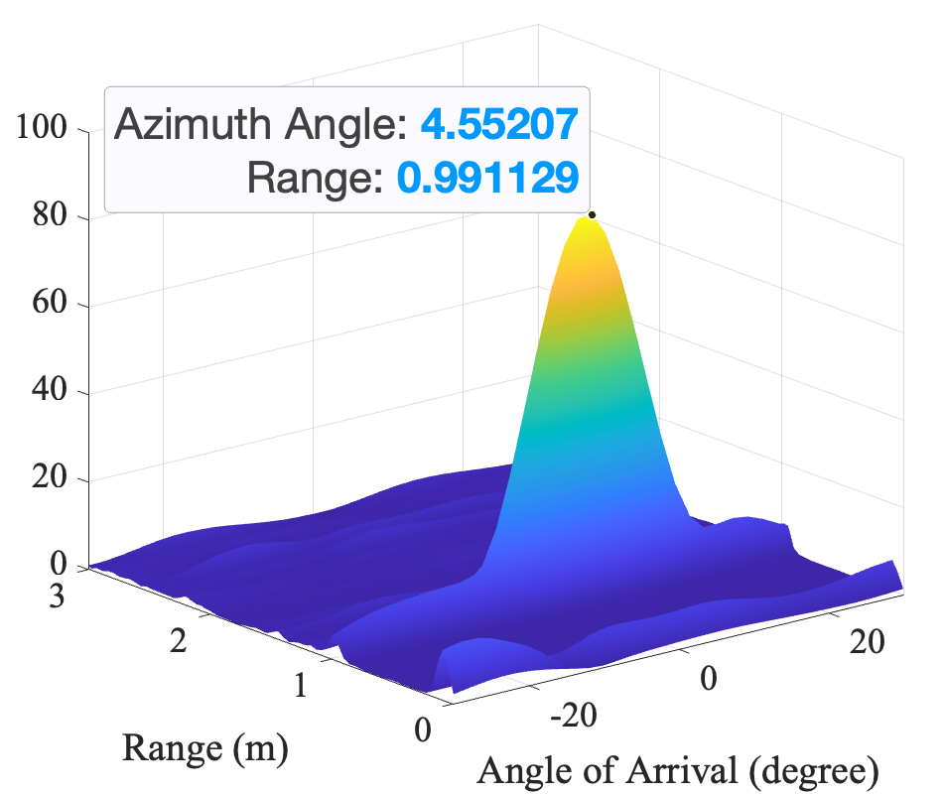



RA map for single frame
(a) Range FFT
(b) Angle FFT
Received Signal
Transmitted Signal
Frequency
Chirp
Tx1
Tx2
Time
FFT
FFT
TDM-MIMO
$$d_{0}+d_{v}$$
$$d_{0}$$
Range (Fast Time)
Rx 1
Rx 2
Rx 3
Rx 4
Range (Fast Time)
8 Virtual Channels
Ch. 1
Ch. 2
Frame (Slow Time)
FFT
Angle of Arrival
Notes:
Already graduated and will get the degree in November

