Slide 1
Condition Assessment of Stay Cables through Enhanced Time Series Classification Using a Deep Learning Approach ---- Project 3 of IPC-SHM 2020
The 1st International Project Competition for Structural Health Monitoring
IPC-SHM 2020
June 15 - September 30, 2020, Harbin, China
Zhiming Zhang*, Louisiana State University
Jin Yan, Iowa State University
Liangding Li, University of Central Florida
Hong Pan, North Dakota State University
Chuanzhi Dong, University of Central Florida
*Email: zzhan59@lsu.edu
08/31/2020

Slide 2
IPC-SHM 2020
Outline
Project 3 of IPC-SHM 2020: Goal & Tasks
Conclusions & Future Work
Methodology: TSC via Deep Learning with the LSTM-FCN Model
Experimental Case study: Results & Discussions

Slide 3
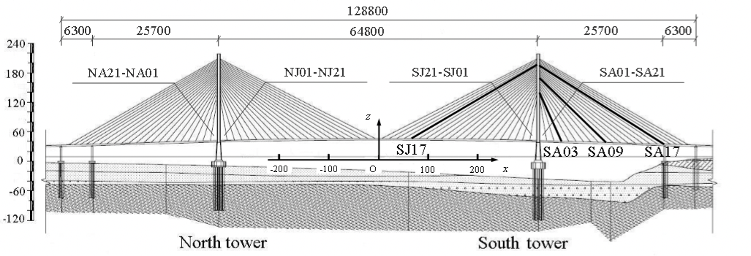
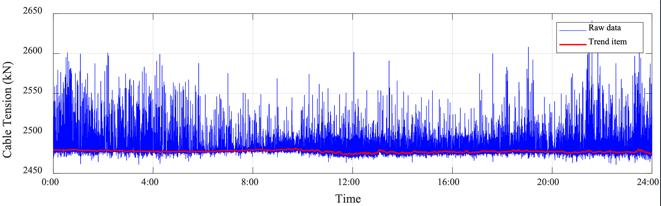
Project 3: Condition Assessment of Stay Cables
Basic info:
cable-stayed bridge
168 stay cables (84 pairs)
dataset:
cable tension force
load cell
sampling frequency: 2 Hz
14 cables: SJS08 to SJS14 and SJX08 to SJX14
10 days: (2006-05-13 to 2006-05-19, 2007-12-14, 2009-05-05, and 2011-11-01)
Goal: find the damaged cable
data preprocessing
feature extraction
statistical model development

Slide 4
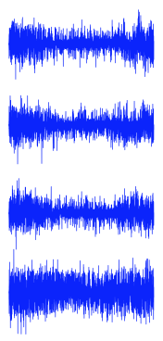
Methodology
Time series classification
wide applications in health care, financial analysis, etc.
cable damage detection
data X: segments of measure time series
Scenario 1: cable force of a certain cable (SJS08)
Scenario 2: cable force ratio of a certain cable pair (SJ08 = SJS08/SJX08)
label Y: ID of cable or cable pair
Scenario 1: e.g., SJS08
Scenario 2: e.g., SJ08
X Y
data 1
data 2
data l
data n
label i
label i
label i
label i
TSC
cable i

Slide 5

Methodology
Time series classification
intact condition
data 1
data 2
data l
data n
label i
label i
label i
label i
intact condition
cable i
data 1
data 2
data l
data n
label i
label i
label i
label i
data 1
data 2
data l
data n
label i
label i
label i
label i
cable i
test
cable i
data 1
data 2
data l
data n
label j
label j
label j
label j
TSC model
cable j
data 1
data 2
data l
data n
label j
label j
label j
label j
data 1
data 2
data l
data n
label m
label p
label i
label k
data 1
data 2
data l
data n
label k
label k
label k
label k
cable j
cable j
test
cable k
damaged condition
model training
model testing

Slide 6
Methodology
LSTM-FCN model for TSC (Karim et al. 2017)
reduced preprocessing compared with other deep learning models
components
input layer
FCN module
Conv layer
ReLU activation function
global average pooling
LSTM module
feature augmentation
regularization
dimension shuffle
reduce overfitting
feature concatenation
softmax layer
input (cable force/cable force ratio)
dimension shuffle
LSTM
dropout
concatenate
softmax
Conv1D
Conv1D
Conv1D
global pooling
ReLU
ReLU
ReLU

Slide 7
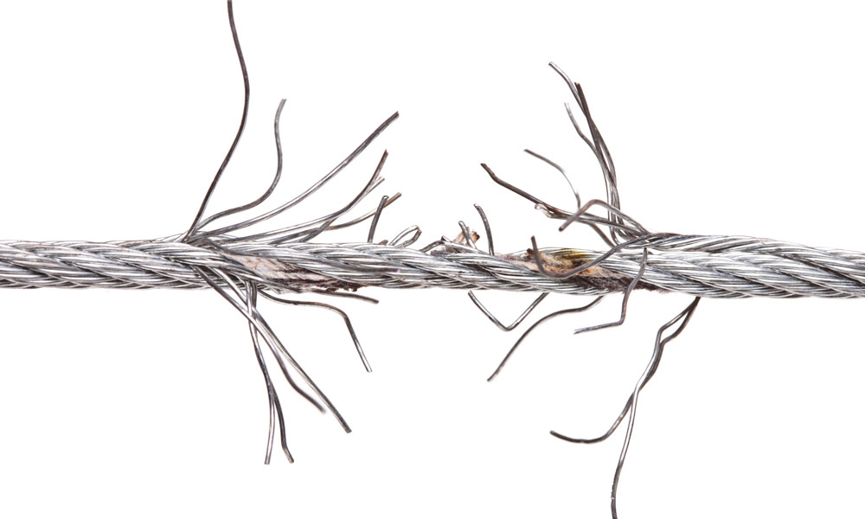
Experimental case study
Project 3: condition assessment of stay cables
Data preprocessing
outlier
sensor failure
LSTM-FCN model Configuration & training
Results and discussions
Scenario 1 with cable force as input
Scenario 2 with cable force ratio as input
Decision making on the damaged cable
Scenario 1
Data Preprocessing
LSTM-FCN
Scenario 2

Slide 8
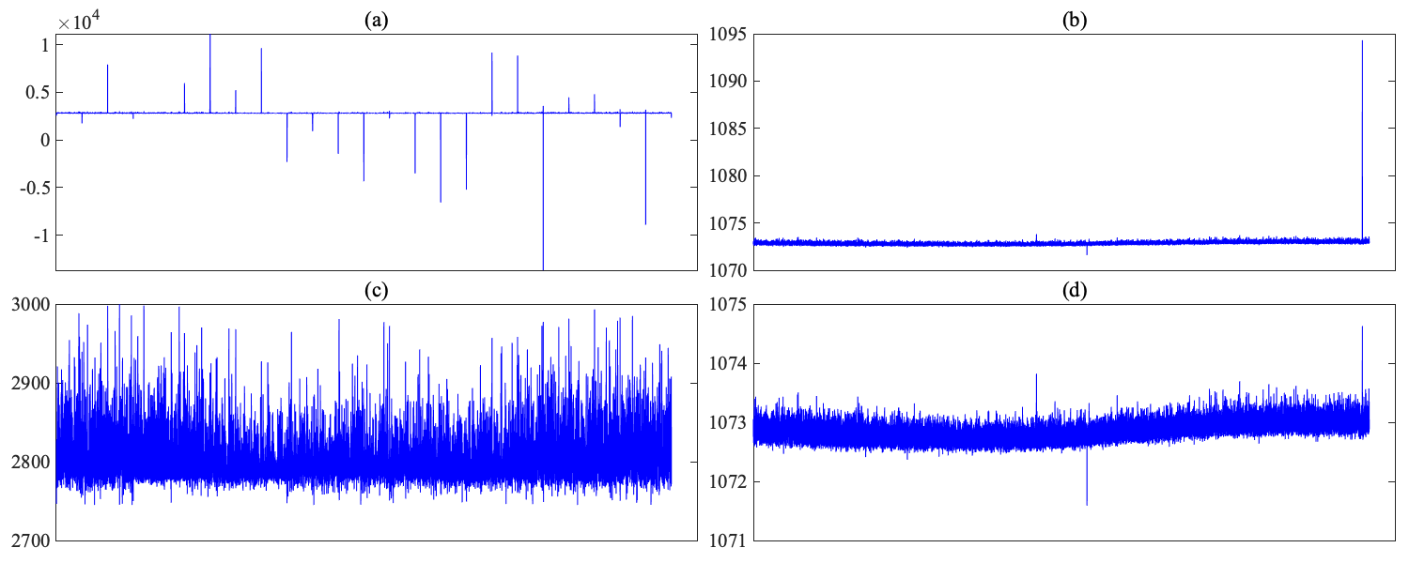
Preprocessing: outlier
outlier: extreme values
remove outliers based on the range elsewhere
(a) SJS13 with outlier
(b) SJX13 with outlier
(c) SJS13 with outlier removed
(d) SJX13 with outlier removed

Slide 9
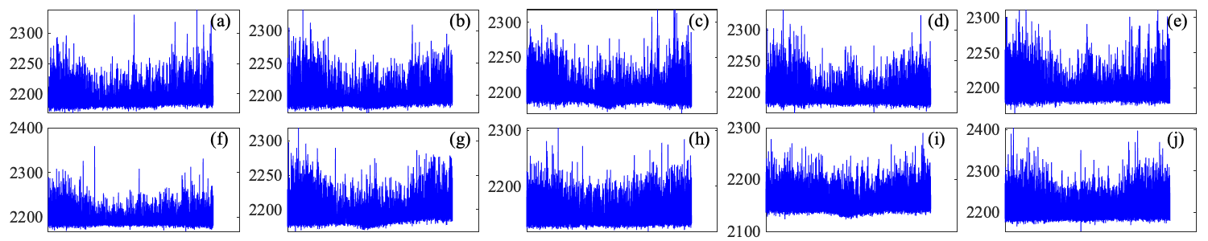
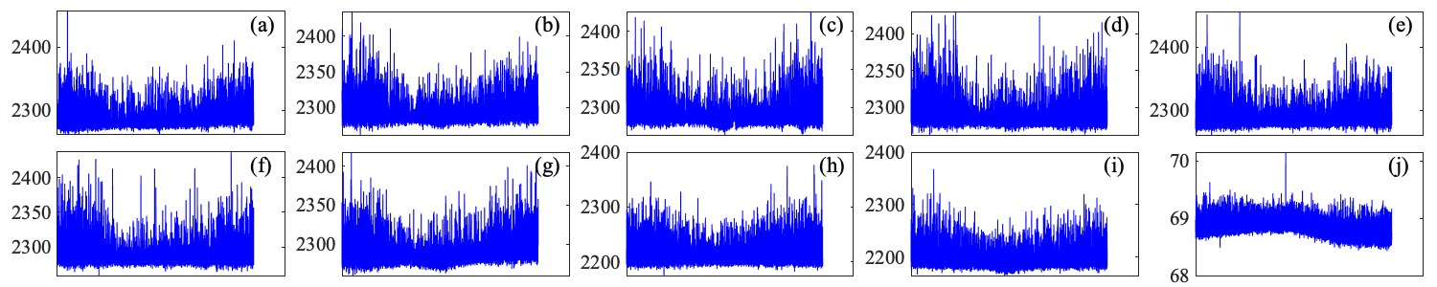
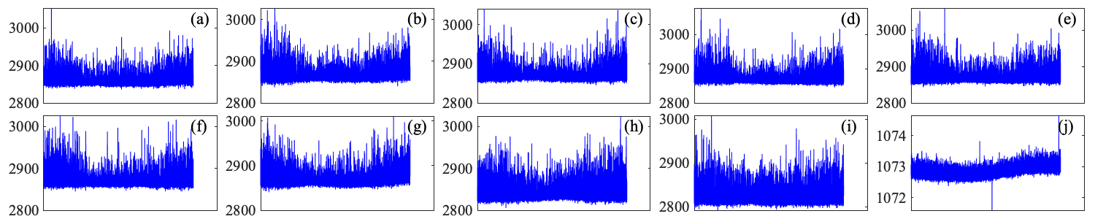
Preprocessing: sensor failure
SJS08
periodicity pattern
traffic loads
environment
Day 10 on SJX08 & SJX13
notably small magnitude
small fluctuation
reversal or random drift
sensor failure
cable force: SJS08 (a) to (j): day 1 to day 10
cable force: SJX08 (a) to (j): day 1 to day 10
cable force: SJX13 (a) to (j): day 1 to day 10

Slide 10


Preprocessing: data segmentation and assignment
data segmentation
172800 = 108*1600
referring to UCR datasets
label each segment with the class ID
training and testing data
data prior to 2011
50% for training
50% for testing
data in 2011
test using the learned model
172800
data prior to 2011
…
…
1600*108
training
testing
LSTM-FCN model
data in 2011

Slide 11
Investigated scenarios
Scenario 1:
input: cable force
target: 14 cable labels
Scenario 2:
input: cable force ratio
target: 7 cable pair labels
cable force
LSTM-FCN model
score on cable 1 (SJS08)
score on cable 2 (SJS09)
…
score on cable 14 (SJX14)
cable force ratio
LSTM-FCN model
score on cable pair 1 (SJ08)
score on cable pair 2 (SJ09)
…
score on cable pair 7 (SJ14)

Slide 12
LSTM-FCN Model Configuration and Training
Framework
Keras library with the TensorFlow backend
Parameters
cell number of LSTM
number of Conv layers in FCN
kernel size of Conv layers
Training settings
2000 epochs
initial batch size:128
Adam optimizer
adaptive learning rate
Evaluation metric: accuracy
cell number: 8
128*1 256*1 128*1
(kenrl size)

Slide 13
Results
Classification accuracy
pre-2011: data prior to the year of 2011
overall-2011: all data in 2011
SJS/SJX**: data in 2011 labeled with cable ID in Scenario 1
SJ**: data in 2011 labeled with cable pair ID in Scenario 2
dataset | pre- 2011 | overall-2011 | SJS08 | SJS09 | SJS10 | SJS11 | SJS12 | SJS13 | SJS14
accuracy | 0.79 | 0.56 | 0.53 | 0.69 | 0.59 | 0.28 | 0.65 | 0.89 | 0.55
dataset | - | - | SJX08 | SJX09 | SJX10 | SJX11 | SJX12 | SJX13 | SJX14
accuracy | - | - | - | 0.83 | 0.25 | 0.60 | 0.61 | - | 0.60
Scenario 1
dataset | pre- 2011 | overall-2011 | SJ08 | SJ09 | SJ10 | SJ11 | SJ12 | SJ13 | SJ14
accuracy | 0.96 | 0.75 | - | 0.94 | 0.95 | 0.02 | 0.94 | - | 0.91
Scenario 2

Slide 14
Results
Decision making: combining the results of Scenarios 1 & 2
Scenario 1: possible damage in cables SJS11 and SJX10
Scenario 2: possible damage in cable pair SJ11
the most probable cable with damage: SJS11
consistent with results in [1]: SJ11
improvement
[1] Li, S., Wei, S., Bao, Y. and Li, H. 2018, “Condition assessment of cables by pattern recognition of vehicle-induced cable tension ratio”, Engineering Structures 155, 1–15.
SJS
SJX
SJ

Slide 15
Conclusions and future work
This study proposes detecting cable damage from collected cable force data through time series classification (TSC) using the deep learning framework LSTM-FCN.
Two scenarios are investigated with different input and class labels
Combining the results of the two scenarios, the most probable damaged cable is detected, which is consistent with the results in the literature.
This proposed method enables fast and convenient early detection and warning in real applications.
More case studies will be conducted in the future work.

Slide 16




Acknowledgment
Our team would like to acknowledge the organizing committee of the 1st International Project Competition for structural health monitoring (IPC-SHM 2020) for sharing all the materials used in Project 3 for cable condition assessment
We also would like to thank the committee for kindly replying to our inquiries every time. They did great job!

