Slide 1
Experiment design

Slide 2
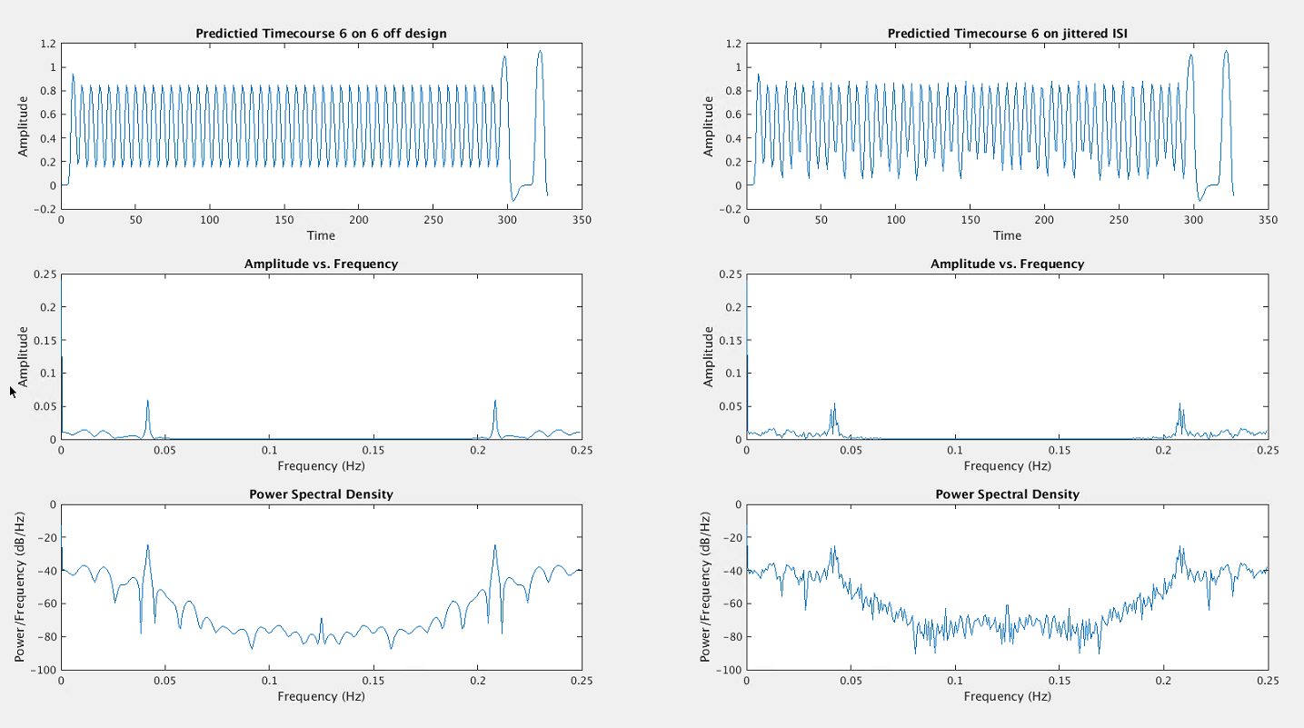
6s/6s design

Slide 3
6s/jittered (5s-7s)

Slide 4
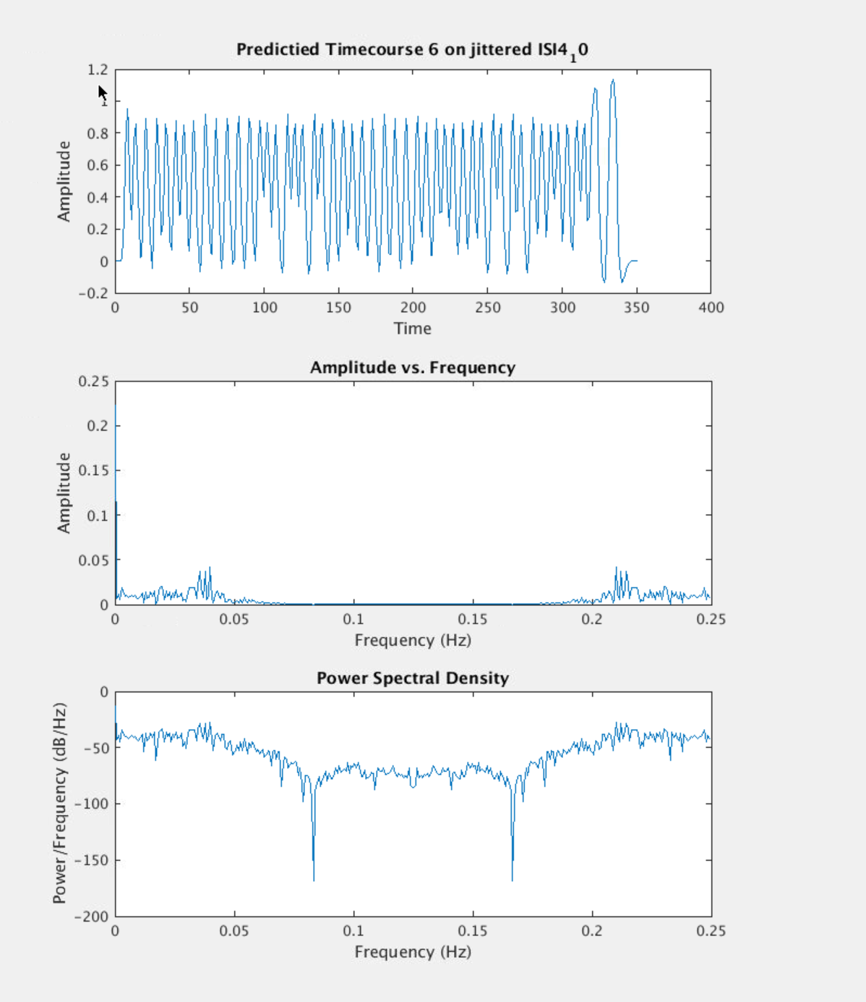
6/jittered (4s – 10s)

Slide 5
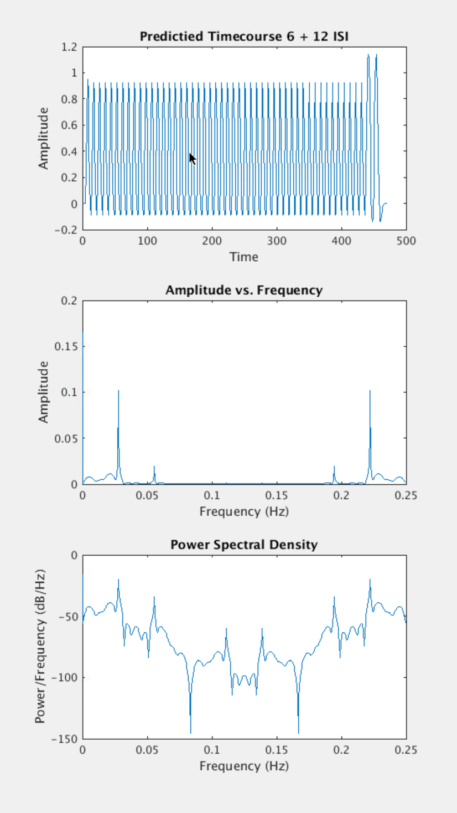
6s/12s

Slide 6
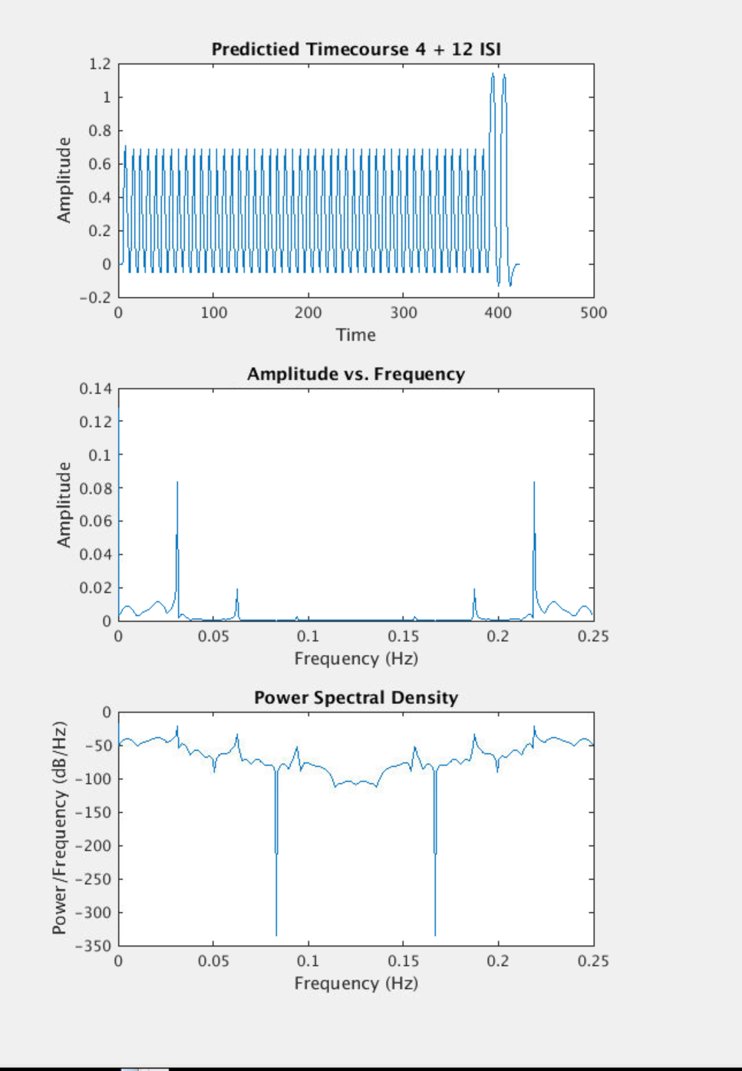
4s/12s

Slide 7
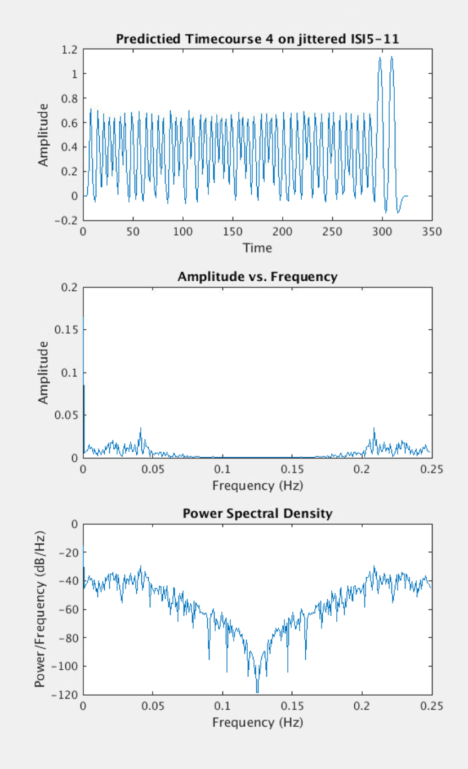
4s/jittered (5s – 11s)

Slide 8
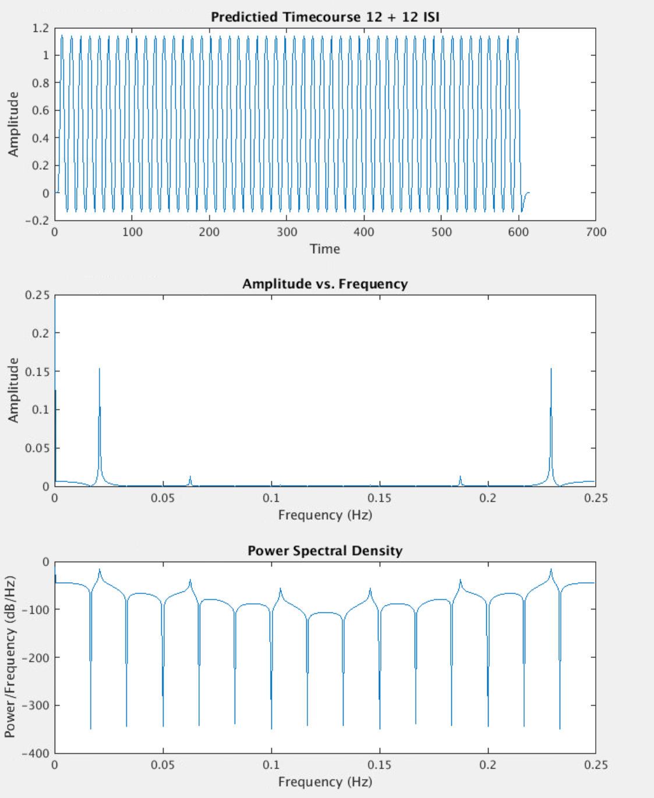
12s/12s ISI

Slide 9
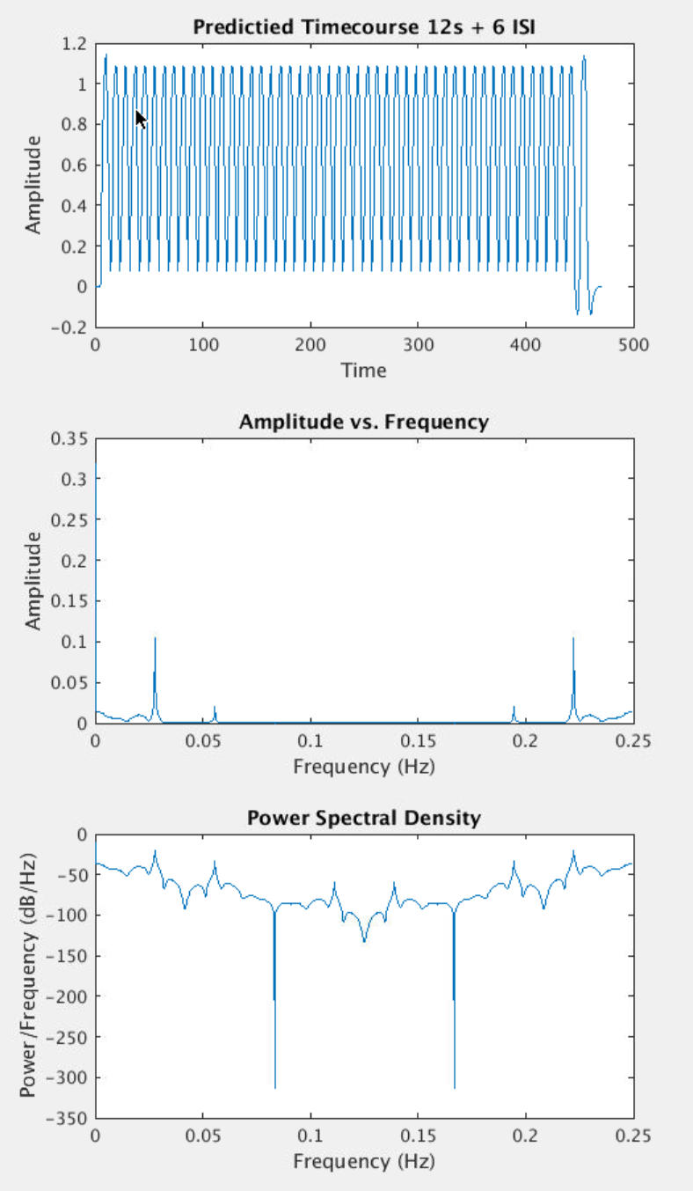
12s/6s ISI

Slide 10
