Slide 1



NBA Team Oklohoma City Thunder Analysis
Zhiyuan Zhang

Slide 2

Operations in summer
1. The prediction of the salaries for rookies in this team.
2. Who fits this team best according to analysis of advanced stats of this team?

Slide 3
Operation 1
Data Acquisition and Cleaning Process
Data Collection:
CSV files for OKC team statistics, historical NBA draft data, and salary information.
Data Cleaning:
Standardizing column headers using the first row of CSV files.
Removing currency symbols and converting salary fields to numeric for analysis.
Merging datasets to align player statistics with their corresponding salary data.

Slide 4
Implementation of Data Analysis Techniques
Feature Selection:
Selected features for prediction: Games Played (G), Minutes Played (MP), Points (PTS), Total Rebounds (TRB), Assists (AST), Field Goal Percentage (FG%), Three-Point Percentage (3P%), Free Throw Percentage (FT%), Win Shares (WS), Win Shares per 48 minutes (WS/48), Box Plus/Minus (BPM), Value Over Replacement Player (VORP).
Data Imputation:
Using median values to fill missing data points ensuring robust model training.
Model Training:
Linear Regression model to predict salaries based on performance indicators.

Slide 5
Training and Evaluating the Predictive Model
Data Splitting:
80% for training and 20% for testing to validate model accuracy.
Scaling:
Standardizing features to normalize data distribution.
Model Evaluation:
Discuss the training process and initial results from the test set to validate predictions.

Slide 6
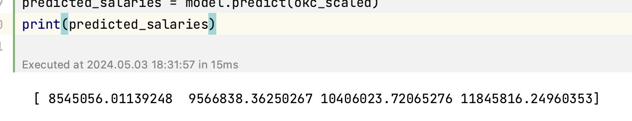
Outcomes
Prediction Results:
Display a few examples of predicted salaries for OKC rookies and discuss their accuracy.
Future Enhancements:
Consideration of additional variables such as player efficiency and injury history.
Implementation of more complex models such as Random Forest or Neural Networks to improve prediction accuracy.
Potential Applications:
This model can assist NBA teams in financial planning and contract negotiations.

Slide 7

Operation 2
Who fits this team best according to analysis of advanced stats of this team?

Slide 8
Sections
Data Loading and Preprocessing
Feature Selection and Standardization
Naive Bayes Classifier
Support Vector Machine (SVM)
K-Means Clustering
Output and Conclusion

Slide 9
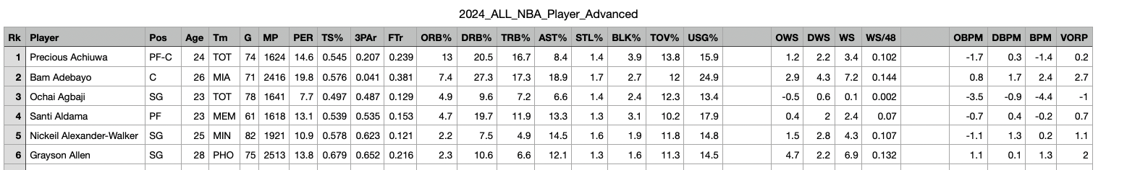
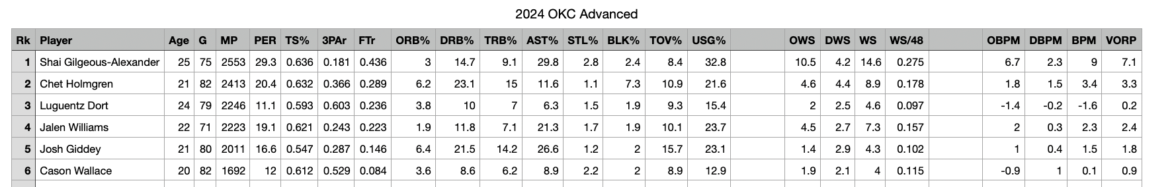
Raw Data

Slide 10
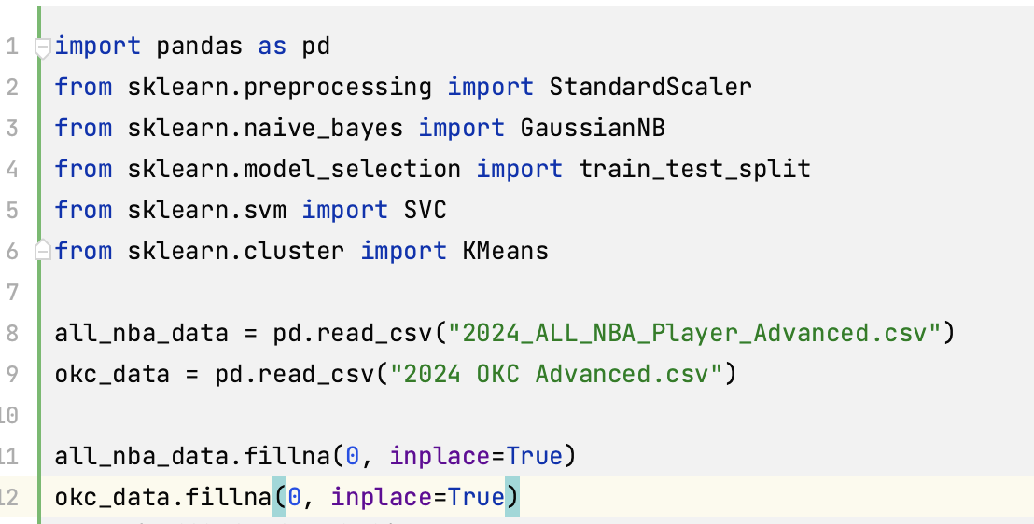
Data Loading and Preprocessing

Slide 11

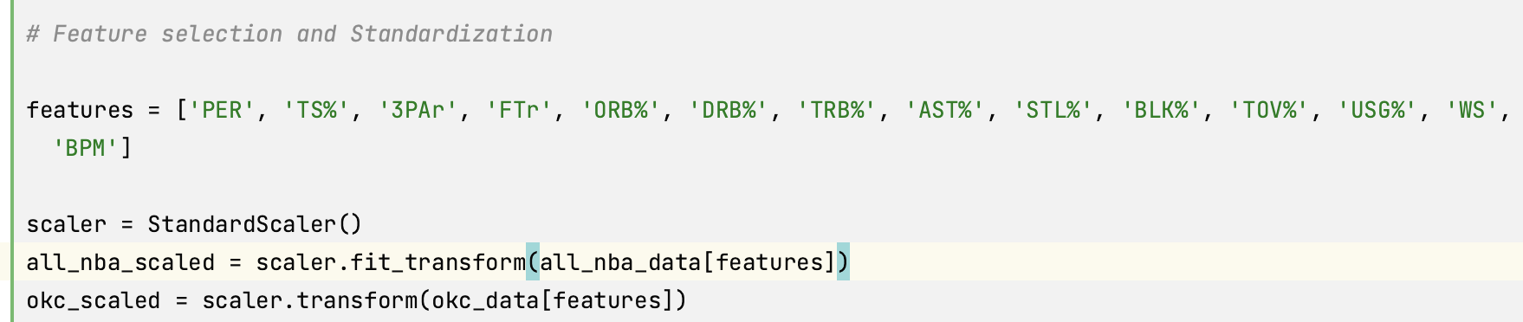

Feature selection and Standardization
PER: Player Efficiency Rating, a comprehensive metric assessing a player's performance on the court.
TS%: True Shooting Percentage, a measure of a player's shooting efficiency, considering field goals, three-pointers, and free throws made.
3PAr: Three-Point Attempt Rate, the percentage of a player's field goal attempts that are three-pointers.
FTr: Free Throw Rate, the ratio of free throw attempts to field goal attempts in a player's scoring.
ORB%: Offensive Rebound Percentage, the percentage of offensive rebounds a player grabs.
DRB%: Defensive Rebound Percentage, the percentage of defensive rebounds a player grabs.
TRB%: Total Rebound Percentage, the percentage of total rebounds a player grabs.
AST%: Assist Percentage, the percentage of a team's made field goals that a player assists on.
STL%: Steal Percentage, the percentage of opponent possessions that end with a steal by the player.
BLK%: Block Percentage, the percentage of opponent two-point field goal attempts blocked by the player.
TOV%: Turnover Percentage, the percentage of a player's possessions that end in a turnover.
USG%: Usage Percentage, the percentage of a team's possessions a player uses while on the court.
WS: Win Shares, a statistic used to estimate the number of wins contributed by a player.
BPM: Box Plus-Minus, a box score-based metric that estimates a player's impact on the game's score differential while on the court.

Slide 12
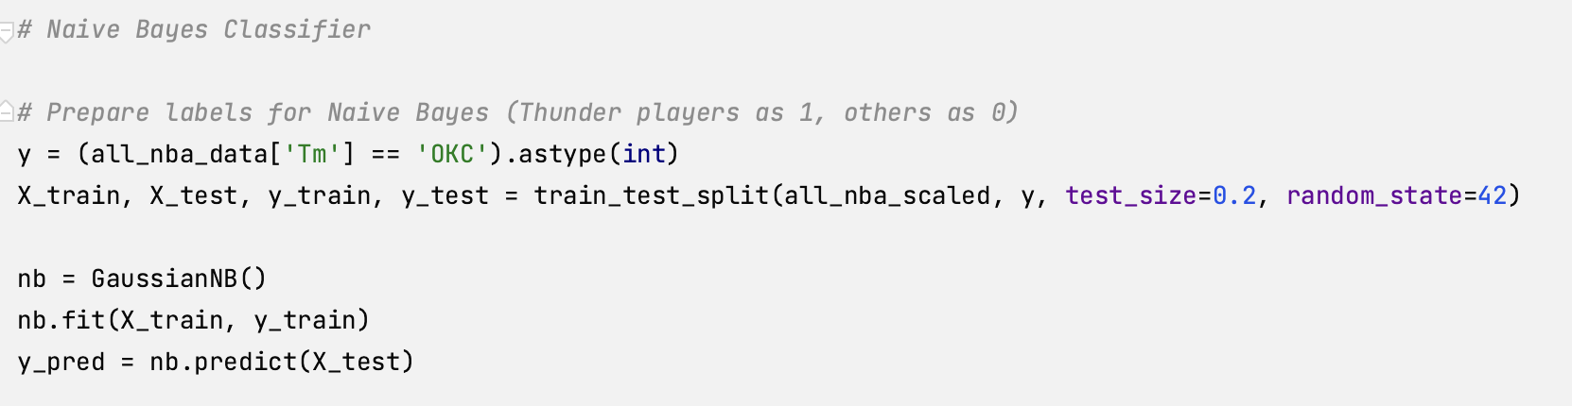
Naive Bayes Classifier

Slide 13
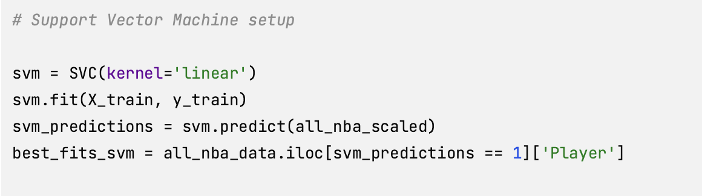
SVM setup

Slide 14
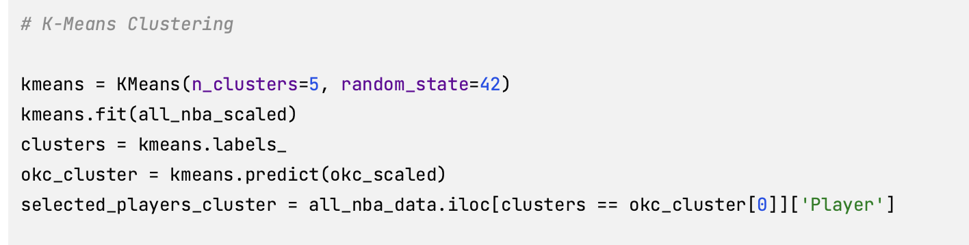
K-Means Clustering

Slide 15
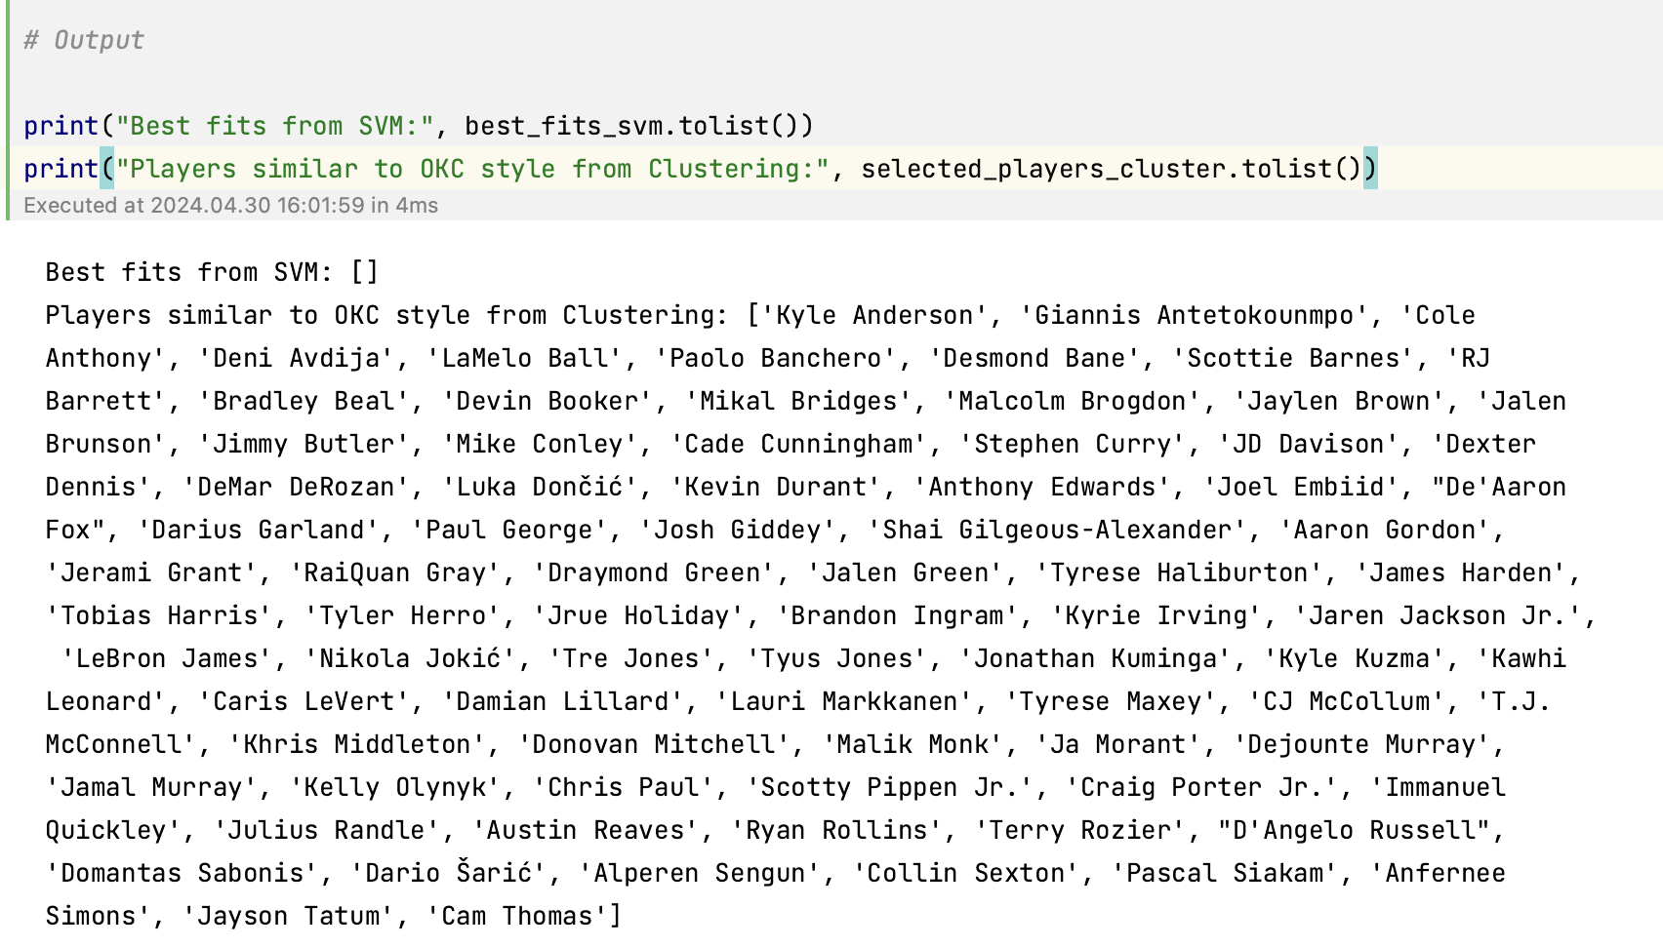
Output

Slide 16
Modification
SVM reset
Result filtering

Slide 17
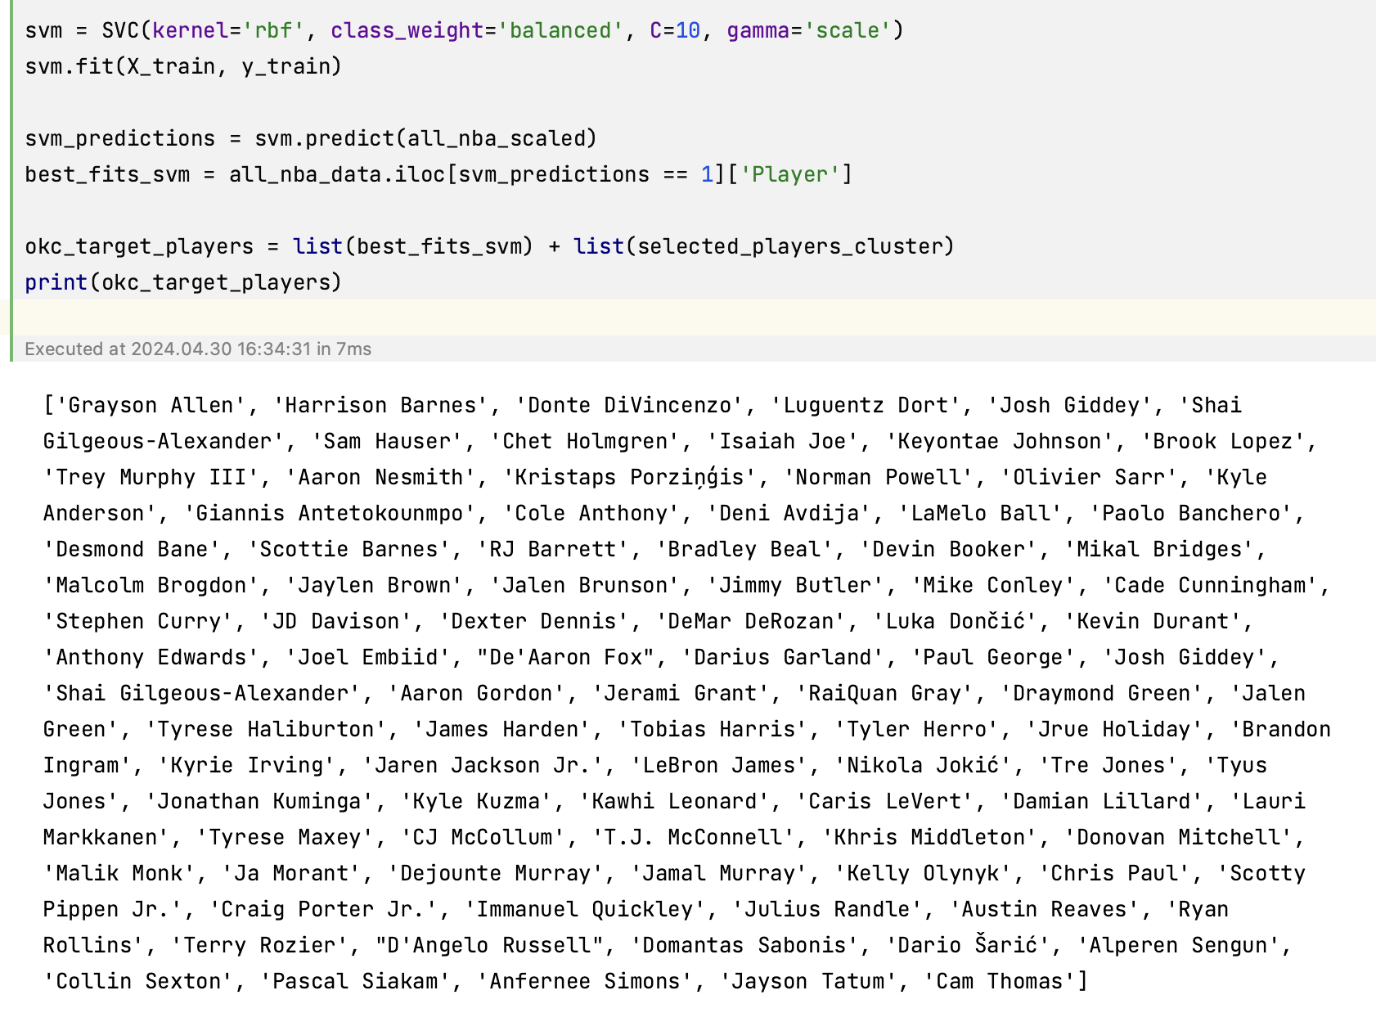
SVM reset

Slide 18

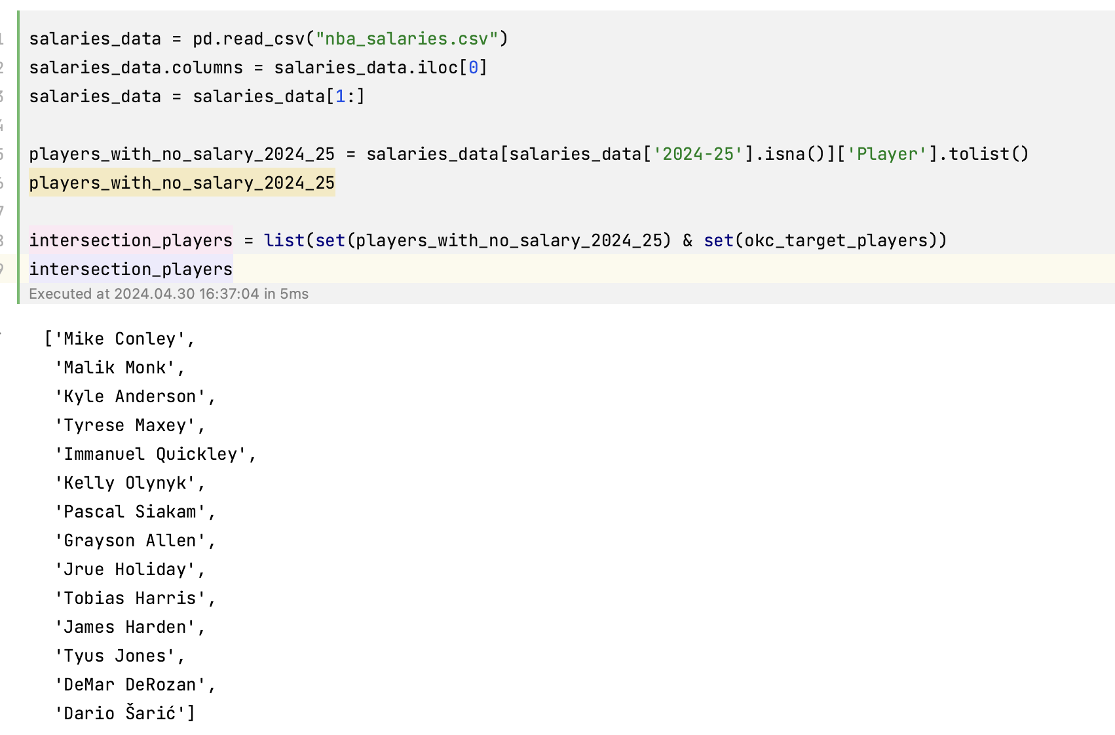
Result filtering

Slide 19
Final Report for OKC in 2024 Summer
Rookie Salaries Analysis:
According to the salary predictions, the projected salaries for rookies in the team are as follows:
Josh Giddey: $8,545,056.01
Isaiah Joe: $9,566,838.36
Aaron Wiggins: $10,406,023.72
Lindy Waters III: $11,845,816.25

Slide 20
Final Report for OKC in 2024 Summer
Best Fit Players Analysis:
Mike Conley
Malik Monk
Kyle Anderson
Tyrese Maxey
Immanuel Quickley
Kelly Olynyk
Pascal Siakam
Grayson Allen
Jrue Holiday
Tobias Harris
James Harden
Tyus Jones
DeMar DeRozan
Dario Šarić

Slide 21

Thank you for watching

