Slide 1

Life Expectancy Analysis
Jinghan Xu
Zuer Zheng
Xueyin Zhu
Fengsheng Zhou

Slide 2
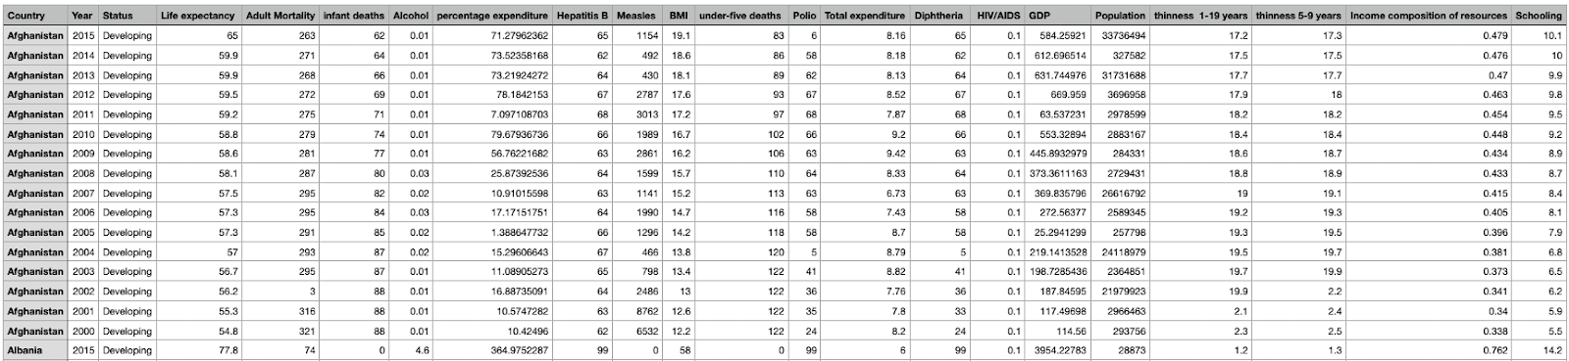
Data Description
Source:
https://www.kaggle.com/datasets/kumarajarshi/life-expectancy-who
Collected by WHO and the United Nation website
Preview of the data

Slide 3

Purpose of the project
To construct a multiple linear regression model for life expectancy
To check the model’s performance through simulation study and regression diagnostics
To find the efficient way of solving the question among LU decomposition, Cholesky decomposition, and QR decomposition
To explore the dataset, research and analyze how predictor variables affect our response variable, life expectancy

Slide 4

Model Construction

Slide 5
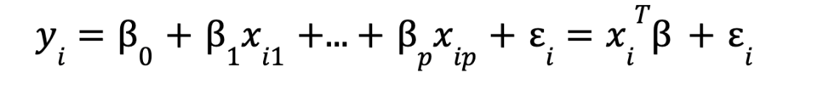
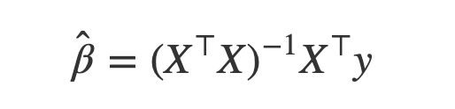
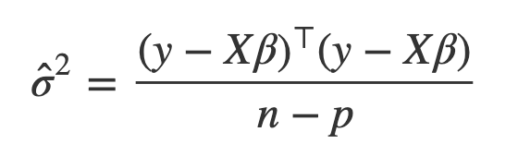
Proposed Methods
Linear Regression
Least Squares
Simulation Study
Model Selection

Slide 6
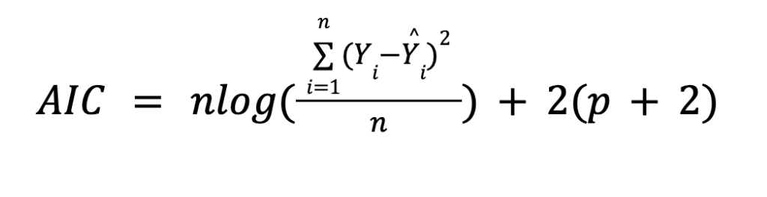
Model Selection
Number of regressors
Mean Squared Error
Penalty Term
AIC keep balance of the model performance and number of regressors

Slide 7
Computation time comparation for Least-squares methods
LU
user system elapsed 0.166 0.044 0.224
Cholesky
user system elapsed 0.034 0.018 0.055
QR
user system elapsed 0.038 0.024 0.064

Slide 8

Regression Diagnostics

Slide 9
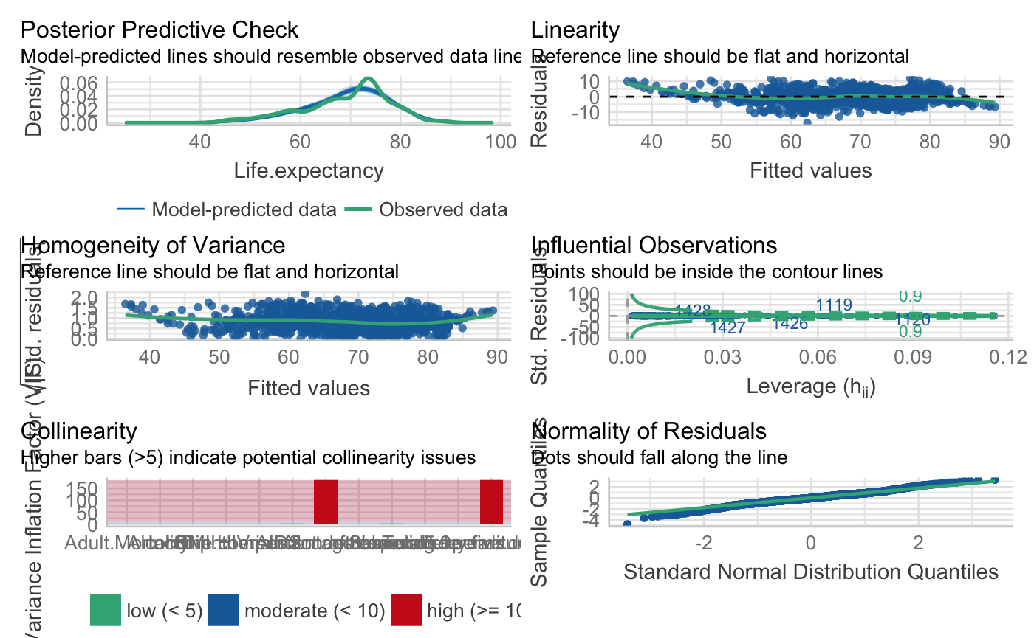
Regression Diagnostics
Linearity between x and y
Independence of observations
Normality of residuals
Constant variance of residuals
Outliers

Slide 10

Interesting Results

Slide 11
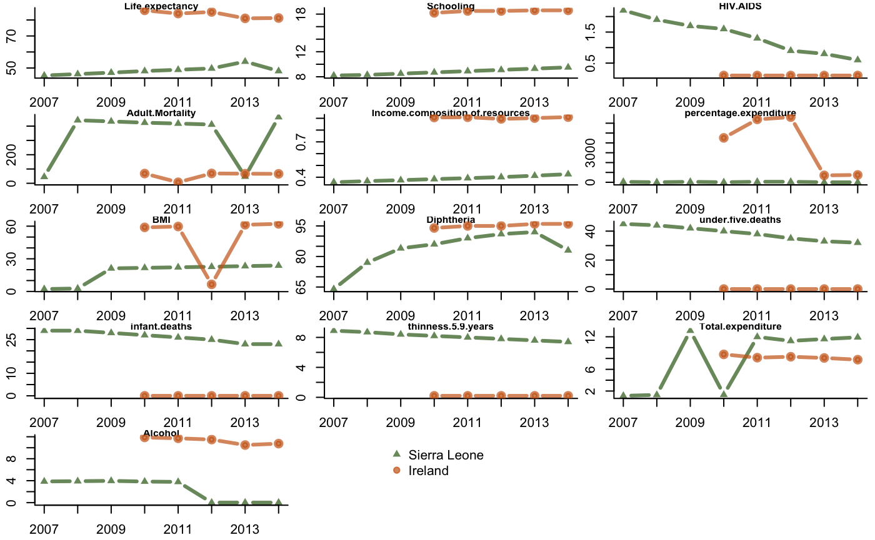
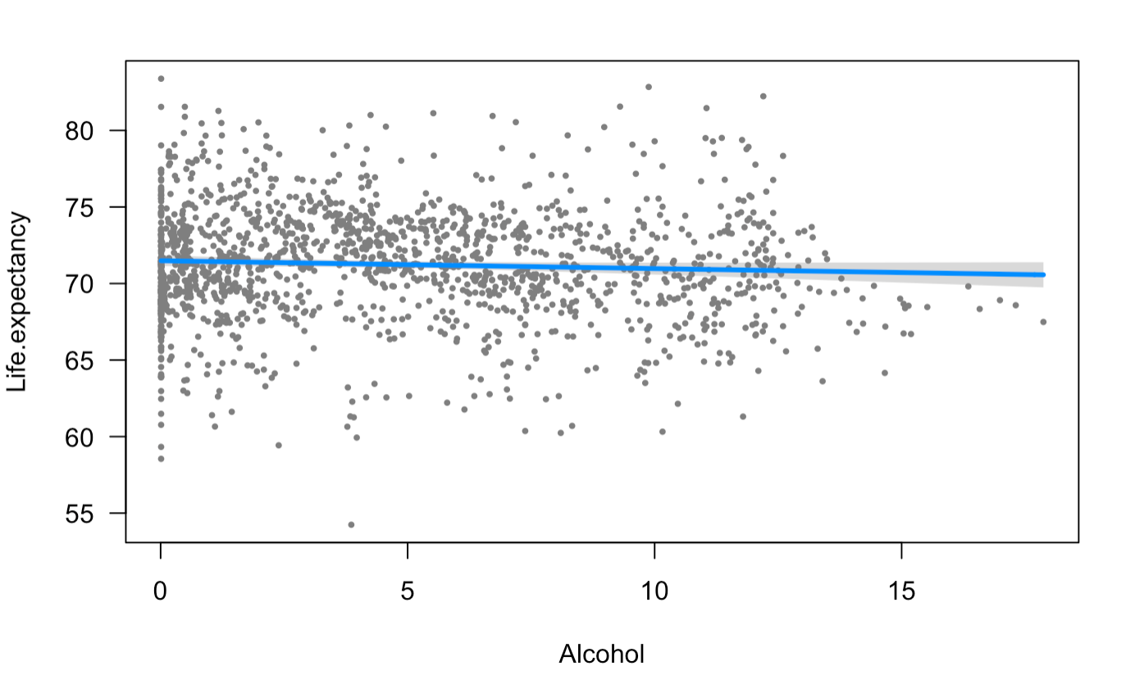
Alcohol consumption might be unrelated to life expectancy

Slide 12
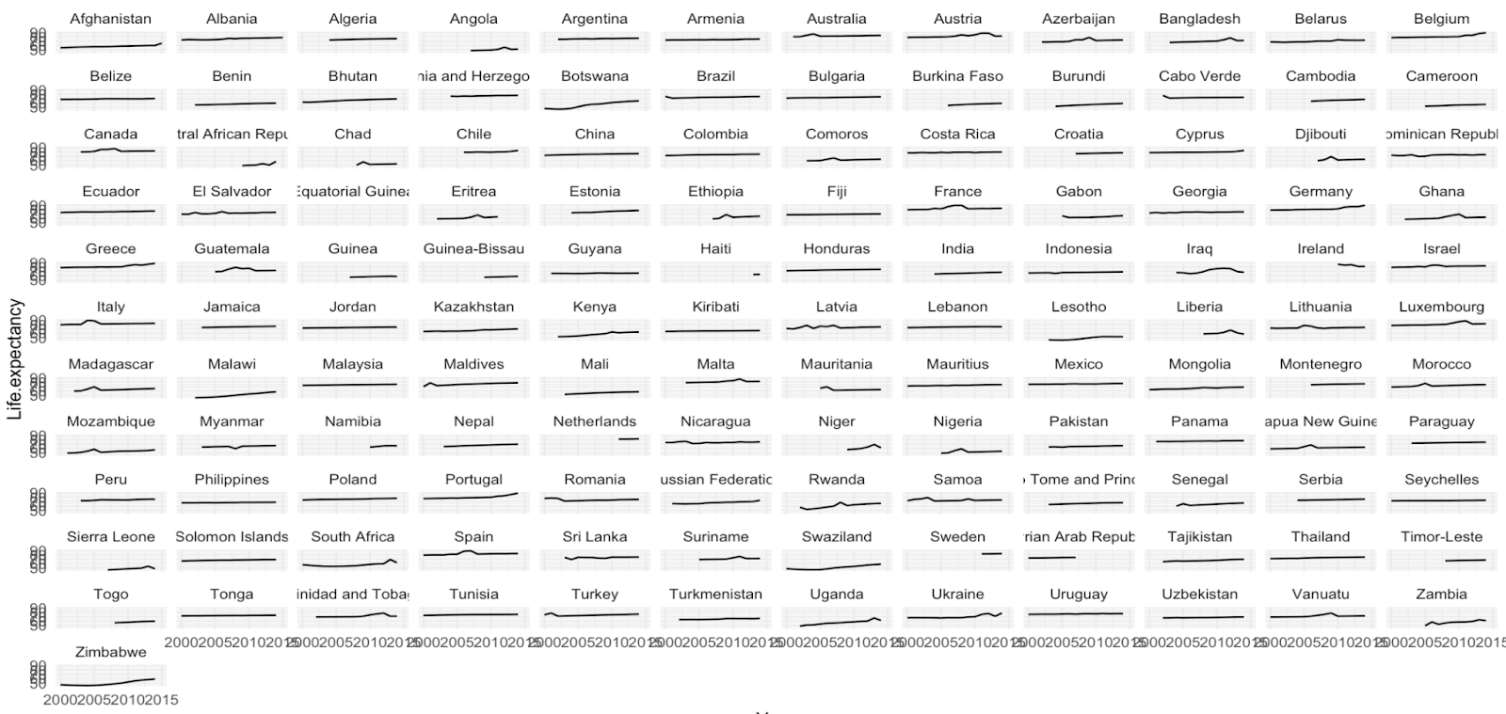
Time Series Plot for All Countries
Most countries have stable trends
Developing countries in Africa have the most obvious improvements
Ireland is experiencing a decrease in life expectancy

Slide 13
Thank you for watching!!!

