Slide 1
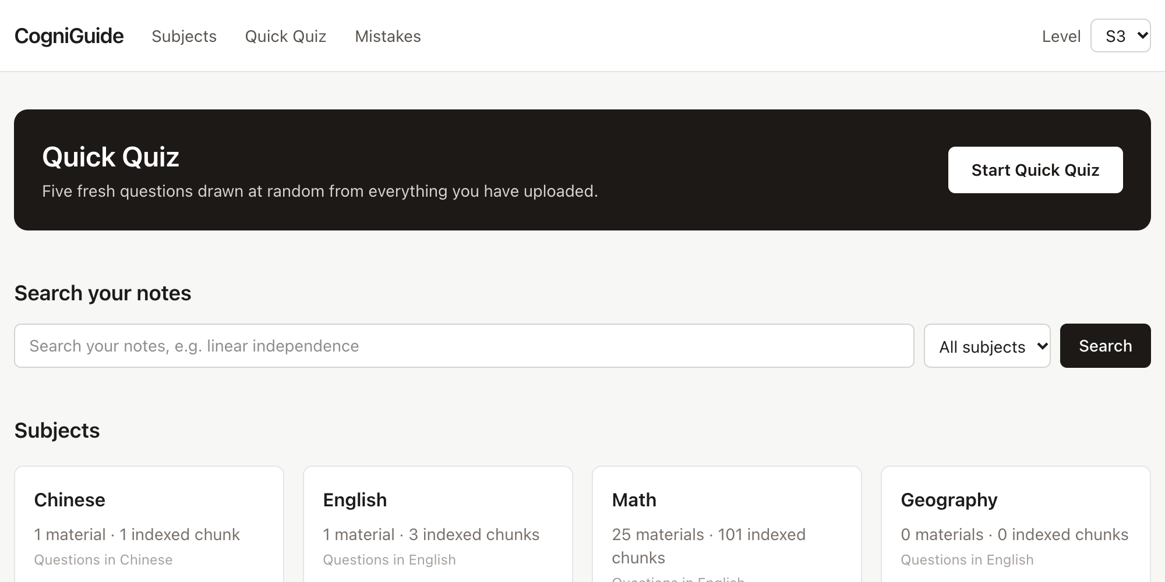
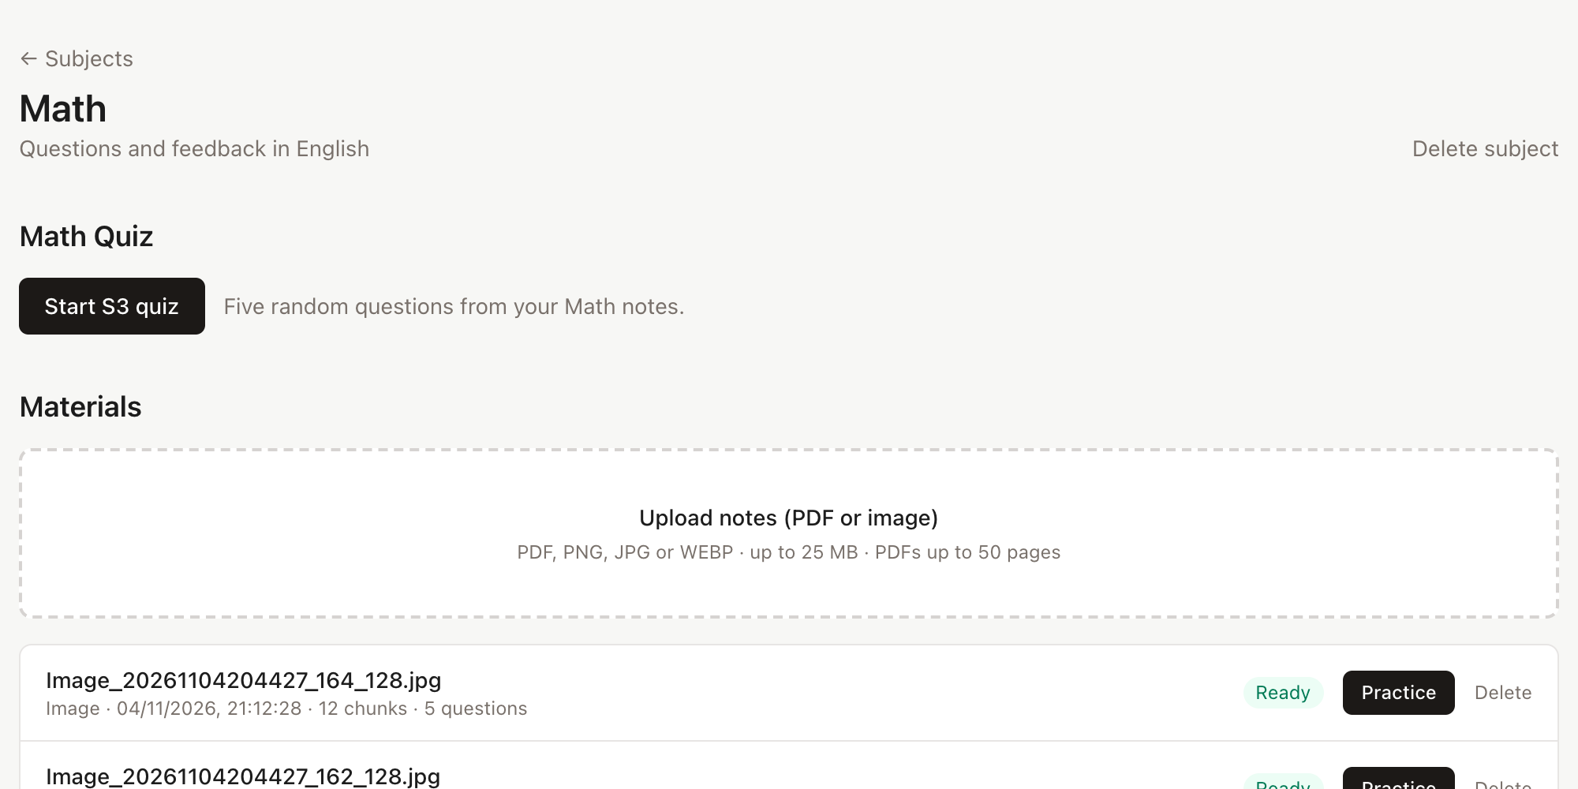
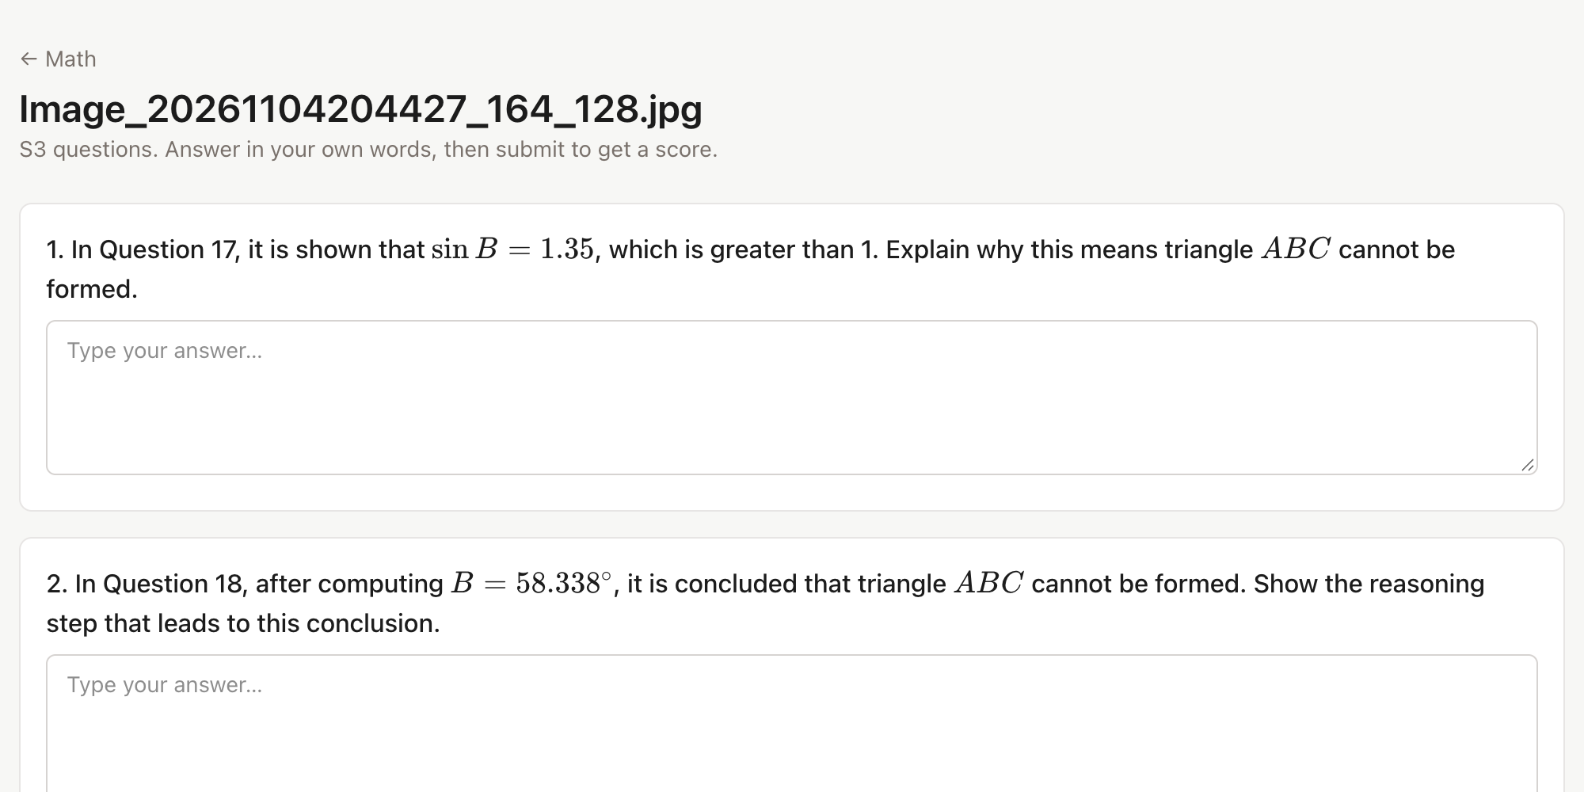


AI STUDY COMPANION · RETRIEVAL PRACTICE
CogniGuide
Upload your notes. Get questions written from them. Answer, get graded against your own material, and keep reviewing what you missed.
Zachary Zhang · Hugo Wong
WHY COGNIGUIDE
DESIGN PRINCIPLES
Re-reading notes feels productive but builds little memory; testing yourself (active recall) works far better. CogniGuide turns handwritten or digital notes into short-answer quizzes, so every session becomes self-testing on your own material.
Grounded in your notes
Level-aware
RAG: questions and grading are based on the original note chunks.
Hong Kong levels S1–S6; questions and grading adapt to the level.
Passive re-reading
Familiarity feels like understanding; gaps stay hidden.
Active recall with CogniGuide
Scores and feedback reveal what you have not mastered.
Learn from mistakes
Cloud or fully local
Scores below 60 are logged and reviewed until mastered.
Runs on your own machine, no login. Use Bailian cloud models, or Ollama so notes never leave it.
HOW IT WORKS: FROM NOTES TO MASTERY
01 · UPLOAD
02 · TRANSCRIBE
03 · INDEX
04 · GENERATE
05 · GRADE
Add notes
Image → text
Chunk & embed
Write questions
Score & feedback
PDFs or photos of handwritten notes, sorted into subject folders and processed in the background.
›
Each page is rendered to an image; a vision model transcribes text and math into Markdown + LaTeX.
›
Text is split into ~800-character overlapping chunks, embedded and stored in LanceDB for semantic search.
›
An LLM writes five short-answer questions per material, tuned to the student's level.
›
Answers are scored 0–100 against the source notes, with correct points, missed points and feedback.
PDF · PNG · JPG · WEBP
CLOUD qwen3-vl-plus
CLOUD text-embedding-v4
CLOUD qwen-plus
CLOUD qwen-plus
LOCAL qwen2.5vl:3b
LOCAL bge-m3
LOCAL qwen3:4b-instruct
LOCAL qwen3:4b-instruct
↺ Feedback loop: any answer scoring below 60 is saved to the Mistakes log → review rounds of five → a later score of 60 or more marks it mastered. Quick Quiz mixes questions from all subjects, optionally focused on a topic via semantic search.
SYSTEM ARCHITECTURE
FRONTEND
API & SERVICES
STORAGE
AI MODELS · SWITCHABLE
Next.js 16 · React 19
Next.js route handlers
Local data directory
MODEL_PROFILE = cloud | local
Subjects
Practice
/api/grade
/api/search
LanceDB vectors
Same OpenAI-compatible API for both
Vision
Cloud · Bailian
Local · Ollama
Quick Quiz
/api/quick-quiz
extract.md
Embed
qwen3-vl-plus
qwen2.5vl:3b
Mistakes
Search
/api/mistakes
questions-<level>.json
Chat
text-embedding-v4
bge-m3
Level picker
jobs queue · extract · rag · quiz
attempts
mistakes
qwen-plus
qwen3:4b-instruct
KaTeX
Transcripts and questions are cached.
Local: ~6.4 GB of models, works fully offline. Switching profiles needs one index rebuild.
THE APP IN ACTION
Home. Quick Quiz, semantic note search and subject folders with indexed chunks.
Subject page. Upload notes, track processing status and start a five-question quiz.
Practice. Questions generated from a handwritten math note, rendered with LaTeX.
DEMO VIDEO ON YOUTUBE
SOURCE CODE ON GITHUB
AUTHORS
youtu.be/5Exw-_zTLdY
github.com/ZZZ-zac/CogniGuide
Zachary Zhang
Hugo Wong
Scan to watch the walkthrough: each member presents the code they built.
Runs on Windows, macOS and Ubuntu with Node.js 22, using Bailian cloud models or local Ollama models.

