Slide 1
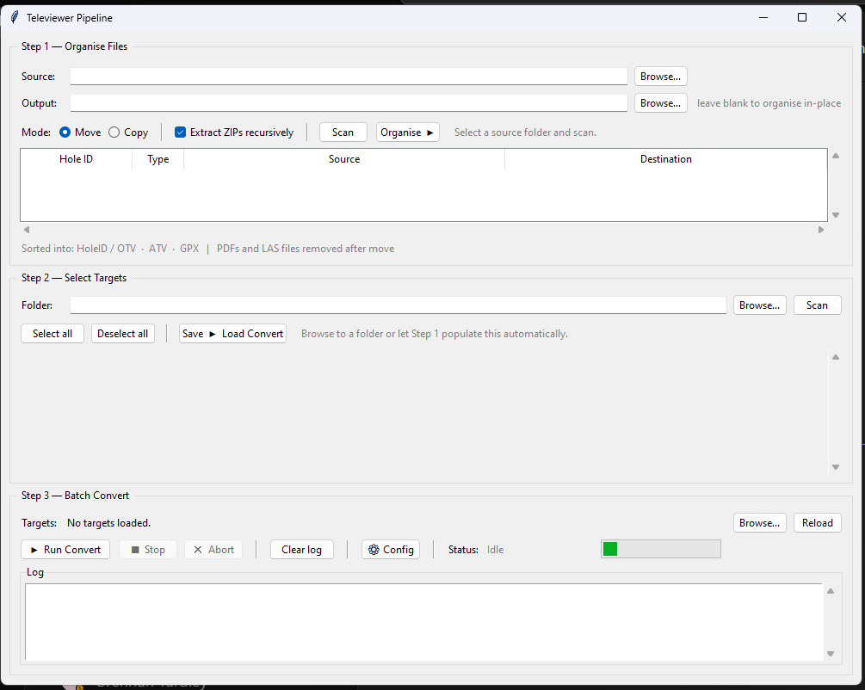
1.Set working folder
2. Press scan to seek package in the folder
3. Organise
4. Mostly current working folder or other folder with files sorted already.
5. Scan and choose in/out/all runs
6. Save-> load convert to next step
8 run convert and wait
7. (optional) Define where is Emind OTV/ATV
By default it is set in C drive

