Slide 1

3.6 死锁
3.6.1 死锁产生
3.6.2 死锁防止
3.6.3 死锁避免
3.6.4 死锁检测和解除

Slide 2
3.6.1 死锁产生
若干死锁的例子(1)
例１进程推进顺序不当产生死锁
设系统有打印机、读卡机各一台，被进程Ｐ和Ｑ共享。两个进程并发执行，按下列次序请求和释放资源：
进程Ｐ 进程Ｑ
请求读卡机 请求打印机
请求打印机 请求读卡机
释放读卡机 释放读卡机
释放打印机 释放打印机

Slide 3
若干死锁的例子(2)
例２PV操作使用不当产生死锁
进程Q1 进程Q2
……… ………
P(S1); P(s2);
P(s2); P(s1);
使用r1和r2; 使用r1和r2
V(S1); V(s2);
V(S2); V(S1);

Slide 4
若干死锁的例子(3)
例３资源分配不当引起死锁
若系统中有m个资源被n个进程共享，每个进程都要求Ｋ个资源，而m < n·K时，即资源数小于进程所要求的总数时，如果分配不得当就可能引起死锁。

Slide 5
若干死锁的例子(4)
例４对临时性资源使用不加限制引起死锁
进程通信使用的信件是一种临时性资源，如果对信件的发送和接收不加限制，可能引起死锁。
进程P1等待进程P3的信件S3来到后再向进程P2发送信件S1；P2又要等待P1的信件S1来到后再向P3发送信件S2；而P3也要等待P2的信件S2来到后才能发出信件S3。这种情况下形成了循环等待，产生死锁。

Slide 6
Bridge Crossing Example
Traffic only in one direction.
Each section of a bridge can be viewed as a resource.
If a deadlock occurs, it can be resolved if one car backs up (preempt resources and rollback).
Several cars may have to be backed up if a deadlock occurs.
Starvation is possible.

Slide 7
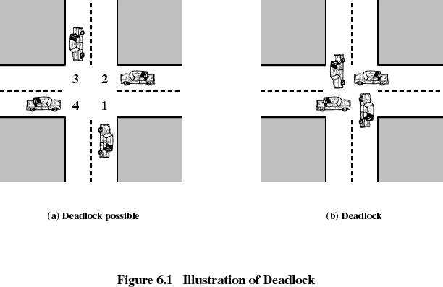

Slide 8
Deadlock
Permanent blocking of a set of processes that either compete for system resources or communicate with each other
Involves conflicting needs for resources by two or more processes
There is no satisfactory solution in the general case
Some OSes (ex: Unix SVR4) ignore the problem and pretend that deadlocks never occur...

Slide 9
Reusable Resources
Used by one process at a time and not depleted by that use
Processes obtain resources that they later release for reuse by other processes
Examples: processors, I/O channels, main and secondary memory, files, databases, and semaphores
Deadlock occurs if each process holds one resource and requests the other

Slide 10
死锁定义
操作系统中的死锁指：如果在一个进程集合中的每个进程都在等待只能由该集合中的其他一个进程才能引发的事件，则称一组进程或系统此时发生死锁。
例如，n个进程P1、P2，…，Pn，Pi因为申请不到资源Rj而处于等待状态，而Rj又被Pi+1占有，Pn欲申请的资源被P1占有，此时这n个进程的等待状态永远不能结束，则说这n个进程处于死锁状态。

Slide 11
产生死锁因素
不仅与系统拥有的资源数量有关，而且与资源分配策略，进程对资源的使用要求以及并发进程的推进顺序有关。

Slide 12
The Conditions for Deadlock
Three conditions must be present for a deadlock to be possible:
  Mutual exclusion: only one process may use a resource at a time
  Hold-and-wait : a process may hold allocated resources while awaiting assignment of others
  No preemption: no resource can be forcibly removed from a process holding it

Slide 13
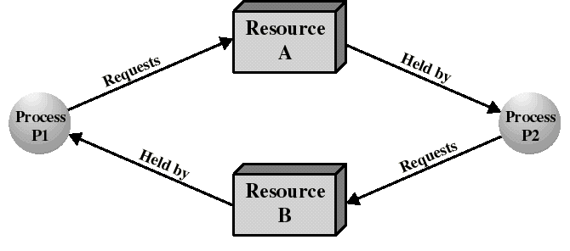
The Conditions for Deadlock
We also need the occurrence of a particular sequence of events that result in:
  Circular wait: a closed chain of processes exists, such that each process holds at least one resource needed by the next process in the chain

Slide 14
The Conditions for Deadlock
Deadlock occurs if and only if the circular wait condition is unresolvable
The circular wait condition is unresolvable when the first three conditions hold
Thus the four conditions taken together constitute necessary and sufficient conditions for deadlock
  Deadlock can occur if the four conditions are satisfied

Slide 15
3.6.2死锁防止(1)
系统形成死锁的四个必要条件
  互斥条件：进程互斥使用资源
  部分分配条件：申请新资源时不释放已占有资源
  不剥夺条件：一个进程不能抢夺其他进程占有的资源
  环路条件：存在一组进程循环等待资源的

Slide 16
Deadlock Characterization
Deadlock can arise if four conditions hold simultaneously.
Mutual exclusion: only one process at a time can use a resource.
Hold and wait: a process holding at least one resource is waiting to acquire additional resources held by other processes.
No preemption: a resource can be released only voluntarily by the process holding it, after that process has completed its task.
Circular wait: there exists a set {P₀, P₁, …, P₀} of waiting processes such that P₀ is waiting for a resource that is held by P₁, P₁ is waiting for a resource that is held by
P₂, …, P_{n–1} is waiting for a resource that is held by
P_{n}, and P₀ is waiting for a resource that is held by P₀.

Slide 17
Methods for Handling Deadlocks
Deadlock prevention
  disallow 1 of the 4 necessary conditions of deadlock occurrence
Deadlock avoidance
  do not grant a resource request if this allocation might lead to deadlock
Deadlock detection
  always grant resource request when possible. But periodically, check for the presence of deadlock and recover from it if occured

Slide 18
死锁防止(2)
破坏第一个条件
使资源可同时访问而不是互斥使用，
破坏第二个条件
静态分配，
破坏第三个条件
采用剥夺式调度方法，
当进程在申请资源未获准许的情况下,如主动释放资源(一种剥夺式),然后才去等待。
破坏第四个条件
上述死锁防止办法造成资源利用率和吞吐率低。介绍两种比较实用的死锁防止方法。

Slide 19
死锁的防止(3)
采用层次分配策略（破坏条件2和4）
  资源被分成多个层次
  当进程得到某一层的一个资源后，它只能再申请较高层次的资源
  当进程要释放某层的一个资源时，必须先释放占有的较高层次的资源
  当进程得到某一层的一个资源后，它想申请该层的另一个资源时，必须先释放该层中的已占资源

Slide 20
死锁防止(4)
层次策略的变种按序分配策略
把系统的所有资源排一个顺序，例如，系统若共有n个进程,共有m个资源，用ri表示第i个资源，于是这m个资源是：
r1,r2……,rm
规定如果进程不得在占用资源ri(1≤i≤m)后再申请rj(j<i)。不难证明，按这种策略分配资源时系统不会发生死锁。

Slide 21
Deadlock Prevention
The OS is designed to exclude the possibility of deadlock
Indirect methods of deadlock prevention:
  to disallow one of the 3 policy conditions
Direct methods of deadlock prevention:
  to prevent the occurrence of circular wait

Slide 22
Indirect Methods of Deadlock Prevention
Mutual Exclusion
  cannot be disallowed
  example: only 1 process at a time can write to a file
Hold-and-Wait
  can be disallowed by requiring that a process requests all its required resources at one time
  block the process until all requests can be granted simultaneously
  process may be held up for a long time waiting for all its requests
  resources allocated to a process may remain unused for a long time (these resources could be used by other processes)
  application must anticipate all resources it may need

Slide 23
Indirect Methods of Deadlock Prevention
No preemption
  can be prevented in several ways. Whenever a process must release a resource still in use, the state of this resource must be saved for later resumption.
  practical only when the state of a resource can be easily saved and restored later, such as the processor.

Slide 24
Direct Methods of Deadlock Prevention
A protocol to prevent circular wait:
  define a strictly increasing linear ordering O( ) for resource types. Ex:
    R1: tape drives: O(R1) = 2
    R2: disk drives: O(R2) = 4
    R3: printers: O(R3) = 7
  Initially, a process requests a number of instances of a resource type, say Ri (a single request must be issued to obtain several instances).
  after that, the process can request instances for resource type Rj if and only if O(Rj) > O(Ri)

Slide 25
Prevention of Circular Wait
Circular wait cannot hold under this protocol. Proof:
  Processes {P0, P1..Pn} are involved in circular wait iff Pi is waiting for Ri which is held by Pi+1 and Pn is waiting for Rn held which is held by P0 (circular waiting)

Slide 26
Deadlock Avoidance
We allow the three policy conditions but make judicious choices to assure that the deadlock point is never reached
Allows more concurrency than prevention
Two approaches:
  do not start a process if its demand might lead to deadlock
  do not grant an incremental resource request if this allocation might lead to deadlock
In both cases: maximum requirements of each resource must be stated in advance

Slide 27
3.6.3死锁避免
银行家算法
  银行家拥有一笔周转资金
  客户要求分期贷款，如果客户能够得到各期贷款，就一定能够归还贷款，否则就一定不能归还贷款
  银行家应谨慎的贷款，防止出现坏帐
用银行家算法避免死锁
  操作系统（银行家）
  操作系统管理的资源(周转资金)
  进程（要求贷款的客户）

Slide 28
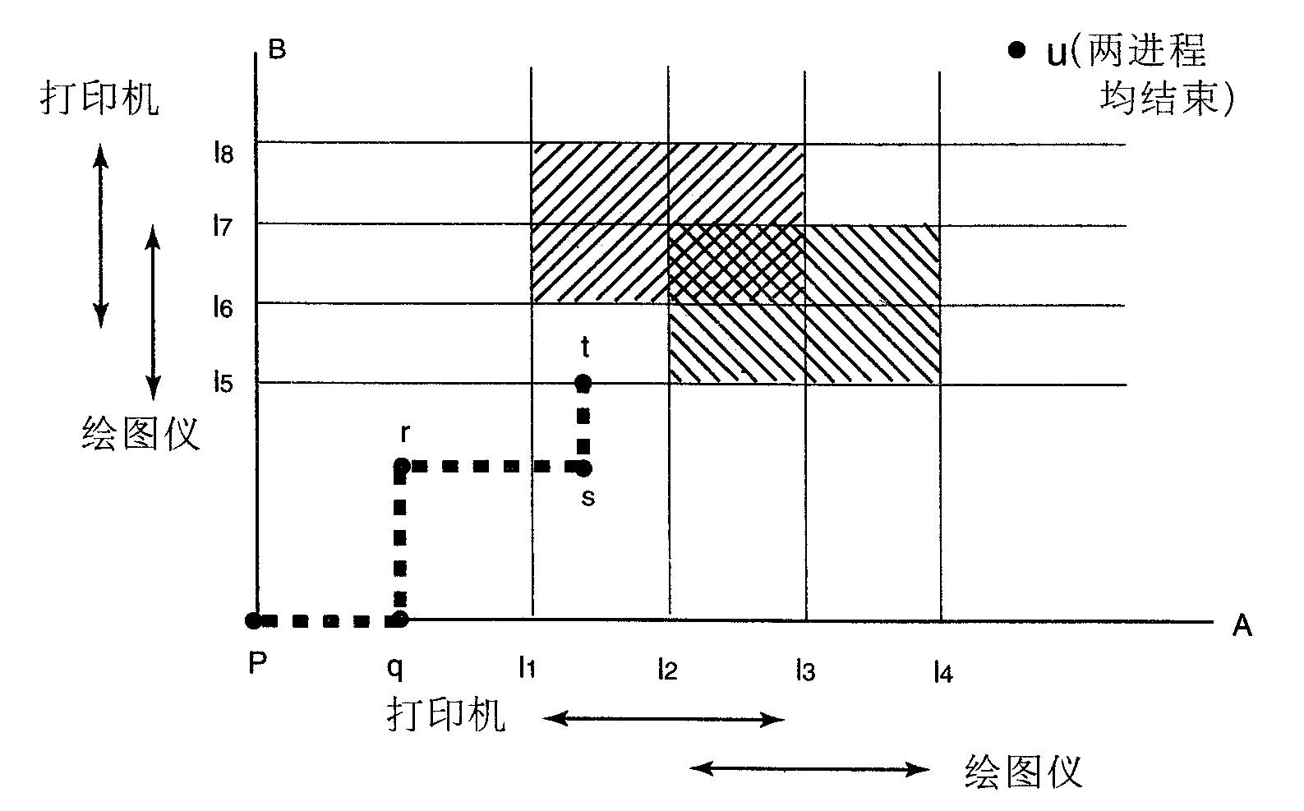
进程资源轨迹图

Slide 29
Resource Allocation Denial: The Banker’s Algorithm
Processes are like customers wanting to borrow money (resources) to a bank...
A banker should not allocate cash when it cannot satisfy the needs of all its customers
At any time, the state of the system is defined by the values of R(i), C(j,i) for all resource type i and process j, and the values of other vectors and matrices.

Slide 30
The Banker’s Algorithm
The amount allocated A(j,i) of resource type i to process j for all (j,i)
The total amount available of resource i is given by: V(i) = R(i) - Σ_k A(k,i)
N(j,i) of resource type i required by process j to complete its task: N(j,i) = C(j,i) - A(j,i)
To decide if a resource request made by a process should be granted, the banker’s algorithm tests if granting the request will lead to a safe state:
  If the resulting state is safe then grant request
  Else do not grant the request

Slide 31
Safe State
A state is safe if there is a sequence {P1..Pn} where each Pi is allocated all of its needed resources to be run to completion
  ie: we can always run all the processes to completion from a safe state
The safety algorithm determines if a state is safe
Initialization:
  all processes are said to be “unfinished”
  set the work vector to the amount resources available: W(i) = V(i) for all i;

Slide 32
Safe State
REPEAT:
  Find a unfinished process j such that N(j,i) <= W(i) for all i.
  If no such j exists then
    goto EXIT
  Else:
    “finish” this process
    recover its resources: W(i) = W(i) + A(j,i) for all i.
  Goto REPEAT
EXIT:
  If all processes have “finished” then this state is safe.
  Else it is unsafe.

Slide 33
The Banker’s Algorithm
Let Q(j,i) be the amount of resource type i requested by process j.
To determine if this request should be granted we use the banker’s algorithm:
  If Q(j,i) <= N(j,i) for all i then continue. Else raise error condition (claim exceeded).
  If Q(j,i) <= V(i) for all i then continue. Else wait (resource not yet available)
  Pretend that the request is granted and determine the new resource-allocation state:
    V(i) = V(i) - Q(j,i) for all i
    A(j,i) = A(j,i) + Q(j,i) for all i
    N(j,i) = N(j,i) - Q(j,i) for all i

Slide 34
The Banker’s Algorithm
  If the resulting state is safe then allocate resource to process j. Else process j must wait for request Q(j,i) and restore old state.

Slide 35
Example of the Banker’s Algorithm
We have 3 resources types with amount:
  R(1) = 9, R(2) = 3, R(3) = 6
and have 4 processes with initial state:
Claimed Allocated Available
R1 R2 R3
R1 R2 R3
R1 R2 R3
P1
P2
P3
P4
3 2 2
6 1 3
3 1 4
4 2 2
1 0 0
5 1 1
2 1 1
0 0 2
1 1 2
Suppose that P2 is requesting Q = (1,0,1). Should this request be granted?

Slide 36
Example of the Banker’s Algorithm
The resulting state would be:
Claimed Allocated Available
R1 R2 R3
R1 R2 R3
R1 R2 R3
P1
P2
P3
P4
3 2 2
6 1 3
3 1 4
4 2 2
1 0 0
6 1 2
2 1 1
0 0 2
0 1 1
This state is safe with sequence {P2, P1, P3, P4}. After P2, we have W = (6,2,3), which enables the other processes to finish. Hence: request granted.

Slide 37
Example of the Banker’s Algorithm
However, if from the initial state, P1 requests Q = (1,0,1). The resulting state would be:
Claimed Allocated Available
R1 R2 R3
R1 R2 R3
R1 R2 R3
P1
P2
P3
P4
3 2 2
6 1 3
3 1 4
4 2 2
2 0 1
5 1 1
2 1 1
0 0 2
0 1 1
This is not a safe state since any process would need an additional unit of R1 to finish. Request refused: P1 is blocked.

Slide 38
银行家算法的数据结构(1)
一个系统有n个进程和m种不同类型的资源,定义包含以下向量和矩阵的数据结构：
•系统每类资源总数--该m个元素的向量为系统中每类资源的数量
Resource=(R₁,R₂,…,R_{m})
•每类资源未分配数量--该m个元素的向量为系统中每类资源尚可供分配的数量
Avilable=(V₁,V₂,…,V_{m})

Slide 39
银行家算法的数据结构(2)
最大需求矩阵--每个进程对每类资源的最大需求量,C_{ij}表示进程P_{i}需R_{j}类资源最大数
C11
C12
…
C1m
C21
C22
…
C2m
Claim =
Cn1
Cn1
…
Cnm

Slide 40
银行家算法的数据结构(3)
分配矩阵—表示进程当前已分得的资源数,A_{ij}表示进程P_{i}已分到R_{j}类资源的个数
A11
A12
…
A1m
A21
A21
…
A21
Allocation=
An1
An1
…
Anm

Slide 41
银行家算法中
下列关系式确保成立
• R_{i}=V_{i}+∑A_{ki} 对i=1,..,m,k=1,..,n; 表示所有资源要么已被分配、要么尚可分配
• C_{ki} ≤R_{j} 对i=1,..,m,k=1,..,n; 表示进程申请资源数不能超过系统拥有的资源总数
• A_{ki} ≤C_{ki} 对i=1,..,m,k=1,..,n; 表示进程申请任何类资源数不能超过声明的最大资源需求数

Slide 42
一种死锁避免策略
系统中若要启动一个新进程工作,其对资源Ri的需求仅当满足下列不等式：
R_{i} ≥ C_{(n+1)i}+ ∑C_{ki} 对i=1,..,m,k=1,..,n;
即应满足当前系统中所有进程对资源R_{i}的最大资源需求数加上启动的新进程的最大资源需求数不超过系统拥有的最大数。

Slide 43
系统安全性定义
系统安全性定义：在时刻T0系统是安全的,仅当存在一个进程序列P_{1,}..,P_{n},对进程P_{k}满足公式：
Cki-Aki≤Vi+ ∑Aji
k=1,…,n;i=1,…,m;

Slide 44
Banker’s Algorithm
Multiple instances.
Each process must a priori claim maximum use.
When a process requests a resource it may have to wait.
When a process gets all its resources it must return them in a finite amount of time.

Slide 45
Data Structures for the Banker’s Algorithm
Let n = number of processes, and m = number of resources types.
Available: Vector of length m. If available [j] = k, there are k instances of resource type R_{j} available.
Max: n x m matrix. If Max [i,j] = k, then process P_{i} may request at most k instances of resource type R_{j}.
Allocation: n x m matrix. If Allocation[i,j] = k then P_{i} is currently allocated k instances of R_{j.}
Need: n x m matrix. If Need[i,j] = k, then P_{i} may need k more instances of R_{j} to complete its task.
    Need [i,j] = Max[i,j] – Allocation [i,j].

Slide 46
Safety Algorithm
1. Let Work and Finish be vectors of length m and n, respectively. Initialize:
      Work = Available
      Finish [i] = false for i = 0, 1, …, n- 1.
2. Find and i such that both:
  (a) Finish [i] = false
  (b) Need_{i} ≤ Work
  If no such i exists, go to step 4.
3. Work = Work + Allocation_{i}
Finish[i] = true
go to step 2.
4. If Finish [i] == true for all i, then the system is in a safe state.

Slide 47
Resource-Request Algorithm for Process P_{i}
Request = request vector for process P_{i}. If Request_{i} [j] = k then process P_{i} wants k instances of resource type R_{j.}
  1. If Request_{i} ≤ Need_{i} go to step 2. Otherwise, raise error condition, since process has exceeded its maximum claim.
  2. If Request_{i} ≤ Available, go to step 3. Otherwise P_{i} must wait, since resources are not available.
  3. Pretend to allocate requested resources to P_{i} by modifying the state as follows:
      Available = Available – Request;
      Allocation_{i} = Allocation_{i} + Request_{i};
      Need_{i} = Need_{i} – Request_{i};
    If safe ⇒ the resources are allocated to Pi.
    If unsafe ⇒ Pi must wait, and the old resource-allocation state is restored

Slide 48
实例说明系统所处的安全或不安全状态(1)
如果系统中共有五个进程和A、B、C三类资源;
A类资源共有10个,B类资源共有5个,C类资源共有7个。
在时刻T₀,系统目前资源分配情况如下：

Slide 49
实例说明系统所处的安全或不安全状态(2)
process Allocation Claim Available
A B C A B C A B C
P₀ 0 1 0 7 5 3 3 3 2
P₁ 2 0 0 3 2 2
P₂ 3 0 2 9 0 2
P₃ 2 1 1 2 2 2
P₄ 0 0 2 4 3 3

Slide 50
实例说明系统所处的安全或不安全状态(3)
每个进程目前还需资源为Cki-Aki
process C_{ki}-A_{ki}
A B C
P₀ 7 4 3
P₁ 1 2 2
P₂ 6 0 0
P₃ 0 1 1
P₄ 4 3 1

Slide 51
实例说明系统所处的安全或不安全状态(4)
    可以断言目前系统处于安全状态,因为,序列{P₁,P₃,P₄,P₂,P₀}能满足安全性条件。

Slide 52
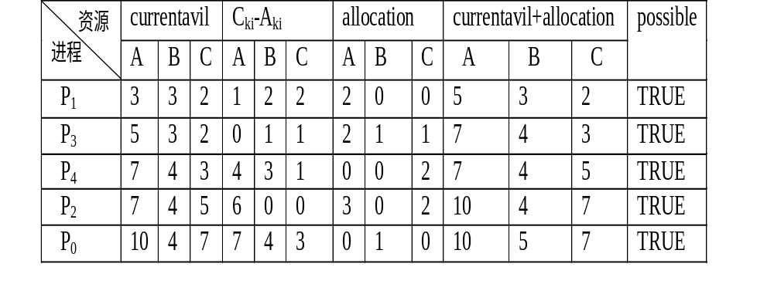
实例说明系统所处的安全或不安全状态(5)

Slide 53
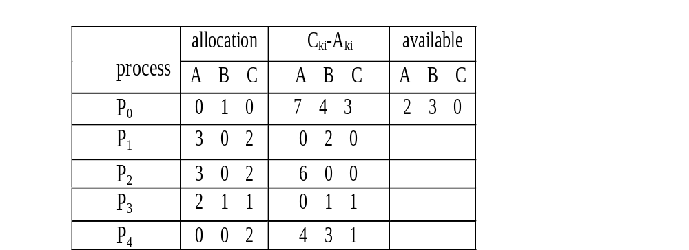
实例说明系统所处的安全或不安全状态(6)
进程P1申请资源request1=(1,0,2) ,检查request1≤Available、比较(1,0,2) ≤(3,3,2),结果满足条件,试分配,得到新状态：

Slide 54
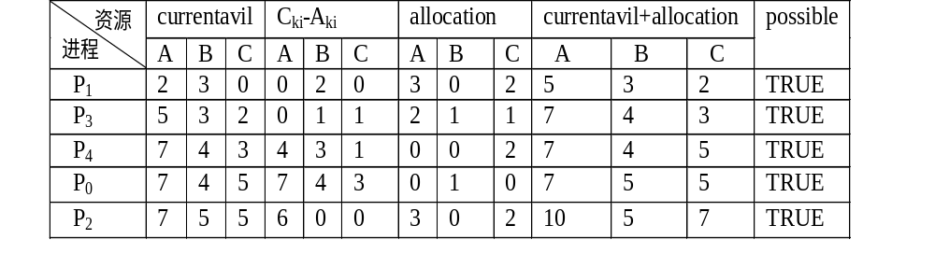
实例说明系统所处的安全或不安全状态(7)
判定新状态是否安全?可执行安全性测试算法，找到一个进程序列{P₁,P₃,P₄,P₀,P₂}能满足安全性条件,可正式把资源分配给进程P1;

Slide 55
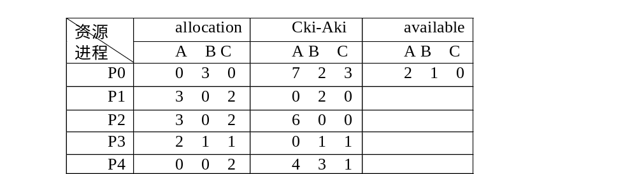
实例说明系统所处的安全或不安全状态(8)
系统若处在下面状态中, 进程P4请求资源(3,3,0),由于可用资源不足,申请被系统拒绝;此时, 系统能满足进程P0的资源请求(0,2,0);但可看出系统已处于不安全状态了。

Slide 56
银行家算法的基本思想(1)
系统中的所有进程进入进程集合,
在安全状态下系统收到进程的资源请求后,先把资源试探性分配给它。
系统用剩下的可用资源和进程集合中其他进程还要的资源数作比较，在进程集合中找到剩余资源能满足最大需求量的进程,从而,保证这个进程运行完毕并归还全部资源。
把这个进程从集合中去掉, 系统的剩余资源更多了,反复执行上述步骤。
最后,检查进程集合,若为空表明本次申请可行,系统处于安全状态,可实施本次分配;否则,有进程执行不完，系统处于不安全状态,本次资源分配暂不实施,让申请进程等待。

Slide 57
银行家算法的程序及简短说明(1)
typedef struct state {//全局数据结构
int resource[m];
int available[m];
int claim[n][m];
int allocation[n][m];
};

Slide 58
银行家算法的程序及简短说明(2)
void resource_allocation( ) { //资源分配算法
if(allocation[i,*]+request[*]>claim[i,*])
{error}; //申请量超过最大需求值
else {
if(request[*]>available[*])
{suspend process.};
else { //尝试分配，define newstate by:
allocation[i,*]=allocation[i,*]+request[*];
available[*]=available[*]-request[*];
}
}
if(safe(newstate))
{carry out allocation};
else {
{restore original state};
{suspend process};
}
}

Slide 59
银行家算法的程序及简短说明(3)
bool safe(state s) { //安全性测试算法
int currentavail[m];
set <process> rest;
currentavail[*]=available[*];
rest={all process};
possible=true;
while(possible){ //rest中找一个Pk，满足以下条件
claim[k,*]-allocation[k,*]<=currentavail[*];
if(found){ currentavail[*]=currentavail[*]+allocation[k,*];
rest=rest–{Pk};
}
else
possible=false;
}
return(rest=null);
}

Slide 60
3.6.4死锁检测和解除
资源分配图和死锁定理
解决死锁问题的一条途径是死锁检测和解除，这种方法对资源的分配不加任何限制，也不采取死锁避免措施，但系统定时地运行一个“死锁检测”程序，判断系统内是否已出现死锁，如果检测到系统已发性了死锁，再采取措施解除它。

Slide 61
进程-资源分配图
约定Pi→Rj为请求边，表示进程Pi申请资源类Rj中的一个资源得不到满足而处于等待Rj类资源的状态，该有向边从进程开始指到方框的边缘，表示进程Pi申请Rj类中的一个资源。
Rj→Pi为分配边，表示Rj类中的一个资源已被进程Pi占用，由于已把一个具体的资源分给了进程Pi，故该有向边从方框内的某个黑圆点出发指向进程。

Slide 62
资源分配图的一个例子
R1
R2
．
．
P1
P2
P3
．．
R3

Slide 63
资源分配图的另一个例子
资源分配图的另一个例子
P1
R1
R2
P2
P3
P4

Slide 64
简化进程-资源分配图检测系统是否处于死锁状态(1)
(1)如果进程-资源分配图中无环路，则此时系统没有发生死锁。
(2)如果进程-资源分配图中有环路，且每个资源类中仅有一个资源，则系统中发生了死锁，此时，环路是系统发生死锁的充要条件，环路中的进程便为死锁进程。
(3)如果进程-资源分配图中有环路，且涉及的资源类中有多个资源，则环路的存在只是产生死锁的必要条件而不是充分条件。

Slide 65
简化进程-资源分配图检测系统是否处于死锁状态(2)
如果能在进程-资源分配图中消去此进程的所有请求边和分配边，成为孤立结点。经一系列简化，使所有进程成为孤立结点，则该图是可完全简化的；否则则称该图是不可完全简化的。
系统为死锁状态的充分条件是：当且仅当该状态的进程-资源分配图是不可完全简化的。该充分条件称为死锁定理。

Slide 66
2死锁的检测和解除方法(1)
(1) 借助于死锁的安全性测试算法来实现。死锁检测算法与死锁避免算法是类似的，不同在于前者考虑了检查每个进程还需要的所有资源能否满足要求；而后者则仅要根据进程的当前申请资源量来判断系统是否进入了不安全状态。

Slide 67
死锁的检测和解除方法(2)
    一种具体的死锁检测方法，检测算法步骤如下：
    1)currentavail=available；
    2)如果allocation[k,*]!=0，令finish[k]=false;否则finish[k]=true；
    3)寻找一个k，它应满足条件：(finish[k]==false)&&(request[k,*]<=currentavail[*]);若找不到这样的k，则转向5)；
    4)修改currentavail[*]=Currentavail[*]+allocation[k,*];
    finish[k]=true;然后转向3)；
    5)如果存在k(1≤k≤n),finish[k]=false,则系统处于死锁状态，并且finish[k]=false的Pk为处于死锁的进程。

Slide 68
Detection Algorithm
1. Let Work and Finish be vectors of length m and n, respectively Initialize:
  (a) Work = Available
  (b) For i = 1,2, …, n, if Allocation_{i} ≠ 0, then
  Finish[i] = false;otherwise, Finish[i] = true.
2. Find an index i such that both:
  (a) Finish[i] == false
  (b) Request_{i} ≤ Work
  If no such i exists, go to step 4.

Slide 69
Detection Algorithm (Cont.)
3. Work = Work + Allocation_{i}
Finish[i] = true
go to step 2.
4. If Finish[i] == false, for some i, 1 ≤ i ≤ n, then the system is in deadlock state. Moreover, if Finish[i] == false, then P_{i} is deadlocked.

Slide 70
死锁的解除(1)
结束所有进程的执行，重新启动操作系统。方法简单，但以前工作全部作废，损失很大。
撤销陷于死锁的所有进程，解除死锁继续运行。
逐个撤销陷于死锁的进程，回收其资源重新分派，直至死锁解除。

Slide 71
死锁的解除(2)
剥夺陷于死锁的进程占用的资源，但并不撤销它，直至死锁解除。可仿照撤销陷于死锁进程的条件来选择剥夺资源的进程
根据系统保存的检查点，让所有进程回退，直到足以解除死锁，这种措施要求系统建立保存检查点、回退及重启机制。
当检测到死锁时，如果存在某些未卷入死锁的进程，而随着这些进程执行到结束，有可能释放足够的资源来解除死锁。

Slide 72
Deadlock Recovery
Needed when deadlock is detected. The following approaches are possible:
  Abort all deadlocked processes (one of the most common solution adopted in OS!!)
  Rollback each deadlocked process to some previously defined checkpoint and restart them (original deadlock may reoccur)
  Successively abort deadlocked processes until deadlock no longer exists (each time, we need to invoke the deadlock detection algorithm)

Slide 73
Deadlock Recovery (cont.)
  Successively preempt some resources from processes and give them to other processes until deadlock no longer exists
    a process that has a resource preempted must be rolled back prior to its acquisition
For the two last steps, a victim process needs to be selected according to:
  least amount of CPU time consumed so far
  least total resources allocated so far
  least amount of “work” produced so far...

Slide 74
An Integrated Deadlock Strategy
We can combine the previous approaches into the following way:
  Group resources into a number of different classes and order them. Ex:
    Swappable space (secondary memory)
    Process resources (I/O devices, files...)
    Main memory...
  Use prevention of circular wait to prevent deadlock between resource classes
  Use the most appropriate approach for deadlocks within each class

