Slide 2
极化编码：
——差分曼彻斯特码（Differential Manchester）
0
0
1
1
0
1
NRZ
曼彻斯特
差分
曼彻斯特

Slide 3
双极性编码：
——双极性传号交替反转码（AMI）
与RZ相同的是: 采用三个电平：正、负与零
与RZ不同的是: 零电平表示“0”，正负电平的跃迁表示“1”，实现对“1”电平的交替反转。
优点：
    对每次出现的“1”交替反转，使直流分量为0
    尽管连续“0”不能同步，但连续“1”可以同步
0
0 1 0 0 1 0

Slide 4
Flow Control in LLC Sub-layer
卫星信道传输速率50kbps，往返传输延迟500ms，则:
  若传输一个1000bit的帧，时间为：
  发送时间 + 信息信道延迟 + 确认信道延迟（确认帧很短，忽略发送时间）= 1000bit / 50kbps + 250ms + 250ms = 520ms
  信道利用率 = 20 / 520 ≈ 4%
信道带宽b比特/秒，帧长度L比特，往返传输延迟R秒，则信道利用率为 (L/b) / (L/b + R) = L / (L + Rb)
结论
  传输延迟大，信道带宽高，帧短时，信道利用率低

Slide 5
How many bits can I borrow?
The minimum number of bits you can borrow is two
 | Size of Host Field | Maximum # of borrowed bits
Class A | 24 | 22
Class B | 16 | 14
Class C | 8 | 6

Slide 6
Byproduct: Waste Addresses
We must strike a balance between the number of subnets required, the hosts per subnet that is acceptable, and the resulting waste of addresses.
Number of Bits Borrowed | Number of Subnets Created | Number of Hosts Per Subnet | Total Number of Hosts | Percent Used
2 | 2 | 62 | 124 | 49%
3 | 6 | 30 | 180 | 71%
4 | 14 | 14 | 196 | 77%
5 | 30 | 6 | 180 | 71%
6 | 62 | 2 | 124 | 49%
Class C

Slide 7
Step #1
Determine the default subnet mask
What class IP address is this?
  Class C
Class C default subnet mask:
  255.255.255.0

Slide 8
Step #2
Figure the actual number of subnets and hosts by borrowing bits from host ID
Let’s see how many subnets and hosts
  13 subnets
  10 hosts on each subnet
Borrow 4 bits from the host

Slide 9
Step #3
223.14.17.0
X X X X
H H H H
16 possible subnets
16 possible hosts for each subnet

Slide 10
Step #3 continued…
We get 16 possible subnets and 16 possible hosts for each subnet because:
  For the 4 bits borrowed each bit can be a 1 or a 0 leaving you with 2⁴ or 16 possible combinations.
  The same goes for the 4 leftover host bits.
Important: There are only 14 available subnets and hosts on each subnet. Why?

Slide 11
Step #3 continued…
Because you cannot use the first and last subnet.
Because you cannot use the first and last address within each subnet.
For each, one is the broadcast address and one is the network address.

Slide 12
Step #4
Determine the subnet mask.
223.14.17.0
X X X X
H H H H
Where X represents the borrowed bits for subnetting.

Slide 13
Step #4 continued…
Add the place values of X together to get the last octet decimal value of the subnet mask.
128 + 64 + 32 + 16 = 240
The subnet mask is: 255.255.255.240
The subnet mask is used to reveal the subnet and host address fields in IP addresses.

Slide 14
Step 5
Determine the ranges of host addresses
Subnet # | Subnet Bits | Host Bits | In Decimal
1 | 0000 | 0000-1111 | .0 -.15
2 | 0001 | 0000-1111 | .16 - .31
3 | 0010 | 0000-1111 | .32 - .47
4 | 0011 | 0000-1111 | .48 - .63
5 | 0100 | 0000-1111 | .64 - .79
6 | 0101 | 0000-1111 | .80 - .95
7 | 0110 | 0000-1111 | .96 - .111
8 | 0111 | 0000-1111 | .112 - .127

Slide 15
Step 5 continued…
Subnet # | Subnet Bits | Host Bits | In Decimal
9 | 1000 | 0000-1111 | .128 -.143
10 | 1001 | 0000-1111 | .144 - .159
11 | 1010 | 0000-1111 | .160 - .175
12 | 1011 | 0000-1111 | .176 - .191
13 | 1100 | 0000-1111 | .192 - .207
14 | 1101 | 0000-1111 | .208 - .223
15 | 1110 | 0000-1111 | .224 - .239
16 | 1111 | 0000-1111 | .240 - .255

Slide 16
Step 5 continued…
16 possible subnets.
16 possible hosts on each subnet
14 available subnets
14 available hosts on each subnet

Slide 17
Figuring Subnet Network Addresses
Step #1: Change the IP host address to binary.
Step #2: Change the subnet mask to binary.
Step #3: Use the boolean operator AND to combine the two.
Step #4: Convert the network binary address to dotted decimal.

Slide 18
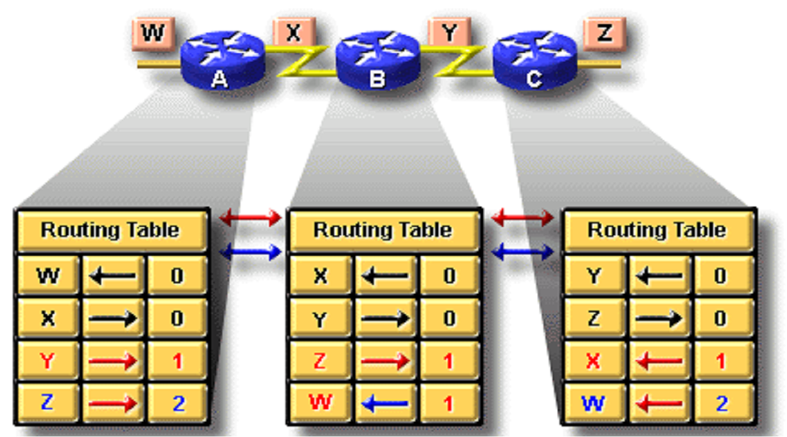
Distance vector routing

Slide 19
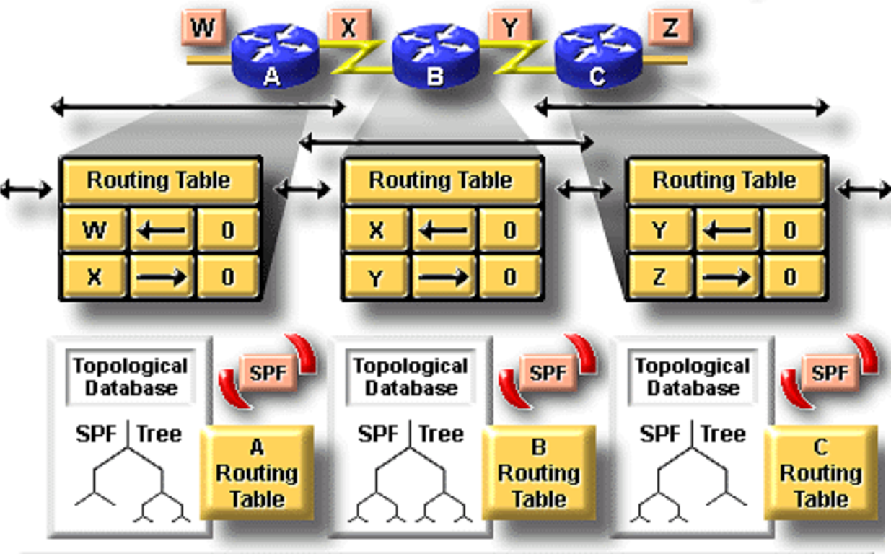
Link state routing

Slide 20
VLSM（Variable-Length Subnet Masks）

Slide 21
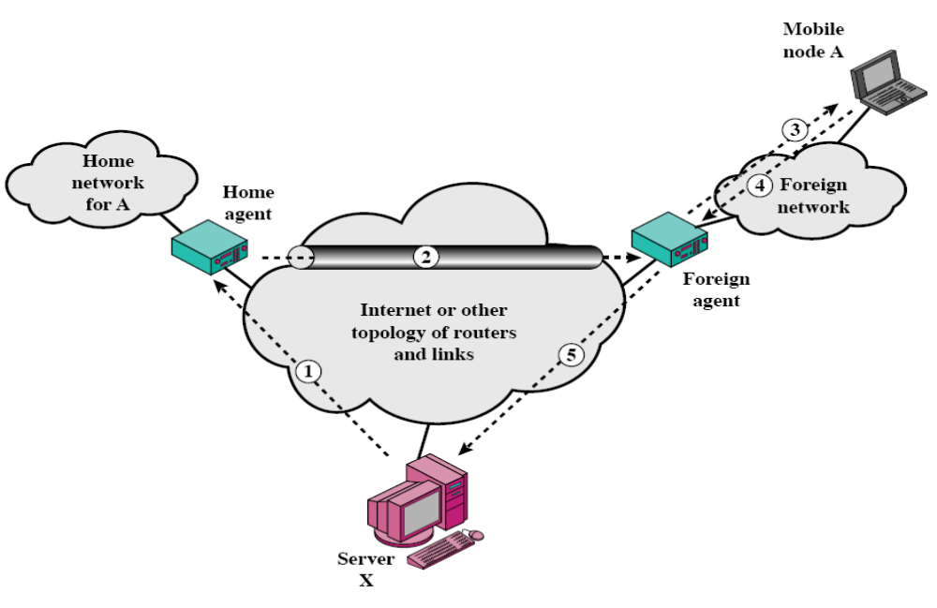
10.1.1.7 本地地址
20.1.6.9 协同定位转交地址
10.1.0.0/16 归属地/本地网络
20.1.0.0/16 外地网络
TUNNEL
20.1.6.4 外地代理转交地址
转交地址的两种形式：
  协同定位转交地址
  外地代理转交地址
本地代理 地址 | 转交地址
源地址 | 目标地址 | 原IP载荷

