Slide 1

OSI Layer 2:
Data Link Layer

Slide 2
Layer2: Data Link Layer
Overview of the Data Link Layer
Ethernet and CSMA/CD
  LLC and MAC Sub-layers
  Media Access Control in MAC Sub-layer
Wireless LAN and CSMA/CA
Layer 2 Devices

Slide 3
Data Link Layer
Problem:How to transfer data correctly on a instable link?
The DATA LINK LAYER provides:
  Access to the networking media
  Physical transmission across the media
Layer 2 protocols (procedures) define:
  The format of data exchanged on a link
  The action of the two nodes on the link
In Data Link Layer, ‘procedure’ = ‘protocol’
Node
Node
frame
frame
  Node：Host and router in the network
  Link：The channel connects the adjacent nodes

Slide 4
LANS and the Data Link Layer
Main tasks:
  Error notification
  Network topology
  Flow control
Differences between Layer 1 and Layer 2:
  Layer 1 cannot communicate with the upper-level layers; Layer 2 does that with Logical Link Control (LLC).
  Layer 1 cannot decide which host will transmit or receive binary data from a group;
  Layer 2 does that with Media Access Control (MAC)
  Layer 1 cannot name or identify computers;
  Layer 2 uses an addressing (or naming) process.
  Layer 1 can only describe streams of bits;
  Layer 2 uses framing to organize or group the bits.

Slide 5
Services provided by Layer 2
Three services provided to the network layer (by LLC)
  Connectionless service with no acknowledgement, used on:
    Reliable links (upper layers to ensure the data correctness)
    Real-time tasks
    Most of LANs
  Connectionless service with acknowledgements: unreliable link, such as the wireless network
  Connection service with acknowledgements

Slide 6
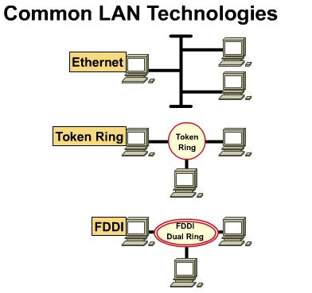
Media Access Control in Common LANs
Ethernet - logical bus topology (information flow is on a linear bus) and physical star or extended star (wired as a star)
Token Ring - logical ring topology (information flow is in a ring) and a physical star topology (wired as a star)
FDDI - logical ring topology (information flow is in a ring) and physical dual-ring topology (wired as a dual-ring)

Slide 7
Access Methods for Media-Access Control
Two broad categories:
  Deterministic—taking turns
    Token Ring and FDDI
  Non-deterministic (probabilistic)—first come, first served
    Ethernet/802.3

Slide 8
Deterministic MAC Protocols
A special data token circulates the ring.
When a host receives the token, it can transmit data instead of the token. This is called seizing the token.
When the transmitted frame comes back around to the transmitter, the station transmits a new token; the frame is removed or stripped from the ring.

Slide 9
Non-Deterministic MAC Protocols
This MAC protocol is called Carrier Sense Multiple Access with Collision Detection (CSMA/CD)
To use this shared-medium technology, Ethernet allows the networking devices to arbitrate for the right to transmit.

Slide 10
LAN Transmission Methods
LAN data transmissions fall into 3 classifications:
unicast--a single packet is sent from the source to a single destination on a network
multicast--consists of a single data packet that is sent to a specific subset of nodes on the network.
broadcast--consists of a single data packet that is transmitted to all nodes on the network.

Slide 11
Layer2: Data Link Layer
Overview of the Data Link Layer
Ethernet and CSMA/CD
  LLC and MAC Sub-layers
  Media Access Control in MAC Sub-layer
Wireless LAN and CSMA/CA
Layer 2 Devices

Slide 12
LAN Standards
Define the physical media and the connectors used to connect devices to media
Define the way devices communicate at the DATA LINK LAYER
The DATA LINK LAYER defines how data is transported over a physical media.
The DATA LINK LAYER also defines how to encapsulate protocol-specific traffic in such a way that traffic going to different upper-layer protocols can use the same channel as it goes up the stack.

Slide 13
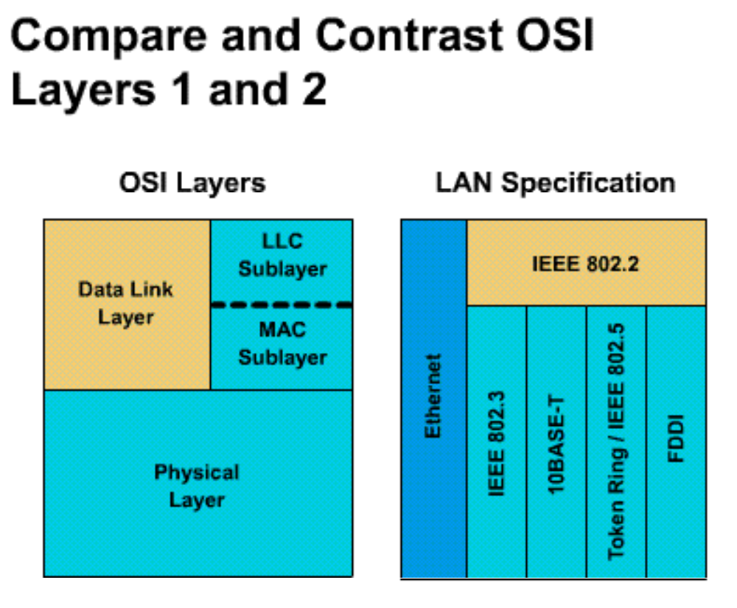
LAN Standards
Data link layer is broken into two parts by IEEE :
  Media Access Control (MAC) (transitions down to media)
  Logical Link Control (LLC) (transitions up to the network layer)

Slide 14
LAN Standards
The IEEE standard appears, at first glance, to violate the OSI model in two ways.
  First, it defines its own layer (LLC), including its interfaces, etc.
  Second, it appears that the MAC layer standards, 802.3 and 802.5, cross over the Layer 2/Layer 1 interface.
However, 802.3 and 802.5 define the naming, framing, and Media Access Control rules around which specific technologies were built.

Slide 15
LAN Standards
MAC sublayer (802.3)
  Defines how to transmit frames on the physical wire
  Handles physical addressing
  Define network topology
  Define line discipline.
LLC sublayer (802.2)
  logically identifies different protocol types and then encapsulates them.
  Use SAP identifier to perform the logical identification
  The type of LLC frame depends on what identifier the upper layer protocol expects.

Slide 16
Media Access Control Sublayer
# of bytes 8 6 6 2 Variable 4
Preamble
Dest. add.
Source add.
Length
Data
FCS
Ethernet II uses “Type” here and does not use 802.2
0000.0C XX.XXXX
MAC Layer 802.3
IEEE assigned Vendor assigned
MAC address

Slide 17
MAC Sub-layer: Fields in a Frame
Begin with an alternating pattern of 1s and 0s called a preamble. (10101011)
The preamble tells receiving stations that a frame is coming.
# of bytes 8 6 6 2 Variable 4
Preamble
Dest. add.
Source add.
Length
Data
FCS
Ethernet II uses “Type” here and does not use 802.2
0000.0C XX.XXXX
IEEE assigned Vendor assigned

Slide 18
MAC Sub-layer: Fields in a Frame
Destination and source physical address fields
  source address: always a unicast address
  destination address: unicast, multicast, or broadcast.
# of bytes 8 6 6 2 Variable 4
Preamble
Dest. add.
Source add.
Length
Data
FCS
Ethernet II uses “Type” here and does not use 802.2
0000.0C XX.XXXX
IEEE assigned Vendor assigned

Slide 19
MAC Sub-layer: Fields in a Frame
length field indicates the number of bytes of data that follow this field and precede the frame check sequence field.
The data field contains the information you want to send.
# of bytes 8 6 6 2 Variable 4
Preamble
Dest. add.
Source add.
Length
Data
FCS
Ethernet II uses “Type” here and does not use 802.2
0000.0C XX.XXXX
IEEE assigned Vendor assigned

Slide 20
MAC Sub-layer: Fields in a Frame
FCS field (four bytes) contains a cyclic redundancy check value
  The sending device creates the CRC
  The receiving device recalculates the CRC to check for damage that might have occurred to the frame in transit.
# of bytes 8 6 6 2 Variable 4
Preamble
Dest. add.
Source add.
Length
Data
FCS
Ethernet II uses “Type” here and does not use 802.2
0000.0C XX.XXXX
IEEE assigned Vendor assigned

Slide 21
Logical Link Control Sublayer
The Logical Link Control (LLC) sublayer manages communication between devices over a single link
LLC is defined in the IEEE 802.2 specification and supports both connectionless and connect-oriented services.
LLC sublayer allows part of the DATA LINK LAYER to function independently from existing technologies.
  A single LLC sub-layer can be compatible with different MAC sub-layers.

Slide 22
LLC Sub-layer: Encapsulation
Network Layer
Packet
LLC
LLC | Packet
Data Link
Layer
MAC
MAC | LLC | Packet | MAC
Physical Layer
Media
(a) Position of LLC (b) Encapsulation

Slide 23
LLC Sub-layer: Encapsulation
The LLC takes the network protocol data (packet), and adds more control information to help deliver the packet to its destination.
It adds two addressing components of the 802.2 specification to identify the upper layer protocol at each end :
  The Destination Service Access Point (DSAP)
  The Source Service Access Point (SSAP)
This repackaged data then travels to the MAC for further encapsulation of the data.

Slide 24
Layer2: Data Link Layer
Overview of the Data Link Layer
Ethernet and CSMA/CD
  LLC and MAC Sub-layers
  Media Access Control in MAC Sub-layer
Wireless LAN and CSMA/CA
Layer 2 Devices

Slide 25
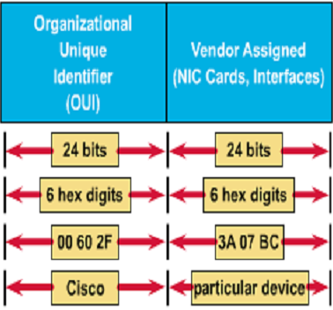
Hexadecimal Numbers as MAC Addresses
MAC addresses are 48 bits and are always expressed as 12 hexadecimal digits.
The first 6 hexadecimal digits (from left to right), which the IEEE administers, identify the manufacturer or vendor and comprise the Organizational Unique Identifier (OUI).
The remaining 6 hex digits comprise the interface serial number, administered by specific vendor.
0000.0c12.3456 or 00-00-0c-12-34-56

Slide 26
Ethernet 802.3 Broadcast
Broadcast
  The destination MAC: all 1s (FFFF.FFFF.FFFF)
Broadcasting can seriously affect the performance of stations by interrupting them unnecessarily
So broadcasts should be used only when:
  The MAC address of the destination is unknown
  The destination is all hosts

Slide 27
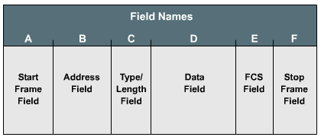
Framing
Framing is the Layer 2 encapsulation process.
A frame is a Layer 2 protocol data unit (PDU).
A frame has sections called fields, and each field is composed of bytes.
  frame start field
  address field
  length/type/control field
  data field
  frame check sequence field
  frame stop field

Slide 28
Ethernet Media Access Control
——CSMA/CD: History
Ethernet /IEEE 802.3 MAC mechanism: CSMA/CD.
CSMA/CD stems from ALOHA
In 1970s, Norman Abramson designed ALOHA
Pure ALOHA:
  Hosts always can send the data if they want:
    If the signals collided, back off appropriate amount of time and resend
Slotted ALOHA:
  Hosts always can send the data if they want, but they must wait for a new slot :
    If the signals collided, back off appropriate amount of time and resend

Slide 29
Ethernet Media Access Control
——CSMA/CD: History
Question: Why don’t we listen to the channel first to make sure that the channel is free?
  That is CSMA(Carrier Sense Multiple Access)
1-persist CSMA :
  Hosts always can send the data (have the probability of 1) if they find the channel is free; if the channel is busy,they will listen to the channel and wait :
    If the signals collided, back off appropriate amount of time and resend

Slide 30
Ethernet Media Access Control
——CSMA/CD: History
non-persist CSMA :
  Hosts always can send the data (have the probability of 1) if they find the channel is free. if the channel is busy, they will wait for a while to listen to the channel again :
    If the signals collided, back off appropriate amount of time and resend
p-persist CSMA(working on slotted channel) :
  If the hosts find the channel is free, they will send the data in this slot at a probability of p, or propone the sending operation to the next slot at a probability of 1-p; if the channel is busy, they will wait until the next slot:
    If the signals collided, back off appropriate amount of time and resend

Slide 31
Ethernet Media Access Control
——CSMA/CD
Another improvement of ALOHA: Listen to the channel while transmitting data. If a collision detected, all transmissions will be cancelled at once
CSMA/CD(Carrier Sense Multiple Access)
  Use CSMA mechanism to judge if the host should send the data
  In the transmitting process, listen to the channel at the same time
    When a collision detected, broadcast the jam signal
    Back off algorithms determine when the colliding stations can retransmit.

Slide 32
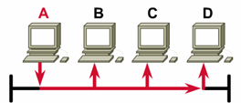
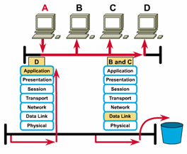
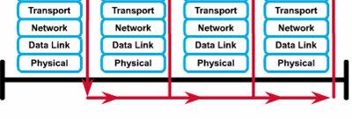
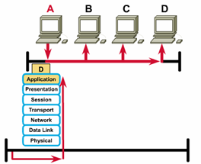
Ethernet Operation
1
3
4
2
Ethernet is broadcast network—that is, each station can see all the frames, regardless of whether they are the destination
Whether a station is the destination is judged by MAC address
Destination station sends data up OSI layers. Other nodes discard frame

Slide 33
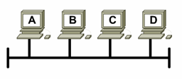
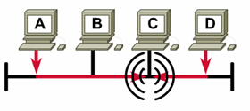
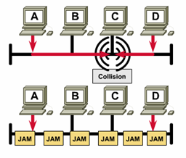
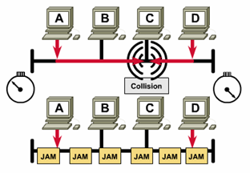
Ethernet Operation
1
Listen then transmit
Broadcast jam signal
Collision occurs
Devices back off appropriate amount of time and then retransmit
2
3
4

Slide 34
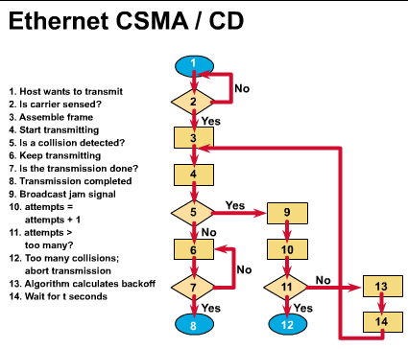

Slide 35
Layer2: Data Link Layer
Overview of the Data Link Layer
Ethernet and CSMA/CD
  LLC and MAC Sub-layers
  Media Access Control in MAC Sub-layer
Wireless LAN and CSMA/CA
Layer 2 Devices

Slide 36
Wireless LAN
Wireless LAN
  Communications based on cells
  The signals sent by a station can only be received by the stations nearby
  Short-distance transmission
Wireless LAN Standard
  IEEE 802.11
  IEEE 802.11b
  IEEE 802.11a
  IEEE 802.11g
  IEEE 802.11n

Slide 37
Wireless LAN Standard
IEEE 802.11
  A key technology: Direct Sequence Spread Spectrum (DSSS)
  DSSS applies to wireless devices operating within a 1 to 2 Mbps range.
  DSSS may operate at up to 11 Mbps but will not be considered compliant above 2 Mbps
IEEE 802.11b
  Also called Wi-Fi™
  It increased transmission capabilities to 11 Mbps
  All 802.11b systems are backward compliant in that they also support 802.11 for 1 and 2 Mbps data rates for DSSS only
  Achieves higher data throughput rate by using a different coding technique from 802.11
  Operate within 2.4 GHz

Slide 38
Wireless LAN Standard
IEEE 802.11a
  Covers WLAN devices operating in the 5 GHz transmission band.
  Using the 5 GHz
  802.11a is capable of supplying data throughput of 54 Mbps and with proprietary technology known as "rate doubling" has achieved 108 Mbps.
  In practice, a more standard rating is 20-26 Mbps.

Slide 39
Wireless LAN Standard
IEEE 802.11g
  provides the same throughout as 802.11a (54Mbps) but with backwards compatibility for 802.11b
  using Othogonal Frequency Division Multiplexing (OFDM) technology.
IEEE 802.11n: next generation WLAN
  provide double bandwidth than 802.11g, that is, 108Mbps, and theoretically up to 500-600Mbps

Slide 40
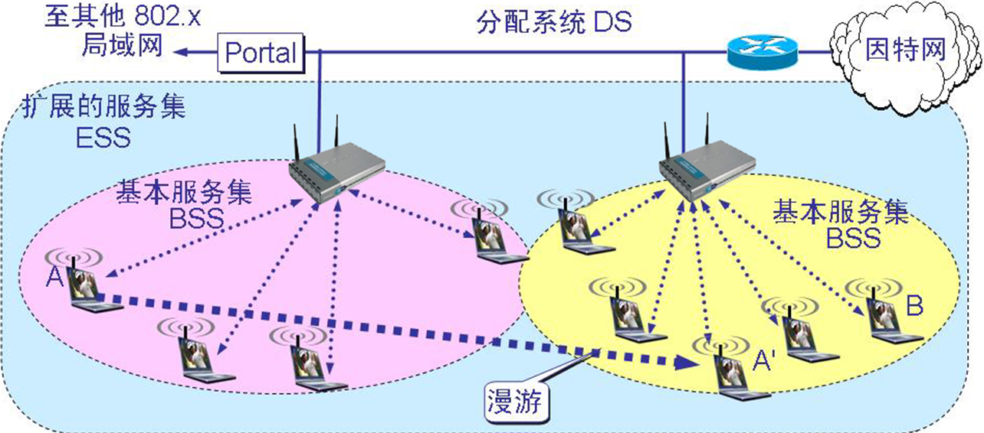
Wireless LAN Topology
Infrastructure mode and ad-hoc mode
Fig. Infrastructure Mode

Slide 41
Wireless LAN: Infrastructure Mode
A Basic Service Set(BSS) includes a Base Station(BS) and several wireless hosts
  All hosts can communicate with each other directly in local BSS
Access Point (AP) acts as a Base Station(BS) for infrastructure mode
  AP is hard wired to the cabled LAN to provide Internet access and connectivity to the wired network
  When an AP is installed, a Service Set Identifier(SSID) and a channel are assigned
  The range of the cell will be from 91.44 to 152.4 meters (300 to 500 feet)
A BSS can connect to another BSS via a Distribution System(DS), and constructs an Extended Service Set (ESS)

Slide 42
Accessing Procedure
When a client is activated within the WLAN
  it will start "listening" for a compatible device with which to "associate“
This is referred to as "scanning"
  Active scanning
  Passive scanning

Slide 43
Active scanning
Cause a probe request to be sent from the wireless node seeking to join the network.
The probe request will contain the Service Set Identifier (SSID) of the network it wishes to join
When an AP with the same SSID is found, the AP will issue a probe response
The authentication and association steps are completed.

Slide 44
Passive scanning
Listen for beacon management frames (beacons), which are transmitted by the AP (infrastructure mode) or peer nodes (ad hoc)
When a node receives a beacon that contains the SSID of the network it is trying to join, an attempt is made to join the network.
Passive scanning is a continuous process and nodes may associate or disassociate with APs as signal strength changes.

Slide 45
Frames in WLAN
WLANs do not use a standard 802.3 frame.
There are three types of frames
  Control Frames
  Management frames
  Data frames(Only data frames are similar to 802.3 frames)
The payload of wireless data frames and 802.3 frames is 1500 bytes
  However, an Ether frame may not exceed 1518 bytes whereas a wireless frame could be as large as 2346 bytes.
  Usually the WLAN frame size will be limited to 1518 bytes as it is most commonly connected to a wired Ethernet network.

Slide 46
Data Frames in 802.11 WLAN
MAC 首部
MAC尾部
字节 2 2 6 6 6 2 6 0 ~ 2312 4
帧控制
持续期
地址 1
地址 2
地址 3
序号控制
地址 4
帧主体
FCS
位 2 2 4 1 1 1 1 1 1 1 1
协议
版本
类型
子类型
去往
AP
来自
AP
更多
分片
重试
功率
管理
更多
数据
WEP
顺序

Slide 47
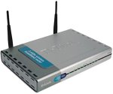



Addresses in 802.11 Data Frames
802.11 数据帧有四个地址字段。地址 4 用于自组网络
去往 AP | 来自 AP | 地址 1 | 地址 2 | 地址 3 | 地址 4
0 | 1 | 目的地址 | AP 地址 | 源地址 | ——
1 | 0 | AP 地址 | 源地址 | 目的地址 | ——
BSS₁
AP₁
R
1
去往 AP = 1
来自 AP = 0
A
AP₂
2
BSS₂
0
去往 AP = 0
来自 AP = 1
C
B
因特网
站点 A 向 B 发送数据帧。数据帧必须经过 AP 转发

Slide 48




Why We Need CSMA/CA?
Collisions can occur in WLAN, but the stations can only know the transmission nearby, so CSMA/CD is not a good choice.
  Hidden Station Problem
    When A is transmitting data to B, C can’t detect the transmission between A and B, so perhaps C will decide to transmit data to B and result in a collision at B.
  Exposed Station Problem
    When B is transmitting data to A, C can detect the transmission, so C will not transmit data to D. But that is a mistake.
B
A
C
D

Slide 49
Multiple Accessing Mechanism
Ethernet
  Signals is transmitted to all stations on the cable.
  The sending station detects the collisions.
  At a time, only an effective frame can be transmitted on the channel.
WLAN
  Signals is transmitted to stations near to the sending station on the cable
  The MAC protocol must try it best to ensure only a sending station near to the receiving station
  The receiving station detects the collisions.
  At a time, multiple effective frames can be transmitted on the channel.

Slide 50
CSMA/CA
CSMA/CA（Carrier Sense Multiple Access with Collision Avoidance）
  发送站点在发送数据前，以控制短帧刺激接收站点发送应答短帧，使接收站点周围的站点监听到该帧，从而在一定时间内避免数据发送
  基本过程
    A向B发送RTS（Request To Send）帧，A周围的站点在一定时间内不发送数据，以保证CTS帧返回给A；
    B向A回答CTS（Clear To Send）帧，B周围的站点在一定时间内不发送数据，以保证A发送完数据；
    A开始发送
    若控制帧RTS或CTS发生冲突，采用二进制指数后退算法等待随机时间，再重新开始。

Slide 51
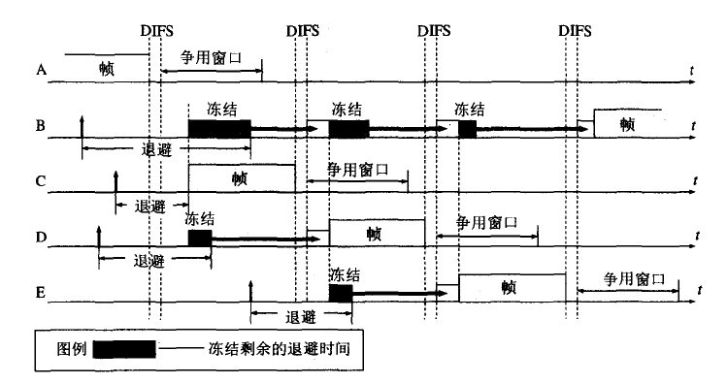
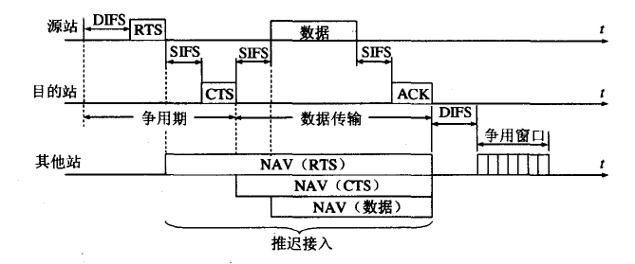
CSMA/CA

Slide 52
CSMA/CA
DIFS
DIFS
DIFS
DIFS
争用窗口
A
帧
冻结
冻结
冻结
B
帧
退避
帧
争用窗口
C
退避
冻结
争用窗口
D
帧
退避
冻结
E
帧
退避
图例 冻结剩余的退避时间

Slide 53
The Actual Throughput
When a source node sends a frame, the receiving node returns a positive acknowledgment (ACK).
  This can cause consumption of 50% of the available bandwidth.
  This reduces the actual data throughput to a maximum of 5.0 to 5.5 Mbps on an 802.11b wireless LAN rated at 11 Mbps.
Performance of the network will also be affected by signal strength
  As the signal becomes weaker, Adaptive Rate Selection (ARS) may be invoked
  The transmitting unit will drop the data rate from 11 Mbps to 5.5 Mbps, from 5.5 Mbps to 2 Mbps or 2 Mbps to 1 Mbps.

Slide 54
Layer2: Data Link Layer
Overview of the Data Link Layer
Ethernet and CSMA/CD
  LLC and MAC Sub-layers
  Media Access Control in MAC Sub-layer
Wireless LAN and CSMA/CA
Layer 2 Devices

Slide 55
Layer 2 Devices—NICs
NICs perform important Layer 2 data link layer functions:
  Logical Link Control - communicates with upper layers in the computer
  Media Access Control - provides structured access to shared access media
  naming - provides a unique MAC address identifier
  framing - part of the encapsulation process, packaging the bits for transport
  signaling - creates signals and interface with the media by using built-in transceivers

Slide 56
Layer 2 Devices—Bridges
Bridges divide traffic into segments and filters traffic based on the MAC address, not based on protocols.
Bridges can improve network performance by reducing large collision domains.
Bridges work best where traffic is low from one segment of a network to other segments.
  When traffic between network segments becomes heavy, bridges can become a bottleneck and slow down communication.

Slide 57
Layer 2 Devices—Bridges
  Transparent Bridge
    “透明”是指局域网上的站点并不知道所发送的帧将经过哪几个网桥，因为网桥对各站来说是看不见的
    透明网桥是一种即插即用设备，其标准是 IEEE 802.1D
    目前以太网中使用得最多的网桥
  Source routing Bridge
    源路由(source route)网桥在发送帧时将详细的路由信息放在帧的首部中,从而使每个经过的网桥都了解帧的路径
    在令牌环网络中被广泛使用

Slide 58


Layer 2 Devices—Bridges
以太网网桥的工作原理
（透明网桥）
网桥
站地址
接口
站表
①
1
②
1
③
1
接口管理
软件
网桥协议
实体
④
2
⑤
2
⑥
2
接口 1
缓存
接口 2
网桥
接口 1
接口 2
网段 A
1
2
网段 B
①
②
③
④
⑤
⑥

Slide 59
Transparent Bridge
若从 A 发出的帧从接口 x 进入了某网桥，那么从这个接口出发沿相反方向一定可把一个帧传送到 A。
网桥每收到一个帧，就记下其源地址和进入网桥的接口，作为转发表中的一个项目。
在收到一个新的帧时，将转发表中已收集到的地址记录取出，与此帧的目的地址匹配，找到对应的接口，并向该接口转发。
在网桥的转发表中写入的信息除了地址和接口外，还有帧进入该网桥的时间，其原因是：
  拓扑可能经常变化
  站点也可能会更换适配器（这就改变了站点的地址）
  工作站并非总是处于工作状态
把每个帧到达网桥的时间登记下来，就可以在转发表中只保留网络拓扑的最新状态信息，使得网桥中的转发表能反映当前网络的最新拓扑

Slide 60
Transparent Bridge
Problem: When a device on a network wants to send data, but does not know the destination address.
  Send out a broadcast to all devices on a network.
  Since every device on the network has to pay attention to such broadcasts, bridges always forward them.
Too many broadcasts can result in a broadcast storm, and it can cause:
  network time-outs
  traffic slowdowns
  less than acceptable performance.

Slide 61
Source Route Bridge
透明网桥容易安装，但网络资源的利用不充分
源路由(source route)网桥在发送帧时将详细的路由信息放在帧的首部中
源站以广播方式向欲通信的目的站发送一个发现帧，每个发现帧都记录所经过的路由
发现帧到达目的站时就沿各自的路由返回源站
源站在得知这些路由后，从所有可能的路由中选择出一个最佳路由
凡从该源站向该目的站发送的帧的首部，都必须携带源站所确定的这一路由信息

Slide 62
Layer 2 Devices—Switches
Perform two basic operations:
  switching data frames: a frame is received on an input medium and then transmitted to an output medium
  maintenance of switching operations: Switches build and maintain switching tables and search for loops. Routers build and maintain both routing tables and service tables.

Slide 63
Layer 2 Devices—Switches
Switching is a technology that alleviates congestion in Ethernet LANs by reducing traffic and increasing bandwidth.
  Switches create dedicated network segments, or point-to-point connections, and connecting these segments in a virtual network within the switch.
  This is called a virtual circuit because it exists only when two nodes need to communicate and is established within the switch
  You can think of each switch port as a micro-bridge; this process is called microsegmentation.
  Each switch port gives the full bandwidth of the medium to each host

Slide 64
Layer 2 Devices—Switches
LAN switch reduces the size of collision domains
However, All hosts connected to the switch are still in the same broadcast domain.
  That is, a broadcast from one node will still be seen by all other nodes connected through the LAN switch.

Slide 65
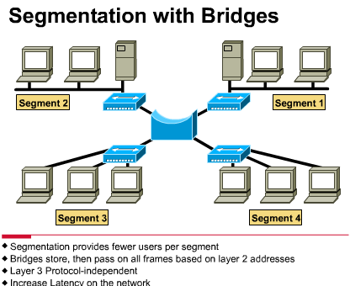
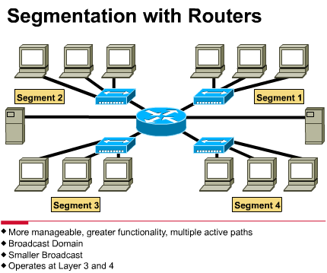
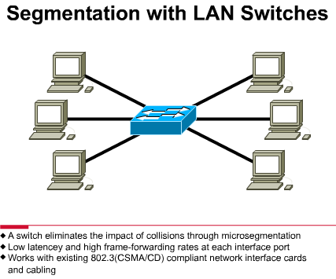
Segmentation of a Collision Domain
We can create collision domains using:
  Bridge (Layer 2)
  Switch (Layer 2)
  Router (Layer 3)

Slide 66
Bridge Segmentation of a Collision Domain
Ethernet LANs that use a bridge for segmenting the LAN provide more bandwidth per user because there are fewer users on the segment.
Bridges pass on data frames regardless of which Layer 3 protocol is used.
Bridges increase the latency (delay) in a network by 10 to 30 percent because of the decision making that is required.
A bridge is considered a store-and-forward device because it must receive the entire frame and verify the cyclic redundancy check before forwarding can take place

Slide 67
Switch Segmentation of a Collision Domain
Switches are significantly faster because they switch in hardware, while bridges switch in software.
A 10 Mbps Ethernet LAN and a 100 Mbps Ethernet LAN can be connected by using a switch.
In a switched Ethernet implementation, the available bandwidth can reach close to 100 percent.
Shared Ethernet networks perform best when kept to less than 30 to 40 percent of full capacity because of CSMA/CD.
Some switches support cut-through switching, which reduces latency and delays, while bridges only support store-and-forward switching.

Slide 68
Router Segmentation of a Collision Domain
Router can create the highest level of segmentation:
  Create smaller collision domains
  Create smaller broadcast domains: routers do not forward broadcasts unless programmed to do so.
Routers accomplish forwarding of packets by examining the destination logical address on the data packet and then looking in its routing table for forwarding instructions
Because routers perform more functions than bridges, they operate with a higher rate of latency.
Routers can work as gateway:
  be used to connect different networking media and different LAN technologies

Slide 69




