Slide 1

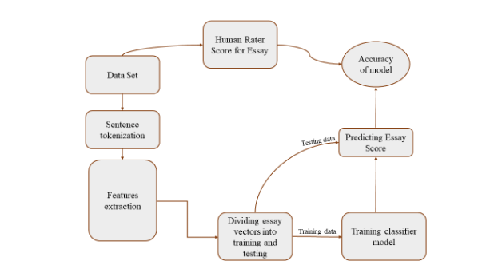
Automated Writing Evaluation in Arabic Language
By Students: Día Maali, Aseel Khaseeb , Zainab shaabneh
Supervisor: Dr. Abualsoud Hanani
Electrical and Computer Engineering, Birzeit university
ABSTRACT
In this project, we propose an Automated Essay Scoring (AES) system for evaluating Arabic essays.
Essays play a significant role in measuring learning outcomes, but manual evaluation is time-consuming. Automated essay assessment offers a solution for educational institutions, language assessment, and others.
The automatic AES system eliminates factors that affect manual evaluation, such as the evaluator's mental state and differences in evaluator abilities. It ensures consistent and objective assessment.
The proposed system evaluates essays based on five criteria: spelling, essay structure, coherence level, style, and punctuation.
Features extraction:
A. Surface features: features demonstrate only features dealing with the text itself such as word frequency, Number of paragraphs and sentences, average, maximum, and minimum length, etc.
B. Syntactic and morphological features: Parts of speech (POS) frequency in essay, Number of nominal and verbal sentence, Spelling mistakes in the whole essay, etc.
C. Lexical features: Introduction and conclusion keywords, Arabic Lexicon Features, Punctuation features.
D. Semantic features: Arabic WordNet synonyms and antonyms between essay sentences, paragraphs, and the whole essay.
E. Discourse features: Arabic discourse connectives, Using the POS tag provided by MADAMIRA, we checked the number of words with conjunction tags in the overall essay as well as the number of unique conjunctions
Proposed system
Machine Learning
the collected essays have been split into 70% training and 30% testing.
The essays manual evaluation which was done by the course instructor and other human evaluators, was used as true labels for machine learning.
Different machine learning algorithms have been used for predicting essay assessment class such as
- Random Forest (RF)
- Support Vectors Machines (SVM)
- Convolutional Neural Network (CNN)
- Long Short-Time Memory (LSTM)
System performance is measured by accuracy, recall, precision, and F1-score.
.
.
.
Dataset
Grade | Category | Percentage of student who got this grade
(25_30) | A | 30%
(20_24) | B | 60%
(10_19) | C | 6%
(less than 10) | D | 4%
CONCLUSIONS AND PLANING
70 Arabic essays were collected and manually evaluated by more than one human evacuator according to a specific criteria
.
A set of representative features have been extracted from each essay to be used for the machine learning system
A set of machine learning algorithms have been used for essays evaluation.
A set of experiments are planned to be conducted with different settings.
More feature types and machine learning algorithms are planned to be added and evaluated.
The collected dataset consists of written essays submitted by students at Birzeit University during the online Arabic language course. The essays were in response to three different topics/questions of the final exam, obtained in CSV forma
The collected dataset comprises of 570 essays, averaging around 250 words (3KB) each.
The exam essays of the dataset were evaluated by the course instructor to compare results with the system's evaluation.
Essays are classified into four classes: Class A (excellent), Class B (very good), Class S (good), and Class D (acceptable or poor).

