Slide 1
Employee Attrition
Zachary Campbell Final Project – DSC530-T301 Data Exploration and Analysis

Slide 2
Hypothesis: Does Salary have a significant impact on employee attrition at a company?
Using the dataset on employee attrition for IBM from Kaggle, I wanted to try to understand if there was a potential relationship between salary and the employee attrition. Or if there were other factors that could impact attrition.
Variables:
Monthly Income
Job Level
Performance Rating
Years at the Company
Age

Slide 3
Variable Exploration
Monthly Income
This variable represents the employee’s yearly income in dollars, it was calculated using the monthly rate * 12 months. It could be used to determine if higher-paid employees are less likely to leave the company.
Job Level
This variable represents the employee’s job level within the company – its relevance is higher or lower level employees could have different likelihoods of quitting
Performance Rating
Performance rating represents how the employee is doing as determined by their manager
Years at the Company
Represents the number of years the employee has been with the company, the longer the tenure in theory the longer the employee would stay with the company
Age
This variable represents the employee's age in years. It could be used to determine if employees of a certain age range are more or less likely to leave the company than others.

Slide 4
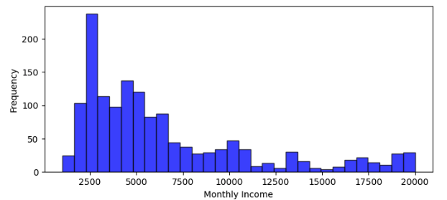
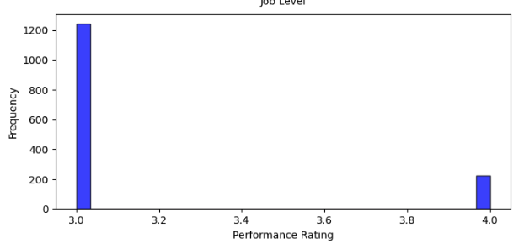
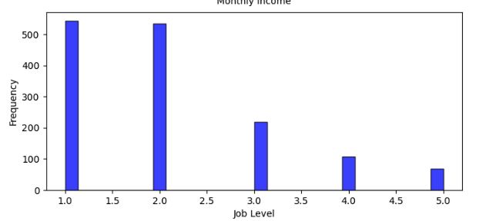
Histogram Graphs of the Variables: 1-3
For monthly income there appears to be individuals with significantly higher incomes than the rest of the sample and this is to be expected as there are C-suite and upper-level executives that would garner higher compensation
For performance rating there is a majority of 3.0 level reviews with 4.0 being the next frequent, this does not indicate that there is an outlier as the the outcomes are close to the average.
For job level, there is a good distribution of jobs as expected, with a majority of the jobs being lower or middle level with a less frequent amount of upper level jobs.

Slide 5
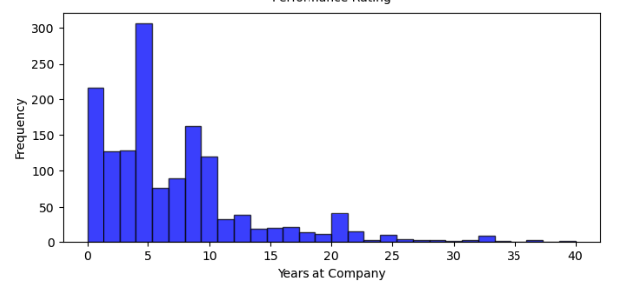
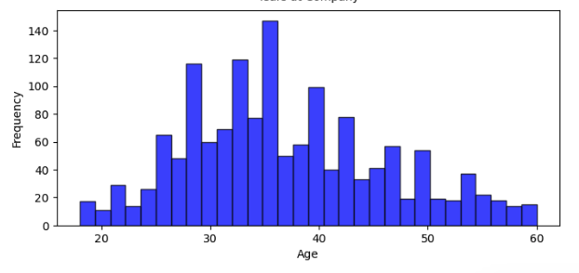
Histogram Graphs of the Variables: 4-5
For years at the company there are a few outliers in the over 20 years at the company level, however, this again is to be expected given the various C-suite employees that could work at a company
In terms of age, the variable is evenly distributed across the date which indicates that there isn’t much in terms of outliers.

Slide 6
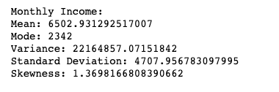
Monthly Income Statistics
For the Monthly Income variable, we can see that the mean income is $6,502.93
The mode of the data is 2,342, which means there is large population of employees make $2,342 monthly.
The variance of the data is 22,164,857.07. This indicates the income of the employees varies a lot which is consistent with expectations as there are C-Suite employees and upper-management who make higher salaries
The standard deviation is 4,707.96, which is another measure of the spread of the data.
The skewness is 1.3698, which indicates that the distribution of the data is positively skewed which means that there are a few employees with very high incomes. This is again consistent with expectations mentioned above.

Slide 7
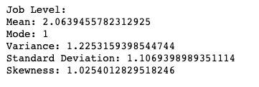
Job Level Statistics
The mean job level of employees is 2.06, indicating that the average employee is just above entry level.
The mode of the job level is 1, which means that most employees work an entry level job.
The variance of job level is 1.23 this means that there isn’t a high level of variability in the level of employees. Which is consistent with a business, you would have a majority of lower level employees with a few managers and C-Suite.
The standard deviation of job level is 1.11
The skewness of job level is 1.03. This means that there are more employees with lower job levels than with higher job levels.

Slide 8
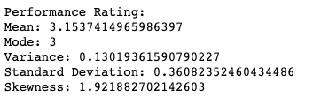
Performance Rating Statistics
The mean performance rating is 3.15 this means that employees tend to receive a rating slightly above the "meets expectations" level.
The mode is 3 meaning most employees get a 3 on their ratings.
The variance of 0.13 means that there isn’t much variations from 3 for a rating.
The standard deviation of 0.36 is relatively small compared to the range of possible ratings (1 to 5), further supporting the idea that the ratings tend to be consistent across employees.
The skewness of 1.92 suggests that a small number of employees may receive much lower ratings than most of their colleagues.

Slide 9
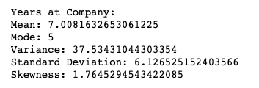
Years at the Company Statistics
The mean years at the company is approximately 7 years, meaning on average an employee has been at the company for 7 years
The mode is 5 this means that a majority of employees have been at the company for 5 years at least.
The variance of 37.53 indicates that there is a wide range of values for years at the company in the dataset.
The standard deviation of 6.13 shows that there is a significant amount of deviation from the mean, suggesting that the distribution of years at the company is somewhat spread out.
The skewness value of 1.76 which means that there are more employees with less years at the company than the mean of 7. This is again consistent with expectations as there should be more lower level employees than upper.

Slide 10
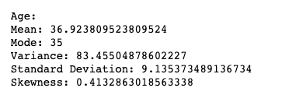
Age Statistics
Overall, the age data seems to be reasonably spread out around the mean with a positive skewness indicating that the data is slightly skewed towards older ages. Which again, is consistent with expectations

Slide 11
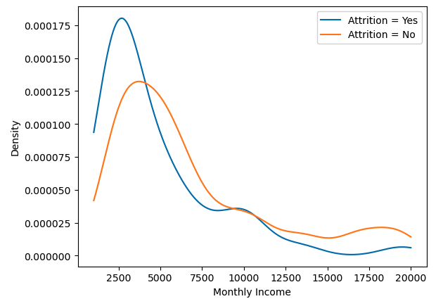
Comparison of Income and its impact on Attrition
The graph shows calculation of the two scenarios (if the employee had attrition or not) based on the monthly data. It shows that there is a lower probability of attrition with higher compensation and vice versa.

Slide 12
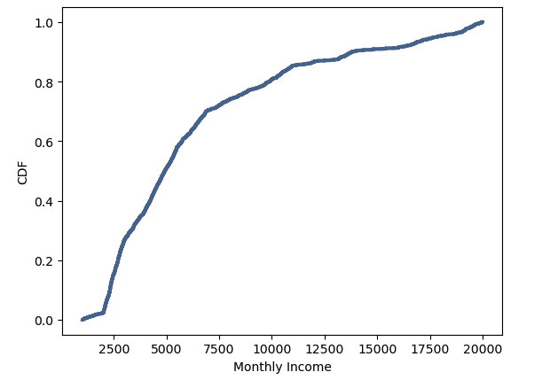
CDF Function of Monthly Income
This graph shows the probability that if you select a random employee that their monthly income would be greater than the amount on the bottom. For example, roughly 70% of the employee population has a less than $6,000 a month income. What this shows is that there is a large population of employees whose salaries are adequate for the monthly household income in the US, which could impact the hypothesis of attrition being related to salary.

Slide 13
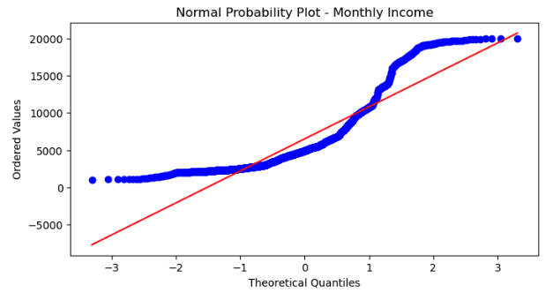
Normal Probability Plot Analysis
For monthly income data, the normal probability plot shows the data from the data set is not a straight line in the lower and upper tails meaning that there is not a purely normal distribution of data.
Overall, while the monthly income data is not a perfectly normal distribution, it does exhibit some characteristics of a normal distribution. Therefore, it may be appropriate to use normal distribution for the purposes of the evaluation of the hypothesis.

Slide 14
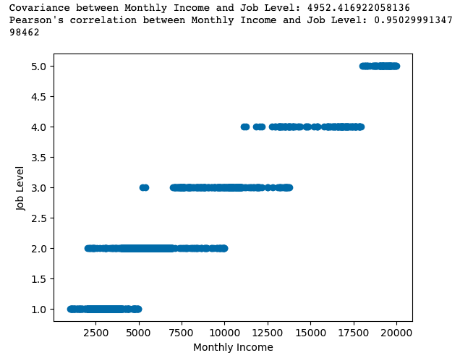
Scatterplot and Statistics – Monthly Income and Job Level
A covariance of 4,952.42 between Monthly Income and Job Level means that the two variables have a positive relationship, indicating that as one variable increases, so does the other variable.
The Pearson's correlation coefficient of 0.95 which suggests a strong positive linear relationship between Monthly Income and Job Level.
The coefficient value indicates that there is a strong correlation between Monthly Income and Job Level, suggesting that higher job levels are associated with higher monthly incomes. This is consistent with expectations but again, due to this being a correlation analysis it does not indicate causation

Slide 15
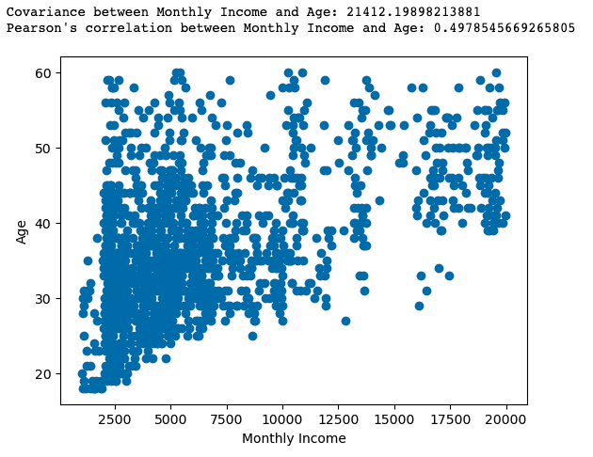
Scatterplot and Statistics – Monthly Income and Age
The positive covariance between Monthly Income and Age indicates that as the age of the employees increases, their monthly income tends to increase as well.
The Pearson's correlation coefficient of 0.50 between Monthly Income and Age indicates a positive correlation, but it is not as strong as the one between Monthly Income and Job Level. A value of 0.50 suggests a moderate positive correlation, meaning that as the age of the employees increases, their monthly income tends to increase as well, but the relationship is not as strong as the one between Monthly Income and Job Level.

Slide 16


Hypothesis Testing:
Null Hypothesis (H0): Salary and employee attrition are independent.
Alternative Hypothesis (Ha): Salary and employee attrition are dependent.
Based on the data to the left which was a contingency table that shows the number of employees who have left the company based on their job level or those who have stayed. The rows of No and Yes represent the number of employees who have left due to job title. The purpose of this is to investigate if there is higher attrition at higher levels of job and therefore a higher level of salary. A chi-squared statistic was performed and as a result of a Chi-Squared Statistic of 72.53 and a P-value of 6.35 it means that there is strong evidence to suggest that salary has a significant impact on employee attrition at this company. Based on the P-value we can reject the null hypothesis meaning that again we can conclude that there is a strong relationship between salary and attrition

Slide 17
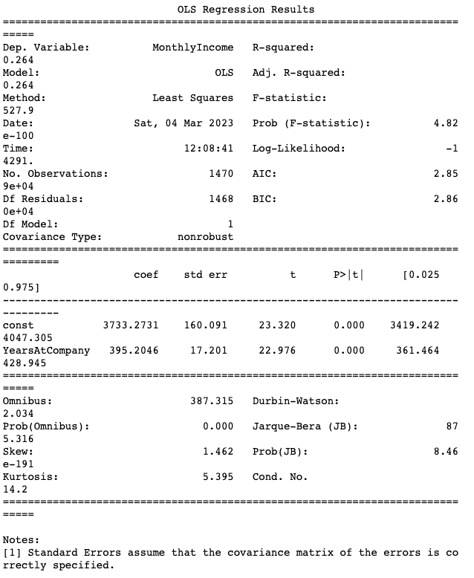
Regression Analysis: Monthly Income vs Years at the Company - Statistics
The regression results show that the model has a low R-squared value of 0.264, indicating that only about 26.4% of the variation in monthly income can be explained by the years an employee has spent at the company.
The p-value of the F-statistic is very low at 4.82e-100, indicating that the model is statistically significant.
The scatter plot of Monthly Income vs. Years at Company with the regression line shows a positive relationship between the two variables, indicating that as years at the company increase, so does monthly income.
See following slide for the visualization of this analysis

Slide 18
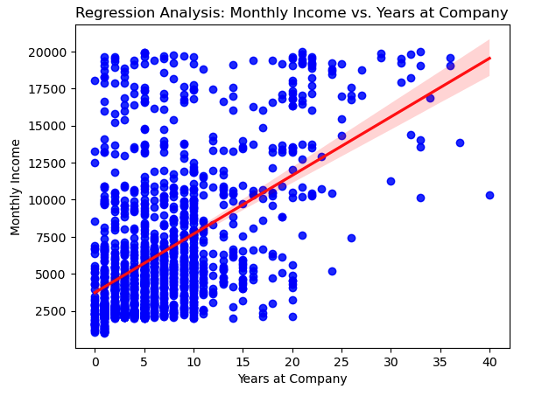
Regression Analysis: Monthly Income vs Years at the Company - Visualization
As mentioned on the previous slide, the regression analysis line has Monthly income as the dependent variable and the Years at the Company as the explanatory variable and the R-squared value indicates that roughly 26.4% of the variance in the monthly income is attributable to the Years at the Company.

Slide 19
Conclusion:
Based on the analysis above there is a significant relationship between an employee’s salary and their attrition from the company, however, there can be other influencing factors that are not captured in the data that could also lead to attrition hence the possibility of attrition not related to salary.

