Slide 1
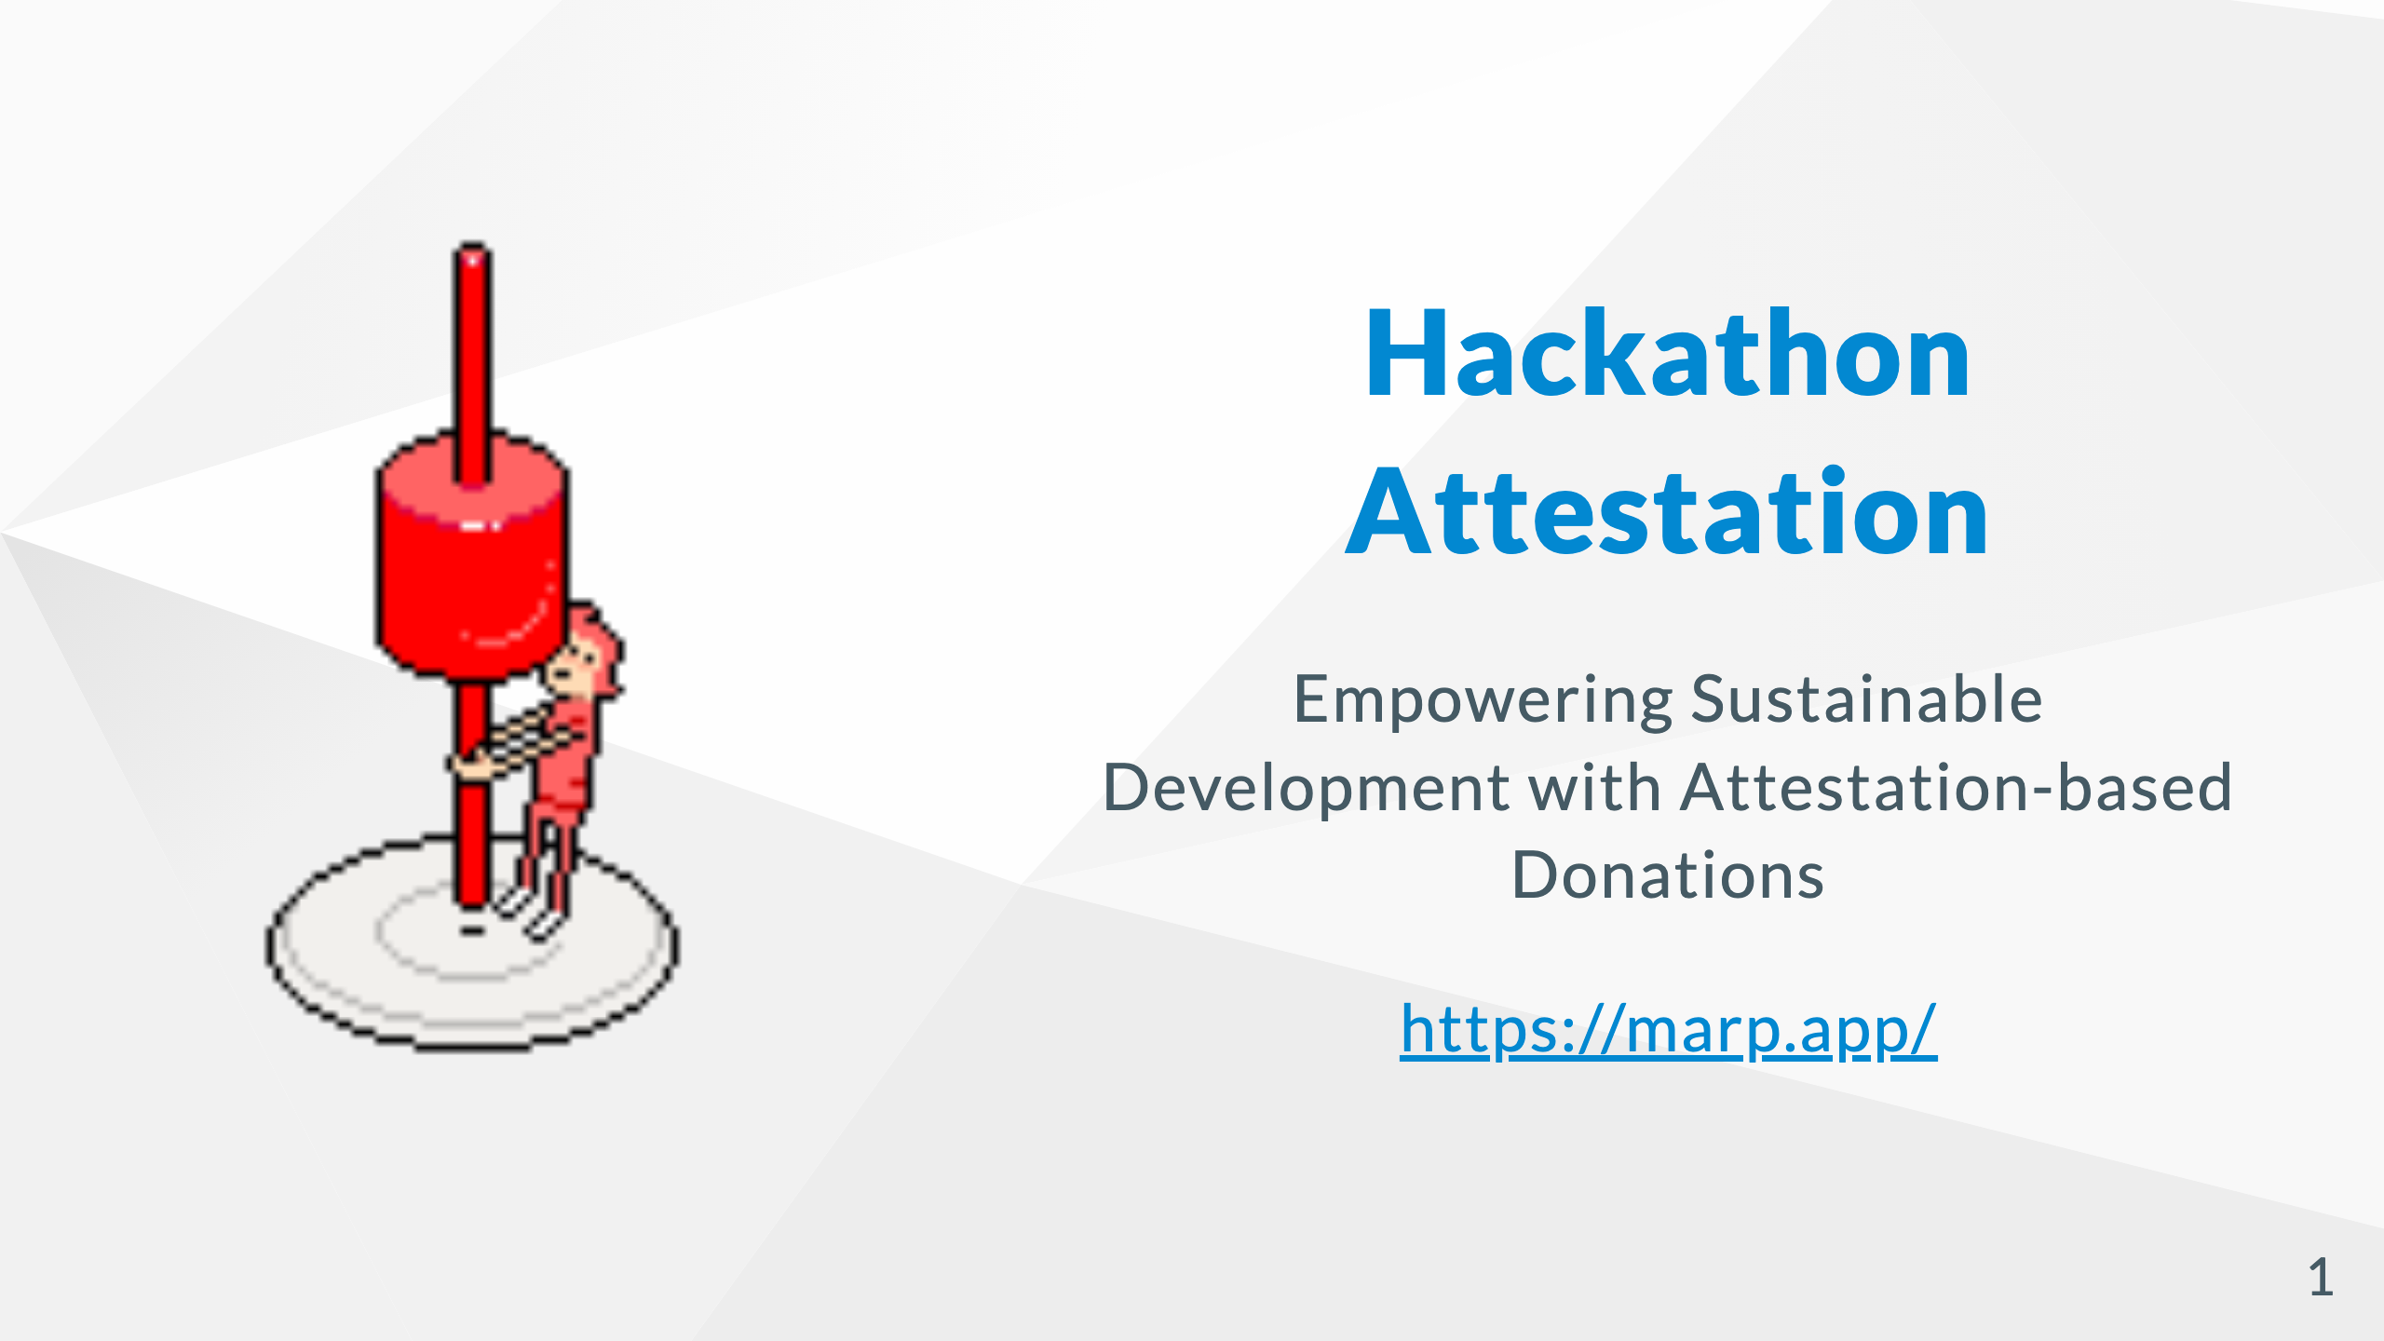

Slide 2
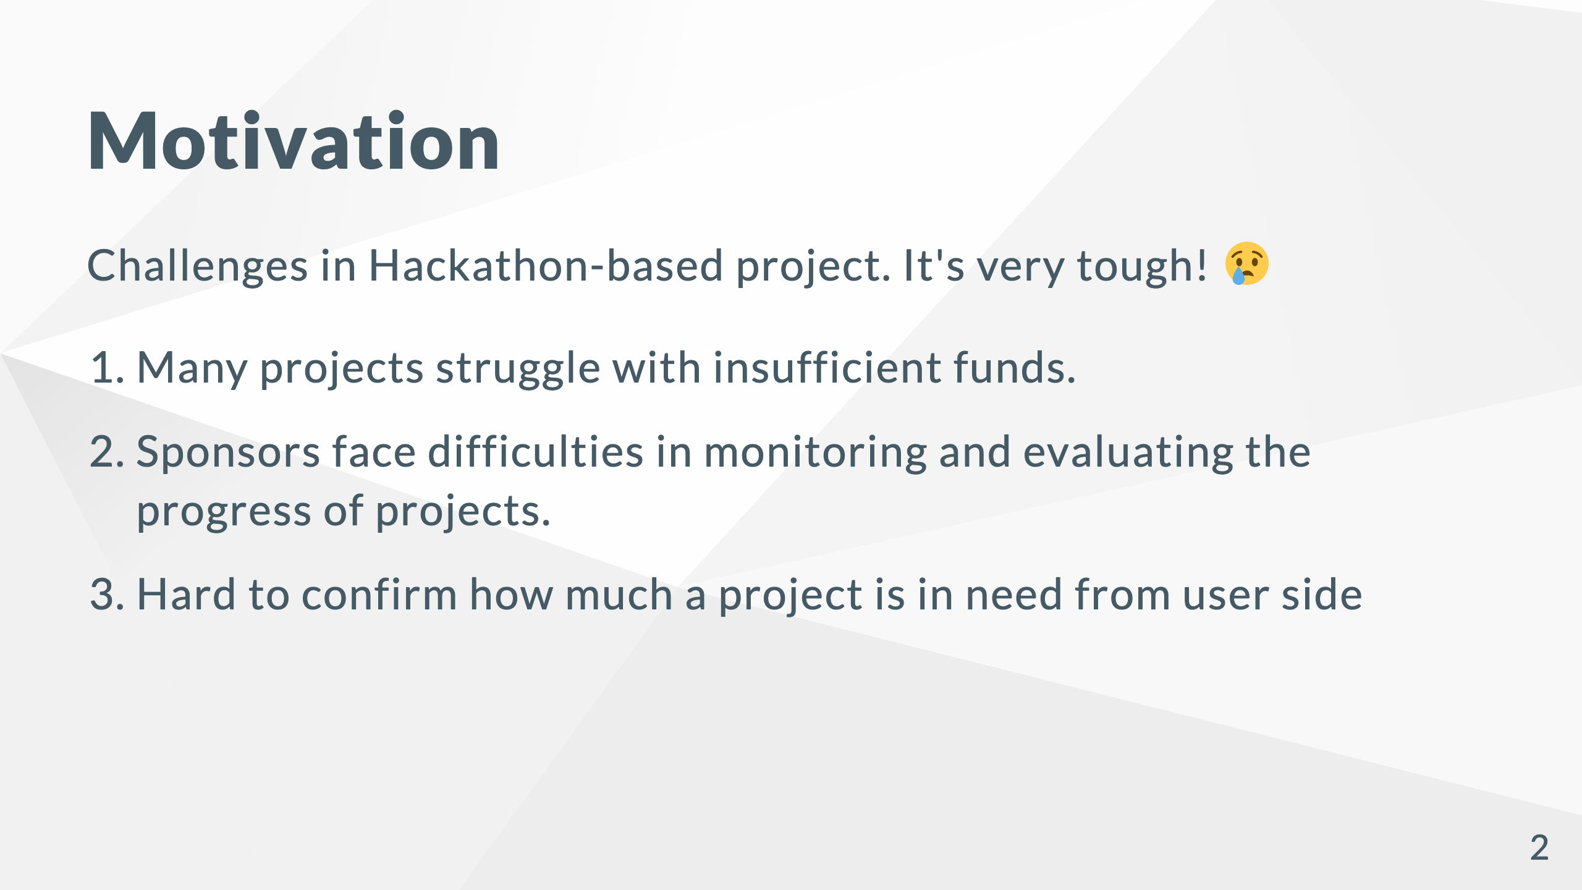

Slide 3


Slide 4
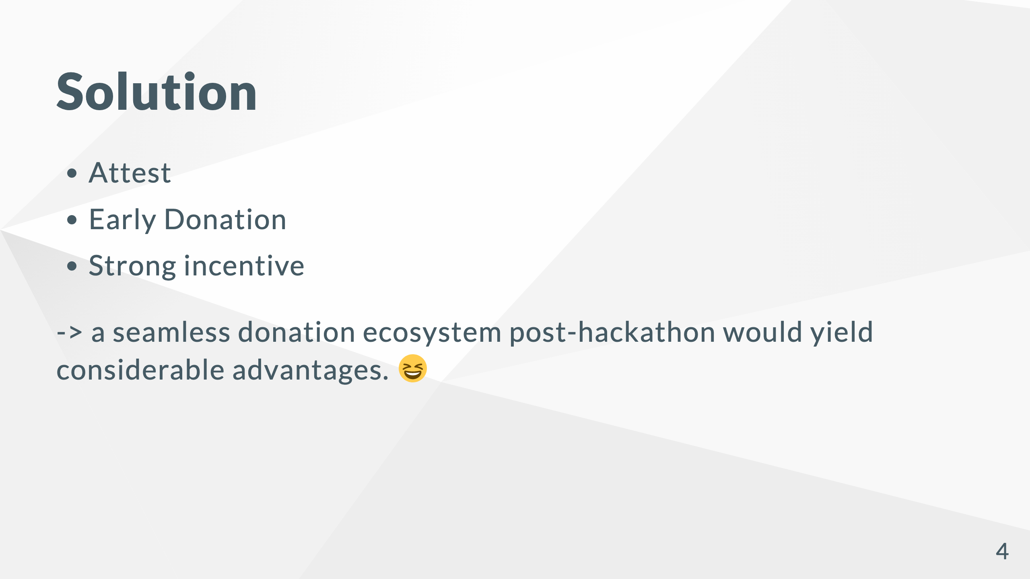

Slide 5

Notes:
# System Flow - Creating an inclusive donation environment that anyone can participate in. Project owner receive all of the donation funds after voting.

Slide 6
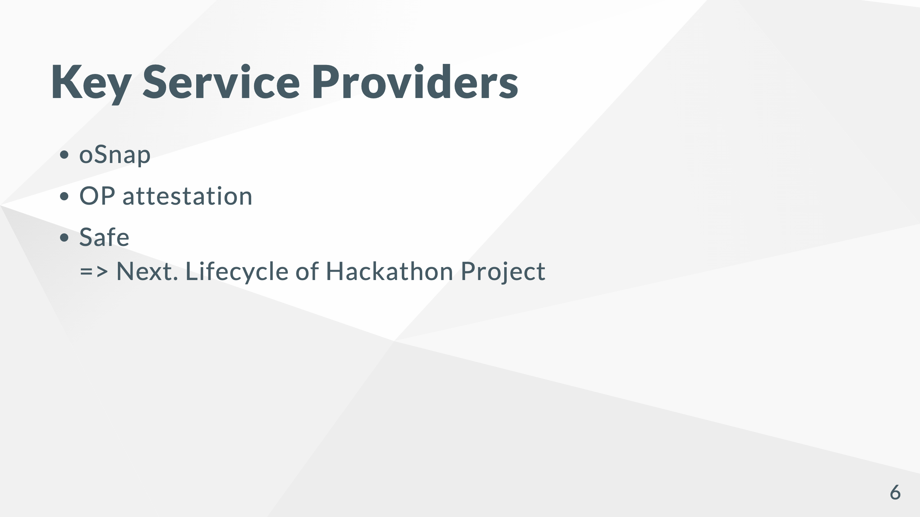

Slide 7
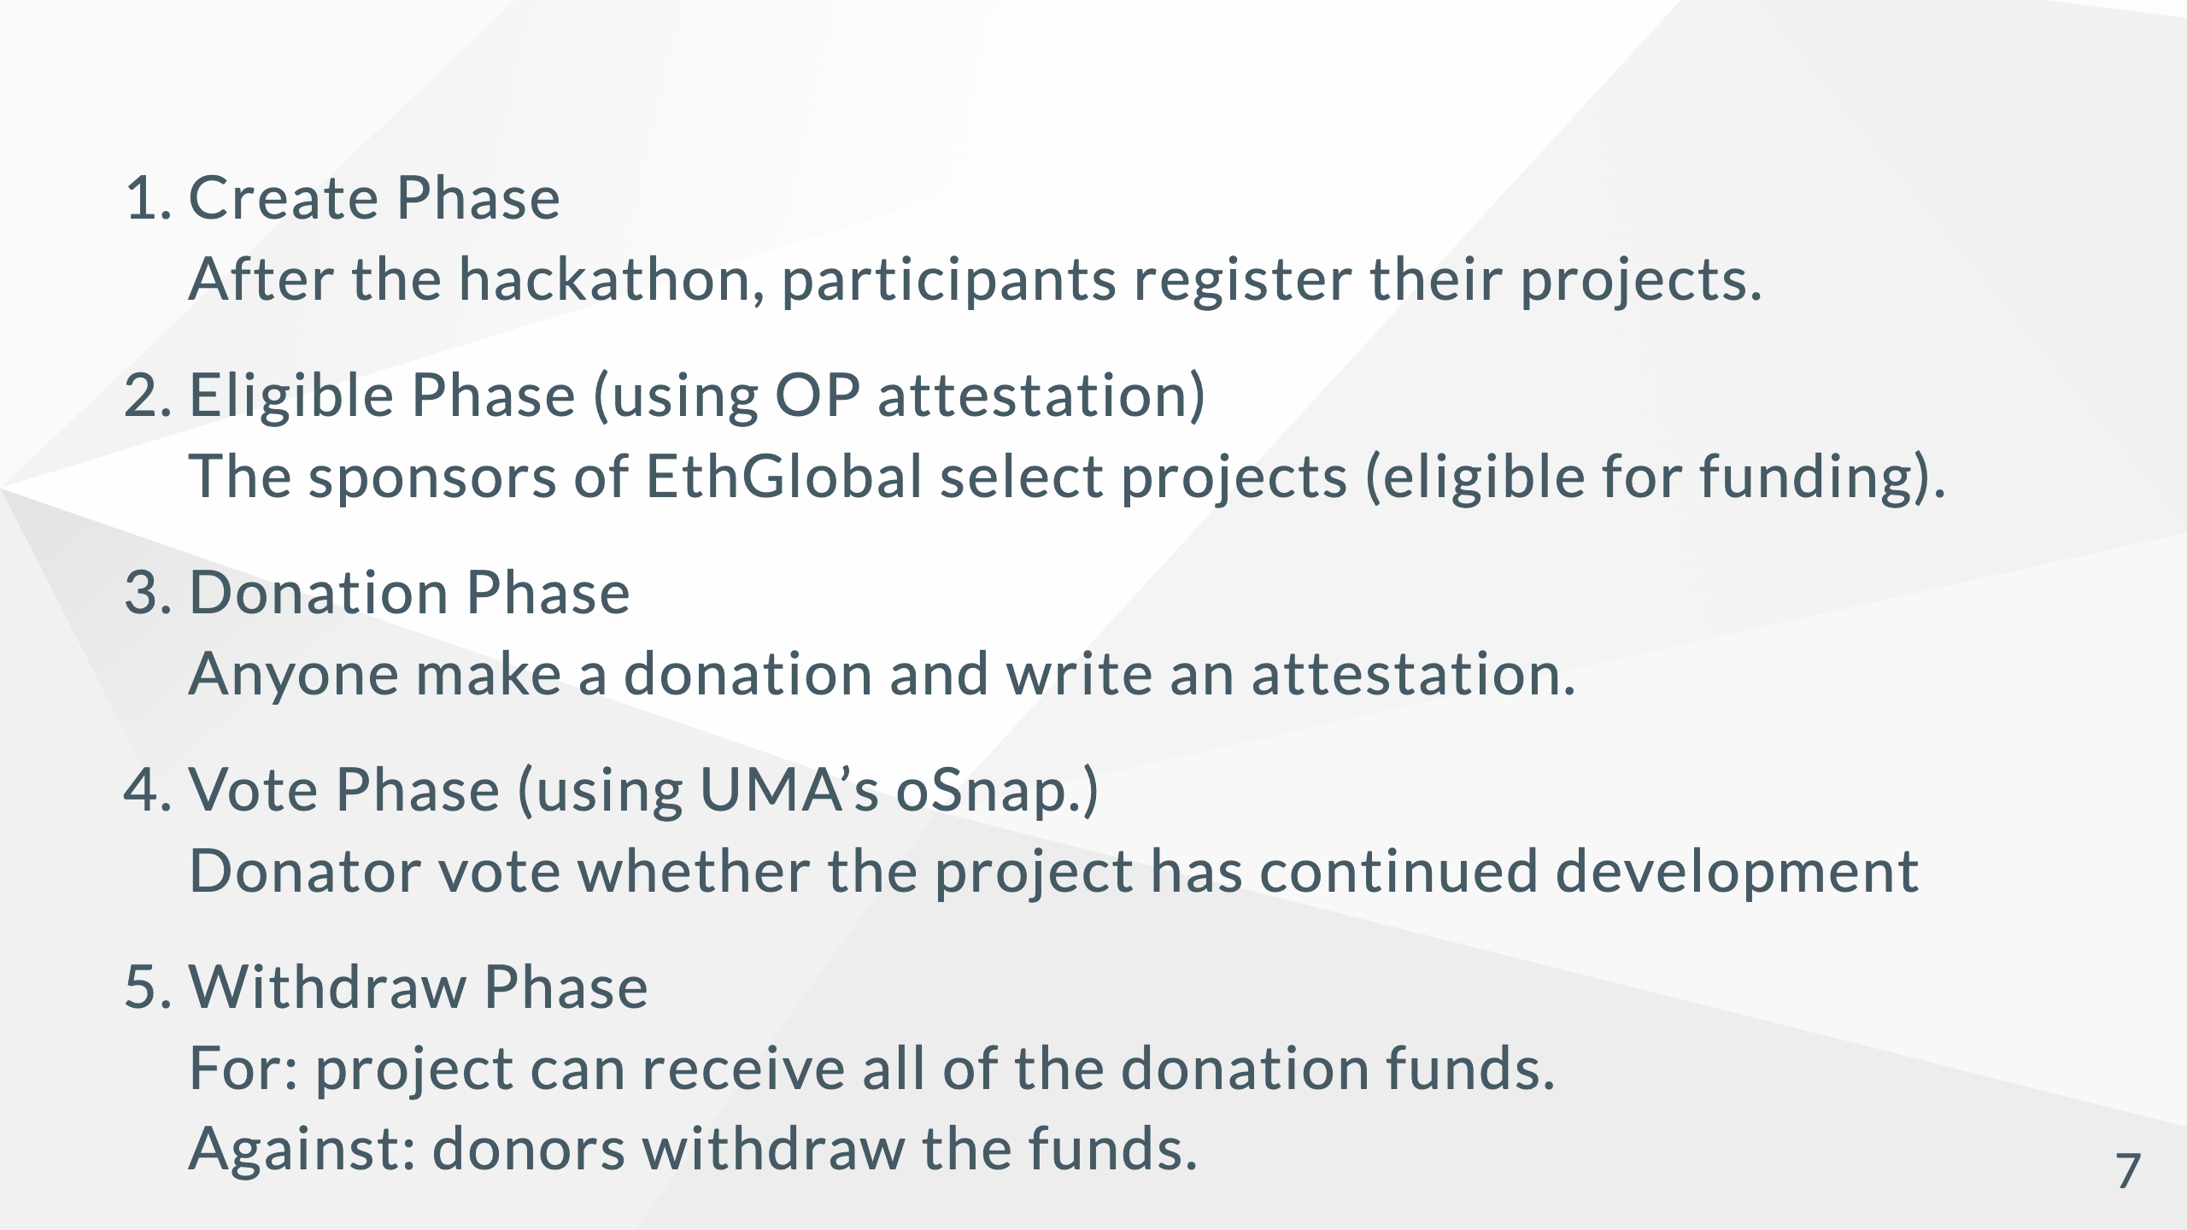
Notes:
# Lifecycle of Hackathon Project

Slide 8
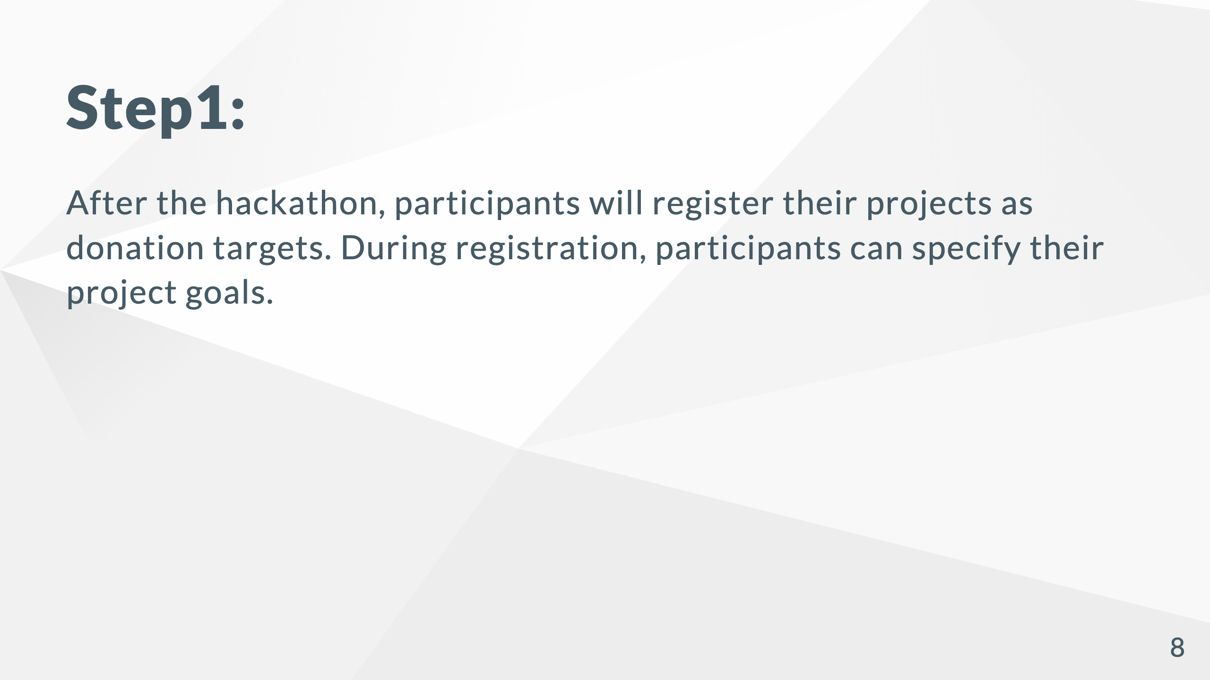

Slide 9
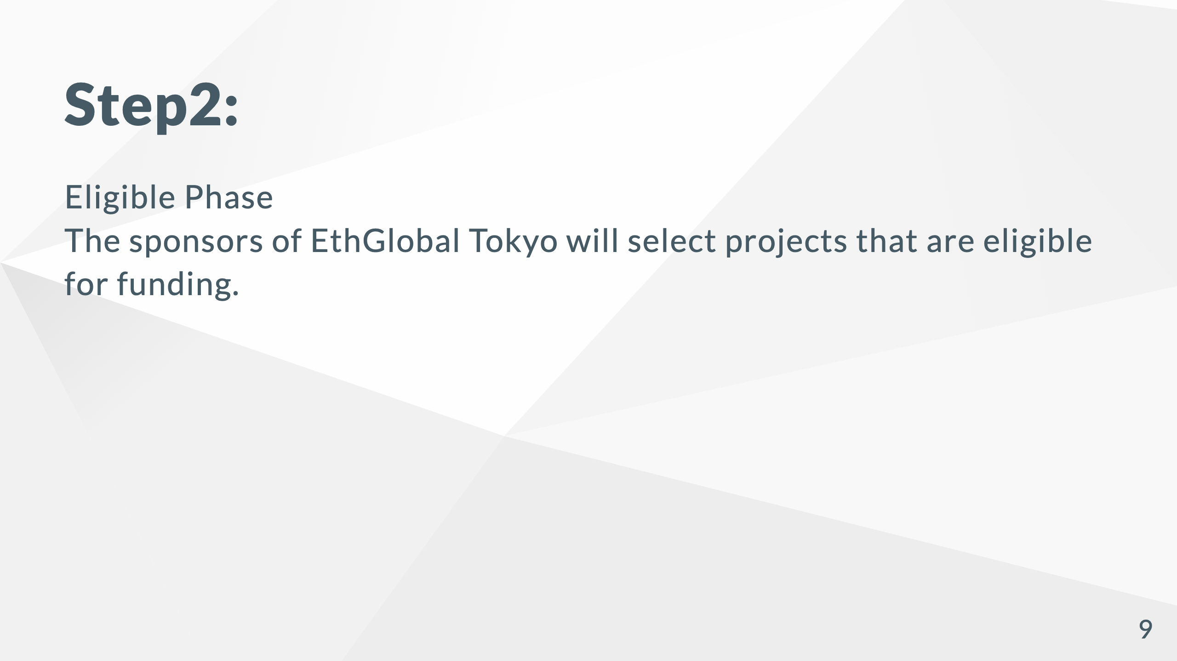

Slide 10
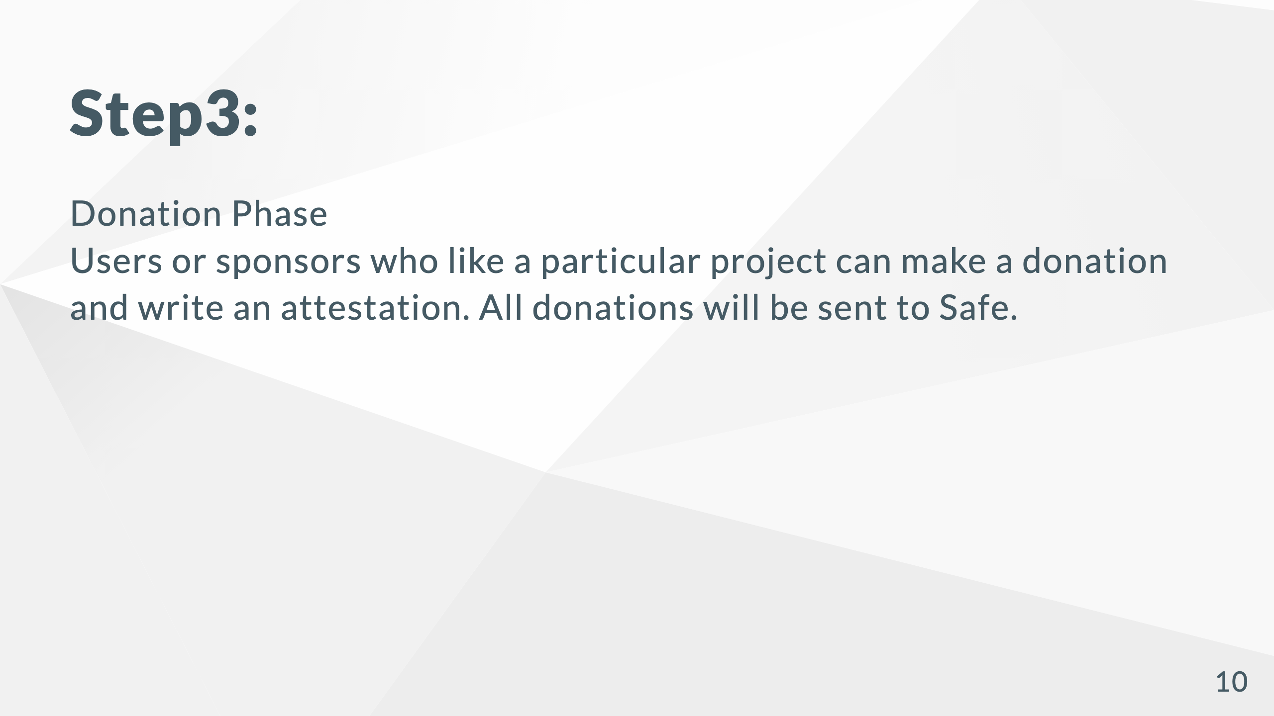

Slide 11


Slide 12
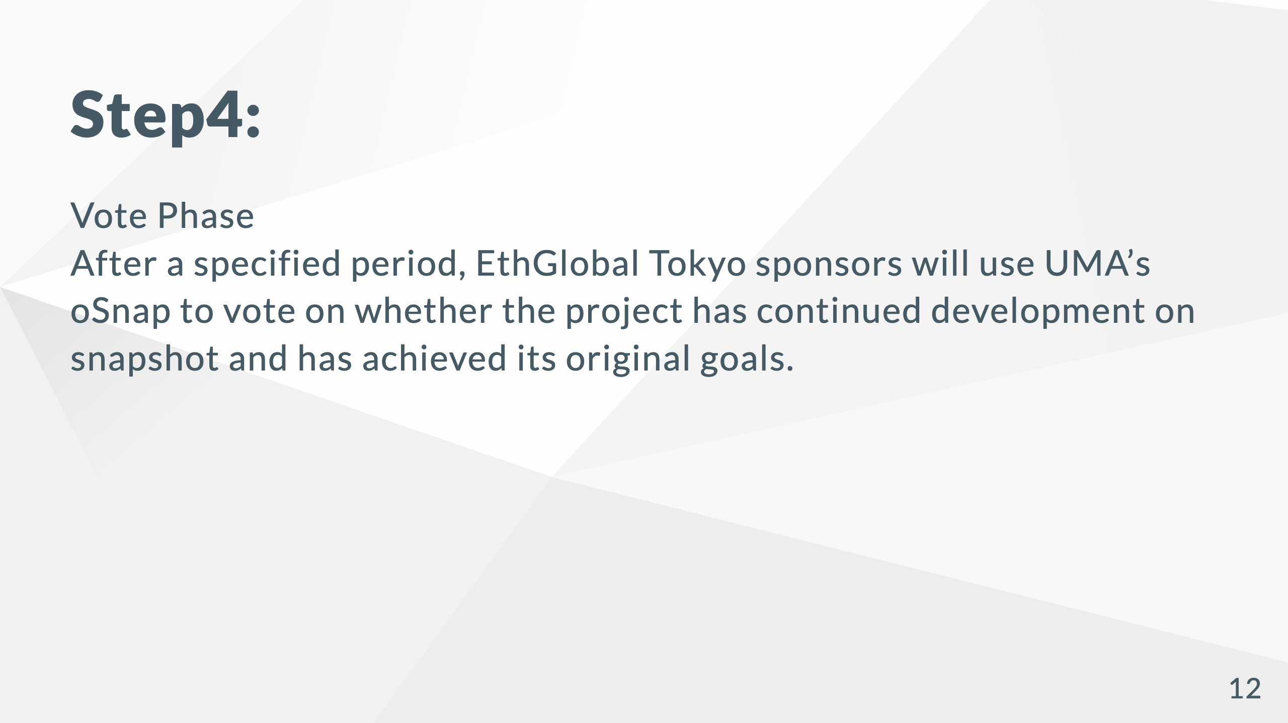

Slide 13
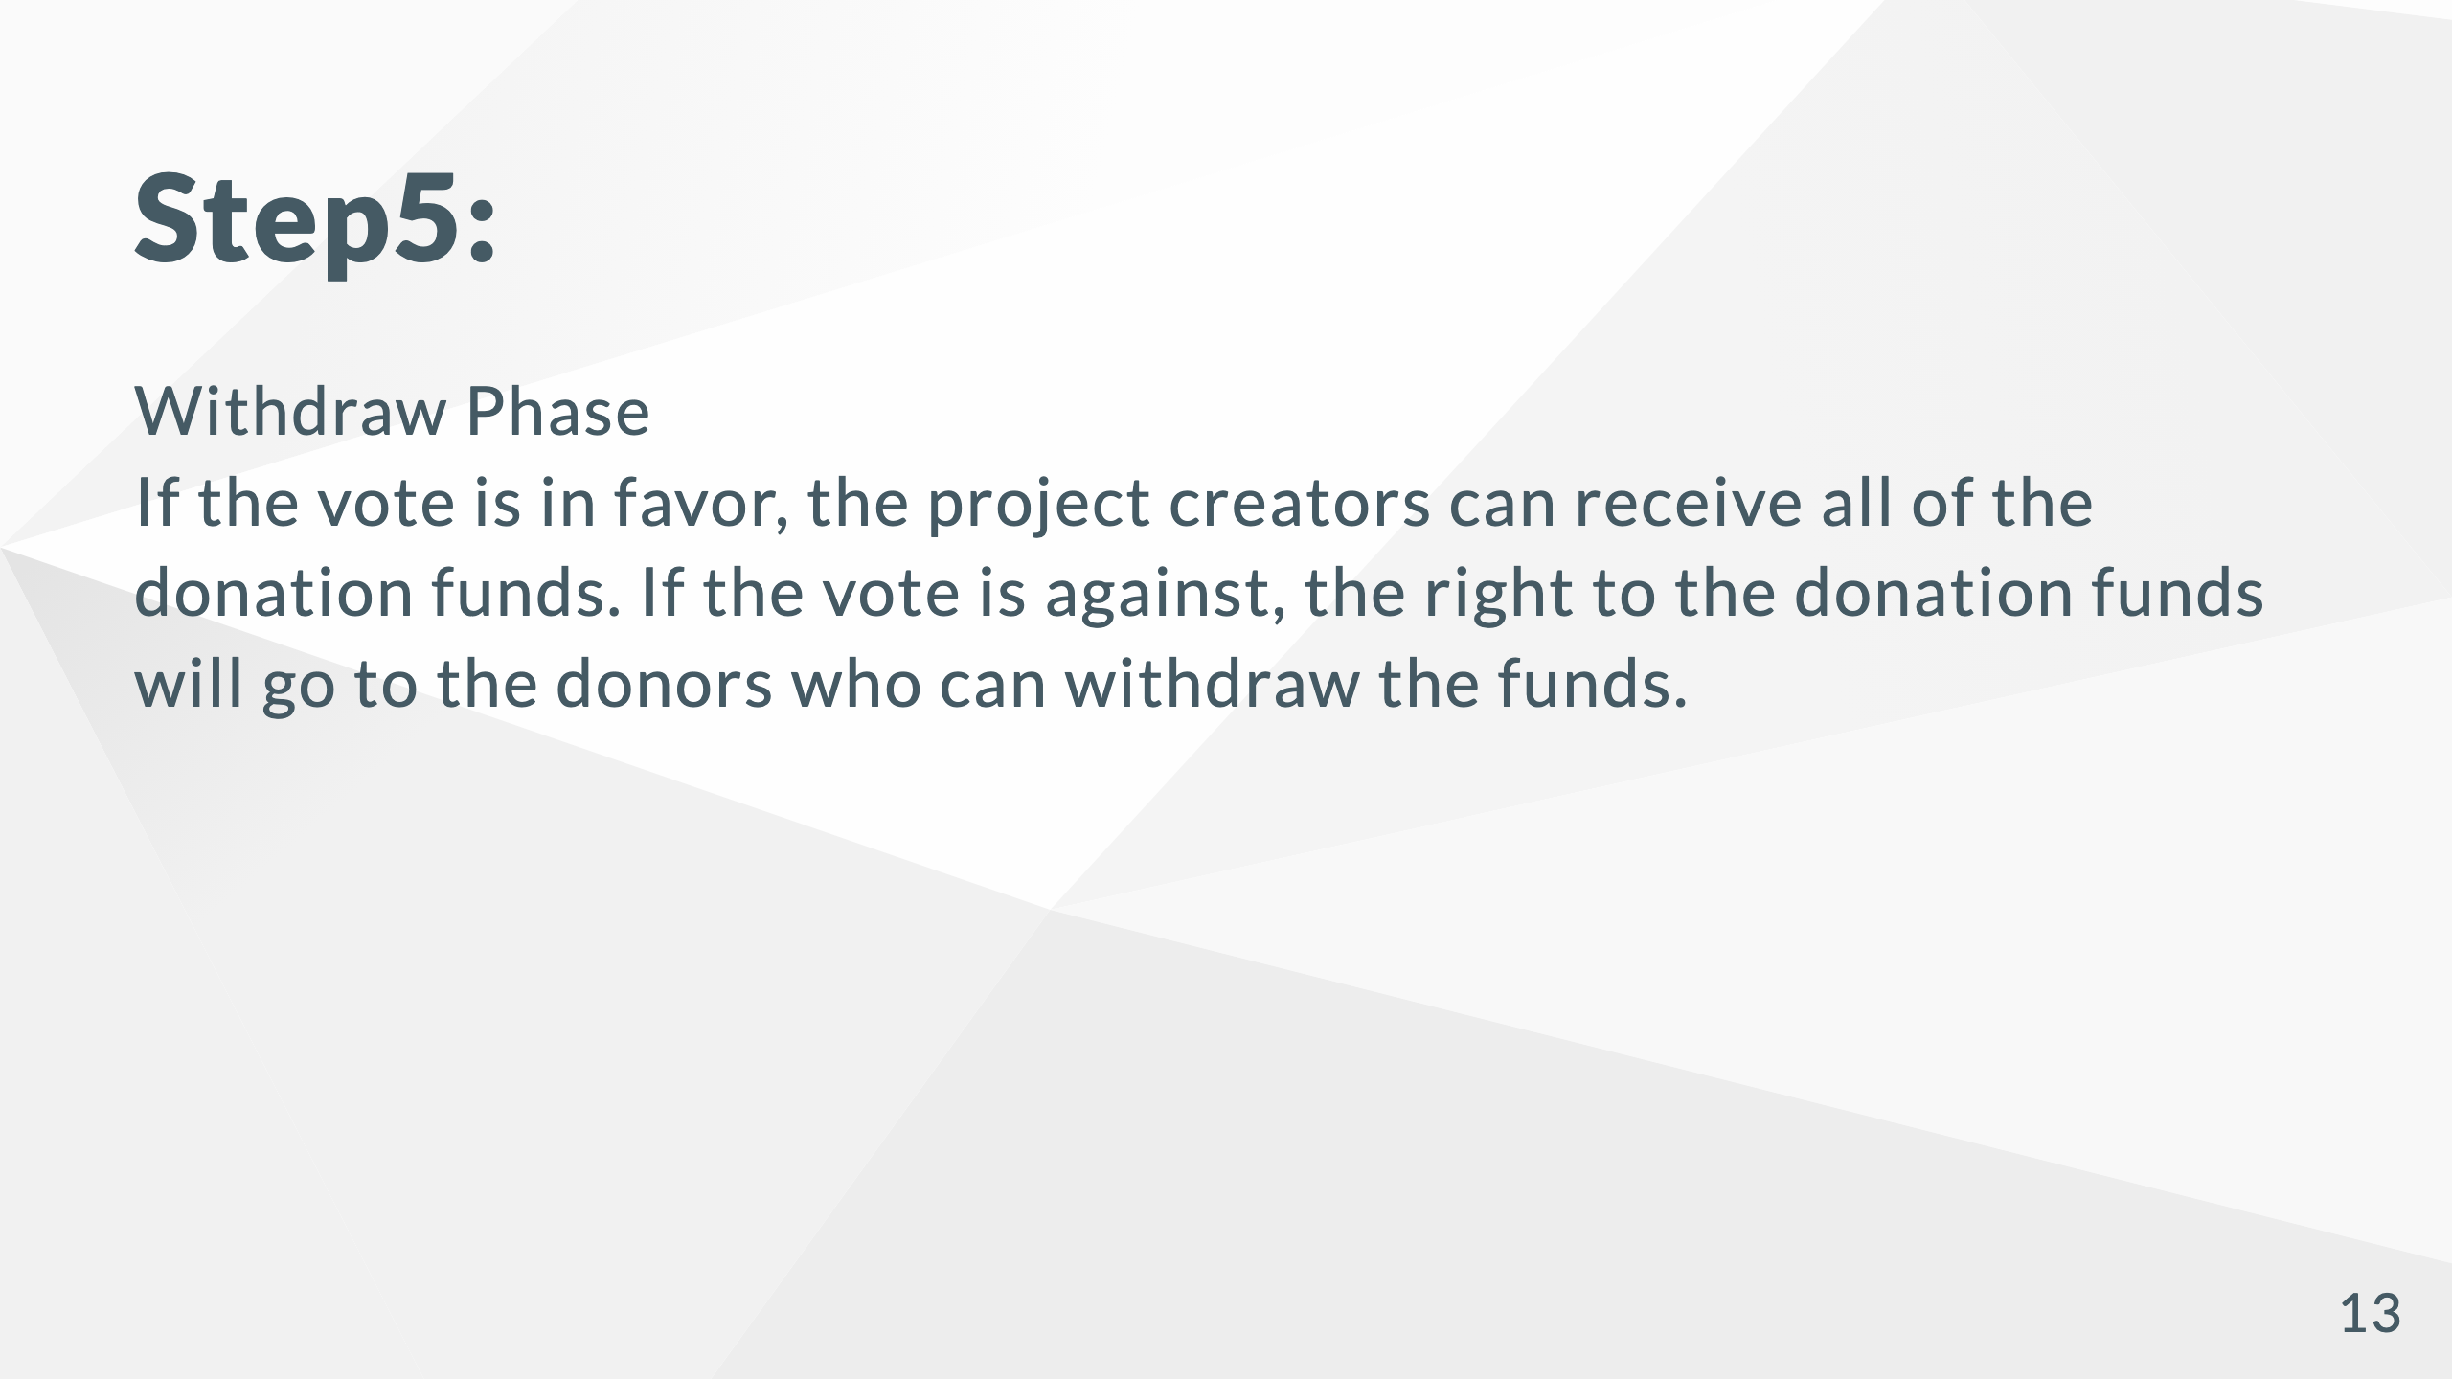

Slide 14


Slide 15
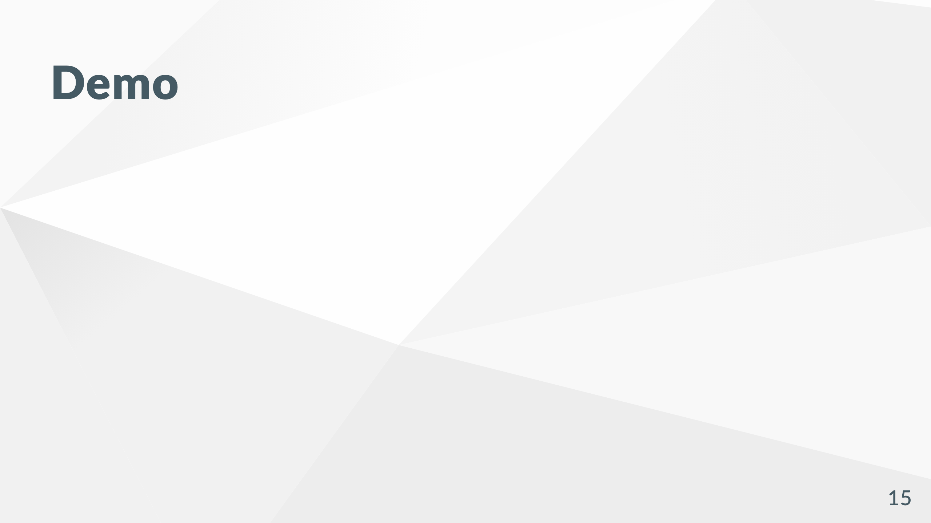

Slide 16
