Slide 1
Project Initialization

Slide 2
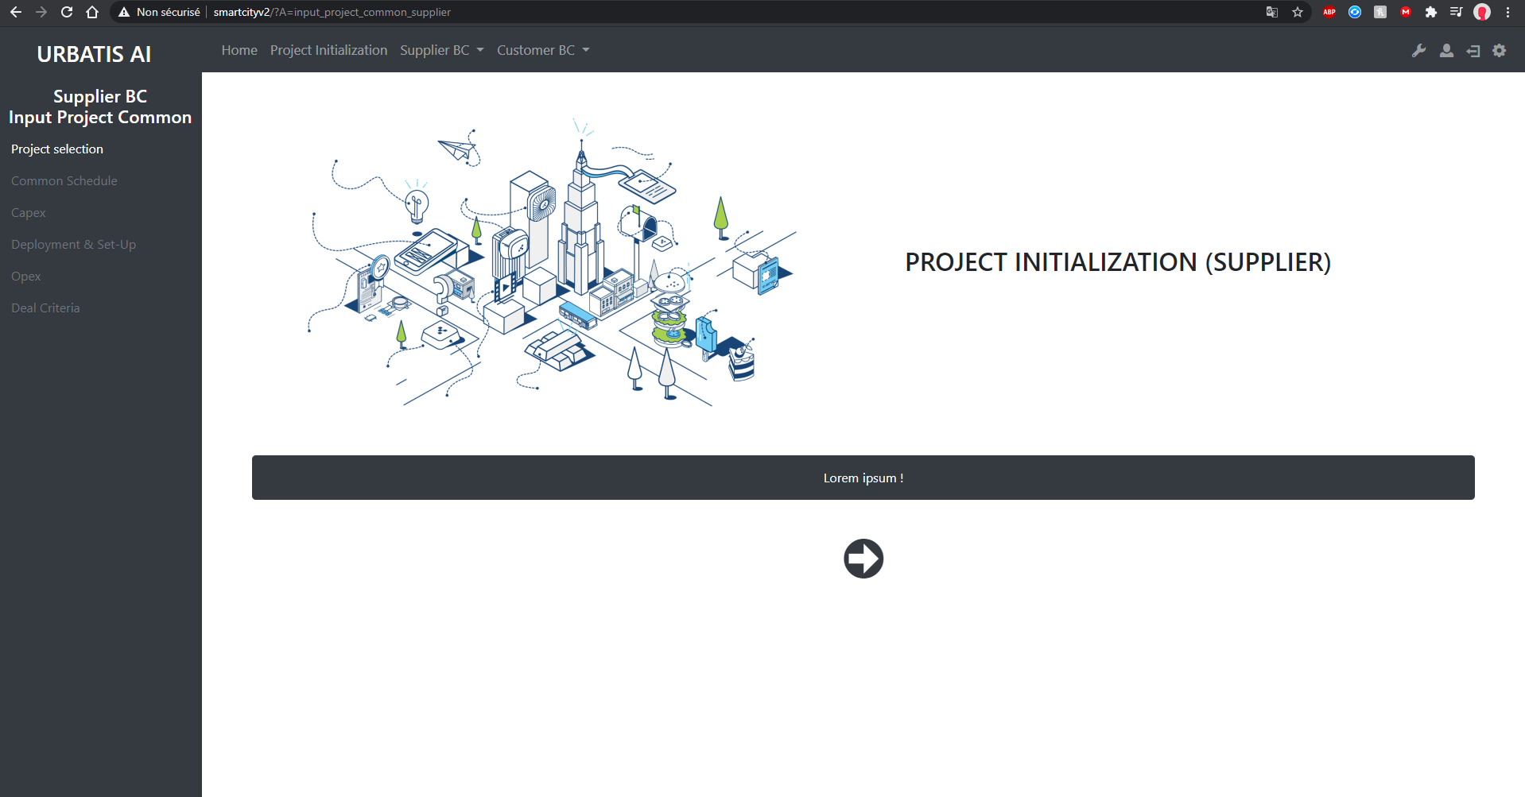
http://smartcityv2/?A=input_project_common_supplier

Slide 3
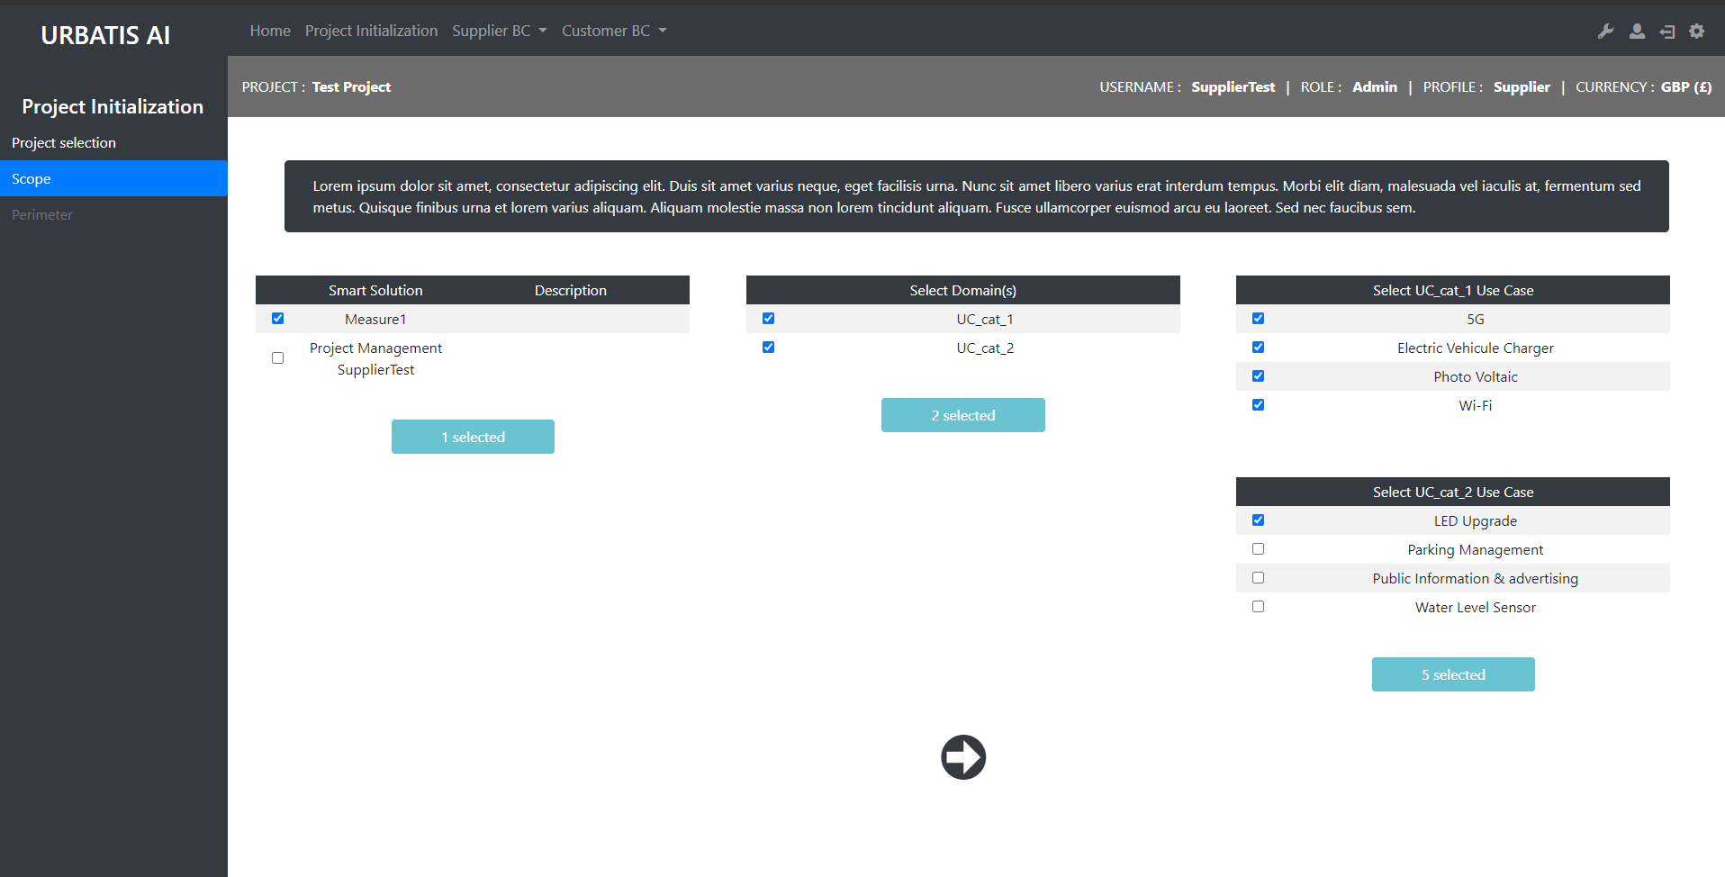
http://smartcityv2/?A=project_sdesign&A2=scope1&projID=21

Slide 4
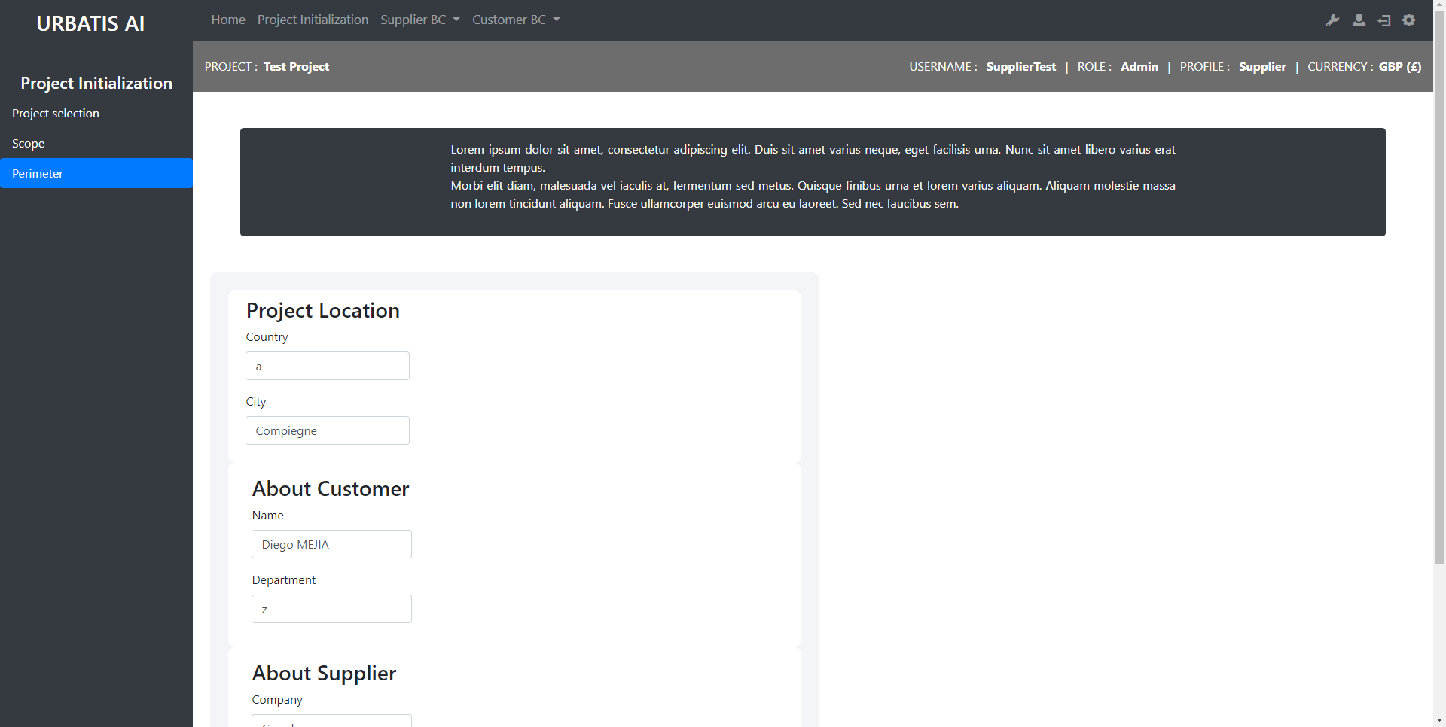
http://smartcityv2/?A=project_sdesign&A2=perimeter1&projID=21

Slide 5
Input Project Common Supplier

Slide 6
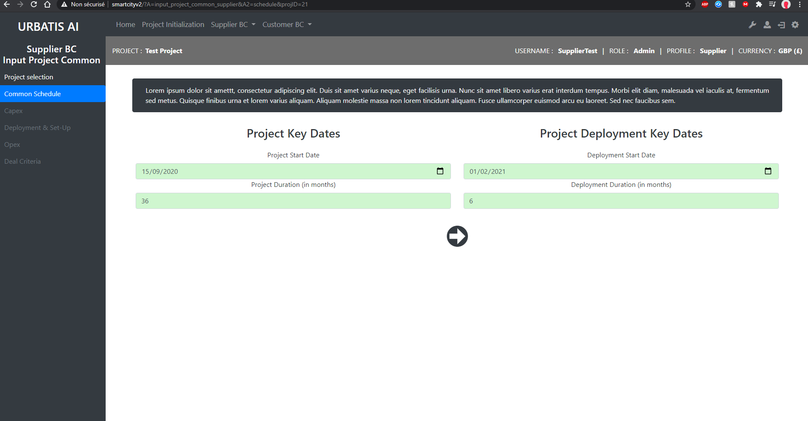
http://smartcityv2/?A=input_project_common_supplier&A2=schedule&projID=21

Slide 7
Input Use Case Supplier

Slide 8
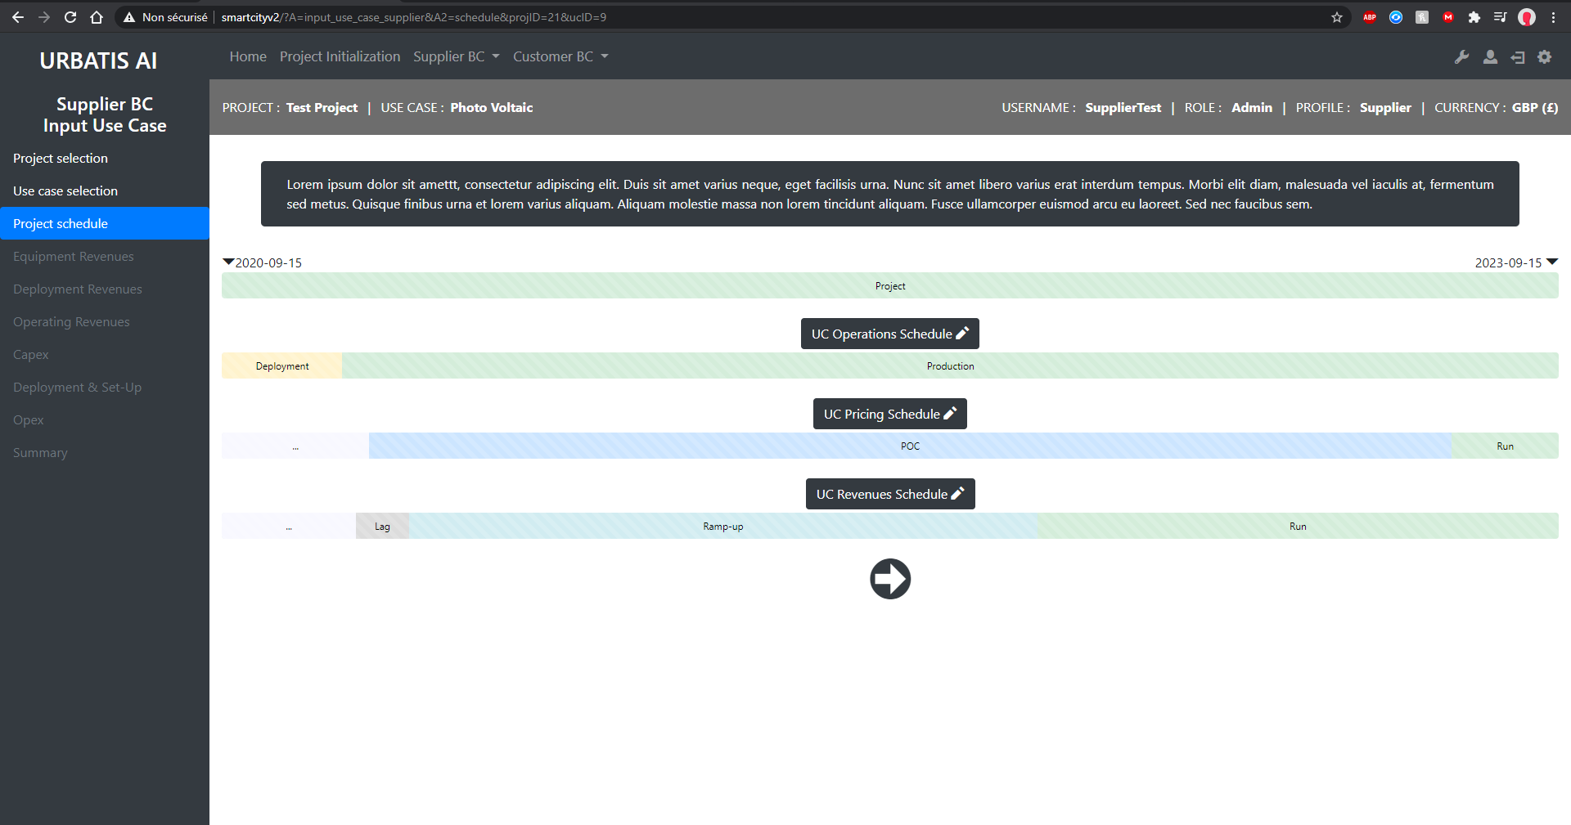
http://smartcityv2/?A=input_use_case_supplier&A2=schedule&projID=21&ucID=9

Slide 9
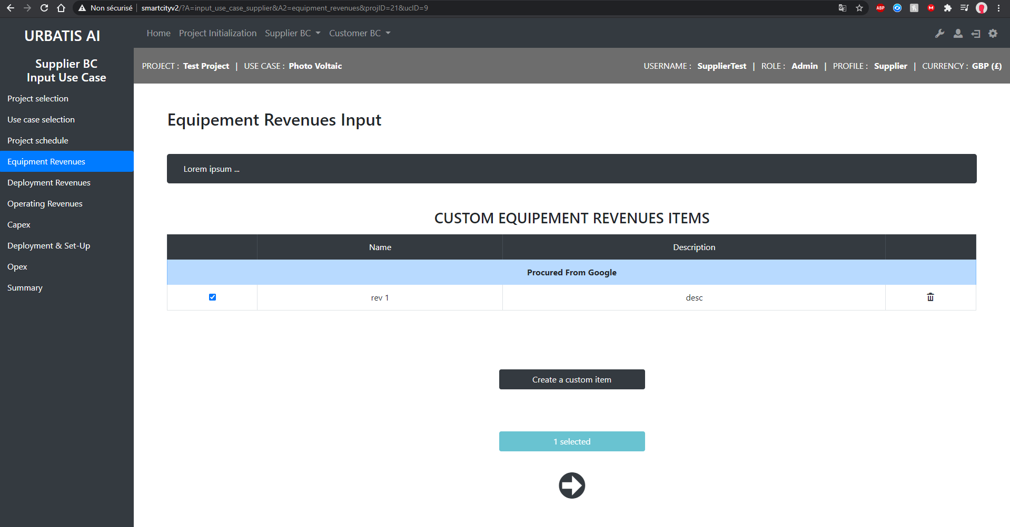
http://smartcityv2/?A=input_use_case_supplier&A2=equipment_revenues&projID=21&ucID=9

Slide 10
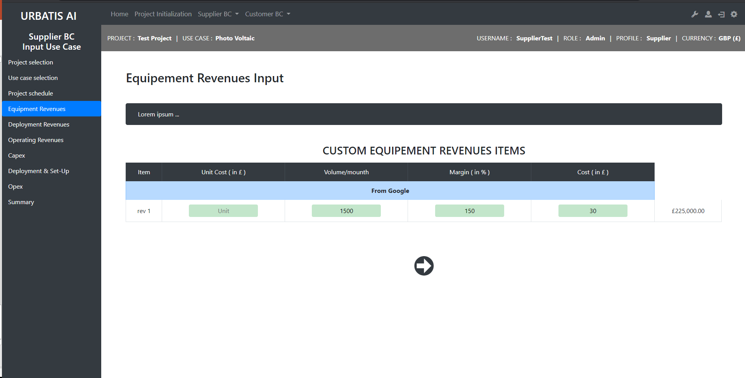
http://smartcityv2/?A=input_use_case_supplier&A2=equipment_revenues&A3=selected&projID=21&ucID=9

Slide 11
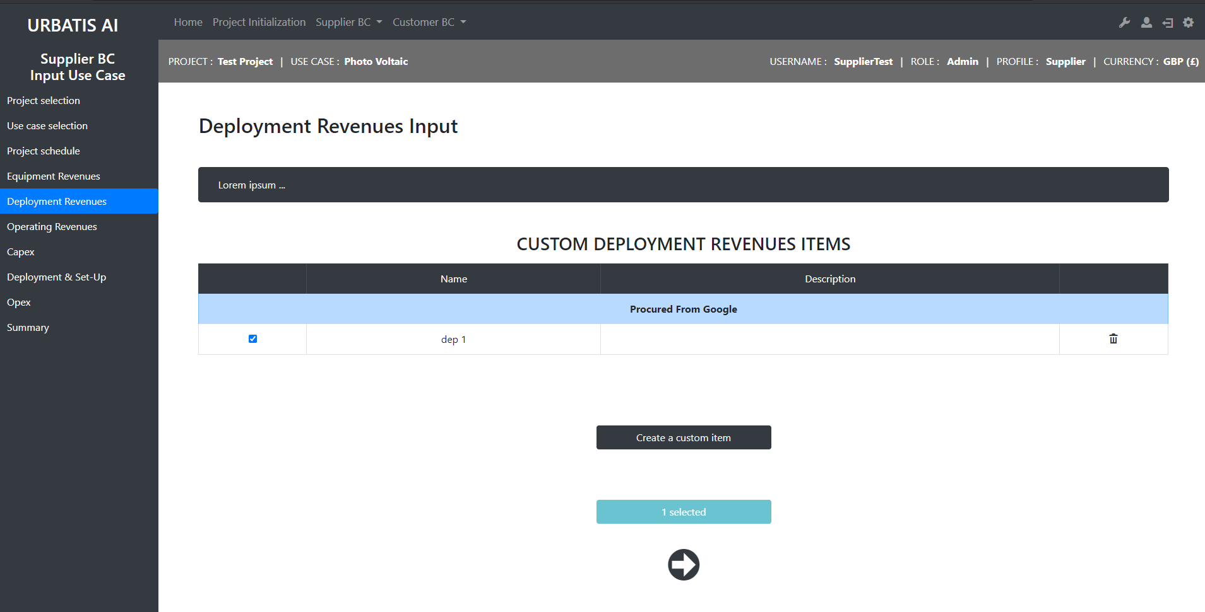
http://smartcityv2/?A=input_use_case_supplier&A2=deployment_revenues&projID=21&ucID=9

Slide 12
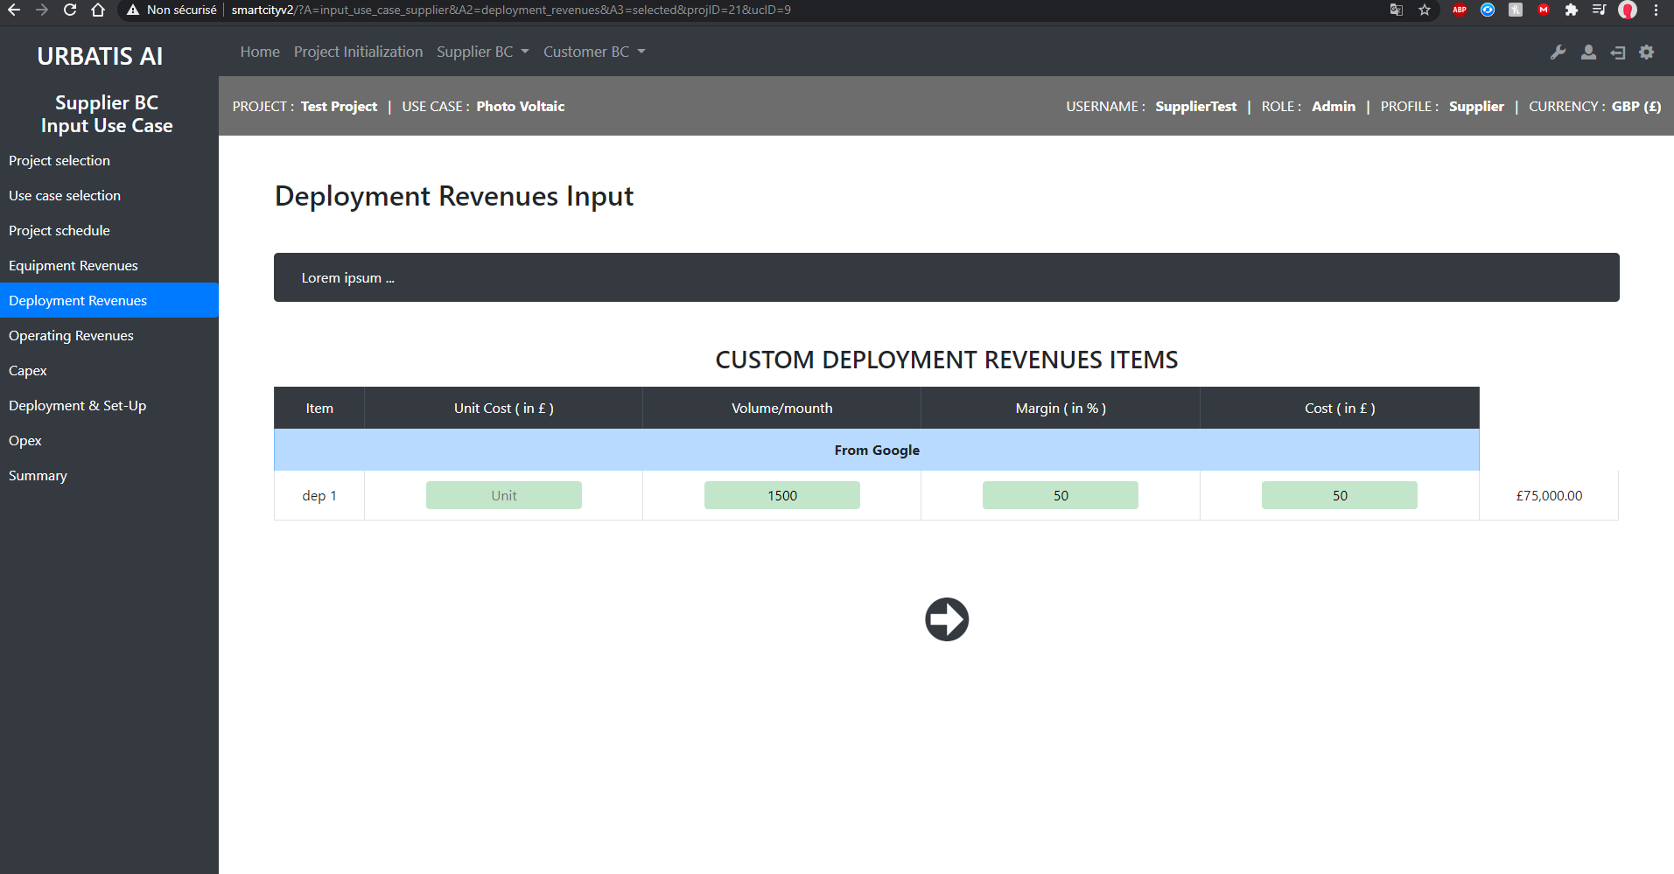
http://smartcityv2/?A=input_use_case_supplier&A2=deployment_revenues&A3=selected&projID=21&ucID=9

Slide 13
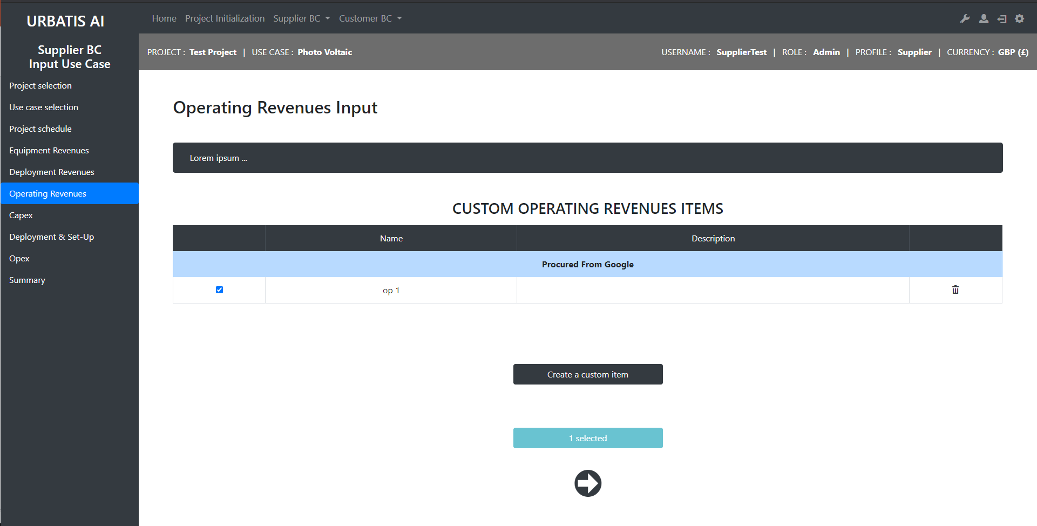
http://smartcityv2/?A=input_use_case_supplier&A2=operating_revenues&projID=21&ucID=9

Slide 14
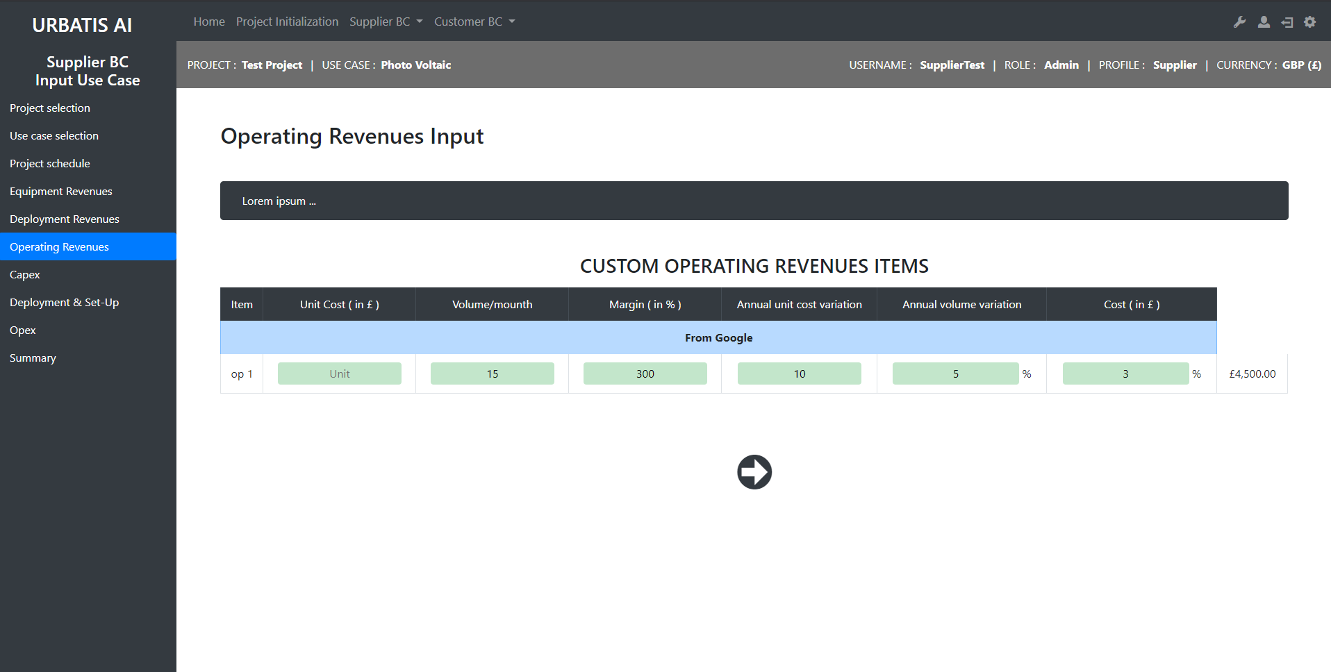
http://smartcityv2/?A=input_use_case_supplier&A2=operating_revenues&A3=selected&projID=21&ucID=9

Slide 15
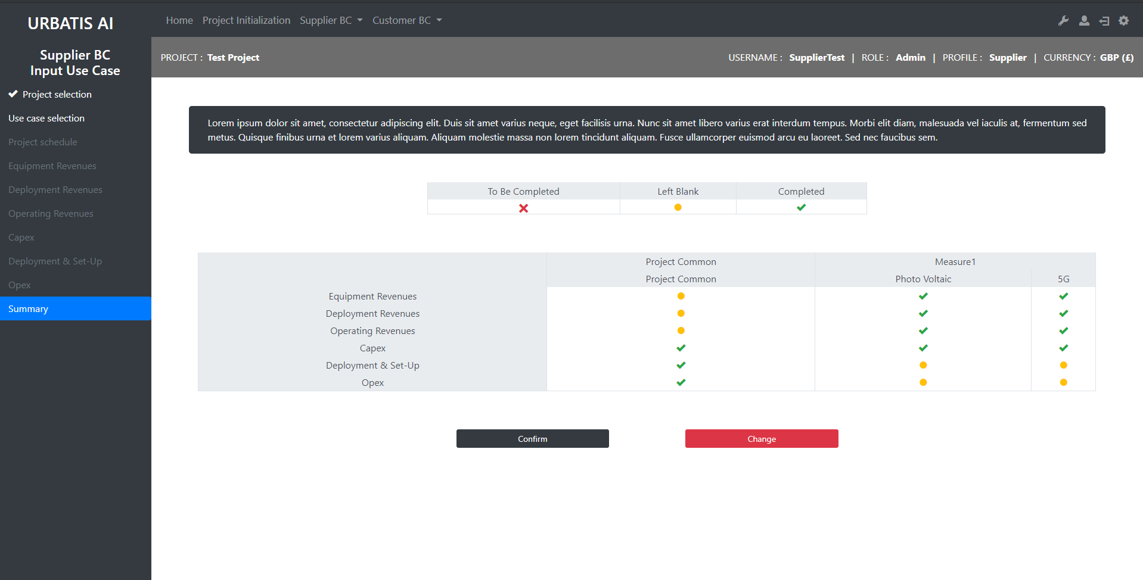
http://smartcityv2/?A=input_use_case_supplier&A2=summary&projID=21

Slide 16
Dashboard Supplier

Slide 17
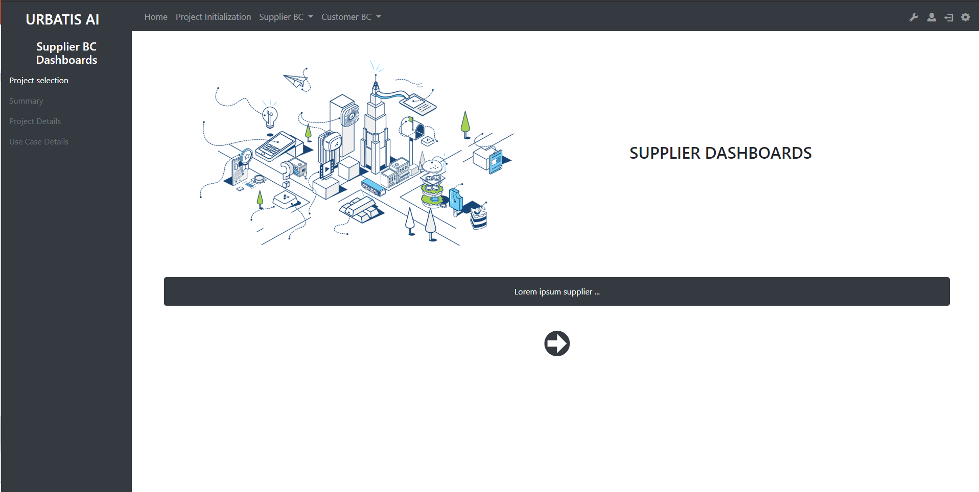
http://smartcityv2/?A=supplier_dashboards

Slide 18
Input Project Common Customer

Slide 19
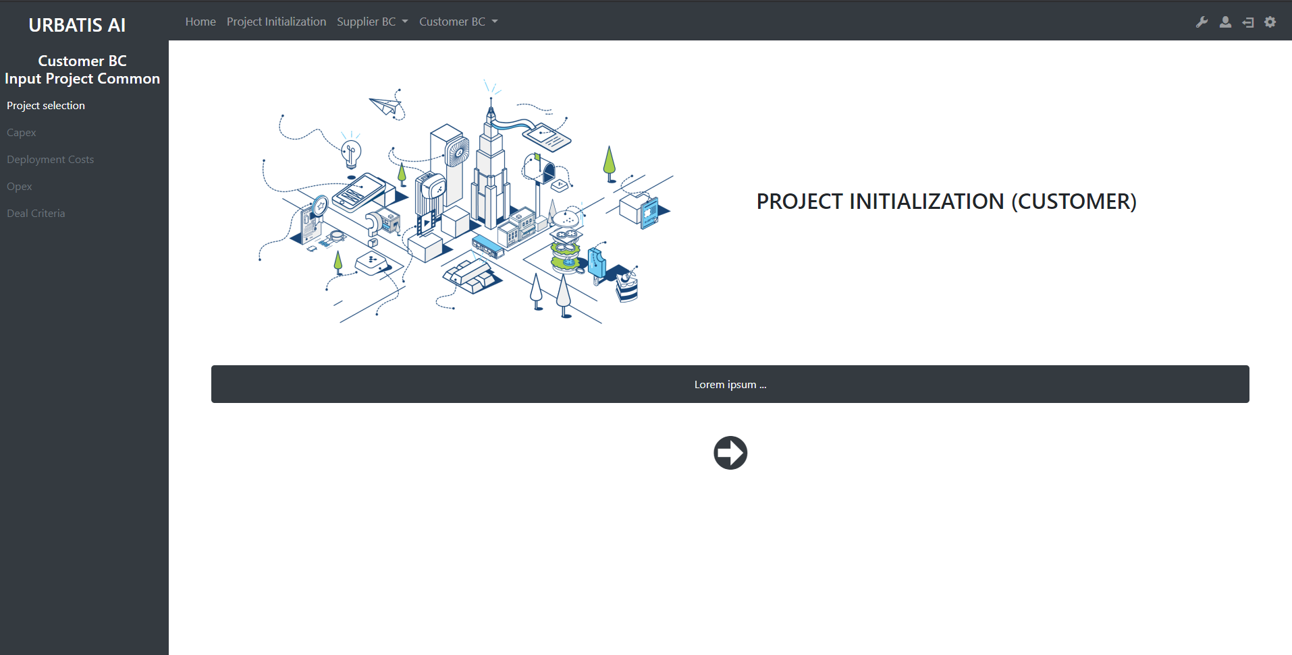
http://smartcityv2/?A=input_project_common

Slide 20
Input Use Case Customer

Slide 21
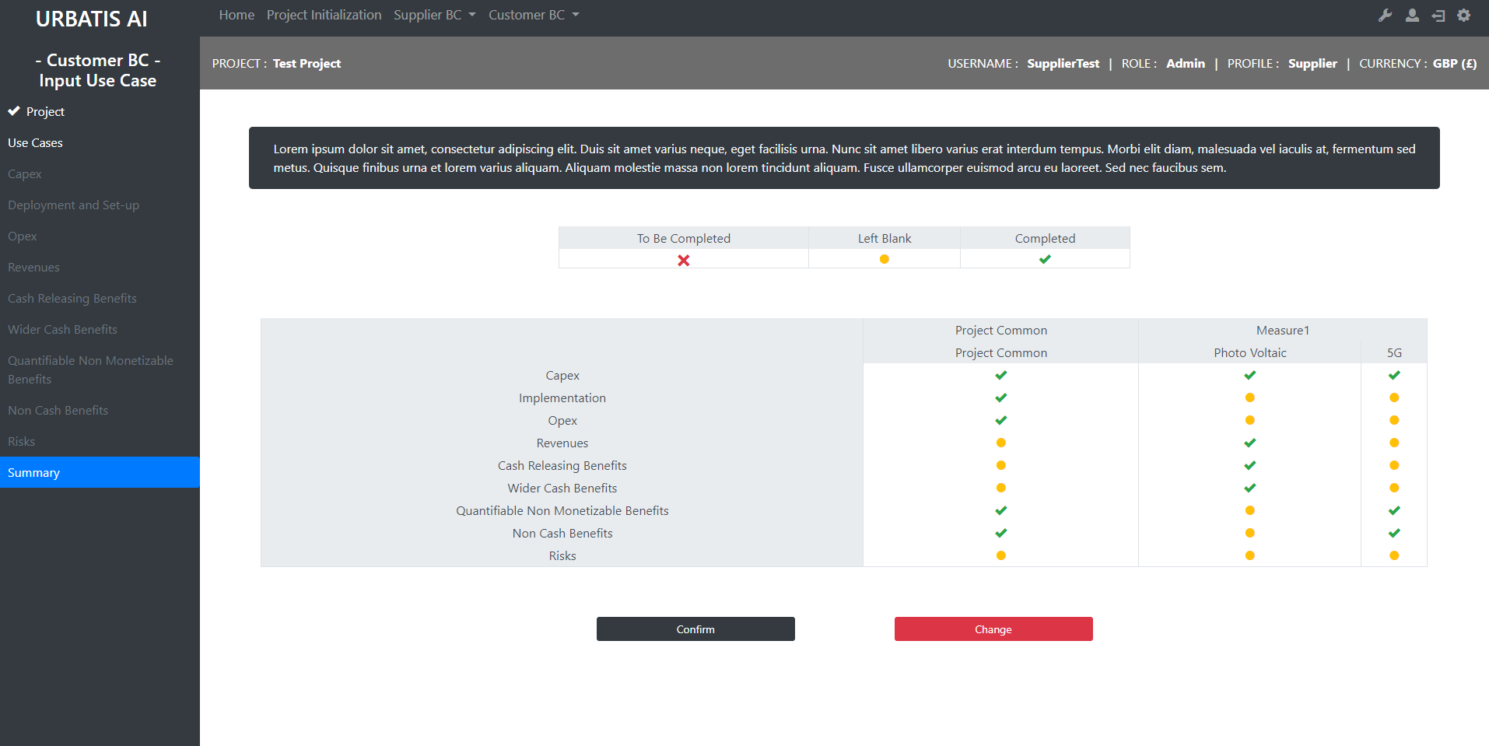
http://smartcityv2/?A=cost_benefits&A2=summary&projID=21

Slide 22
Dashboard Costumer

Slide 23
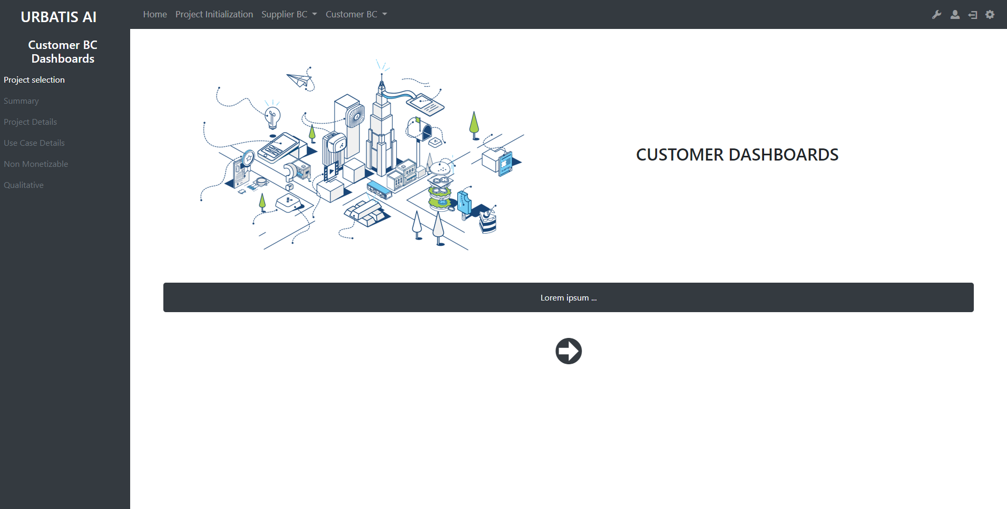
http://smartcityv2/?A=customer_dashboards

