Slide 1
Project Initialization

Slide 2
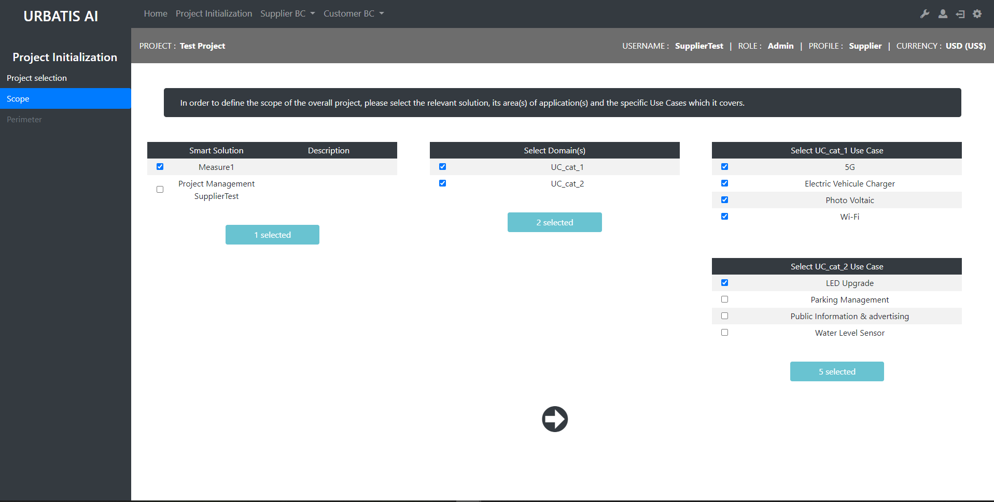
http://smartcityv2/?A=project_sdesign&A2=scope1&projID=21

Slide 3
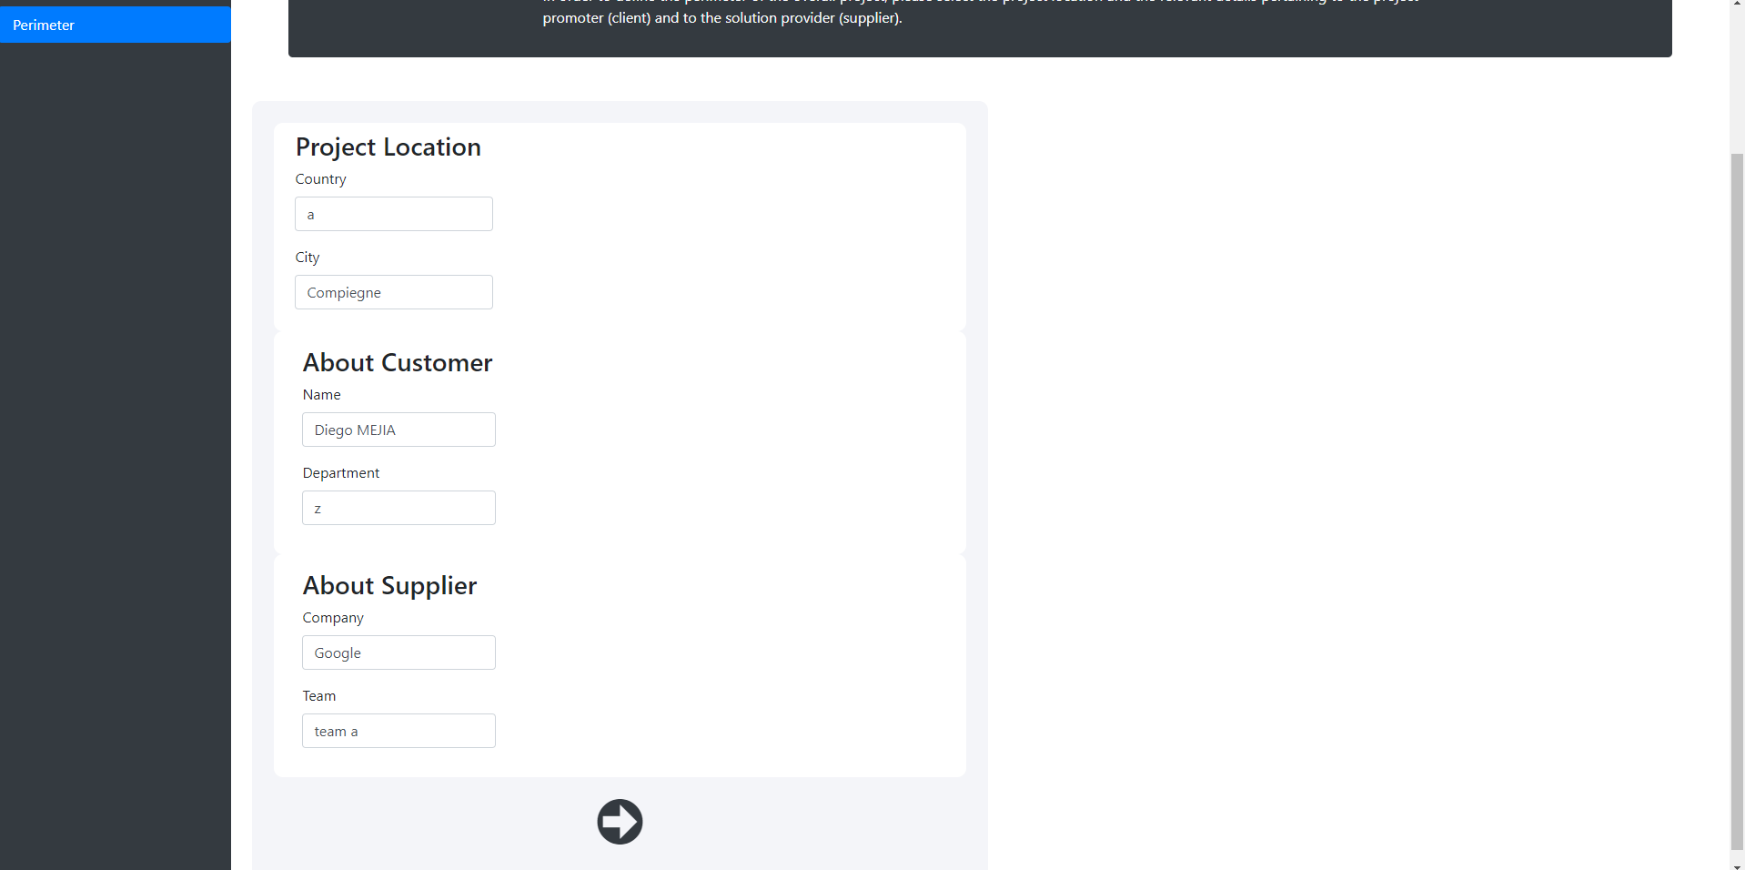
http://smartcityv2/?A=project_sdesign&A2=perimeter1&projID=21

Slide 4
Supplier : Input Project Common

Slide 5
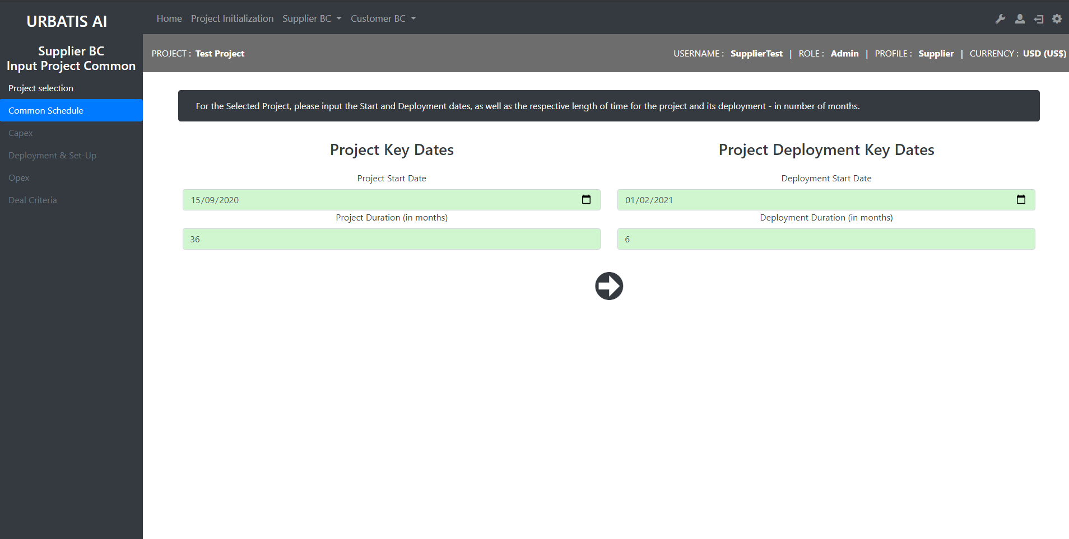
http://smartcityv2/?A=input_project_common_supplier&A2=schedule&projID=21

Slide 6
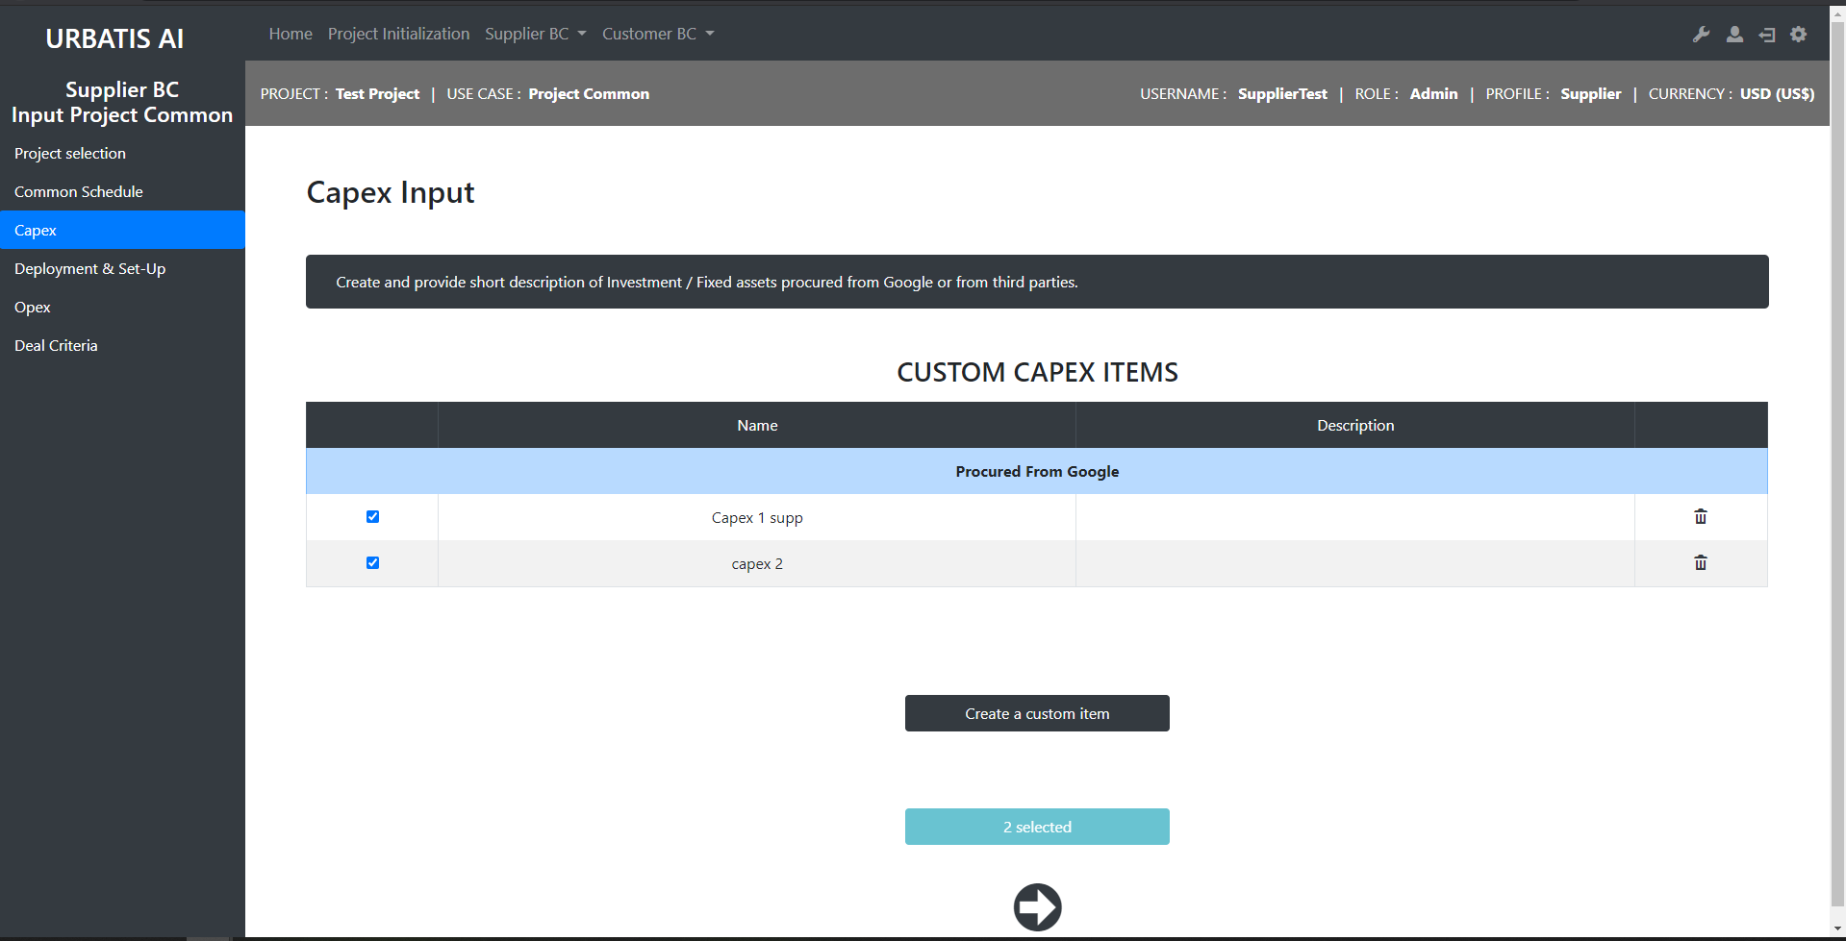
http://smartcityv2/?A=input_project_common_supplier&A2=capex&projID=0

Slide 7
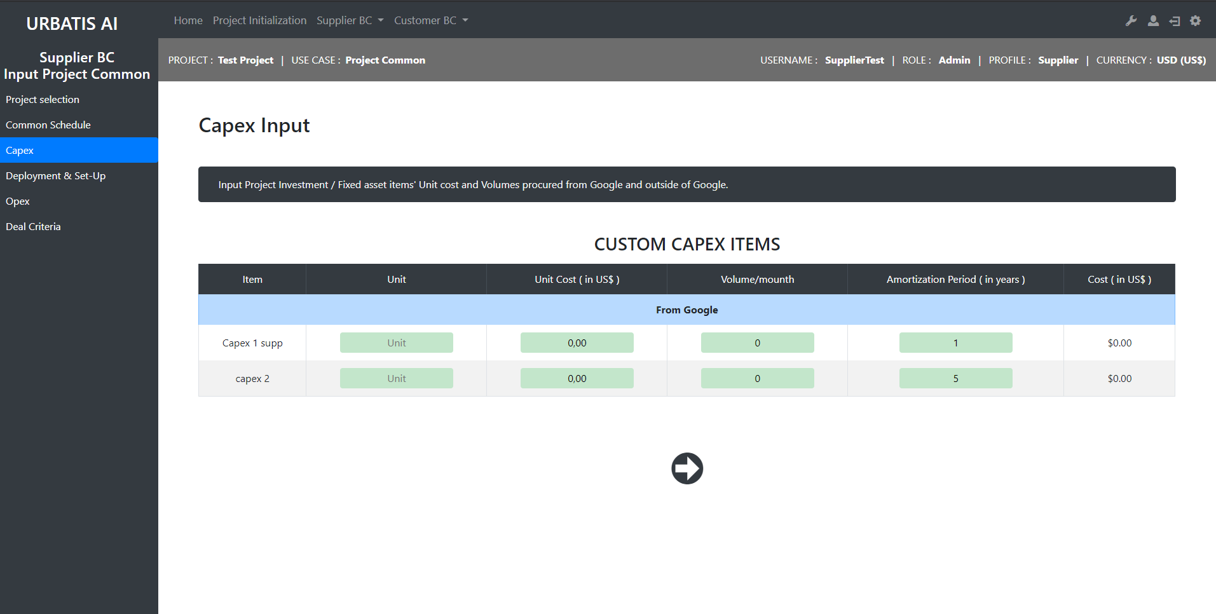
http://smartcityv2/?A=input_project_common_supplier&A2=capex&A3=selected&projID=21&ucID=-1

Slide 8
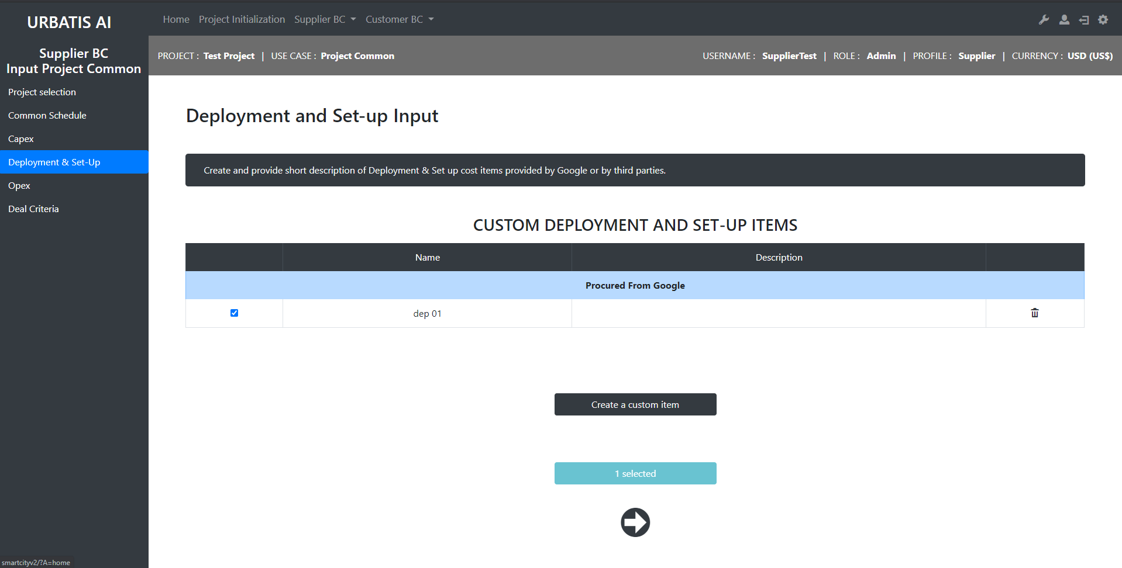
http://smartcityv2/?A=input_project_common_supplier&A2=deployment_costs&projID=21

Slide 9
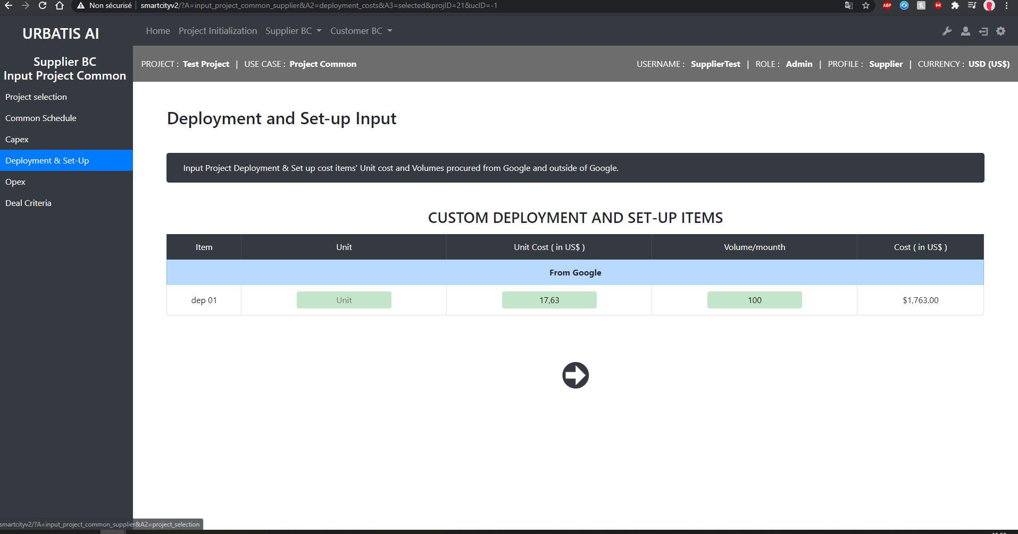
http://smartcityv2/?A=input_project_common_supplier&A2=deployment_costs&A3=selected&projID=21&ucID=-1

Slide 10
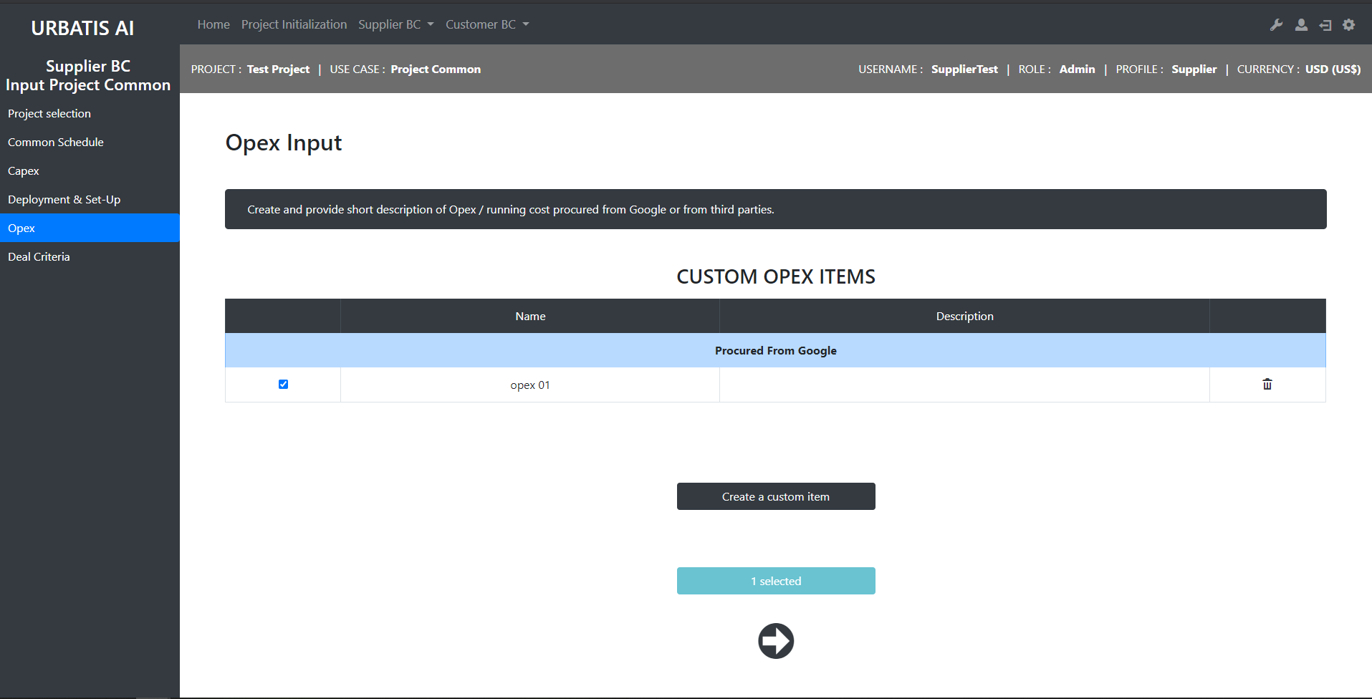
http://smartcityv2/?A=input_project_common_supplier&A2=opex&projID=21

Slide 11
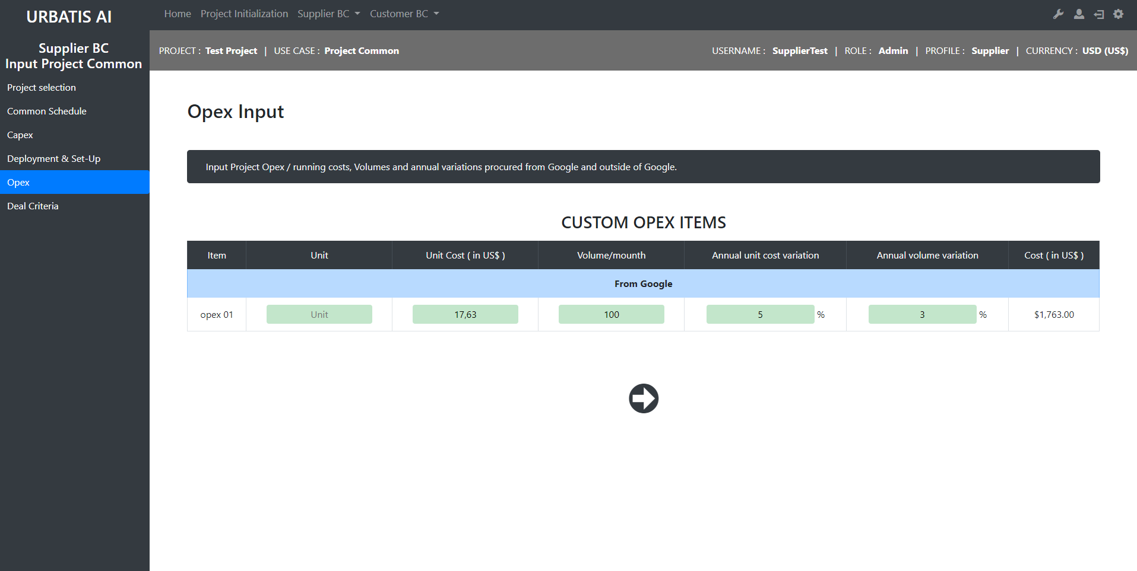
http://smartcityv2/?A=input_project_common_supplier&A2=opex&A3=selected&projID=21&ucID=-1

Slide 12
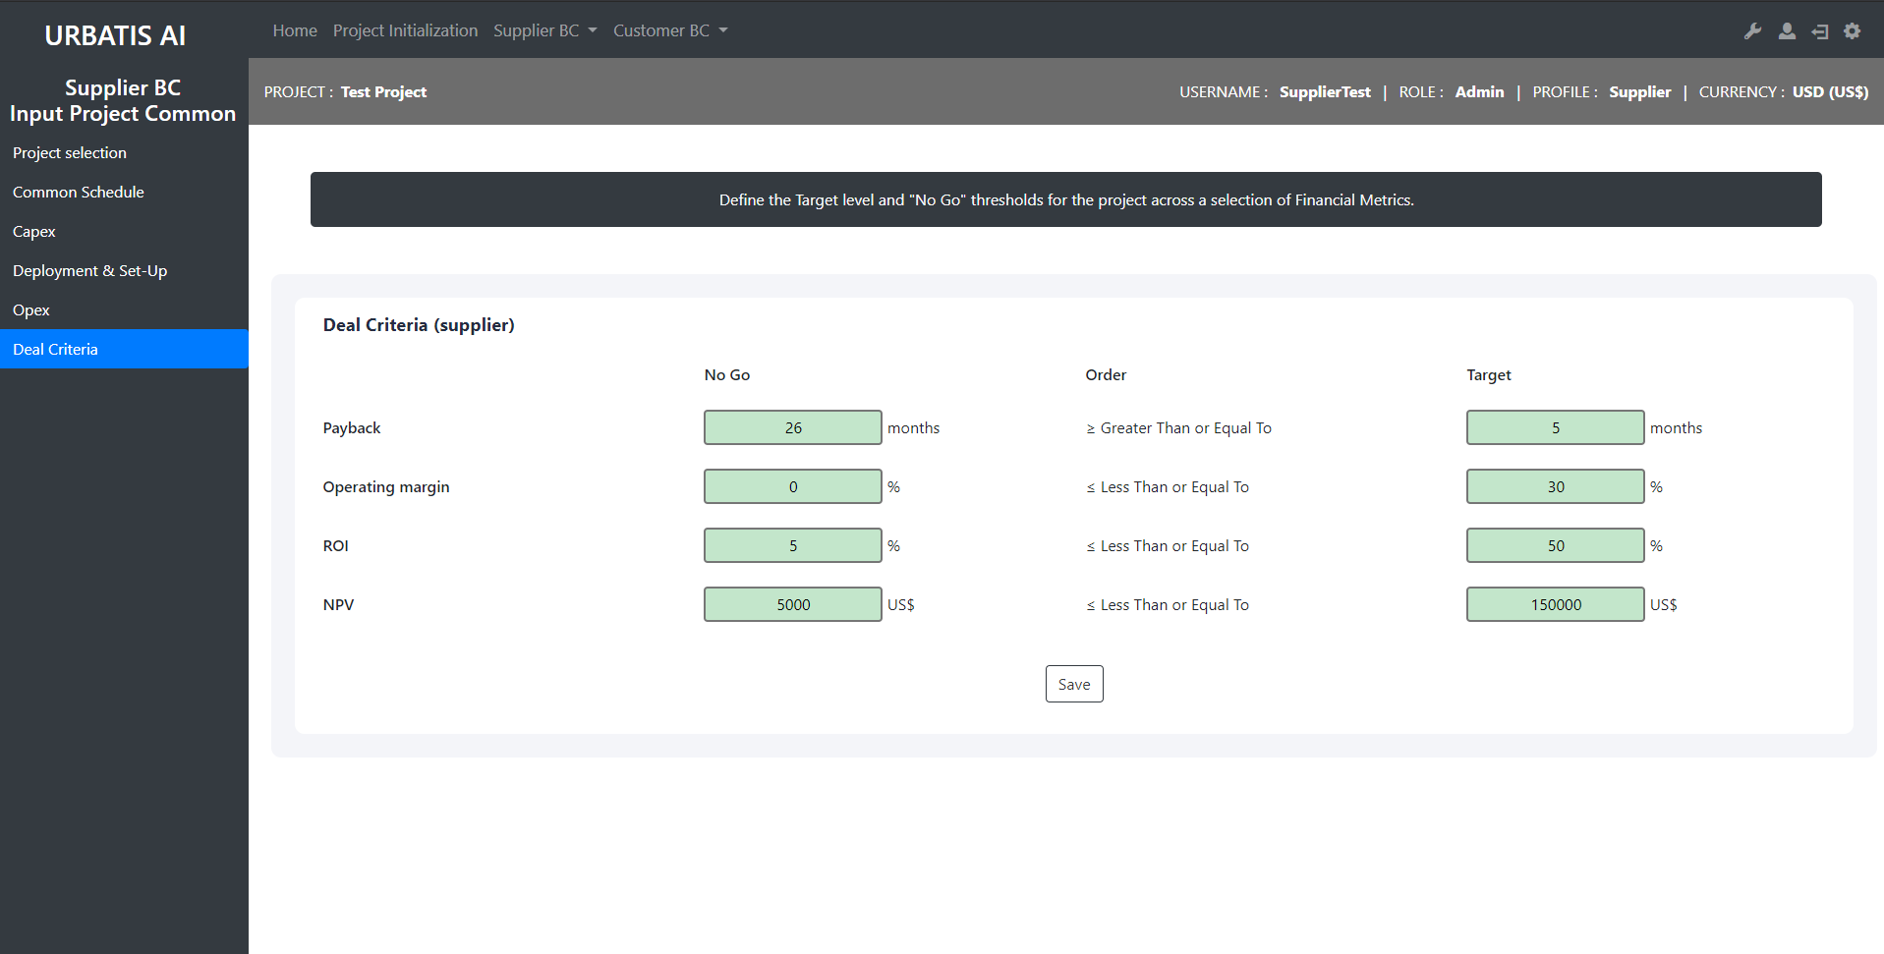
http://smartcityv2/?A=input_project_common_supplier&A2=deal_criteria&projID=21

Slide 13
Supplier : Input Use Case

Slide 14
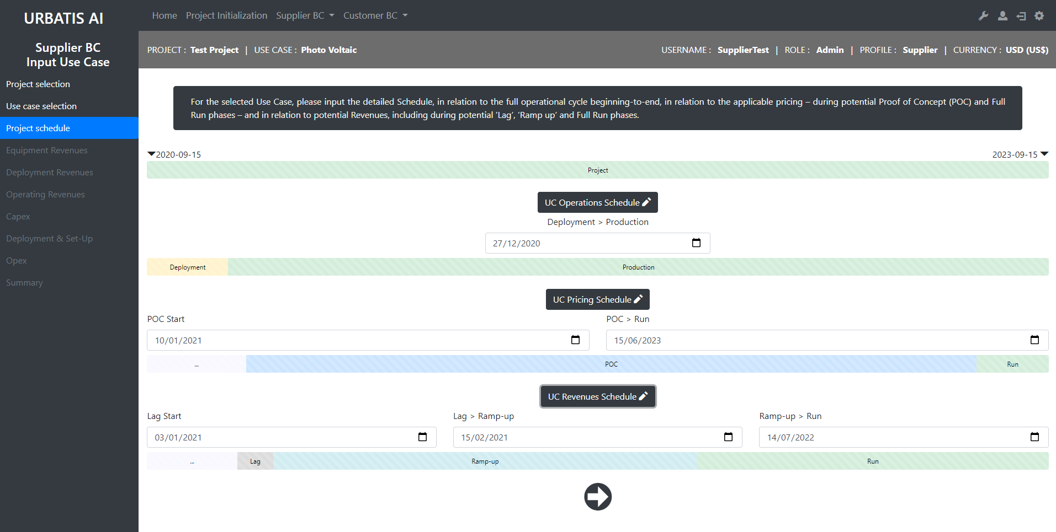
http://smartcityv2/?A=input_use_case_supplier&A2=schedule&projID=21&ucID=9

Slide 15
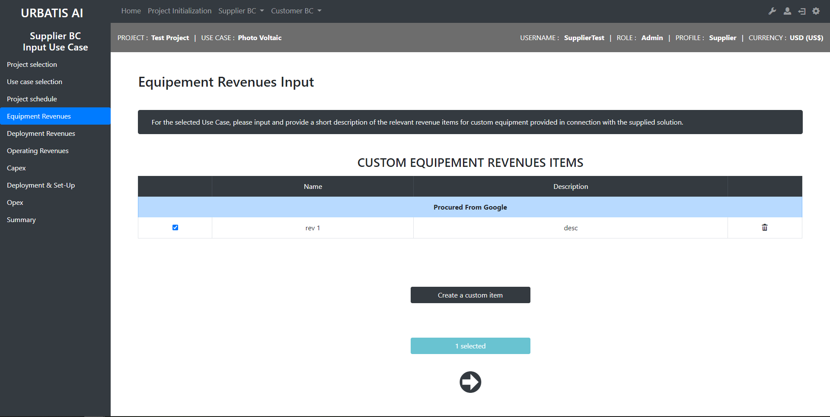

Slide 16
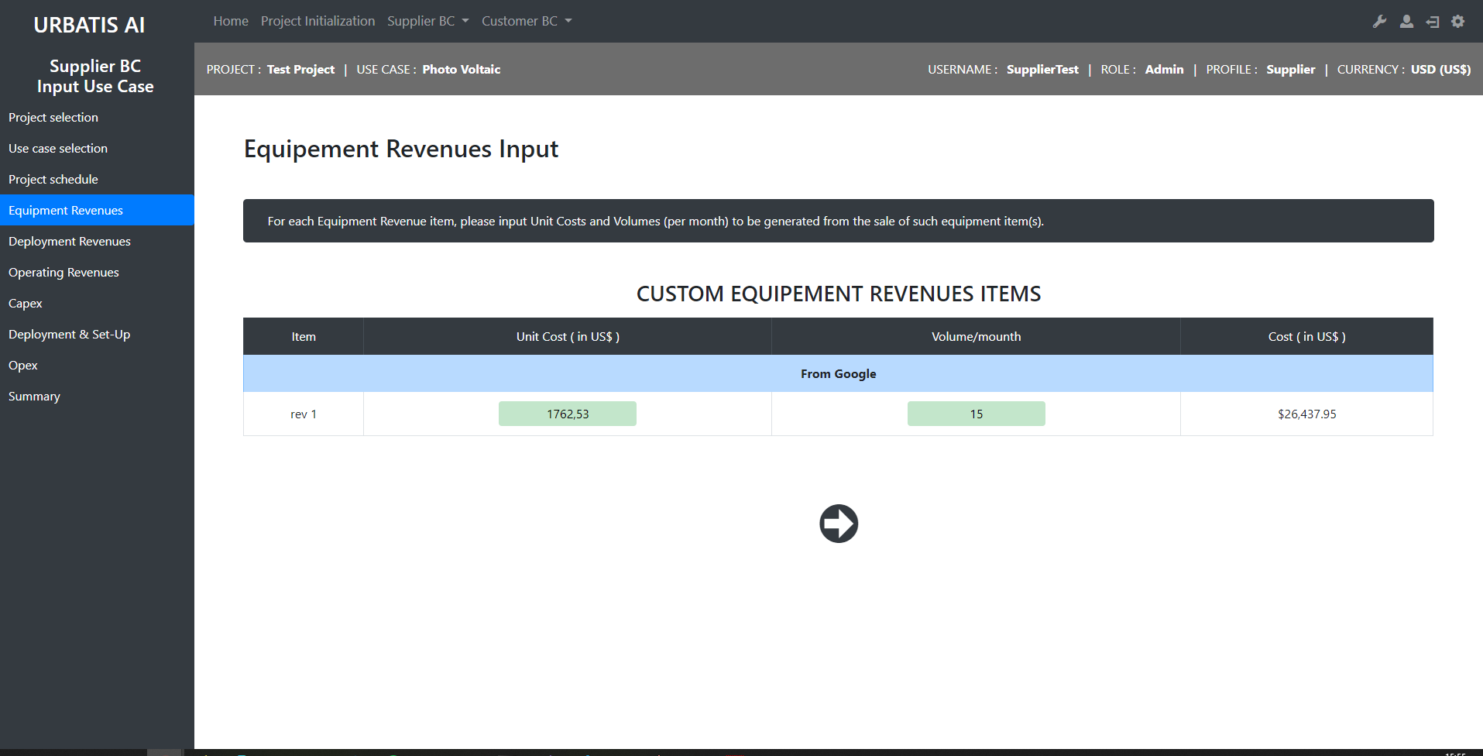
http://smartcityv2/?A=input_use_case_supplier&A2=equipment_revenues&A3=selected&projID=21&ucID=9

Slide 17

http://smartcityv2/?A=input_use_case_supplier&A2=deployment_revenues&projID=21&ucID=9

Slide 18
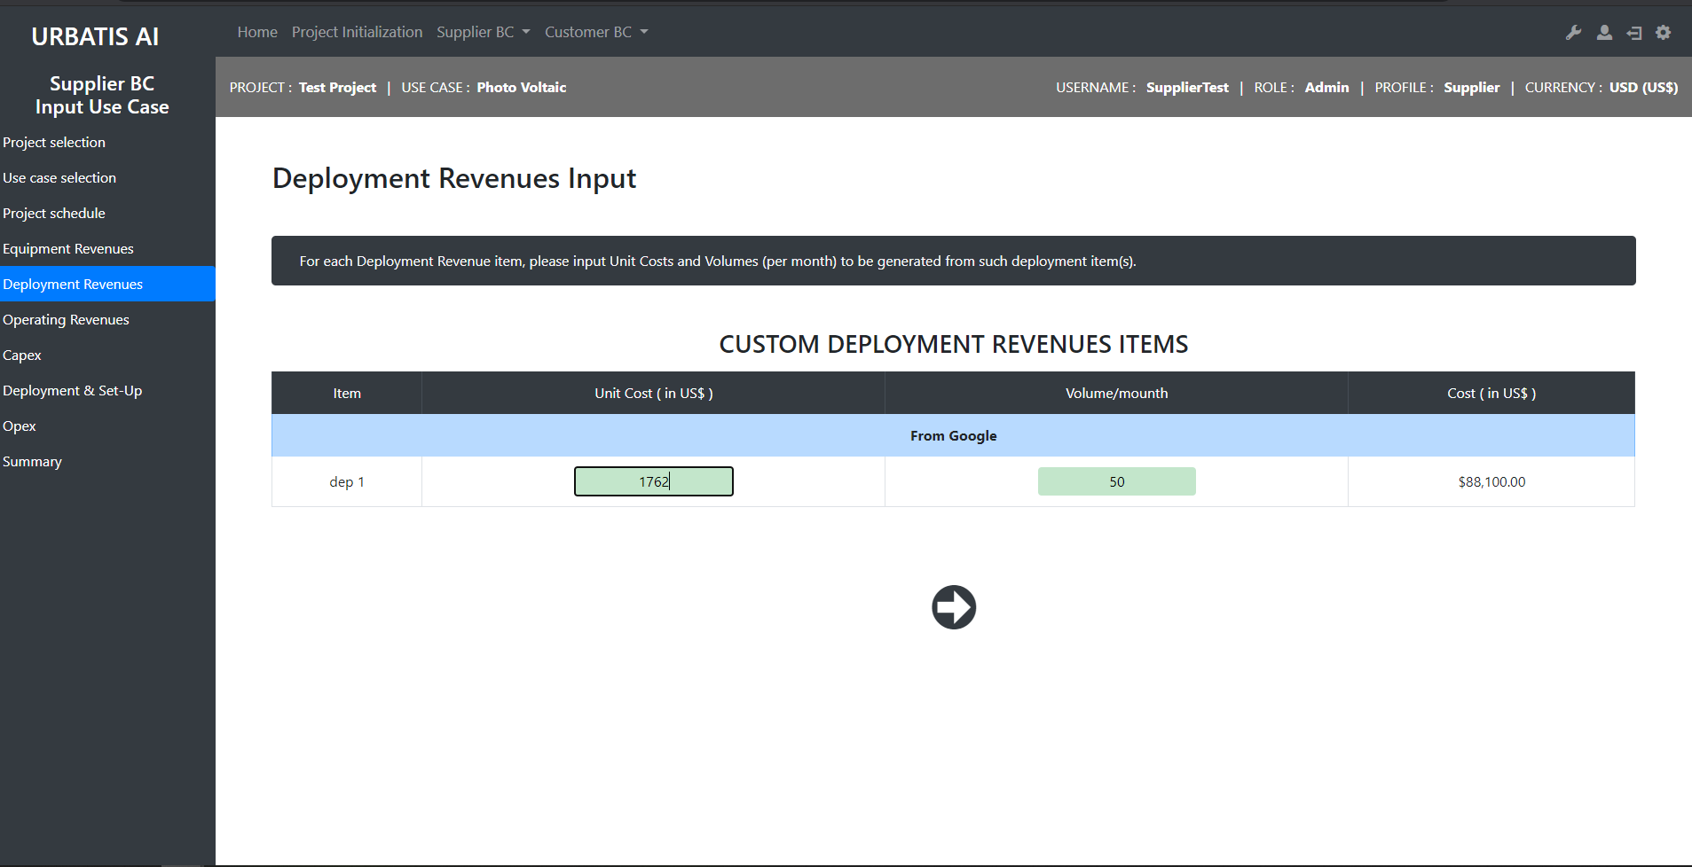
http://smartcityv2/?A=input_use_case_supplier&A2=deployment_revenues&A3=selected&projID=21&ucID=9

Slide 19
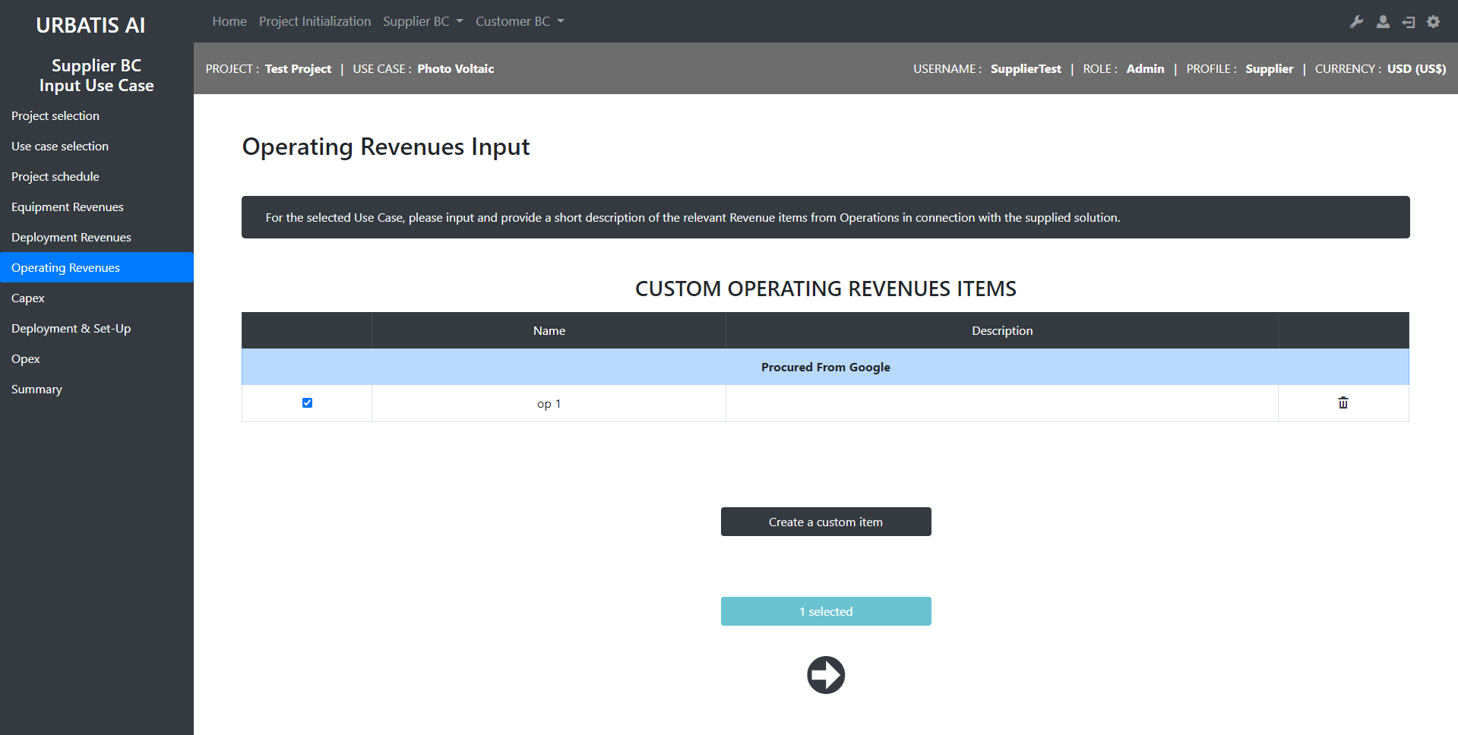
http://smartcityv2/?A=input_use_case_supplier&A2=operating_revenues&projID=21&ucID=9

Slide 20
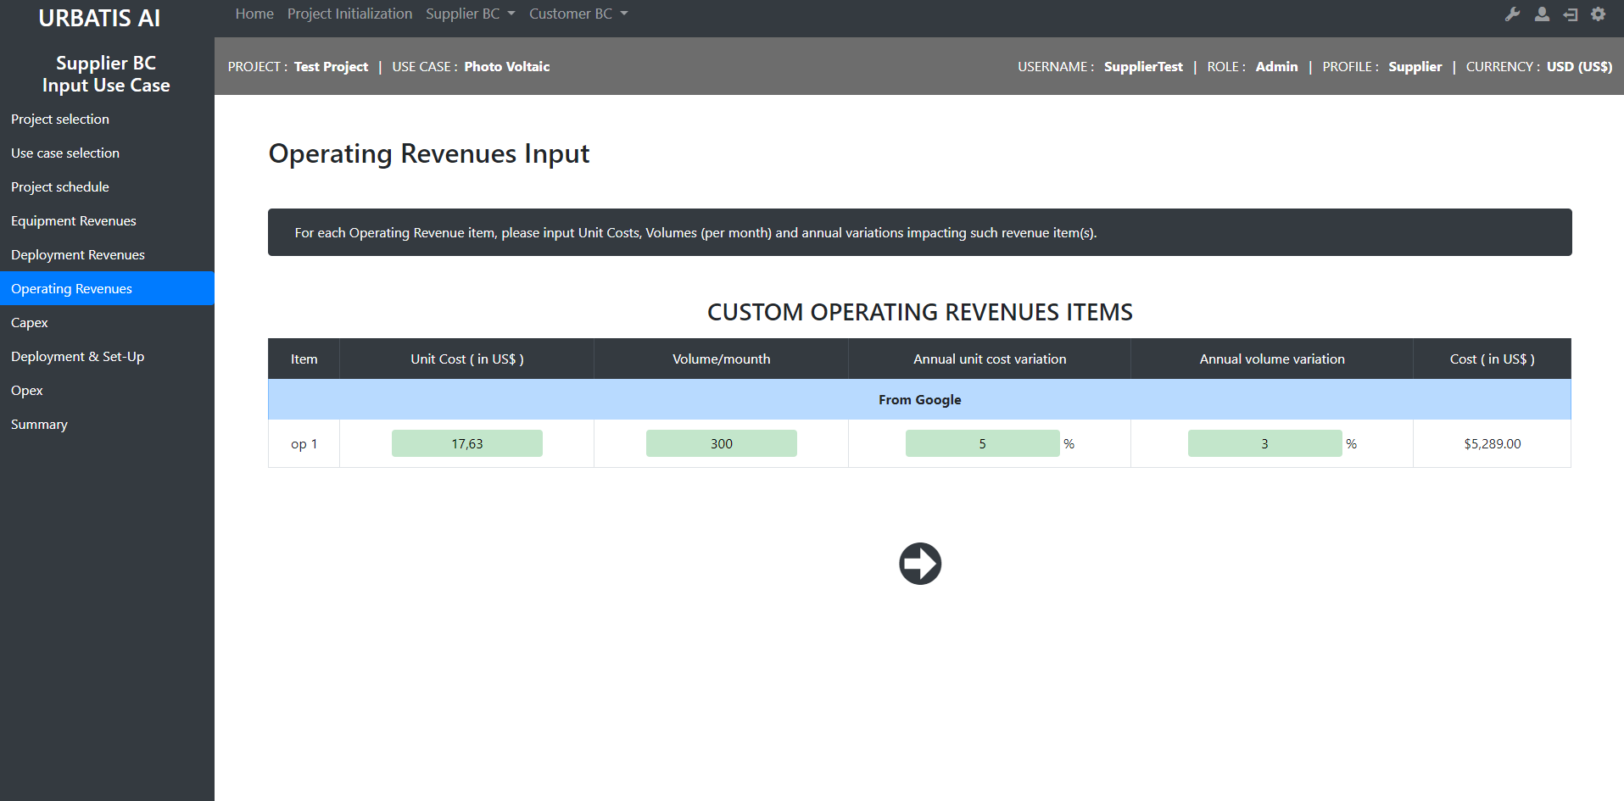
http://smartcityv2/?A=input_use_case_supplier&A2=operating_revenues&A3=selected&projID=21&ucID=9

Slide 21

http://smartcityv2/?A=input_use_case_supplier&A2=capex&projID=21&ucID=9

Slide 22
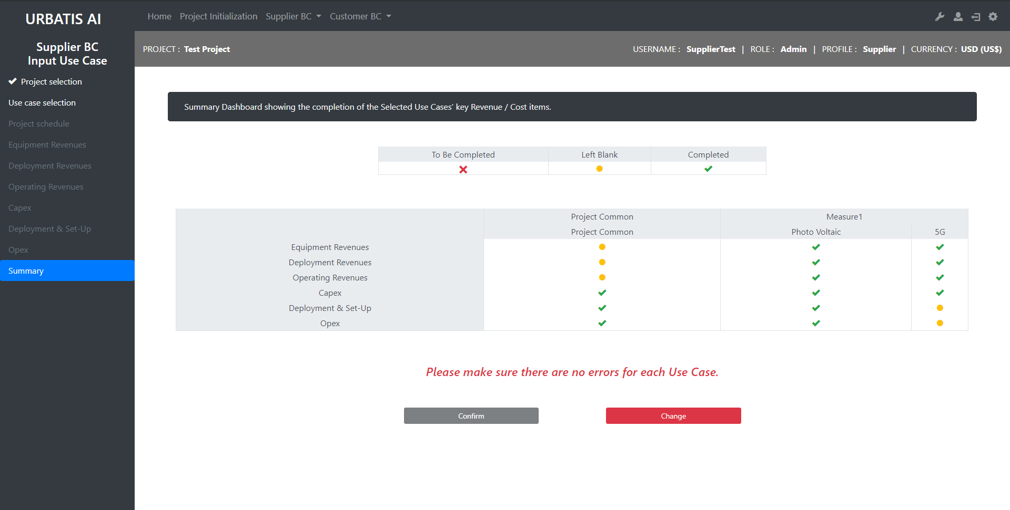
http://smartcityv2/?A=input_use_case_supplier&A2=summary&projID=21

Slide 23
Supplier : Dashboards

Slide 24
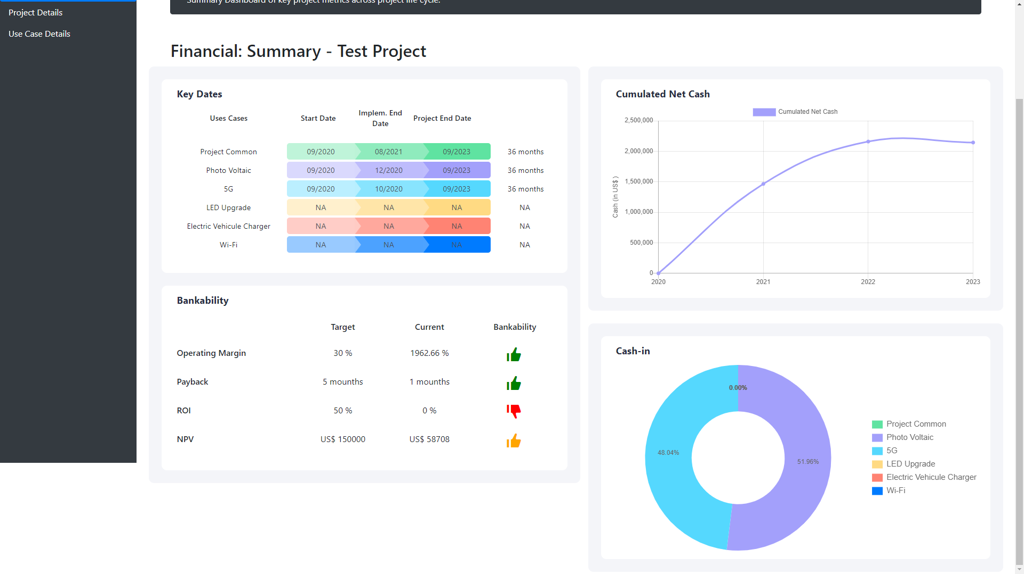
http://smartcityv2/?A=supplier_dashboards&A2=summary&projID=21

Slide 25
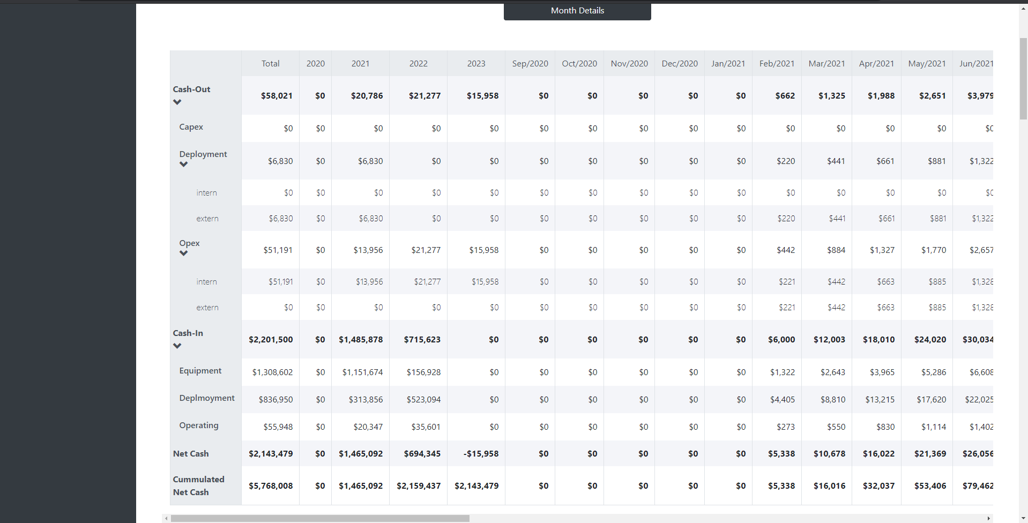
http://smartcityv2/?A=supplier_dashboards&A2=project_details&projID=21

Slide 26
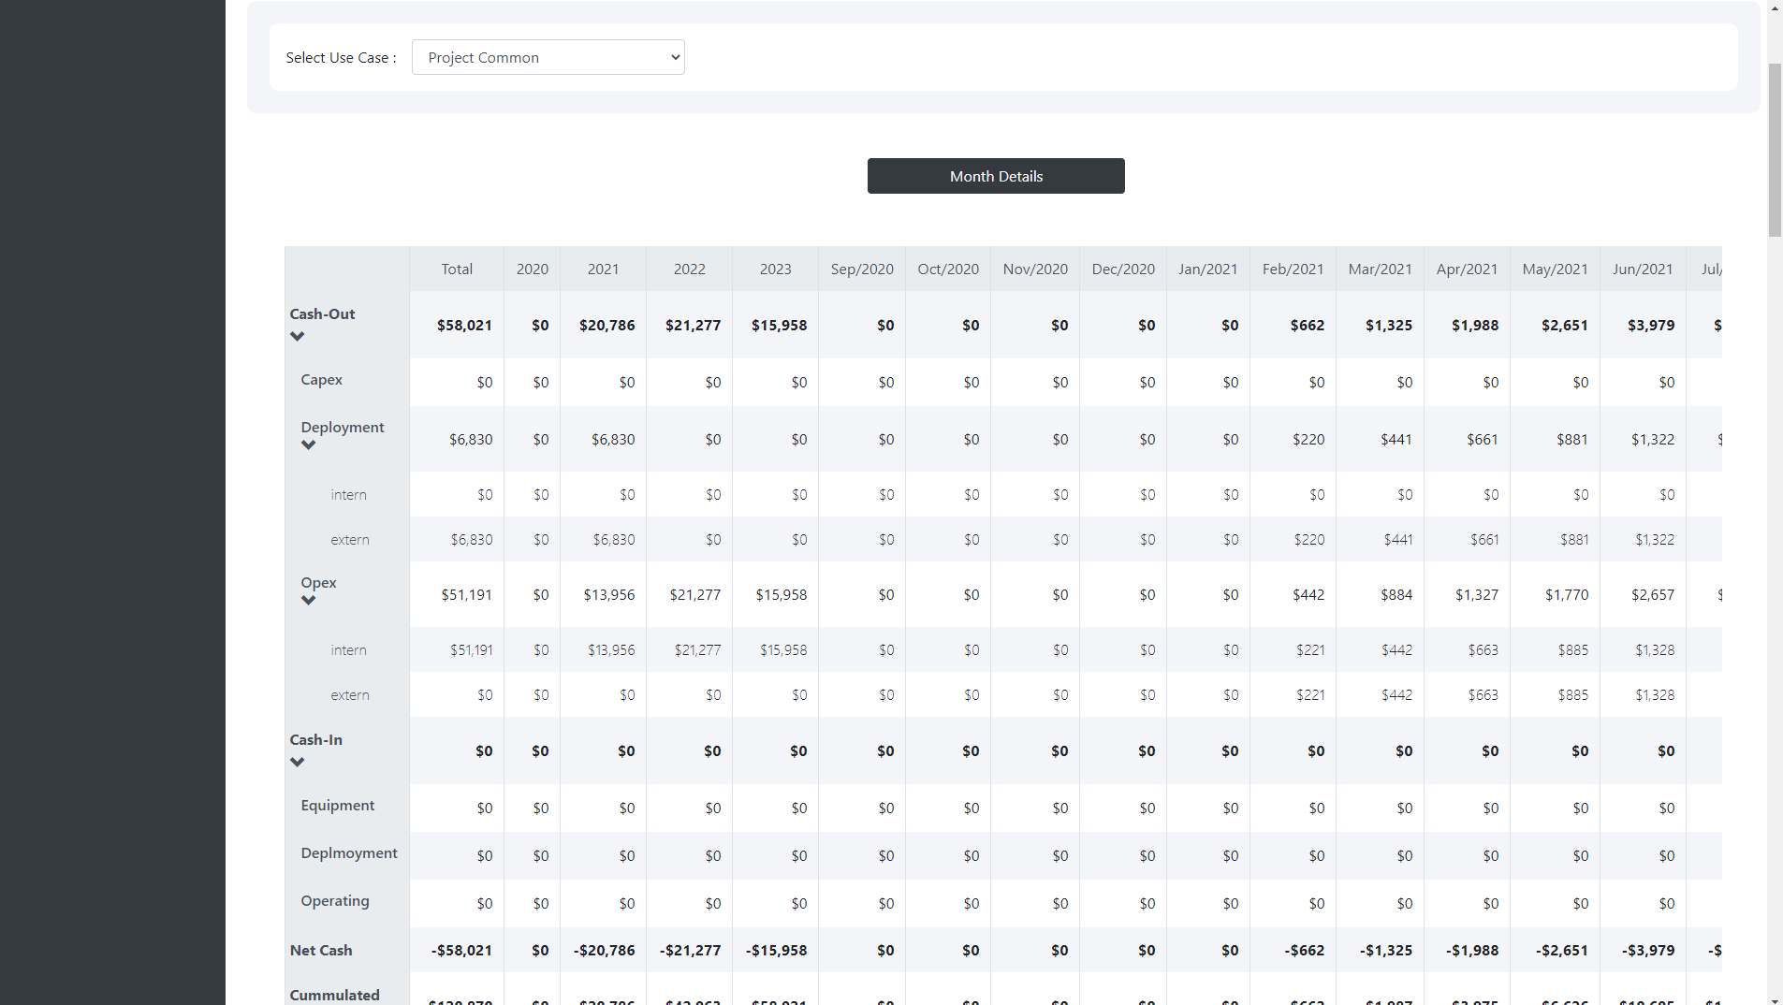
http://smartcityv2/?A=supplier_dashboards&A2=use_case_details&projID=21

Slide 27
Customer : Input Project Common

Slide 28
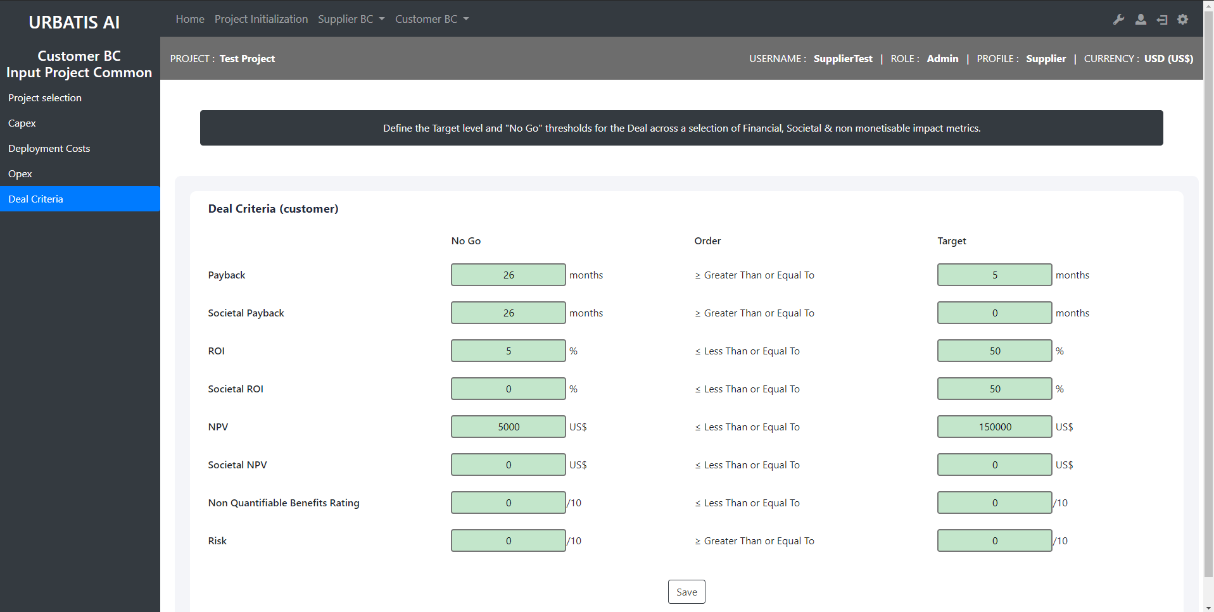
http://smartcityv2/?A=input_project_common&A2=deal_criteria&projID=21

Slide 29
Customer : Input Use Case

Slide 30
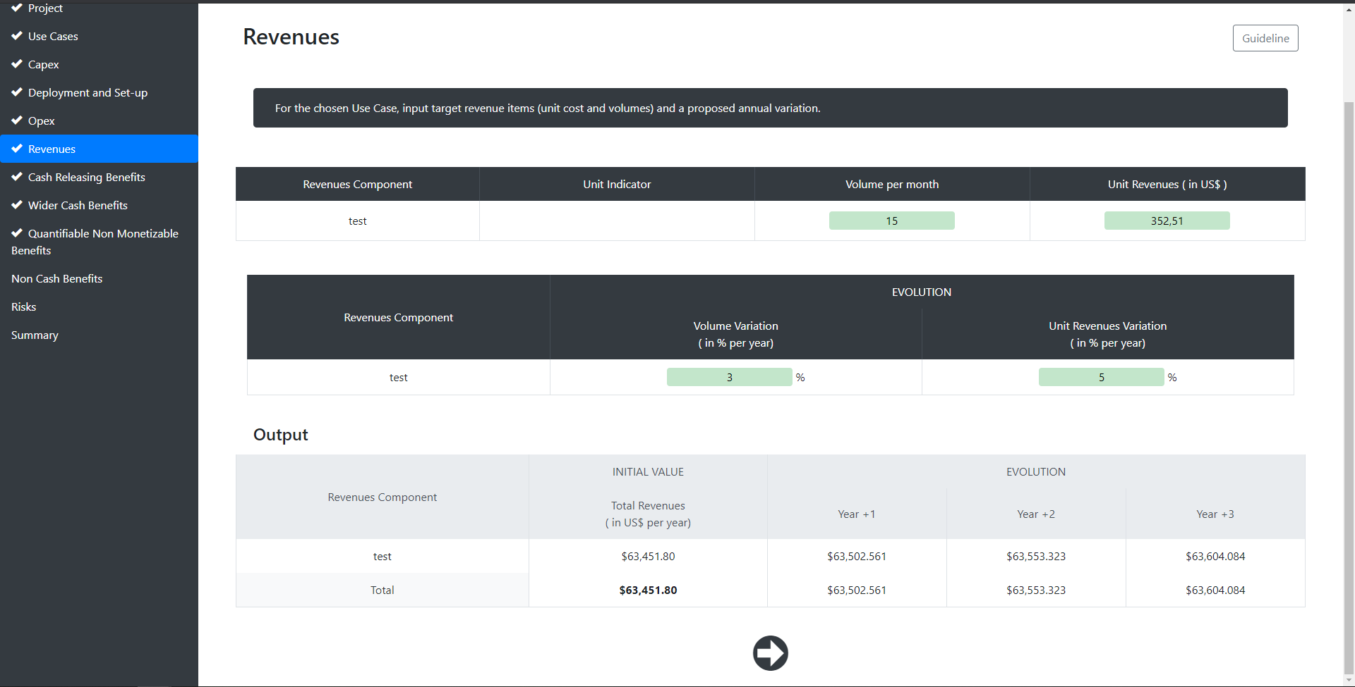
http://smartcityv2/?A=cost_benefits&A2=revenues&A3=revenues_selected&projID=21&ucID=9

Slide 31
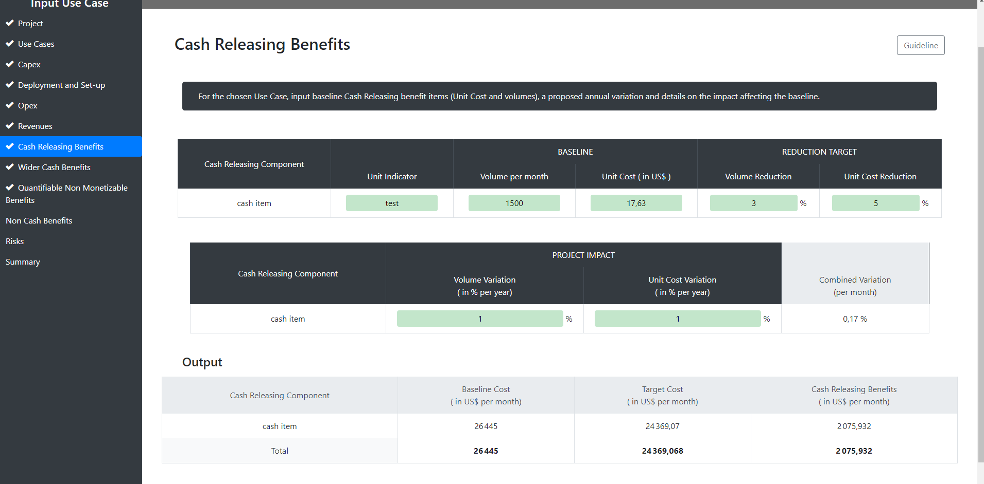
http://smartcityv2/?A=cost_benefits&A2=cashreleasing&A3=cashreleasing_selected&projID=21&ucID=9

Slide 32
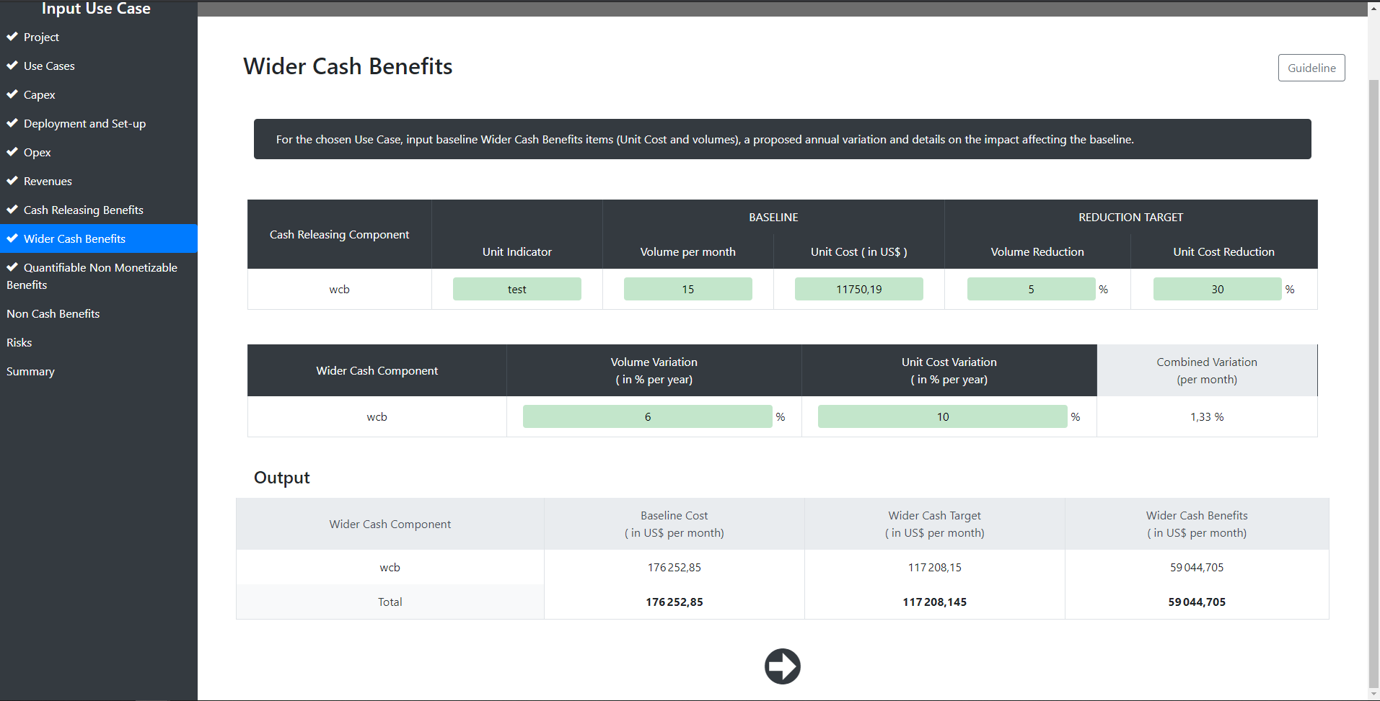
http://smartcityv2/?A=cost_benefits&A2=widercash&A3=widercash_selected&projID=21&ucID=9

Slide 33
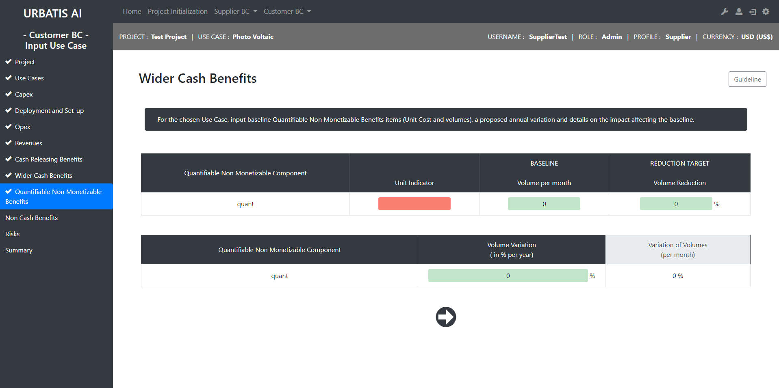
http://smartcityv2/?A=cost_benefits&A2=quantifiable&A3=quantifiable_selected&projID=21&ucID=9

Slide 34
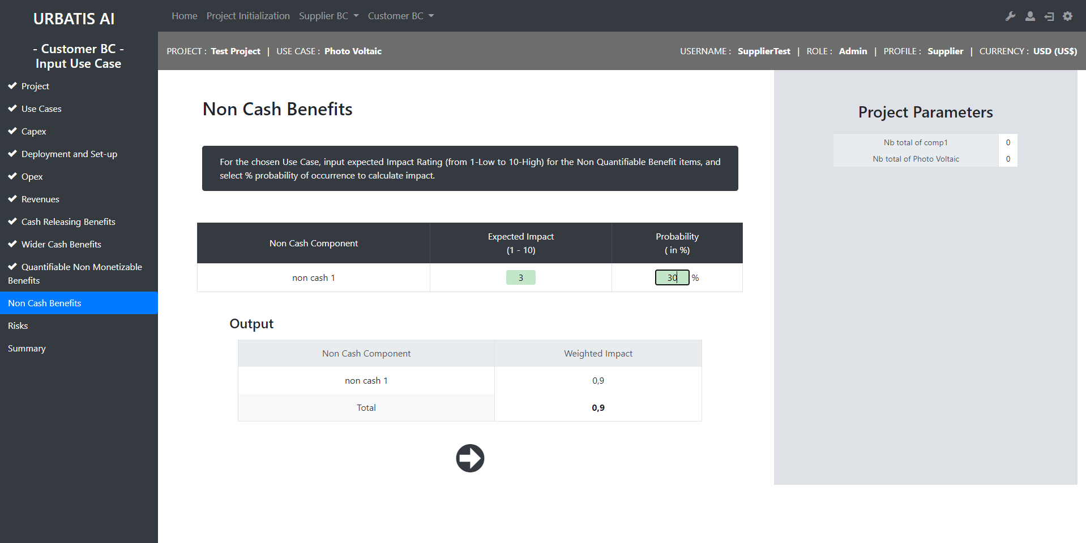
http://smartcityv2/?A=cost_benefits&A2=noncash&A3=noncash_selected&projID=21&ucID=9

Slide 35
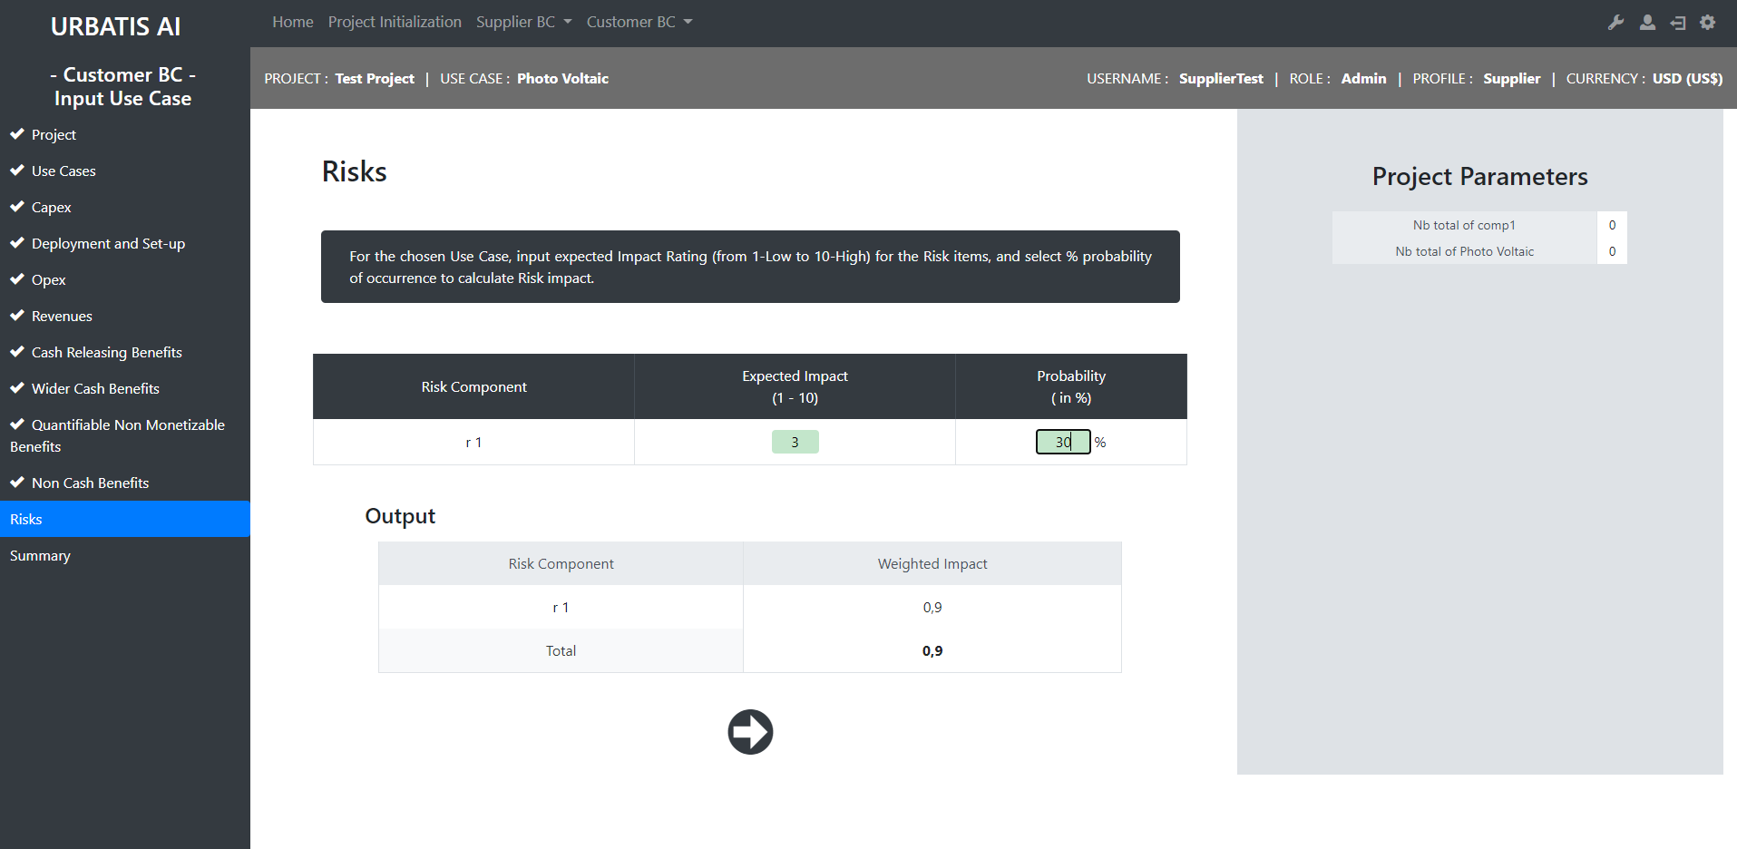
http://smartcityv2/?A=cost_benefits&A2=risks&A3=risks_selected&projID=21&ucID=9

Slide 36
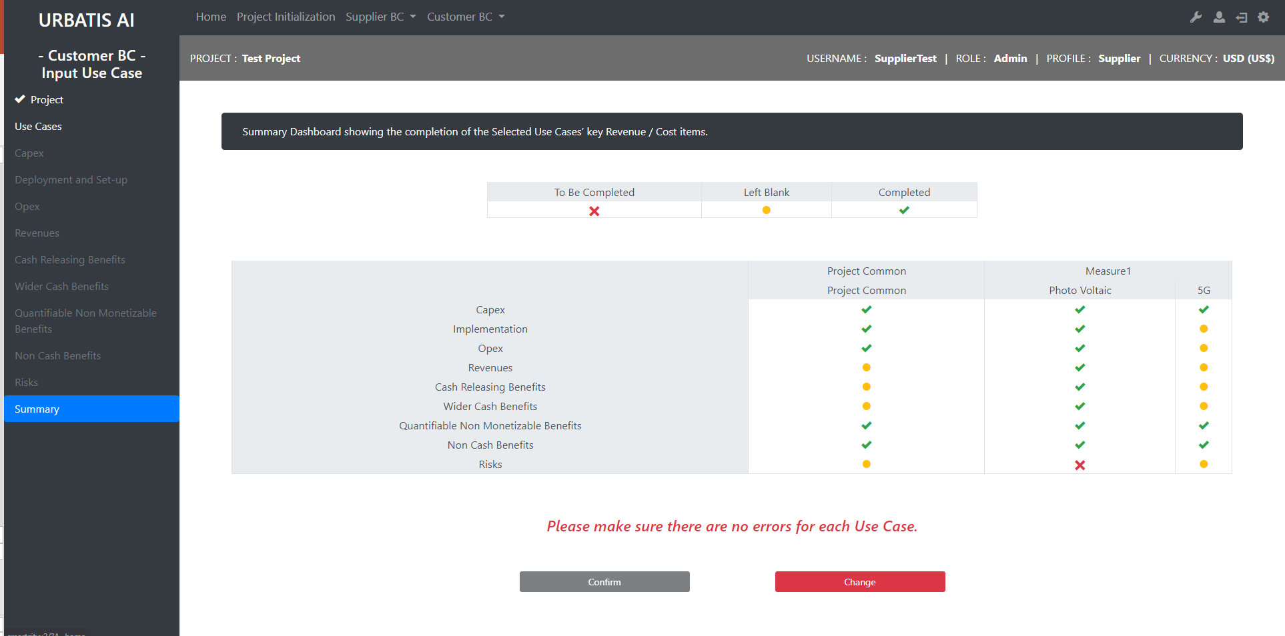
http://smartcityv2/?A=cost_benefits&A2=summary&projID=21

Slide 37
Customer : Dashboard

Slide 38
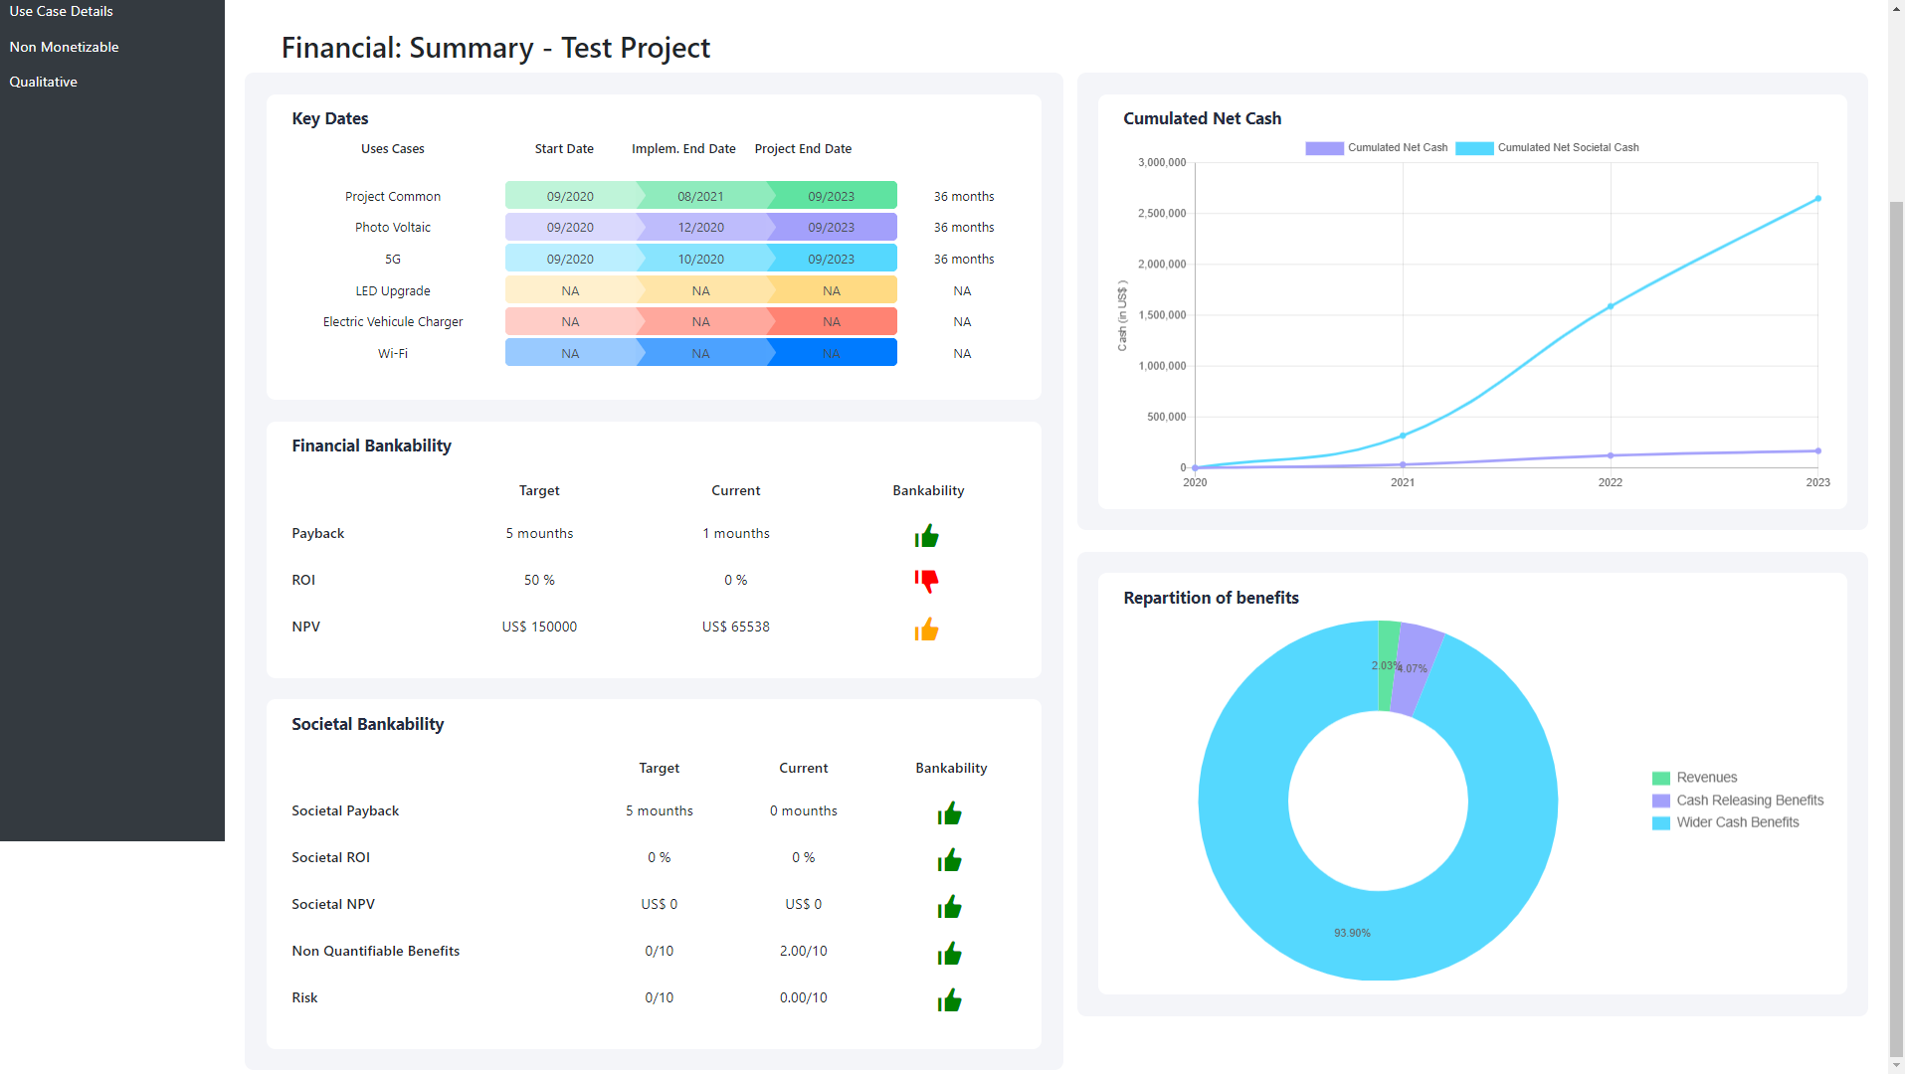
http://smartcityv2/?A=customer_dashboards&A2=summary&projID=21

Slide 39
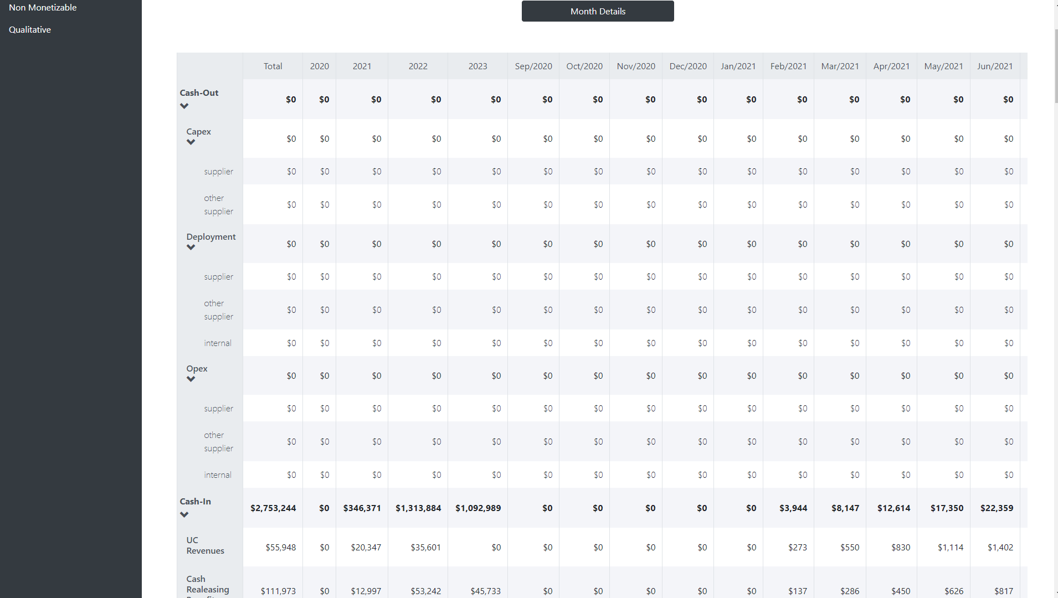
http://smartcityv2/?A=customer_dashboards&A2=project_details&projID=21

Slide 40
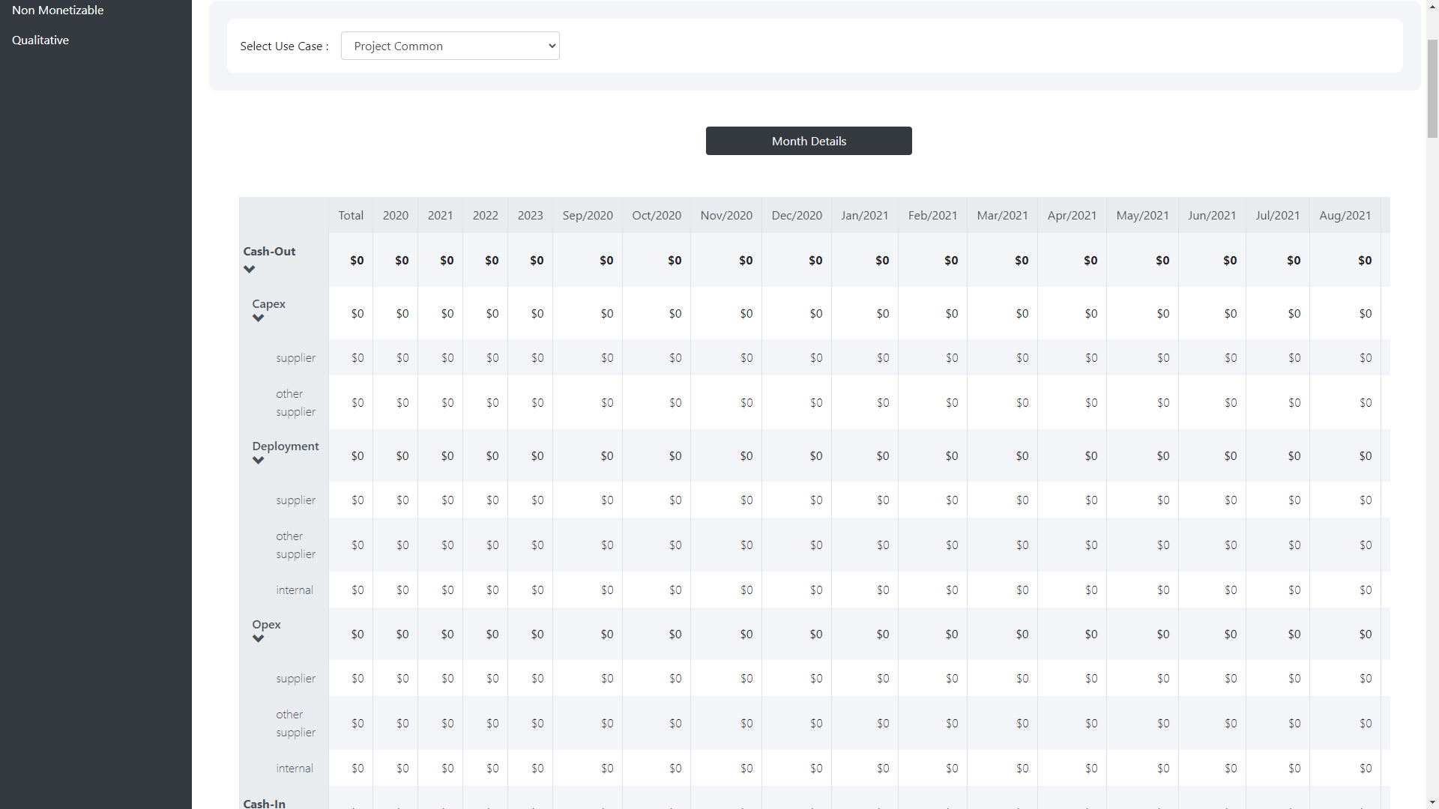
http://smartcityv2/?A=customer_dashboards&A2=use_case_details&projID=21

Slide 41
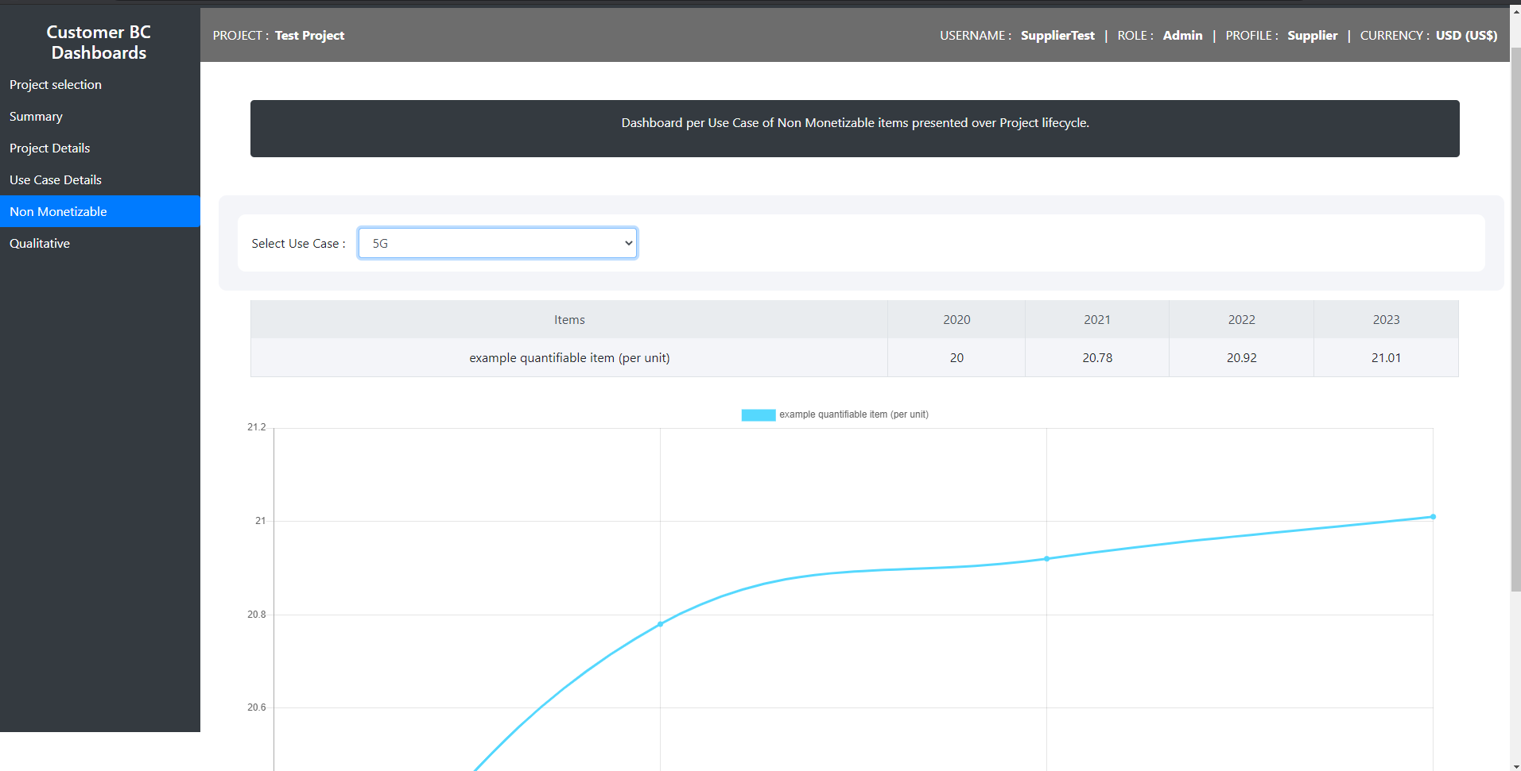
http://smartcityv2/?A=customer_dashboards&A2=non_monetizable&projID=21

Slide 42
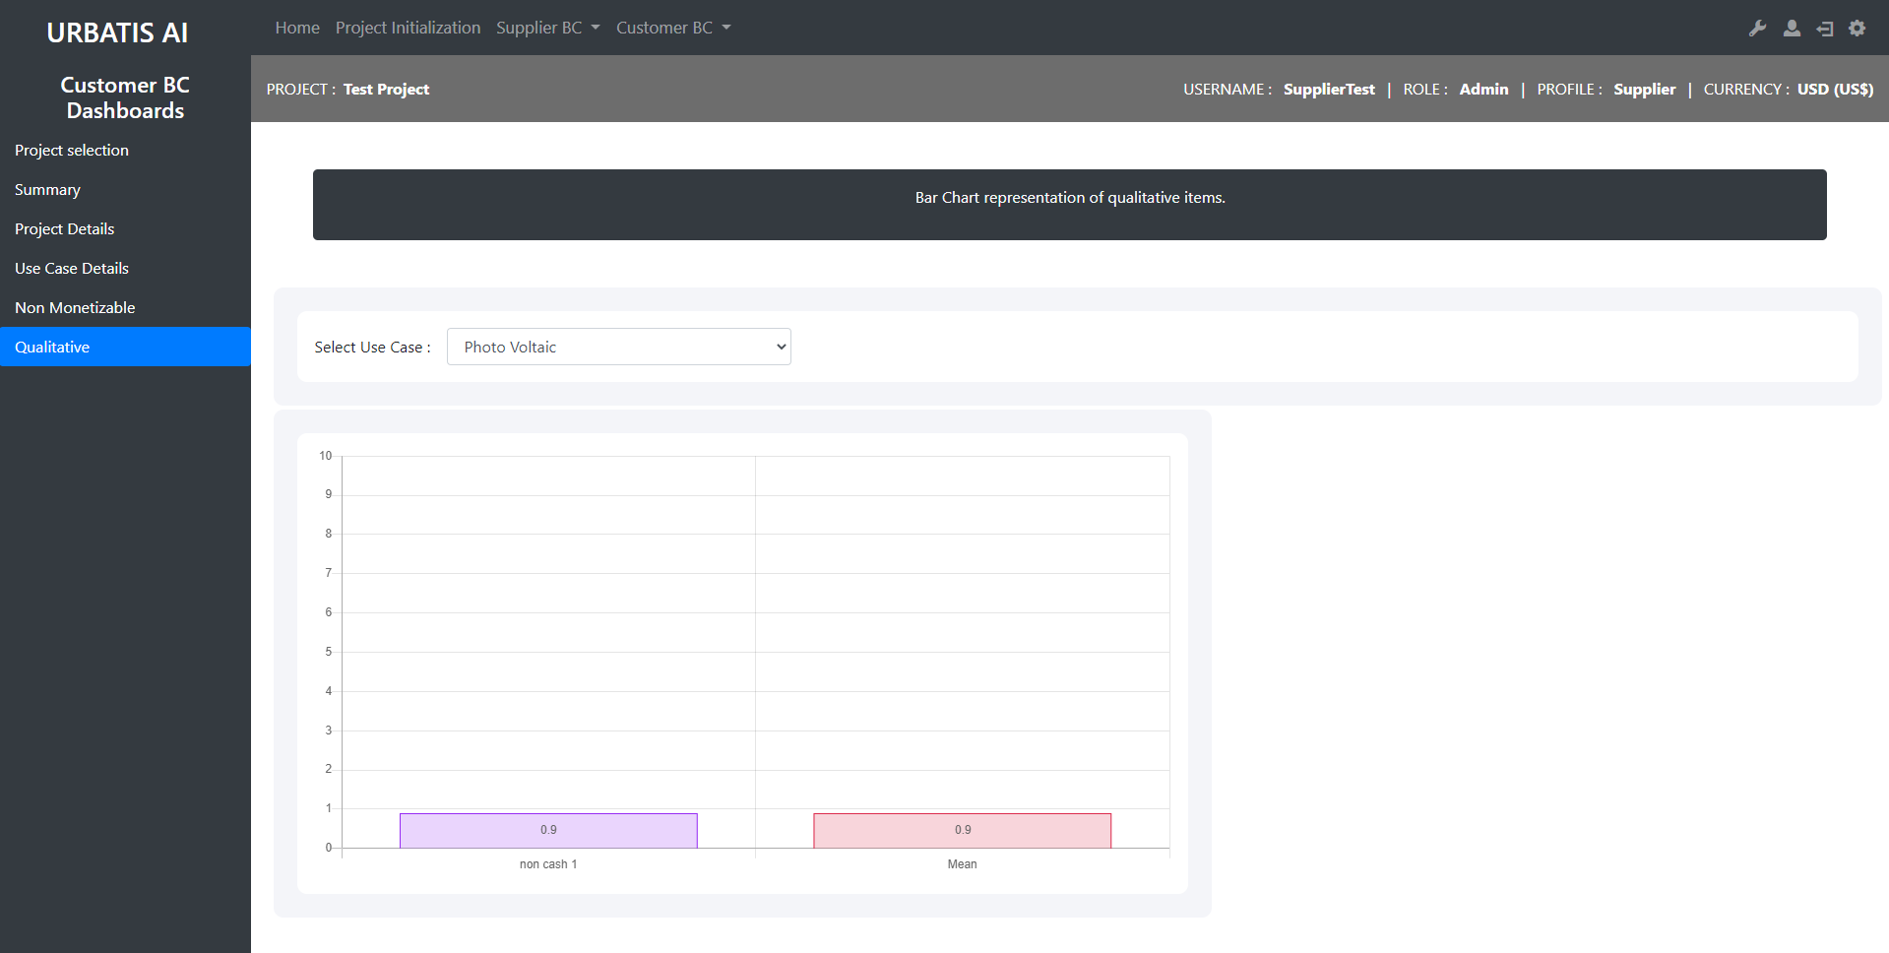
http://smartcityv2/?A=customer_dashboards&A2=qualitative&projID=21

