Slide 1
Cost-benefits :Input Project

Slide 2
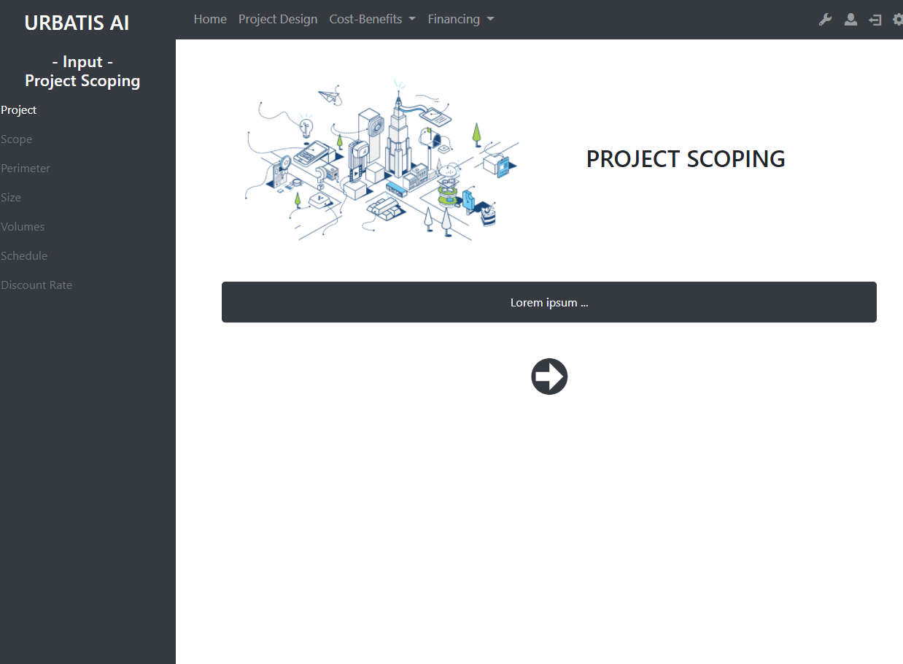
http://smartcityv2/?A=project_scoping

Slide 3
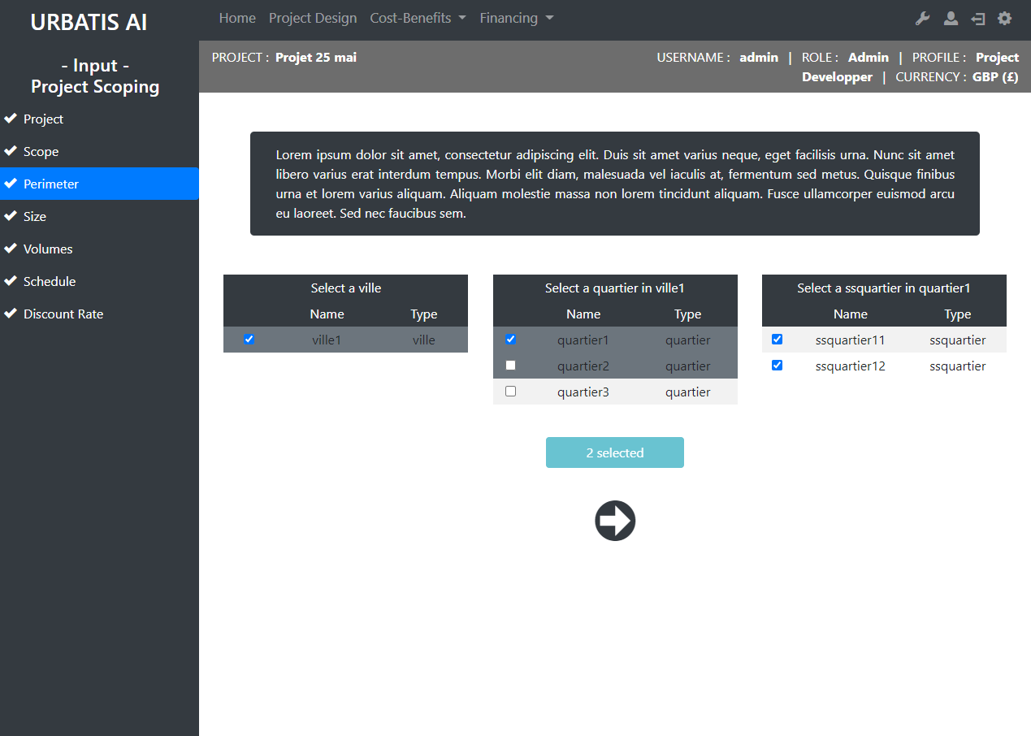
http://smartcityv2/?A=project_scoping&A2=perimeter&projID=6

Slide 4
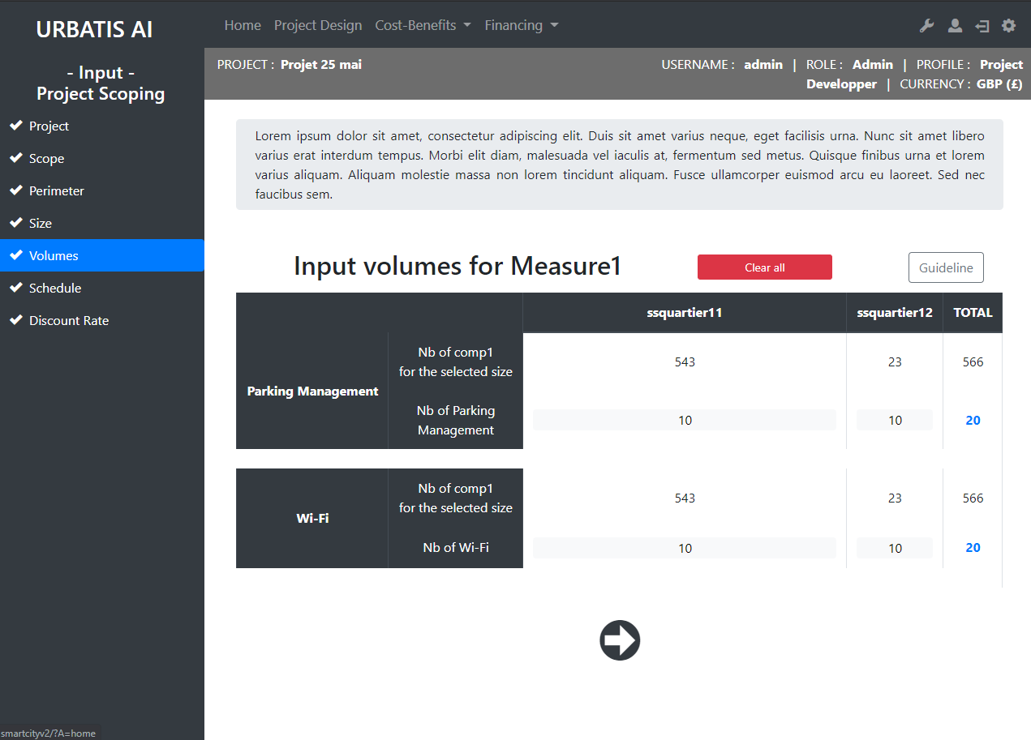
http://smartcityv2/?A=project_scoping&A2=volumes&projID=6

Slide 5
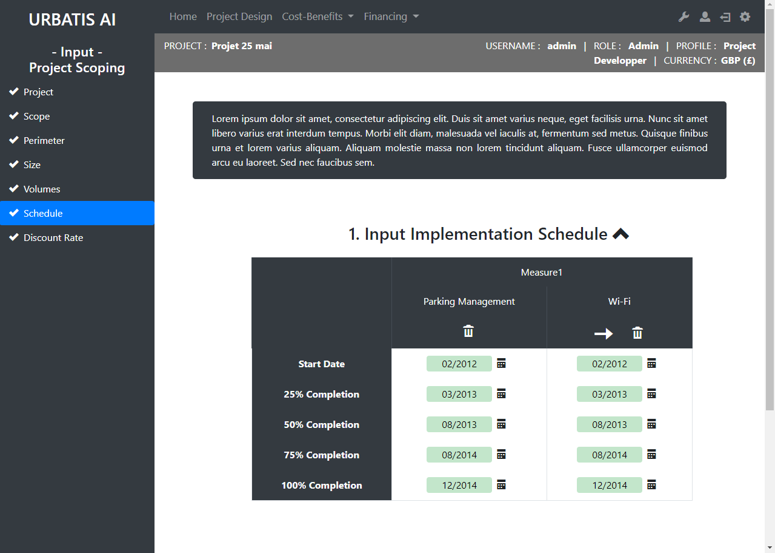
http://smartcityv2/?A=project_scoping&A2=schedule&projID=6

Slide 6
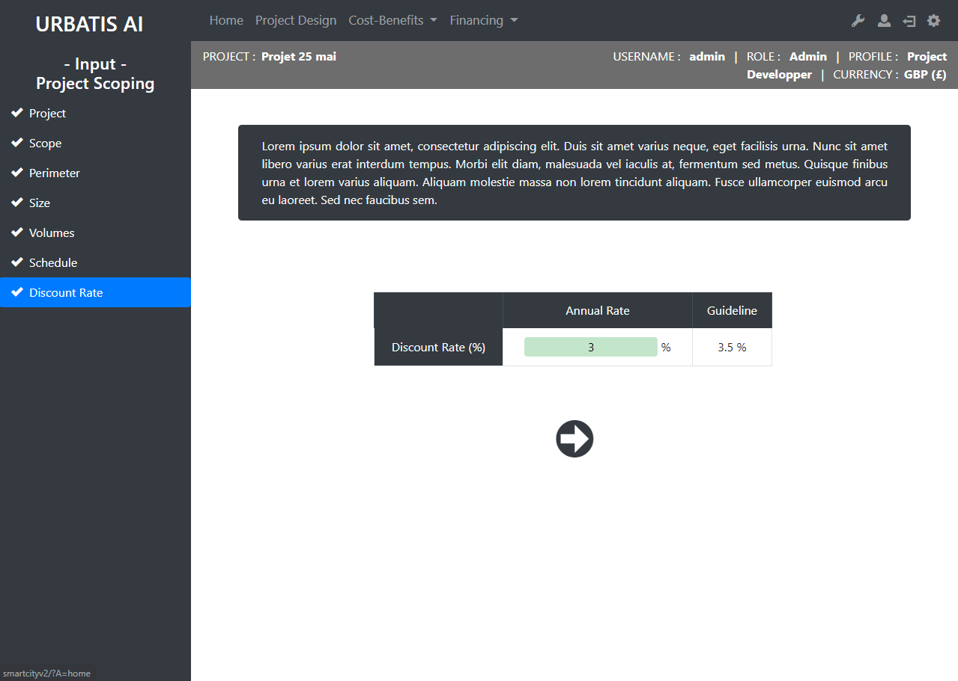
http://smartcityv2/?A=project_scoping&A2=discount_rate&projID=6

Slide 7
Cost-benefits :Dashboards

Slide 8
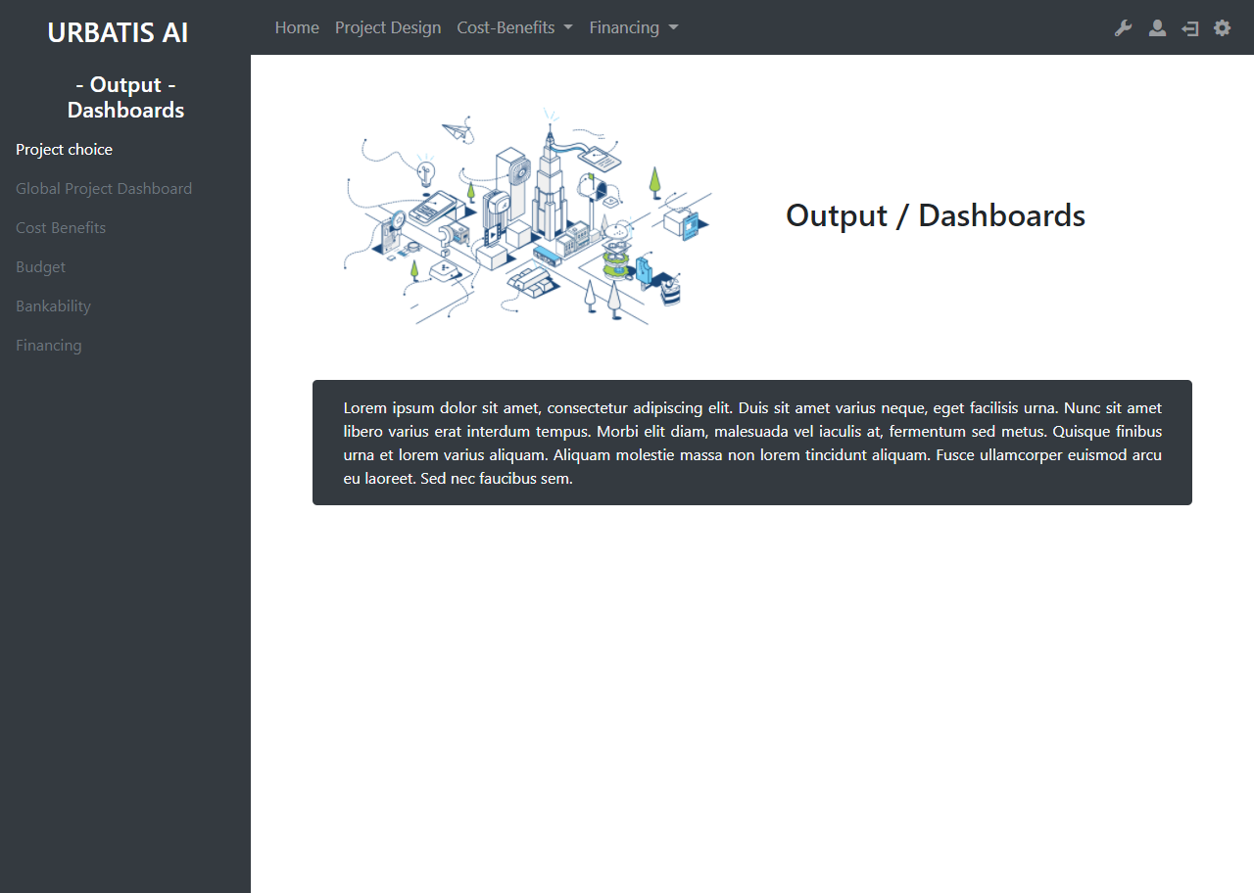
http://smartcityv2/?A=dashboards

Slide 9
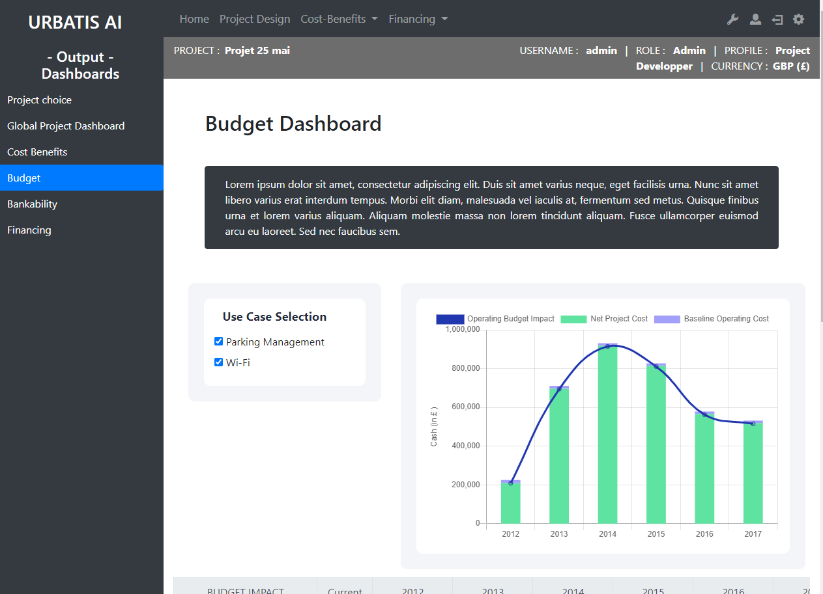
http://smartcityv2/?A=dashboards&A2=budget&projID=6

Slide 10
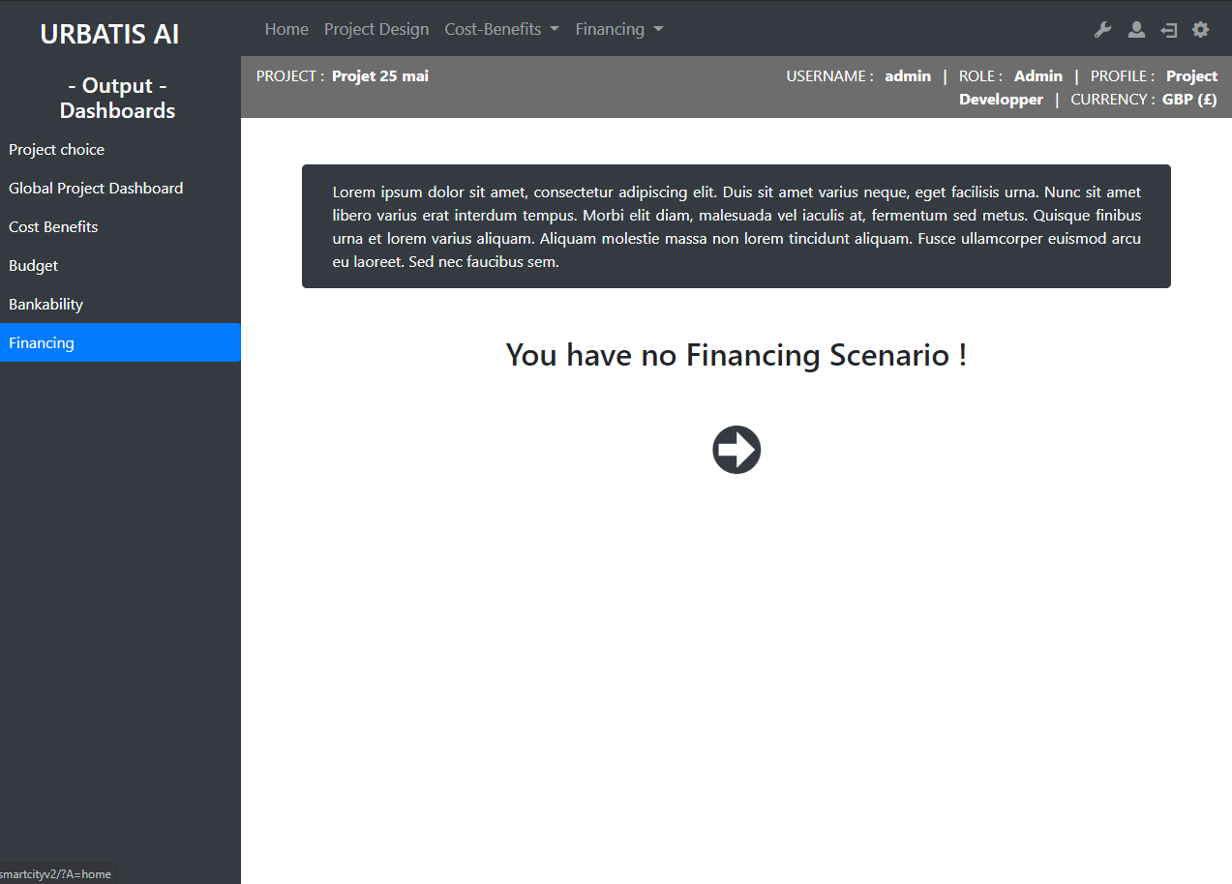
http://smartcityv2/?A=dashboards&A2=financing&projID=6

Slide 11
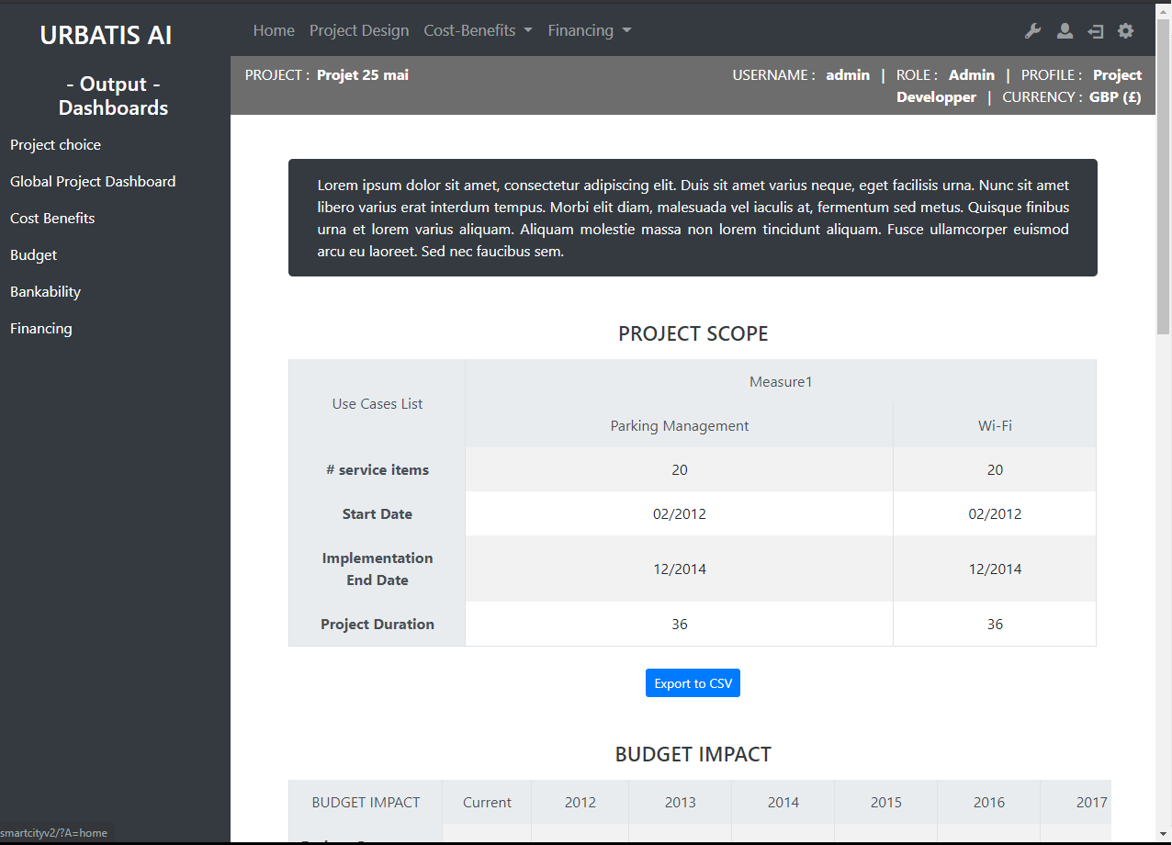
http://smartcityv2/?A=dashboards&A2=project_dashboard&projID=6

Slide 12
Cost-benefits :Comparison

Slide 13
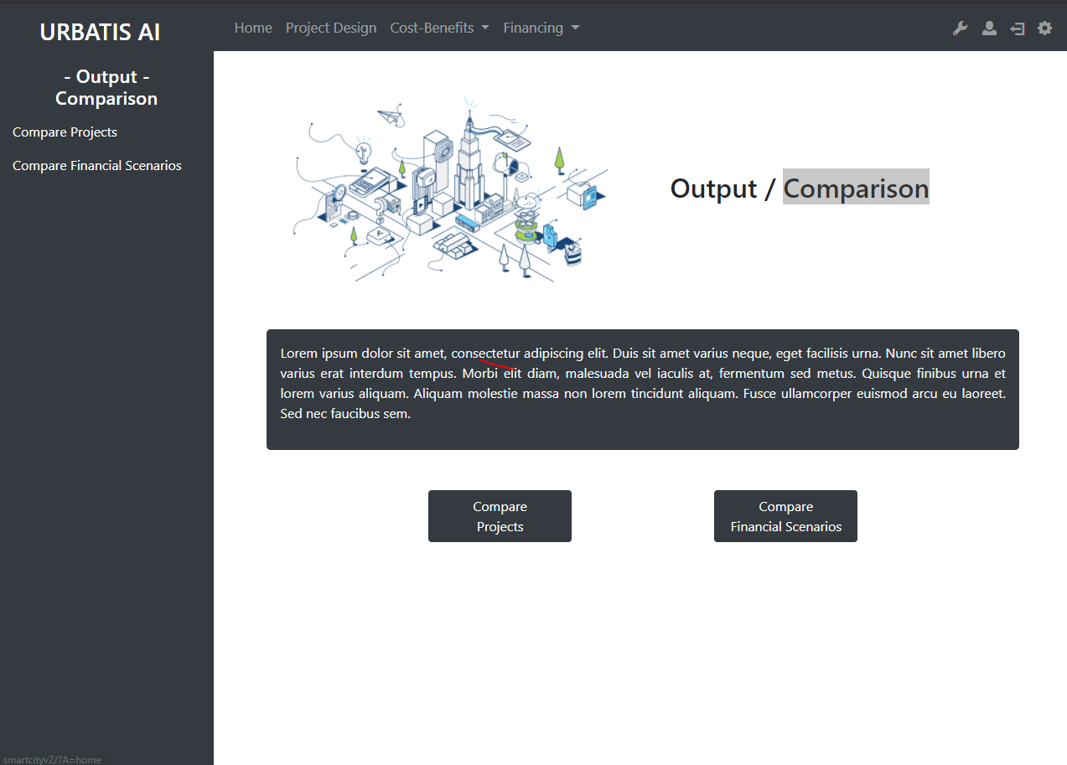
http://smartcityv2/?A=comparison

Slide 14
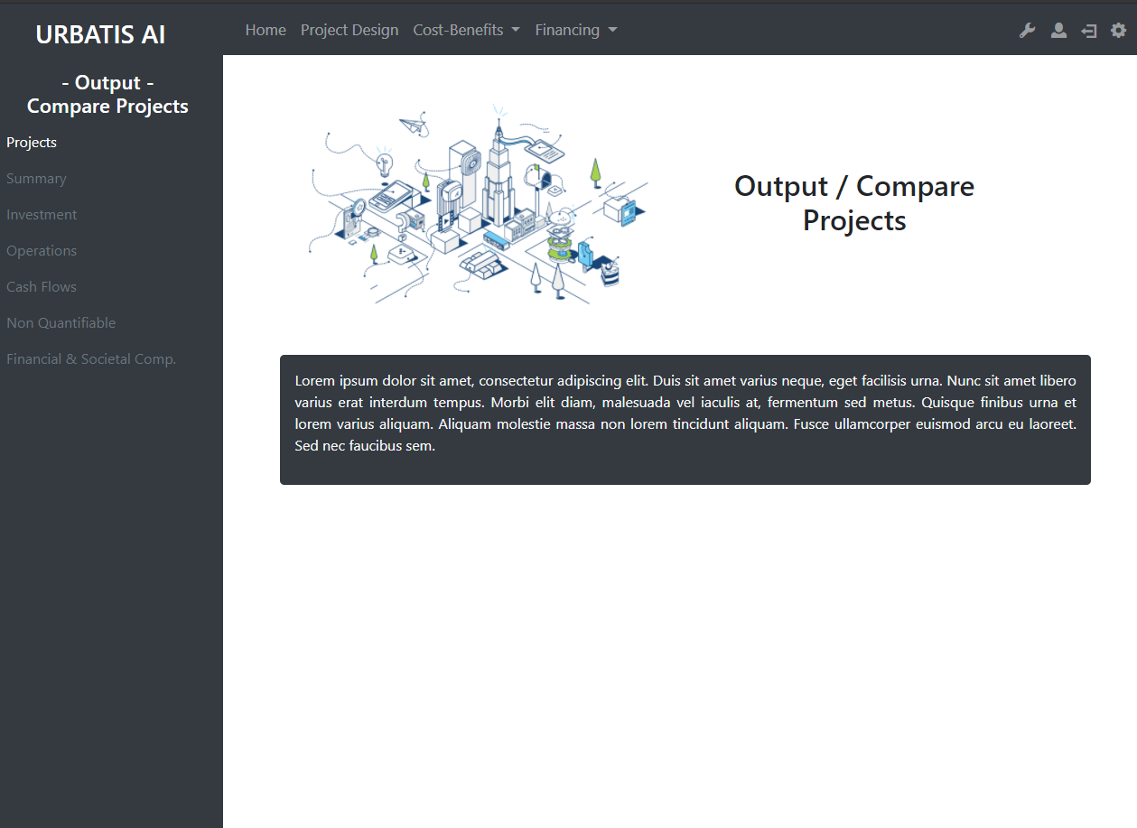
http://smartcityv2/?A=comp_projects

Slide 15
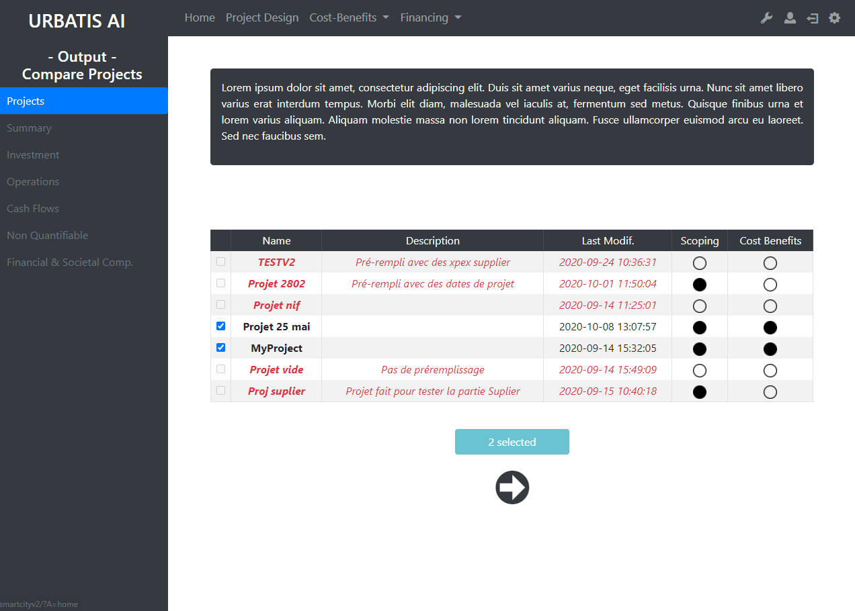
http://smartcityv2/?A=comp_projects&A2=projects

Slide 16
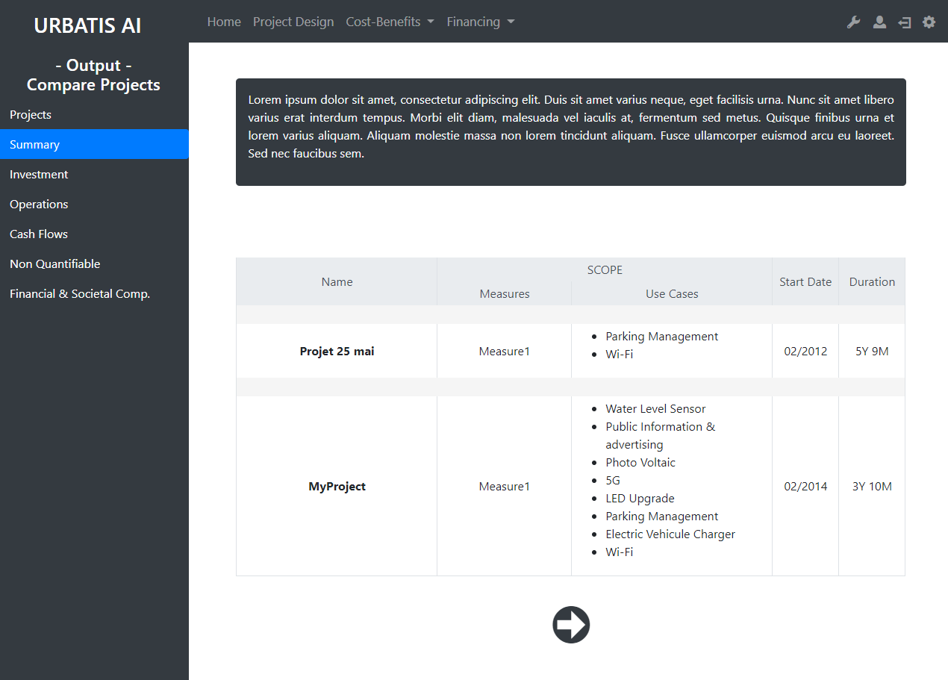
http://smartcityv2/?A=comp_projects&A2=summary

Slide 17
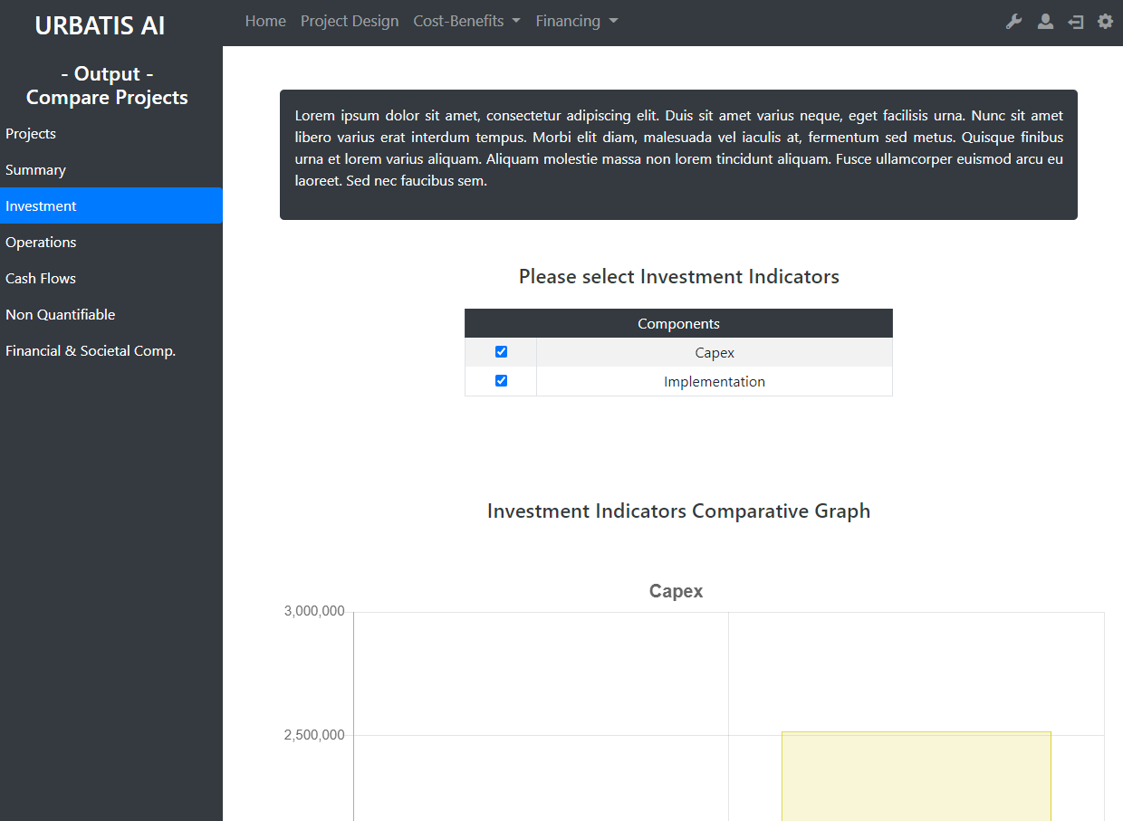
http://smartcityv2/?A=comp_projects&A2=summary

Slide 18
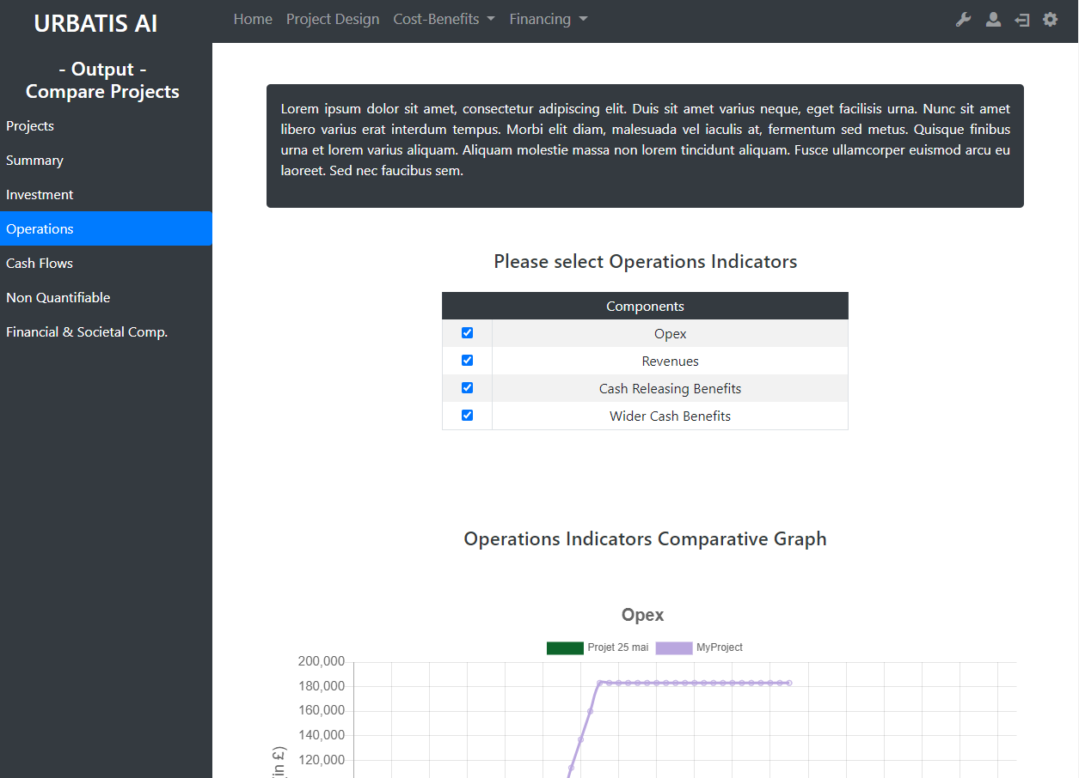
http://smartcityv2/?A=comp_projects&A2=op

Slide 19
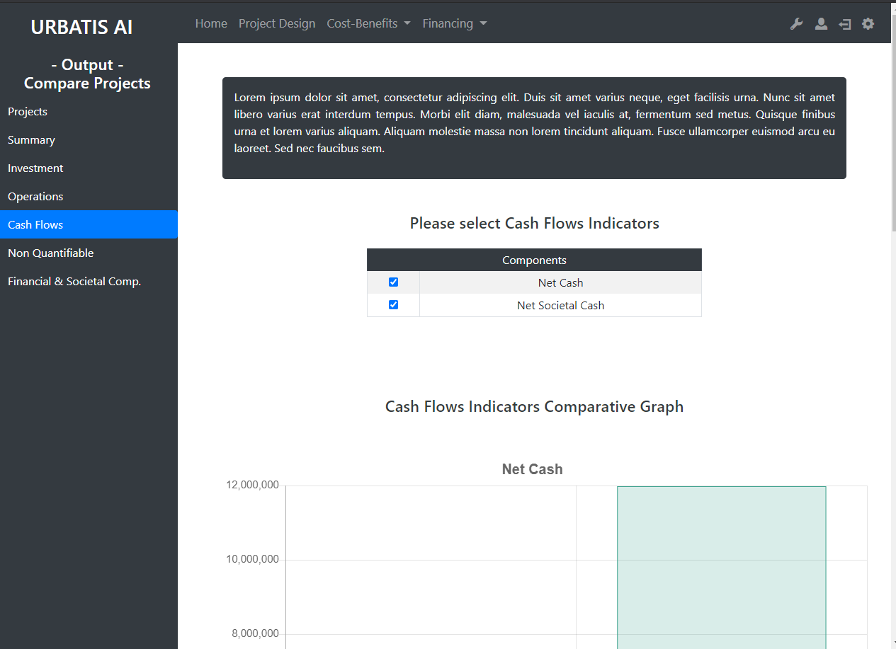
http://smartcityv2/?A=comp_projects&A2=cash_flows

Slide 20
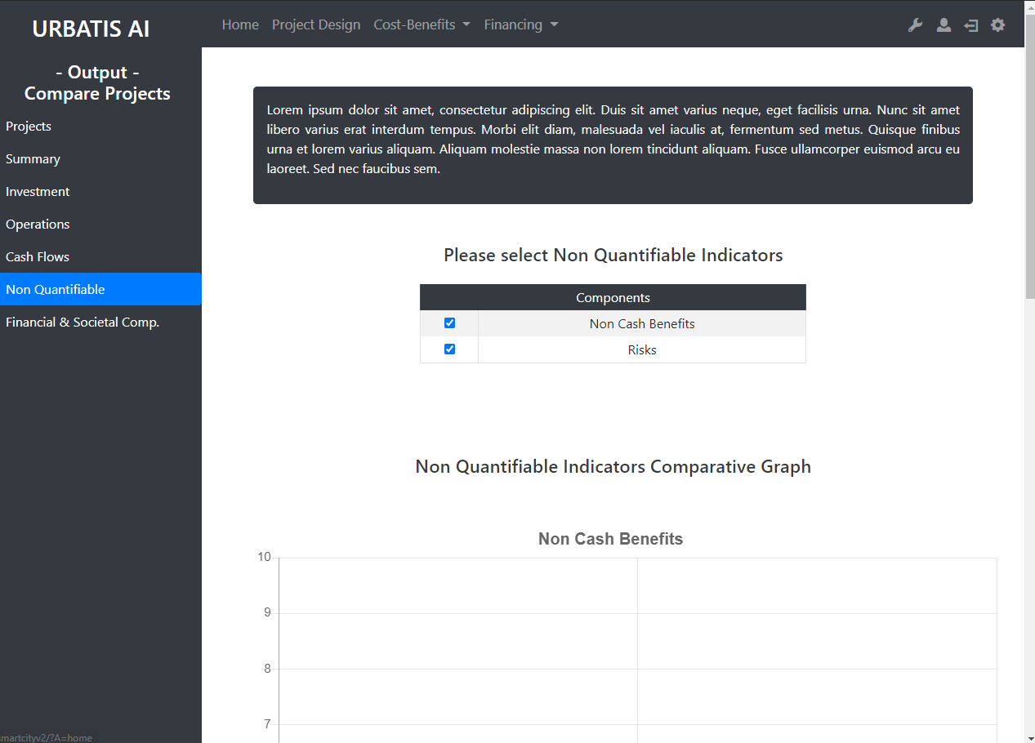
http://smartcityv2/?A=comp_projects&A2=non_quant

Slide 21
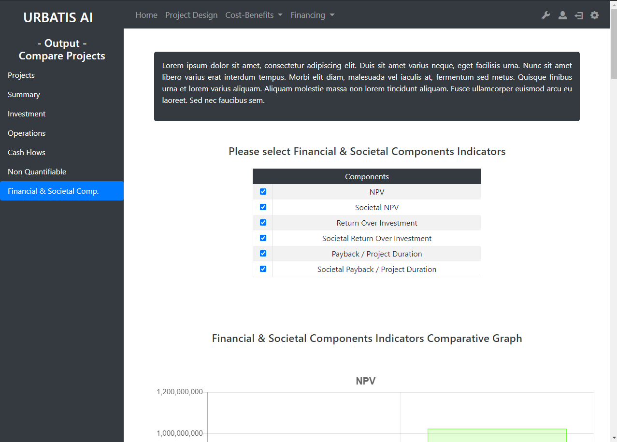
http://smartcityv2/?A=comp_projects&A2=finsoc_comp

Slide 22
Financing :Funding

Slide 23
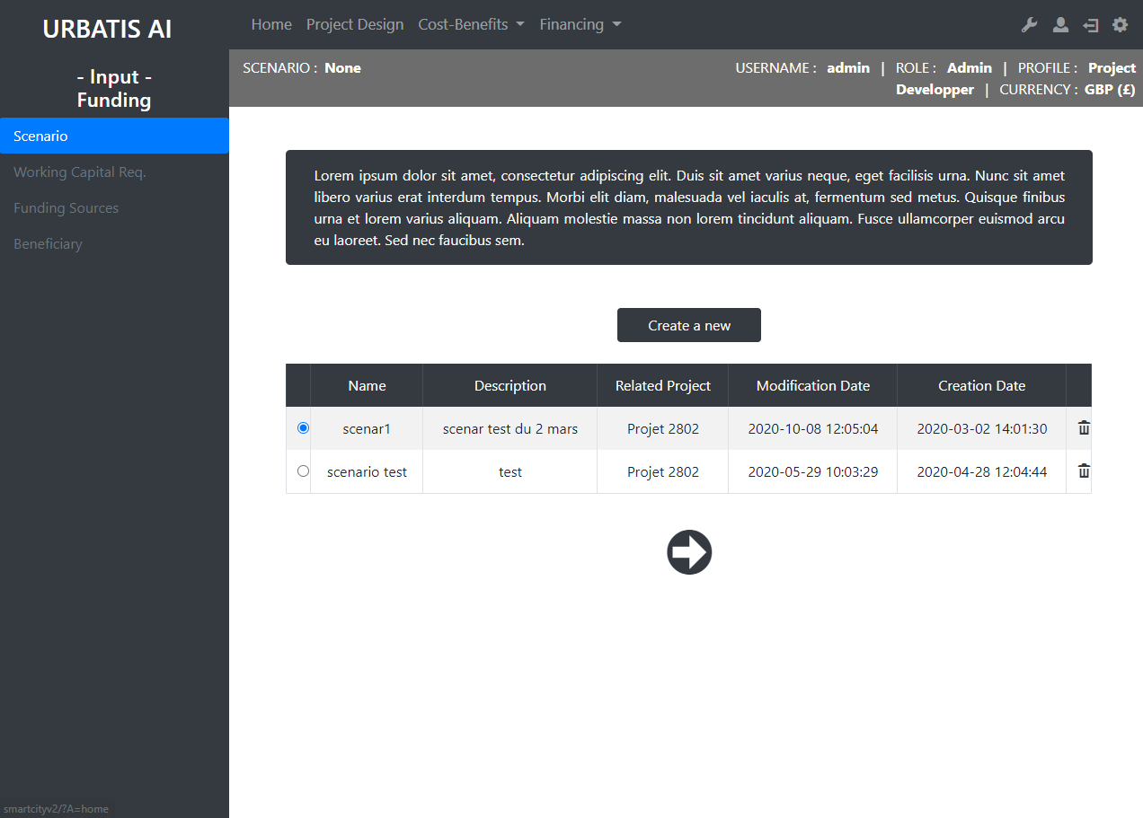
http://smartcityv2/?A=funding&A2=scenario

Slide 24
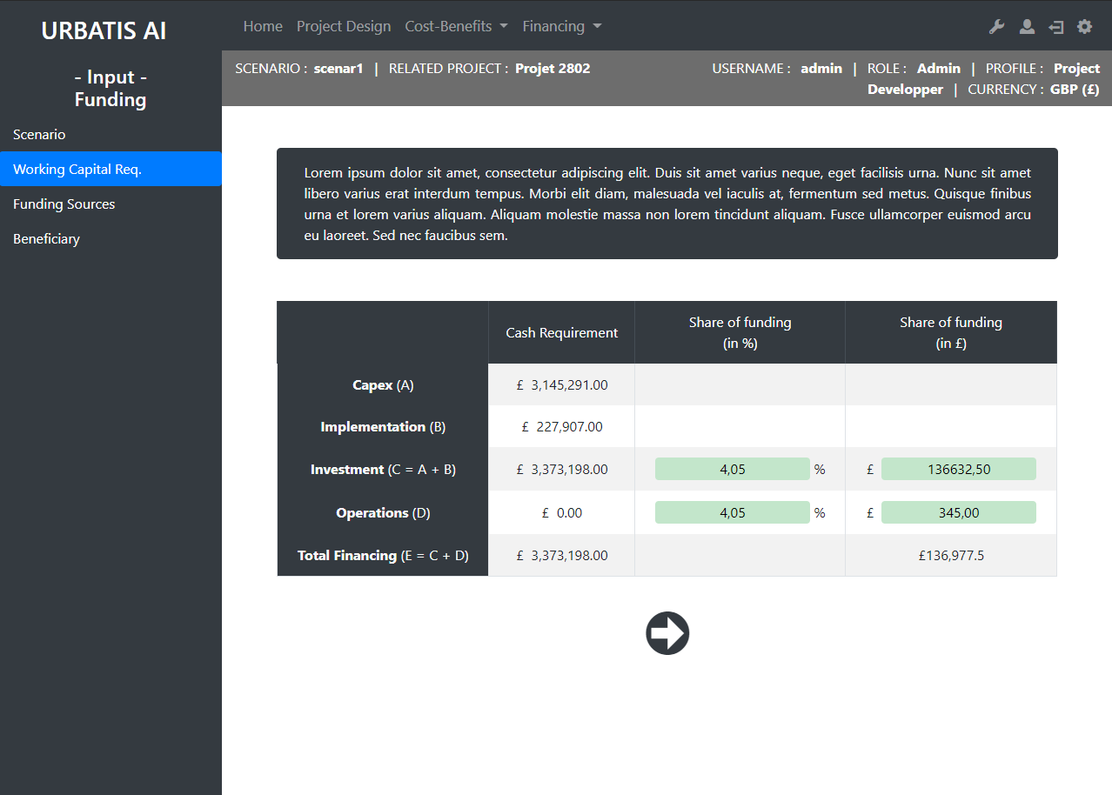
http://smartcityv2/?A=funding&A2=work_cap_req&scenID=3

Slide 25
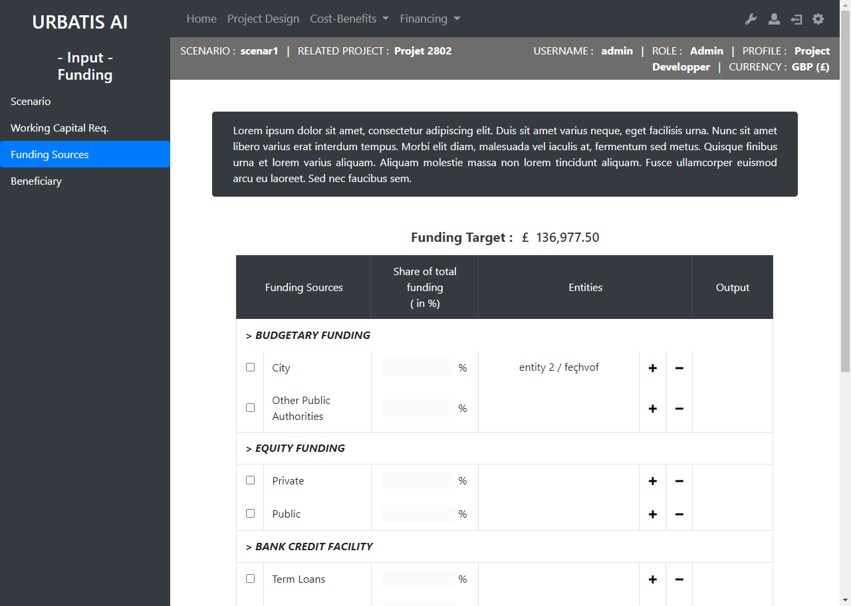
http://smartcityv2/?A=funding&A2=funding_sources&scenID=3

Slide 26
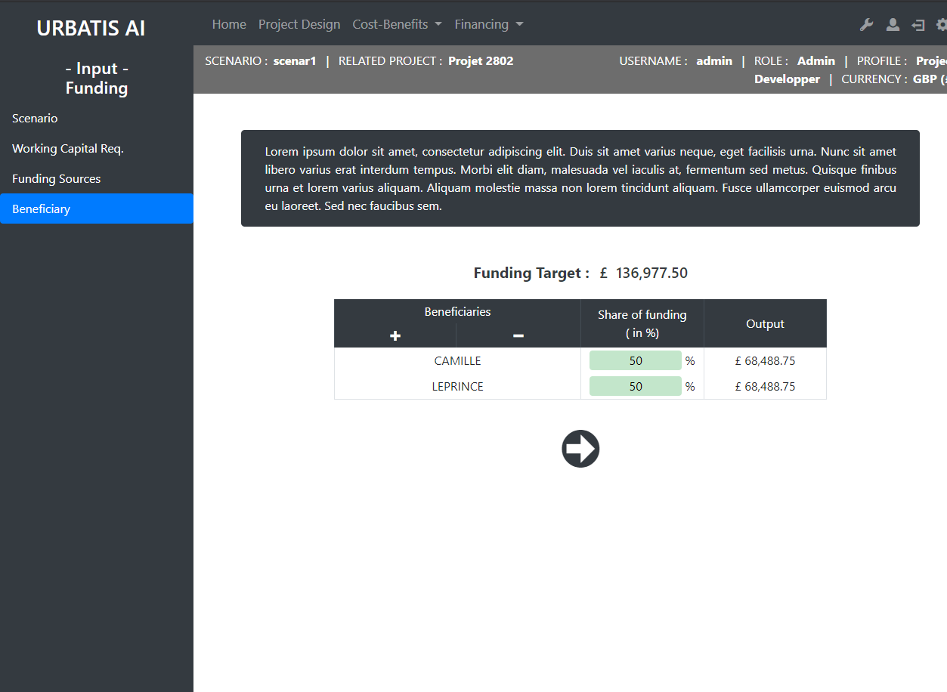
http://smartcityv2/?A=funding&A2=benef&scenID=3

Slide 27
Administratio

Slide 28
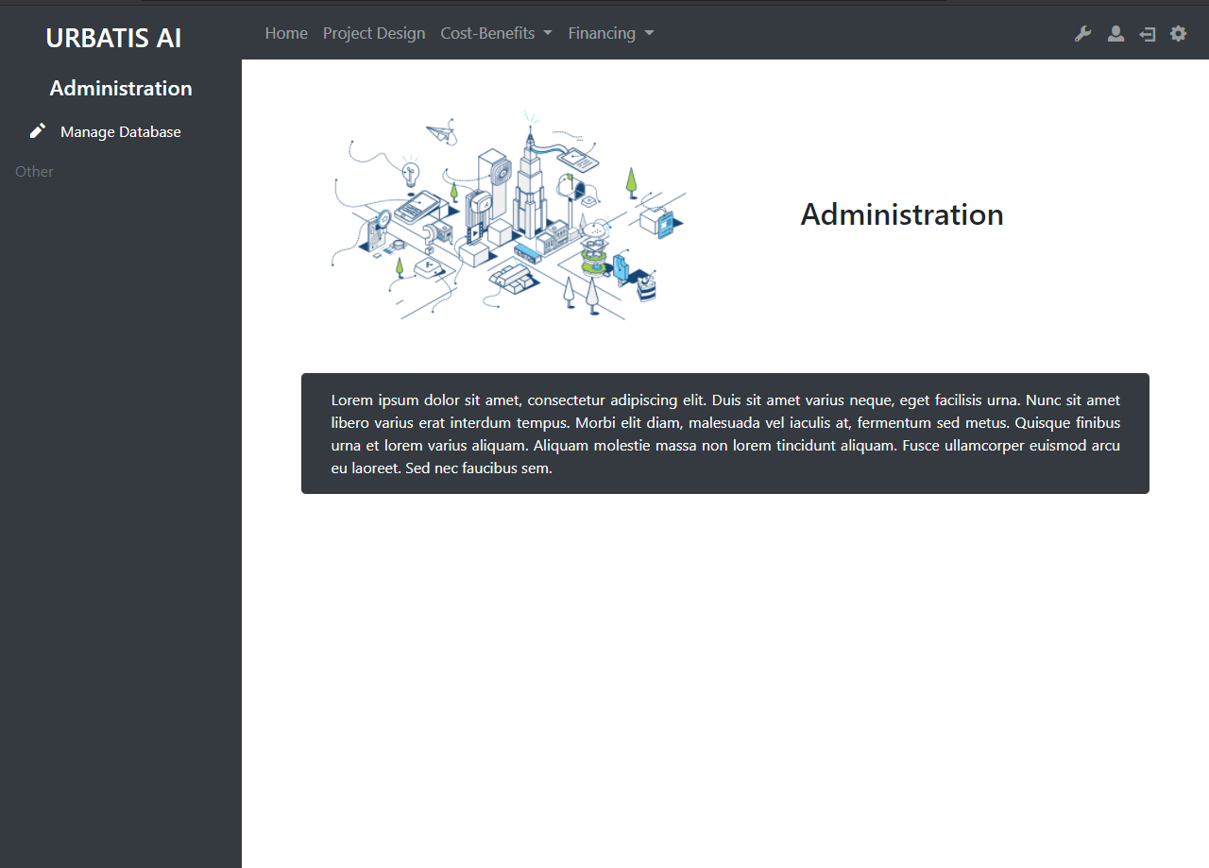
http://smartcityv2/?A=admin

