Slide 1
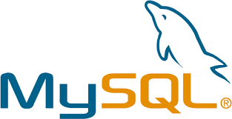
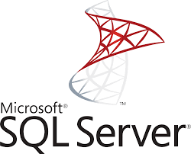

Checkpoint: Introduction To DATABASES
Presented by Mohamd Zaatouti

Slide 2
What’s a Database?
A database is an organized collection of structured information, or data, typically stored electronically in a computer system.
A database typically requires a comprehensive database software program known as a database management system (DBMS).

Slide 3
Database management system (DBMS)?
A DBMS serves as an interface between the database and its end users or programs, allowing users to retrieve, update, and manage how the information is organized and optimized. A DBMS also facilitates oversight and control of databases, enabling a variety of administrative operations such as performance monitoring, tuning, and backup and recovery.
Some examples of popular database software or DBMSs include MySQL, Microsoft SQL Server, PostgreSQL....

Slide 4
MySQL Defintion
MySQL:
is the most popular Open Source SQL database management system.
Developed, distributed, and supported by Oracle Corporation.
MySQL software is Open Source.
It may be anything from a simple shopping list to a picture gallery or the vast amounts of information in a corporate network. To add, access, and process data stored in a computer database, you need a database management system such as MySQL Server.

Slide 5
Microsoft SQL Server Definition
Microsoft SQL Server :
is a relational database management system (RDBMS) developed by Microsoft.
It’s primarily designed and developed to compete with MySQL and Oracle database.
SQL Server supports ANSI SQL, which is the standard SQL (Structured Query Language) language.
It’s a standard programming language for interacting with the relational databases.

Slide 6
Definiton
PostgreSQL:
is a powerful, open source object-relational database system that uses and extends the SQL language combined with many features that safely store and scale the most complicated data workloads.
is an inexhaustive list of various features found in PostgreSQL, with more being added in every major release: Data Types, Data Integrity, Concurrency, Performance, Reliability, Disaster Recovery, Security…

Slide 7
Comparison MySQL, Microsoft SQL Server Defintion & PostgreSQL
 | MySQL | SQL Server | PostgreSQL
Languages | in C, has a few C++ modules | In C++ with a few exceptions | Written in C
Maturity | in 1995 | in 1989 | in 1989
Costs | Open source / Owned by Oracle and has several paid editions | SQL Server Express is a free edition, but it is limited to using 1 processor, 1 GB memory and 10 GB database files. | Completely free / Open source

