Slide 1
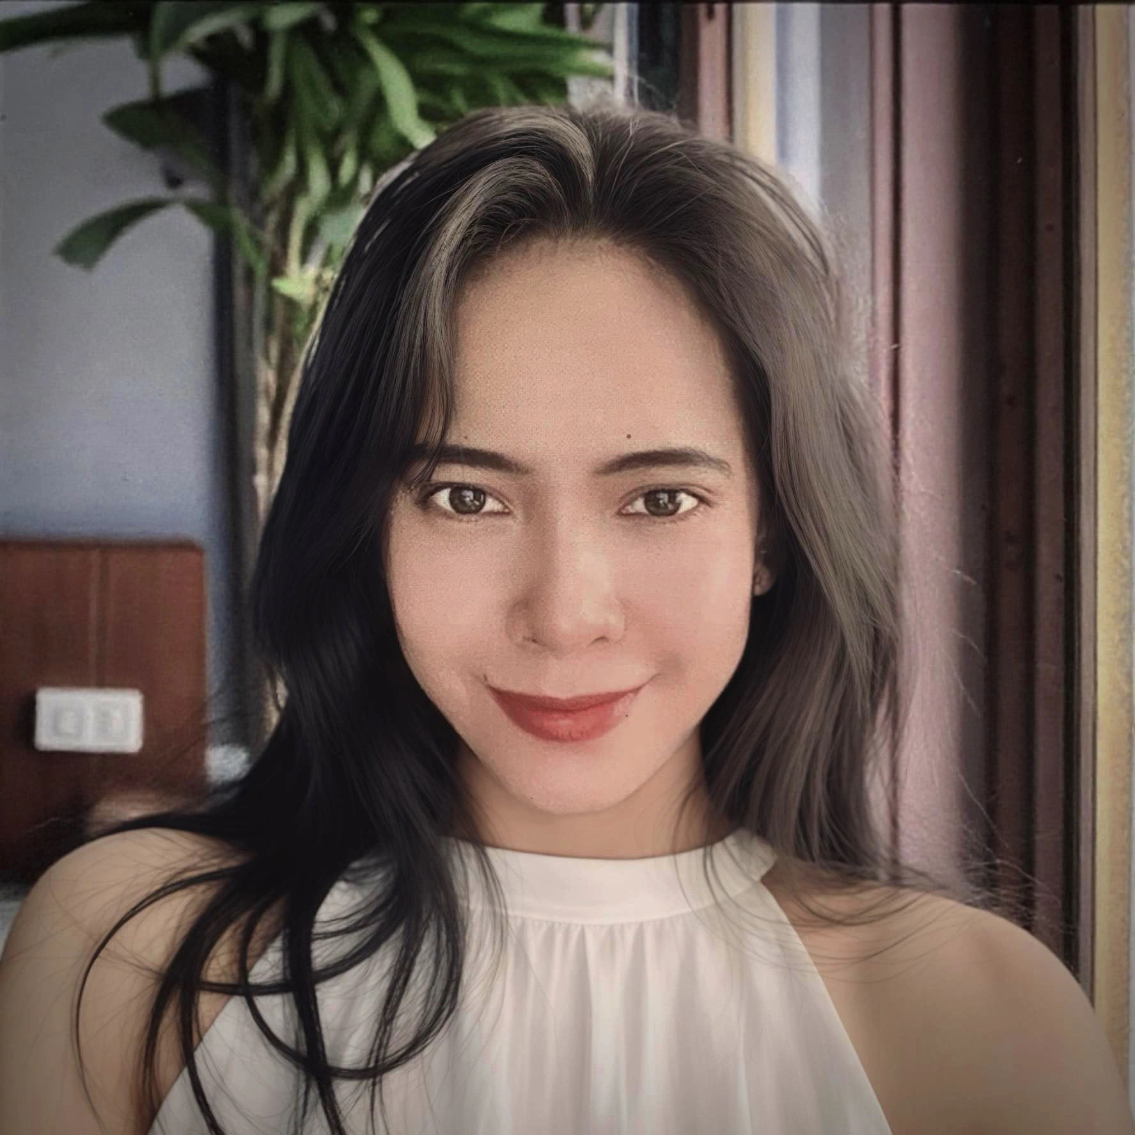






Jessa Belle S. Castillo
Packaged App Development Associate
+639-39-716-9774
jessa.belle.castillo@accenture.com
Minglanilla, Cebu
English
Tagalog
Bisaya
BACKGROUND
Currently working as a Boomi Developer for the TIBCO Replatform – Exelon project, where I’ve spent the past 11 months building and configuring integration processes for assigned services. My responsibilities include designing Boomi processes, performing API testing using Postman, and conducting smoke testing to ensure deployment stability.
SKILLS
Primary Skill
Boomi Atmosphere Integration
Secondary Skill
Other Services
CONTACT
Manual Testing
Technical Documentation
Agile Testing
API Testing
ACCENTURE TECHNOLOGY
ASP.NET C#
Azure
JavaScript
Microsoft Front End development (FED) Angular
Microsoft FED ReactJS
Node.JS
LANGUAGE
Programming Languages
Frameworks
Databases
Node.JS, REST API
C#, JavaScript, PHP
Microsoft SQL Server Management Studio
MySQL Workbench
Oracle SQL Developer
CERTIFICATION
HOBBIES
Professional API Design Certification
Badminton
TECHNICAL EXPERTISE
Photography
Basketball
July 26, 2024
Reading
Running
Professional Integration Developer Certification
Billiard
Microsoft SQL
Cooking
July 19, 2024
Workout
Postman
Hiking
C#
Associate Integration Developer Certification
ReactJS
July 16, 2024
NodeJS

