Slide 1
Predicting Stock Price using WSJ Report
Junting Ma, Yineng Liu,Yong Wang,Wanru Shao,Ziyue Wu

Slide 2
Procedures
1. Preprocess the data
2. Exploratory Analysis of the Titles: Use titles of the articles to find topics of these reports
3. Full Article Analysis: Use full articles to predict the stock price
4. Sentiment Analysis: Use sentiment analysis to predict the stock price

Slide 3
Preprocessing the data
The file contains six-months worth of Dow Jones Newswires data,which delivers comprehensive business and market information.
We read the raw file into a .csv file with python, which contains variables like the ID of the articles, the date of the articles, titles of the articles, companies mentioned in the articles, the source and the contents.
Using python, we read each article into a separate txt file, each title into a separate txt file and stored the files respectively in a article folder and a title folder.
We cleaned all these files, such as transforming uppercase to lowercase, deleting stop words, and removing punctuations and so forth.

Slide 4
Preprocessing the data
For full articles, we made document term matrixes out of the cleaned files and deleted the words with column frequencies less than 10.
We combined word frequencies of articles published on the same day.
We bind stock prices with our document term matrixes, generating a large data frame using date as index.

Slide 5
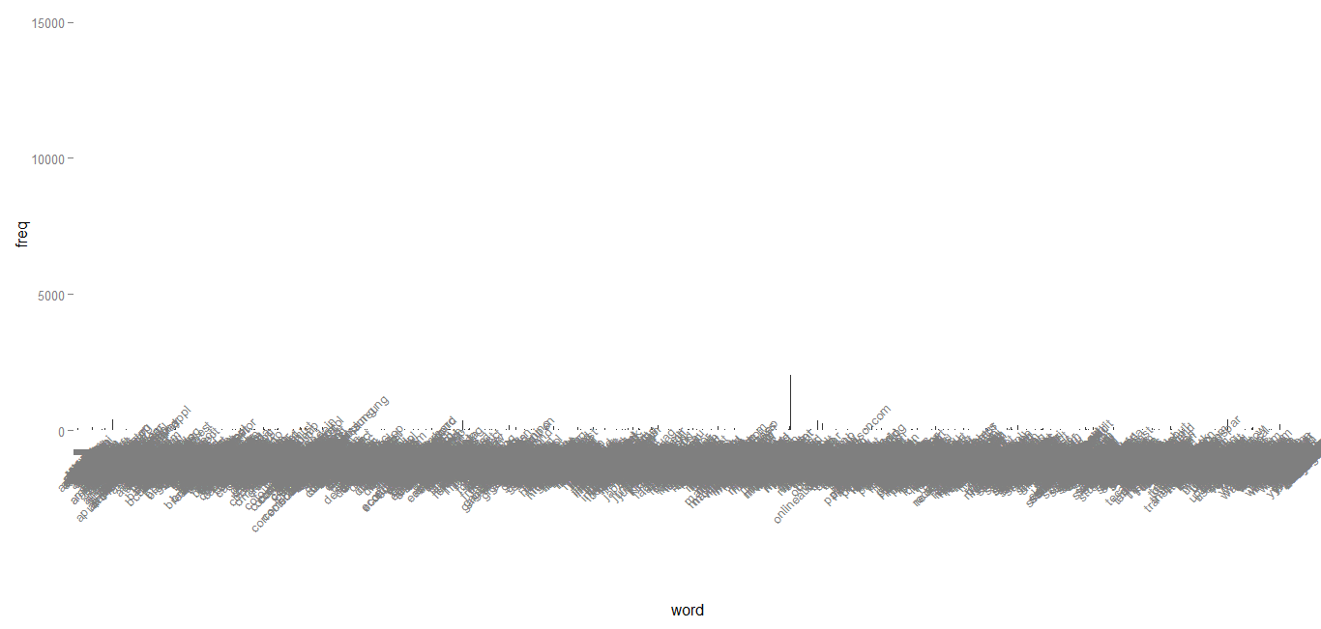
Exploratory Analysis of the Titles
Plot frequencies of words in titles

Slide 6
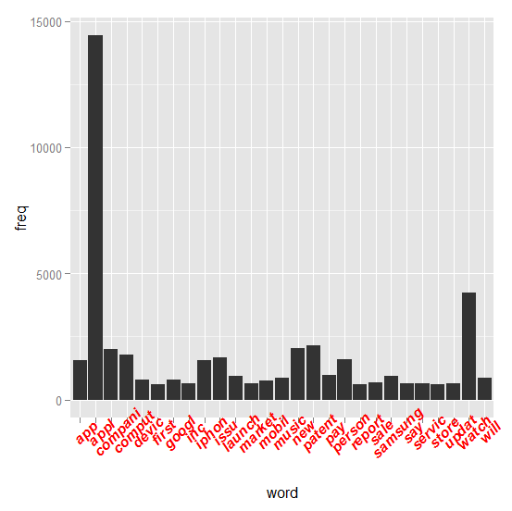
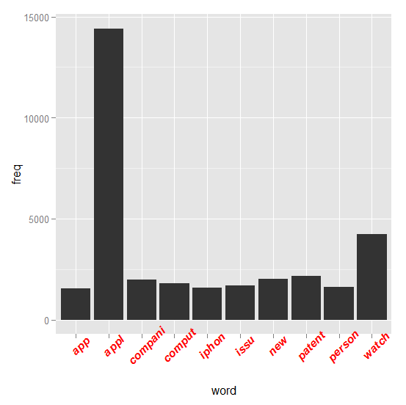
Exploratory Analysis of the Titles
Plot frequencies of words in titles

Slide 7
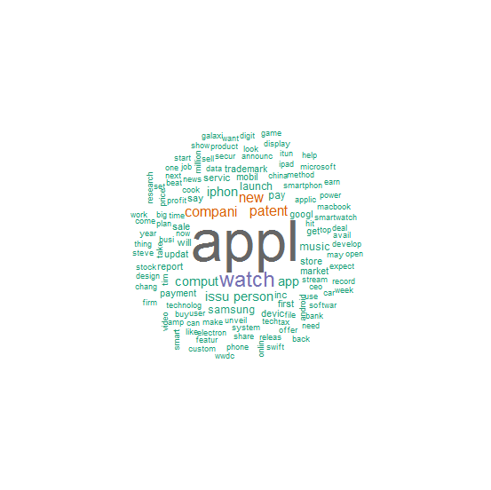
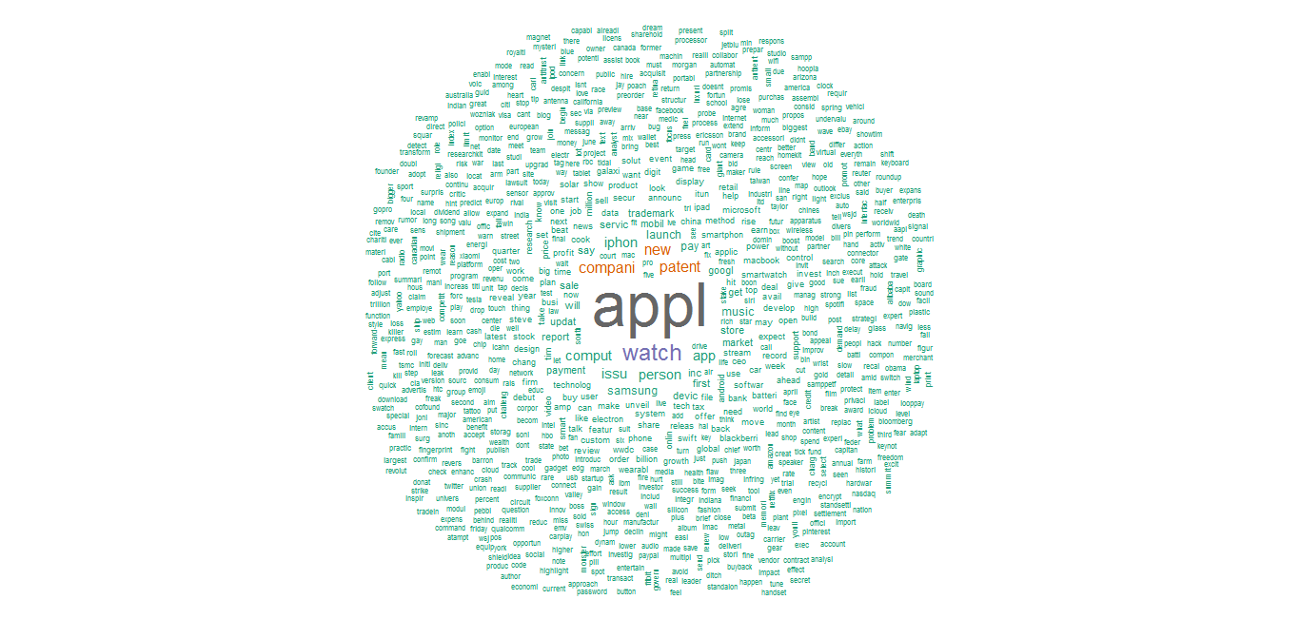
Exploratory Analysis of the Titles
Generate Wordcloud
min.freq=500

Slide 8
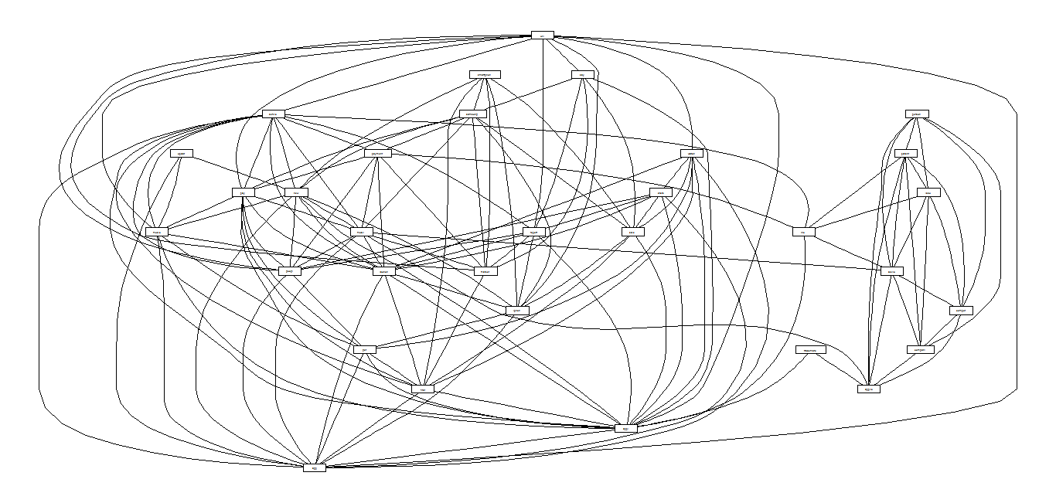
Exploratory Analysis of the Titles
Plot associations between words (lowfreq=500, cor=0.01)

Slide 9
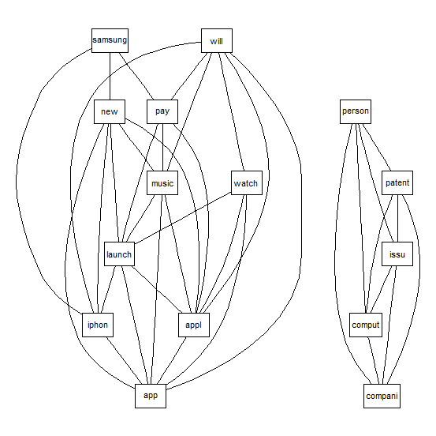
lowfreq=800, cor=0.01

Slide 10
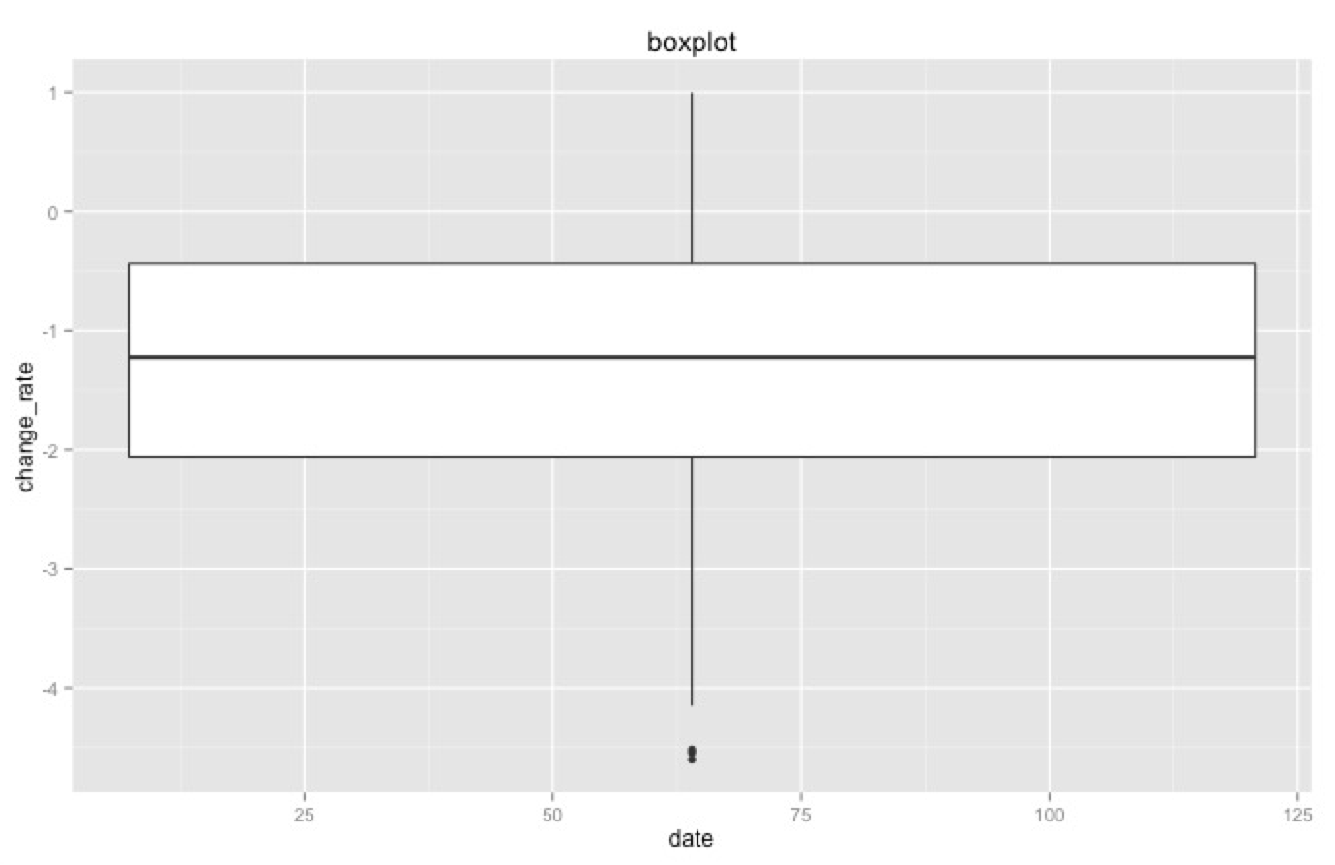
Overview of stock price data
Full Article Analysis
Outliers: -4.600579 -4.517768 -4.544040

Slide 11
Full Article Analysis
Overview of word frequencies
Lasso Regression
Principal Component Regression

Slide 12
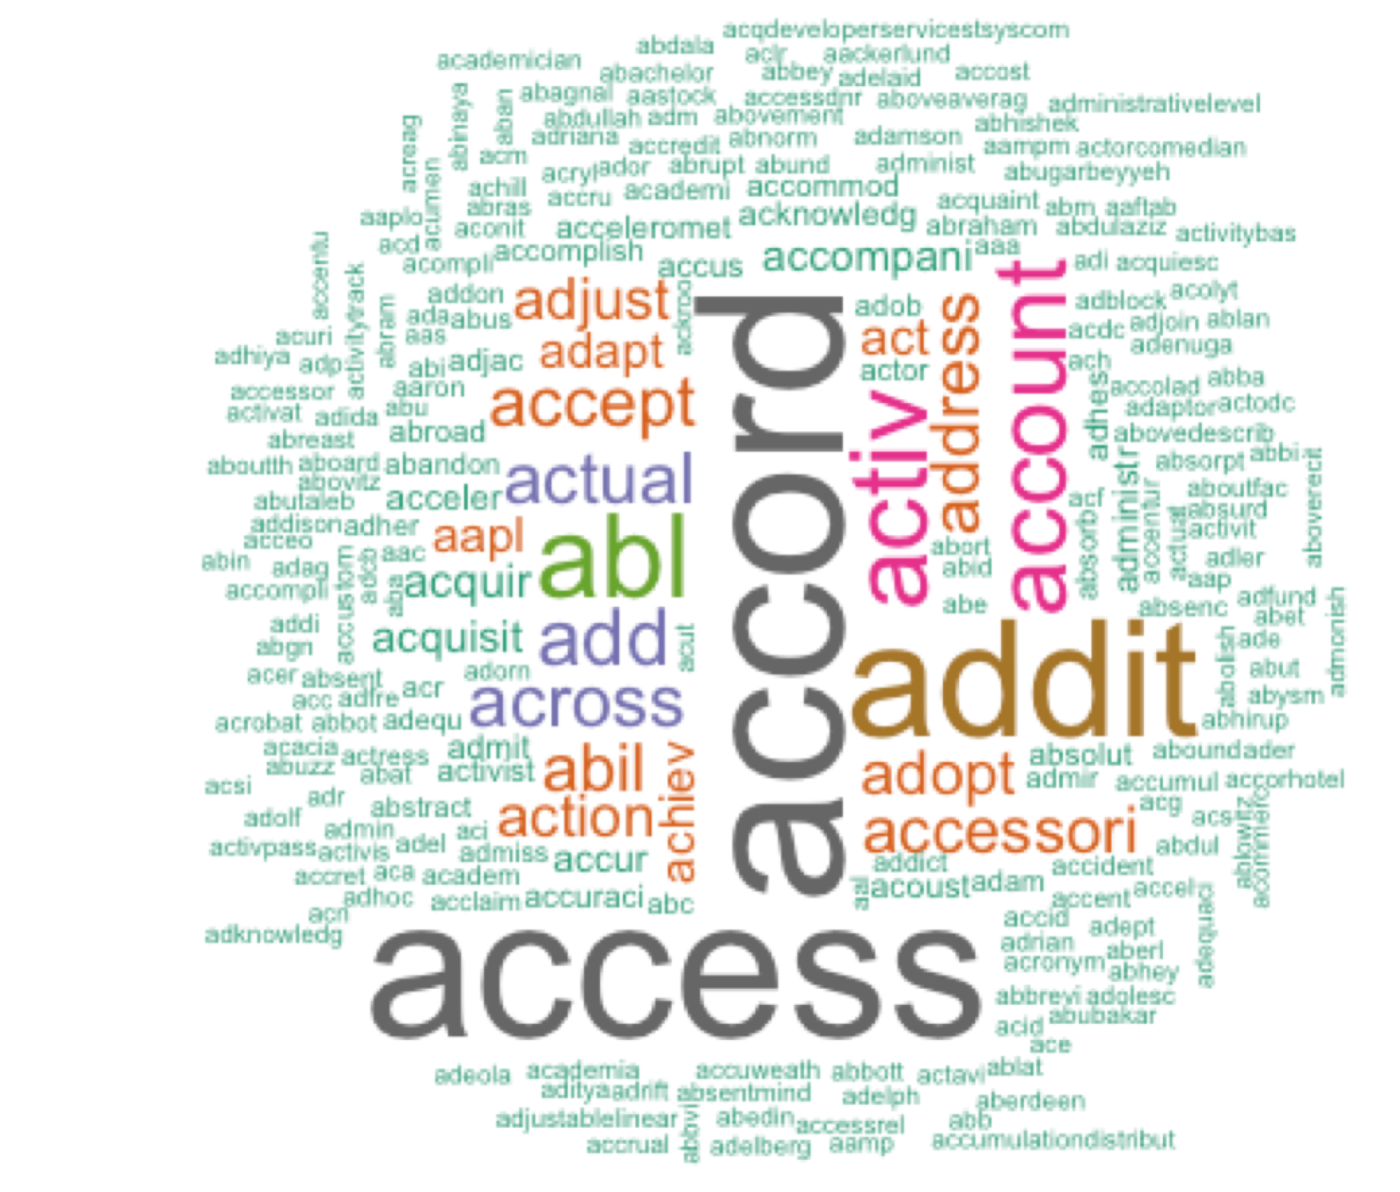
Overview of word frequencies

Slide 13
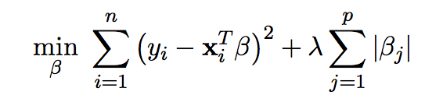
Lasso Regression
Fit a regularized linear regression function
Use cross validation to choose λ

Slide 14
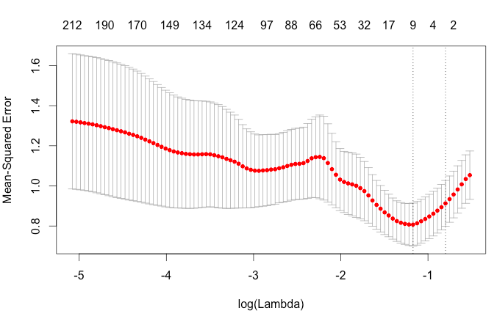

Outputs

Slide 15
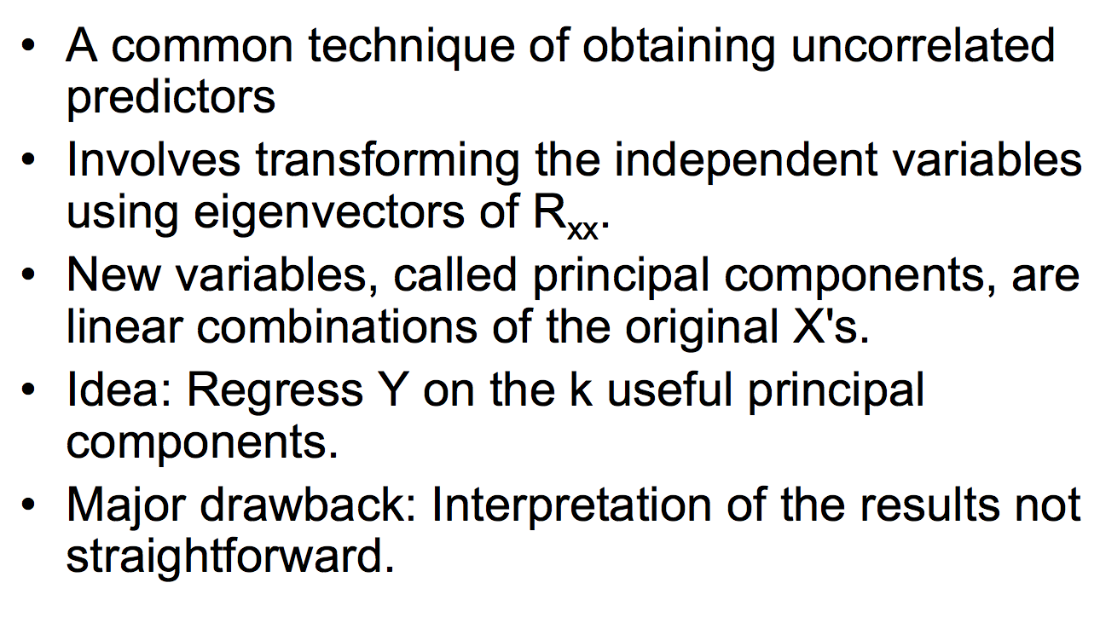
Principal Component Regression

Slide 16
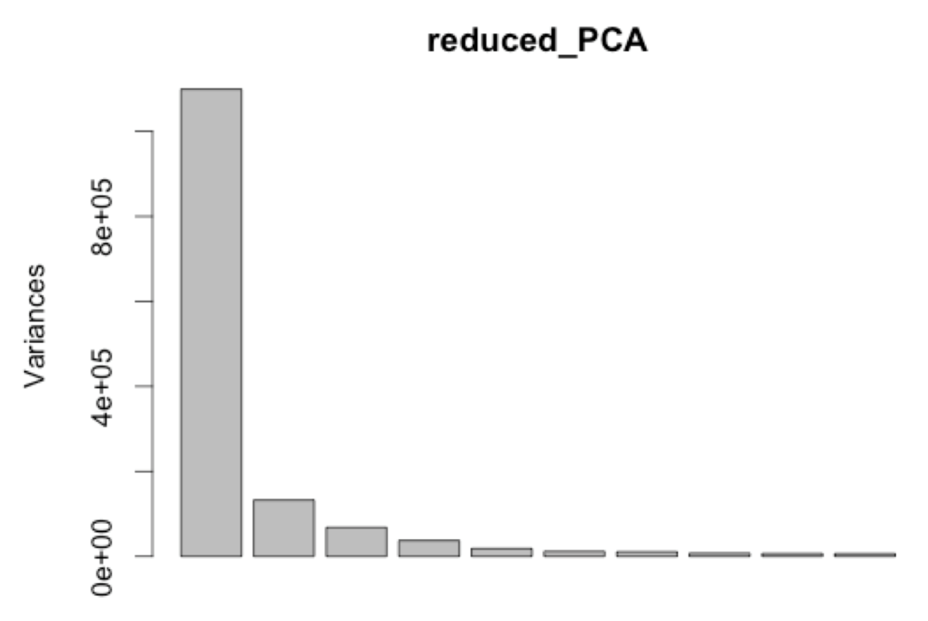
Outputs

Slide 17
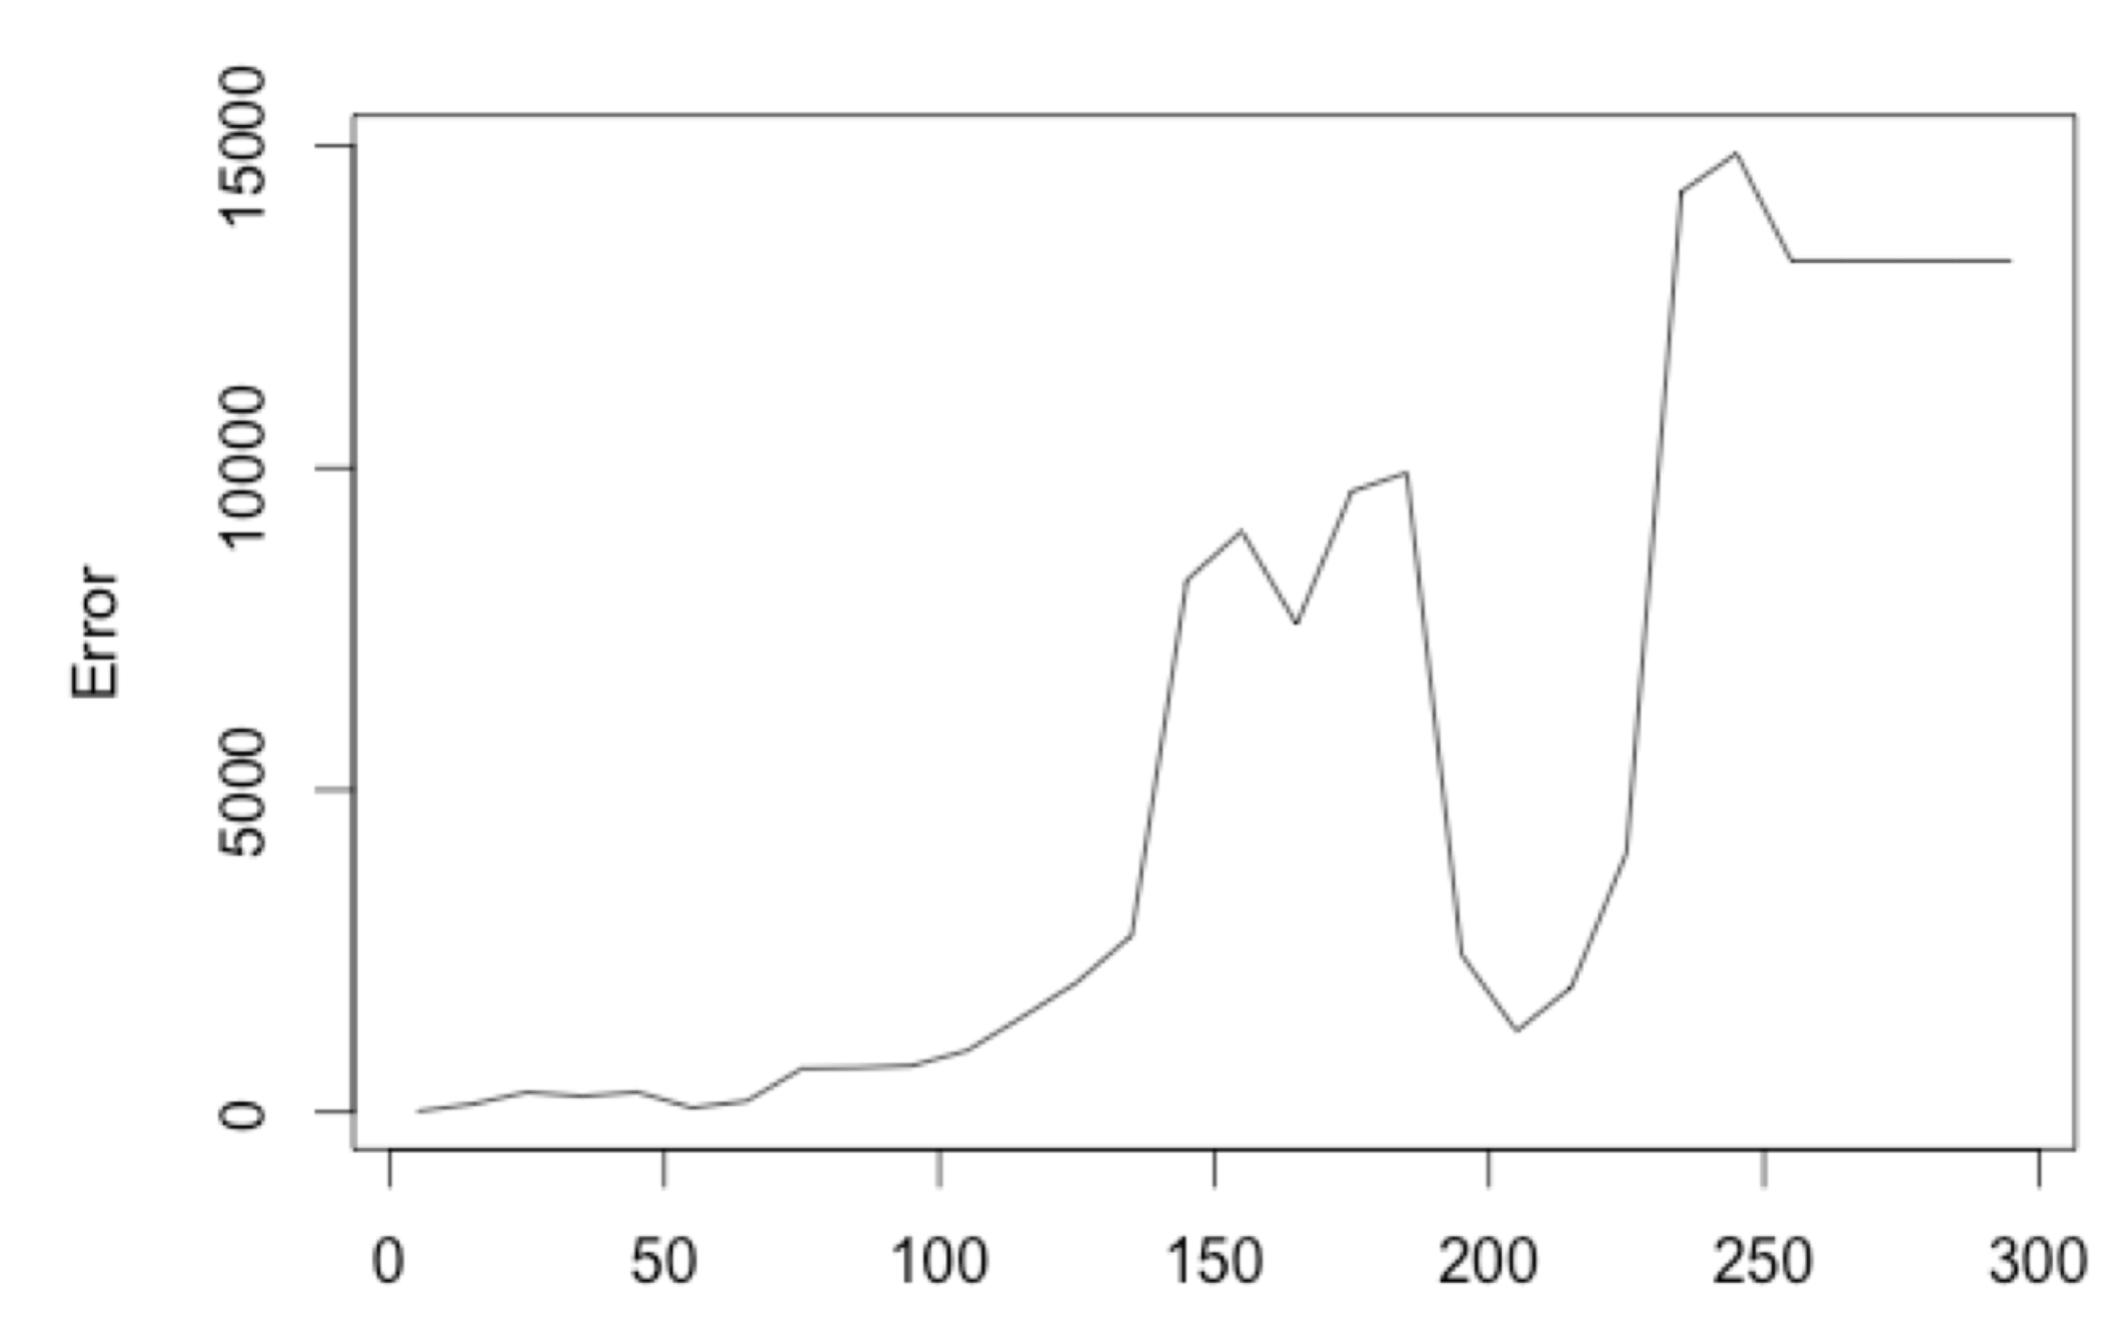
Test Errors for Top1-300 PCs

Slide 18
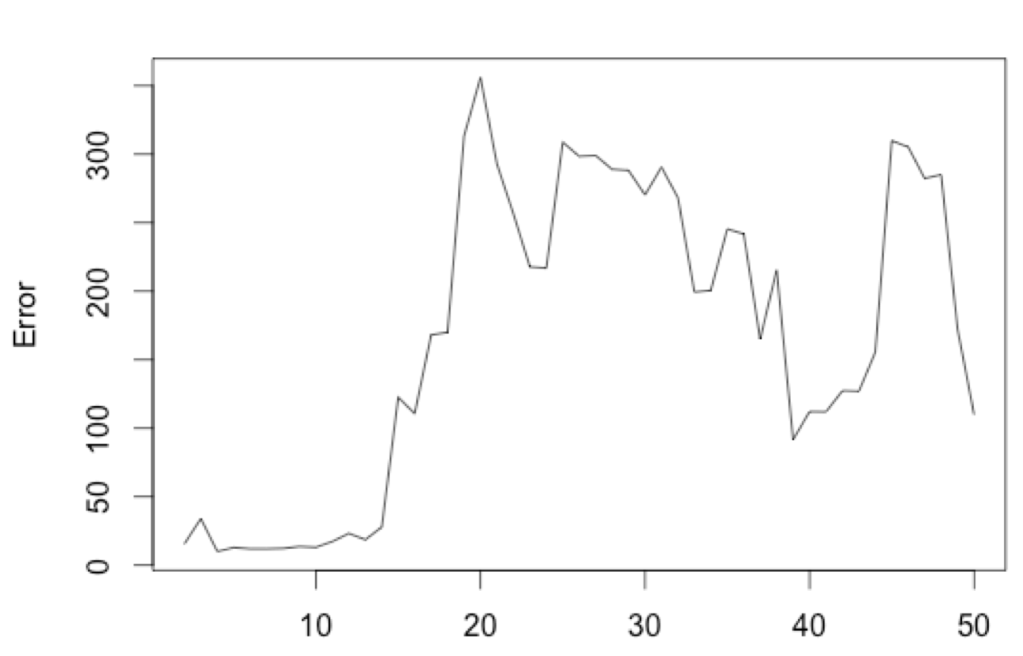
Test Errors for Top1-50 PCs

Slide 19
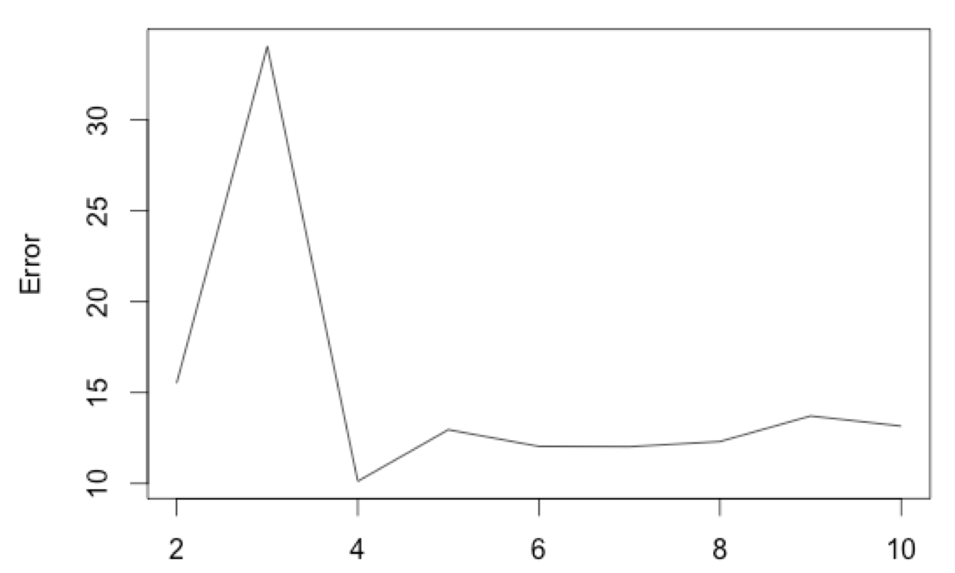
Test Errors for Top1-50 PCs

Slide 20
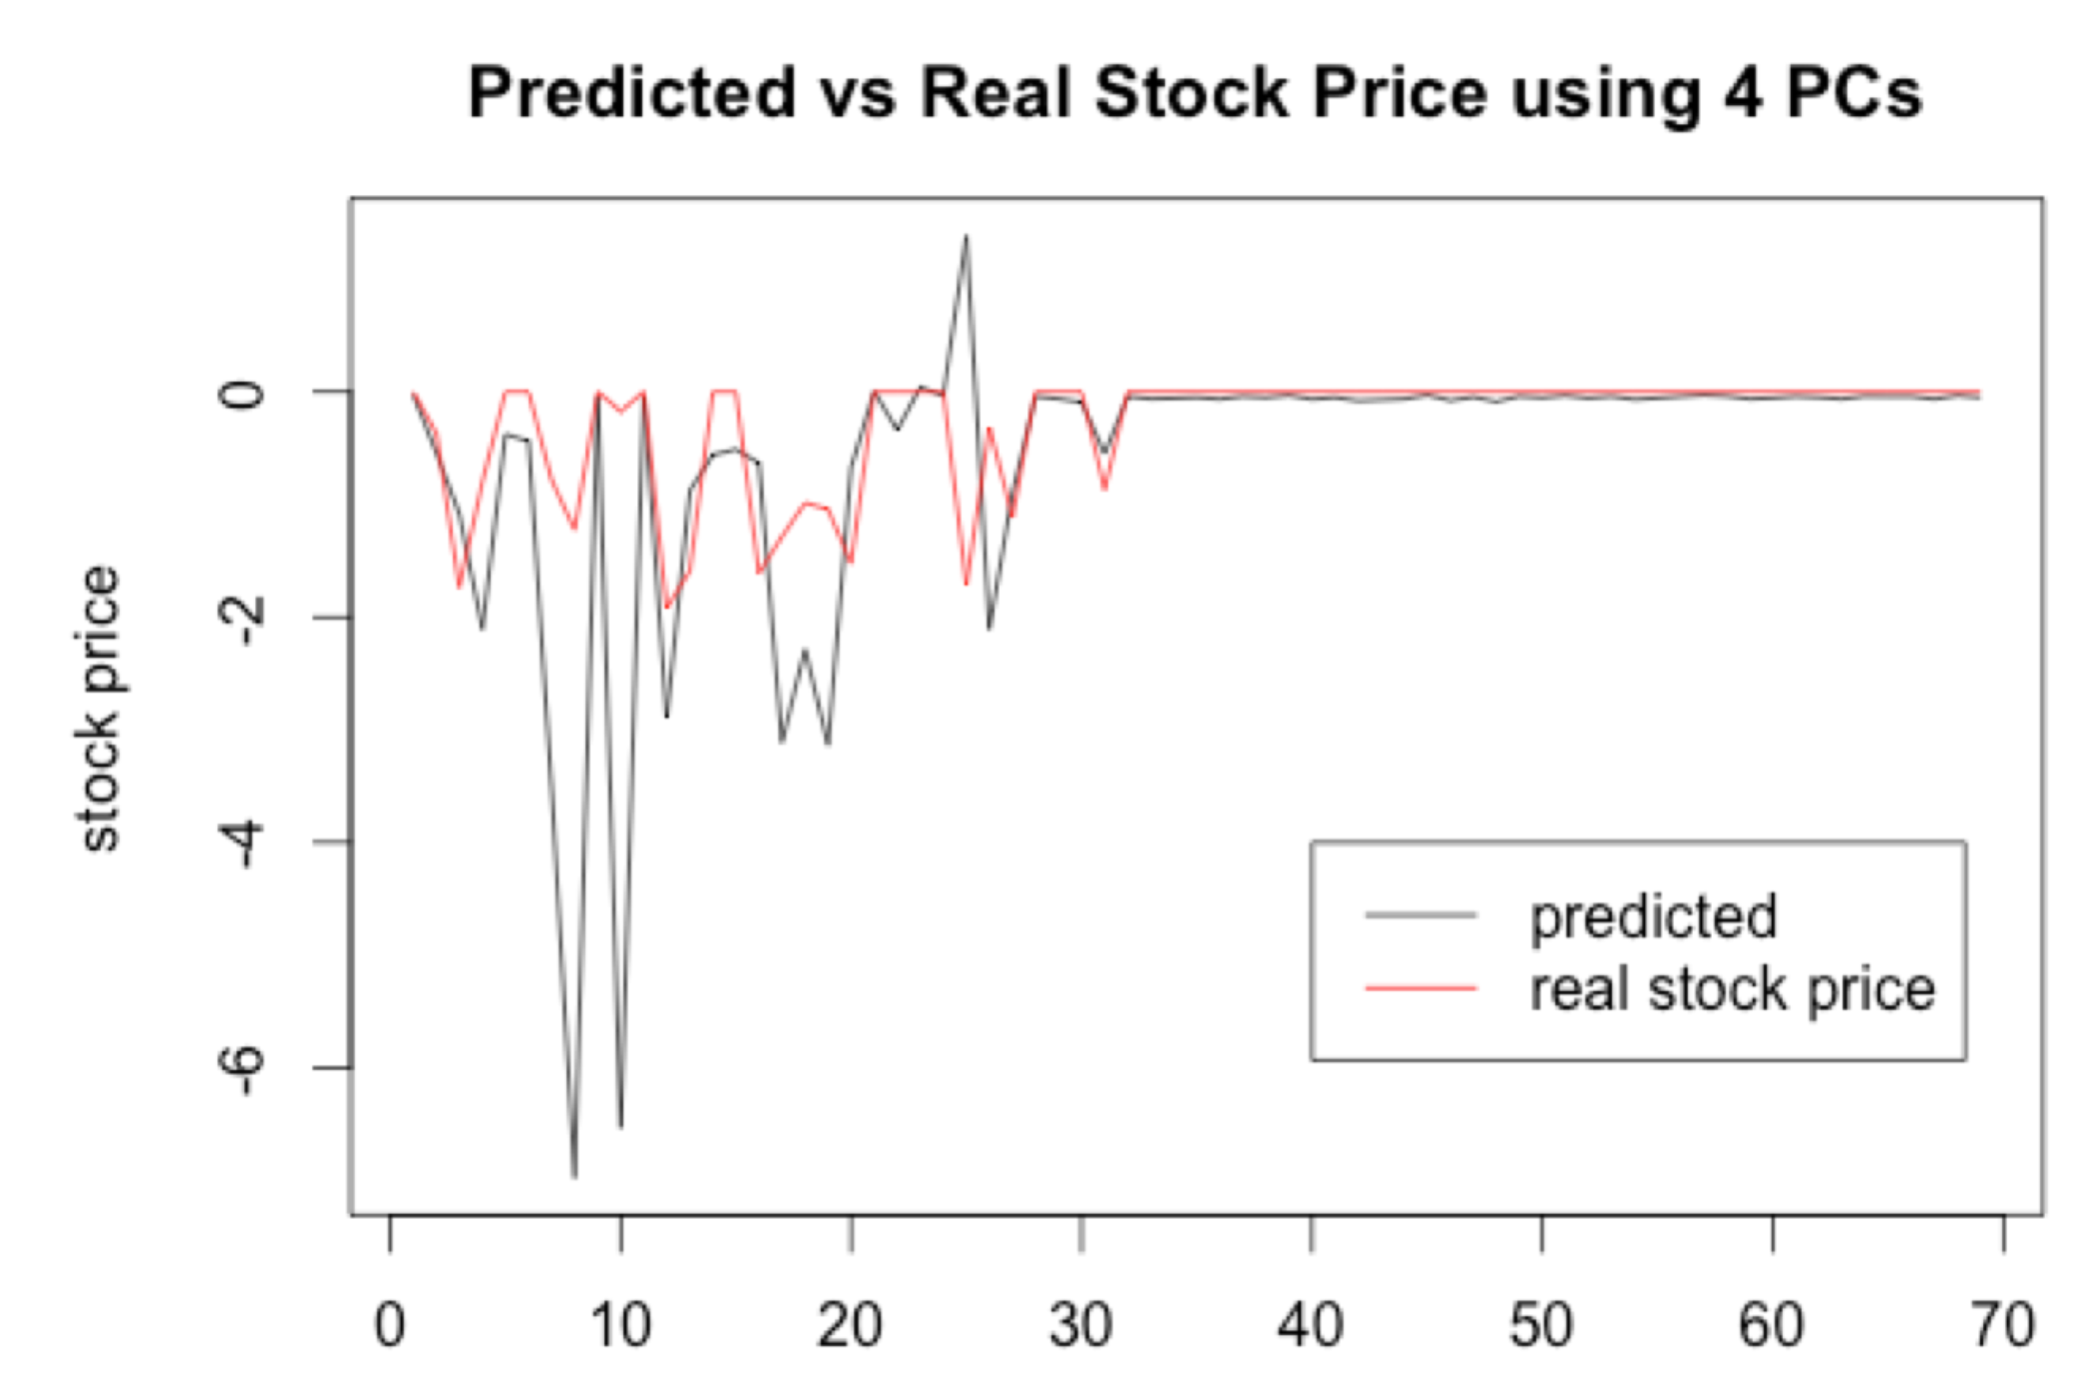

Slide 21
Sentiment Analysis
We downloaded two dictionaries of positive and negative words.
We used these words as “word variables” and full articles to generate a new document term matrix.
We used stock prices as our response variables, and ran a LASSO regression.

Slide 22
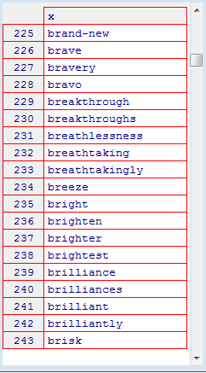
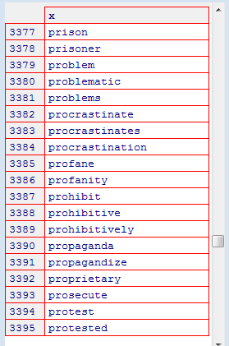

Slide 23
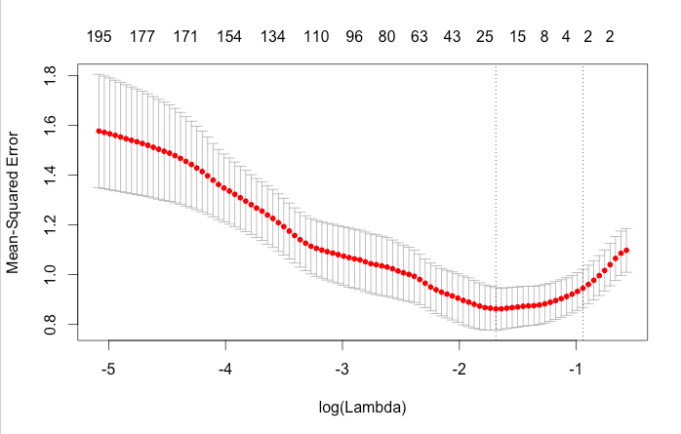
Sentiment Analysis
We used cross validation to choose the best Lambda for our regression.

Slide 24

Sentiment Analysis
These are the most important words the LASSO regression selected for fitting the model.
We could see most of them are negative words.

Slide 25
Conclusion
There are many things we could mine from news reports.
The data mined from reports about a certain company is highly correlated with the company’s stock price.
We could even use these data to predict the trend of stock price, which could be served as a guidance of our buying and selling stocks and evaluating the development of a company.
Thank you!

