Slide 1
Final Project Deep Learning
Using the Nutrition5k Dataset | 3 Model Architecture Comparison
Zac Bland
Deep Learning | Spring 2026

Slide 2
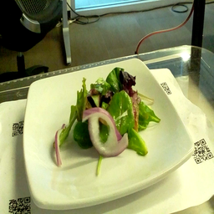
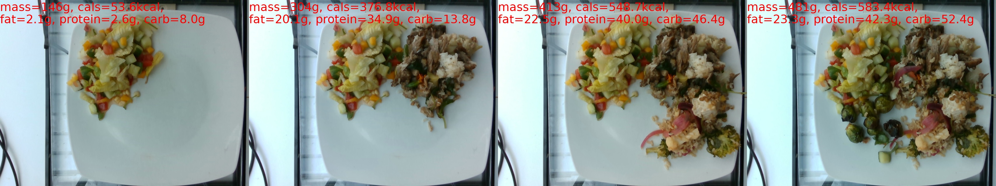
Project Definition
This project tackles the problem of automated nutrition estimation from food images.
Given a single overhead photograph of a prepared dish, the model predicts five nutritional values — calories, mass, fat, carbohydrates, and protein.
https://github.com/google-research-datasets/Nutrition5k

Slide 3
Dataset: Nutrition5k
https://github.com/google-research-datasets/Nutrition5k
5,006 unique dishes — each assembled in a lab with known ground-truth weights
Overhead RGB images + 4× side-angle video streams
~3,500 dishes have overhead images (subset used here)
Targets (continuous regression): Calories · Mass · Fat · Carbs · Protein
Split used in this project:
Train: 4,058 dishes Test: 708 dishes
Label normalization applied per-target (zero mean, unit variance) during training
Augmentation: random horizontal flip + random crop

Slide 4
Approach: Shared Backbone + Task Heads
Backbone: InceptionV3 pretrained on ImageNet
— Paper used InceptionV2 + JFT-300M (not publicly available)
Shared representation: 2048-dim feature vector from backbone
Multi-task regression: 5 independent (or conditioned) output heads
Loss: L1 (Mean Absolute Error) — robust to outliers
Optimizer: RMSProp (lr = 0.001, momentum = 0.9)
Schedule: CosineAnnealingLR (T_max = 100 epochs)
Backbone frozen for first 5 epochs, then fine-tuned end-to-end

Slide 5
Model 1: Baseline CNN
Architecture:
InceptionV3 (2048) → Dropout(0.6) → FC(4096) → ReLU
→ 5 × FC(4096) → ReLU → FC(1) [one head per target]
5 completely independent prediction heads
Direct translation of the paper’s described architecture
Training: batch=32, 100 epochs, early stopping patience=15

Slide 6
Model 2: Mass-Focus
Hypothesis: Mass is the most important nutrient; All other nutrients scale with mass.
Architecture:
InceptionV3 (2048) → mass_head → predicted_mass
[2048 || predicted_mass] (2049) → 4 × FC(4097) → ReLU → FC(1)
[cal, fat, carbs, protein conditioned on mass]
Task weights: TASK_WEIGHTS = [1, 3, 1, 1, 1] (mass weighted 3×)
Extra loss term encourages accurate mass prediction before downstream heads

Slide 7
Model 3: Mixture of Experts (MoE)
Architecture:
InceptionV3 (2048) → Gate Network (2048 → 4 logits, softmax)
4 Expert Networks: each FC(2048) → ReLU → FC(2048) → ReLU → FC(2048)
Weighted sum of expert outputs → 5 Task Heads: FC(2048→1024) → ReLU → FC(1)
Gating encourages specialization: different experts handle different dish types
Soft routing – all experts run, weighted by gate score

Slide 8
Training Details (All Models)
Common hyperparameters:
Batch size: 32
Max epochs: 100
Learning rate: 0.001
Dropout: 0.6
Backbone freeze: first 5 epochs
Early stopping: patience = 15
Optimizer: RMSProp (momentum=0.9)
Scheduler: CosineAnnealingLR
Loss: L1 (MAE)
Label normalization:
Mean & std computed on training set
Applied per target independently
Predictions de-normalized for evaluation
Data augmentation:
RandomHorizontalFlip
RandomResizedCrop(299)
Normalize (ImageNet stats)

Slide 9
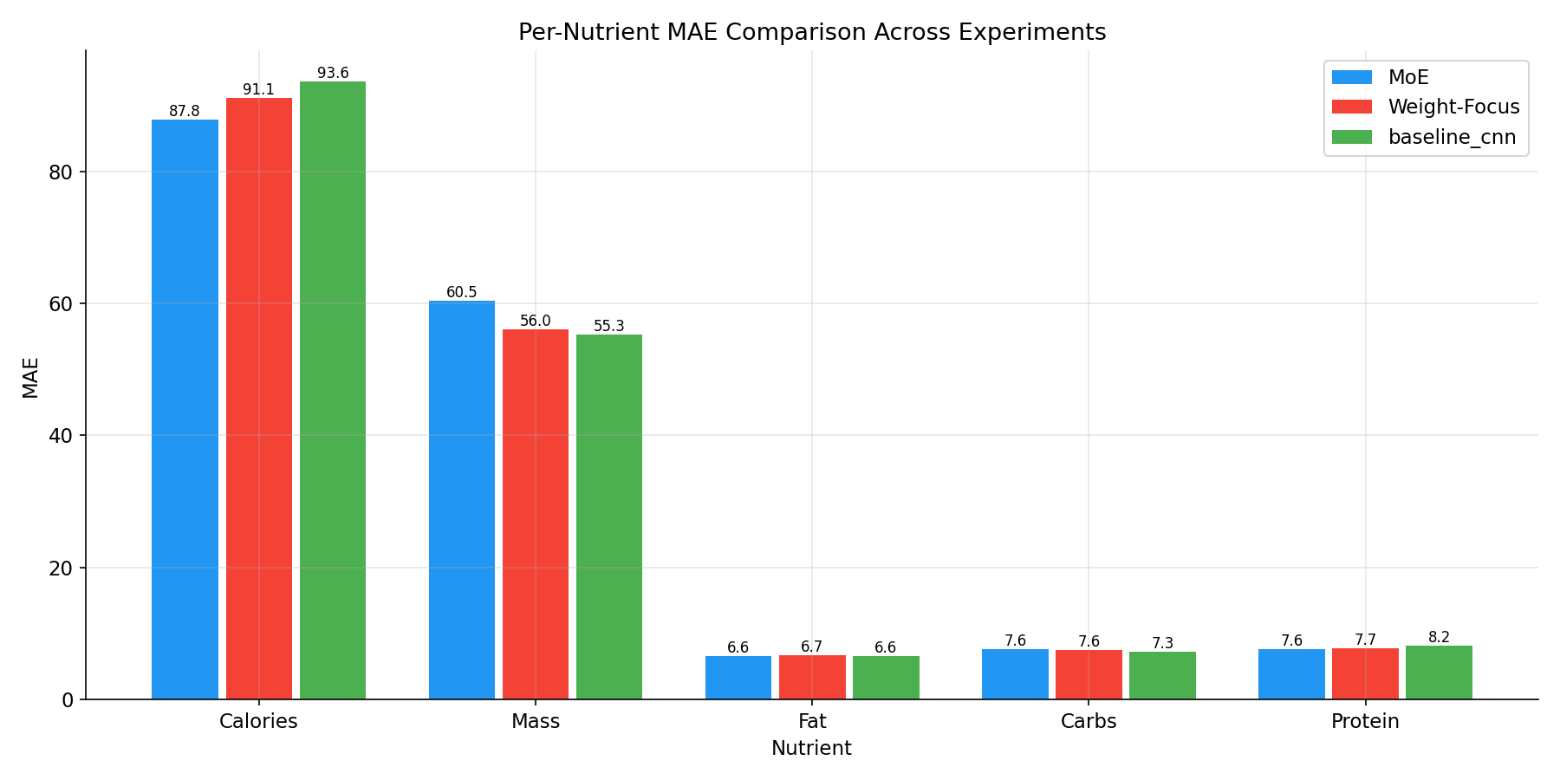
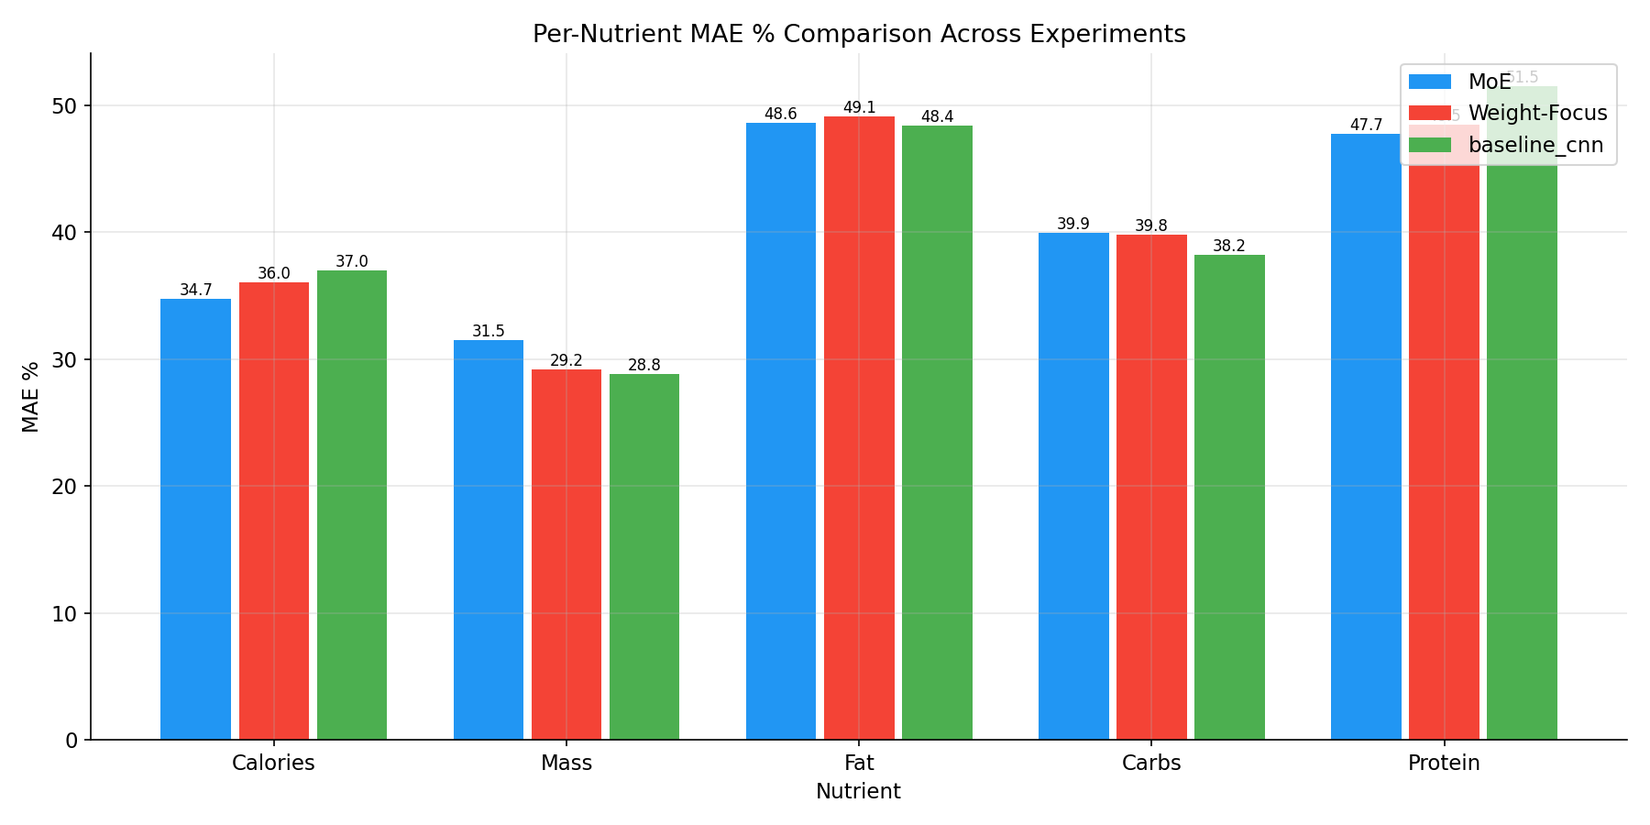
Results: MAE Comparison

Slide 10
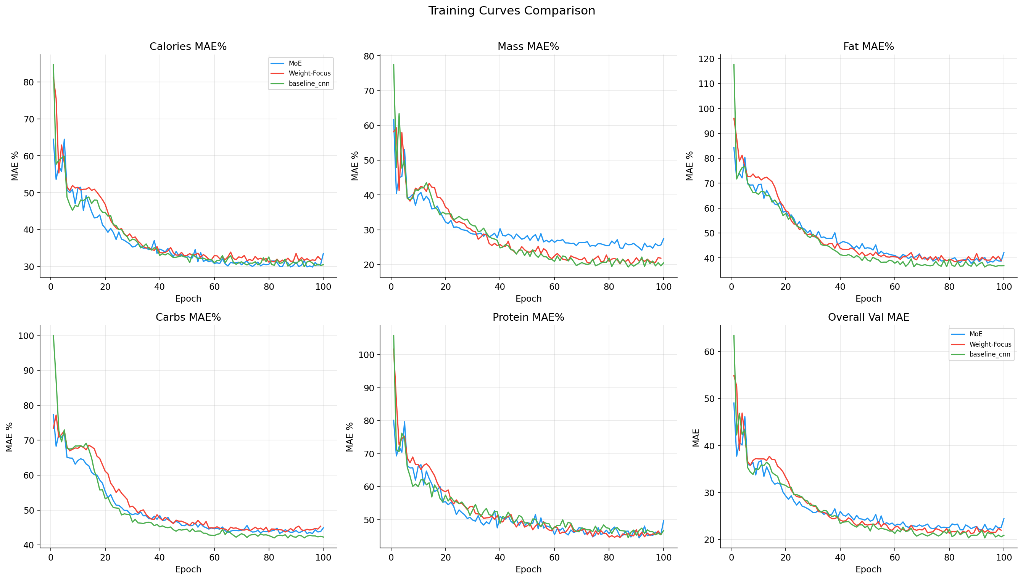
Results: Training Curves

Slide 11
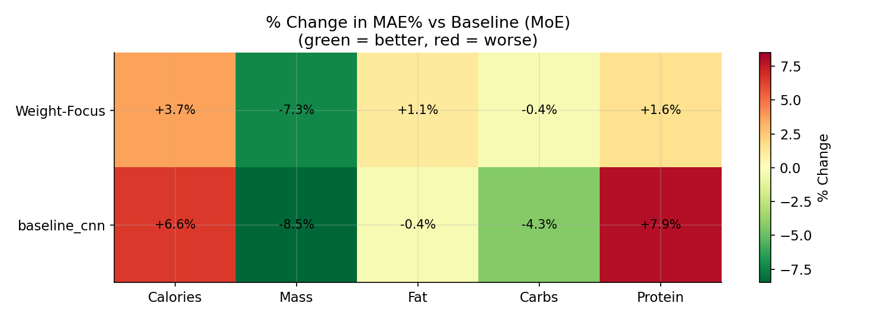
Results: Improvement Heatmap vs MoE

Slide 12
Conclusions
Baseline CNN achieved the best MAE% (Simple multi-head regression is hard to beat)
Weight Focus added complexity without the consistent gain
Mass Conditioning didn’t reliably help other targets as much as expected
MoE halves parameter count (65.9M vs 130.9M) with slight MAE% error.
Promising efficiency trade-off for deployment.
What else to explore:
More aggressive data augmentation.
Larger / newer backbone (EfficientNet-V2, etc.)

Slide 13
Questions?

