Slide 1
Final Project Screen Layout
By
Zac McClain, Jon Weldon, Arnold Filliat, and David Grisham

Slide 2
A Dynamic Layout
We intend to make our layout dependent on user selection for type of game.
When the program first starts up the user will see a dialog box that will prompt them for what type of game they would like to play.
The user will also be able change games whenever they want by using a file menu option.

Slide 3
A Dynamic Layout
Both the field and control panels will be unique based on the users choice for what game they wish to use.
The field panel will display the game field and player positions.
The control panel will give the user the ability to run plays at the speed and strategy of their choice.

Slide 4
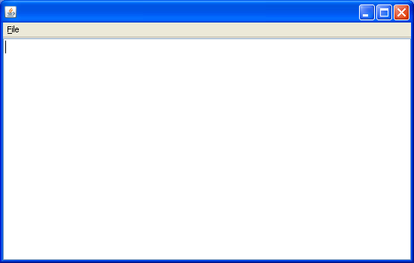
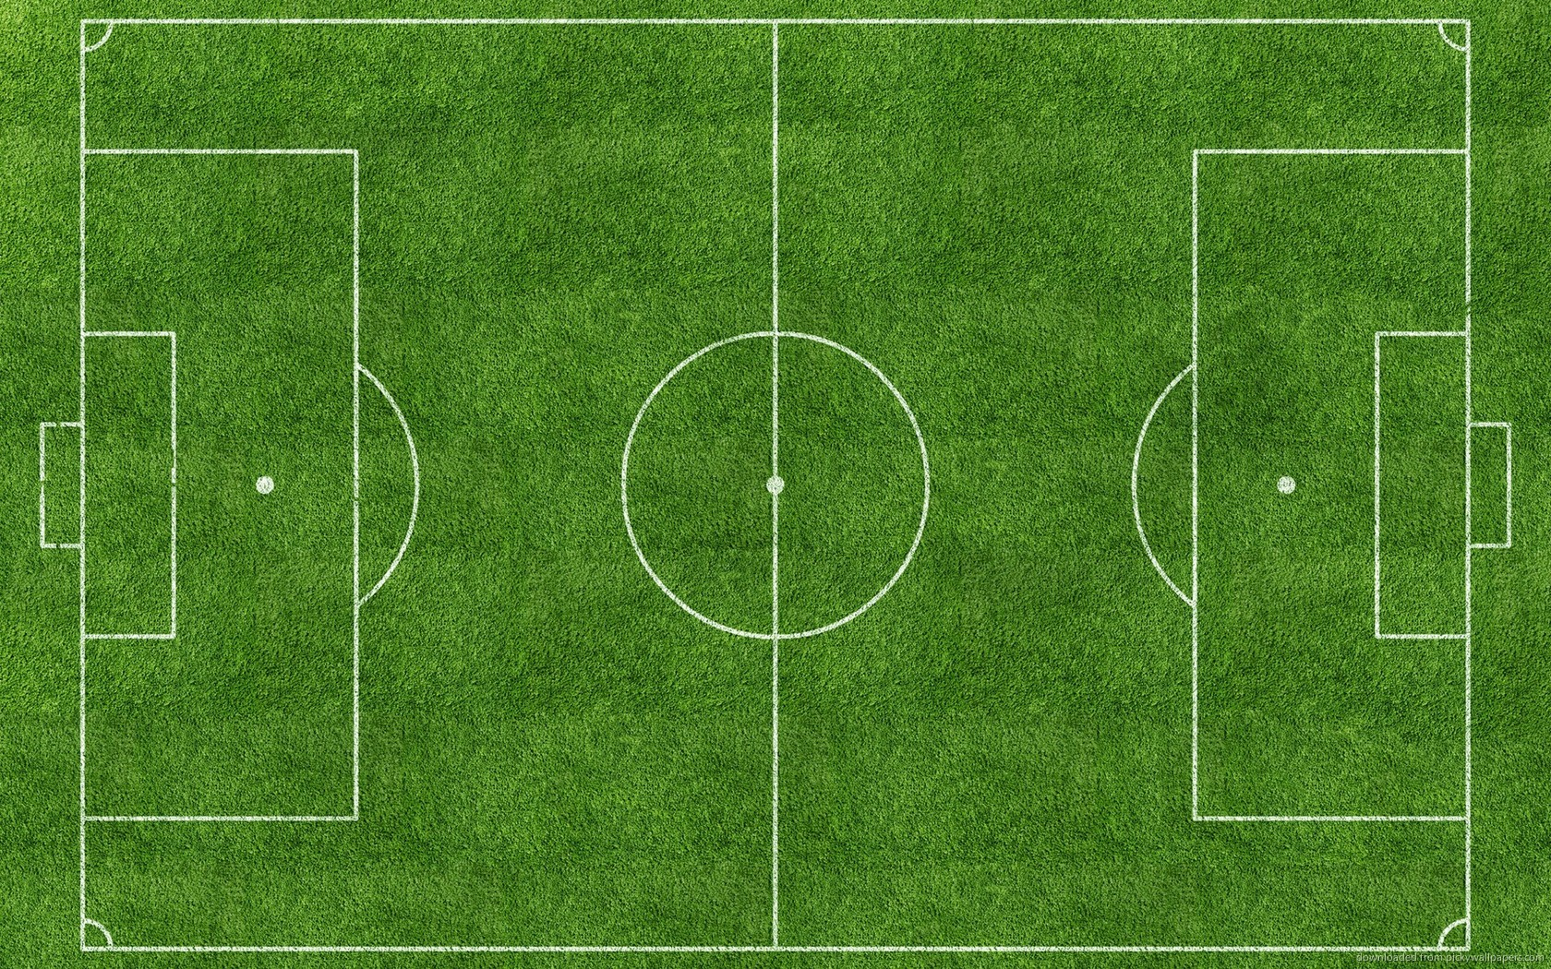
Soccer Layout
Strategy Simulator
Soccer
Game Speed:
Fast
Slow
Game Speed:
Play 1
Play 2
Play 3

Slide 5
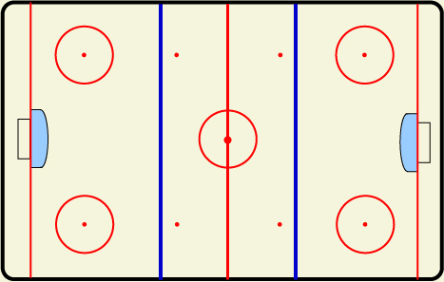
Hockey Layout
Strategy Simulator
Hockey
Game Speed:
Fast
Slow
Game Speed:
Play 1
Play 2
Play 3

Slide 6
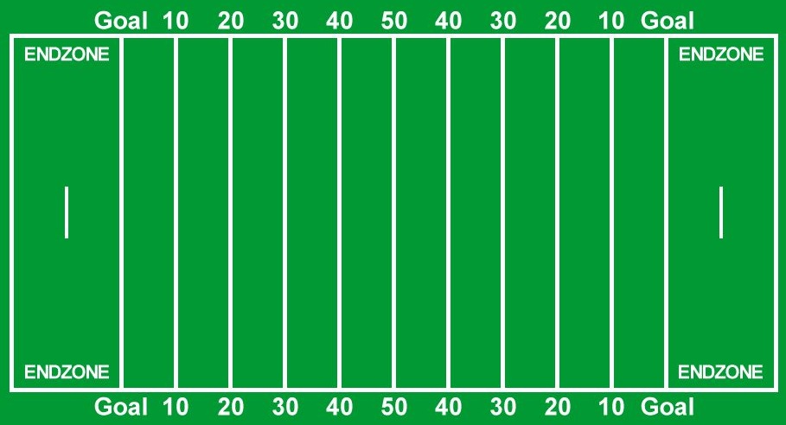
Football Layout
Strategy Simulator
Football
Game Speed:
Fast
Slow
Game Speed:
Play 1
Play 2
Play 3

