Slide 1

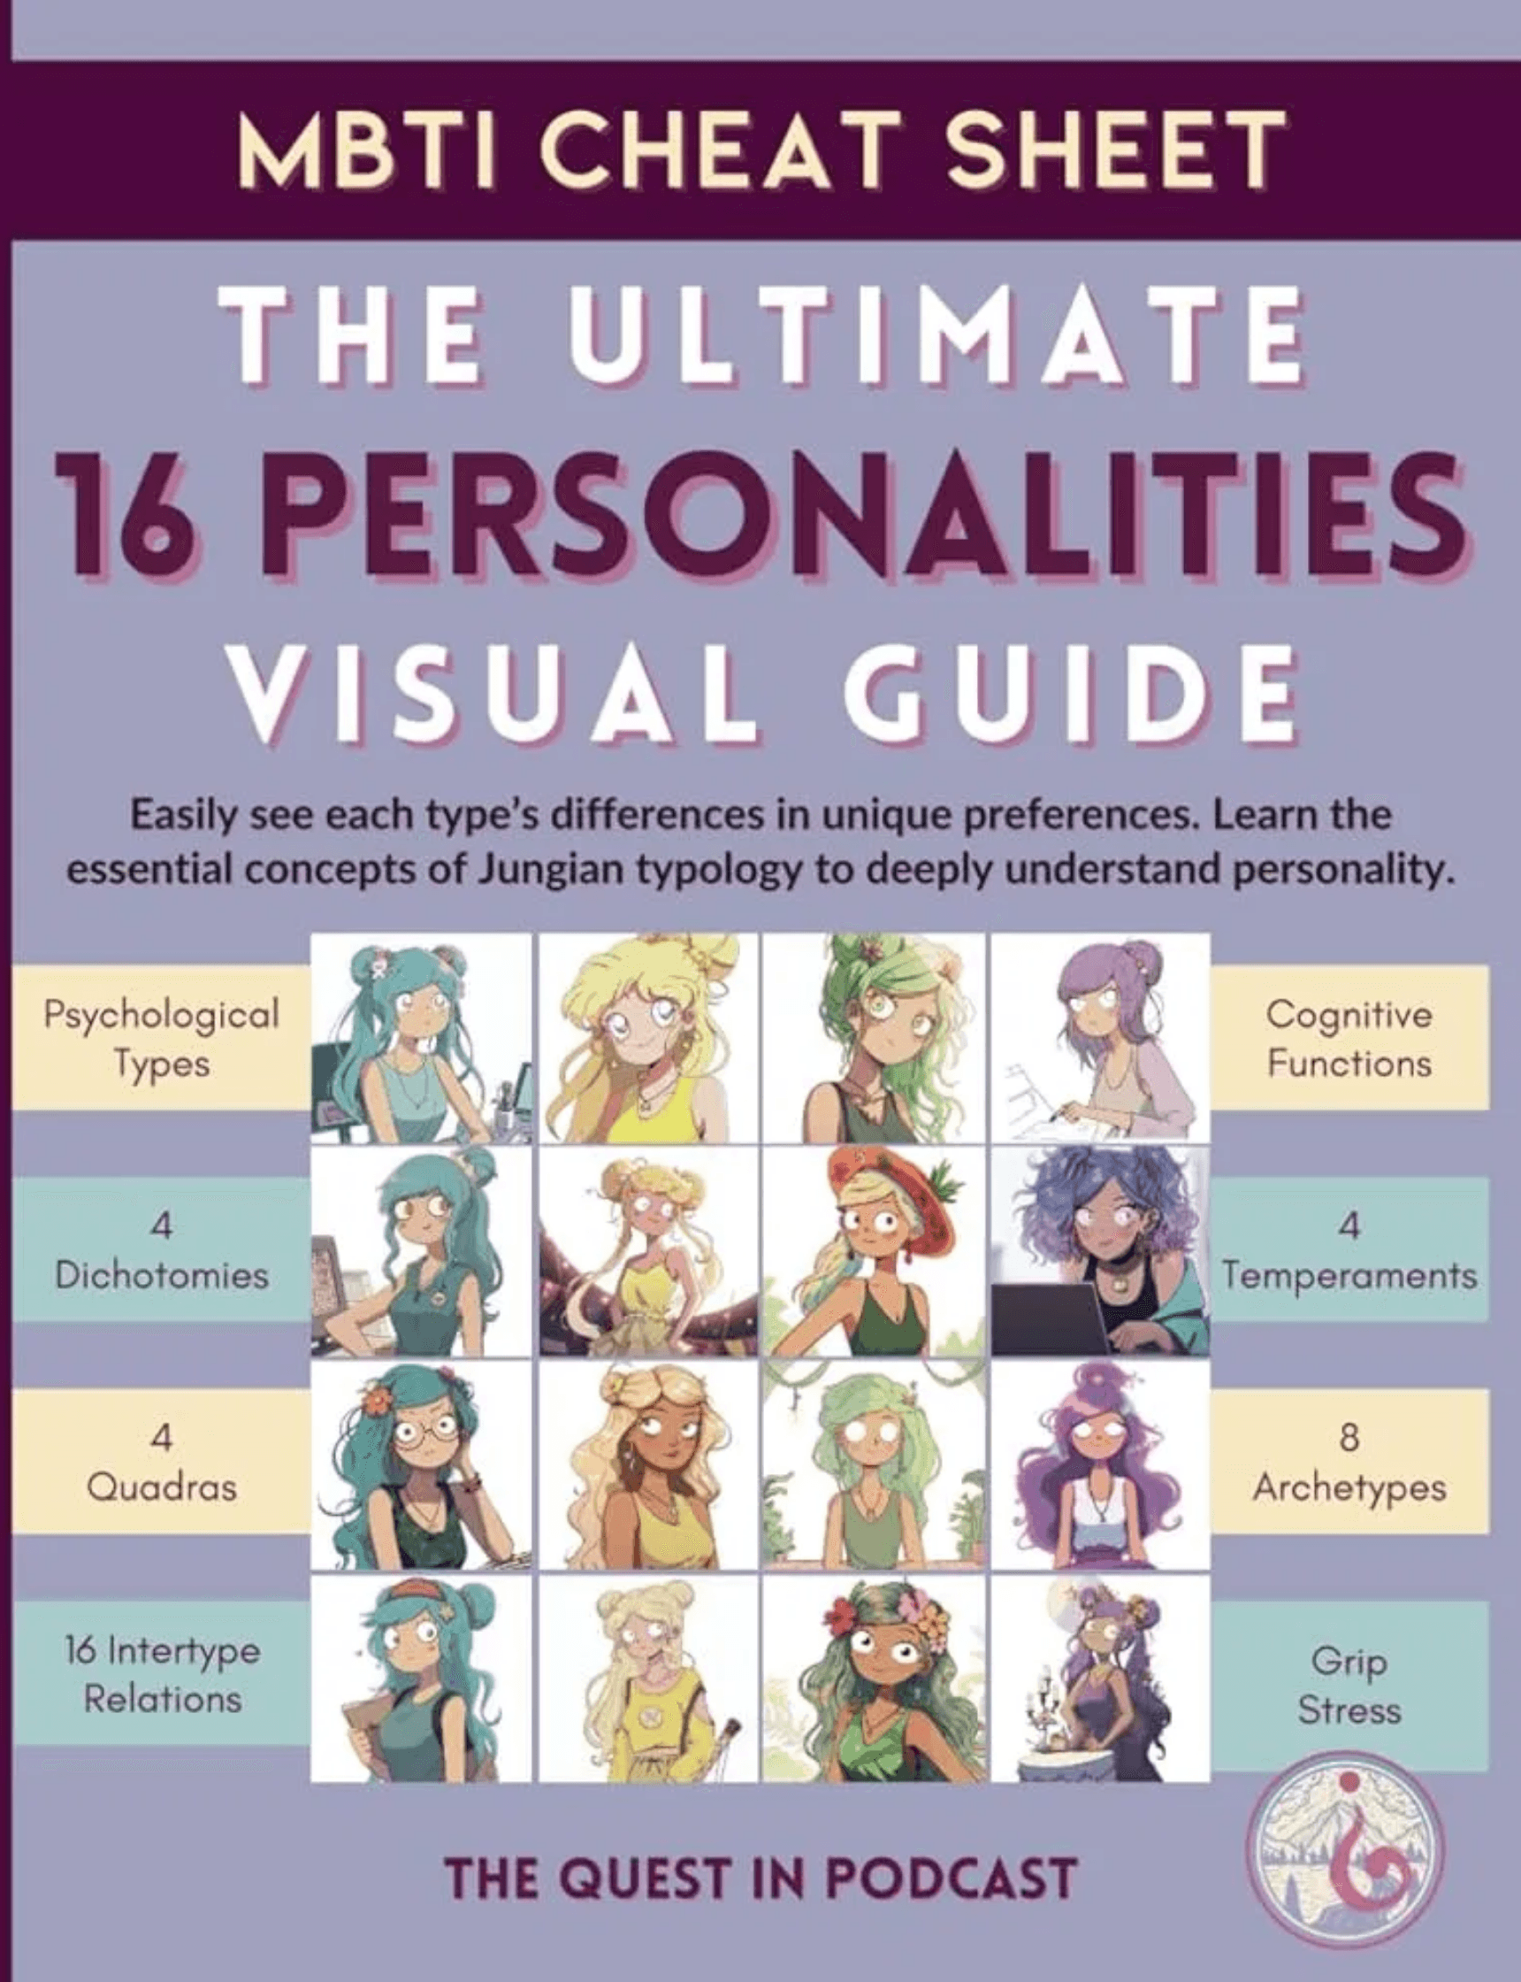
Understanding
Personality Types
A Journey of Self-Discovery
Manus AI
January 11, 2026

Slide 2

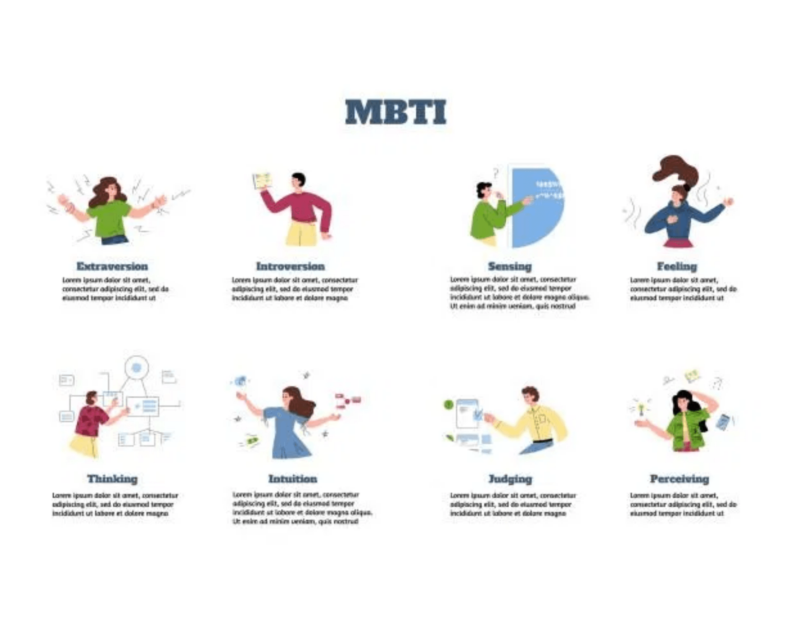
What Are Personality Types?
Personality types are frameworks for understanding human behavior, motivations, and preferences. They offer insights into how individuals perceive the world and make decisions.
Popular frameworks include the Myers-Briggs Type Indicator (MBTI) and the Big Five (OCEAN) model.
These tools are designed for self-understanding and appreciation of diversity, not for rigid labeling.

Slide 3

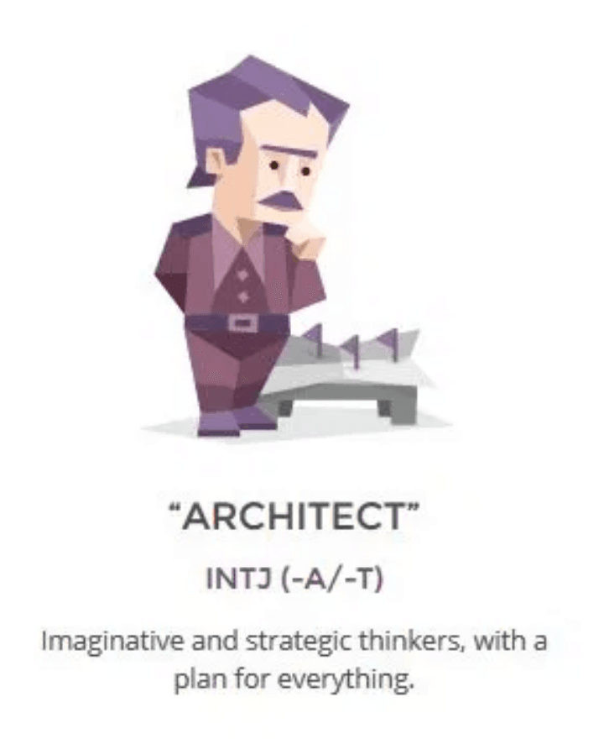
The Analysts: Strategic & Bold Thinkers
ENTJ
ENTJ (Commander)
INTJ (Architect)
Bold, imaginative, and strong-willed leaders who excel at strategy and organization. They are confident and charismatic.
Imaginative and strategic thinkers with a plan for everything. They value knowledge and competence.
Strengths
Decisive, Efficient, Inspiring
Strengths
Analytical, Innovative, Determined
Challenges
Impatience, Insensitivity
Challenges
Overly Critical, Dismissive of Emotions

Slide 4

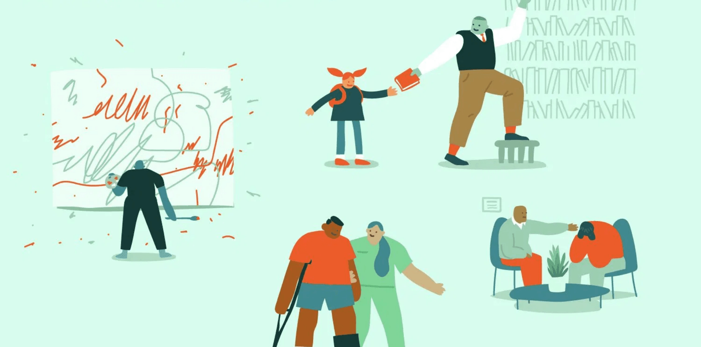
The Diplomats: Idealistic & Enthusiastic Advocates
ENFP
The Campaigner
INFP (Mediator)
ENFP (Campaigner)
Poetic, kind, and altruistic individuals driven by strong inner values and a desire for harmony. They are creative and open-minded.
Enthusiastic, creative, and sociable free spirits who love exploring new ideas. They are curious, energetic, and people-oriented.
Strengths:
Empathetic, Compassionate, Dedicated
Strengths:
Charismatic, Creative, Communicative
Challenges:
Excessive Idealism, Self-Isolation
Challenges:
Distraction, Difficulty with Routine

Slide 5

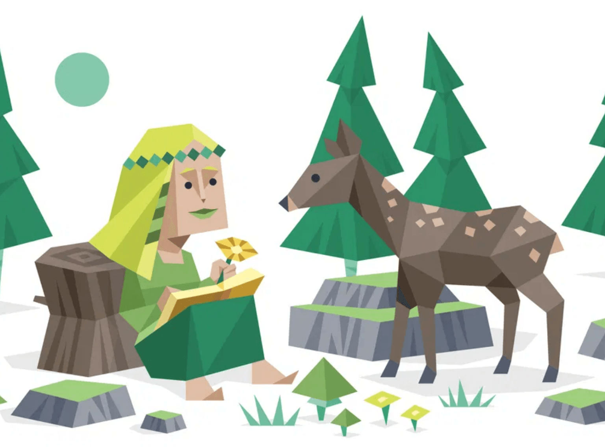
The Sentinels: Practical & Dedicated Guardians
ISTJ (Logistician)
ISFJ (Defender)
Practical and fact-minded individuals whose reliability is unquestionable. They are responsible, organized, and detail-oriented.
Very dedicated and warm protectors, always ready to defend their loved ones. They are observant, supportive, and value security.
Strengths:
Responsible, Logical, Meticulous
Strengths:
Supportive, Reliable, Patient
Challenges:
Shyness, Over-burdened
Challenges:
Rigidity, Resistant to Change

Slide 6

The Explorers: Artistic & Bold Experimenters
ISFP (Adventurer)
ISTP (Virtuoso)
Flexible and charming artists, always ready to explore and experience something new. They are spontaneous, sensitive, and appreciate beauty.
Bold and practical experimenters, masters of all kinds of tools. They are independent, spontaneous, and enjoy hands-on work.
Strengths
Strengths
Artistic talent, Adaptability, Living in the present, Charming
Practicality, Calmness under pressure, Technical skill, Spontaneous
Challenges
Challenges
Unpredictability, Avoiding conflict, Easily stressed
Stubbornness, Risk-proneness, Private nature

Slide 7

The Debater (ENTP)
The Intellectual Challenger
Core Identity
Key Strengths
Growth Areas
Smart and curious thinkers who cannot resist an intellectual challenge. ENTPs are innovative, quick-witted, and enjoy playing "devil's advocate" to explore every angle of an idea. They thrive on brainstorming and deconstructing complex concepts.
Can be Argumentative
Knowledgeable
& Versatile
Quick & Original Thinkers
Insensitivity to Others
Excellent Communicators
Difficulty with Focus
Charismatic & Energetic
Dislike for Routine
The Intellectual Edge
Unlike more rigid types, Debaters are masters of mental agility. They don't just solve problems; they redefine them, often finding solutions that others miss by questioning fundamental assumptions.

Slide 8

The Protagonist (ENFJ): The Inspiring Mentor
Charismatic and inspiring leaders who are able to mesmerize their listeners. They are warm, empathetic, and highly social, driven by a desire to help others.
Key Characteristics
Strengths & Challenges
ENFJs are natural-born leaders, full of passion and charisma. They often serve as the backbone of their communities, guiding others with their strong intuition and altruistic nature.
Strengths:
Inspiring, Tolerant, Reliable, Altruistic
Challenges:
Overly Idealistic, Self-Sacrificing, Struggle with Tough Decisions

Slide 9

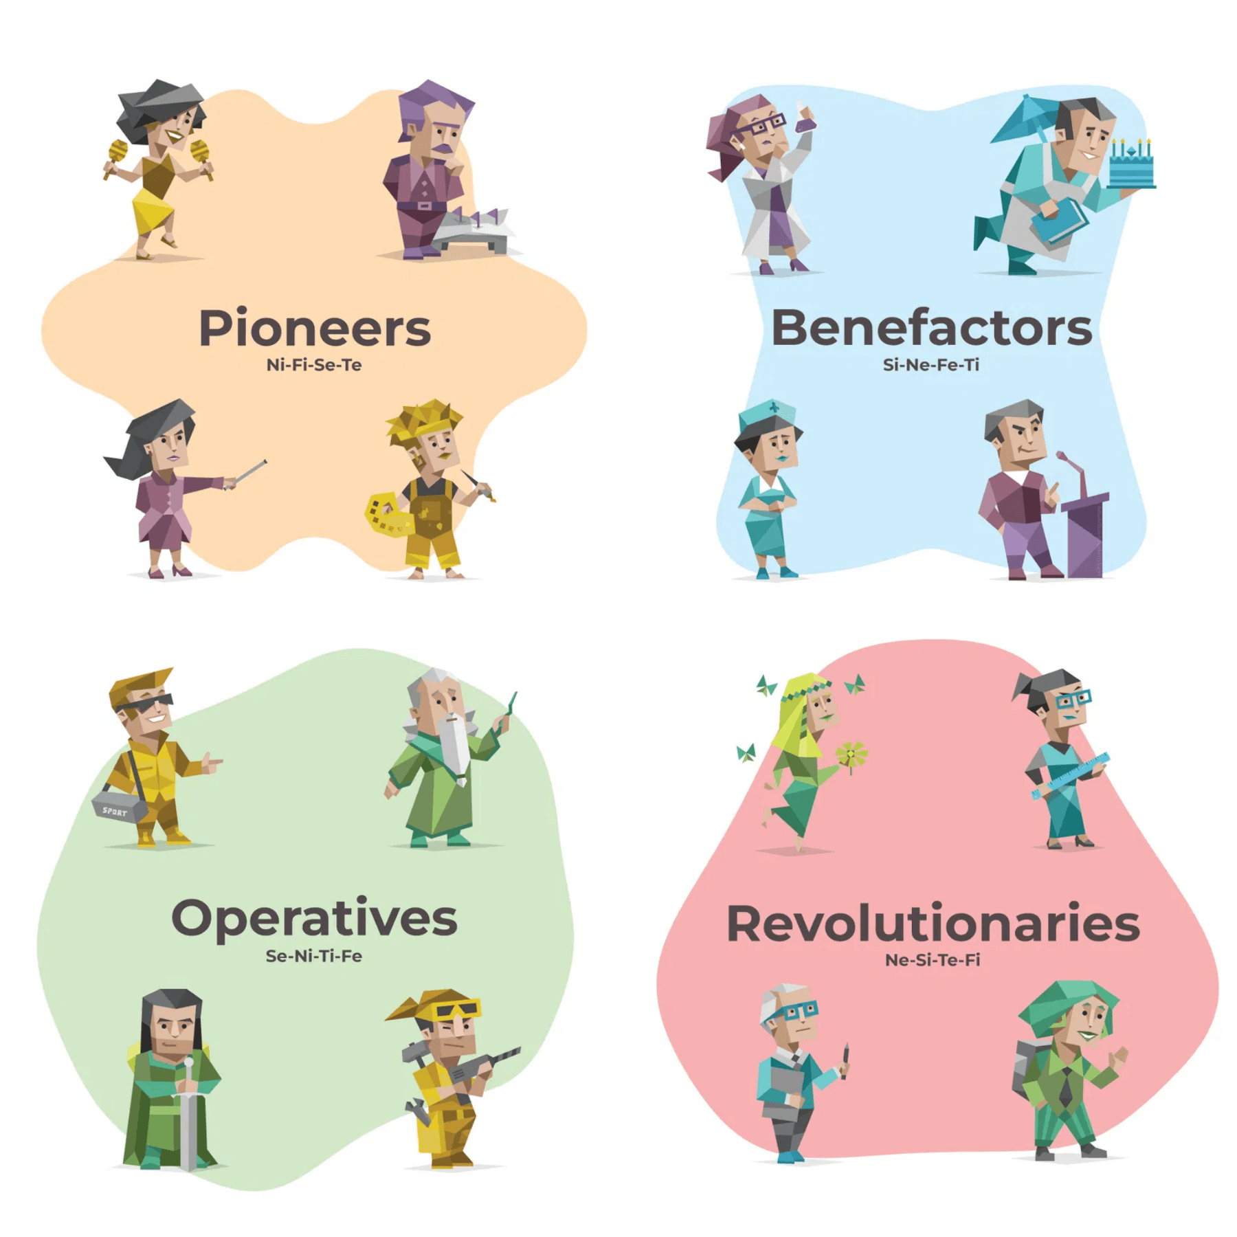
Embracing Diversity: The Power of Different Personalities
Self-Awareness
Empathy
Understanding your own type is the first step toward personal growth and emotional intelligence.
Recognizing the motivations of others fosters better communication and reduces interpersonal conflict.
Collaboration
Synergy
Diverse teams bring a wider range of perspectives, leading to more innovative and robust solutions.
When we appreciate our differences, we can leverage each other's strengths to achieve common goals.

Slide 10

THANK YOU
Questions & Discussion
"The meeting of two personalities is like the contact of two chemical substances: if there is any reaction, both are transformed." — C.G. Jung

