Slide 1
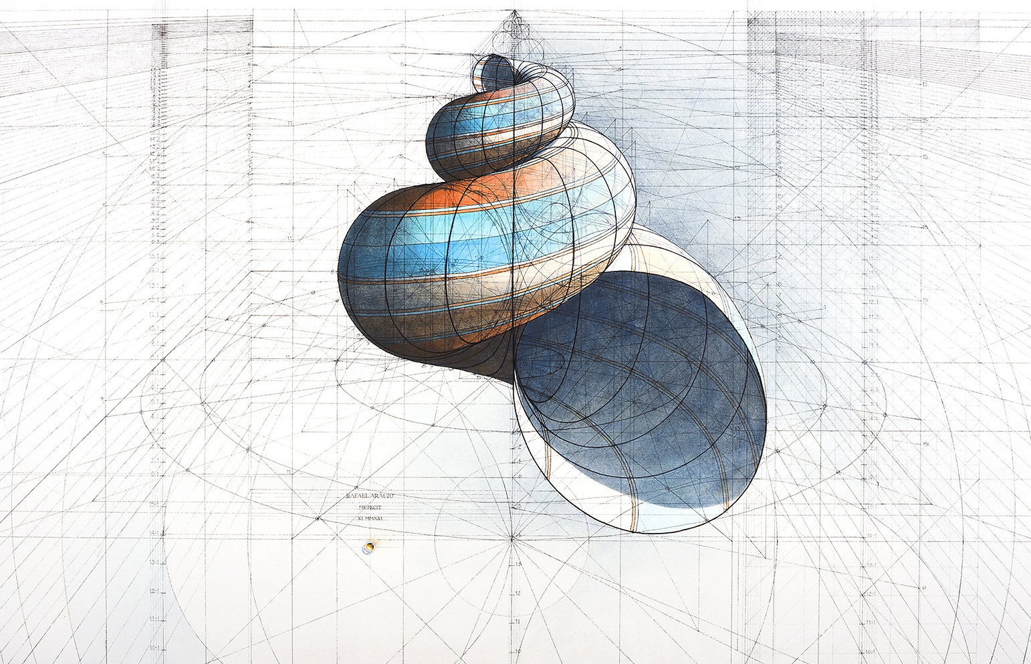

Slide 2
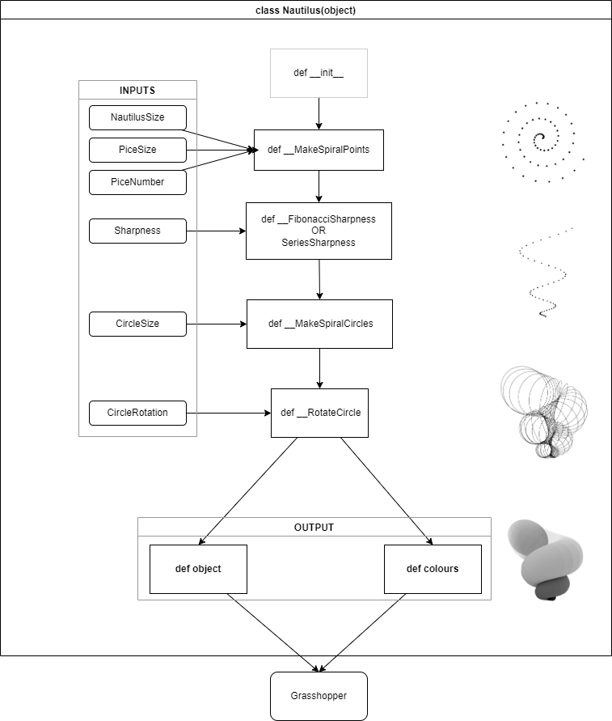

Slide 5
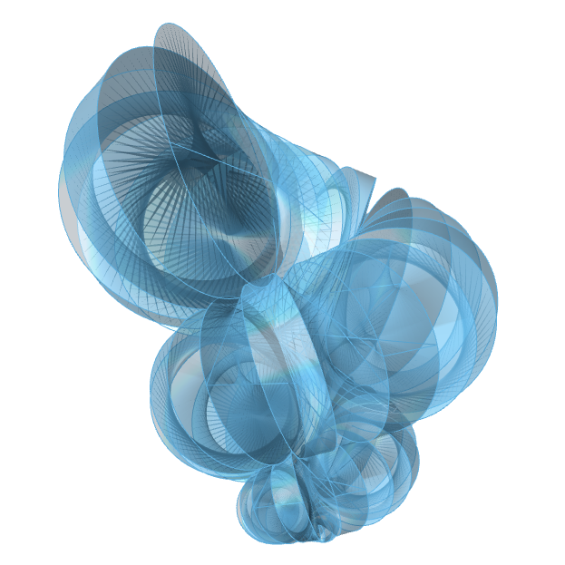
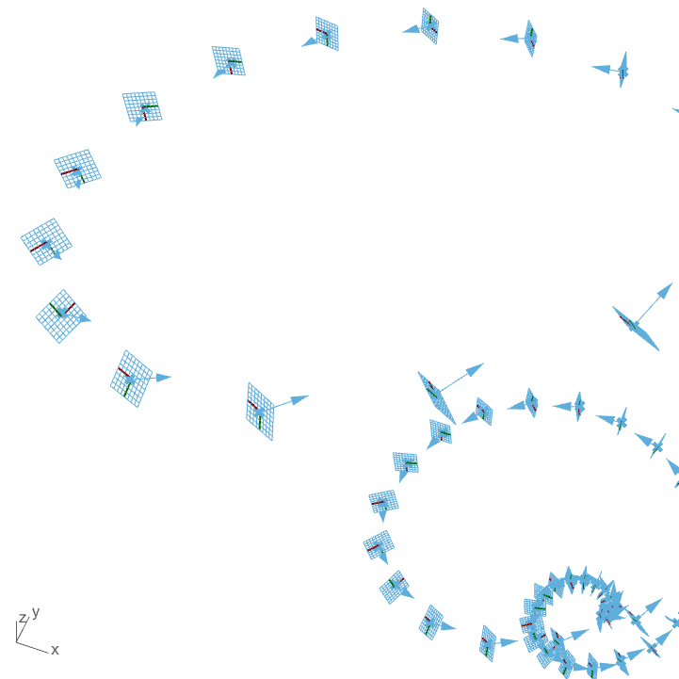

Slide 6
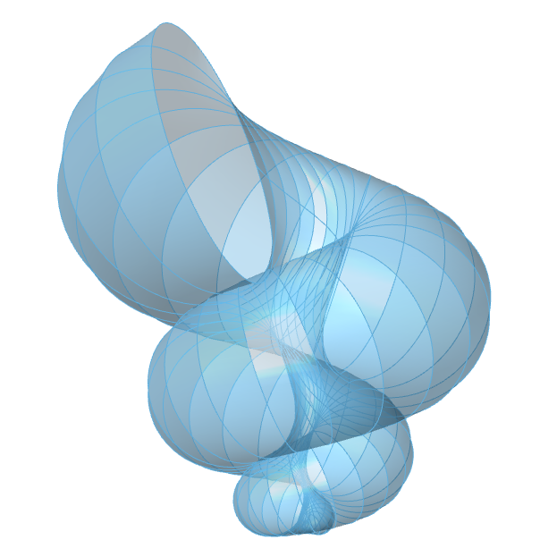


Slide 7
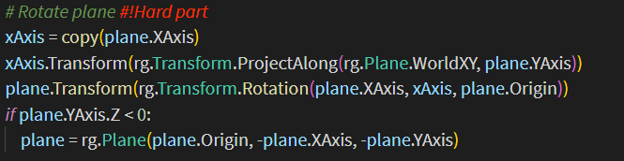
# Rotate plane #!Hard part
xAxis = copy(plane.XAxis)
xAxis.Transform(rg.Transform.ProjectAlong(rg.Plane.WorldXY, plane.YAxis))
plane.Transform(rg.Transform.Rotation(plane.XAxis, xAxis, plane.Origin))
if plane.YAxis.Z < 0:
plane = rg.Plane(plane.Origin, -plane.XAxis, -plane.YAxis)

