Slide 1
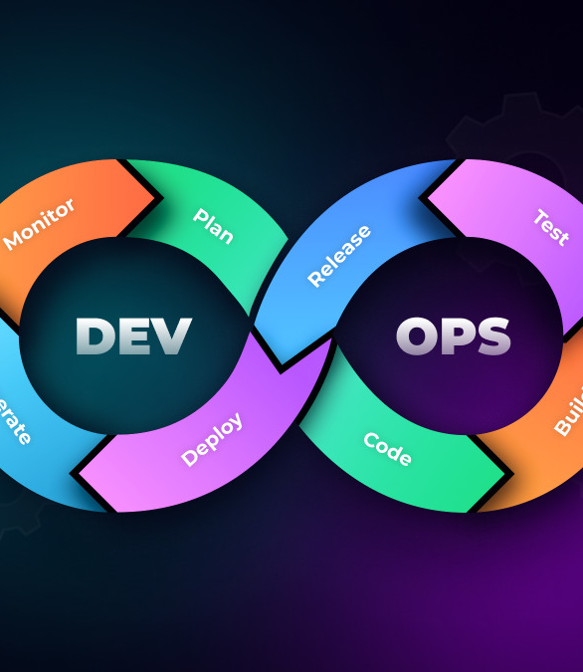
The Technology Value Stream
Zac Baker

Slide 2
Topics
What is it?
Lead vs Processing Time
The Common Scenario
DevOps Ideal
Sources

Slide 3
What is it?
Understanding the process

Slide 4
Process
Start to Finish
End-to-end process.
Increase visibility and reduce bottlenecks
Practices to improve and deliver quality experiences for the customer.
Improves engagement between teams
Utilization of Value Stream Management (VSM)
Notes:
The Technology Value Stream is an end-to-end process, starting from the first customer or client and ends with the delivery of a finished product. The process helps establish requirements, bottlenecks, highlight focus areas, and other specifications early on well before starting the development process. Creating a well-established plan early helps the development and deployment processes proceed smoothly since most pitfalls and shortcomings will already have been addressed. This helps specific teams understand their part in the project which helps with increased efficient and visibility as teams will understand their part and those around them.

Slide 5
Lead vs Processing Time
Planning and development

Slide 6
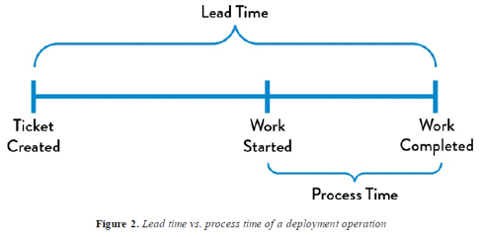
Time Spent
Lead time is the process from start to finish
Process time is from start of development to finished product
Important note
  The customer will only experience the lead time
6
Notes:
Understanding where and how time is spent during the process is important. The lead time is the time it takes from receiving the task or project idea from the customer until it is finished. This counts for planning and processing requirements and specifications, development, and deployment. Process time is the time the development process takes, generally speaking. This is when the work actually starts on the project and finishes when the finished product is then released.

Slide 7
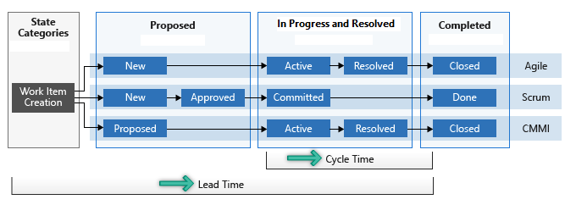
Cycle Dependent Process

Slide 8
The Common Scenario
Overcomplicated deployment lead?

Slide 9
Inefficiency hurts deployment
Complex systems increase workload
Delegate the required tasks to the associated teams
Joining pieces of the product together should enhance the product not take away from it
Streamline the process
Notes:
The common scenario is when an overcomplex system detracts from the efficiency of the lead time. Time should be spent as efficiently as possible, ensuring that tasks are being mapped out and completed in an orderly fashion. When teams are overlapping or overreaching their bounds, this can create issues for the rest of the other teams. Each team has their task to complete in which it helps the other teams. I.e. the front end and back end team should be focusing on separate tasks. Mapping out time spent from the start directly helps with falling into the common scenario pitfall. Effective communication between teams and team members aid in the visibility and transparency between tasks.

Slide 10
DevOps Ideal
Efficiently use time

Slide 11
Strive to be
Efficient
Prompt and direct constant feedback
Proper version control implementation
Small teams coming together to make a larger product
Increase efficiency by allowing and fostering independent solutions
Notes:
The ideal circumstance is one in which developers and other teams are empowered with their individuality paired with a process and system that streamlines the process. Development leads should be able to give prompt and direct feedback to members constantly which gives them the required information on what is going on or what needs to change. Communication is key when it comes to expressing ideas from team to team or within a team. Proper implementation of version control helps with ensuring that code is being testing independently from the main branch and ensures the proper function when merged together. Ensuring for a higher success rate prevents the need to constantly backtrack which directly hinders any progress made. Small teams create the biggest impact on projects. Keeping the teams small ensures that proper oversight can be given but still allow for them to individually come up with solutions while following feedback and specifications. Efficiency is important when it comes to the ideal circumstance as progress should always be forward, not backwards.

Slide 12
Sources
Atlassian. (n.d.). What is Value Stream Management (VSM) and why is it important?. What is Value Stream Management (VSM) and Why is it Important? Article | Agile. https://www.atlassian.com/agile/value-stream-management
Wong, M. (2022, October 28). What is value stream management in software delivery?. Planview. https://www.planview.com/resources/articles/value-stream-management-software-delivery/
12

Slide 13
Thank you
Zac Baker

