Slide 1

A Just Culture
Zac Baker
Module 9.2 Assignment

Slide 2
Agenda
What is it?
Challenges
Steps

Slide 3
Culture of Just Humans
We all make mistakes

Slide 4
Making Mistakes
Everyone makes mistakes
Built on trust
Trust is a fragile currency
More of an agreement than a “culture”
Notes:
Every single human makes mistakes and will continue to make mistakes. Nobody is perfect. The idea of a “Just Culture” is a recognition of this fact and that there are reasonable variabilities when it comes to making a mistake. A sort of acceptable bounds that would not constitute disciplinary action so to speak. Due to this, the whole philosophy of a Just Culture is built on the currency of trust. Employers gain the trust of employees by understanding this simple fact and instead of pointing fingers in blame they solely seek to solve the issue at hand. All it takes is one negative interaction for that trust to be completely eroded, and once gone it will never come back. Due to the nature of how fragile trust can be, it is less of a culture and more of an agreement in a work environment. This sentiment is conveyed by Steven Shorrock in their article on Humanistic Systems about Just Cultures.

Slide 5
Just So Challenging
Where are the pain points?

Slide 6
Challenges
Fear and blame-oriented culture
Hindsight bias
“Just World” bias
Lack of safety and trust
Resistance towards change
Notes:
There are various challenges when it comes to implementing a Just Culture in any work environment. The overarching challenge is a drastic shift in mindset. Changing anyone’s mindset can be a challenging task, however, it is often the first step needed to make any lasting change. The removal of blaming systems allows for organizations to take that “next step” towards building a sustainable environment that puts the employees first. The removal of any fear and blame-oriented culture that tries to single out an individual for their solution causing the error helps everyone feel safer to make mistakes. Along these lines are hindsight bias's which are born from over analyzing the outcome versus the process and laying blame to those who caused it. A “Just World” bias is born from the belief that bad outcomes are caused by bad actions, however, often times errors and bugs may happen regardless of any input or solution that was given. Sometimes the unexpected popups and still needs to be delt with. All of these can cause a lack of safety and trust between the employees and the employer which can cause the workplace environment to spiral out of control. This may even lead to a resistance towards any change by any or both parties, which is the exact opposite of what needs to occur when shifting towards a Just Culture.
Atlassian

Slide 7
Just the Steps
How do we get there?

Slide 8
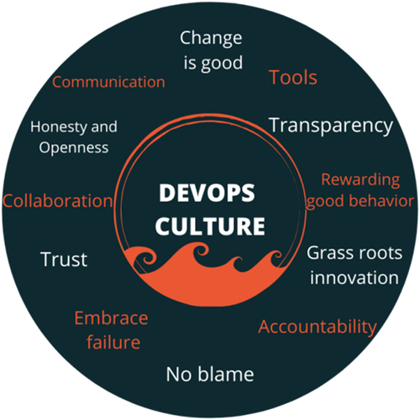
Positive Steps
Empathy and trust
Feedback avenues
Responsibility and accountability
Collaboration and communication
Continuous learning
Cross-functional teams
Notes:
While it is easy to say “so long as the challenges are avoided, then you have a Just Culture” but in actuality that is not the case. Like any change in culture or environment, dedicated actions need to be taken in order to ensure the quality and security of the culture. Empathy and trust between employees and the employer is a must, as it is the foundation everything is built upon. There needs to be ways for constructive feedback to be given both ways, up and down. Responsibility and accountability need to be held without it becoming accusatory. Employees need to be able to collaborate and communicate with each other effectively to tactfully maneuver obstacles and difficulties. Above all, everyone needs to continuously learn what is working, what is not working, and what can be improved upon. It is a learning experience for everyone; everyone has their own insight in these areas. Finally, cross-functional teams allow for diverse skillsets to come together to form a team that can take on more problems with more unique approaches.
Ironhack

Slide 9
Sources
Atlassian. (n.d.). DevOps: The challenges. DevOps: The challenges | Success Central. https://success.atlassian.com/solution-paths/solution-guides/devops-solution-overview-guide/devops-the-challenges
Ironhack. (n.d.). DevOps Culture: Automation and Human Practices. https://www.ironhack.com/us/blog/devops-culture-automation-and-human-practices
Shorrock, S. (2025, October 30). Why is it just so difficult? barriers to “just culture” in the real world. Humanistic Systems. https://humanisticsystems.com/2023/10/18/why-is-it-just-so-difficult-barriers-to-just-culture-in-the-real-world/#:~:text=Personal%20and%20Social%20Barriers&text=When%20it%20comes%20to%20justice,as%20such;%20it%27s%20an%20agreement.
9

Slide 10
Thank you
Zac Baker

