Slide 1
UML Business Stereotype
Business Process Engineering and workflow systems

Slide 2
Agenda
Why model software?

Slide 3
Why model software? Why create business models?

Slide 4
Problem with software for business
Business goals are often misunderstood
both by IT and business
„software requirements” process often goes to deep to early
poor understanding of desired solution

Slide 5
Modeling reality
Model - simplified reprezentation of reality
Makes understanding the system easier
Description of system’s structure and behavior
Documentation of project decisions

Slide 6
Modeling reality
Models help us to
visualize system under construction
understand and describe structure and dynamic behavior of the system
document design decisions
Real life IT systems impossible to understand without models
too complex

Slide 7
Modeling reality
Choice of models influences the solution
Models are built on different complexity levels
Problem domain can never be properly represented with a single model
Each non-trivial problem is best represented with a couple of simple models

Slide 8
Why do I need a business model?
I want to…
understand the structure and functioning of the company
understand current problems of the company
and possibilities of improvement
find a common ground
come up with system requirements

Slide 9
Business modeling idea
Business model „To be”
Use cases
Application design
What should be automated
Specification of automation
Specification of work to be done

Slide 10
When we should build business models?
Scenario #1 - One organization, many systems
Scenario #2 - Organization suport
creation of system supporting a chosen part of organization
Scenario #3 - New business
Scenario #4 - Remapping, reorganization
Reverse engineering of an existing organization, forward engineering for a new organization

Slide 11
What appears on the business model?
Customers
Business processes
Organizational structures
Functions (roles and responsibilities)
Products
Important events

Slide 12
Business modeling in UML

Slide 13
UML in business modeling
Activity diagrams - control flows in processes
Classes - used to model data
objects based on those classes used to model data flows on activity diagrams
Package diagrams - used to model company structure
Actors - hierarchy of users

Slide 14
Two main models
Business Use-Case Model
shows goals and functions in organization
Business Analysis Model
description of behavior of the organization

Slide 15


Model Elements
Business Actor - somebody or something interacting with the organization
Business Use Case - business activities undertaken to satisfy specific needs of a business actor

Slide 16

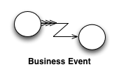
Model Elements
Business Goal - represents requirements that have to be fulfilled by the organization; value that can be measured in the organization
Business Event - important event that requires undertaking an action

Slide 17


Model Elements
Business Entity - represents important, persistent data managed by business actors or workers
Business Worker - abstract entity representing a role in execution of the business use case

Slide 18
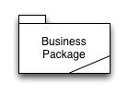

Model Elements
Business Package/Business System - container grouping roles, resources, BP definitions
Business Use Case Realization - implementation of a Business Use Case

Slide 19
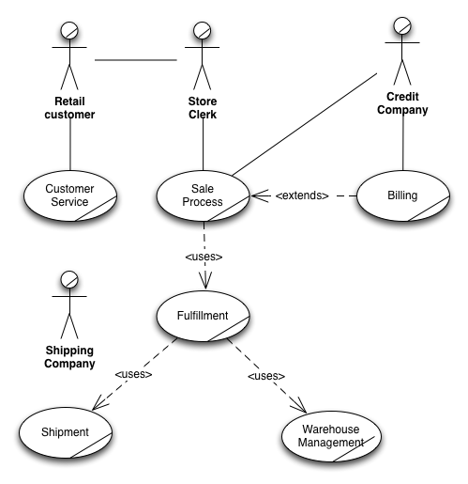
Business Use Case Model

Slide 20
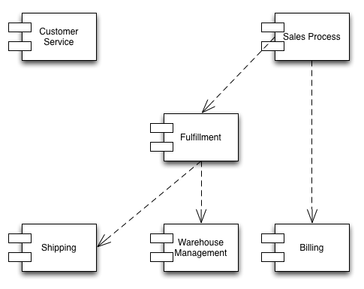
Component Diagram

Slide 21
Business use cases descriptions
Name
Short description
Goals
Value (benefits)
Scenarios
Special requirements
Extension points
Dependencies

Slide 22
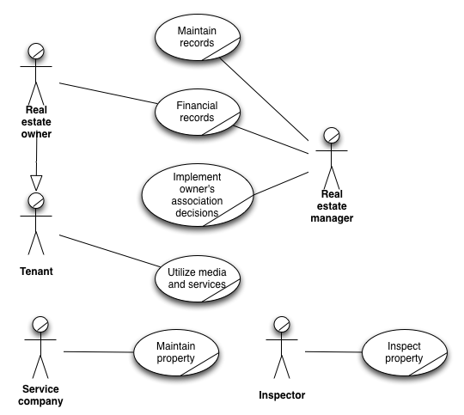
Business Use Case Model

Slide 23
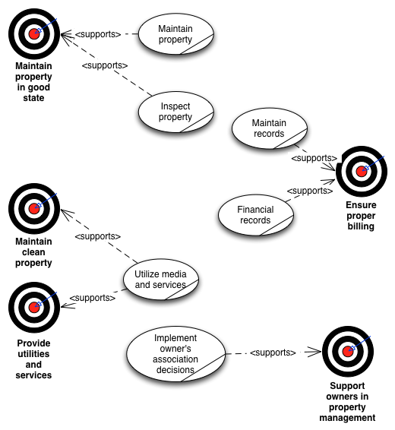
Business Use Case Model

Slide 24
Business analysis model
Contains
business entities
business workers
relationships
Shown using
class diagrams
activity diagrams
sequence diagrams

Slide 25
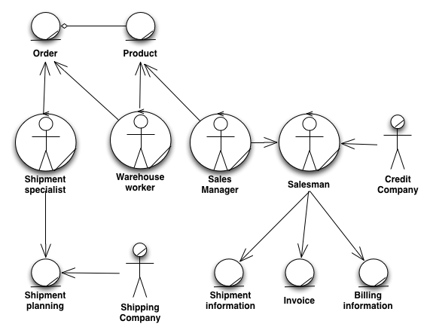
Business analysis model

Slide 26
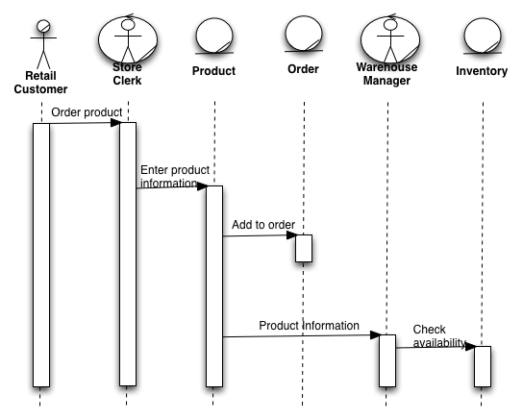
Business analysis model

Slide 27
Construction of business models
Build common business glossary
Create business use case model
find business actors and use cases
create business case diagram
define workflow details
Define business service priorities
Create business entity model (analysis model)
identify business entities and workers
describe their cooperation
create business use case realizations for each business case
Tie business requirements to system requirements

Slide 28
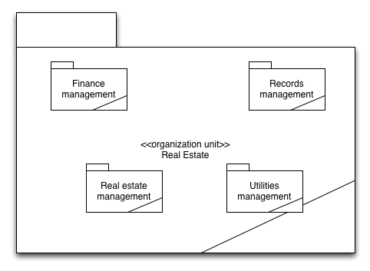
Business analysis model - Business Package Diagram

Slide 29
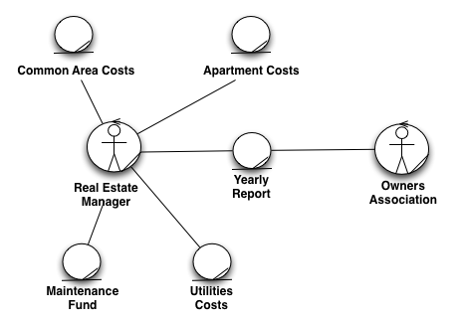
Business analysis model - class diagram

Slide 30
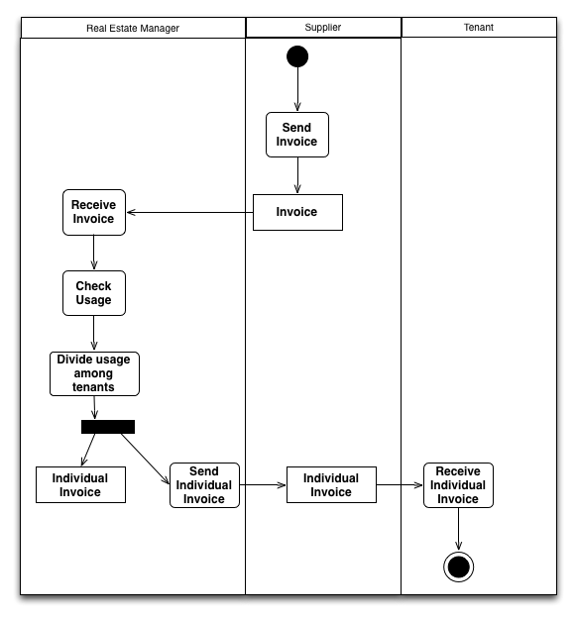
Business analysis model - activity diagram

Slide 31
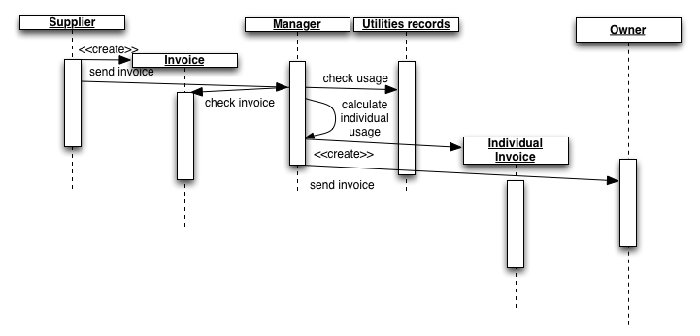
Business analysis model - sequence diagram

Slide 32
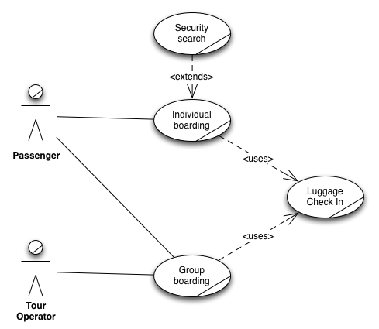
Business Use Case model - use case diagram

Slide 33
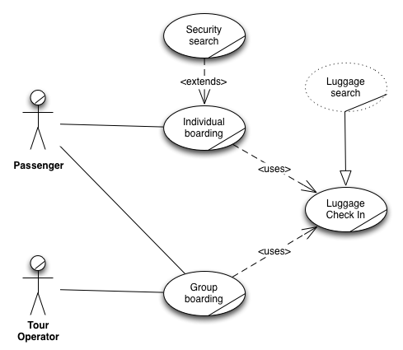
Business Use Case model - use case diagram with a realization

Slide 34
Transition to system modeling
Business Use Case Model -> Use Case Model
Business Analysis Model -> Analytical Model (class diagrams)

Slide 35
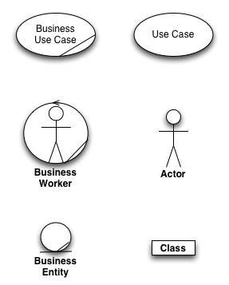
Typical element mapping

Slide 36
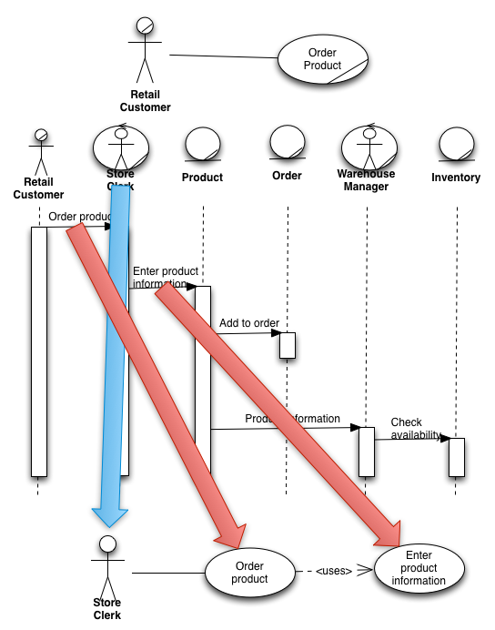
Mapping use cases

Slide 37
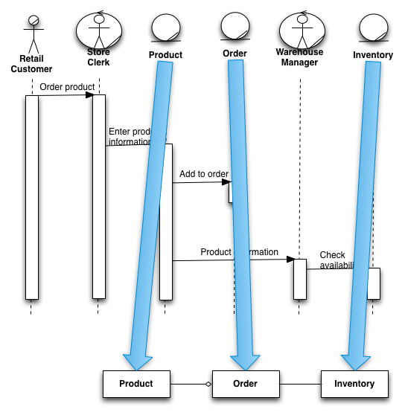
Mapping classes

Slide 38
Questions?
TYFYA

