Slide 1
Using Kanban Techniques to Control Incremental Development

Slide 2
Agenda
1. What is a Kanban System and how does it apply to software development?
2. How to set up a development team Kanban System
3. Applying Lean thinking to software development

Slide 3
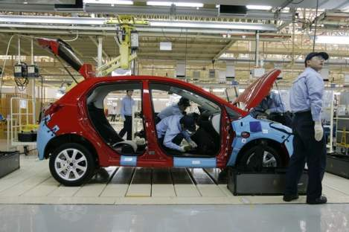
看板 – Kanban cards limit excess work in progress
看板 – Kanban literally means “visual card,” “signboard,” or “billboard.”
Toyota originally used Kanban cards to limit the amount of inventory tied up in “work in progress” on a manufacturing floor
Not only is excess inventory waste, time spent producing it is time that could be expended elsewhere
Kanban cards act as a form of “currency” representing how WIP is allowed in a system.

Slide 4
Why use Kanban in Software Development?

Slide 5
Time-boxed iterative development has challenges
Common problems include:
Short time-boxes give more frequent opportunity to measure progress and inspect software but force development items to be smaller
Smaller development items are often too small to be valuable and difficult to identify
Quality of requirements suffers as analysts rush to prepare for upcoming cycles
Quality of current development suffers when busy analysts are unable to inspect software or answer questions during development
Quality often suffers as testers race to complete work late in the development time-box

Slide 6
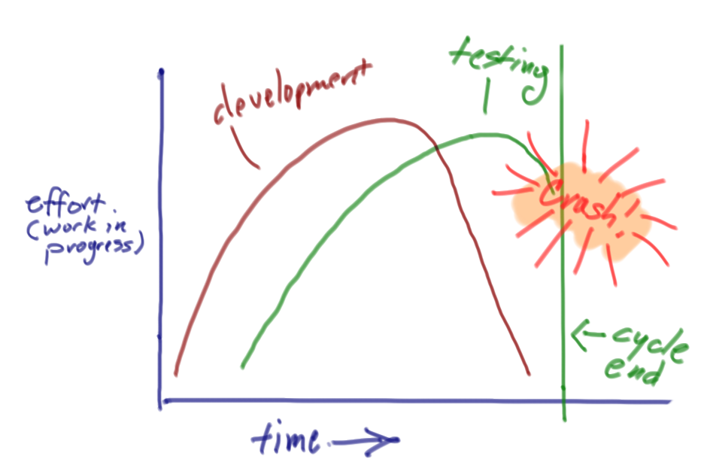
Inside an iteration, effort across roles is uneven
Development work often continues throughout a cycle while testing starts late and never seems to get enough time

Slide 7
Using a Kanban approach in software drops time-boxed iterations in favor of focusing on continuous flow.

Slide 8
How to set up a simple Kanban system for a software development team.

Slide 9
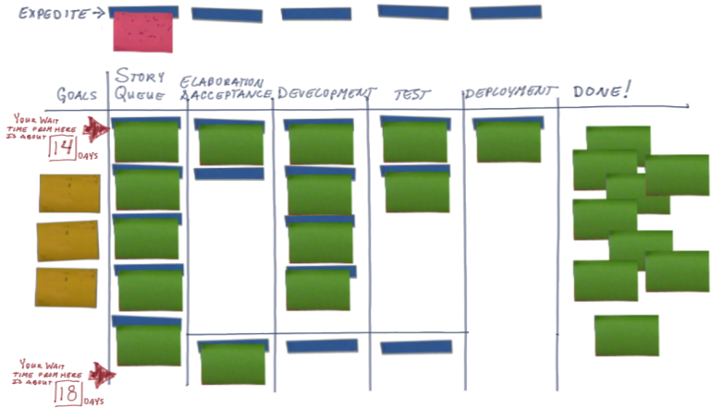
1. Define a work process flow
This simple process flow has the steps:
elaboration & acceptance criteria
development
test
deployment
Look at the typical flow for features, stories, or work packages and describe typical process steps

Slide 10
2. Lay out a visual Kanban board
Place an expedite track above the main left to right queue
Place “done and waiting” queues between each work queue
(in this example they’re placed below)
Place a goals column on the left, then a waiting queue, the process steps, and a final “done” column to the right

Slide 11
3. Decide on limits for items in queue and work in progress
This board uses painters tape to indicate available “slots” for work in progress
A good limit is a factor of the number of people in a role that can work on an item in a given process step. Start with number of people * 1.5

Slide 12
4. Place prioritized goals on the left column of the board
Having goals visible:
promotes focus
helps us prioritize
helps us manage feature scope & requirements
A good goal describes the outcome we hope to achieve after software ships. Goals help keep focus on the larger outcome.

Slide 13
5. Start the board by placing stories or features in queue
Product owners manage the waiting queue
Mark on the story or feature card the date it entered the queue. This begins our measurement of cycle time.

Slide 14
6. Move features through the process flow as work is completed
As the story enters the first process step, mark that date on the card. This is the start date. As it’s finished, mark that date on the card. This is the finish date.

Slide 15
7. Use the dates on the cards to calculate cycle time
Cycle time = finish date – start date
The average cycle time from the date the item enters the board is the wait time from this point in the queue
Use average cycle time to set wait times from different points on the board. Pay attention to flow and bottlenecks: relieving bottlenecks as quickly as possible.

Slide 16
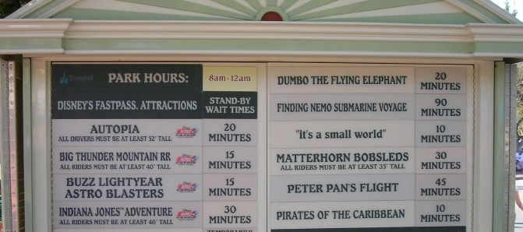
Display and manage cycle times
Disneyland’s public display of cycle-times
Reduce the number of Kanban slots allowed until cycle time remains unchanged
Reduce the size of development items
Work in progress is actually the number of items * the average size of items
Identify and act on bottlenecks immediately
Relieve repeated bottlenecks by changing the number and types of people in each role and cross training

Slide 17
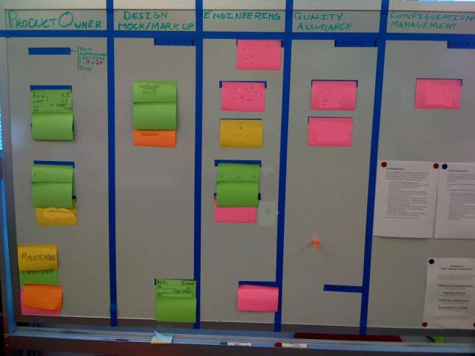
Kanban Boards

Slide 18
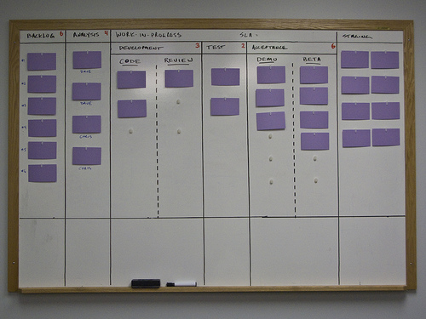
Kanban Boards

Slide 19
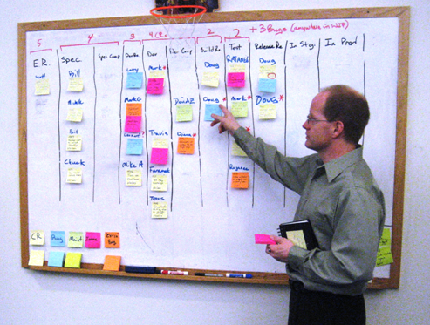
Kanban Boards

Slide 20
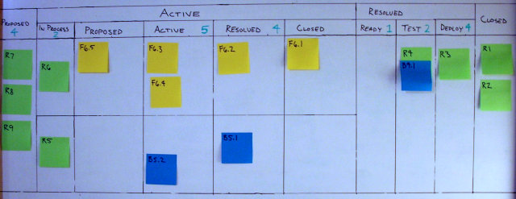
Kanban Boards

Slide 21
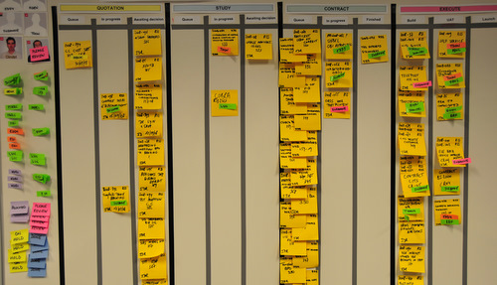
Kanban Boards

Slide 22


Explode large process steps into tasks to improve visibility
When a feature, user story, or work item is large:
  Takes longer than a couple days to complete
  Requires that multiple people collaborate on its completion
Decompose that step into cards to track independently
Feature to develop
Tasks in progress
Tasks complete
Feature complete
Tasks in queue

Slide 23
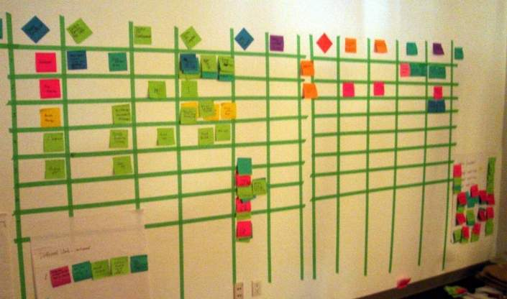
Kanban Board with Task Decomposition

Slide 24
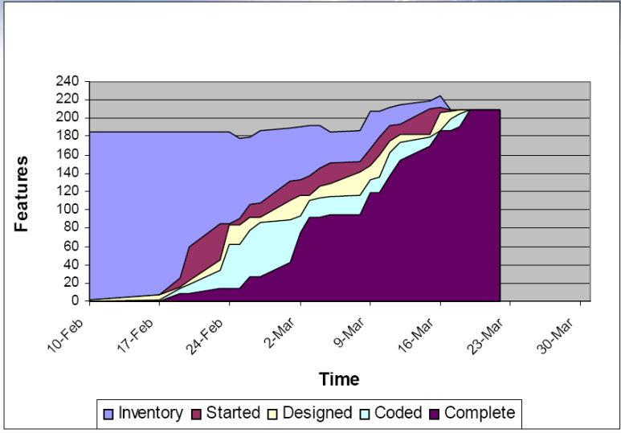
Use cumulative flow diagrams to visualize work in progress
www.agilemanagement.net/Articles/Papers/BorConManagingwithCumulat.html

Slide 25
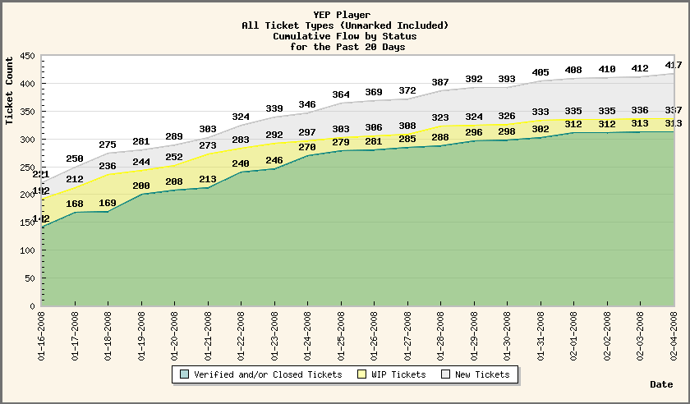
Use cumulative flow diagrams to visualize work in progress
www.agilemanagement.net/Articles/Papers/BorConManagingwithCumulat.html

Slide 26
Keep time-boxed product and process inspection
Keep regular time-boxes in your process as a cue for product inspection:
Evaluate the quality of the growing product from a functional, engineering, and user experience perspective
Evaluate your pace of development:
Look at the number of development items completed relative to goals
Look at the average cycle time per development item
Calculate the ratio of developer days per completed item. Use this ratio to estimate the completion time for undeveloped items
Adjust your development plan as necessary
Evaluate and adjust the process you’re using
Use a process reflection session to identify changes you could make to improve your product or pace
Ending cycles right: http://www.stickyminds.com/s.asp?F=S14865_COL_2

Slide 27
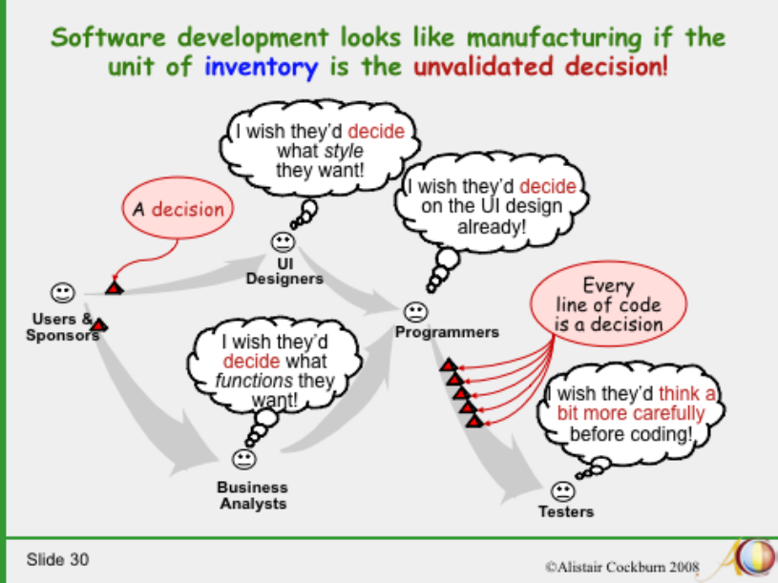
Begin looking at your process using Lean thinking
Cockburn’s Software Engineering in the 21st Century:
http://alistair.cockburn.us/Software+engineering+in+the+21st+century.ppt

Slide 28
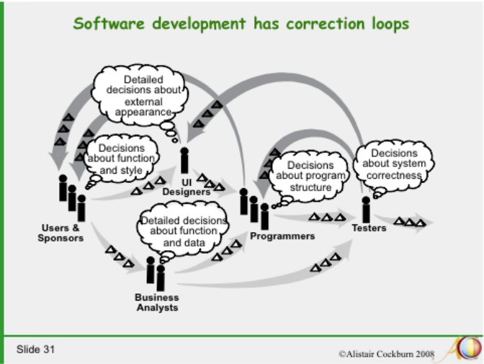
Since we’re engaged in “knowledge work” look at the cycle time of validated decisions, or knowledge
Cockburn’s Software Engineering in the 21st Century:
http://alistair.cockburn.us/Software+engineering+in+the+21st+century.ppt

Slide 29
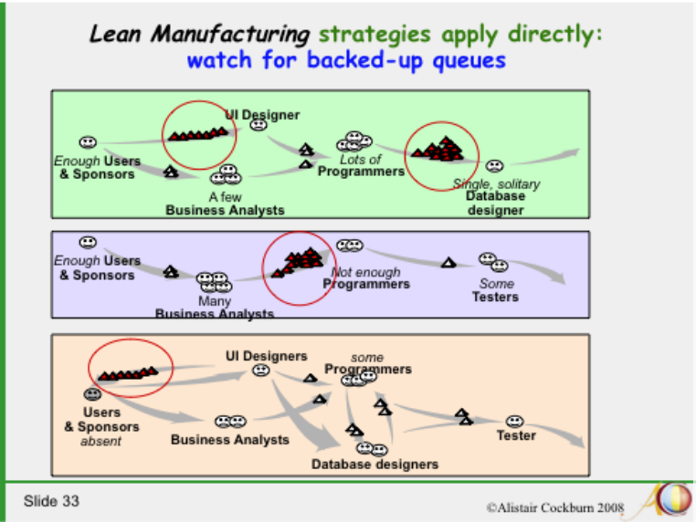
Often the feedback loop is overlooked – it’s the invisible backed-up queue
Cockburn’s Software Engineering in the 21st Century:
http://alistair.cockburn.us/Software+engineering+in+the+21st+century.ppt

Slide 30
Setting up a simple Kanban system starts to focus the team on the cycle-time of delivered work and gives a way to detect and begin to resolve bottlenecks

