Slide 1
Introduction
Business Process Engineering and workflow systems

Slide 2
Agenda
Scope of the course
Business processes
Business process modeling
Workflow systems

Slide 3
Scope of the course and general rules

Slide 4
Goal and scope of the course
Familiarize students with applications of IT in business
identification, documentation, modeling of business processes
use of IT tools to support them
Principles of documenting processes using
UML business stereotype
BPMN
Petri nets
Software support
BP modeling
BP simulation
construction of apps

Slide 5
Business processes

Slide 6
Business Process
Organized, coordinated flow of activities, conducted by participants, acting on and deciding with data and knowledge to achieve a business goal

Slide 7
Business Process
defined
ordered
repeatable
divided into stages
clear decision making points

Slide 8
Business Process Management
Identification, understanding and management of business processes that support an organization’s business model

Slide 9
Business Process types
Ad-hoc
predetermined activities
path determined during execution
human control of the process
Production processes
well defined model
complex technically
critical from business point of view

Slide 10
Business Process types
Administrative processes
simple from technical point of view
potentially complex model
predictable
Collaborative
similar to ad-hoc
involve more people
require good coordination
critical from business point of view

Slide 11
Business Process Modeling Patterns
Human-Centric – automate human activities, e.g. interactions between employees, customers, managers…
personnel on-boarding
claims processing
…
Document Management – manage life cycles of documents, control versions, manage repositories…

Slide 12
Business Process Modeling Patterns
System integrations – integrate systems and applications to orchestrate their execution
Event driven – respond appropriately to particular event
integration of mobile systems

Slide 13
Business Process Modeling Patterns
Decision driven – processes in which a decision is central to the process
medical and insurance benefits
fraud detection
…
Application-centric – monitors integrations between various applications, controls timing cycles and content of transferred data
e.g. integration of CRM, ERP and supply chain systems

Slide 14
Business process modeling

Slide 15
Process analysis and design
Identification of the process
borders, current goals
goals of the redesigned process
Understanding the process
Design of the new process
improvement on the current one
Design of use cases and services

Slide 16
Business process modeling methods
Communication-based modeling
communication between participants is the basic driver of the process
process is seen as a conversation
conversation in order to take action
conversation in order to determine possibilities
…
we model paths of those conversations

Slide 17
Business process modeling methods
Activity-based modeling
dependencies between activities are the basic driver of the process
most common approach, supported by majority of tools

Slide 18
Modeling views
functional view
what we are supposed to achieve
information view
what information is necessary
behavioral view
when the actions should be taken
control flow
time constraints

Slide 19
Modeling views
Operational view
how we are supposed to do things?
Organizational view
who is supposed to do them?
Security view
who has the appropriate authorization?
causal view
is the model compatible with company policy and strategy

Slide 20
Modeling views
Historical view
what happened in the past in this process?
Quality view
how will we assure the quality of the process?
Integrity view
how will we deal with errors and unexpected situations?

Slide 21
Modeling notations
UML Business Stereotype
UML itself good for business process modeling
activity diagrams, statechart diagrams – mainly used to model the flow of activities
use case diagrams, class diagrams – auxiliary role

Slide 22
Modeling notations
YAWL
created by researchers from Eindhoven University of Technology and Queensland University of Technology
generic, simple

Slide 23
Modeling notations
Petri Nets
used mostly in academia
very good for mathematical proofs and formal analysis
rather limited applications in business
too limited

Slide 24
Modeling notations
BPMN – Business Process Modeling Notation
industry standard
based on (or at least similar to) UML Activity Diagrams
excellent support in the form of tools

Slide 25
Workflow systems

Slide 26
Workflow
A Workflow is defined as
the automation of a business process,
in whole or part, during which
documents, information or tasks are passed
from one participant to another for action,
according to a set of procedural rules
(Workflow Management Coalition)

Slide 27
Workflow systems
Process-oriented approach
Process logic separated from application (activity) logic
DBMS manages data
activity logic often implemented as „services”
workflow system uses process definition to manage it

Slide 28
Workflow model / Process definition
Description of a business process
includes activities, participants, data, resources, rules and procedures
often in form of a graph
machine-readable form

Slide 29
Process instance
Specific instance of a workflow
Various instances of the same process may follow different paths in the graph
instance type - all instances following a specific path in graph

Slide 30
Activity
Unit of work
logical step in a process
Human or automated task
Human/manual task – requires human interaction
Automated – does not require (or allow) human interaction

Slide 31
Task / Activity Instance
Activity instance
related to a specific process instance
initiated by workflow system, system is informed when task is completed

Slide 32
Participant
Resource performing task
Usually a human resource

Slide 33
State
Set of information related to a particular process instance at a specific point in time
includes data, events, assigned participants, current activity, dates and times of starting and completion of activities and so on
changes should be recorded in system logs

Slide 34
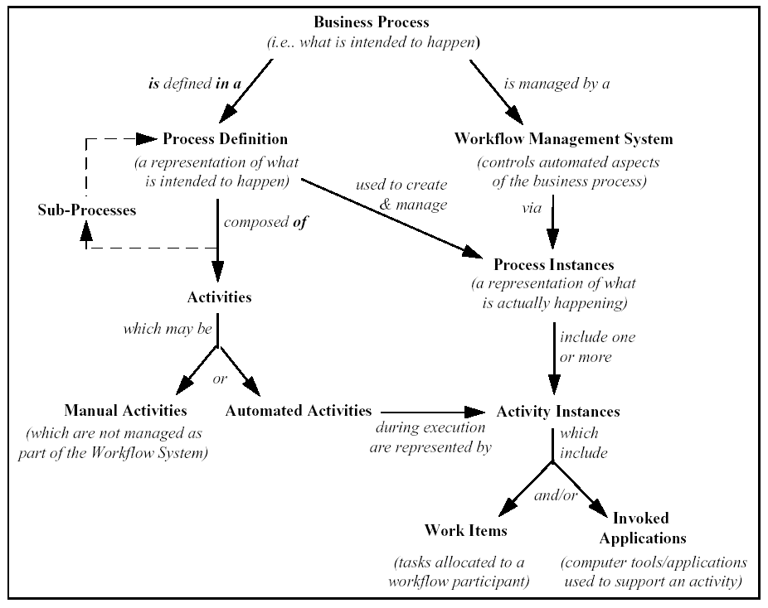

Slide 35
Execution of a process
User initializes process instance
System chooses next activity in the control flow, instantiates it and puts it on the task list of a participant
Participant starts the task
System is informed about task being complete
GOTO 2

Slide 36
Thank you for your attention
Questions?

