Slide 1
Documenting Business Processes
Business Process Engineering and workflow systems

Slide 2
Business Process Documentation Steps
Name Process and Assign Ownership
Define Business Process Boundaries
Document Operational Definitions
Document Process Flow
Define Control Points and Measurement
Assess and Validate

Slide 3
Name Process and Assign Ownership
Process Owner is responsible and accountable for the operational quality of the process
Owner's position in the organization assures the ability to influence change in practices and procedures and to implement a plan for improvement

Slide 4
Name Process and Assign Ownership
Owner is specifically responsible for:
Defining the subprocesses
Establishing subprocess ownership
Identifying critical success factors and key dependencies
Ensuring integrity of information, including measurements (i.e. exit criteria)

Slide 5
Criteria for Determining Process Owners
Who is the person with the most:
Ownership
Resources (People, systems)?
Work (time)?
Pain (critiques, complaints, fire fighting)?
Actual (or potential) credit?
Ability to effect change

Slide 6
Criteria for Determining Process Owners
Who is the person with the most:
Power to Act on the Process - Who is the person who operates at a level high enough to:
Influence changes in policies and procedures affecting the process?
Commit to a plan and implement changes?
Monitor the effectiveness and efficiency of the process?

Slide 7
Criteria for Determining Process Owners
Who is the person with the most:
Leadership Ability
Process Knowledge
Who has a good understanding of the total overall process?

Slide 8
Criteria for Determining Process Owners
Who is most appropriately:
Perceived as highly credible?
Able to support and encourage improvement team member efforts?
Willing to change
Able to deal with higher-level management?
Able to knock down roadblocks?
Unafraid to take risk?
Able to live up to commitments?

Slide 9
Business Process Documentation Steps
Name Process and Assign Ownership
Define Business Process Boundaries
Document Operational Definitions
Document Process Flow
Define Control Points and Measurement
Assess and Validate

Slide 10
Define Process Boundaries
Definition should include:
Process begins with....
Process includes....
Process ends with....
Specify process customers and tangible outputs the process delivers to them

Slide 11
Define Process Boundaries
Work with customers to define measurements to determine if the process outputs meet their requirements
Specify suppliers and what they provide for the process to function correctly
Specify process implementers who manage tasks and resources within the process

Slide 12
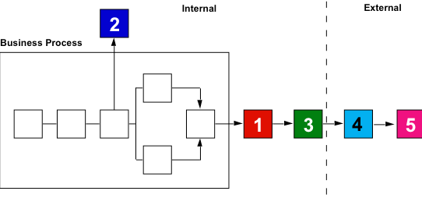
A single process can have as many as five different types of customers...

Slide 13
Customers
1. Primary Customer - Customers who directly receive the output from the process.
2. Secondary Customer - Customers outside the process boundaries that receive output from the process but are not directly needed to support the mission of the process.
3. Indirect Customer - Customers within the organization who do not directly receive the output from the process but are affected if the output from the process is wrong and / or late.

Slide 14
Customers
4. External Customer - Customers outside the company who receive the end product or service.
5. Consumers - Customers that are indirect and external.

Slide 15
Business Process Documentation Steps
Name Process and Assign Ownership
Define Business Process Boundaries
Document Operational Definitions
Document Process Flow
Define Control Points and Measurement
Assess and Validate

Slide 16
Document Operational Definitions
"An operational definition is a procedure agreed upon for translation of a concept into measurement of some kind." - W. Edwards Deming
An operational definition describes exactly what the variables are and how they are measured within the context of your study.

Slide 17
Business Process Documentation Steps
Name Process and Assign Ownership
Define Business Process Boundaries
Document Operational Definitions
Document Process Flow
Define Control Points and Measurement
Assess and Validate

Slide 18
Document Process Flow
Document current process down to activity level
Graphically portray major steps and identify relationships of subprocesses and activities. Include all tasks within the process boundaries and the groups or individuals responsible for performing them.
Describe each step in the sequence it occurs
Record the timing (effort or duration) of each task in the process.

Slide 19
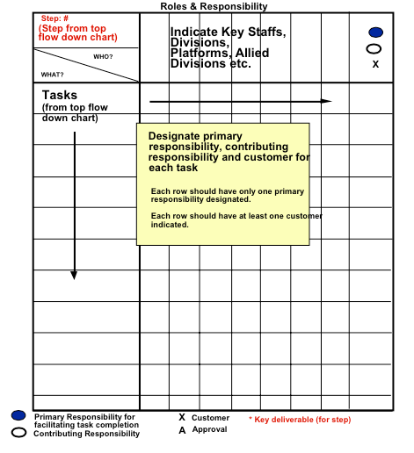
Roles and Responsibility within the process

Slide 20
Roles and Responsibility within the process
Primary Responsibility - for facilitating the process not content
Contributing Responsibility - for providing content and actual work activity not the process
Approval - responsible for approving the deliverable of that task
Customer - needs deliverable to perform subsequent work or needs to be informed that deliverable is complete

Slide 21
Business Process Documentation Steps
Name Process and Assign Ownership
Define Business Process Boundaries
Document Operational Definitions
Document Process Flow
Define Control Points and Measurement
Assess and Validate

Slide 22
Define Control Points and Measurement
Identify, on the process flow diagram, places where quality measurements can be taken (exit criteria)
Ensure that adequate measurements are in place throughout the processes so that process objectives can be met
Identify control points on the process flow chart (points within the process where business controls must be applied to maintain satisfactory control of the process)

Slide 23
Why Measure?
Measurements are key ..........
If you can not measure it , you can not control it .......
If you can not control it, you can not manage it ........
If you can not manage it, you can not improve it !!!

Slide 24
What are Control Points and When & Where Should They Be Used?
Identify control points on the process flow chart (points within the process where business controls must be applied) to maintain satisfactory control of the process

Slide 25
What are Control Points and When & Where Should They Be Used?
Control points should be utilized whenever information (output) changes hands within the process eg: Transmitting data from one source to another for further processing
Identify all potential points at which you could establish effectiveness measures
Prioritize the ones that have a major impact on overall quality
Establish what measurements will be taken (Measurement criteria to be established jointly by supplier & customer)

Slide 26
What are Control Points and When & Where Should They Be Used?
Control points become the proactive formalized process feedback loop (they signal possible corrective action instead of the typical after the fact feedback)

Slide 27
What are Control Points and When & Where Should They Be Used?
Value of Control Points
Keep process focused on necessary information required
Allow for proactive corrective action minimizing lengthy re-dos
Foster customer / supplier communication and trust

Slide 28
Establishing Measurement
Why should you measure?
Provide direct and immediate feedback on progress
Where should you measure?
Points at which feedback will be direct, immediate, and relevant for activities critical to the overall process
Control points significantly impact total process efficiency and effectiveness

Slide 29
Establishing Measurement
When should you measure?
As soon as the critical activity has been completed
What should you measure?
Efficiency, effectiveness and adaptability of each critical activity

Slide 30
Establishing Measurement / Feedback Loops
Relate feedback loops to individuals to quickly understand their impact.
Make constructive feedback the consumers obligation.
Encourage positive and negative feedback.
Use continuous feedback for continuous improvements.
Avoid the old proverb "no news is good news."
Encourage customer complaints.
Give responsibility to take immediate action.

Slide 31
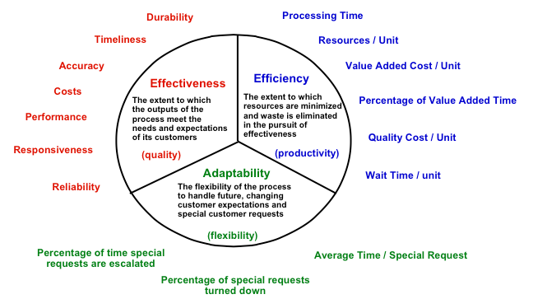
Business Process Measures

Slide 32
Business Process Documentation Steps
Name Process and Assign Ownership
Define Business Process Boundaries
Document Operational Definitions
Document Process Flow
Define Control Points and Measurement
Assess and Validate

Slide 33
Assess and Validate
Analysis of the process in order to estabilish, how well it meets the business needs of the customers
Validation of the process description
correctness of the description
is the description accurate?

Slide 34
Thank you for your attention
Questions?

