Slide 1
Business Process Simulation
Business Process Engineering and workflow systems

Slide 2
WHY SIMULATION(S)?
Reasons (past)
Purposes (future)

Slide 3
WHY: Reasons (past)
The world without Simulations:
Complexity
Uncertainty
Interdependencies
Myths of the No-Sim world...

Slide 4
WHY: Purposes (future)
What are we trying to achieve?
Understand & Communicate
Validate the Process Model(s)
Exploration & Experimentation
Facilitating Decisions:
Design choices
Manage Operations
Rule out the UNEXPLAINED
Seek to explain the UNEXPECTED

Slide 5
WHY/WHEN NOT?
Alternative methods that are…
Better
Cheaper
Easier to implement/execute
Not sure why we [want to] do it…
Risks too high to tinker with something that looks like “reality”, BUT is not

Slide 6
WHAT IS IT?
Goals & Objectives
Discover
Model
Simulate
Analyze
Optimize
Part of a larger process…

Slide 7
WHAT IS IT?
Types of Analyses
Process Validation
Structural Analysis
Resource Analysis
Time Analysis
Calendar Analysis
Areas of Use
Types of Simulation
Operations Management
Exploratory
Design

Slide 8
WHAT IT IS NOT
The Real “Thing”
Process Modeling
Pure Math
Pure Testing
Guess-work
Related but not the same…

Slide 9
WHAT WE FEAR IT IS
Expensive
People can’t understand it
Risky
Hard to do or understand
Can’t be done with partial data…
Needs tons of data
Something only Statisticians can do
“Some” of the fears/concerns…

Slide 10
Simulation vs. Alternatives
Experimenting with the Real Thing/Process:
Do we have a/the REAL THING?
Technically/operationally possible?
Convenient? Any distractions?
Practical? Costs, resources…
Too risky? Can we control it?
Do we have enough time?
Any processes too long to even try it?
Politically/strategically possible?
Any possible misinterpretations?
Can competitors find out about it?

Slide 11
Simulation vs. Alternatives
Using Mathematical Models:
Possible?
Do we have the Knowledge?
Do we have the “Rocket scientist”?
Do we have the Data?
Too complex?
Any moving parts?
Any complex interdependencies?
Predictable? Any uncertainties?
Certain about the… uncertainties?
Can we model the data behind the model?

Slide 12
Simulation vs. Alternatives
Guessing (“What do we THINK it would happen?”)
Possible?
Can we tell if we are right?
How risky (if we are wrong)?
Who knows enough (for smart guesses)?
Any differences of opinion?
How many chances do we have (before we get it right)?

Slide 13
Myths
Limited applicability
Too complex
Too expensive (to setup and run)
Too expensive (tools)
Only highly specialized people (the SIM-experts) can do it
There are ALWAYS easier ways to do it (using other methods)
Simulations are THE ONLY WAT to do it…

Slide 14
HOW
Process Modeling
Data:
In: Parameters
Out: Results
Analysis:
Multi-level Analysis
Scenarios & What-If Analyses
Interpretation:
Unexpected (OK) vs. Unexplained (not OK!)
Options/ideas to optimize
Standards & Best Practices
Tools

Slide 15
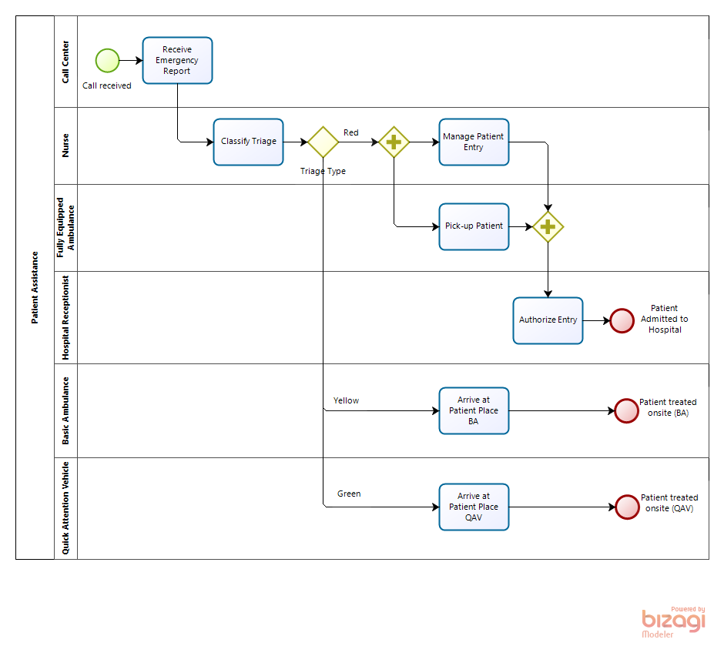
Process Model(s) [BPMN]
Core Process Elements:
Activities:
Tasks
Sub-Processes
Decisions/Gateways:
Exclusive work (either A or B)
Parallel work (A and B)
Optional work (A and/or B and/or C)
Events:
Start + Trigger
End (Waiting or Terminating)
Intermediate (e.g. Delays, Messages, etc.)
Interrupting (e.g. Timers, Exceptions, Cancellations, etc.)

Slide 16
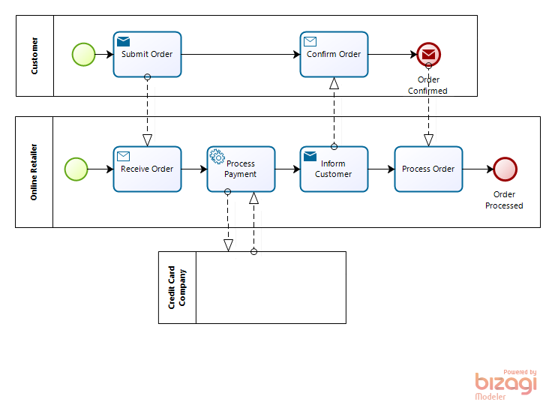
Process Modeling (2)
Work coordination:
Orchestration (within Processes)
Collaboration (between Processes)

Slide 17
Multi-Levels of Analysis
Process Validation:
Deadlocks
Infinite loops
Branches that are never used
Logic faults (e.g. unexpected work items/tokens)
Time & Throughput Analysis:
Processing & Cycle Times
Resources & Constraint Analysis:
Resource Capacity & Over/Under Utilization
Delays (due to waiting on available resources)
Costs (fixed & variable)
Calendar:
Resources availability by Calendar Periods

Slide 18
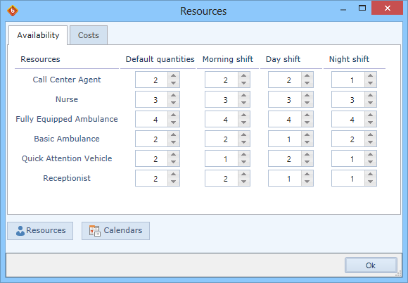
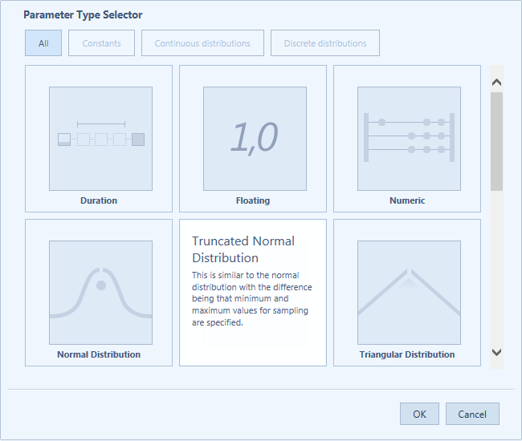
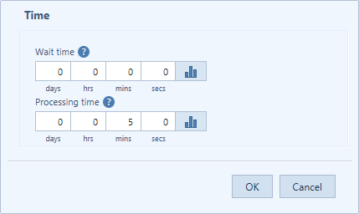
Simulation Data
Inputs (parameters):
Historical data
Estimates (constant)
Probabilistic/Statistical (distributions)

Slide 19
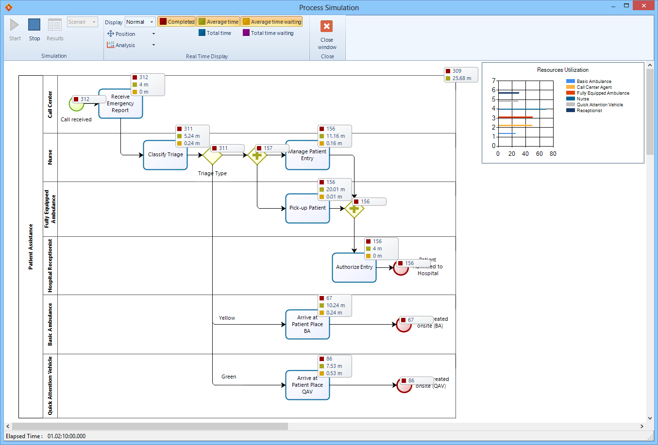
Simulation Data
“Real-Time” (accelerated) data:
Animation
Items processed
Items waiting (to be processed)
Utilization Graphs
Etc.

Slide 20
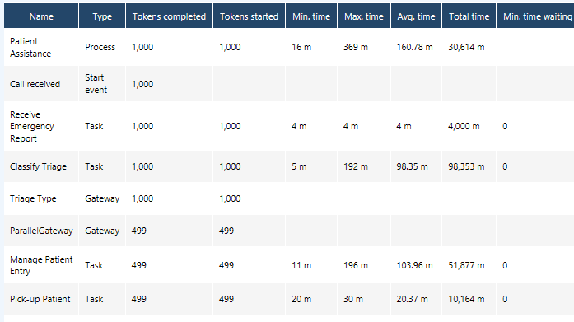
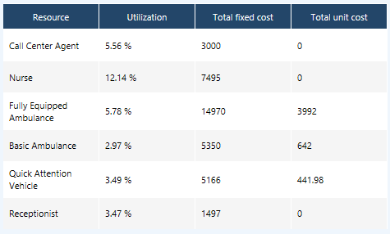
Simulation Data
Outputs/Results:
Time Estimates
Resource Estimates
Capacity Estimates
What-If Comparisons

Slide 21
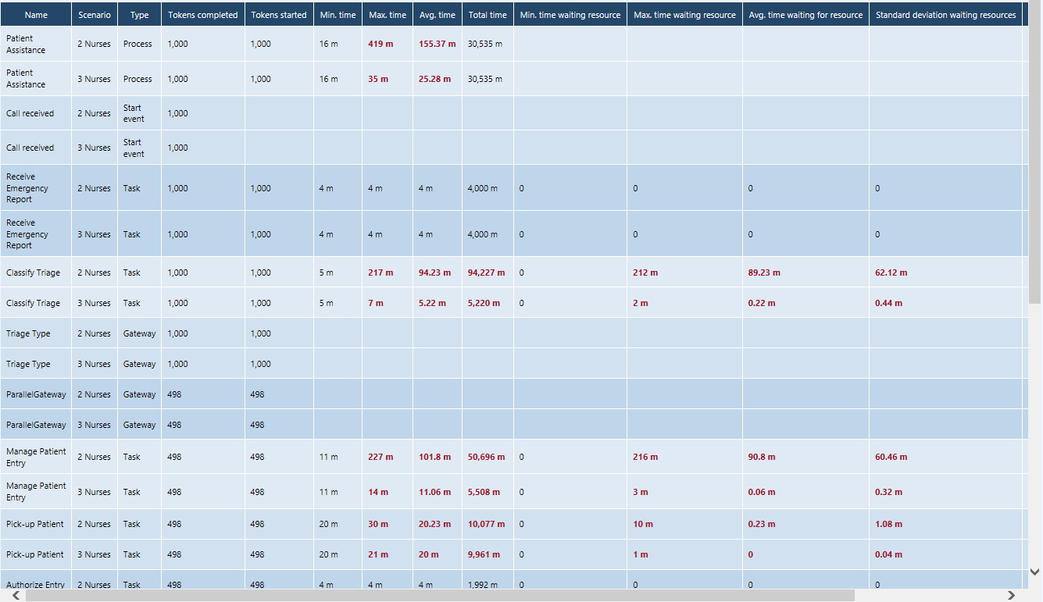
Scenarios & What-If Analyses (“2 or 3 Nurses?”): Times…

Slide 22
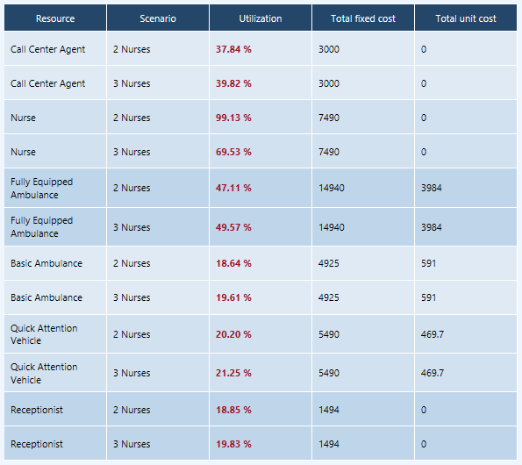
Scenarios & What-If Analyses (“2 or 3 Nurses?”): Resources…

Slide 23
Remember this?
Refine the inputs:
From:
Estimates (constant)
To:
Historical data
Probabilistic/Statistical (distributions)

Slide 24
Standards
BPSim: http://www.bpsim.org/

Slide 25
LEVEL 0: BPMN VALIDATION
What are we looking for?
Verify BPMN Specification conformity

Slide 26
LEVEL 1: PROCESS LOGIC/STRUCTURE
What are we looking for?
Deadlocks
Infinite loops
Branches that are never used
Logic faults (e.g. unexpected work items/tokens):
Anti-patterns

Slide 27
LEVEL 2: TIME ANALYSIS
Assumptions:
Level 1 assumptions +
Unlimited resources
No Costs associated with either Resources or Activities
What are we looking for?
Level 1 results (i.e. valid BPMN & Logic) +
Cycle-Time
Processing Time
Preliminary “Critical Path”

Slide 28
LEVEL 3a: TIME + RESOURCES ANALYSIS
Assumptions:
Level 2 assumptions +
Resources ARE limited
Resources are either People or other kind of Resources (e.g. systems, materials)
What are we looking for?
Level 2 results +
Waiting times (delays) due to Resources not being available, Critical Path
Resource Over and Under-Utilization

Slide 29
LEVEL 3b: TIME, RESOURCES + COST ANALYSIS
Assumptions:
Levels 2, 3a assumptions +
Variable-Costs associated with Resources (e.g. hourly rate)
Fixed-Costs associated with Activities (e.g. materials)
What are we looking for?
Levels 2, 3a results +
Costs to perform the process

Slide 30
LEVEL 4: RESOURCES, TIME, COSTS + CALENDAR ANALYSIS
Assumptions:
Level 3 assumptions +
Resources Availability varies by Calendar Periods (e.g. Shifts)
What are we looking for?
Level 3 results +
Optimizing Costs & Resource Utilization
Identify Critical Time/Calendar Periods

Slide 31
LEVEL 5: SCENARIOS & WHAT-IF ANALYSIS
Assumptions:
Level 4 assumptions +
Some scenarios may work better (or worse) than others
What are we looking for?
Level 4 results +
Optimization:
Compare various alternate scenarios
Chose BEST alternative/option

