Slide 1
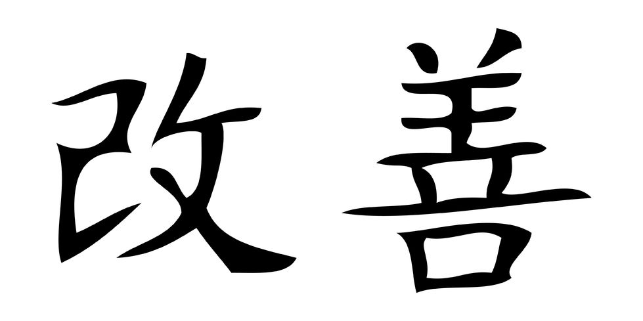
Introduction to Kaizen
Answering the how, when, and why…

Slide 2
What is Kaizen?
Kai = Change; Zen = Good
Kaizen = Good Change, Change for the Better, Continuous Improvement
Small, incremental changes; break apart and put back together better
Focus on small, quick changes for long-term success
Elimination of the 8 Wastes

Slide 3
What is Kaizen?
Kaizen is:
Rapid improvement in a particular work cell, work station, small process, factory location, office area, etc.
Kaizen is not:
Improvements in complex cross-functional or systemic problems where Projects or 6-Sigma are required

Slide 4
Kaizen Targets
Eliminate waste (non value added activities)
Increase productivity / output
Reduce inventory (less material and labor)
Reduce cycle time (less time to produce specific part)
Reduce space (work cell, office area)
Improve On-Time Delivery (OTD)
Improve quality of product and process
Improve housekeeping, 5S and visual management
Reduce downtime (setup time, maintenance)
Reduce transport time and distance
Standardize the process (less variation)
Reduce operating costs

Slide 5
Ground Rules & Guidelines
Try to make all improvements within the event area. Avoid blame on suppliers (internal or external)
Don’t accept excuses. Just say no to “we’ve always done it that way” and the status quo. Keep an open mind to change
Think of how it can be done, not why it won’t work. Don’t make excuses-just make improvement happen
Ask “why” five times until you get to the root cause of the problem (The 5 Why’s)
The Team solution is usually the best solution
Don’t over-analyze. Understand the process, then “just do it,” and see if it works
Don’t seek perfection the first time. Do something now – a 20% improvement is better than nothing

Slide 6
Ground Rules & Guidelines
“Fast and crude” is better than “slow and elegant” or “maybe never”.
In the worst case, the original process can be restored
Never leave in silent disagreement; Silence is agreement = ‘I can live with it’
Every person has a voice and there is no such thing as a dumb question
Keep a positive attitude and have fun. The possibilities for improvements are unlimited
Everyone respect everyone else

Slide 7
What is Lean?
Lean production focuses on eliminating waste in all processes
Lean production is not about eliminating people
Lean production is about expanding capacity by reducing costs and shortening cycle times between order and ship date
Lean is about understanding what is important to the customer

Slide 8
Value Add & Non-Value Add
Value Adding Activity
An activity that transforms or shapes product or information to meet customer requirements.
Value added is always determined from the customer’s perspective.
How would you define value for your customers?
Non-Value Adding Activity
Those activities that take time, resources or space, but do not add to the value of the product itself.

Slide 9
Value Add & Non-Value Add
Value Add – Activities that are performed that the customer is willing to pay for
Value Enabling – Activities that support Value Add
Waste – Activities that do not contribute to Value Add

Slide 10
Value Adding Activity
Steps that could be considered essential because they:
Physically change the product / service
Are done in the right sequence or location in the process
Provide a real and sustainable competitive advantage
Would be seen by the client as delivering the value they seek that they would be willing to pay for them

Slide 11
Value Enabling Activity
Steps that could be considered necessary because they:
Support company measurement or reporting requirements?
Reduce risk, defect, cost, etc.
Allow subsequent work for the customer to be performed more quickly or accurately
Satisfy legal or regulatory requirements
Satisfy good business practice requirements

Slide 12
Waste
Steps that could be considered non-essential because they:
Do not change/add to the product or service to be delivered
Are done out of sequence and/or are performed to correct prior actions
Would not be seen by the client as delivering value and so they would be unwilling to pay for them

Slide 13
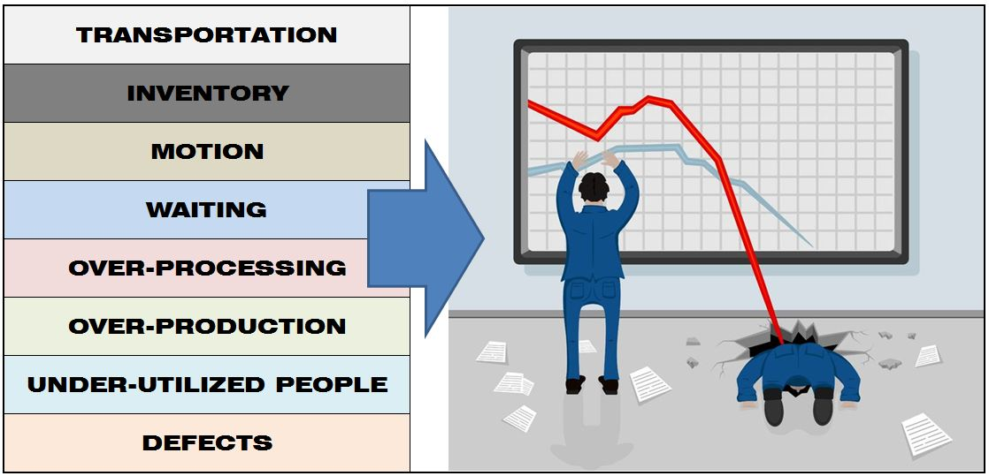
8 Wastes

Slide 14
Waste 1 - Transportation
Definition
Unnecessary movement of items between processes
Causes
Poor layout and/or process Design & Planning
Unstructured or not understood Value Stream
Complex Material flow
Problems
Increased Time & Cost to transport & search
Increased Defects due to accidents

Slide 15
Waste 2 - Inventory
Definition
Any raw material, Work in Progress (WIP) or finished goods which are being stored
Causes
Overproduction causes inventory build up between processes
Problems
Adds cost
Requires space
Hides process defects
Can become a defect

Slide 16
Waste 3 - Motion
Definition
Unnecessary movement within a Process
Causes
Poor workplace layout
Poor process planning
Poor Housekeeping
No Standard Operating Procedures
Problems
Adds time & cost
Can be a safety issue

Slide 17
Waste 4 - Waiting
Definition
People or Parts that are waiting for a work cycle to be completed
Causes
Unreliable Supply Chain
Bottlenecks
Down Time
Problems
Excessive Lead Time
Causes Bottle Necks
Additional Time & Cost

Slide 18
Waste 5 – Over processing
Definition
Processing beyond the value required by the Customer
Causes
Lack of Customer Focus
“Always done it this way”
Lack of understanding
Scheduled work time is longer than needed
Problems
Increases Time & Cost

Slide 19
Waste 6 – Over production
Definition
To produce items sooner or in greater quantities than required for customer demand
Causes
Poor planning
Incorrect bottleneck assumptions
Problems
Overproduction discourages a smooth flow of production
Leads to excessive work in process inventory

Slide 20
Waste 7 – Underutilized People
Definition
Underutilization of people’s Abilities, Knowledge, and Skills
Causes
Constant management turnover unaware of talent pool
Employee not happy in current position
Problems
Great ideas might be missed
Dominant personalities may force focus in wrong direction

Slide 21
Waste 8 - DEFECTS
Definition
A defect is when the Customer believes they did not get what they paid for
Causes
Process Variation
Customer requirements not understood
Problems
Additional Time & Cost
Reduces Customer Confidence

Slide 22
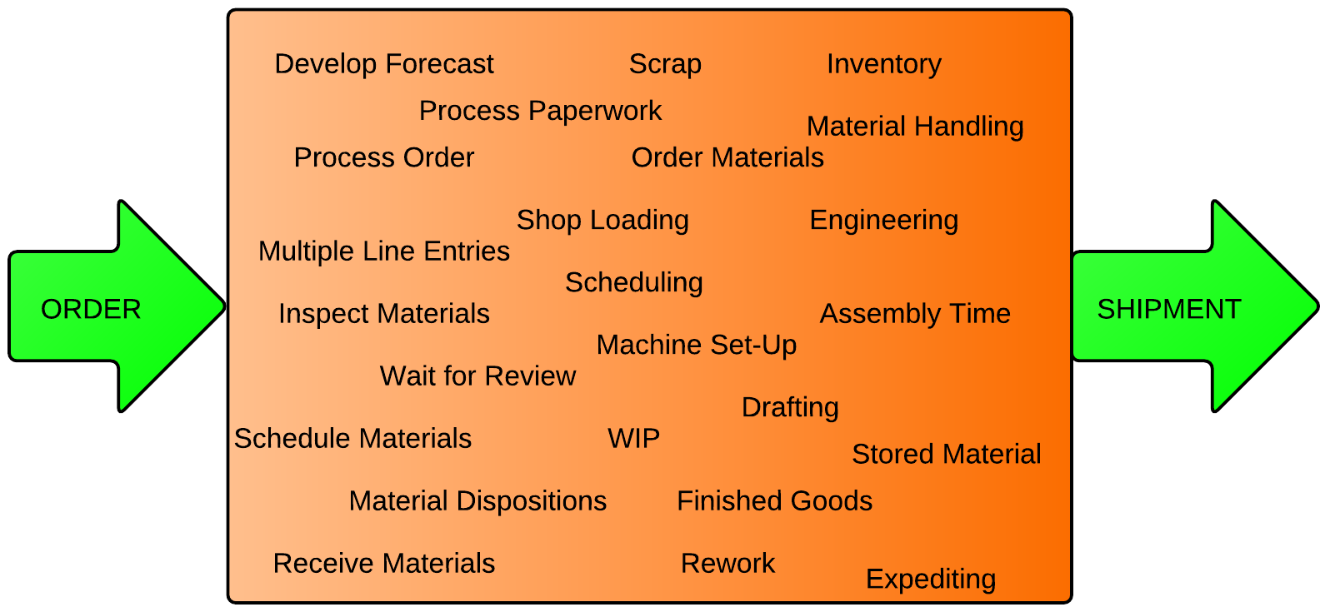
Potential Non-Value Add Opportunities

Slide 23
Kill The “Re’s”
Action verbs that start with “re” usually bad news:
Rework
Retool
Reject
Restock
Retest
Recall
Retrain, etc.

Slide 24
Steps to Eliminate Waste
Brainstorm!
Clearly identify business, processes or area to focus improvements on where bottlenecks, high costs, or long throughputs exist
Perform detailed “current state” process analysis through value stream mapping, time and motion studies, video, measurements, interviews with employees, collect process data, stand and observe the process, etc.
Identify “value-added”, “non value-added but necessary” and “waste”.
Define “ideal / future state” map for the targeted process (What should it be without any or with minimum waste?).
Justify improvement benefits in safety, quality, customer and financial impact

Slide 25
Steps to Eliminate Waste
Involve employees and perform Kaizen events; apply problem solving & analysis (Plan-Do-Check-Act); define and prioritize solutions.
Set action plans to get from current state to future state (assign ownership for improvements, set timelines and follow-up method).
Execute improvements and follow-up on agreed actions.
Train employees; document and standardize the process based on improvements made.
Reflect and learn from the process (what we did right and what we did wrong, how to improve in future).

Slide 26
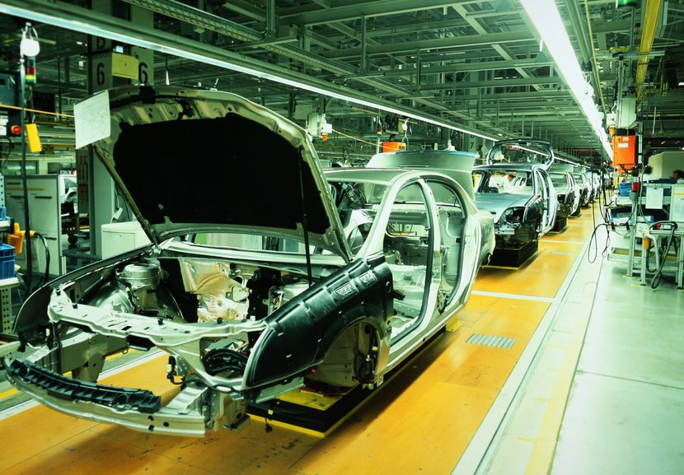
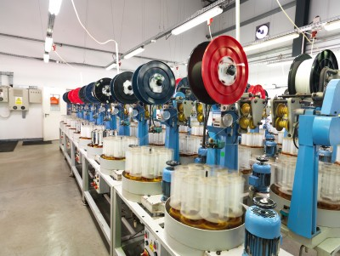
The Visual Factory
Describes how information and data flows. Uses visual methods to display and convey how material flows, where it is located, and how the work is accomplished. Visual Factory tools include Andon boards, signs, and charts.

Slide 27
5S
Workplace organization standard focused on efficiency, effectiveness, and safety
Sort (Seiri)
Straighten, Set in order (Seiton)
Shine, Sweep (Seiso)
Standardize (Seiketsu)
Sustain (Shitsuke)

Slide 28
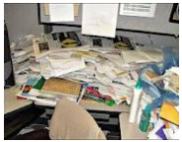
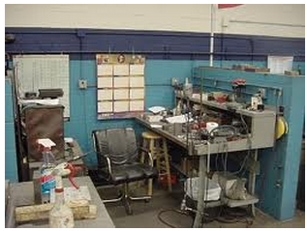
5S - Before
Workplace Targets
Office (Before)
Factory (Before)

Slide 29
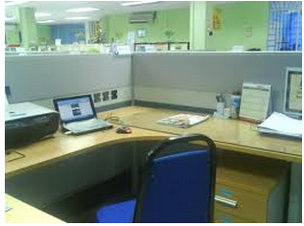
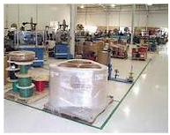
5S - After
Office (After)
Factory (After)

Slide 30
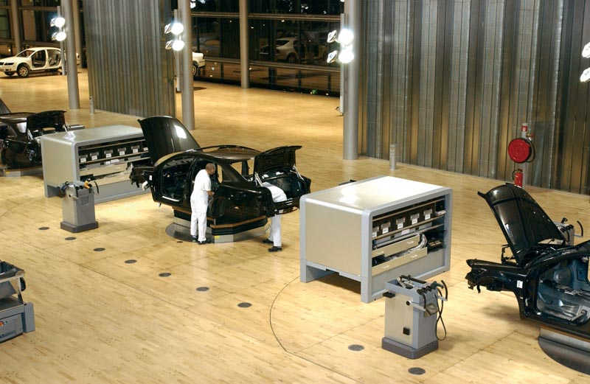
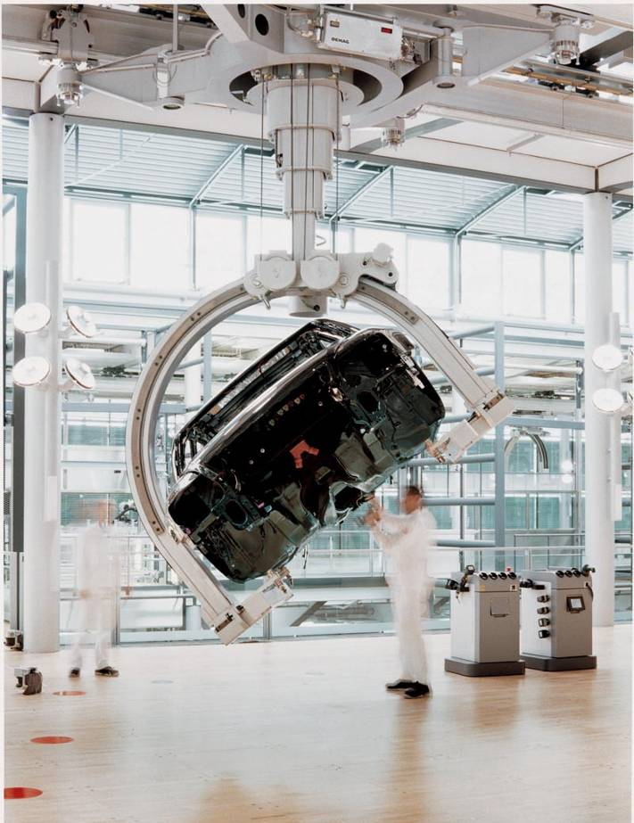
Importance of the Visual Image

Slide 31
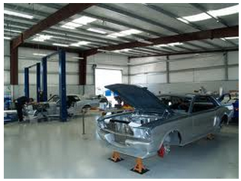
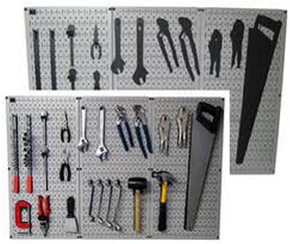
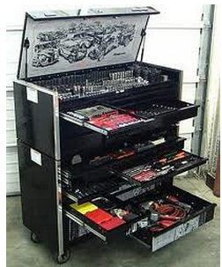
Importance of the Visual Image
All factories should be as clean as “Clean Rooms”

Slide 32
Rules to Good Housekeeping
Remove / eliminate everything you don’t need from the floor, drawers, shelves, etc.
Gain space and eliminate waste (simplify)
Everything left will have a clearly defined place (lined-up & identified)
Everything left will be clean and neat (regularly cleaned, re-painted, etc.)
Ownership in the area
Keep the area neat and don’t let others mess it up

Slide 33
Waste ID – Gemba/MUDA Walk
Spend 1 to 2 hours in the area identifying waste
Write down every waste you see for 30 minutes (use form)
Prioritize and identify top 3 (15 minutes)
Propose solutions (15 minutes)
Discuss with Team all opportunities while in the area following the process (1 hour)

Slide 34
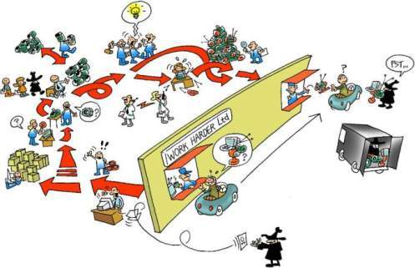
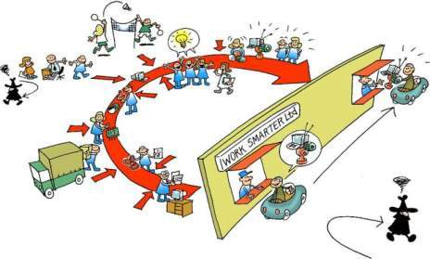
Going Lean Thru Kaizen
Turn This…
…Into This!

