Slide 1

ITIL
dr inż. Tomasz Pieciukiewicz pietia@pjwstk.edu.pl

Slide 2
ITIL – what is it?
guidelines for IT service proces organization
set of rules based on best practices
lowering IT costs
improvement of service quality
considered to be the most complete approach to managing IT services
de facto standard

Slide 3
ITIL – what is it?
5 publications (numer depends on edition)
Service Strategy
Service Design
Service Transition
Service Operation
Continual Service Improvement

Slide 4
History
1989: first elements published by CCTA (Central Computer and Telecommunications Agency),
initially created as an aid for IT infrastructure management projects conducted by british governmental agencies
2000: CCTA becomes part of OGC (Office of Government Commerce) – current owner of ITIL

Slide 5
History
2001: first major changes:
previous publications (40!) reorganized into 6 items (2 additional added later)
2005: standard ISO/IEC 20000, based in part on ITIL
2007: ITIL 3 published

Slide 6
History
OGC created other well known products:
PRINCE2 (Projects in Controlled Environments version 2)
SSADM (Structured Systems Analysis and Design Method)
CRAMM (CCTA Risk Analysis & Management Method)

Slide 7
Contents
ITIL describes best practices in IT service management
Basis for procedures and instructions customized for the company
directions on how to improve IT departments
most common errors
how to avoid them
best practices
Does not contain ready-made procedures and instructions
adapt and adopt approach

Slide 8
Basic concepts
Service
provides value to the customer
results without ownership of certain costs and risks
Service level
measurable
maintaining specified parameters
Service Level Agreement
contract specifying services, service levels, prices and penalties
between Service Provider and Customer

Slide 9
Basic Concepts
Configuration Management System
tools and databases to manage configuration data
contains Configuration Management Database (CMDB)
data about hardware and software, documentation, other IT service description data
Release
software, hardware, docs, processes, other elements required to implement approved changes in services

Slide 10
Basic Concepts
4 Ps of Service Management
People – skills, training, communication
Processes – actions, activities, changes, goals
Products – tools, monitoring, measurements, improvement
Partners – specialized suppliers

Slide 11
Service strategies
In-sourcing
Out-sourcing (specific areas, not core business)
Co-sourcing
Knowledge Process Outsourcing (outsourcing of core business-related processes)
Application Outsourcing (external hosting)
Business Process Outsourcing (outsourcing of specific processes, e.g. HR)
Partnership/Multi-sourcing (sharing services between several organizations)

Slide 12
Service life cycle
Service Strategy
Service Design
Service Transition
Service Operation
Continual Service Improvement

Slide 13
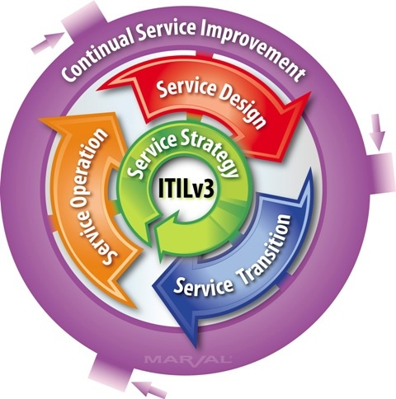
Service life cycle

Slide 14
Service Strategy
What we will provide?
Can we afford it?
Are we able to?
How to be competitive?
Plan
Make sure it fits strategy, mission and culture of the company

Slide 15
Service Strategy
Determine the market
Determine your offer
Prepare strategic resources
Prepare execution

Slide 16
Service Design
How will we provide the service?
How will we build it?
How will we test it?
How will we deploy it?

Slide 17
Service Design - processes
Availability management
Capacity management
Supplier management
Service level management
Information security management
Service catalogue management
Service continuity management

Slide 18
Service Transition
Construction
Deployment
Testing
Acceptance
Bed-in

Slide 19
Service Transition
Important elements
understand customer’s expectations
prepare integration of future releases
reduce effectiveness variations
document well known issues
minimise risk
make sure the services are used properly
Important processes
knowledge management
configuration and service resources management
change management
release management

Slide 20
Service Transition
Change management
defined roles in management proces
defined change types
Release management
change level – from delta (small update) to full release

Slide 21
Service Operation
Incident management
unplanned problems with services or quality drop
problems with configuration elements, with no impact on service (failed RAID HDD)
Event management
information
warning
exception
Requests
information
advice
other kind of service
Access management

Slide 22
Service Operation
Problem management
goal – prevention of problems and incidents
reduction of incident consequences
elimination of repeating incidents
Proactive
identification of weak points
identification of workarounds
Reactive
identification of incident causes
changes

Slide 23
Continual Service Improvement
Make sure that services support business
monitor and upgrade Service Level
Plan-do-check-act

Slide 24
Continual Service Improvement
Service measurement
Technology (components, MTBF…)
Processes (KPI)
Services (customer satisfaction)
Why bother?
check, whether our decisions were right
decide on direction of changes
prove that contract is fulfilled
intervene if necessary

Slide 25
7 steps to improvement
What we should measure?
What we can measure?
Gather data
Process data
Analyse data
Present and use information
Take action

Slide 26
ITIL - roles
Process owner
Decides, if service is useful for given goals
Process manager
monitors and reports
Service owner
responsible for providing service
Service manager
Manages service life cycle

Slide 27
ITIL - roles
Manager of business relationships
Configuration and resource management:
service resources manager
knowledge manager
configuration manager
configuration analyst
configuration archivist
CMS administrator

Slide 28
Questions?
TYFYA

