Slide 1
Studco
CS2 PROJECT
I made this entire thing in powerpoint ☹
Created by Zach Adriell Chavero
Notes:
CONFIDENCE DON’T FIDGET!!!!! BREATHE

Slide 2
Studco
CS2 PROJECT
PROBLEM STATEMENT
All students and scholars alike share one common problem they encounter in their academic journey; studying. For a short quiz, a long test, or a periodical exam, there’s always going to be a moment where a student freezes in hunt for knowledge.
This is where my project comes in to fix that.
Created by Zach Adriell Chavero
Notes:
ZACH CONFIDENCE IS KEY REMEMBER THAT PLEASE ZACH BREATHE

Slide 3
CS2 PROJECT
Addresses the study issue by making it easy to access, online or offline, with lightweight and minimal equipment requirements and internet.
Because the files are just blocks of texts, the file size would be small, making it lightweight.
PROBLEM STATEMENT
All students and scholars alike share one common problem they encounter in their academic journey; studying. For a short quiz, a long test, or a periodical exam, there’s always going to be a moment where a student freezes in hunt for knowledge.
This is where my project comes in to fix that.
PROJECT OBJECTIVES
Organized, with sorting of notes using folders and other tools, making it easy to find where anything is and helps the unorganized to practice their organization skills.
Communication and transparency, making it easier to collaborate with other people.
Notes:
ZACH DON’T FIDGET REMAIN CONFIDENT YOU CAN DO THIS JUST BREATH

Slide 4
CS2 PROJECT
Addresses the study issue by making it easy to access, online or offline, with lightweight and minimal equipment requirements and internet.
Addresses the study issue by making it easy to access, online or offline, with lightweight and minimal equipment requirements and internet.
Because the files are just blocks of texts, the file size would be small, making it lightweight.
Because the files are just blocks of texts, the file size would be small, making it lightweight.
PLANNED FEATURES
FOLDERS
Folders are used to organize notes and ensure that it's a neat freak's best dream ever. If the time frame allows it, we can name, color, and sort folders out so that all notes are exactly where they should be in without a messy scatter.
FILE SHARING
Using accounts, you can share people your file by either clicking on the settings of your note, or sharing the link to them. You can even collaborate in making notes, but due to time limitations only one of them can access at a time.
NOTES
Notes are created directly from the homepage on the "+" button, from there the user can pick settings on how it will look, function, and be rendered. (e.g. can be shared with others, blue background, etc.) After selecting their settings, the user can start notetaking right away.
PROJECT OBJECTIVES
BLACKLISTING
The reason why you recquire an account to view, edit, and see others' notes is in the case of when you're exercising innapropriate behavior. The folder owner has the option to blacklist delinquent notetakers on the settings of their notes and folders to prevent any mishaps.
MARKDOWN FORMATTING
Using markdown formatting, you can easily make clean looking notes with easy to use functions to make your notes stand out. Also, it's very easy to implement because of the Python-Markdown.
https://python-markdown.github.io/
Organized, with sorting of notes using folders and other tools, making it easy to find where anything is and helps the unorganized to practice their organization skills.
Organized, with sorting of notes using folders and other tools, making it easy to find where anything is and helps the unorganized to practice their organization skills.
Communication and transparency, making it easier to collaborate with other people.
Communication and transparency, making it easier to collaborate with other people.
ACCOUNT CREATING
Click "create account" on the start menu when you first open the app, choose a name and password and access shared notes. Go to settings to create account if you missed the start menu.
* Ignore the bold fade animation
Notes:
ZACH IF U FUMBLE IM TELLING UR MOM THAT UR GAY

Slide 5
CS2 PROJECT
Addresses the study issue by making it easy to access, online or offline, with lightweight and minimal equipment requirements and internet.
Because the files are just blocks of texts, the file size would be small, making it lightweight.
PLANNED FEATURES
FOLDERS
Folders are used to organize notes and ensure that it's a neat freak's best dream ever. If the time frame allows it, we can name, color, and sort folders out so that all notes are exactly where they should be in without a messy scatter.
FILE SHARING
Using accounts, you can share people your file by either clicking on the settings of your note, or sharing the link to them. You can even collaborate in making notes, but due to time limitations only one of them can access at a time.
NOTES
Notes are created directly from the homepage on the "+" button, from there the user can pick settings on how it will look, function, and be rendered. (e.g. can be shared with others, blue background, etc.) After selecting their settings, the user can start notetaking right away.
PROJECT OBJECTIVES
BLACKLISTING
The reason why you recquire an account to view, edit, and see others' notes is in the case of when you're exercising innapropriate behavior. The folder owner has the option to blacklist delinquent notetakers on the settings of their notes and folders to prevent any mishaps.
MARKDOWN FORMATTING
Using markdown formatting, you can easily make clean looking notes with easy to use functions to make your notes stand out. Also, it's very easy to implement because of the Python-Markdown.
https://python-markdown.github.io/
Organized, with sorting of notes using folders and other tools, making it easy to find where anything is and helps the unorganized to practice their organization skills.
Communication and transparency, making it easier to collaborate with other people.
ACCOUNT CREATING
Click "create account" on the start menu when you first open the app, choose a name and password and access shared notes. Go to settings to create account if you missed the start menu.
Notes:
ZACH MAINTAIN UR BREATHING GOGOGOGO

Slide 6
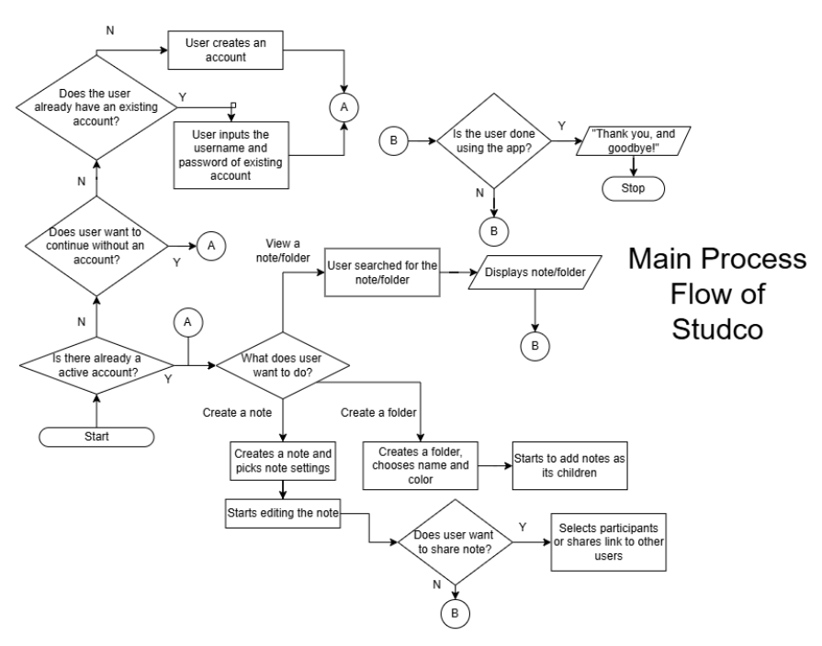
CS2 PROJECT
Planned Input & Outputs
You have good eyesight
Notes:
Oh ignore this slide haha

Slide 7

CS2 PROJECT
THE END
Notes:
ITS FINALLY OVER ZACH YOU DID IT

