Slide 1
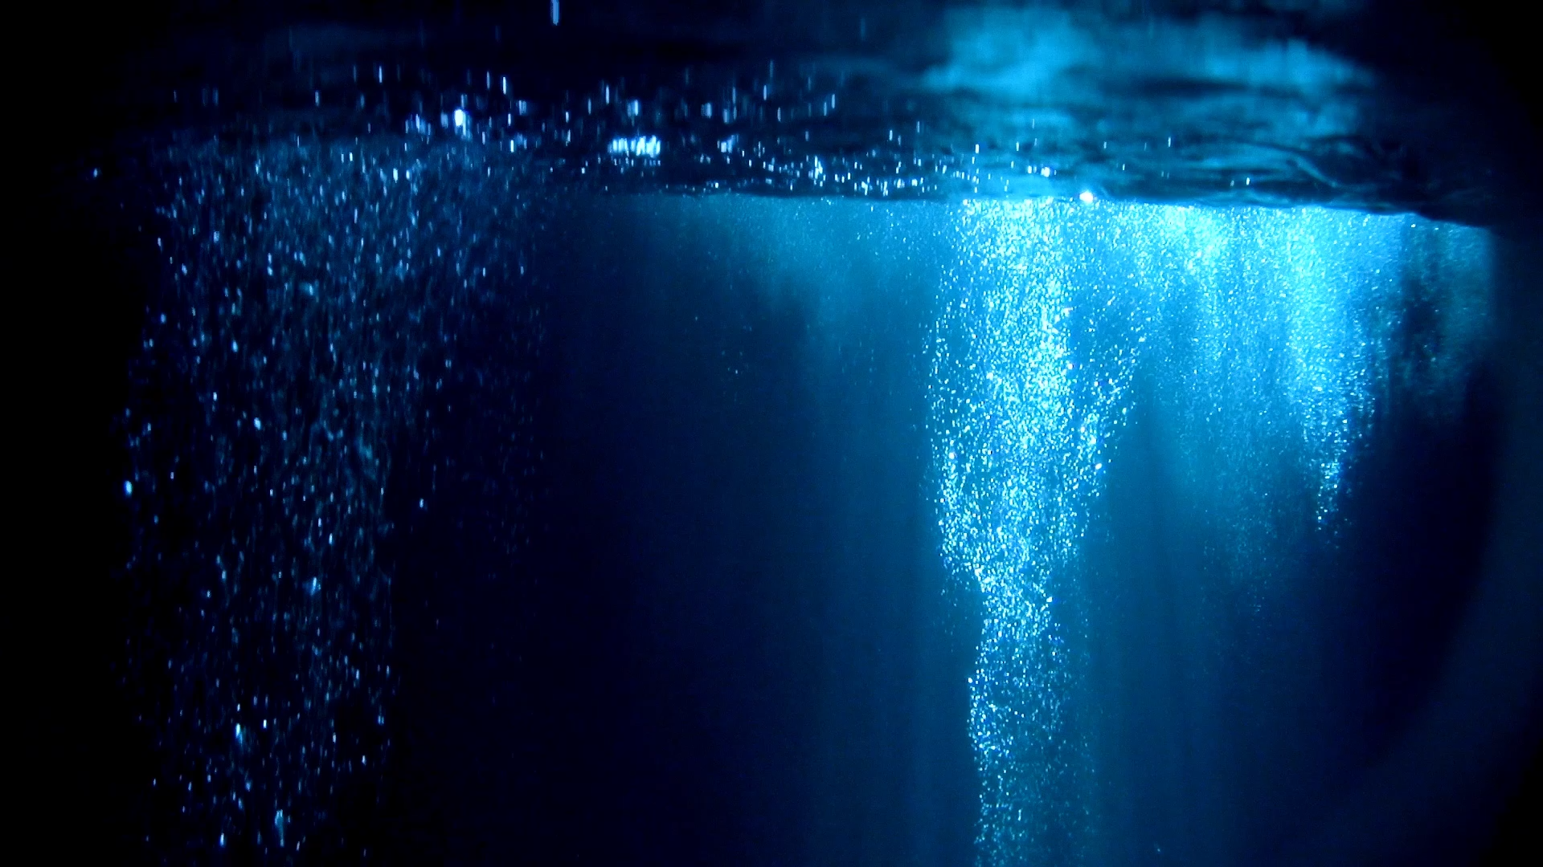
SDG 14: Life Below Water
Zach Ahearn
K00282339

Slide 2
What is SDG 14?
One of 17 Sustainable Development Goals
Created 2015
193 member states of the United Nations
Plan for 2030
Focus: Oceans, Seas, and Marine Life
Aim: Protect & use oceans sustainably

Slide 3
Why Do Oceans Matter?
Cover 70% of Earth
Produce 50% of oxygen – plants and plankton
Support > 3 Billion people – Food and Livelihoods
Helps regulate climate
Absorbs:
30% carbon emissions
90% excess heat in climate

Slide 4
Ocean Biodiversity
Millions of species
Coral reefs, fish, mammals
Complex ecosystems

Slide 5
Major Threat: Pollution
Plastic waste – 12 Million Tonnes
Oil Spills
Chemical runoff

Slide 6
Impact of Pollution
Animals ingest plastic
Entanglement
Microplastics in food chain
Birds/Fish killed by oil

Slide 7
Major Threat: Overfishing
Excessive fishing
Illegal fishing
Declining fish population
Impacts food supply

Slide 8
Major Threat: Climate Change
Rising ocean temperature
Coral bleaching – expel symbiotic algae – vulnerable starvation/death
Sea level rise

Slide 9
Ocean Acidification
CO2 absorbed by ocean
Reduces pH level of water
Harms shellfish and coral
Harder to build shells and skeletons

Slide 10
Goals of SDG 14
Reduce pollution
Protect ecosystems
Sustainable fishing
Increase marine research
Expand marine proctected areas

Slide 11
Marine Protected Areas
Areas where human activity is limited
Helps ecosystems recover
Protects biodiversity

Slide 12
Why SDG 14 Matters
Food security
Jobs (fishing, tourism)
Climate regulation
Global economy

Slide 13
What Can We Do?
Reduce plastic use
Recycle
Cycle/Carpool (if possible)
Promote Promote Promote

Slide 14

H2O(h) No!

Slide 15
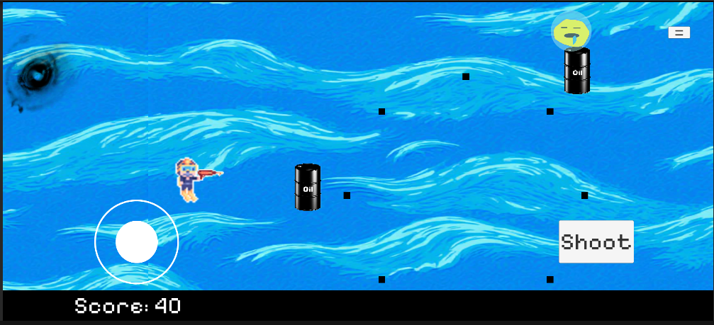
Level 1

Slide 16
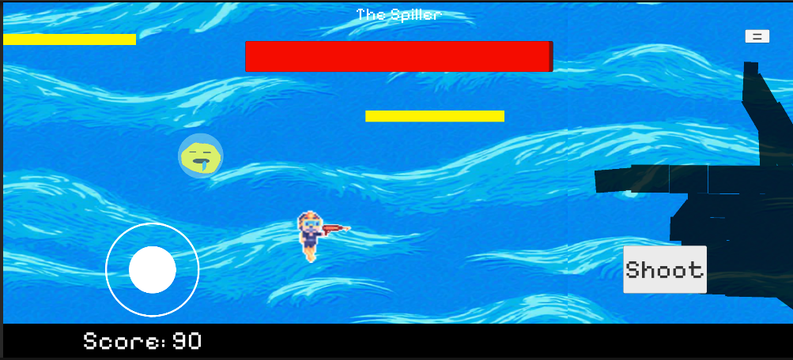
Level 1 Boss

Slide 17
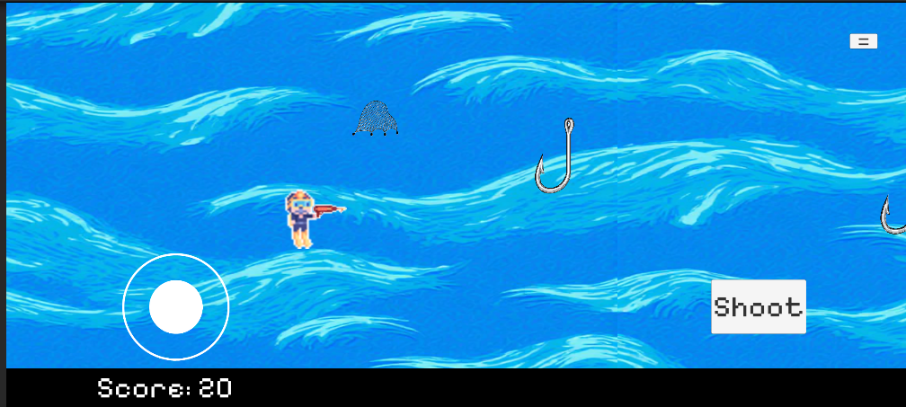
Level 2

Slide 18
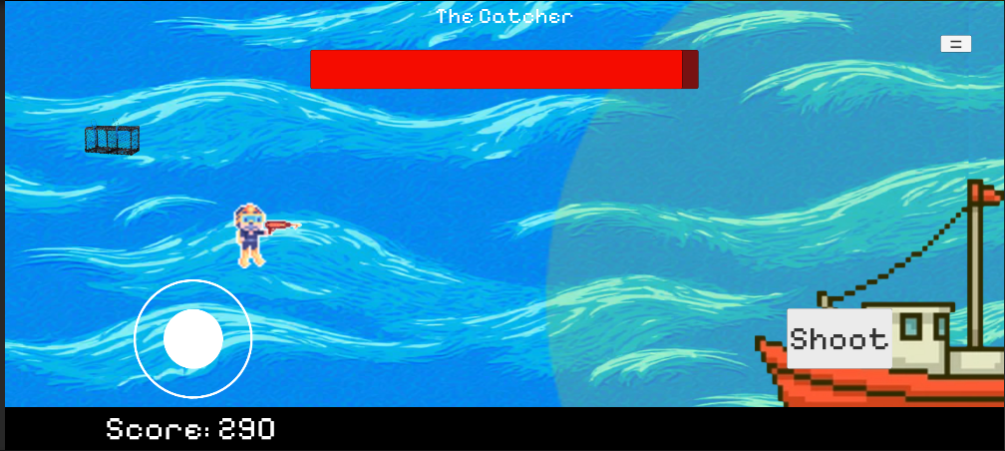
Level 2 Boss

Slide 19
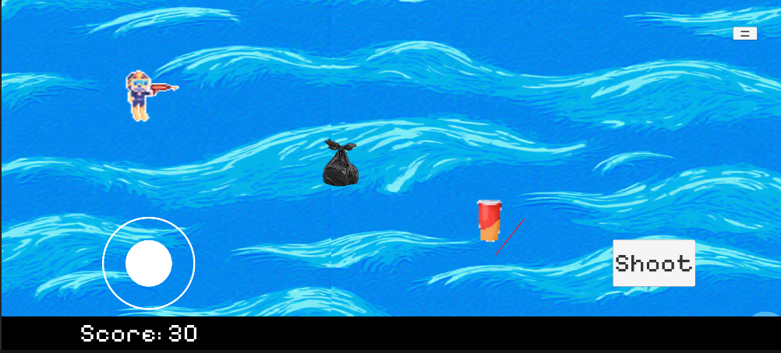
Level 3

Slide 20
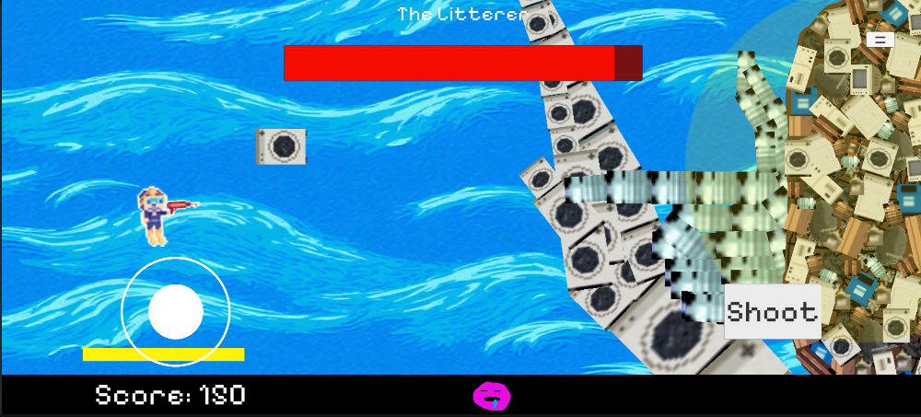
Level 3 Boss

Slide 21
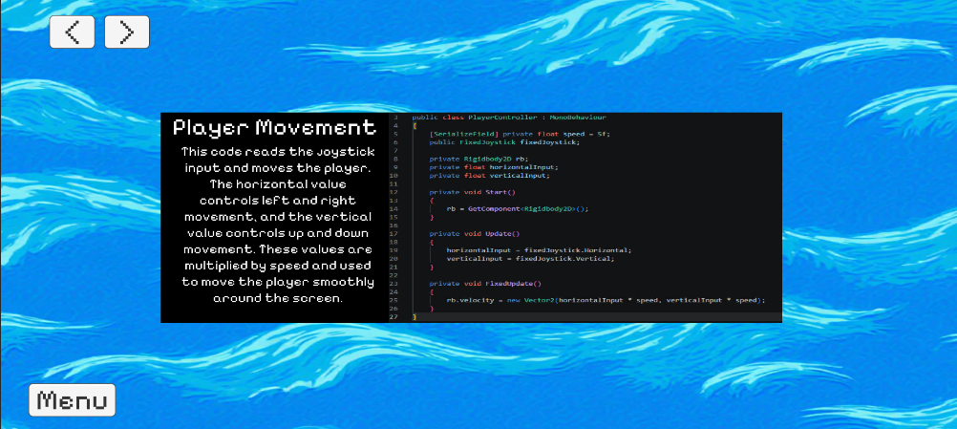
Educational Scene

Slide 22
References
https://sdgs.un.org/goals/goal14
https://www.un.org/sustainabledevelopment/oceans/
https://stakeholderforum.org/sdg-14-conserve-and-sustainably-use-the-oceans-seas-and-marine-resources-for-sustainable-development/
https://www.sas.org.uk/plastic-pollution/plastic-pollution-facts-figures/

