Slide 1
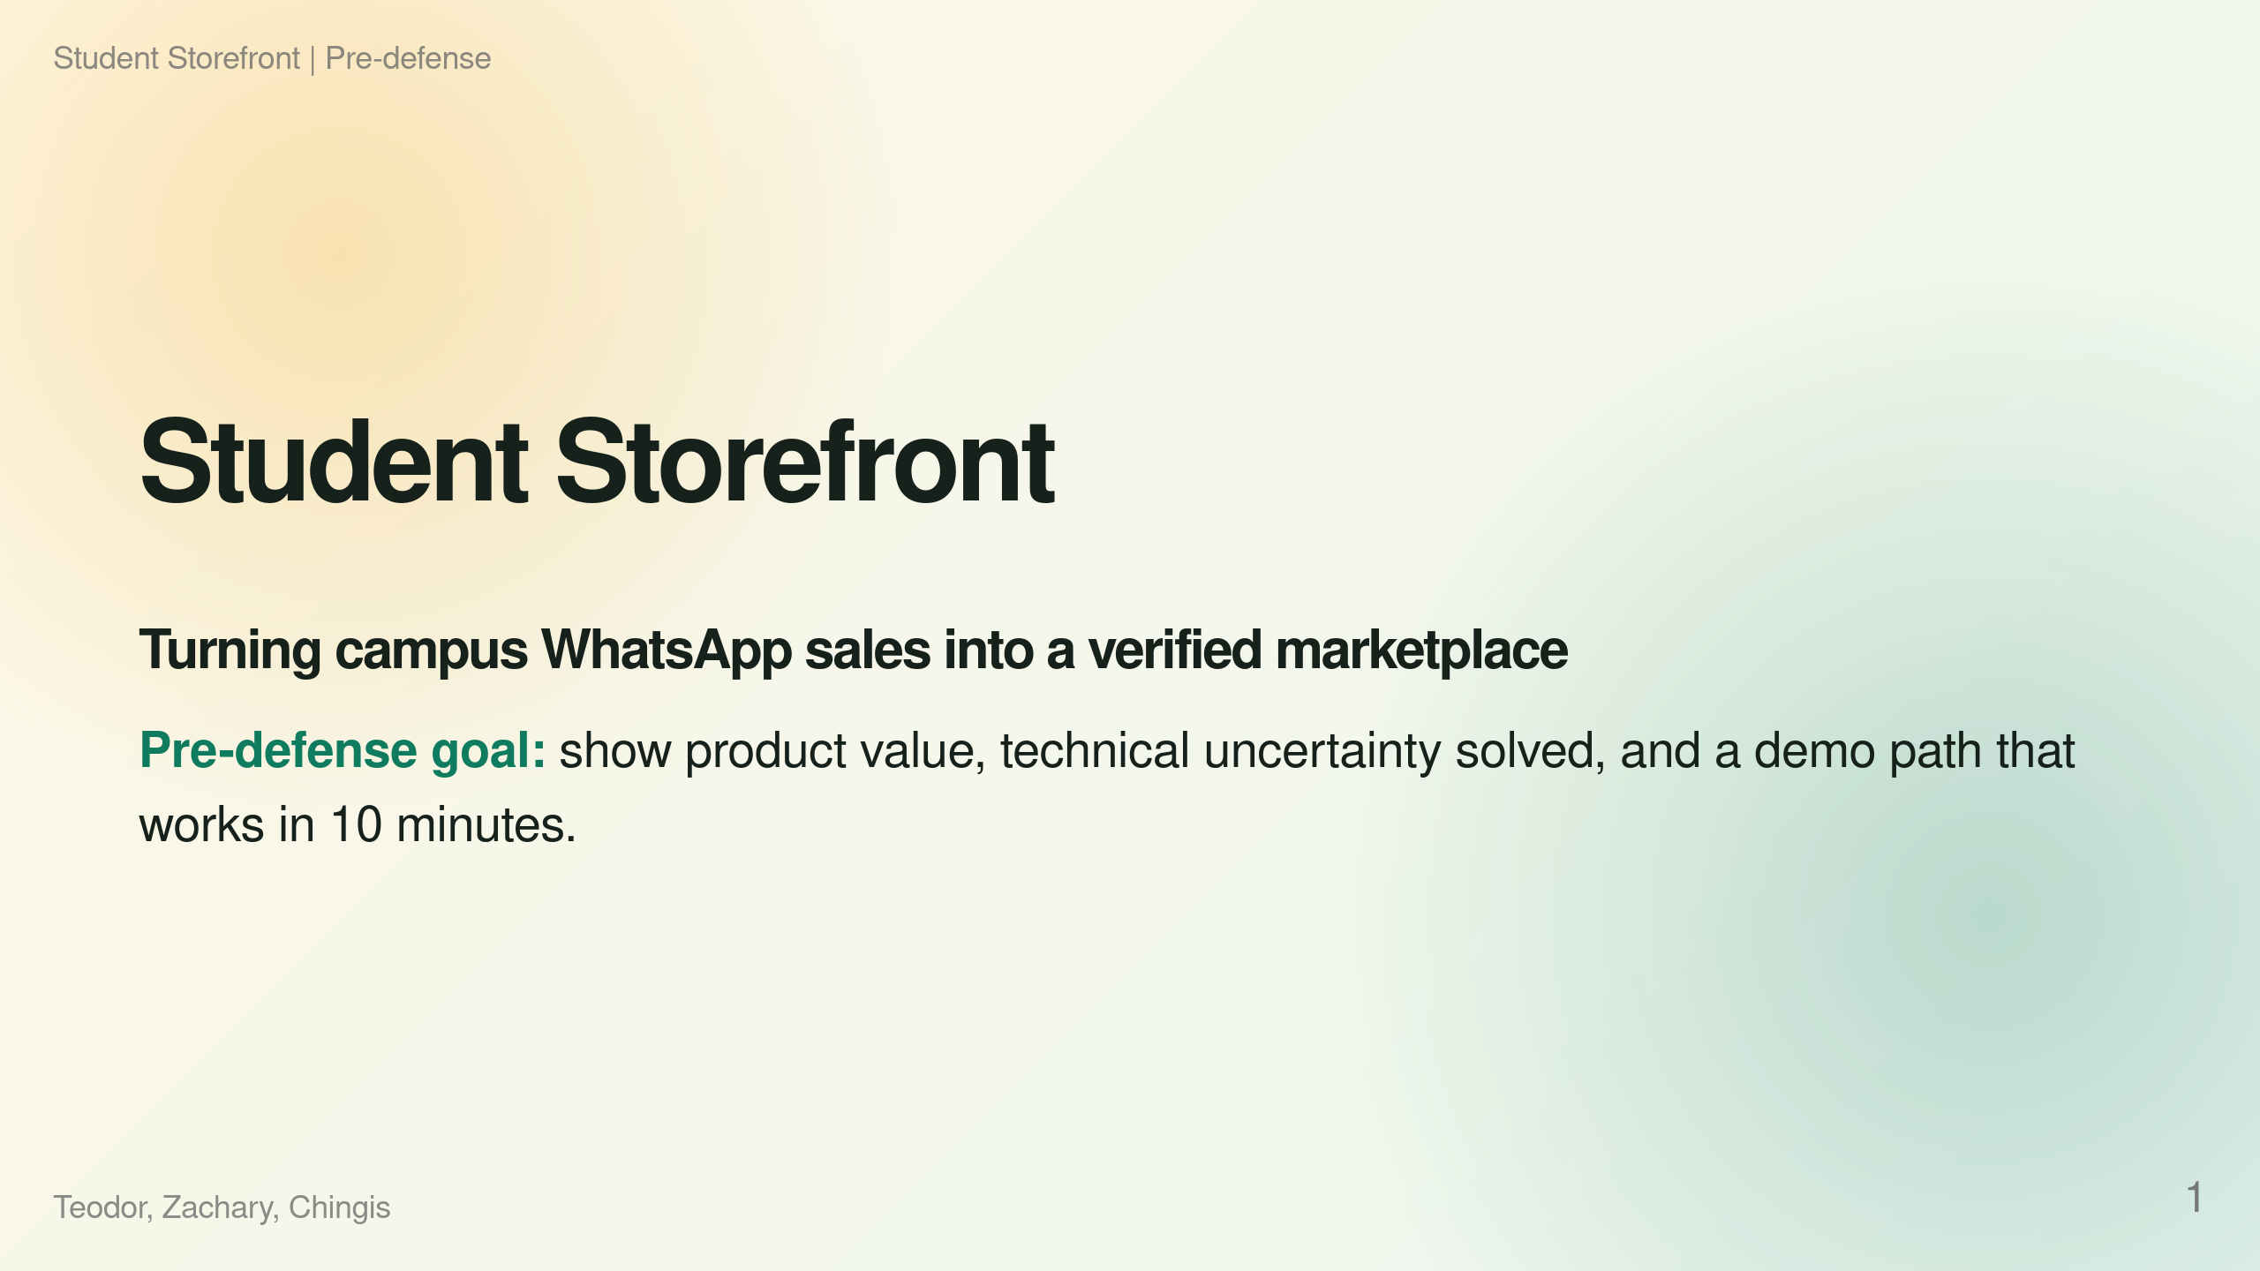
Notes:
Speaker notes: Target: 25s. State the goal: this is not a feature list. We are showing why the product matters, what is working now, and which technical risks we solved.

Slide 2
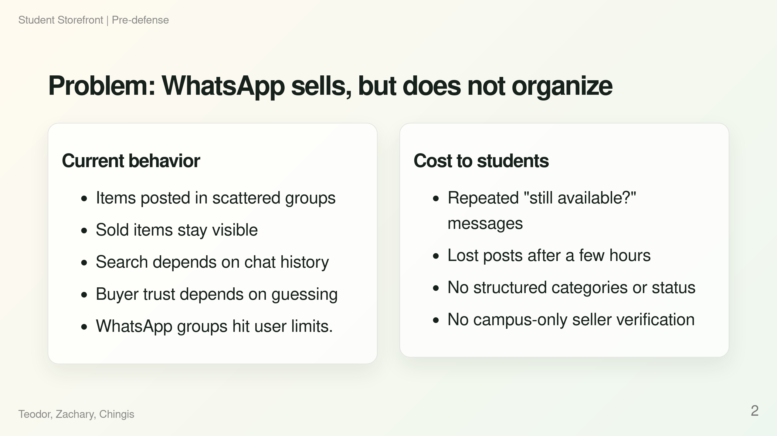
Notes:
Speaker notes: Target: 35s. Make this concrete: campus sales already happen, but the channel is optimized for conversation, not inventory. The product value is not inventing sales; it is removing friction from an existing behavior.

Slide 3
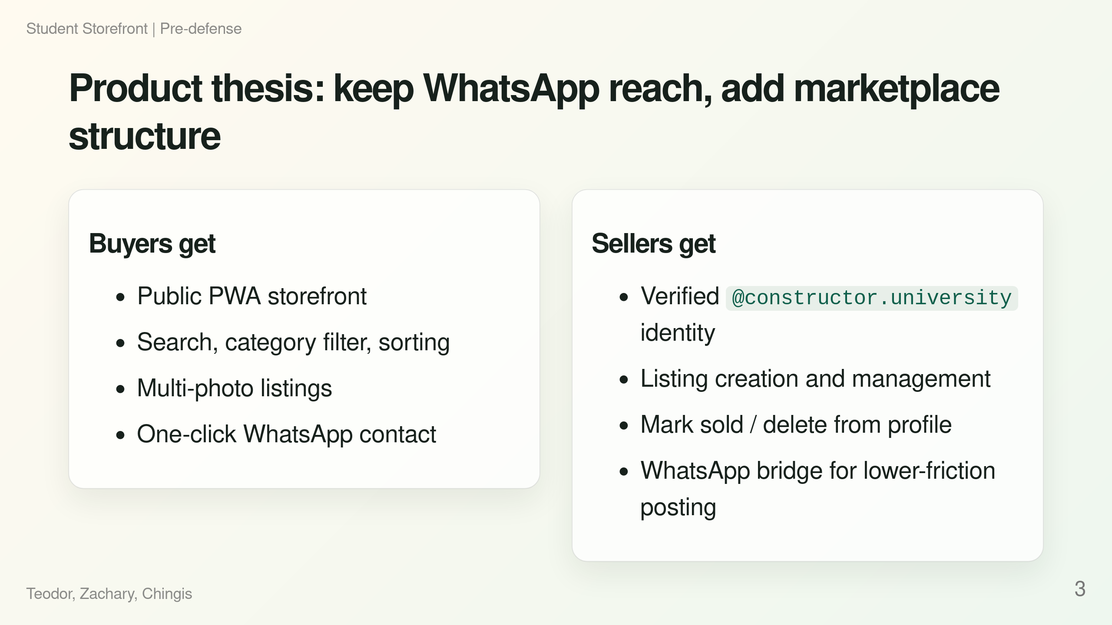
Notes:
Speaker notes: Target: 35s. Emphasize why users would switch: we do not force them to abandon WhatsApp. WhatsApp remains the contact and optional posting channel; the web app becomes the source of truth.

Slide 4
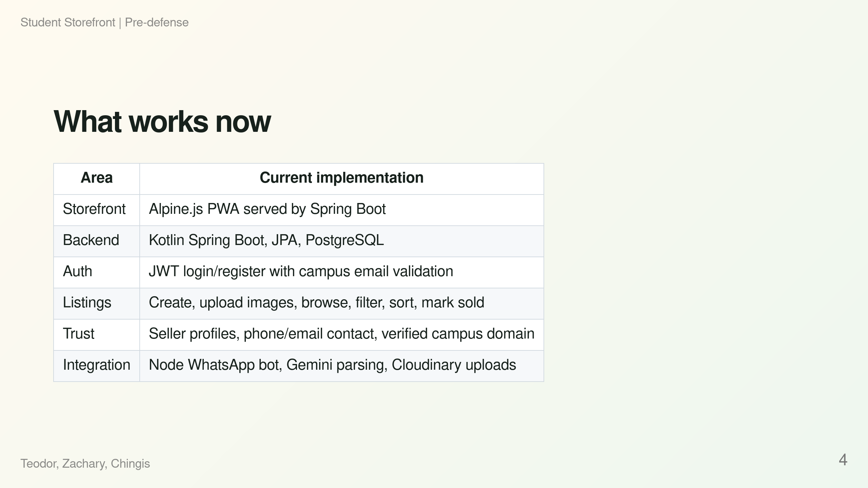
Notes:
Speaker notes: Target: 35s. Keep this factual. Mention that the repo has a usable vertical slice, not just mockups: UI, API, DB, security, and integration services.

Slide 5
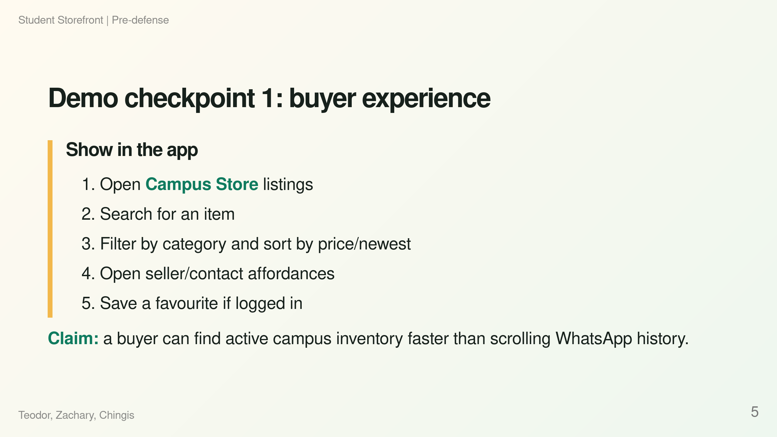
Notes:
Speaker notes: Target: 60s including live demo. If the app is slow, use seeded data from DataLoader or existing DB. Do not explain implementation here; let the demo prove the product value.

Slide 6
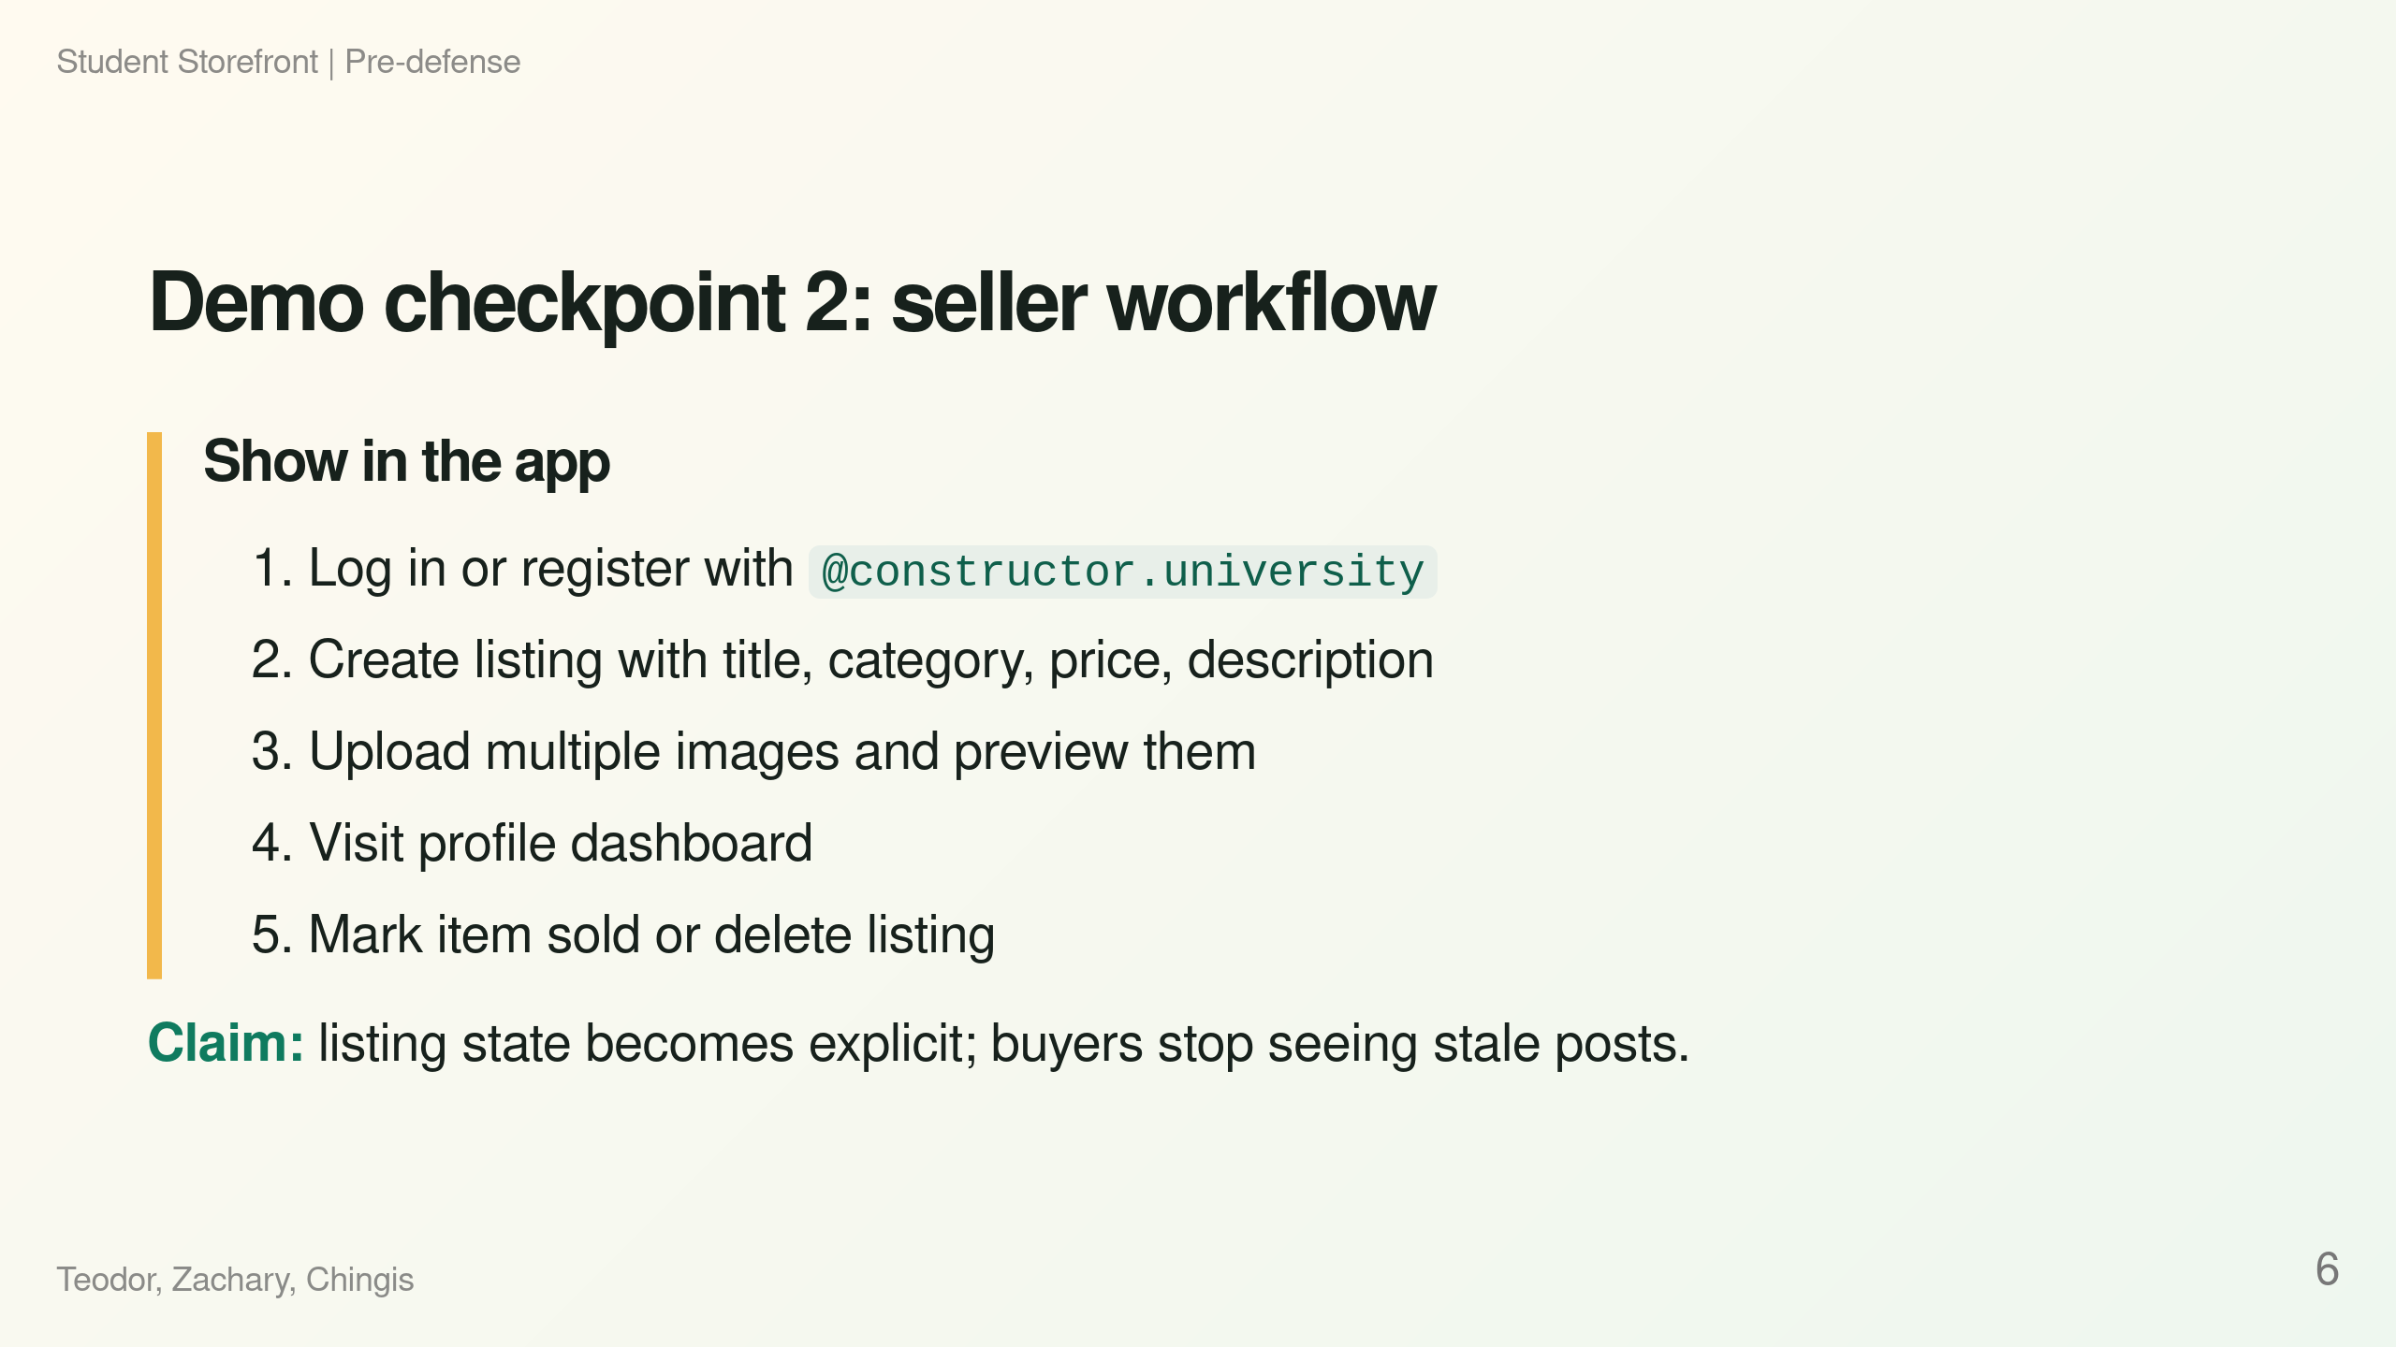
Notes:
Speaker notes: Target: 70s including live demo. If Cloudinary is unavailable, say one sentence: image upload depends on env config, then show existing listing management instead. Do not debug live.

Slide 7
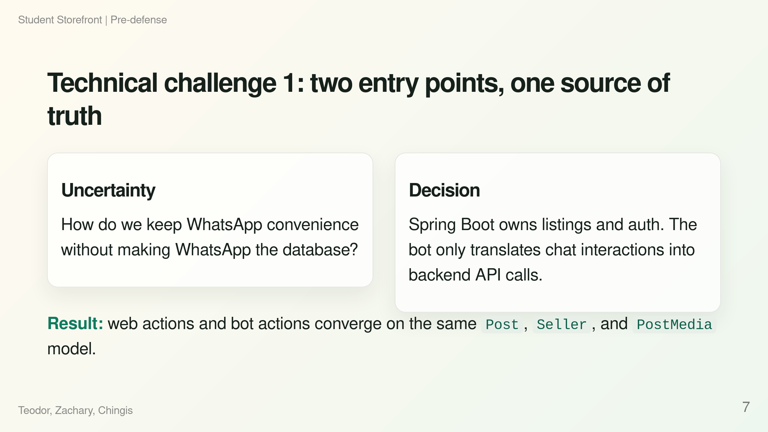
Notes:
Speaker notes: Target: 50s. This is a real technical challenge because the risk is duplicated state and inconsistent sold status. The solution is clear boundary setting: backend is source of truth; bot is an adapter.

Slide 8
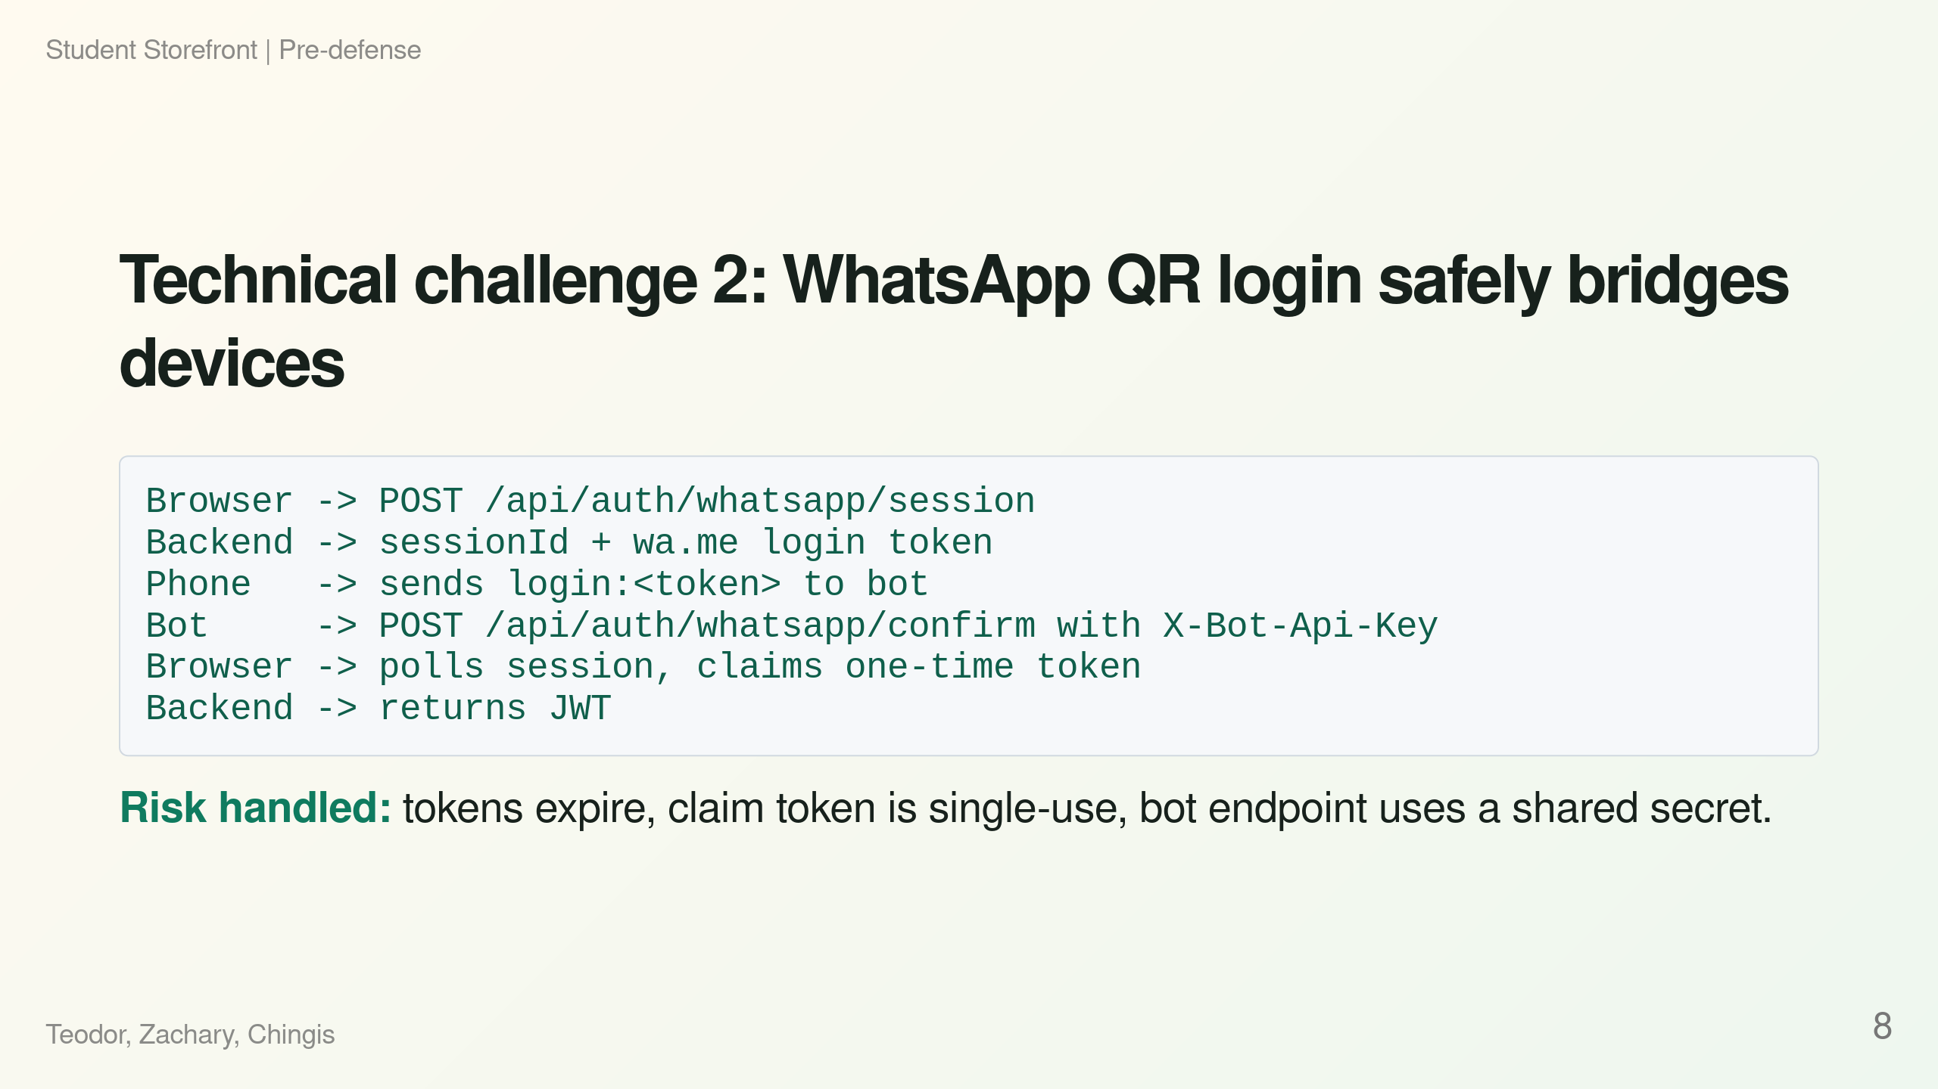
Notes:
Speaker notes: Target: 60s. This is stronger than saying "we used JWT". Explain the uncertainty: the user begins on desktop/browser but confirms identity from WhatsApp. We solved it with a short-lived polling session and one-time claim token.

Slide 9
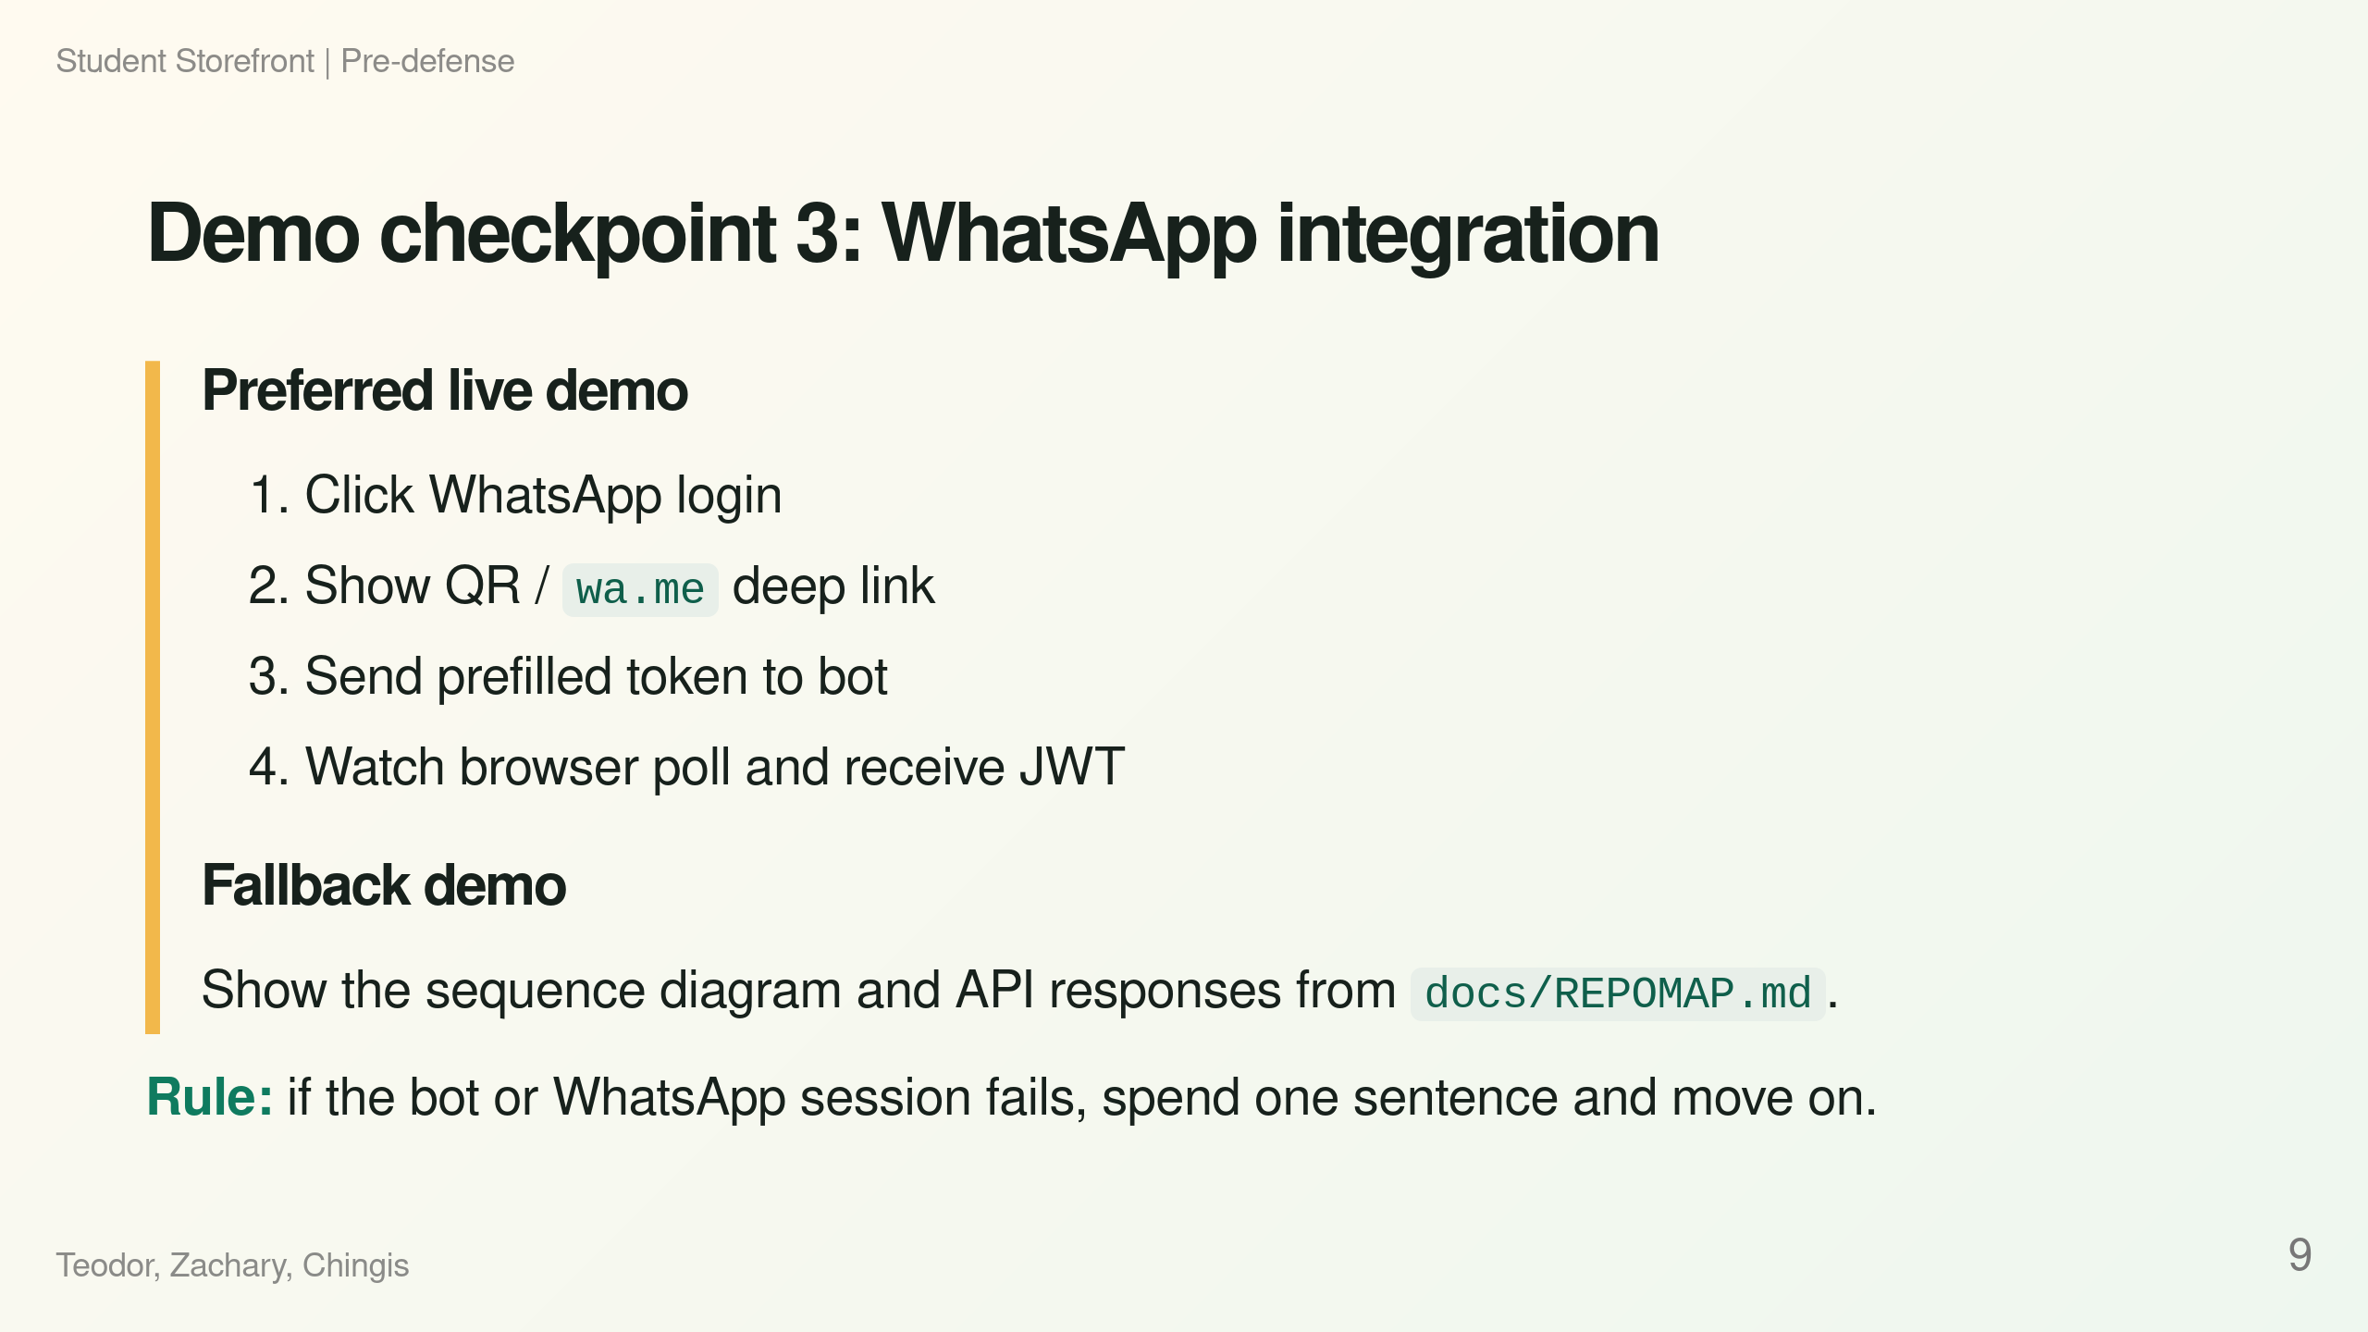
Notes:
Speaker notes: Target: 45s. This is intentionally optional because external services are risky in a defense. Have terminal/API screenshots or docs open as a fallback.

Slide 10
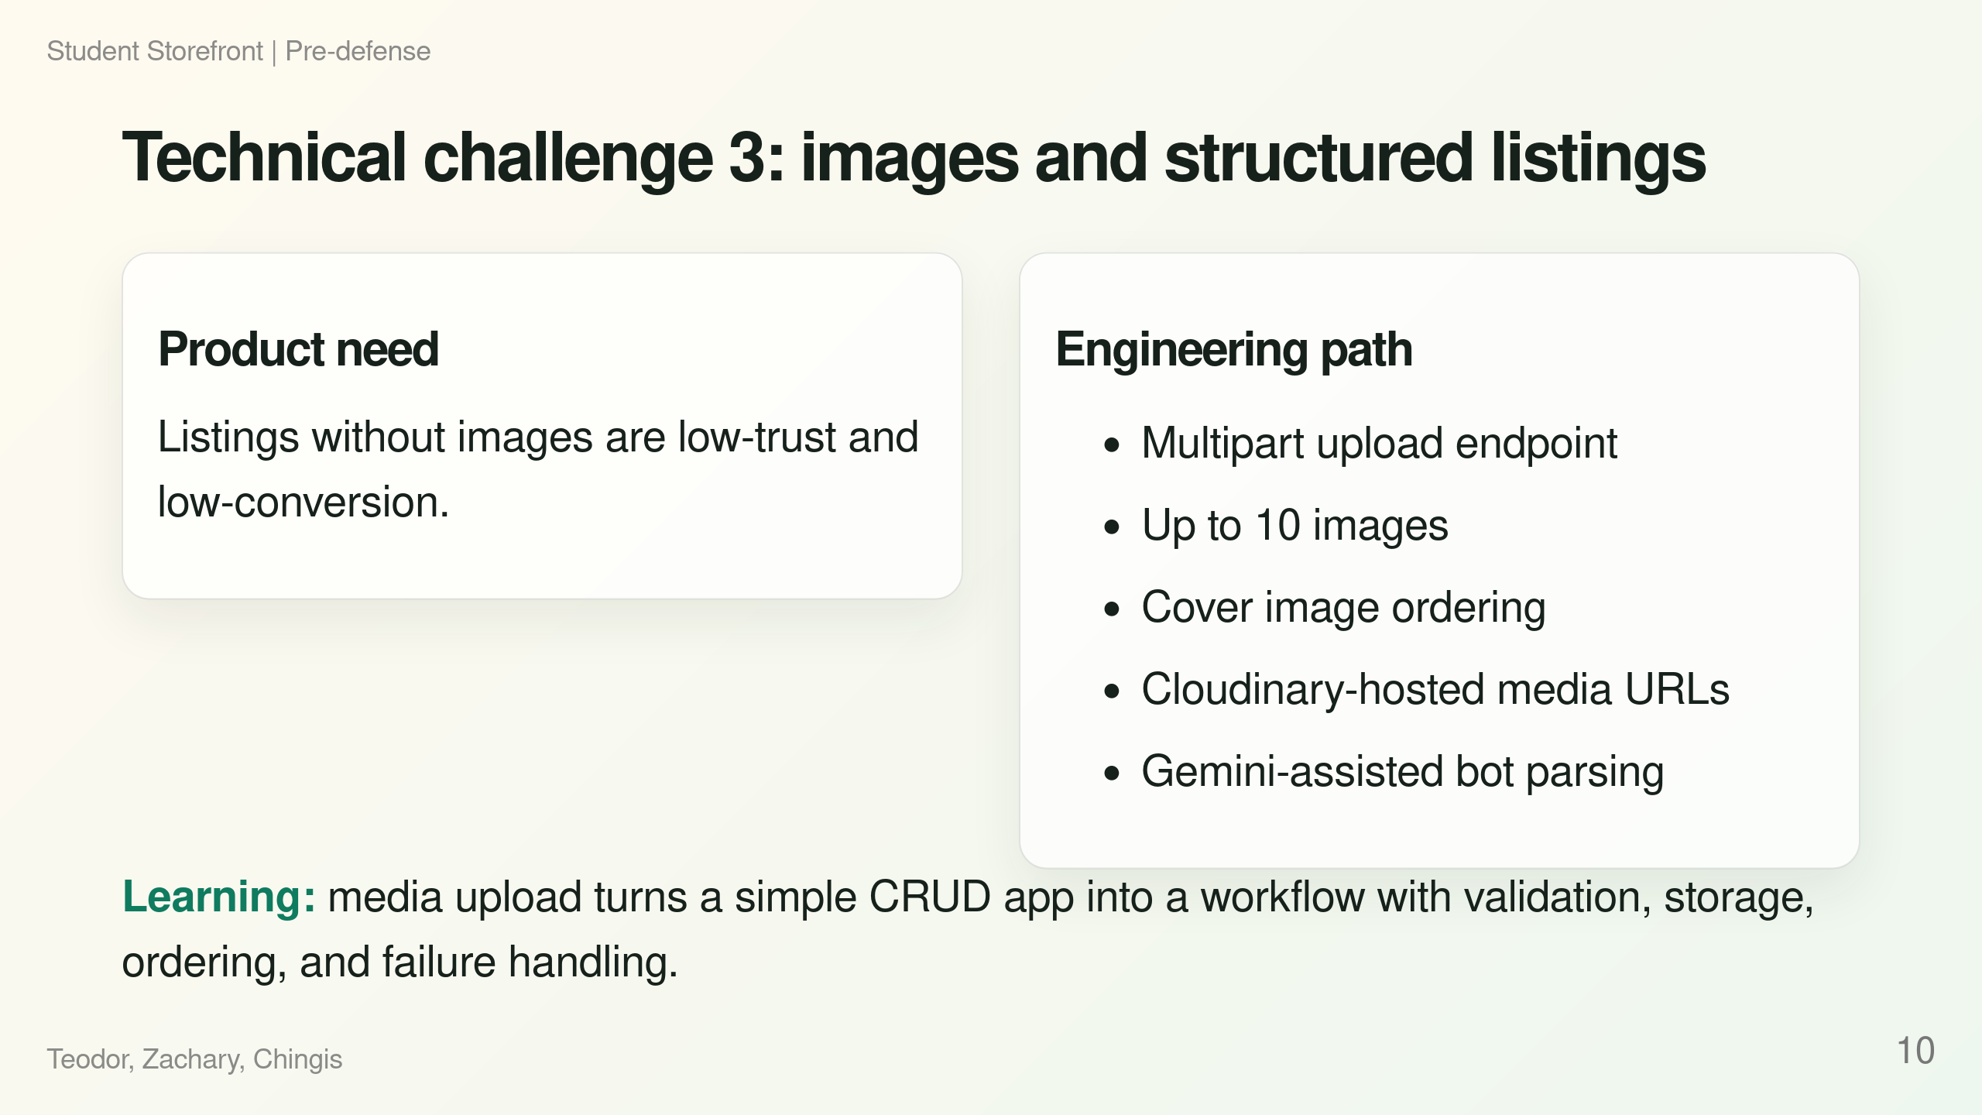
Notes:
Speaker notes: Target: 45s. Avoid overclaiming. The important point is that this is not just a form; image handling affects data model, API shape, UI preview, external storage, and bot ingestion.

Slide 11
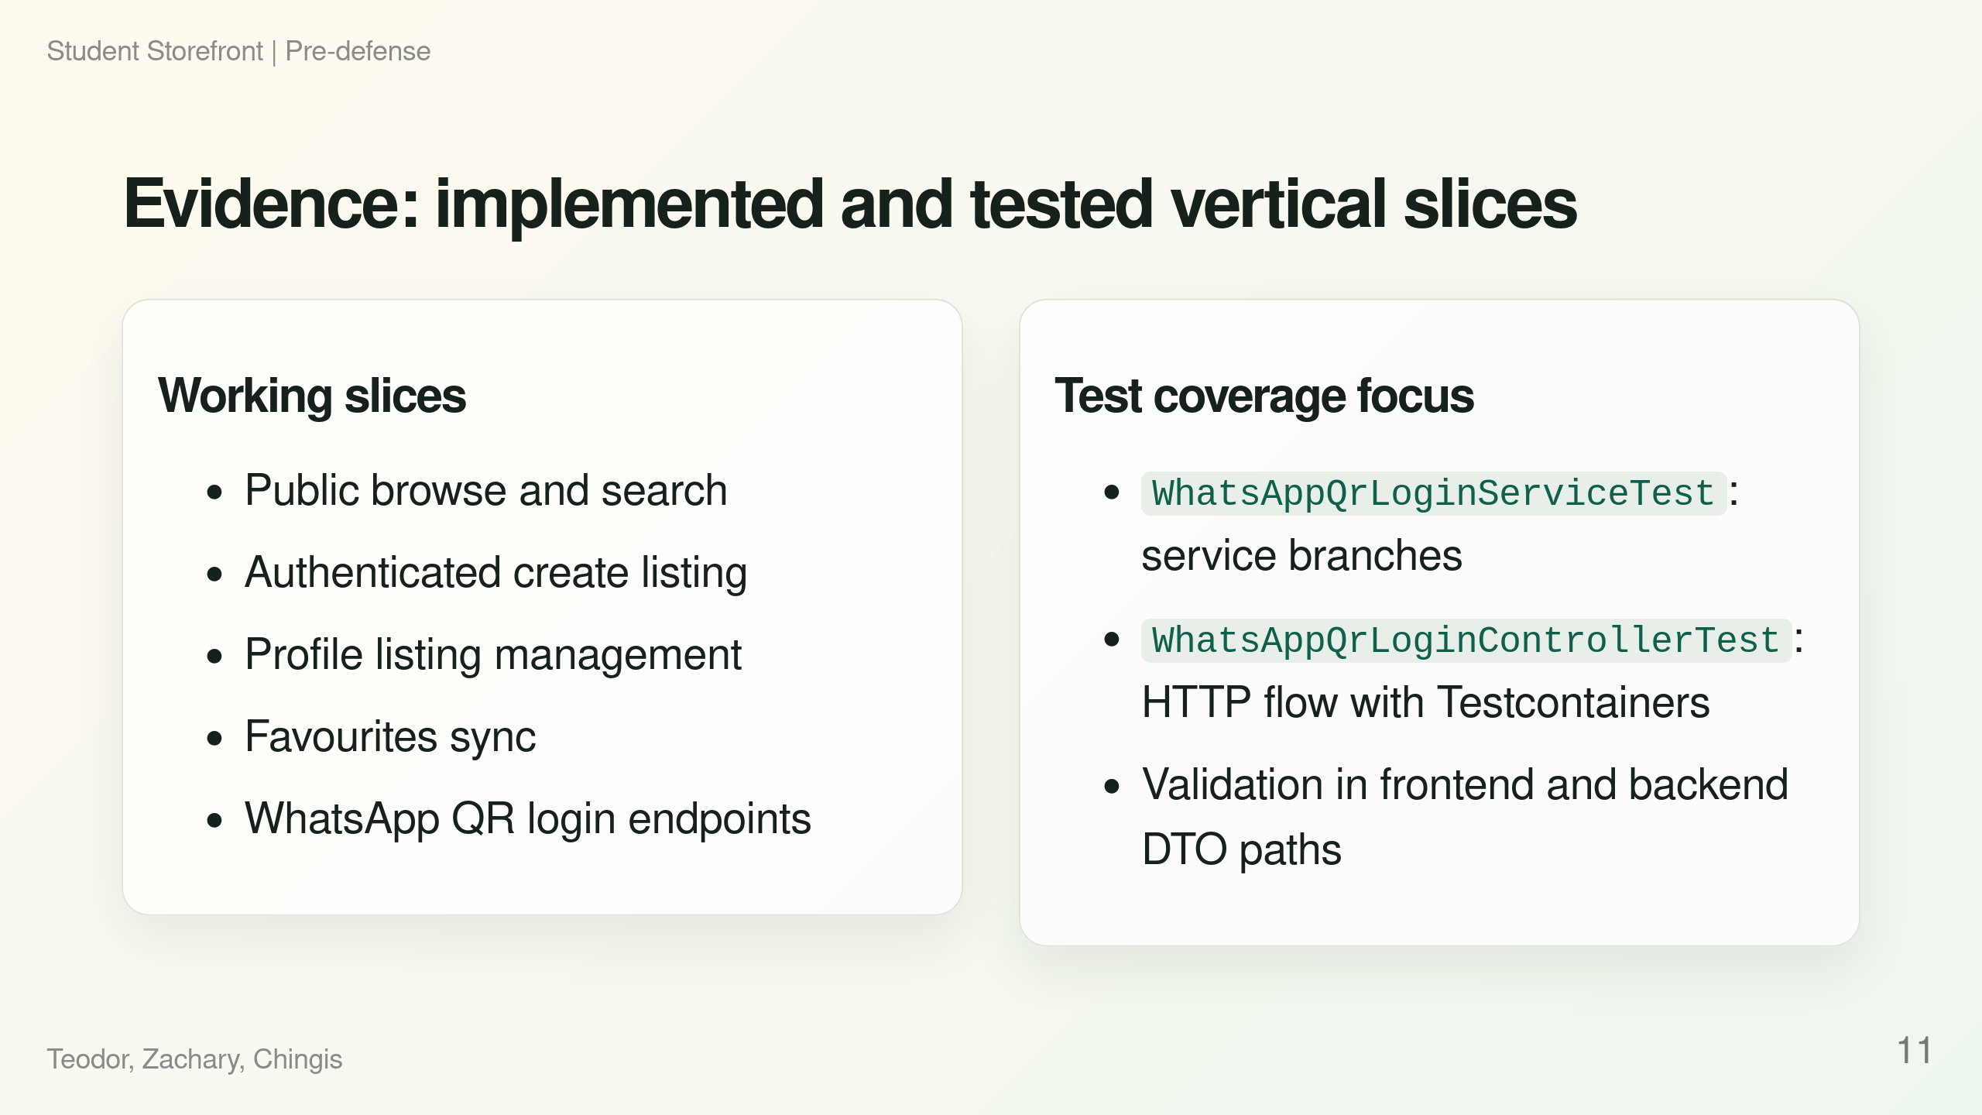
Notes:
Speaker notes: Target: 35s. Evidence must be concrete. Mention tests for the riskiest auth integration, not just generic "we tested it".

Slide 12
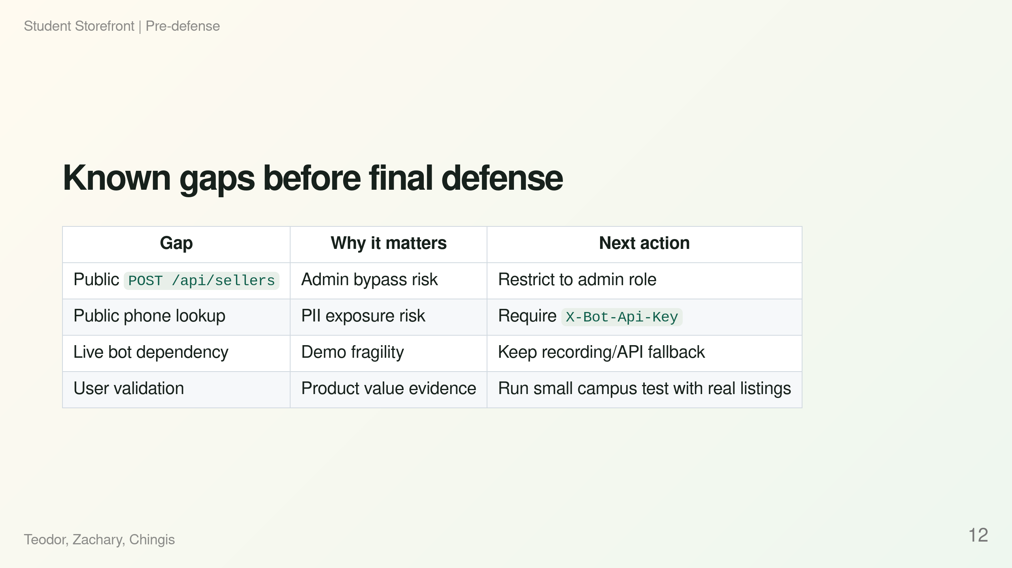
Notes:
Speaker notes: Target: 40s. This improves credibility. Present gaps as controlled engineering risk, not surprises. Tie each gap to a next action.

Slide 13
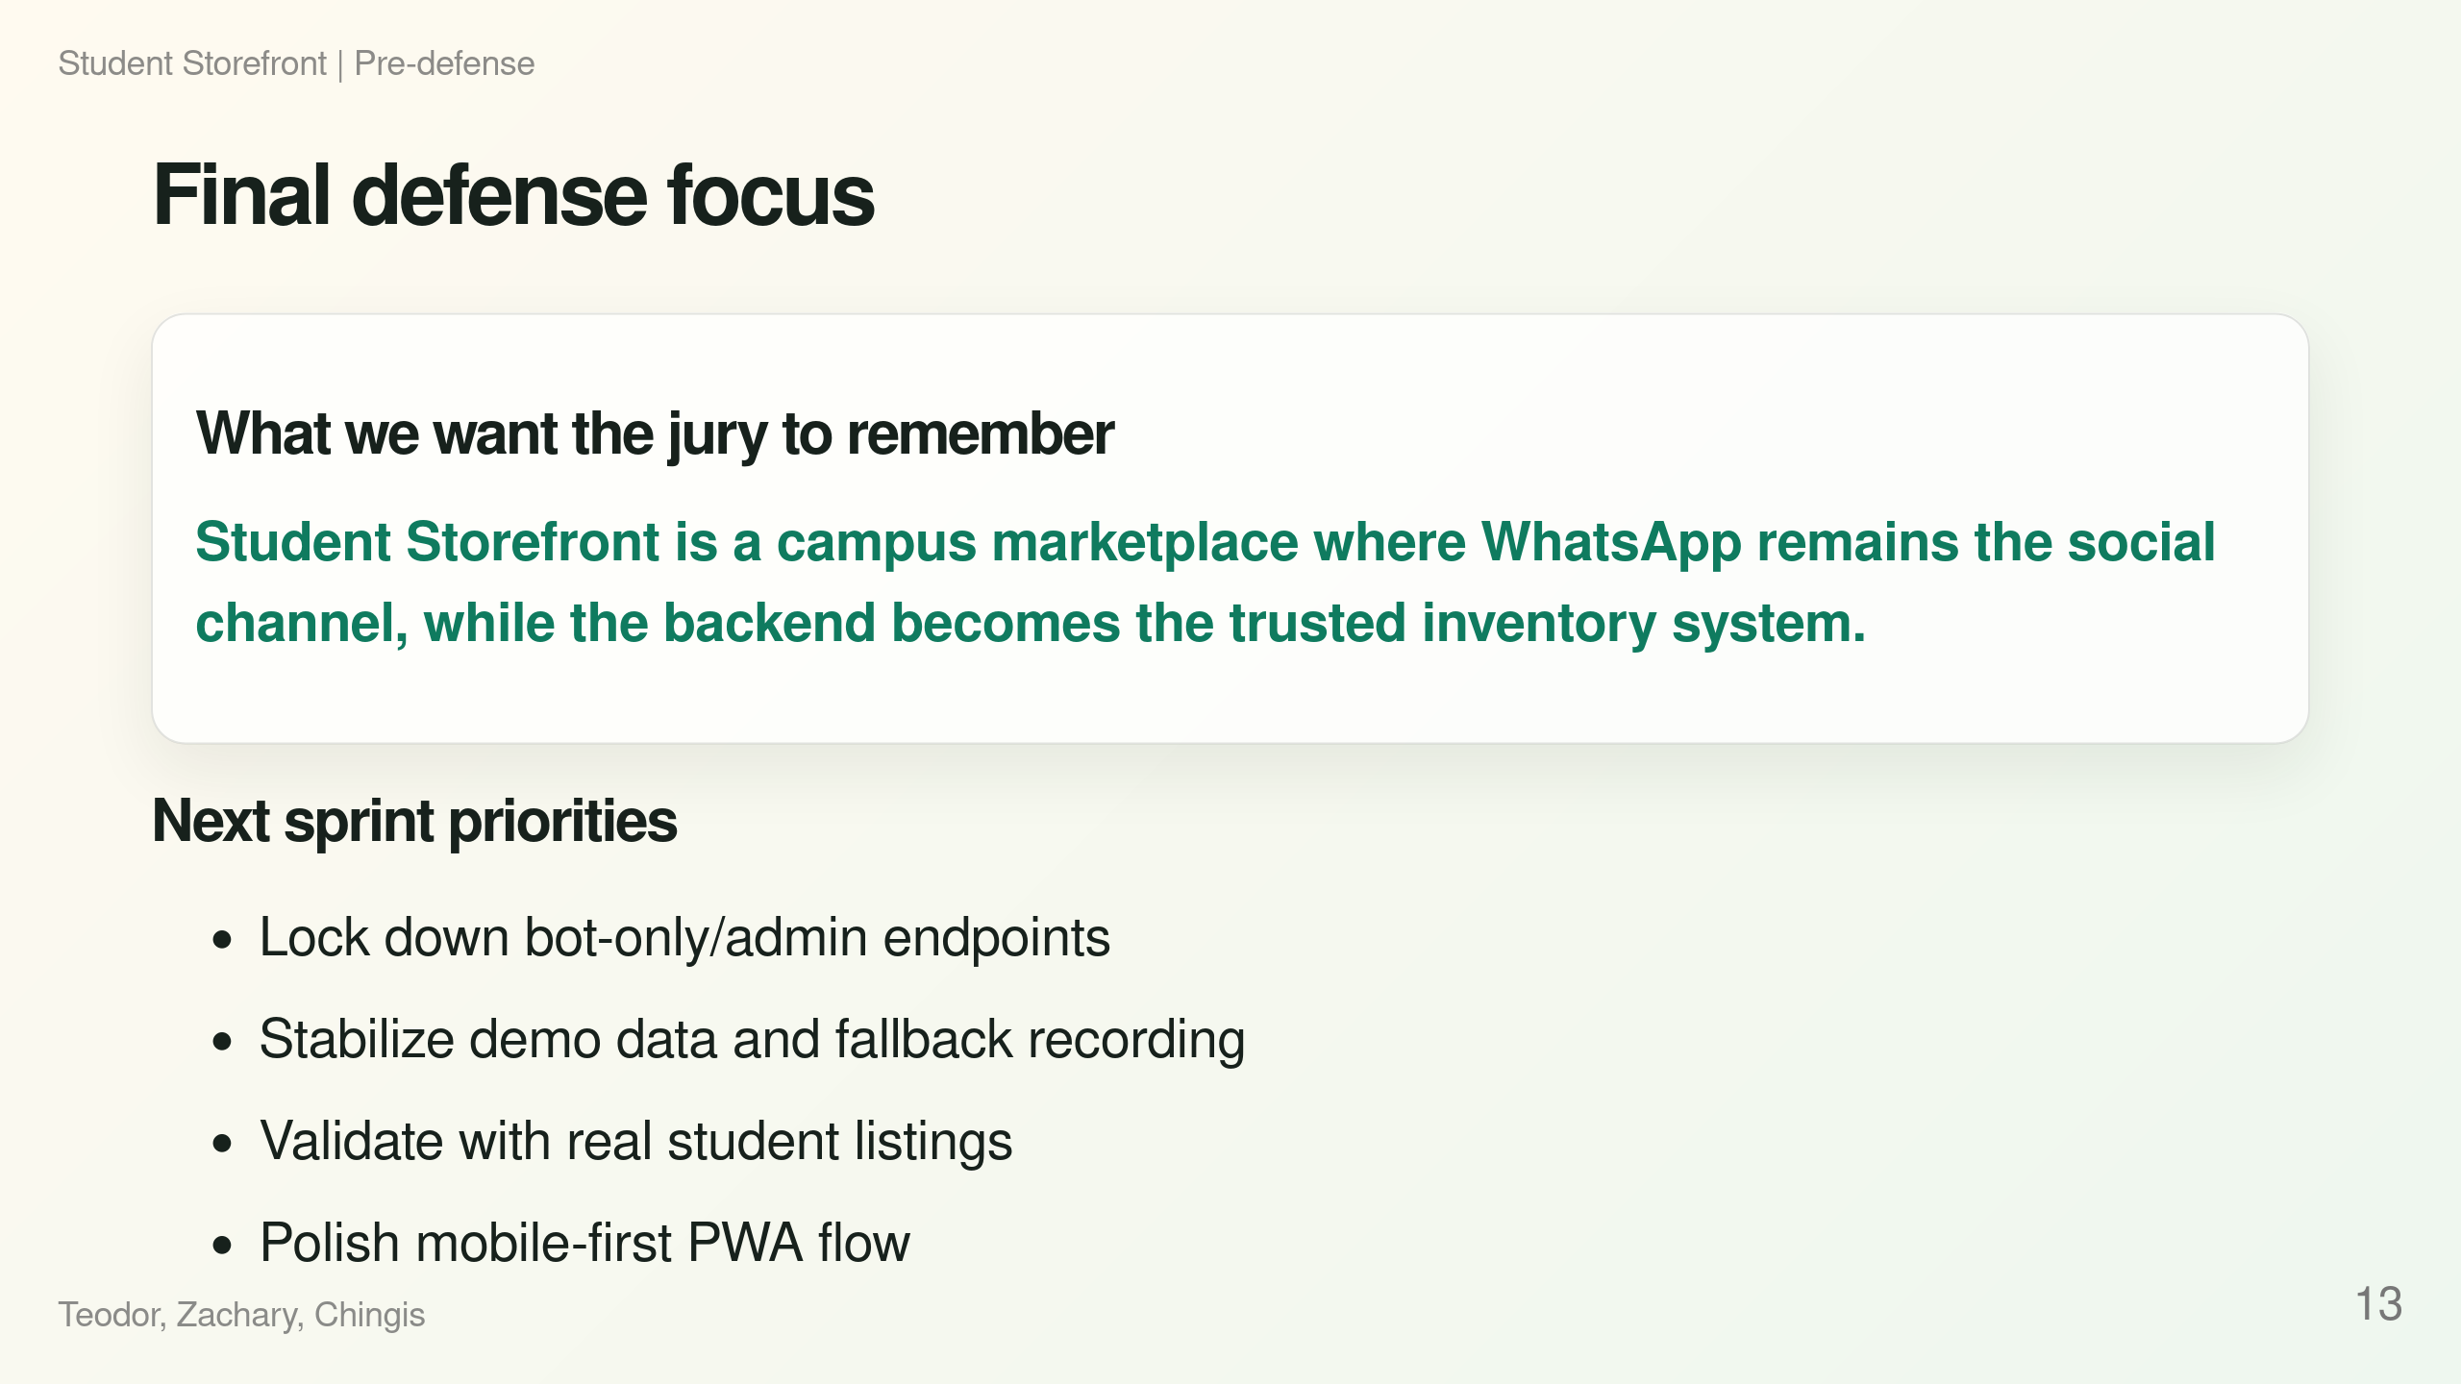
Notes:
Speaker notes: Target: 25s. End with the one-sentence takeaway and concrete sprint priorities. Do not introduce new features here.

