Slide 1
Modeling Housing Prices with Linear Regression
Zach Barnhart

Slide 2
Statistical Question
Which variables have strongest relationship with housing prices?
Can intangible aspects such as neighborhood have a noticeable impact on the value of a home, controlling for the differences in the tangible properties of a home that might impact its value?
What kind of model can we build that will have strong predictive power for determining home prices in contexts similar to our data set?

Slide 3
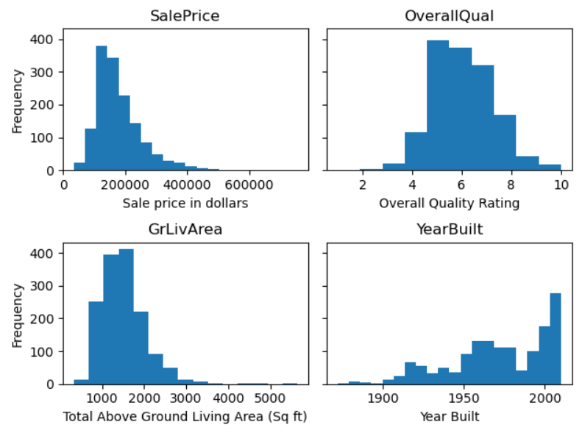
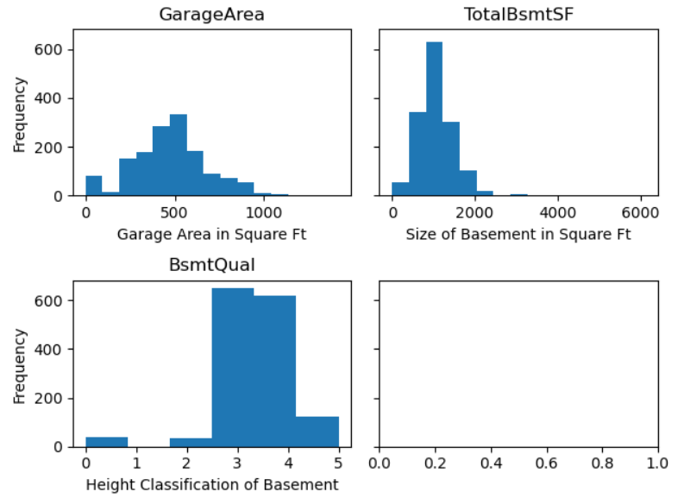
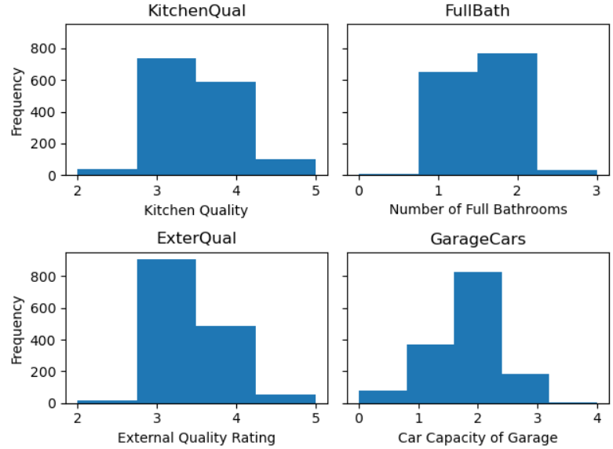
Distribution of variables
Area and price variables are strongly right-skewed, with a few large values distorting means. Most quality variables are normal(ish). YearBuilt is strongly left-skewed, with most houses being newer, though many very, very old houses are still on the market

Slide 4
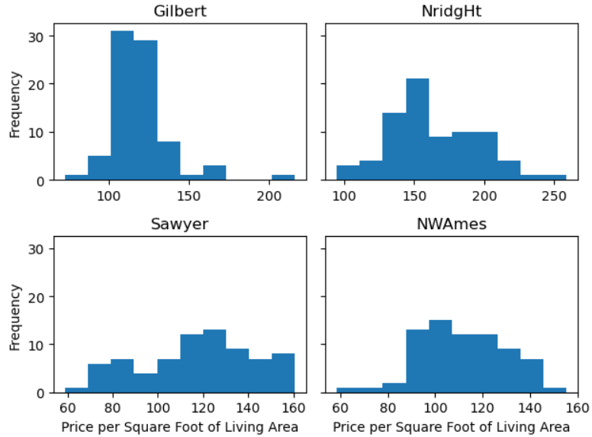
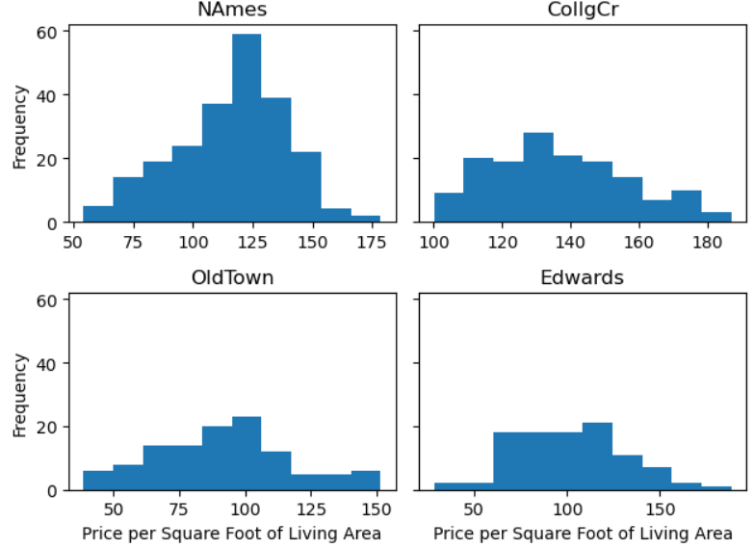
Impact of Neighborhood
Since different neighborhoods might have vastly different size houses, to get a real assessment of neighborhood value, we need to look at price per square foot
Indeed, we do see some differences here (differences that are confirmed via statistical tests – see notebook)
On this basis, we decide to include it in our linear model

Slide 5
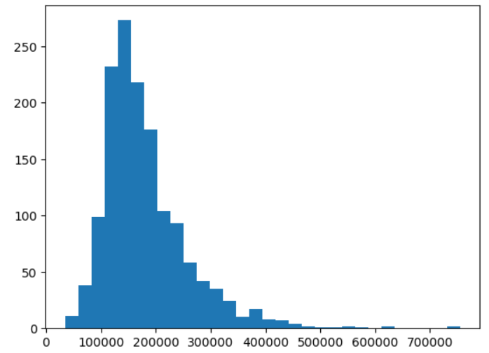
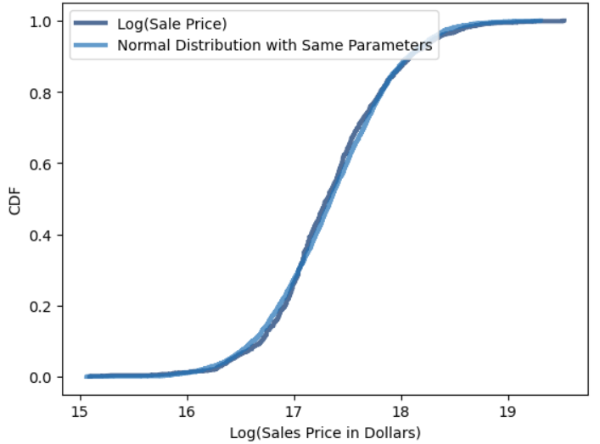
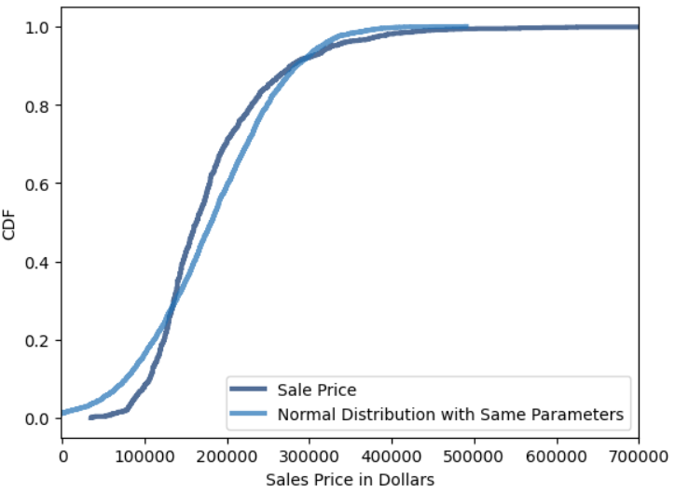
Reeling in Sales Price
Sales price has long tails
Taking the log brings in these log tails, making the data distribution more normal and ultimately improving model performance

Slide 6
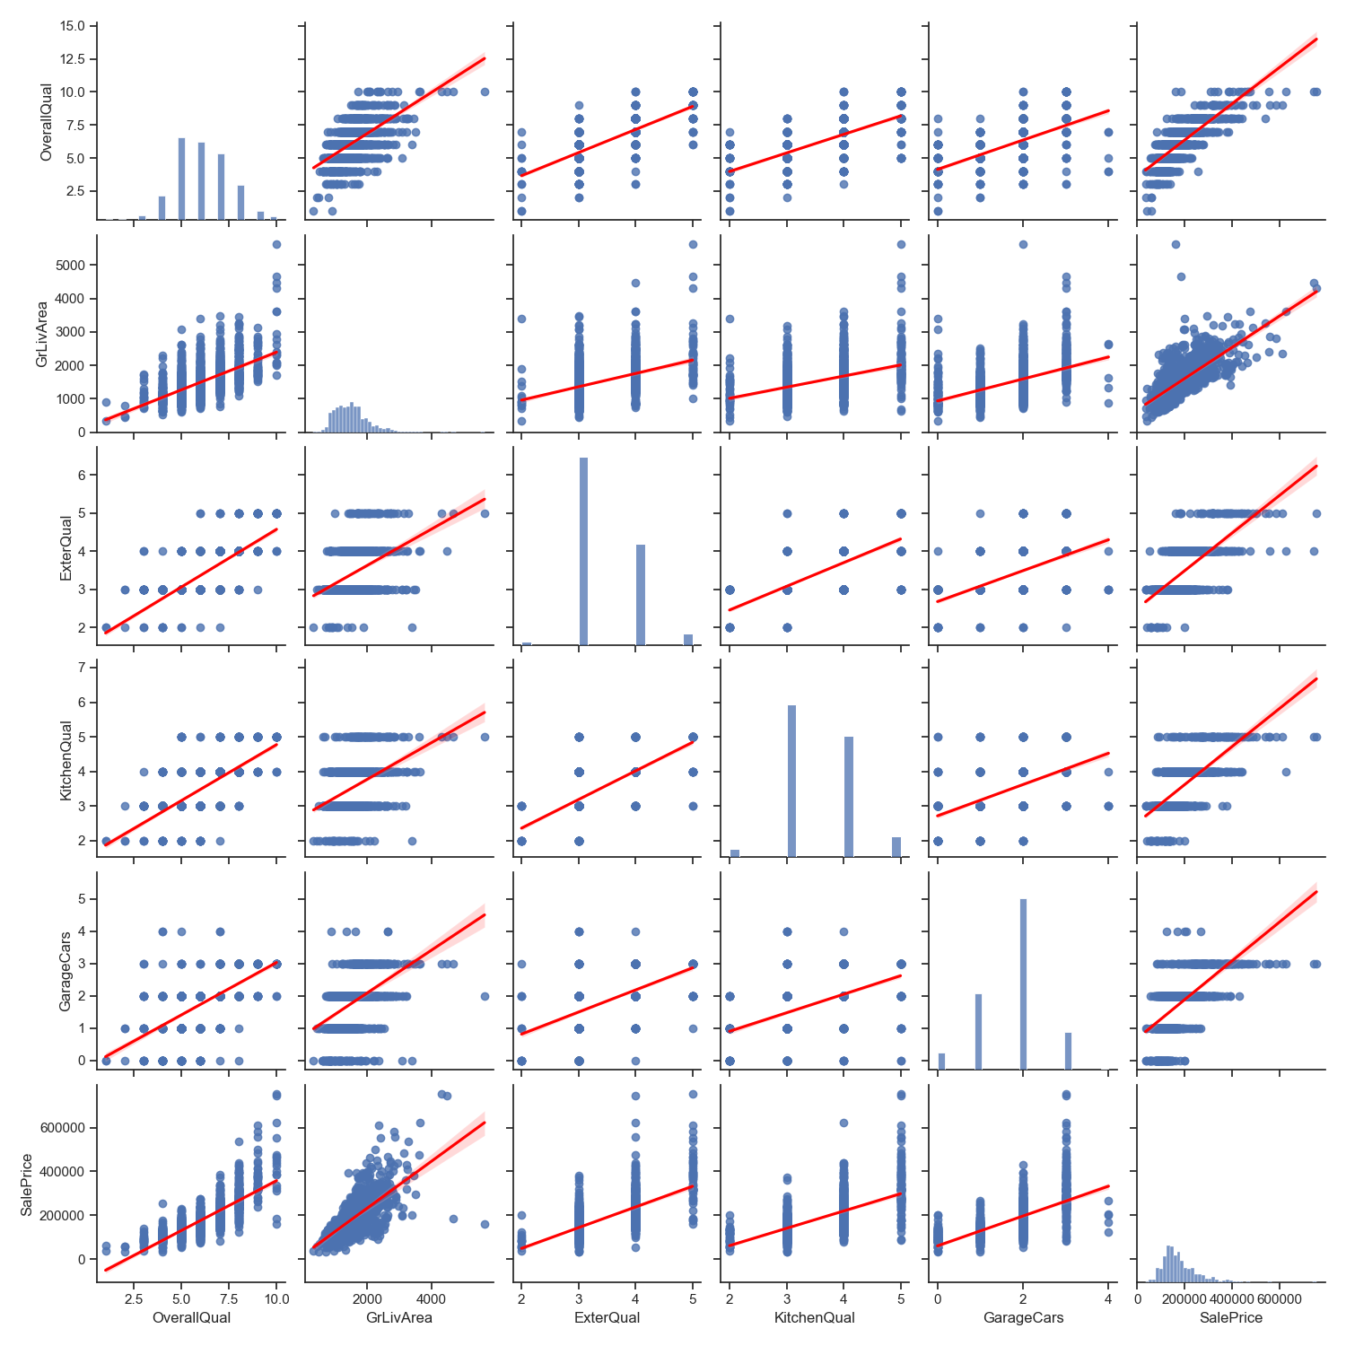
Two-Variable relationships
Too much variance for a single variable to offer a strong-model

Slide 7
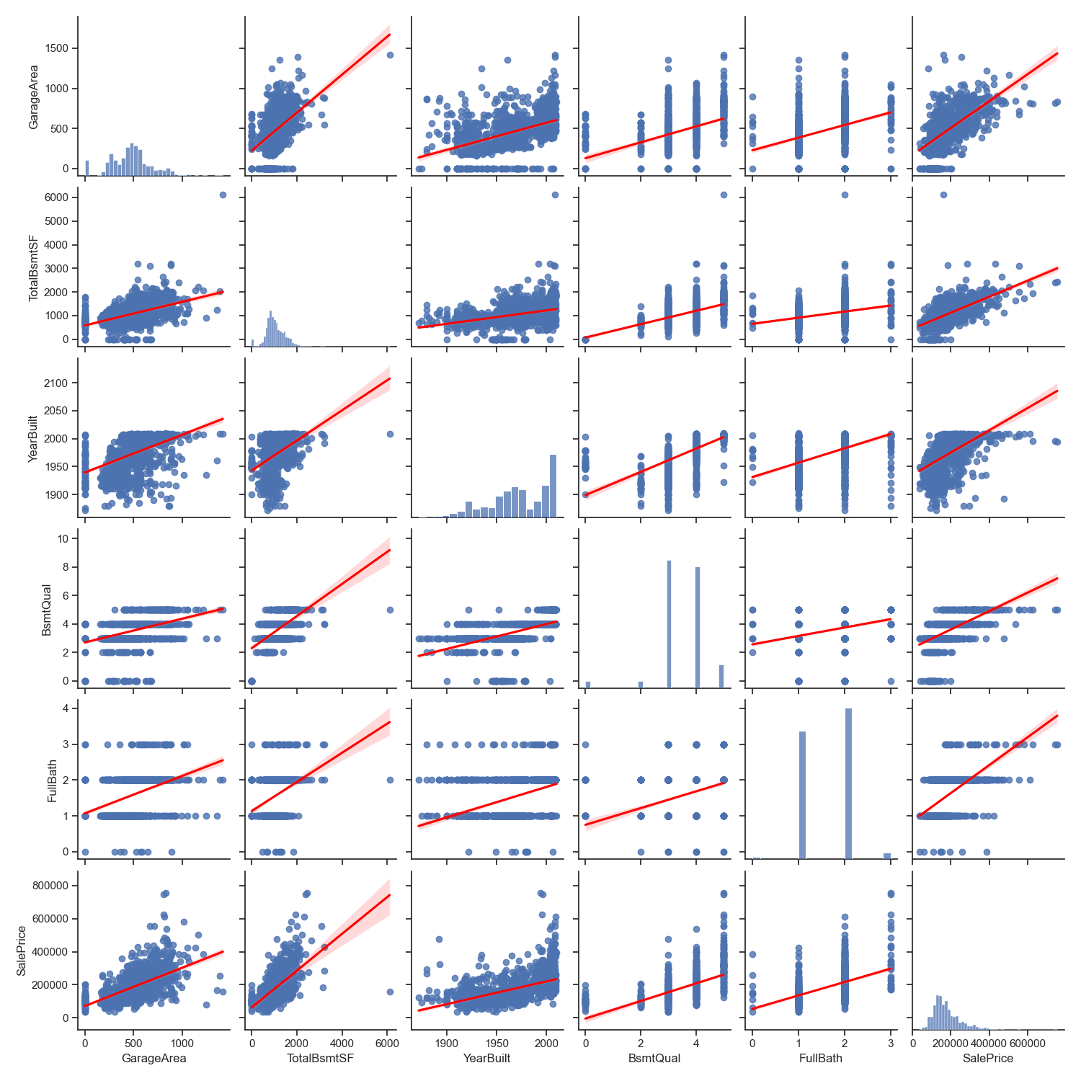
Two-Variable relationships
Let us hope that the combination of linear features can offer some stronger predictive power

Slide 8
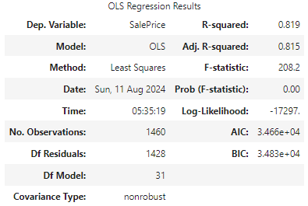
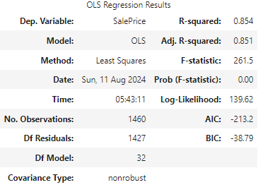
Linear Model
With SalePrice
(after cleaning out weak features):
With Log(SalePrice) (after cleaning out weak features):
As expected, Log(SalePrice) ends up being the better choice of target variable

Slide 9
THANK YOU
(Please see Jupyter Notebook for full details of the statistical analysis)

