Slide 1
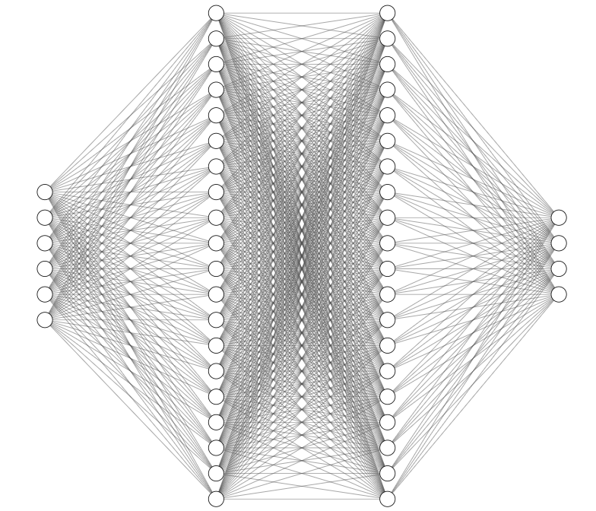
Hidden layer: 20 nodes
Activation: Linear
Hidden layer: 20 nodes
Activation: Linear
Input layer:
Distance to food in X direction
Distance to food in Y direction
Boolean: Will going N result in death?
Boolean: Will going S result in death?
Boolean: Will going E result in death?
Boolean: Will going W result in death?
Output layer (SoftMax):
Move North probability
Move South probability
Move East probability
Move West probability

Slide 2
Hidden layer: 20 nodes
Activation: Linear
Hidden layer: 20 nodes
Activation: Linear
Input layer:
Distance to food in X direction
Distance to food in Y direction
Boolean: Will going N result in death?
Boolean: Will going S result in death?
Boolean: Will going E result in death?
Boolean: Will going W result in death?
Output layer (SoftMax):
Move North probability
Move South probability
Move East probability
Move West probability

