Slide 1
Snake AI
By: Zachary Bowyer and Jonathan Olderr

Slide 2
Introduction:
Snake
The goal is to create an AI that can play the game snake and survive for as long as possible

Slide 3
Results
Insert video here
Training took X hours

Slide 4
Implementation
Neural network
Genetic Algorithm
Fitness function

Slide 5
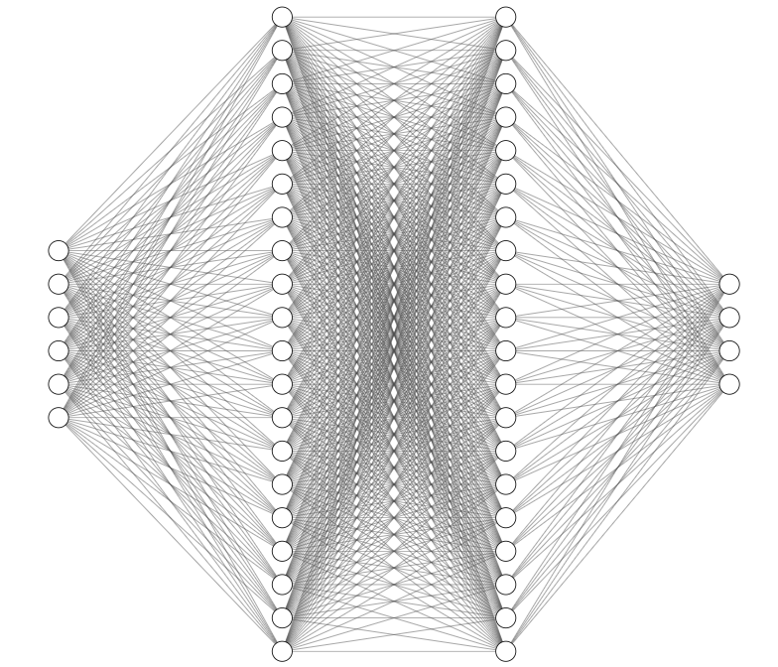
Neural network details
Hidden layer: 20 nodes
Activation: Linear
Hidden layer: 20 nodes
Activation: Linear
Output layer (SoftMax):
Move North probability
Move South probability
Move East probability
Move West probability
Input layer:
Distance to food in X direction
Distance to food in Y direction
Boolean: Will going N result in death?
Boolean: Will going S result in death?
Boolean: Will going E result in death?
Boolean: Will going W result in death?

Slide 6
Genetic algorithm details
GA:
Fitness function

Slide 7
Challenges faced
Deep copy!
Early model – Too many inputs that were not useful
Training slow
Snake going opposite direction
Finding a ‘good enough’ fitness function
Models with too many neurons were slow to train
Some code inefficient – Bots did not share a single network

Slide 8
Questions?
Insert video here again

