Slide 1

System Investigation Project Part 4: Implementation Apache CouchDB
University of Washington
Data 514
Zachary Bowyer

Slide 2
Project Description
As outlined in the original project summary document, the goal of this work was help me gain practical experience with a data management system and communicate what I learned.
Specifically, this had to be a NoSQL system, so I chose Apache CouchDB
Since I worked on this project alone, my goals were to
Understand the high-level components of the system
Implement a CouchDB database on a specified dataset
Write queries for my database to three questions
Link to video recording of project: https://www.youtube.com/watch?v=VL_ApiSyVn8

Slide 3
What I did:
For database and query implementation, I created python scripts, which can be found in a GitHub repository. https://github.com/ZachBowyer/UWData514SystemInvestigation
For understanding the high-level components, I created a pdf file explaining the various components of Apache CouchDB. This file is CouchDBInvestigation.pdf, which is in the root of the GitHub repository.

Slide 4

Dataset used:
I used the General Transit Feed Specification dataset
Data can be found here: http://developer.trimet.org/GTFS.shtml
Documentation can be found here: https://developers.google.com/transit/gtfs/reference#term_definitions
From GTFS.org, “The General Transit Feed Specification (GTFS) is a data specification that allows public transit agencies to publish their transit data in a format that can be consumed by a wide variety of software applications. Today, the GTFS data format is used by thousands of public transport providers.”

Slide 5
Dataset specific questions
For the GTFS dataset, I was tasked with answering these three questions using CouchDB:
List routes that go ‘To Portland City Center’
On which days does the MAX Red Line run within the given time range?
Which modes of public transport (routes) are available near ‘PSU Urban Center’ at the latest possible time before 9.00 AM (ignore date)? Display stops around PSU Urban Center, type of stop location, type of transportation (route), it’s time of arrival and direction (direction name)

Slide 6
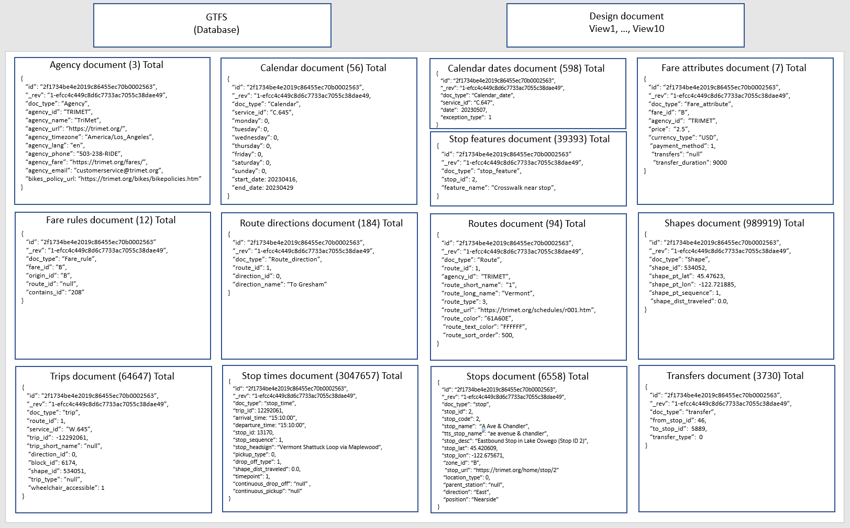
Data model
Each document type has an example shown

Slide 7
Repository code files
/data/gtfs/agency.txt - From GTFS dataset
/data/gtfs/calendar_dates.txt - From GTFS dataset
/data/gtfs/calendar.txt - From GTFS dataset
/data/gtfs/fare_attributes.txt - From GTFS dataset
/data/gtfs/fare_rules.txt - From GTFS dataset
/data/gtfs/feed_info.txt - From GTFS dataset
/data/gtfs/linked_datasets.txt - From GTFS dataset
/data/gtfs/route_directions.txt - From GTFS dataset
/data/gtfs/routes.txt - From GTFS dataset
/data/gtfs/shapes.txt - From GTFS dataset
/data/gtfs/stop_features.txt - From GTFS dataset
/data/gtfs/stop_times.txt - From GTFS dataset
/data/gtfs/stops.txt - From GTFS dataset
/data/gtfs/transfers.txt - From GTFS dataset
/data/gtfs/trips.txt - From GTFS dataset
/data/DATA.md - Description and profile of the GTFS dataset
/scripts/createdatabase.py - Creates database, appends documents, creates design document, creates views
/scripts/resetdatabase.py - Deletes database
/scripts/runqueries.py - Combines client code and view calls to answer the three questions
.gitignore - Excludes data and credentials files (.txt)
CouchDBInvestigation.pdf - High level overview of Apache CouchDB
credentials.txt (hidden) - Contains username, password, port, and ip for the couchDB server
Presentation.pptx - Slides that describe the project
README.md - This file, high level overview
setup.py - Downloads and unzips GTFS dataset into /data/gtfs

Slide 8
Implementation Specifics - Steps
1. Created CouchDB single node, local host
2. Created database named ‘GTFS’
3. Retrieved General Transit Feed Specification (GTFS) dataset from
http://developer.trimet.org/GTFS.shtml
4. Created JSON documents from each row of each file of GTFS dataset
5. Created design document for the ‘GTFS’ database
6. Created ten distinct ‘views’ to help with querying data
7. Combined client code with the views to answer the three questions
8. Created a method to delete the database if needed

Slide 9
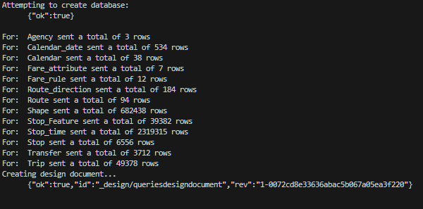
Creating the database – code and results
Enter the command: python createdatabase.py
File is too large to post as a screenshot
Steps:
Read in credentials
Create database
Add documents from each GTFS file
Create design document
Views included
Expected output:

Slide 10
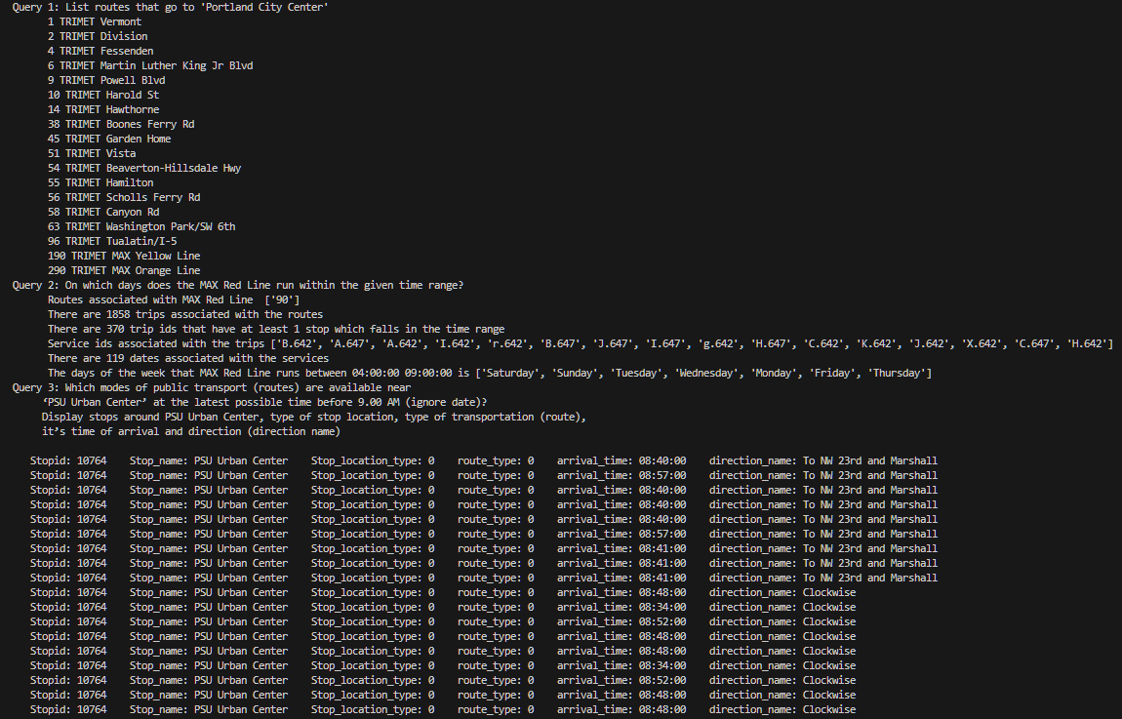
Running the queries
Enter the command: python runqueries.py
File is too large to show
Steps:
Read in credentials
Answer question 1:
Answer question 2:
Answer question 3:
Expected output:

Slide 11
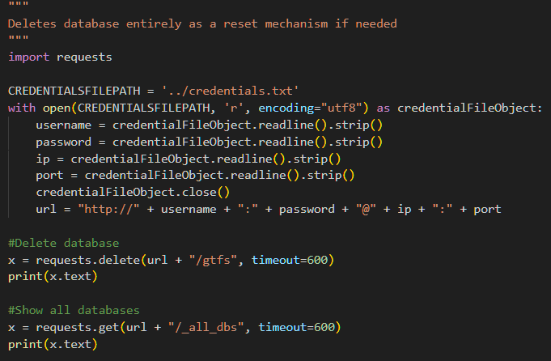

Deleting the database – code and results
Enter the command: python resetdatabase.py
Very simple code
Deletes database
Prints list of databases so you can confirm it is no longer there
Run with ‘python resetdatabase.py’
Expected output:

Slide 12
Lessons learned
If you are to use Apache CouchDB, make sure you don’t need to do a lot of joins, else you will be writing a lot of client code to supplement your views.
When sending a high volume of documents to a CouchDB database, make sure to do it in bulk, rather than doing one HTTP request per document (it will take too long otherwise).
Datasets may not always be the same each time you download them. So be careful not to assume you are working with the same data every time (this messed up part of my documentation).
If something is taking too long to run, you should probably halt execution earlier than you think and figure out if it will finish reasonably through logging or print statements (sunk cost fallacy can easily make you waste an hour).

