Slide 1
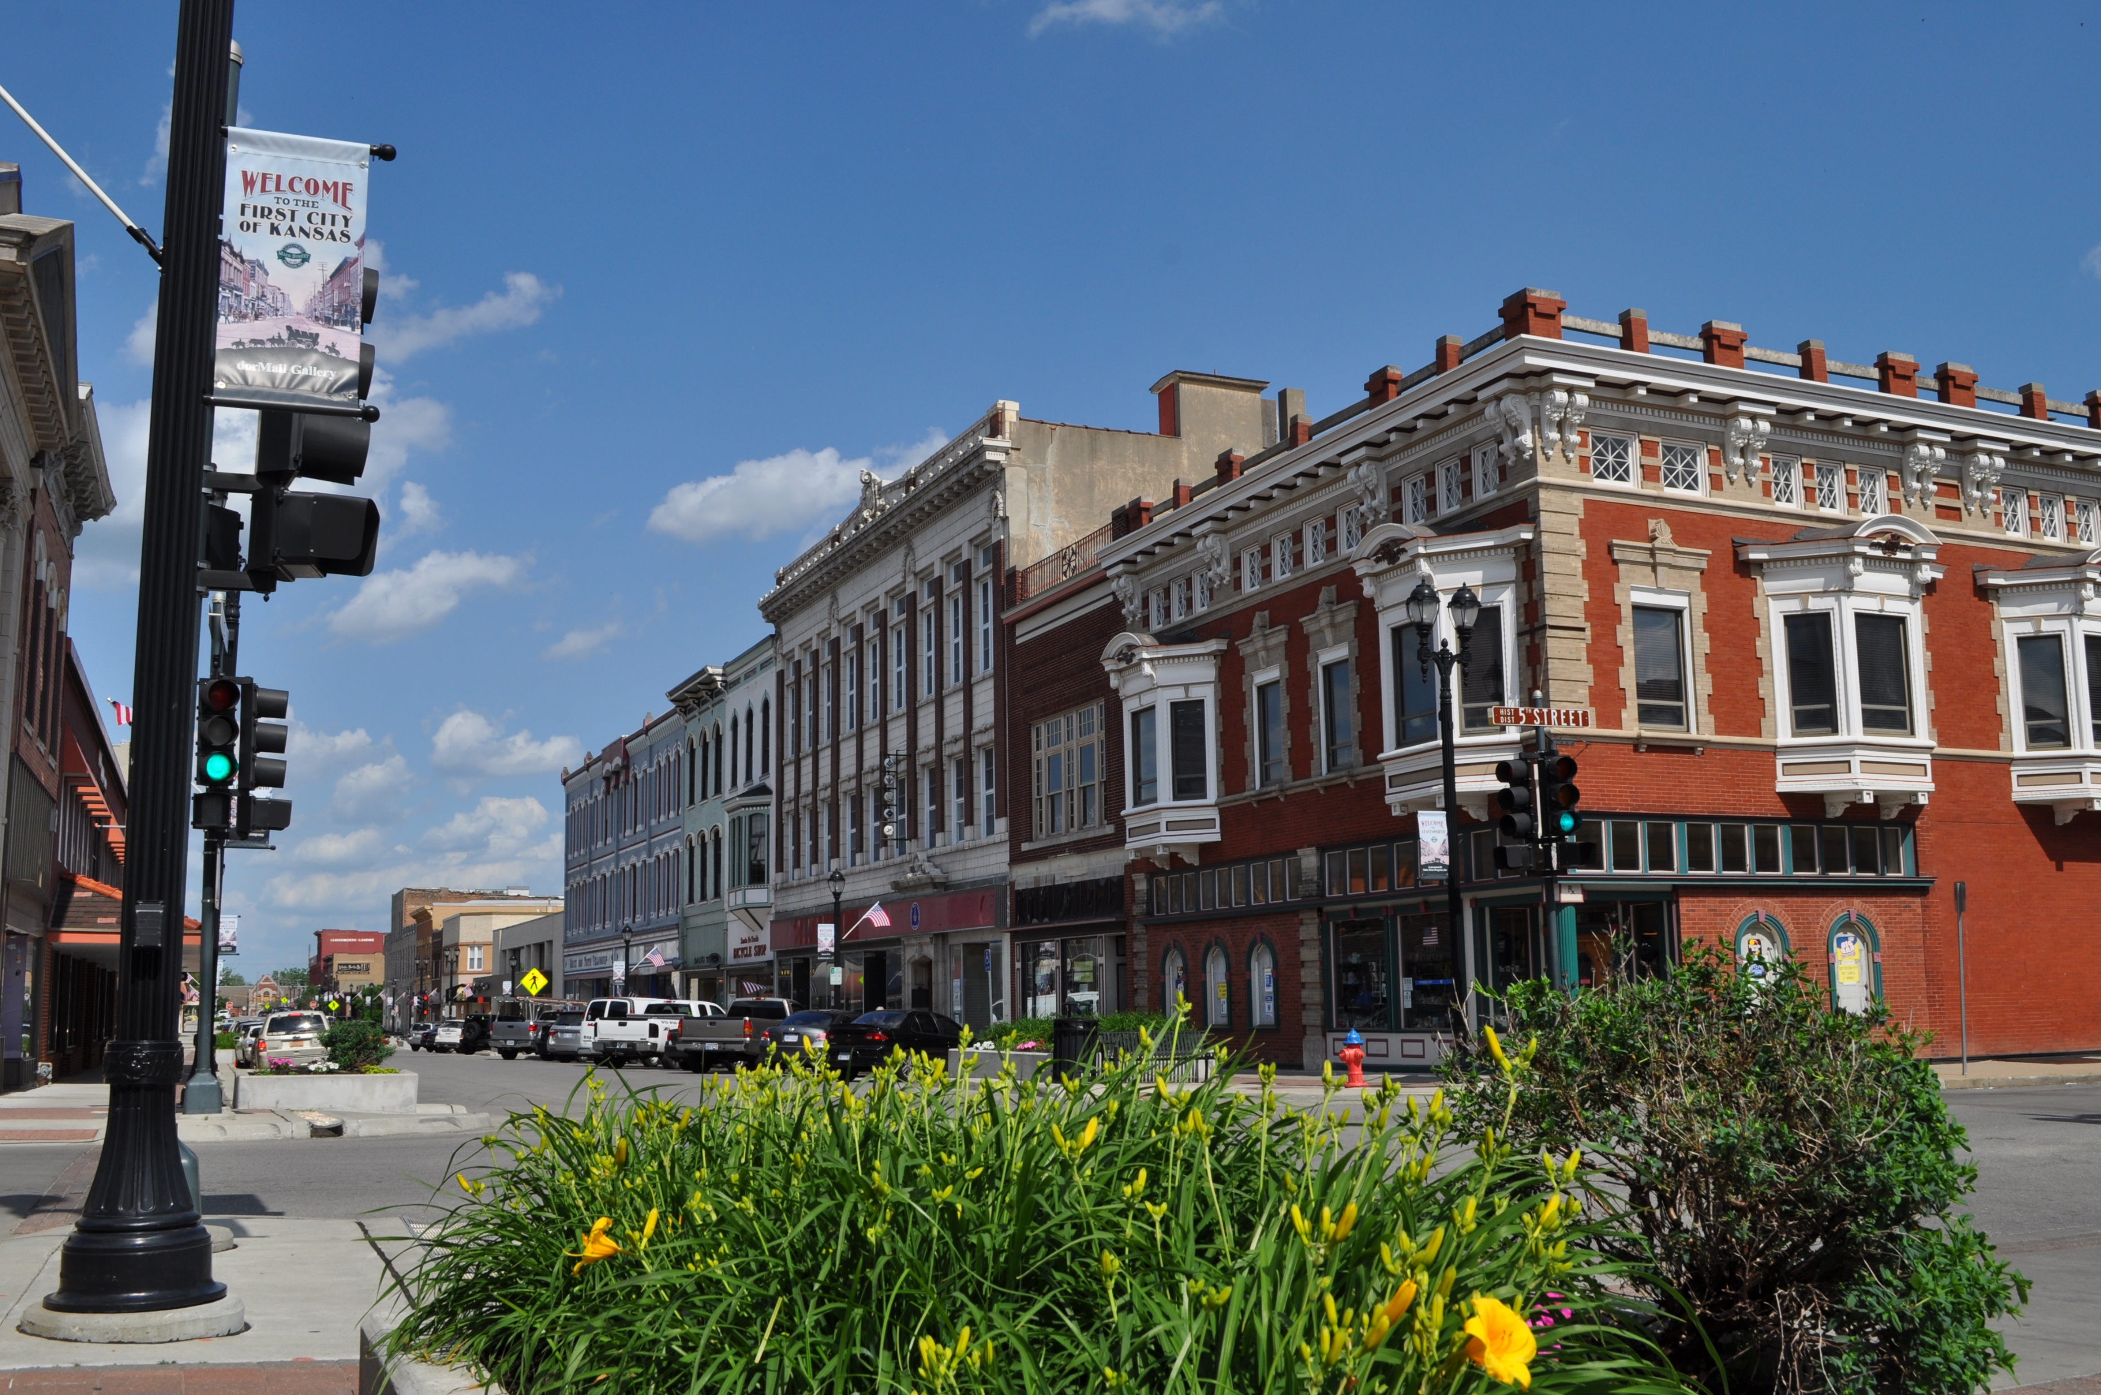
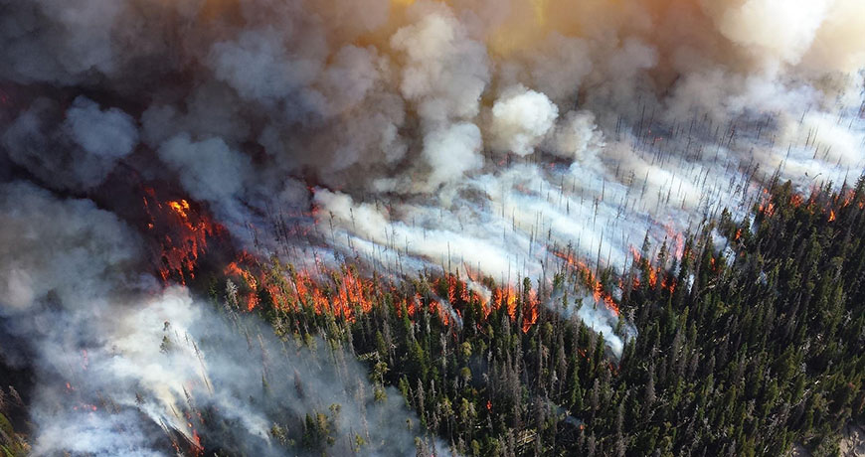
What is it?
Exploration of Healthcare impacts on Leavenworth, Kansas from wildfire smoke.
Use data analysis to form a policy recommendation for the city.
Notes:
https://deohs.washington.edu/pnash/wildfiresmoke
https://en.wikipedia.org/wiki/Leavenworth,_Kansas

Slide 2
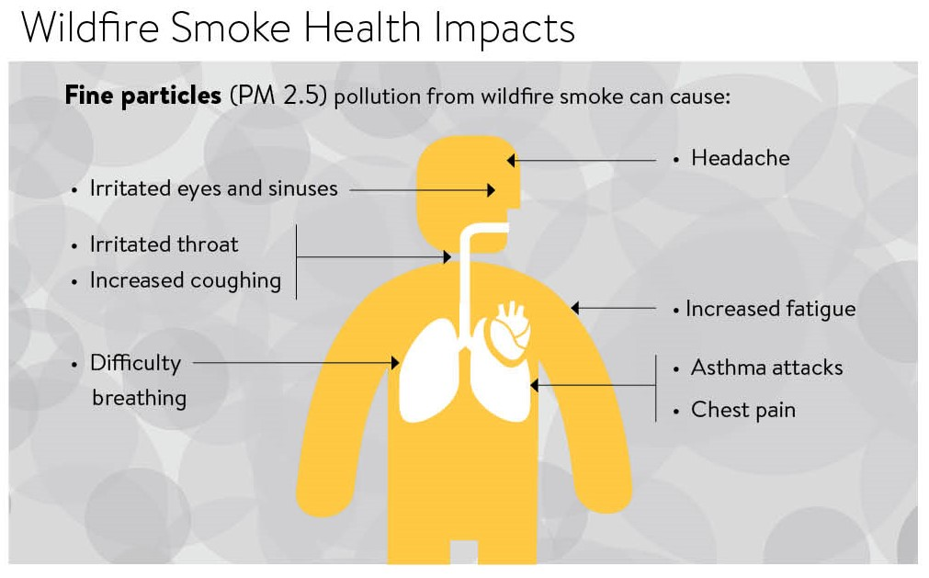
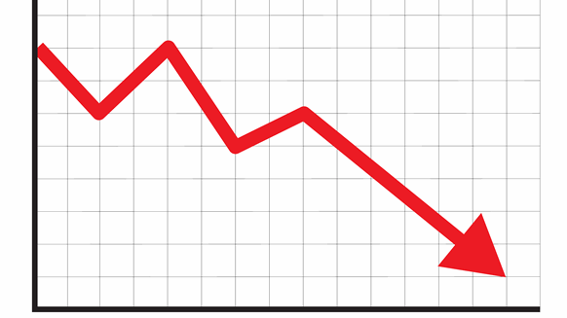

Why this matters
Wildfire smoke is dangerous to inhale over both the short and long term.
This of course comes with associated economic and health costs. To attempt to minimize these future costs, policymakers need to be informed.
Notes:
https://www.health.state.mn.us/communities/environment/emergency/natural/wildfires.html
https://www.rigzone.com/news/wire/oil_extends_decline_amid_global_economy_concerns-21-oct-2019-160107-article/
https://www.health.harvard.edu/blog/is-our-healthcare-system-broken-202107132542

Slide 3
Final results – Policy recommendation
Given the evidence, our recommendation to policymakers for city of Leavenworth is to do nothing.

Slide 4
How did you come to this conclusion?

