Slide 1
Alternative Energy Impact On CO2 Emissions
Zach Cate
Notes:
Hello everyone, I’m Zach. Welcome to my presentation. Today, we'll be delving into the realm of alternative energy and its influence on CO2 emissions. It's a topic of great significance, offering insights into a path toward a greener future.

Slide 2
Introduction
Inspiration Behind the Project:
Topic Selection: Why Alternative Energy and CO2 Emissions?
Personal Connection: Passion for Sustainable Solutions
Global Impact: Addressing Environmental Challenges
Drive for Change: Seeking Viable Pathways for a Greener Future
Notes:
I've always been intrigued by sustainable solutions, and understanding how alternative energy sources impact our carbon footprint felt like a logical step. Our world faces pressing environmental challenges, and exploring viable solutions is essential.
The practicality of embracing alternative energy is undeniable. It's not just a trend but a necessary shift to reduce our impact on the environment and move towards complete higher levels of sustainability.
The global implications of reducing CO2 emissions are substantial. Analyzing data trends helps us uncover insights that drive meaningful change on a broader scale. Our goal is to move from hypothetical scenarios to actionable strategies – all within the context of alternative energy and CO2 emissions.
Throughout this presentation, I'll guide you through data-driven analyses, highlighting how adopting alternative energy sources can lead to reduced CO2 emissions.
Just so you know, 'alternative fuels’ here includes a variety of energy sources such as renewables like solar, wind, hydroelectric, and geothermal, as well as biofuels such as ethanol and biodiesel, along with nuclear energy.
So, let’s jump in and see what the data has to say
So, let's dive in and explore the fascinating world of alternative energy and its potential to create a more sustainable and eco-friendly future.

Slide 3
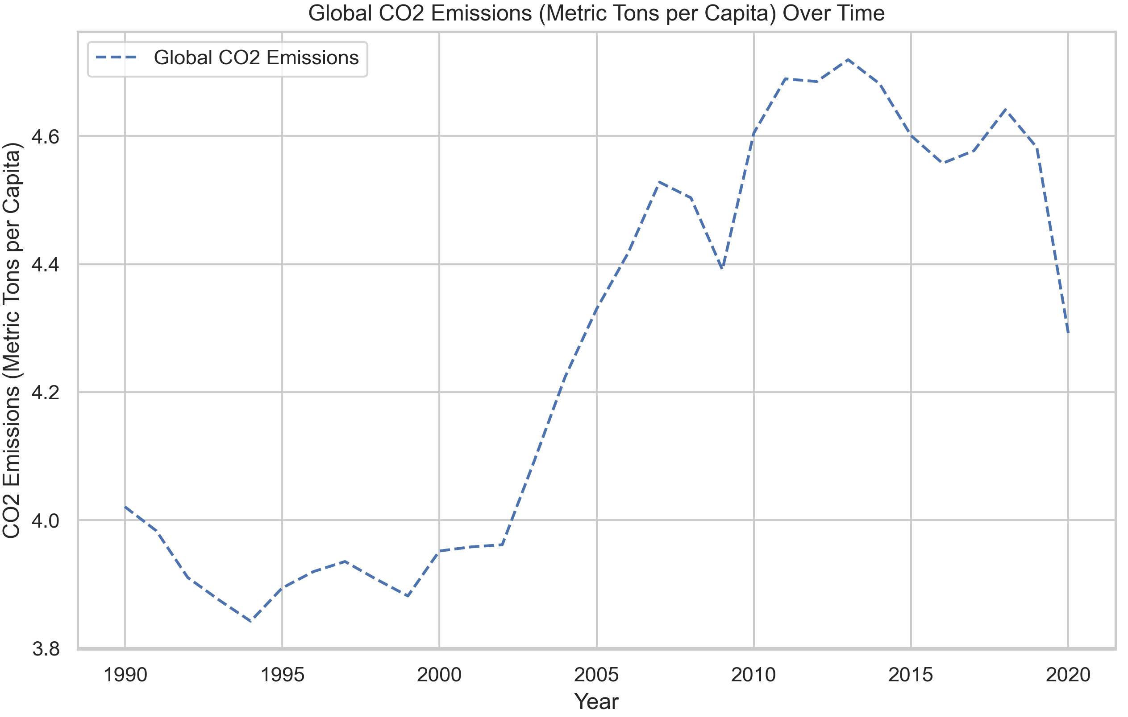
Global CO2 Emissions
Notes:
I want to start off with a general overview of global CO2 emissions per capita over time, which is a potent tool for assessing the environmental impact of various countries and regions.
I chose to use per capita data wherever applicable in my analysis to ensure equitable representation, especially for smaller nations. By examining emissions this way, the data won’t be so skewed towards a few larger countries.
The first notable trend here is the abrupt surge in CO2 emissions per capita during the early 2000s. This period witnessed rapid industrialization, urbanization, and increased energy consumption. The aftermath of this time period underscored the urgency of global actions to tackle climate change and minimize carbon footprints.
However, the landscape has shifted significantly in the past decade or so. Countries worldwide have been proactively working to rein in their CO2 emissions. This shift reflects heightened environmental awareness and a commitment to sustainable practices. The largest drop seen here is from 2019 to 2020, most likely largely influenced by the halt of transportation amidst the early days of the pandemic.

Slide 4
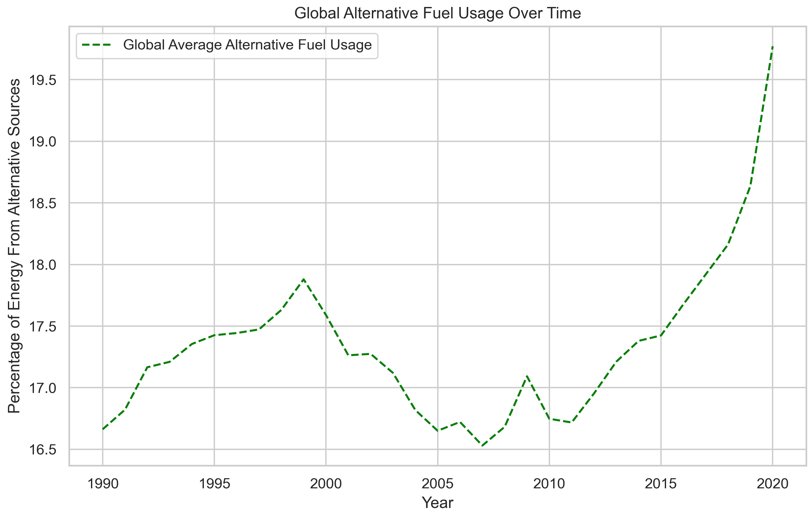
Global Alternative Fuels Usage
Notes:
Next, I want to look at global alternative fuel usage over time, measured by the percentage of a country’s energy that was derived from alternative sources, which for our purposes is being used as a measure of a country’s alternative energy adoption.
As we look here, you’ll see a notable trend that took place in the late 90s and early 2000s. During this period, there was a steep drop in the percentage of energy sourced from alternative fuels. This dip highlights the challenges and setbacks faced during the early days of the transition towards more sustainable energy sources, as alternative fuels couldn’t keep up with increased energy demands.
In contrast, the past decade has shown a remarkable reversal in this trend. We've witnessed substantial growth in the adoption of alternative energy sources. This upward trajectory signifies a collective shift towards cleaner energy options, driven by advancements in technology, policy initiatives, and a growing awareness of the environmental benefits.
Now that we have a general understanding of what these two metrics are, let’s look at how they seem to interact with each other.

Slide 5
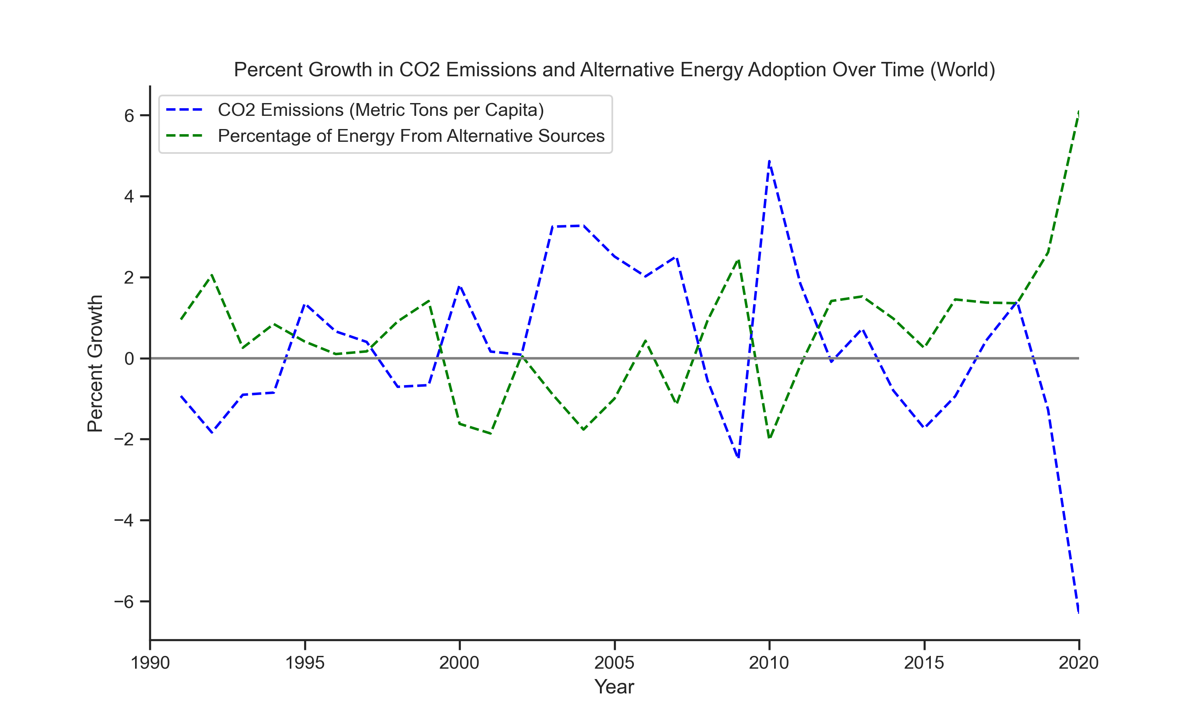
Growth Comparison
There is a notable connection between increases in alternative energy adoption and a reduction in co2 emissions
Notes:
In this growth comparison chart, we're examining the percent growth in worldwide alternative fuel usage and CO2 emissions over time. This means we're analyzing how these values have shifted from one year to another, allowing us to uncover trends and patterns. While they’re not exactly inverse, there is a clear tendency for one to go up when the other goes down.
Think of it as a puzzle – alternative fuel adoption and CO2 emissions reduction are just two pieces of the puzzle. To see the full picture, a much more in-depth look at all related variables will be needed. However, that is outside the scope of this project.
This chart reminds us that addressing climate challenges are not just about one solution; but about getting a better understanding of how the problems and potential solutions interact with each other.
Now that we've grasped the broader landscape, let's shift our focus to the finer details by examining only data from 2020. As it's the most recent year with complete data available, delving into 2020 allows us to analyze the most up-to-date insights.

Slide 6
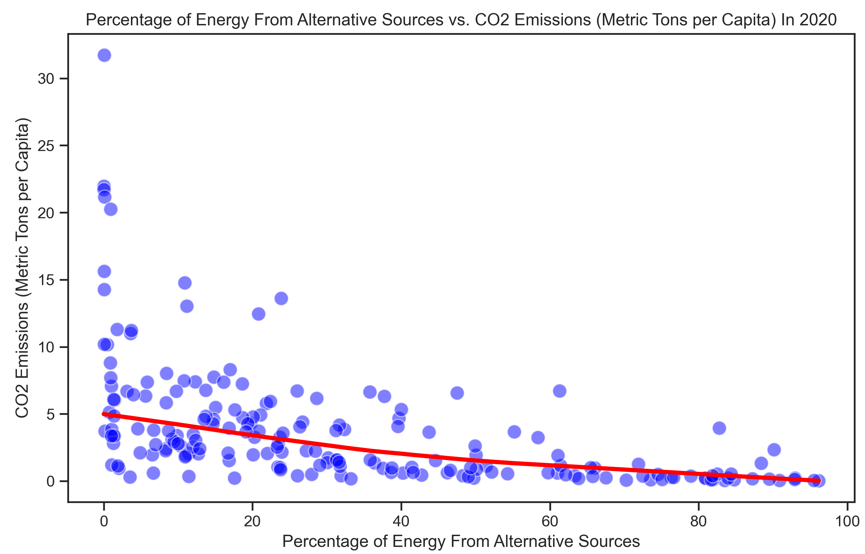
2020 Data
In 2020, there was a -0.5 correlation on average
Notes:
On this slide, we're going to focus our attention on the scatterplot depicting the relationship between alternative fuel usage and CO2 emissions for each country in the year 2020. Each dot on this graph represents a specific country out of the 216 countries included in our analysis.
Now, looking at the graph, you can notice a trend that suggests a connection between the adoption of alternative fuels and the reduction of CO2 emissions. However, something that’s a little harder to notice at first is that the lowess curve shown here appears steeper from around 0% to 40% alternative energy usage, before starting to level out a bit towards the higher end, which could imply a larger impact in emissions reduction at the beginning of the transition from traditional fuel sources.
Now, let's explore further and uncover more insights from the 2020 data.

Slide 7
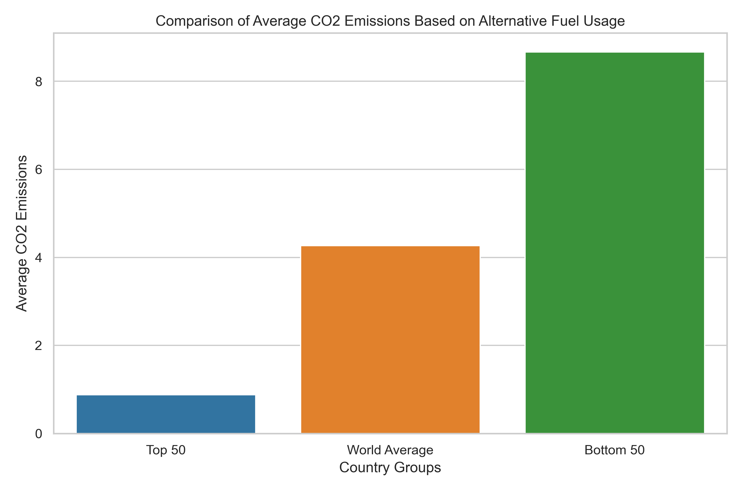
2020 Data (cont.)
Top 50 countries leading in alternative energy show significantly lower average CO2 emissions than bottom 50.
Notes:
After seeing the previous plot, I decided to try aggregating the data to compare the CO2 emissions per capita for different groups of countries based on their level of alternative fuel adoption in 2020.
First, we have the top 50 countries with the highest percentage of energy from alternative fuels. These countries collectively emit less than 1 metric ton of CO2 per capita on average.
Next, I inserted the world average to provide a reference point for understanding the baseline and values you would expect to see here.
Looking at the bottom 50 countries, they emit over 9 metric tons of CO2 per capita on average. This significant disparity once again demonstrates the potential impact of alternative energy on reducing carbon emissions.
A noteworthy observation that I found while reviewing the groups shown here is that among the top 50 countries, 42 of them are situated in sub-Saharan Africa. This led me to be curious about any regional differences that might appear, so I decided to look at all the data divided into six regions.
Now, let’s look at a regional comparison to better understand how different parts of the world are embracing alternative energy and its impact on emissions.

Slide 8
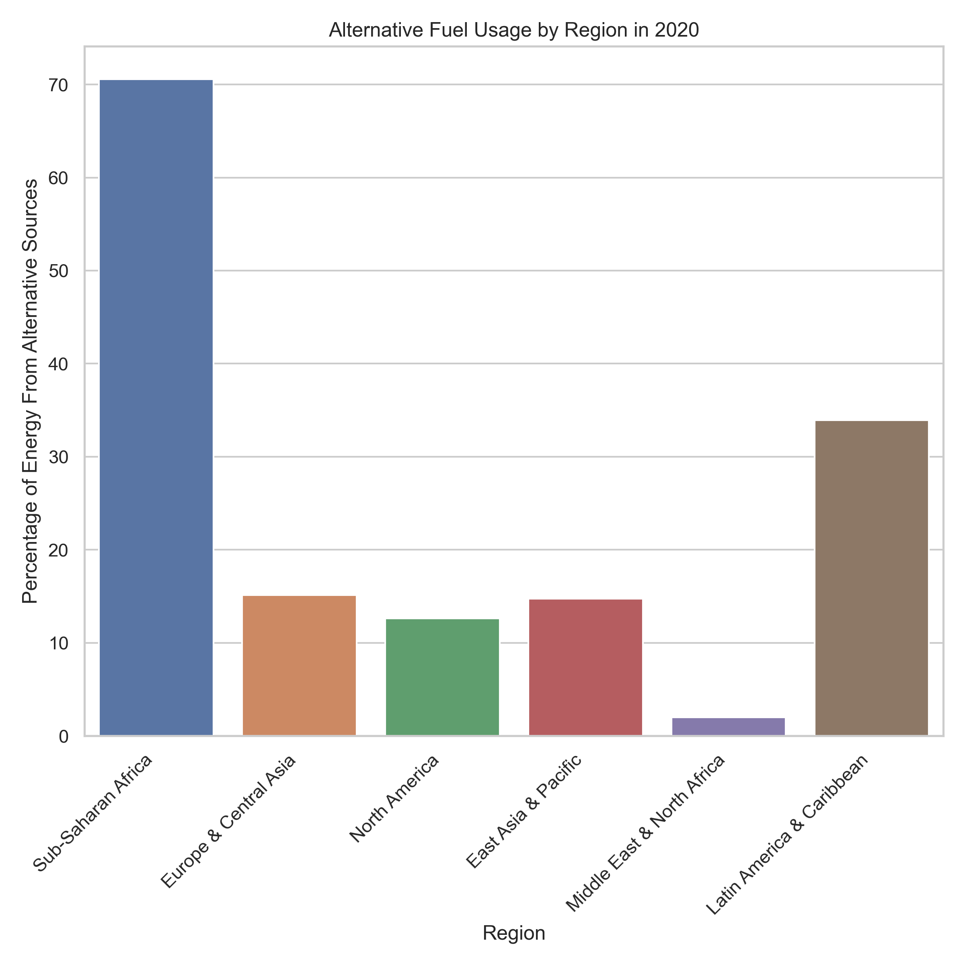
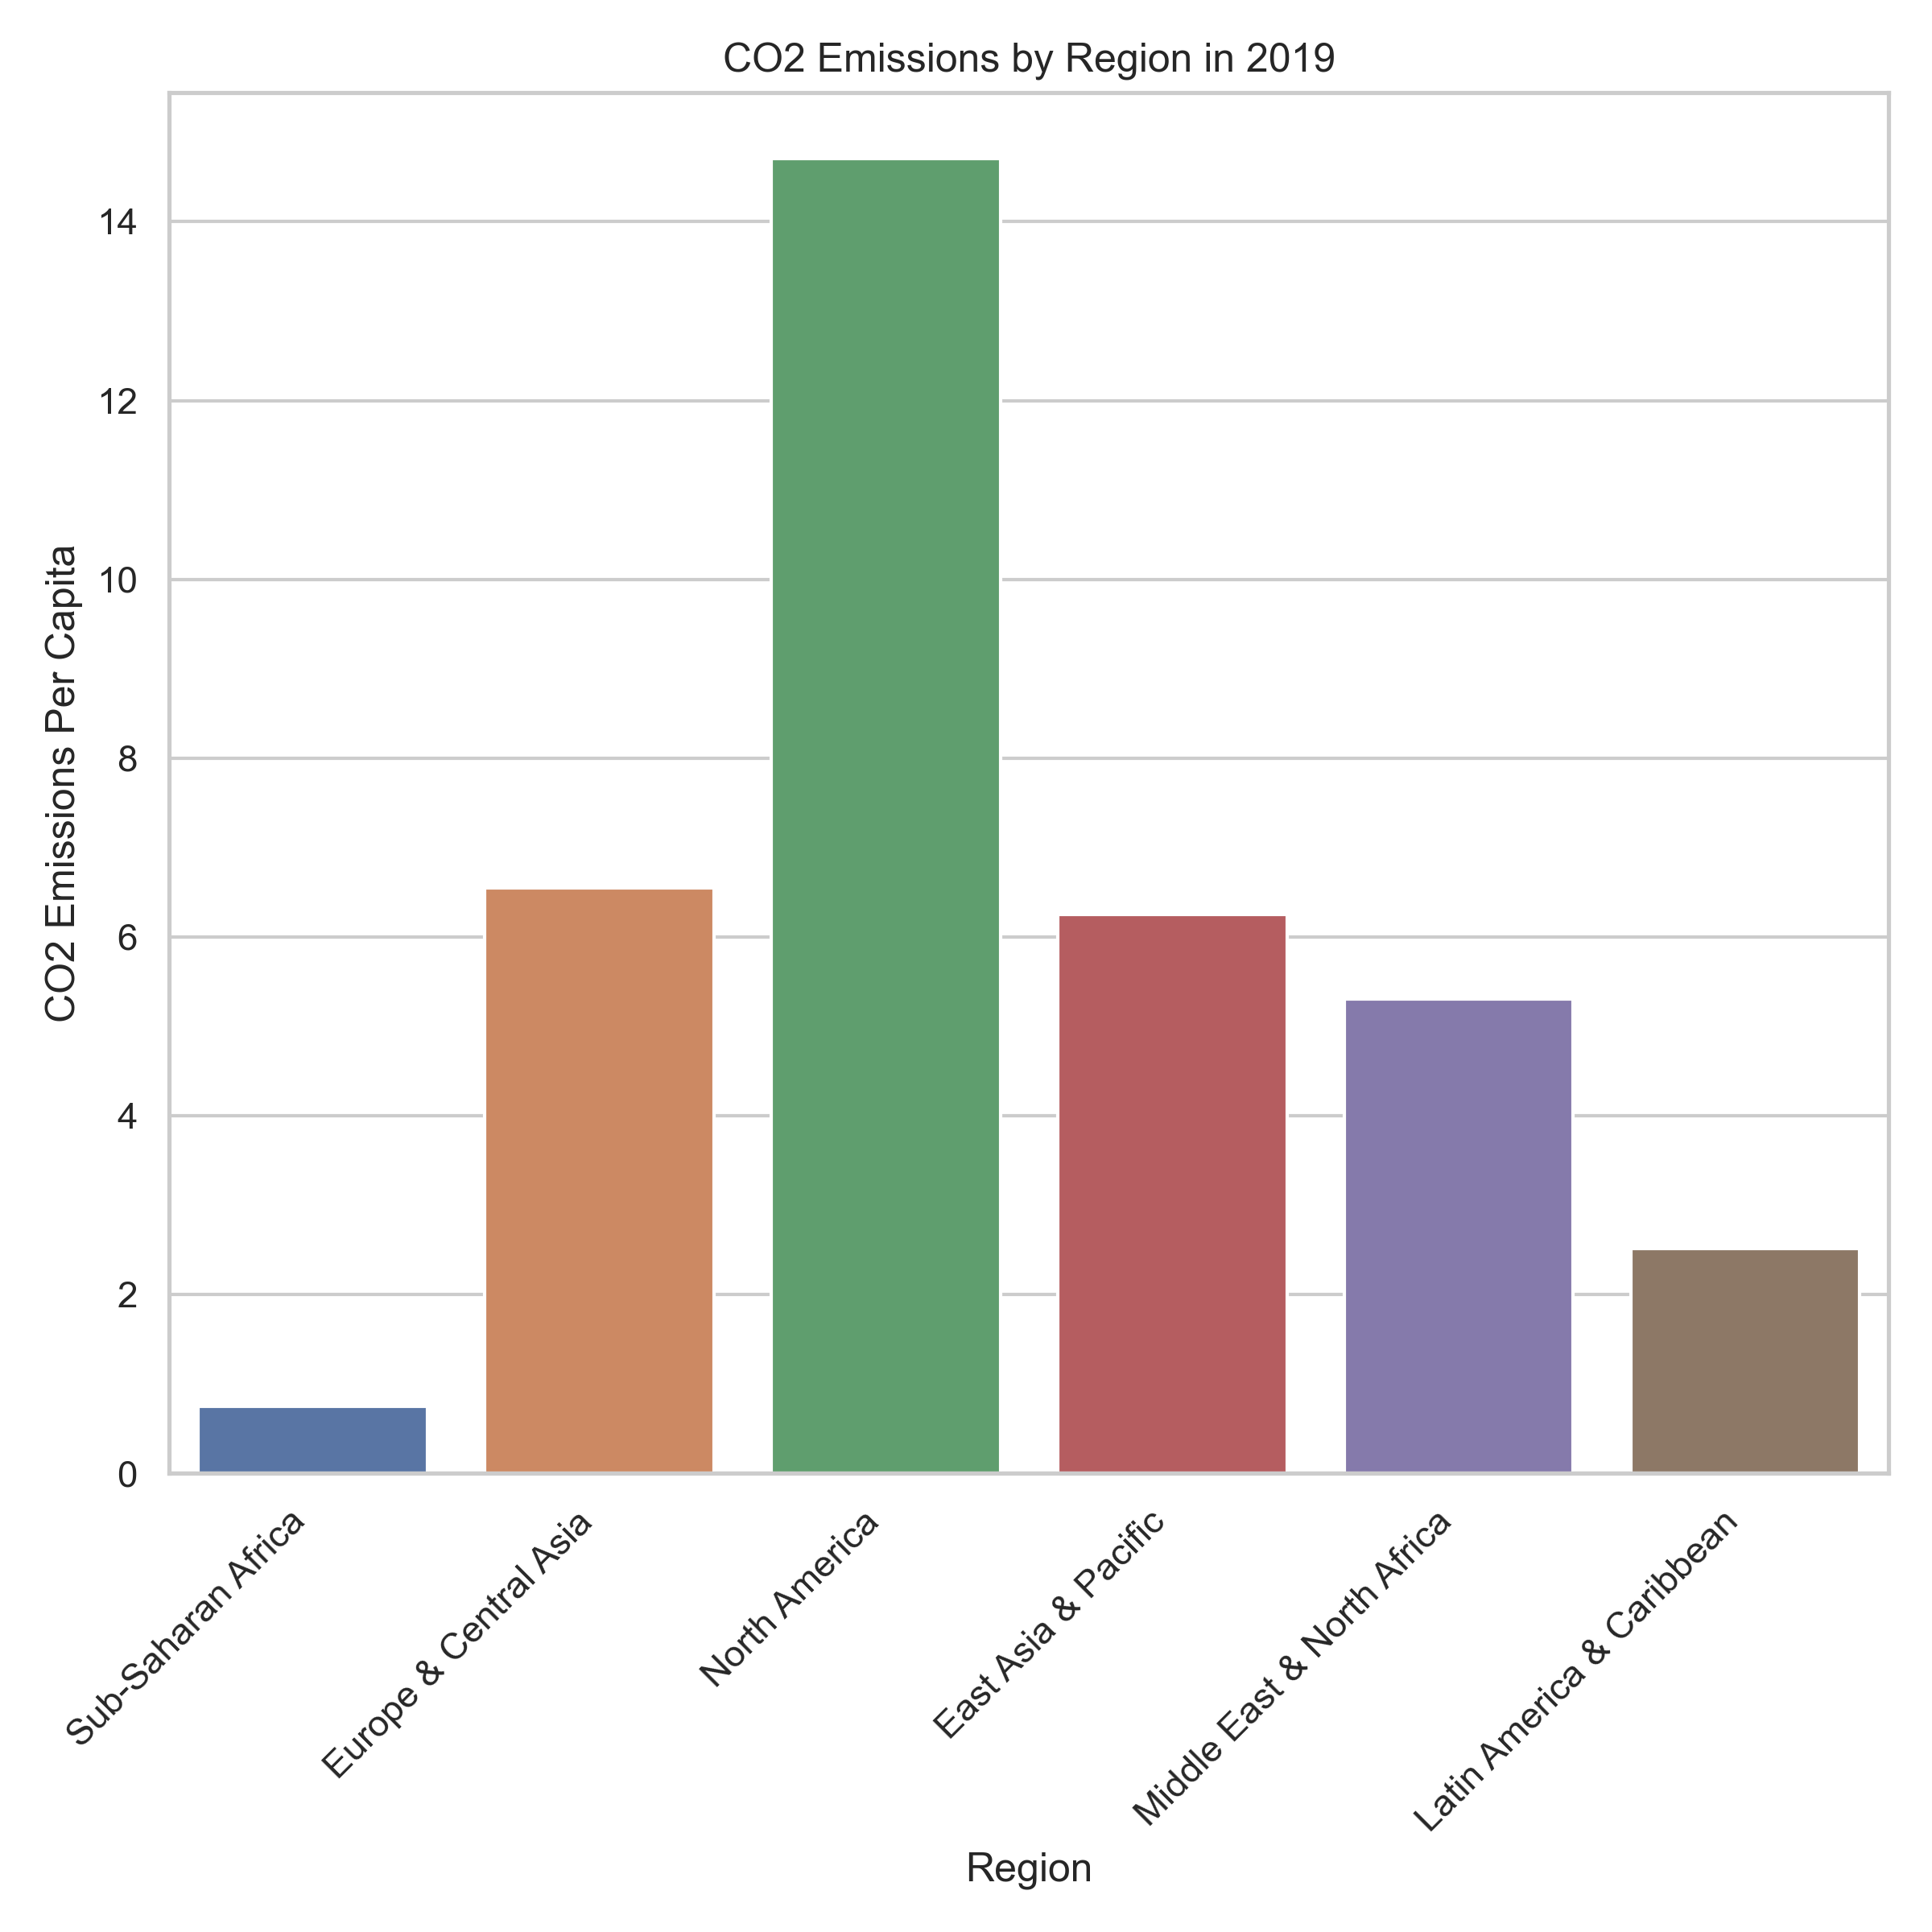
Regional Comparison (2020)
Notes:
On this slide, I've grouped the world into six regions: Sub-Saharan Africa, Europe and Central Asia, North America, East Asia & Pacific, Middle East and North Africa, and Latin America and Caribbean. The chart on the left is alternative fuel usage, while the chart on the right is co2 emissions. The side-by-side bar charts here can help provide insights into how different regions are affected.
Interestingly, the Middle East and North Africa region stands out as an exception. Even though they have extremely low levels of alternative fuel adoption, they've managed to keep their CO2 emissions in check. For every other region, we observe a consistent trend where regions with higher alternative fuel adoption exhibit lower CO2 emissions than their counterparts. However, it's worth noting that North America, even for how low its alternative fuel adoption is, showcases an unexpectedly high CO2 emissions level. The level of alternative fuel usage in sub-Saharan Africa was intriguing to me, so I decided to bring in GNI data in order to analyze the potential connection between income and alternative fuel adoption.

Slide 9
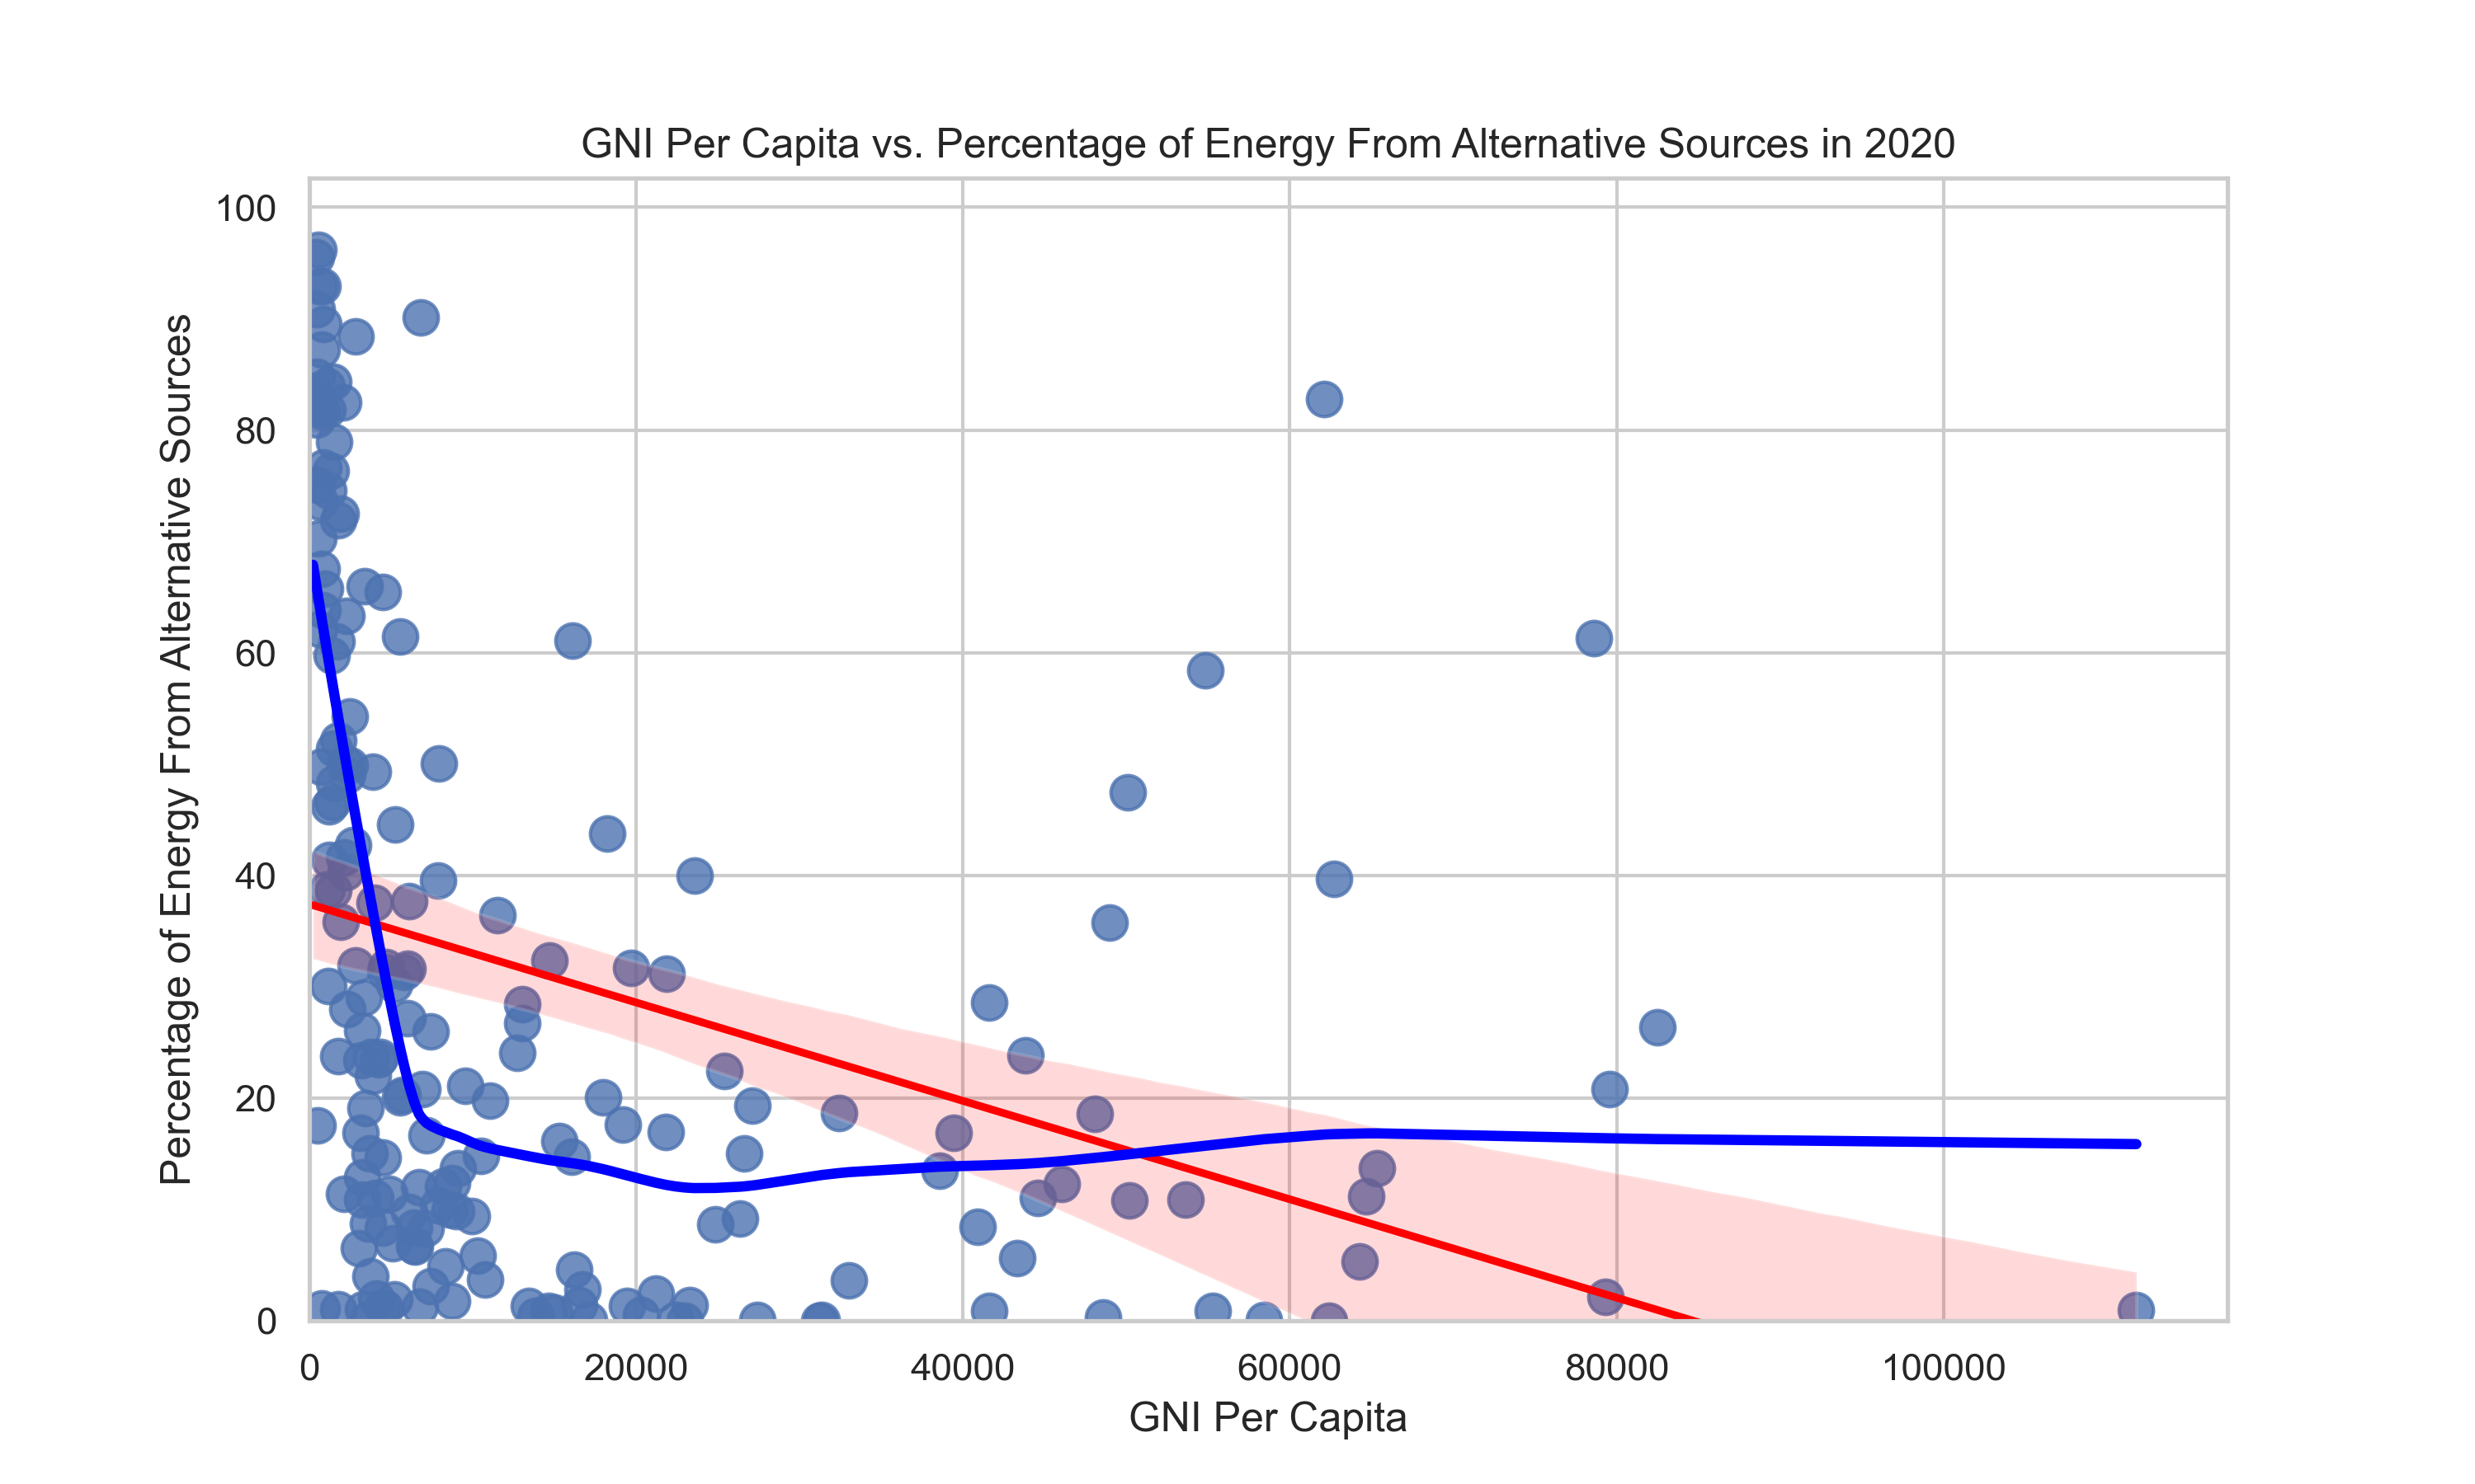
Income Comparison (2020)
Clear correlation between lower GNI per capita and higher usage of alternative fuels
Notes:
On this slide, we're delving into the relationship between income and alternative fuel adoption across all countries. I decided to use GNI per capita as a measure of income. GNI stands for Gross National Income, which is basically GDP plus any additional income from abroad.
As we look at this graph, we see that the regression line demonstrates that as GNI per capita increases, alternative fuel adoption tends to decrease.
However, what’s more interesting to me is the lowess curve overlaid on the graph. This curve reveals that the impact of income on alternative fuel adoption is way higher at lower income levels, where we see a substantial amount of alternative fuel adoption. As income increases, the curve levels out, suggesting that the effect of income on alternative fuel adoption becomes less significant.
This led me to do a little more research on my own and I think what’s happening here is a result of the fact that wealthier nations often have more resources to invest in traditional energy sources, whereas regions like sub-Saharan Africa have historically had a lower level of energy infrastructure, leading to them using more biomass fuels such as burning firewood, which is also considered an alternative fuel source.
This observation just emphasizes the importance of more in-depth research going forward so that we can better understand the factors behind the data seen here.

Slide 10
Conclusion
Explored global CO2 emissions and alternative energy adoption trends over time.
Uncovered regional dynamics in alternative energy adoption.
Investigated the correlation between GNI and alternative energy adoption.
Highlighted the complex balance between economic growth and environmental sustainability.
Acknowledged limitations and opened avenues for future in-depth analysis.
Notes:
As we conclude our analysis, it's worth considering the implications of these findings for both policy makers and researchers. The information found here opens the door to more targeted strategies for sustainable development. Policymakers might want to explore increasing incentives for alternative energy integration, while researchers could delve deeper into understanding the nuanced factors that influence adoption rates, such as climate conditions, natural resources, education availability, emissions standards, and many more. This study is really just a foundation to provide inspiration for future analysis.

Slide 11
References
Data Sources
International Energy Agency (IEA):
https://www.iea.org/data-and-statistics/data-product/greenhouse-gas-emissions-from-energy-highlights
World Bank:
https://databank.worldbank.org/reports.aspx?source=2&series=NY.GDP.MKTP.CD&country=WLD
https://databank.worldbank.org/reports.aspx?source=2&series=EG.FEC.RNEW.ZS&country=WLD#
https://databank.worldbank.org/reports.aspx?source=2&series=EN.ATM.CO2E.PC&country=WLD
https://databank.worldbank.org/reports.aspx?source=2&series=NY.GNP.PCAP.CD&country=WLD#

Slide 12
Q&A Session
Questions?
Contact Information:
Email: zachcate3@gmail.com
LinkedIn: https://www.linkedin.com/in/zachcate/
Thank you for your attention!

